Slide 1
Fast Neural Machine Translation
Hieu Hoang
Tomasz Dwojak
Marcin Junczys-Dowmunt
Rihards Krislauks
Daniel Torregrosa
Kenneth Heafield
January 2019
Seattle

Slide 2
Amun
Prioritize speed
  Focus on GPU
Written in C++
  Custom CUDA kernel functions
Inference only
  Train using another toolkit
Support limited number of models
  RNN
  GRU
  LSTM

Slide 3
Outline of Talk
Profiling
Solutions
  Focus on translation on GPU
  Prioritize speed
  Softmax & Output layer fusion
  Mini Batching
    Remove finished sentences
  Top-up batching
    Replace finished sentence with new sentence
  Conclusion

Slide 4
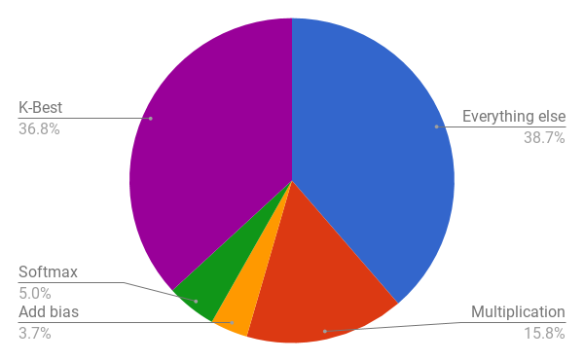
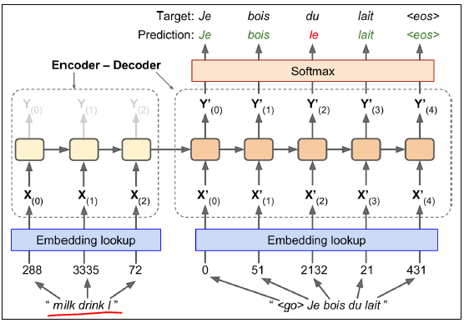
Profiling

Slide 5
Softmax & Output layer fusion
Multiplication p = w x
Add bias p = p + b
Softmax p_{i} = exp(p_{i}) / Sum exp(p_{i})
K-best classes argmax p_{i}

Slide 6
Softmax & Output layer fusion
Multiplication
  p[30000x1024] = w[30000x512] x[512x1024]
Add bias
  p[30,000x1024] = p[30,000x1024] + b[30,000x1]
Softmax
  p_{i} = exp(p_{i}) / Sum exp(p_{i}) [30000x1024]
K-best classes
  argmax p_{i}[30000x1024]

Slide 7
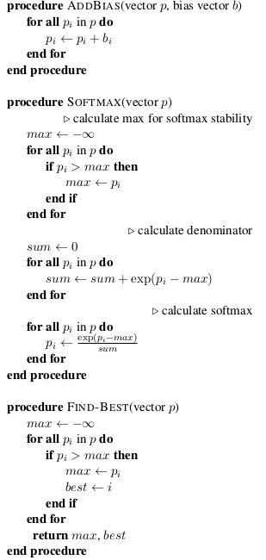
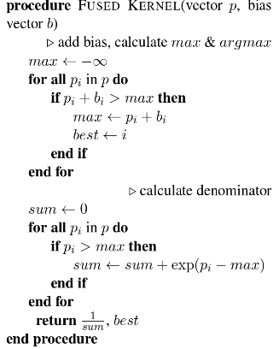
Softmax & Output layer fusion
Add Bias
Softmax
  p_{i} = exp(p_{i}-max) /
  Sum exp(p_{i}-max)
K-Best classes

Slide 8

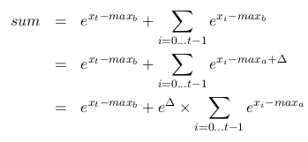
Softmax & Output layer fusion
Max and Sum in 1 loop
Subset
New max

Slide 9
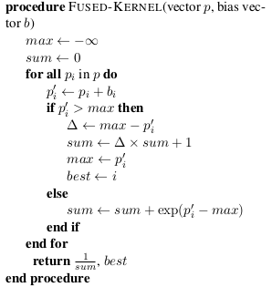
Softmax & Output layer fusion
Add Bias
Softmax
  p_{i} = exp(p_{i}-max) /
  Sum exp(p_{i}-max)
K-Best classes

Slide 10
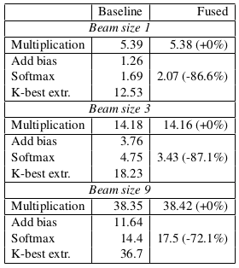
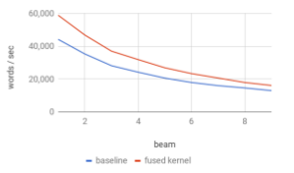
Softmax & Output layer fusion
Results

Slide 11
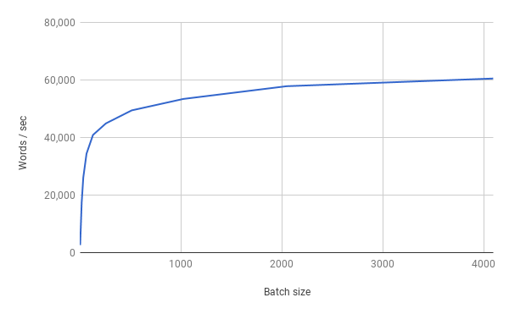
Mini-batching
Process many input in parallel

Slide 12
Mini-batching
Different sentence lengths
  What happens after end of sentence?
... | other | .
... | to | go | their | separate | ways | .
... | said | that | he | and | Kerr | still | love | each | other | .

Slide 13
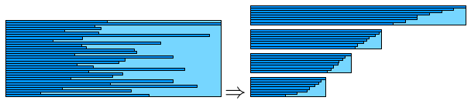
Mini-batching
Masking
  Process all sentences until they ALL finish
  Ignore the problem
Maxi-batching
  Group input (encoder) of similar lengths together
  Don’t know output (decoder) sentence length
Remove completed sentences

Slide 14
Mini-batching
Masking
  Process all sentences until they ALL finish
  Ignore the problem
Maxi-batching
  Group input (encoder) of similar lengths together
  Don’t know output (decoder) sentence length
Remove completed sentences
... | other | .
... | to | go | their | separate | ways | .
... | said | that | he | and | Kerr | still | love | each | other | .

Slide 15
Mini-batching
Masking
  Process all sentences until they ALL finish
  Ignore the problem
Maxi-batching
  Group input (encoder) of similar lengths together
  Don’t know output (decoder) sentence length
Remove completed sentences
... | to | go | their | separate | ways | .
... | said | that | he | and | Kerr | still | love | each | other | .

Slide 16
Mini-batching
Masking
  Process all sentences until they ALL finish
  Ignore the problem
Maxi-batching
  Group input (encoder) of similar lengths together
  Don’t know output (decoder) sentence length
Remove completed sentences
... | said | that | he | and | Kerr | still | love | each | other | .

Slide 17
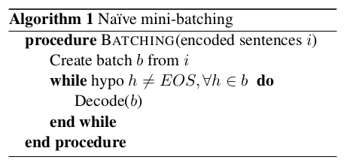
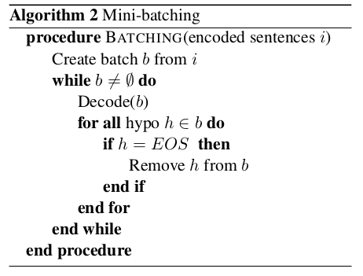
Algorithm

Slide 18
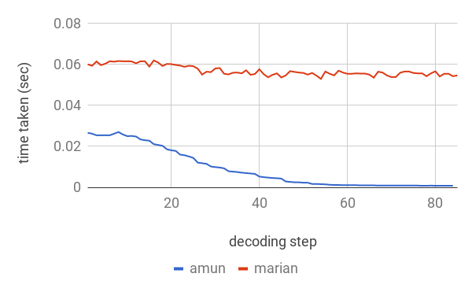
Mini-batching

Slide 19
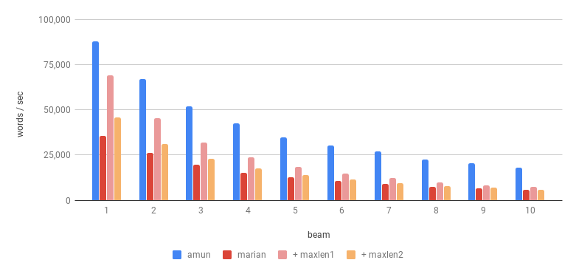
Results
Faster translation
Scalable to large batch size
Beam size and Sentence Length Pruning

Slide 20
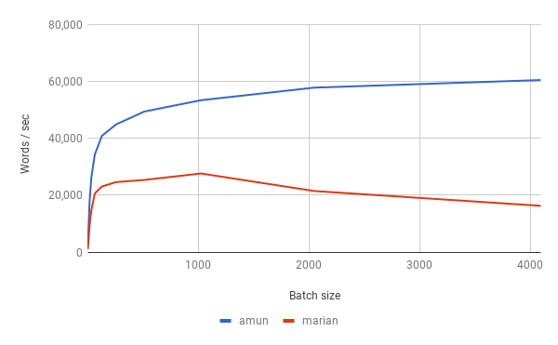
Results
Faster translation
Scalable to large batch size

Slide 21
WNMT 2018 Shared Task
Speed v Quality

Slide 22
Top-up Batching

Slide 23
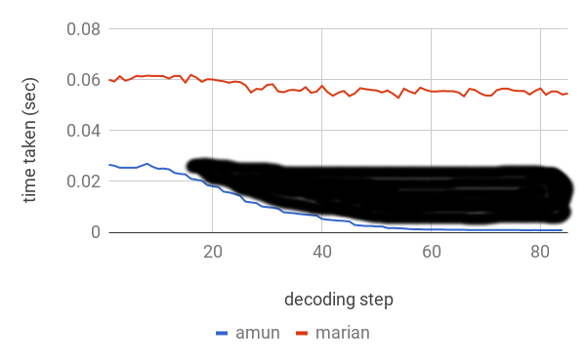
Top-up Batching

Slide 24
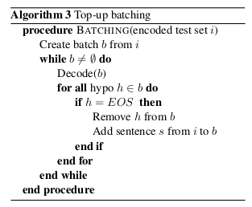
Algorithm

Slide 25
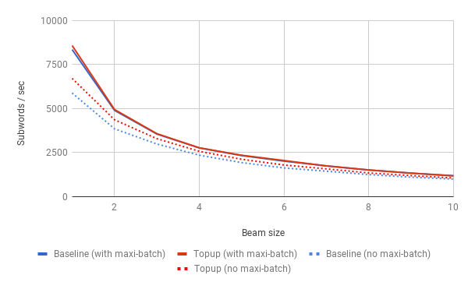
Results
Comparison with maxi-batching
Notes:
+12% topup batching
Not as much as max-batching

