Slide 1

Fast, Scalable Phrase-Based SMT Decoding
Hieu Hoang
Nikolay Bogoychev
Lane Schwartz
Marcin Junczys-Dowmunt
Notes:
This is joint work we’ve these guys on how to make decoding faster
- when you have large, multicore servers
- which is the normal today
This work led to a new decoder which is compatible with Moses
- Also avaiable in the Moses repository
1

Slide 2
Fast Translation
15 years ago
Small number of cores (1-4 cores)
Limited memory (~16GB RAM)
Slow disk drives
Solutions
Read-on-demand models
Compressed representation
Single-threaded efficiency
Notes:
15 years ago when Moses started
- a typical server
- had a small number of cores
- little memory, compared to what we have today
- disk were slow, and still are today
- a lot of work has gone into how to make the best use of the hardware
To conserve memory and reduce loading time
- model files for phrase-tables and language models
- only loaded on demand
To reduce disk usage
- we sometimes compressed those model files
Cos we don’t have many cores
- multithreading was such a priority
These things helped our community
- lowering by barrier to entry into MT
- allow anyone with a normal, affordable pc or laptop
- to use Moses
These innovations are still with us today
- kenlm, binary phrase-table, suffix arrays
1

Slide 3
Fast Translation
Today’s Servers
Large number of cores (+32 cores)
Sufficient memory (~128GB)
Slow disk drives
Challenge
Make best use of hardware
Same decoding algorithm
Compatibility with Moses
Optimize major components of decoder
Notes:
However, we also have to recognise that hardware has evolved
- today’s affordable pc
- much more RAM available
- a lot more processors
With the slow down of Moore’s law
- This trend is likely to continue
Challenge is how to make optimal use of the hardware of today
- with an eye on the future
There’s lots of ways to do this
- we can try to come up with a faster decoding algorithm
- or, find better trade-off between quality for speed
But in this work
- we will keep the same algorithms
- compatible with Moses as far as possible
We will look at some of the major components of the decoder
- and see how they can be optimized
1

Slide 4
Multi-Core Scalability
Non-linear scaling
Negative scaling
Notes:
To give you an idea of the challenge we face
- we don’t make very good use of many cores
- this is for Moses but issue occurs in other decoder too
This graph shows
- number of threads
v.
- decoding speed, measured in words/sec
As you can see,
When we run a typical phrase-based model
- on a large, 32 core server
Speed increase is not linear,
- start of tail of after 4-5 threads
Doesn’t just plateau
- at some point around 15-16 threads
- using more threads actually slows down decoding
So if you have a 32 core server, you might as well let 16 of those cores sit idle
- ‘cos trying to use them will just slow you down
1

Slide 5
Multi-Core Scalability
Non-linear scaling
Negative scaling
Notes:
Ideally, what should happen
- decoding speed should scale linearly
- until all cores are used
1

Slide 6
Outline of Talk
Profiling
Solution
Re-implement decoder
Prioritize speed and scalability
Efficient memory management
Phrase-table optimization
Lexicalized reordering model optimization
Conclusions
Notes:
This is the outline of the rest of the talk
We profile of the decoding process
- to see what taking the most time
- see what things grow when we use more threads
Then I’ll talk about the the things we did
- ultimately led to re-implementation the Moses decoder
- that put speed and scalbility at the forefront of our priority
I’ll go into some detail about what we did
1st – took charge of memory management
- a role that usually done by the operating system
2nd – played around with how we store partial translation in stacks
3rd – create a faster phrase-table which is scales better
Lastly – changed the way the lexicalised reordering model is stored
- reduces the random lookups
1

Slide 7
Profiling
%age decoding time
 | Memory | LM | Phrase-table | Lex RO model | Search | Misc
1 thread | 24% | 12% | 9% | 8% | 2% | 45%
32 threads | 30% | 2% | 5% | 2% | 0% | 39%
Memory allocation & de-allocation
Increases with number of threads
OS-level locking
Notes:
Lets decode a few thousand sentences
- see where the decoder spending most of it time
We find that the biggest drag on speed is memory management
And this rises the more threads we used
- this is a common issue for multi-threaded application
- due to locking to when memory is allocated and deallocated
And there’s actually a ready made solution for better multi-threaded application
1

Slide 8
Memory
Stacks
Phrase-table
Lex Reordering
Memory management (1)
Tcmalloc library
Replacement
malloc/free
Faster multi-threaded
applications
Notes:
The solution is libraries, such as the tcmalloc
- which replaces the default memory functions in the operating system
Does indeed make multi-threaded decoding faster
But still exhibits the non-linear scaling
And it still slows down after a certain number of threads
So can we do better than this?
1

Slide 9
Memory
Stacks
Phrase-table
Lex Reordering
Memory management (2)
Custom memory management
Obtain memory from OS
Allocate to our datastructures
1 pool-per-thread
Notes:
The better solution
- is to take memory mamagement entirely out of the hands of the OS and tcmalloc and manage it ourselves
This is a familiar strategy taken by other mutli-threaded applications
Create a large pool of memory at the start
- giving pieces of this to our objects and datastructures when needed
And, because we know
- we decode a sentence entirely in 1 thread
– have 1 pool per thread
- never have to lock whenever we allocate from the pool
This resulted large improvement in decoding speed
- roughly 3 times that of Moses
- it still have the problem of slowing down when using high number of threads
1

Slide 10
Memory
Stacks
Phrase-table
Lex Reordering
Memory Management (2)
%age decoding time
 |  | Memory | LM | Phrase-table | Lex RO model | Search | Misc
Moses | 1 thread | 24% | 12% | 9% | 8% | 2% | 45%
 | 32 threads | 30% | 2% | 5% | 2% | 0% | 39%
Our Work | 1 thread | 11% | 47% | 2% | 2% | 14% | 24%
 | 32 threads | 13% | 38% | 4% | 2% | 19% | 29%
Notes:
Profiling again, running with the same models
See that memory management is much less than orignal Moses
- hardly grow at all when we use lots of threads
1

Slide 11
Memory
Stacks
Phrase-table
Lex Reordering
Phrase-Table Optimization (1)
Compact phrase-table
Compress target side
Less memory
Less disk space
Decompressing
CPU cycles
CPU working memory
Locking
Probing phrase-table
No compression/decompression
No caching
Notes:
phrase-tables
The most popular phrase-tables implementation in Moses
- is the compact phrase-table
Compresses the target side of translation rules
- to use less disk space
- consume less memory
The flip side
- during decoding
- need to decompress the target side
- requires work by the processing time
- need memory allocation
- with the locking problems that we worked so hard to avoid
Now our servers have
- lots of disk space + memory
- No longer optimal strategy
Create a new phrase-table implementation
- priority is fast rule lookup & creation
- without the need to conserve disk space or memory
1

Slide 12
Memory
Stacks
Phrase-table
Lex Reordering
Phrase-Table Optimization (1)
Compact PT v. Probing PT
Notes:
Result as expected
- for single threaded decoding
- decoding time is roughly the same as the compact phrase-table
But when using multiple threads,
- not having to spend time decompressing
Means that the probing phrase-table is faster and scales to more cores
however, after a certain number of threads
- it still exhbitis this slowdown
1

Slide 13
Memory
Stacks
Phrase-table
Lex Reordering
Phrase-Table Optimization (2)
Dynamic caching
Most recently used translation rules
Active management
Memory allocation
Decreases decoding speed
 | No caching | Caching
Decoding speed (words/sec) | 2877 | 2540 (+12%)
Notes:
2nd phrase table optimization
Moses caches the most recently used translation rules
To do this
- time stamp each entry in the cache
When the cache gets too large
- has to do some work to reduce the cache
This active management of the cache
- requires processing power
- memory allocation
This was required 10 years ago
- didn’t have enough memory to keep the whole phrase table in memory
- now we do
- memory size isn’t the problem
- memory management is
NOW
- using a dynamic cache actually SLOW down decoding
1

Slide 14
Memory
Stacks
Phrase-table
Lex Reordering
Phrase-Table Optimization (2)
Static caching
Most likely source phrase
Learnt from training data
10% increase decoding speed
Cache size (# source phrases) | Decoding time (sec) | Cache hit %age
No caching | 229 | 0%
0 | 239 (+4.4%) | 0%
1,000 | 213 (-7.0%) | 11%
2,000 | 204 (-10.9%) | 13%
4,000 | 205 (-10.5%) | 14%
10,000 | 207 (-9.7%) | 17%
Notes:
Rather than having a dynamic cache
- have to update during decoding
Have a static cache
- keep set of translations
- of most likely source phrases
- Learn what are the most likely source phrases from the training data
Cache is static
- doesn’t change over the course of decoding test set
Using this simpler caching
- can give us around 10% increase in decoding speed
1

Slide 15
Memory
Stacks
Phrase-table
Lex Reordering
Lexicalized Reordering Model
Score partial translations
Model file
Key-Value random lookup
Key = translation rule
Optimization
Add values to phrase-table
No random lookup
Notes:
Lastly, lets look at the lexicalized reordering model
Like all feature functions
- the lex ro gives scores to partial translations
The scores are kept in a model file as key value pairs for random lookup.
- BUT key is acutally just the trasnlation rule
So rather than keeping this information in a separate file
- we can just keep it in the phrase-table, with each rule
- save ourselves the random lookup
1

Slide 16
Memory
Stacks
Phrase-table
Lex Reordering
Lexicalized Reordering Model
Separate model v. Integrated model
Notes:
When we do this
The result is not a great deal faster
- single threaded decoding
But when using multiple threads
- much faster
AND this time
doesn’t exhibit negative scaling we been seeing
1

Slide 17
Cummulative Result
10.4x faster (32 threads)
4.3x faster (1 thread)
Notes:
When we put all the improvements we have together
Compare it with Moses
On a 32 core server
- what would have taken 30 minutes
- now take 3
1

Slide 18
Cumulative Result
10.4x faster (32 threads)
4.3x faster (1 thread)
Notes:
Have we achieved our goal
- linear speed up when using more threads?
Not quite
The 1st thing we notice
After 16 threads
- speedup is not so great
- very easy to explain
- our 32 core server doesn’t actually have 32 cores
- has 16 real cores
- 16 virtual cores
- technique called hyperthreading
- so using more than 16 threads
- the real cores needs to double up on the work they do
Even before 16 threads
- there is some non-linearity
- the cause of this we don’t know
At a guess
- we’ve saturated the communication bus
- page fault in the CPU cache
Regardless of these faults,
the main take home message of this graph
- our work is much faster than Moses
- keep on scaling to 32 cores
1

Slide 19
Longer test sentences & different model
Average sentence length = 28.7
14.5x faster
Notes:
Does it slow down with
- different models
- sentence length
For all our experiments so far
- the average sentence length 7.
Now try with different model
- and test set with average sentence length of 28
Still scales
Comparison with Moses is even better
- about 14.5 time faster
1

Slide 20
Translation Quality
Similar quality
Notes:
Have we inadvertantly traded speed for quality
- perhaps by pruning more harshly than Moses
- is there a bug in our decoder
- forgotten to do some important but lengthy calculations
The proof of the MT pie is in the BLEU score
- BLEU scores are very similar for all pop-limits we’ve tested
1

Slide 21
Hierarchical Phrase-Based Models
More complicated data-structures
Larger phrase-tables
No lexicalized RO
Rarely used commercially
Not optimized
Too slow
Our work
1200+ words per second
Commercially viable
Notes:
This is not in the paper
- might as well tell you now
Apply the same optimizations to the hierarchical model
- also available in Moses
Great speedup compared to Moses
- Unfair to compare our work with Moses here
- hierarchical model has never been speed optimized
- no-one uses it in production
Now that we are able to make better use of multi-core server
- perhaps commercially viable
1

Slide 22
SMT Conclusion
Decoder re-implementation
Drop-in replacement for Moses
Subset of Moses functionality
Similar translation quality
Prioritize multi-core speed
Memory management
Faster phrase-table
Integrated lexicalized reordering model
10-15x faster than Moses (with 32 cores)
4x faster (single thread)
Hierarchical model
Commercially viable
Notes:
In conclusion
- create a drop-in replacement for the Moses decoder
But made multi-core decoder speed a priority
- using customized memory management
- faster phrase-table
- integrated lexicalised reordering model
The result is a phrase-based decoder which is 10-15 times faster than Moses
And
Hierarchical decoder which is a lot faster than moses
1

Slide 23
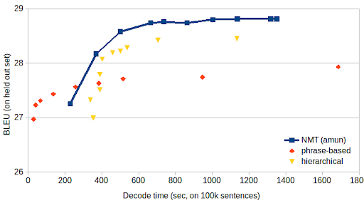
SMT v. NMT
Speed / Quality Trade-off
Varying cube-pruning pop-limit (SMT), beam size (NMT)
Notes:
Rise NMT
- where does SMT stand
- heard a lot about superior quality of NMT output
- it is the case from this graph
- speed v quality
But if we want very fast translation
- SMT still has a place
Where does It stand?
- this is 1 of the last niche for SMT
SMT only has that niche ‘cos I put it there
- spent a yr optimizing it
- unfair on NMT if I didn’t do the same
<number>

Slide 24
Amun
Inference only
Train using Nematus / Marian
Support limited number of models
RNN
GRU
LSTM
Prioritize speed
Focus on GPU
Written in C++
Custom CUDA kernel functions
Notes:
Found out Marcin and tomacz developing amun
- faster replacement for Nematus’ decoder
Sounded a lot like what I had been doing with Moses2
- keep the existing training and models
- change thvee inference
It’s goals altered

Slide 25
Outline of Talk
Profiling
Solutions
Focus on translation on GPU
Prioritize speed
Softmax & Output layer fusion
Mini Batching
Remove finished sentences
Top-up batching
Replace finished sentence with new sentence
Conclusion

Slide 26
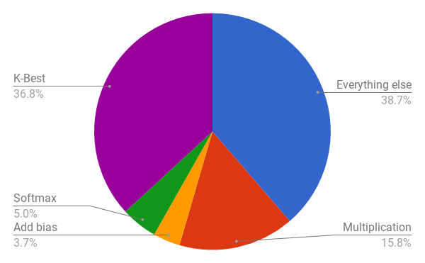
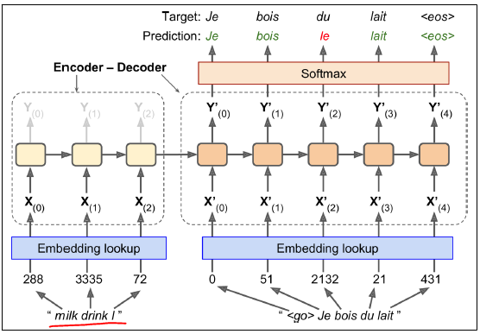
Profiling

Slide 27
Softmax & Output layer fusion
Multiplication p = w x
Add bias p = p + b
Softmax p_{i} = exp(p_{i}) / Sum exp(p_{i})
K-best classes argmax p_{i}

Slide 28
Softmax & Output layer fusion
Multiplication
p[30000x1024] = w[30000x512] x[512x1024]
Add bias
p[30,000x1024] = p[30,000x1024] + b[30,000x1]
Softmax
p_{i} = exp(p_{i}) / Sum exp(p_{i}) [30000x1024]
K-best classes
argmax p_{i}[30000x1024]

Slide 29
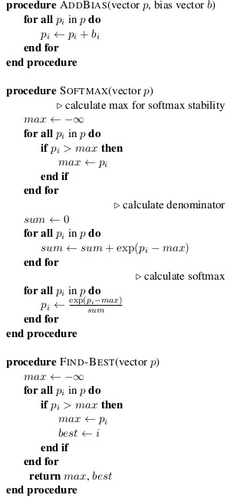
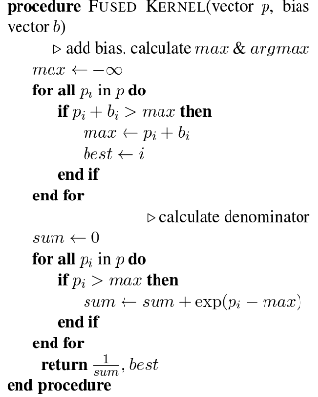
Softmax & Output layer fusion
Add Bias
Softmax
p_{i} = exp(p_{i}-max) /
Sum exp(p_{i}-max)
K-Best classes

Slide 30
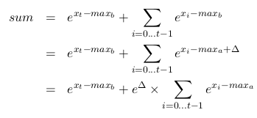
Softmax & Output layer fusion
Max and Sum in 1 loop
Subset
New max

Slide 31
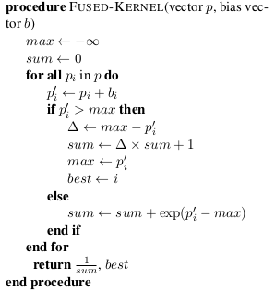
Softmax & Output layer fusion
Add Bias
Softmax
p_{i} = exp(p_{i}-max) /
Sum exp(p_{i}-max)
K-Best classes

Slide 32
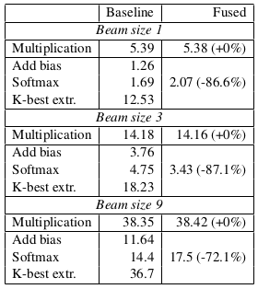
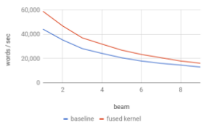
Softmax & Output layer fusion
Results

Slide 33
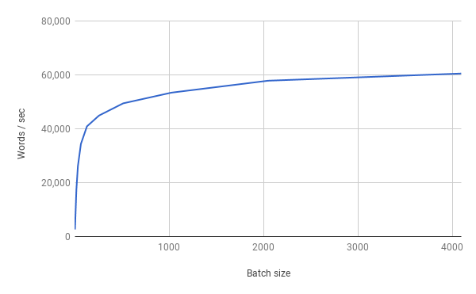
Mini-batching
Process many input in parallel

Slide 34
Mini-batching
Different sentence lengths
What happens after end of sentence?
... | other | .
... | to | go | their | separate | ways | .
... | said | that | he | and | Kerr | still | love | each | other | .

Slide 35
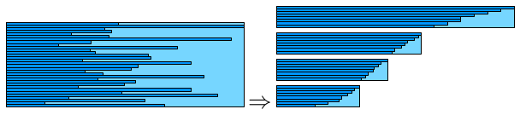
Mini-batching
Masking
Process all sentences until they ALL finish
Ignore the problem
Maxi-batching
Group input (encoder) of similar lengths together
Don’t know output (decoder) sentence length
Remove completed sentences

Slide 36
Mini-batching
Masking
Process all sentences until they ALL finish
Ignore the problem
Maxi-batching
Group input (encoder) of similar lengths together
Don’t know output (decoder) sentence length
Remove completed sentences
... | other | .
... | to | go | their | separate | ways | .
... | said | that | he | and | Kerr | still | love | each | other | .

Slide 37
Mini-batching
Masking
Process all sentences until they ALL finish
Ignore the problem
Maxi-batching
Group input (encoder) of similar lengths together
Don’t know output (decoder) sentence length
Remove completed sentences
... | to | go | their | separate | ways | .
... | said | that | he | and | Kerr | still | love | each | other | .

Slide 38
Mini-batching
Masking
Process all sentences until they ALL finish
Ignore the problem
Maxi-batching
Group input (encoder) of similar lengths together
Don’t know output (decoder) sentence length
Remove completed sentences
... | said | that | he | and | Kerr | still | love | each | other | .

Slide 39
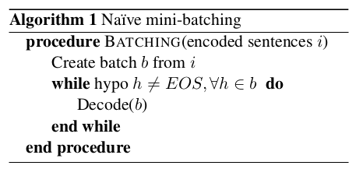
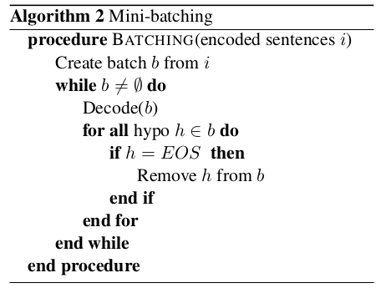
Algorithm

Slide 40
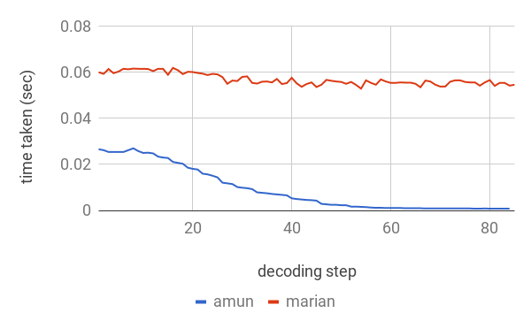
Mini-batching

Slide 41
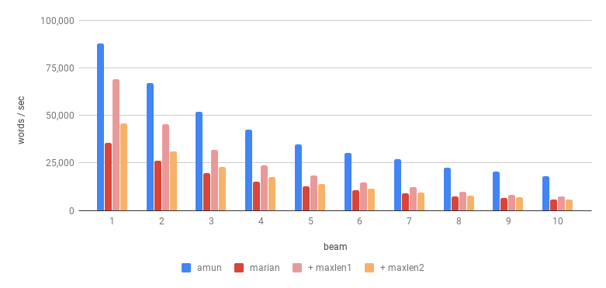
Results
Faster translation
Scalable to large batch size
Beam size and Sentence Length Pruning

Slide 42
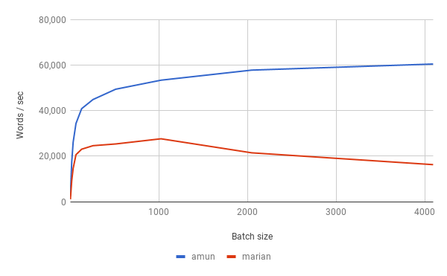
Results
Faster translation
Scalable to large batch size

Slide 43
WNMT 2018 Shared Task
Speed v Quality

Slide 44
Top-up Batching

Slide 45
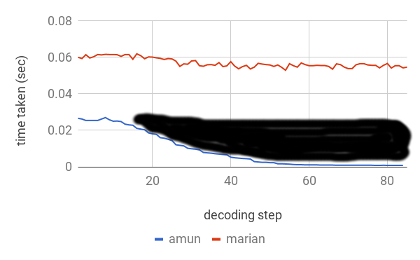
Top-up Batching

Slide 46
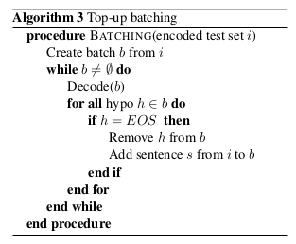
Algorithm

Slide 47
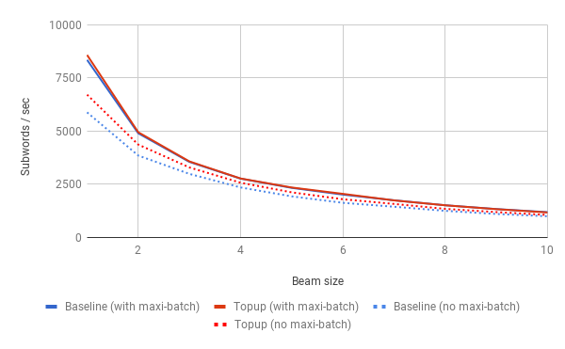
Results
Comparison with maxi-batching
Notes:
+12% topup batching
Not as much as max-batching

