Slide 1

Hands-On Session
Hieu Hoang
Matthias Huck
October 2014

Slide 2
SMT Pipeline
Preprocessing
- tokenizer
- tagging
- lemmatization
Alignment
Phrase extraction
Tuning
Decoding
Postprocessing
- recasing
- detokenizer
Scoring
- BLEU score
Notes:
MT pipeline
- each part is critical to producing good MT system
Can show you how to do each part
- take a week
Lose the will to live!
However, not necessary to know the mechanics of each & every part to start
Those that don’t need to know, or know but just want it to work consistently
- provide a system which wraps up the pipeline

Slide 3
Using the Experiment Management System (EMS)
In brief
  from raw data to tuned MT system
Wrapper for everything needed to
  Train
  Tuning
  Decode
  Evaluate
Require
  config file
Notes:
This system is called the EMS
- included with the Moses toolkit
- a script that creates a series of scripts
What does EMS do?
- takes raw data
- turn into a phrase-based system, or hierarchical system
By running the entire pipeline.
All you need to do it give is a config file

Slide 4
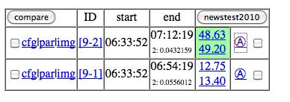
Using the EMS
ssh guest@odin.inf.ed.ac.uk
Password = Edinburgh123
cd workspace/experiment/fr-en/<river>/
nohup ./run.new.sh config.pb &
config file:
steps/1/config.1
Browse: http://amta.statmt.org/
- find your experiment
_
Click Here
Notes:
We’ve set up a small experiemtn for you
- so log onto the our server as guest
- password is ‘welcome’
And run this script
- it’s a standard phrase-based system. Training on just 1000 lines of data
- hopefully it’ll finish in 10-15 minutes.
- can look at this script, it’s 1 line which runs the EMS, telling it which config file to use, in this case it says the 1st config file.
So where’s the config file?
- it’s in the steps directory, under ‘1’
- look inside it
- doesn’t sayhow things are run, EMS already knows that
- instead, specify where the data and the executables are found
- <PAUSE> for questions
Now it’s running, can check on it progress online.
Go to this URL with firefox or whatever
- find your experiment. (Name of fruit)
- ‘cfg’ is the config file your supplied it with
- par is the parameters the EMS extracted from the config file
- click on the ‘image’ link
- shows you progress of your running experiment

Slide 5
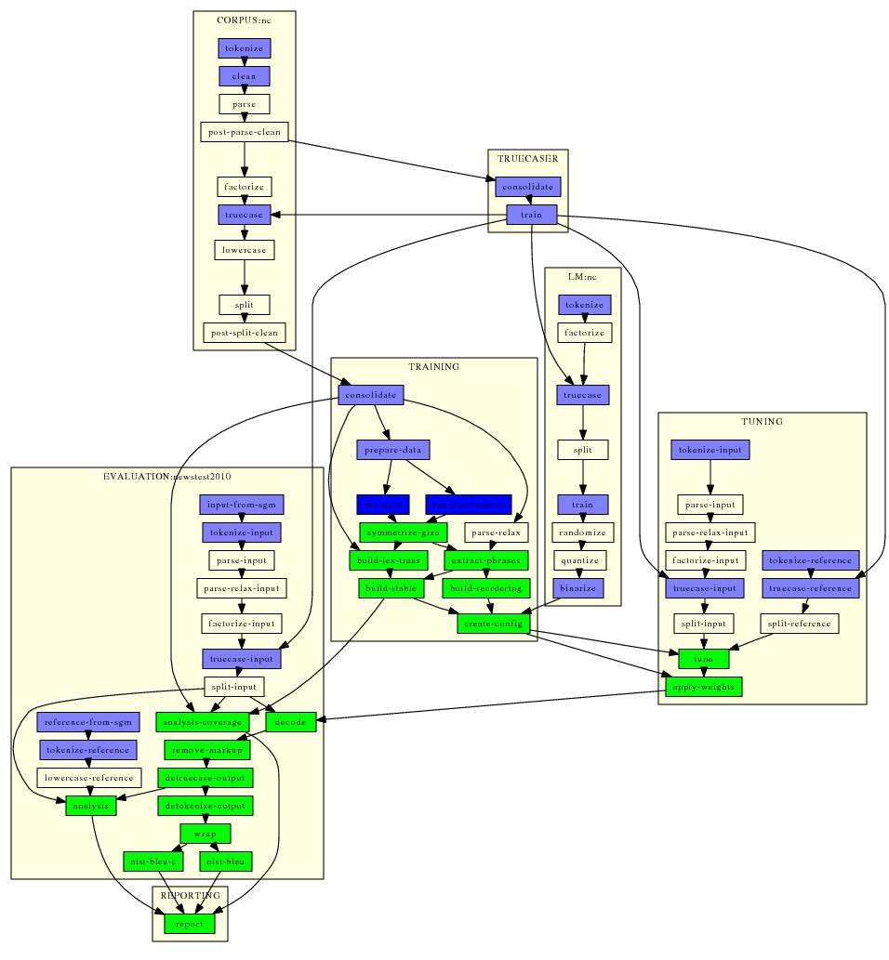
Using the EMS
Notes:
All the steps that you have to do to create MT systems
Refresh your browser to see updates
Wait for all boxes to turn light-blue. Everything has finished!
Green – still to do
Dark blue – Running jobs
- in this 1, GIZA and inverse giza is still running.
If you see RED
- that means that step broke. You have to fix it
R

Slide 6
Hierarchical/Syntax Models
Same pipeline
Different
  Extraction
  Decoding
Reuse common output
  Data cleaning
  Tokenization
  Alignment
Notes:
For hierarchical and syntax models, only the extraction and decoding is different.
Many of the other steps are identical. The EMS understand that
- if a step has identical input and output, and the same arguments
- reuse

Slide 7
Hierarchical/Syntax Models
nohup ./run.new config.hiero &
Browse: http://amta.statmt.org/
- find your experiment
Click Here
Notes:
So do the same thing for another experiement
This uses the same data
- but creates a hierarchical model instead of a phrase-based model
Find your experiment again

Slide 8
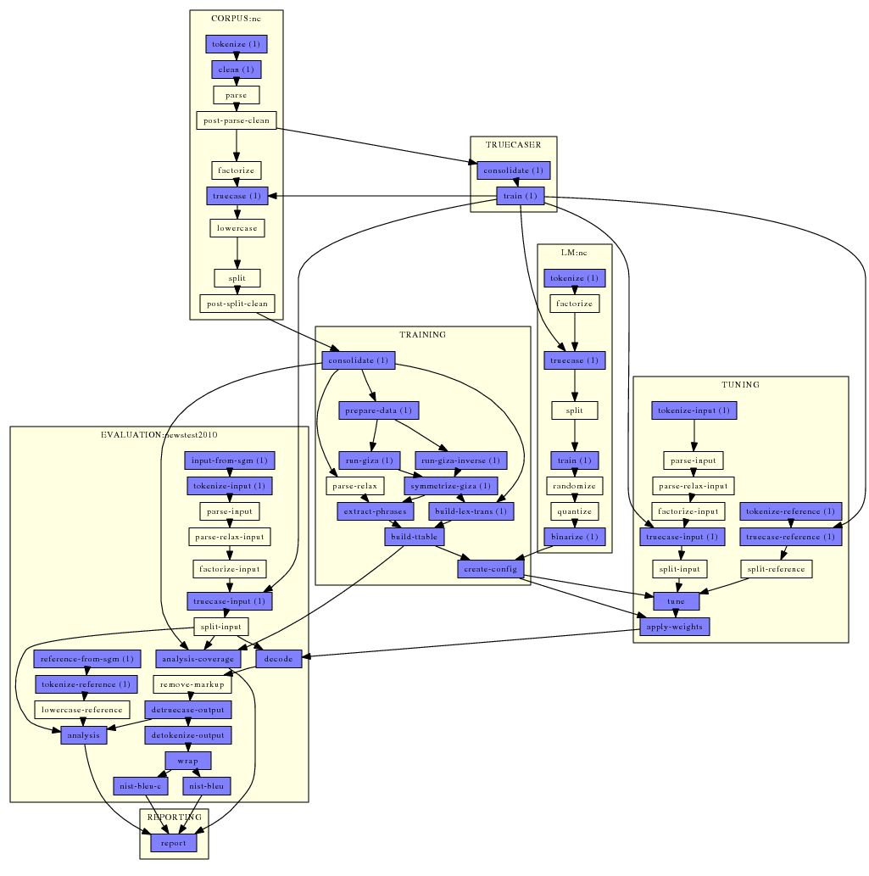
Using the EMS
Notes:
Looks exactly like the phrase-based
However, those parts that can be resused from the phrase-based
- aren’t green, or blue
- those steps are white
- meaning the EMS will reuse the output from the phrase-based experiment instead.
- steps like tokenization, cleaninng, alignment are all white

Slide 9

Using the EMS
Notes:
Looks exactly like the phrase-based
However, those parts that can be resused from the phrase-based
- aren’t green, or blue
- those steps are white
- meaning the EMS will reuse the output from the phrase-based experiment instead.
- steps like tokenization, cleaninng, alignment are all white

Slide 10
Using the EMS
Standardized directories
  corpus
  evaluation
  lm
  model
  steps
  training
  recasing
  Tuning
Standardized file names for each experiments, eg.
  nc.lm.1 - nc.lm.2
  extract.1 - extract.1
  moses.ini.1 - moses.ini.2
Notes:
Digging deeper into how the EMS works
Standardized directories
Standardized naming convention for files
- easy to see which exactly which files have been created by which experiment

Slide 11
Debugging
Incorrect file paths
  Data files
  Executables
Bugs in scripts
Bugs in data

Slide 12
Debugging
steps /<num>/
  Working directory of EMS
config.<num>
  Parameters for experiment <num>
Scripts that run moses script
  eg. TRAINING_run_giza.1
Error logs produced by every script
  eg. TRAINING_run_giza.1.STDERR

Slide 13
Summary of EMS
Create complete MT system from raw data
Consistent, reproduceable
Efficient
  Re-use when it can
Analysis
Support parallelization
  SGI
  Multi-threading

