Slide 1




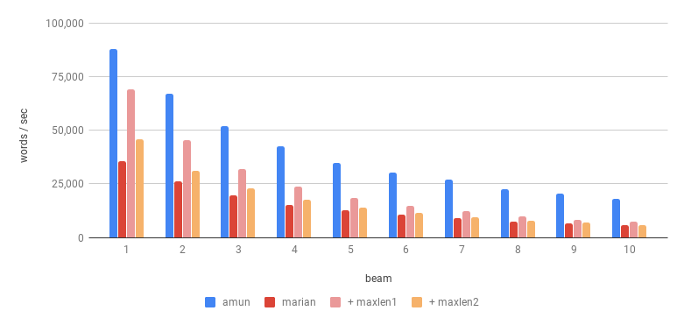
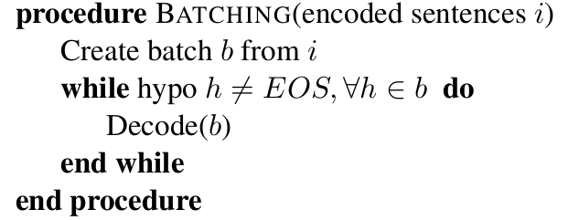
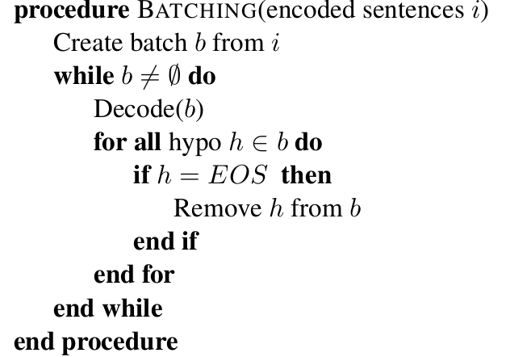
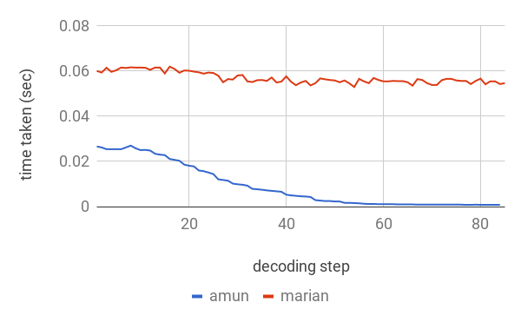
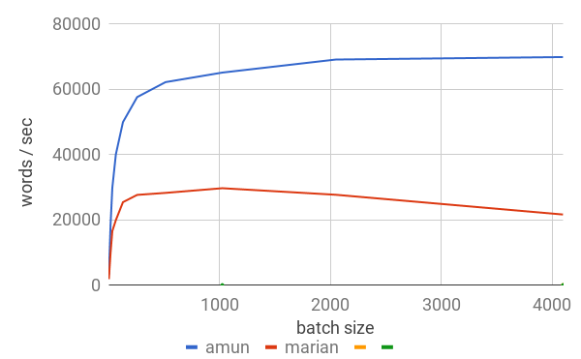
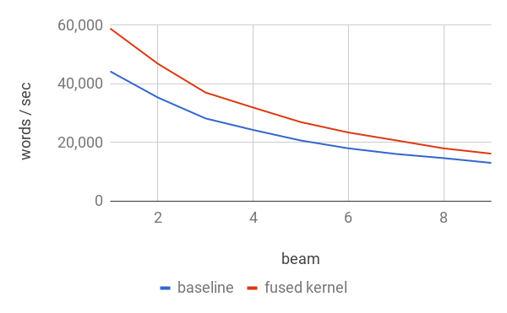
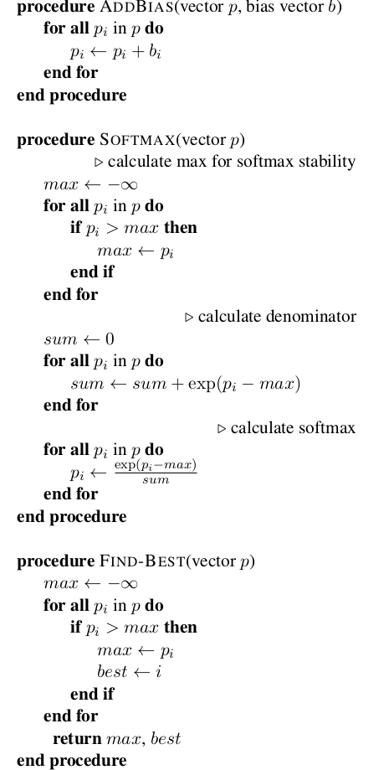
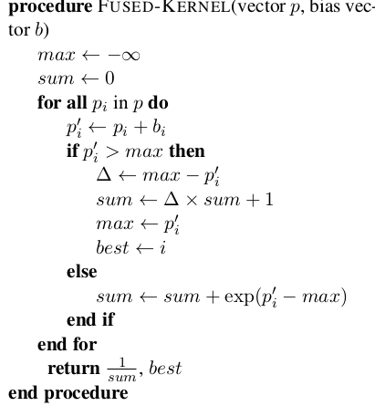
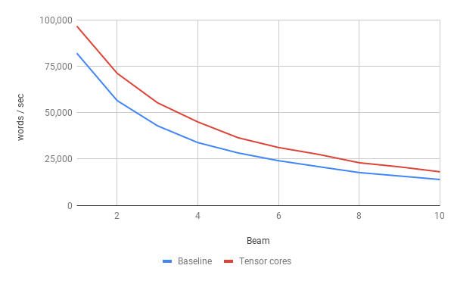
Fast Neural Machine Translation Implementation
`
Hieu Hoang, Tomasz Dwojak, Rihards Krislauks
Daniel Torregrosa, Kenneth Heafield
Fastest translation engine for GPU
Official results of GPU track
30% to 3+ times faster than Marian with the same model
Efficient Mini-Batching
Time taken in each decoding
step (same batch):
Speed v Batch Size
Baseline
Our work
“Remove completed hypotheses from decoding”
Softmax / k-Best Fusion
Speed v. Beam size
Time taken:
Baseline
Our work
 | Baseline | Fused
Beam size 1
Multiplication | 5.39 | 5.38
Add bias | 1.26 | 2.07 (-86.6%)
Softmax | 1.69
K-Best | 12.53
Beam size 3
Multiplication | 14.18 | 14.16
Add bias | 3.76 | 3.43 (-87.1%)
Softmax | 4.75
K-Best | 18.23
Beam size 9
Multiplication | 38.35 | 38.42
Add bias | 11.64 | 17.5 (-72.1%)
Softmax | 14.40
K-Best | 36.70
“Reduce the number of scans over activation matrix”
Tensor Cores
Hardware-accelerated matrix multiplication

