Slide 1

NYPD Shooting Incident Data Analysis Project
Presented by: Hieu Le

Slide 2
Content
Dataset Overview
Exploratory Data Analysis
Modeling
Conclusion

Slide 3
Dataset Overview

Slide 4
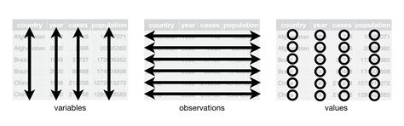
About the Dataset
The dataset is available on NYC OpenData website: https://data.cityofnewyork.us/Public-Safety/NYPD-Shooting-Incident-Data-Historic-/833y-fsy8
The dataset contains information about NYC shooting incidents occurred from 2006-2020
Each row represents a shooting incident with information on time and location, the attacker/victim, and murder status
The dataset is Tidy.

Slide 5
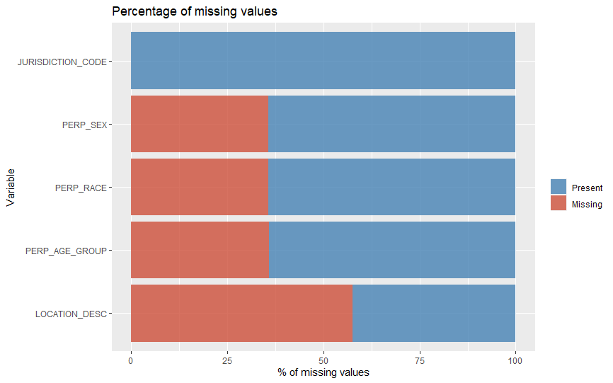
Missing Values

Slide 6

Handling of Missing Data
Remove NAs
Imputation

Slide 7
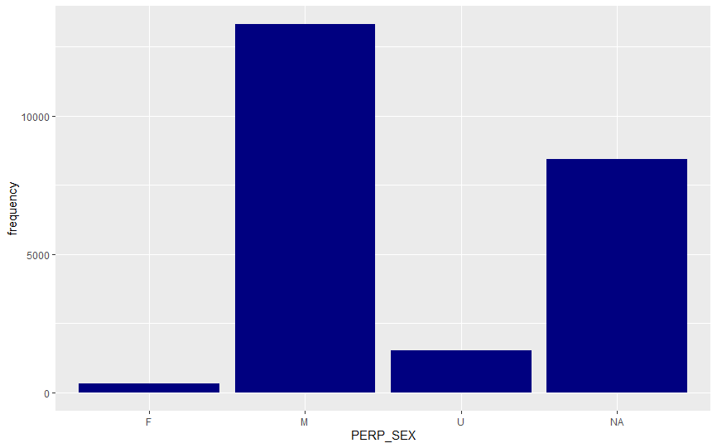
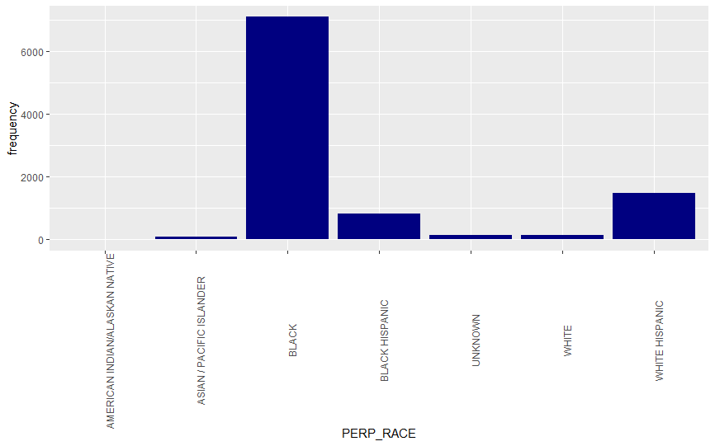
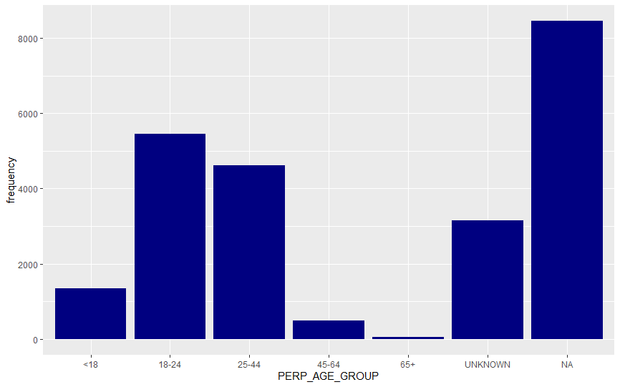
Mode Imputation

Slide 8
Exploratory Data Analysis

Slide 9
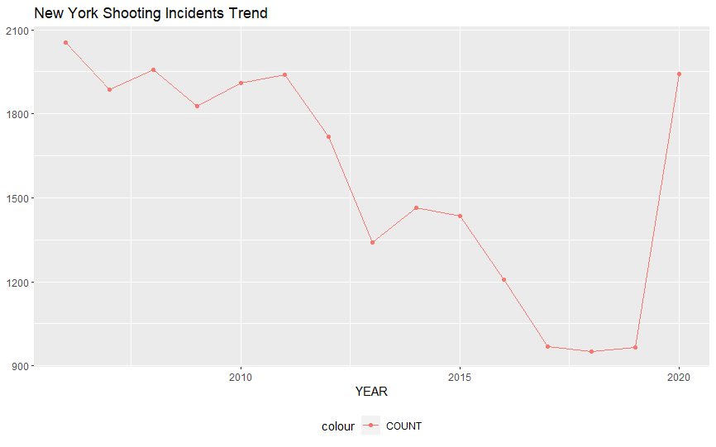
Historical Incidents Trend

Slide 10
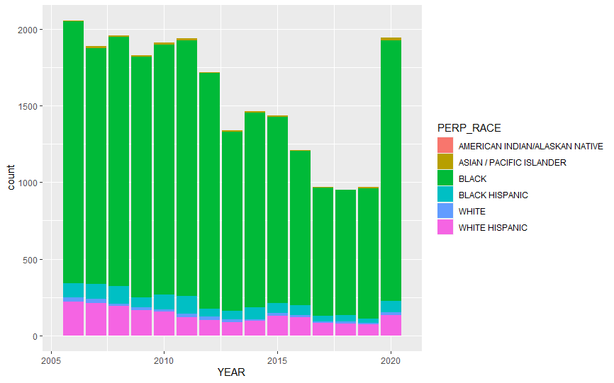
Incidents by Race

Slide 11
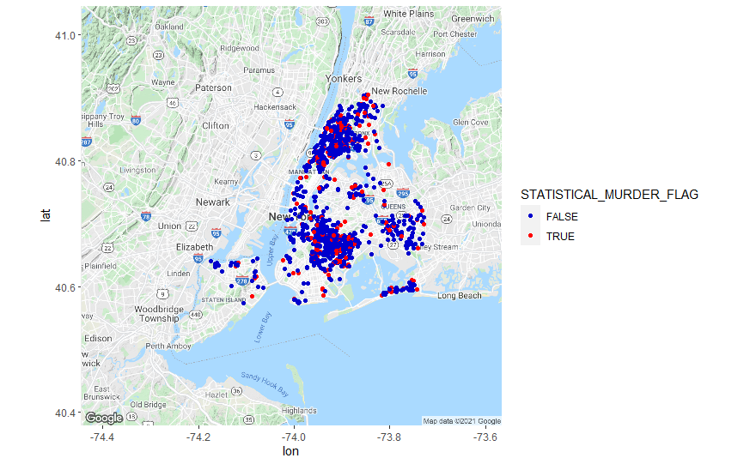
Incidents by Location in 2020

Slide 12
Modeling

Slide 13
Goal & Approach
Goal: Estimate the impact of Covid-19 pandemic on the number of shooting incidents in NYC
Approach:
Predict the number of shooting incidents in 2020 using historical data
Compare predicted to actual number of shooting incidents
Use time series ARIMA model

Slide 14
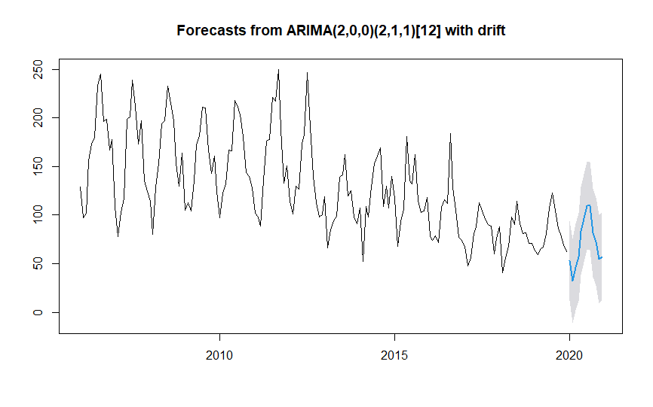
Outcome
Predicted 854 vs. 1,942 shooting incidents

Slide 15
Conclusion

Slide 16
Conclusion & Biases
Conclusion: The spike in shooting incidents in NYC in 2020 likely driven by Covid-19
Biases:
Imputation of missing data
Personal tendency, e.g. predisposition against Covid-19
Using time-series data to predict the future
GitHub link: https://github.com/hieule328/DTSA5301

