Slide 1
Data Science Course Project: Stock Price Prediction
Presenter: Hieu Man - 952034800

Slide 2
Outline
Introduction and Background
Models and Experiments
Discussion and Conclusion

Slide 3
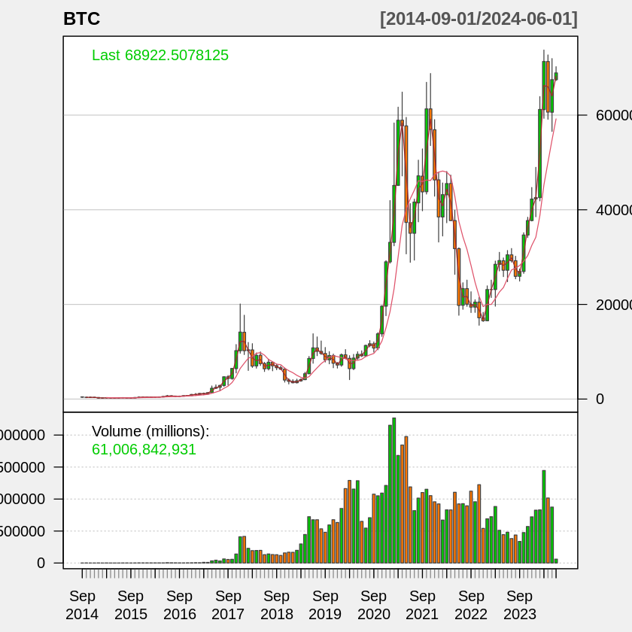
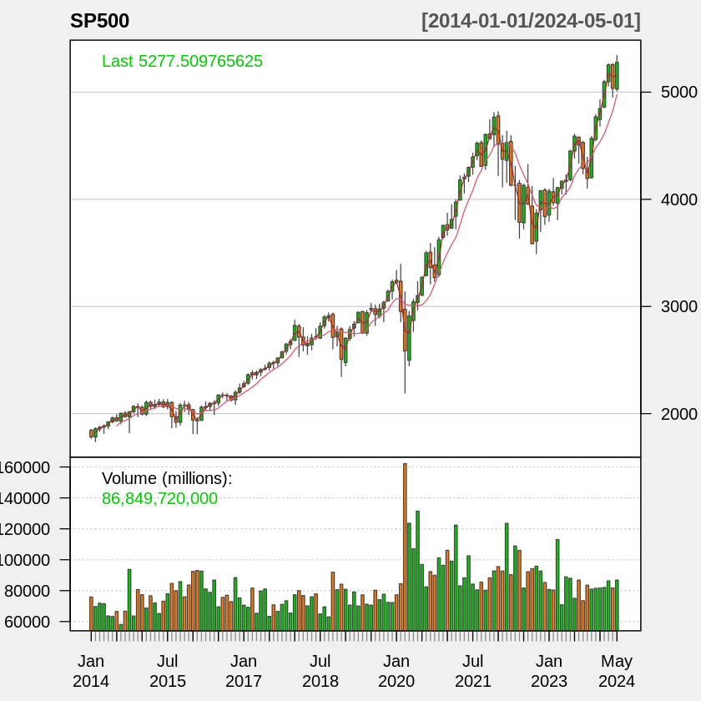
Introduction and Background
Stock of Interest
S&P500: Best indicators of USA’s stock market
BTC: New type of assert with high volatility
Data attributes:
Open: The opening price for that day
High: The highest price paid for the stock that day
Low: The lowest price paid for the stock that day
Close: The closing price for that day
Volume: The volume of stocks traded that day
Adjusted: The adjusted closing price for that day, taking into account corporate actions such as stock splits, dividends, and rights offerings.
Objective: Predict the closing price of next 50 weeks by using previous price movements.

Slide 4
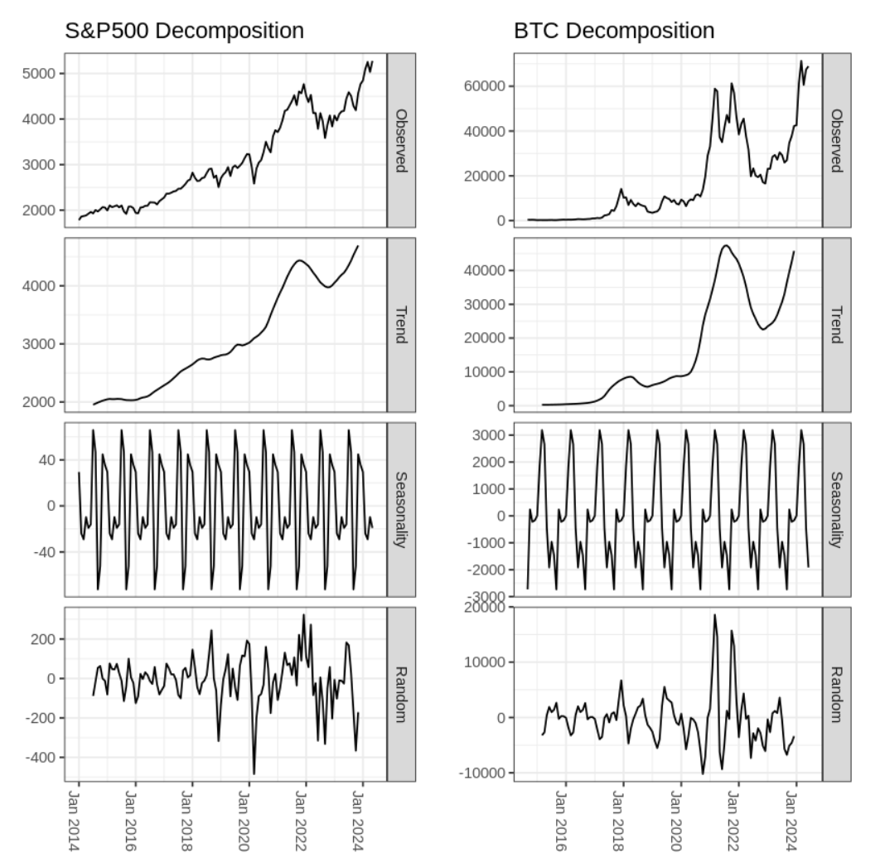

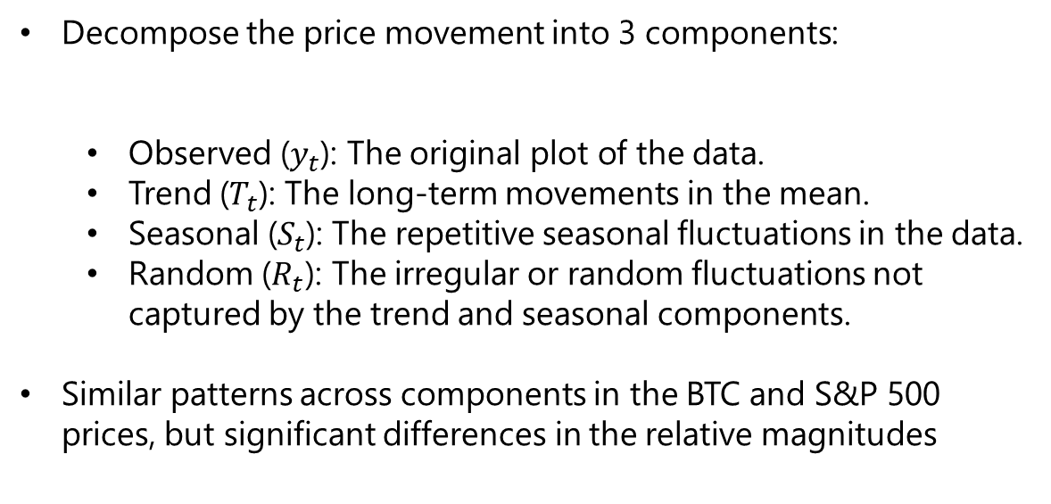
Time Series Decomposition
Decompose the price movement into 3 components:
Observed ($y_{t}$): The original plot of the data.
Trend ($T_{t}$): The long-term movements in the mean.
Seasonal ($S_{t}$): The repetitive seasonal fluctuations in the data.
Random ($R_{t}$): The irregular or random fluctuations not captured by the trend and seasonal components.
Similar patterns across components in the BTC and S&P 500 prices, but significant differences in the relative magnitudes

Slide 5
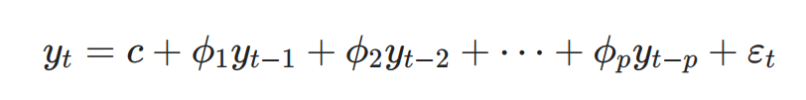
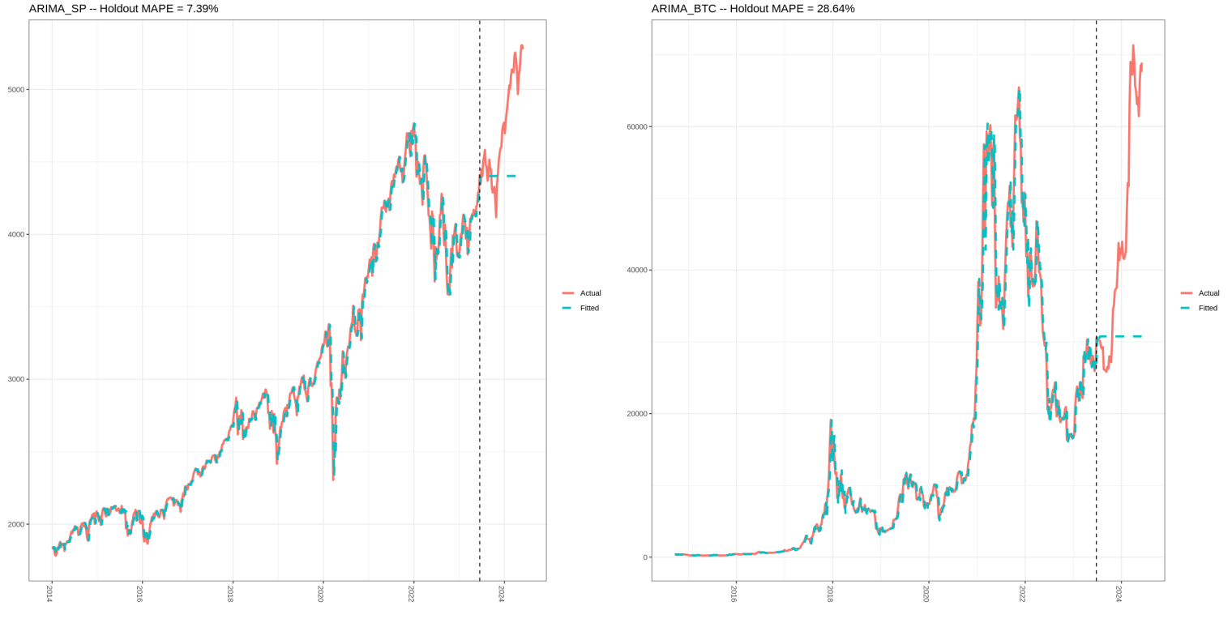
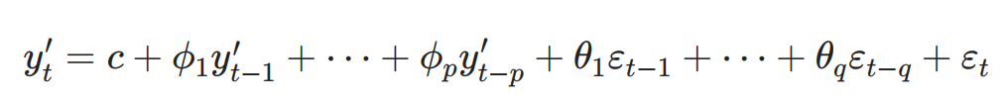
AutoRegressive Integrated Moving Average (ARIMA)
Autoregressive Model (AR): shows a changing variable that regresses on its own lagged, or prior values.
Moving Average Model (MA): Incorporates the dependency between an observation and a residual error from a moving average model applied to lagged observations.
ARIMA: combines differencing with autoregression and a moving average model
ARIMA price predict on S&P 500 and BTC

Slide 6
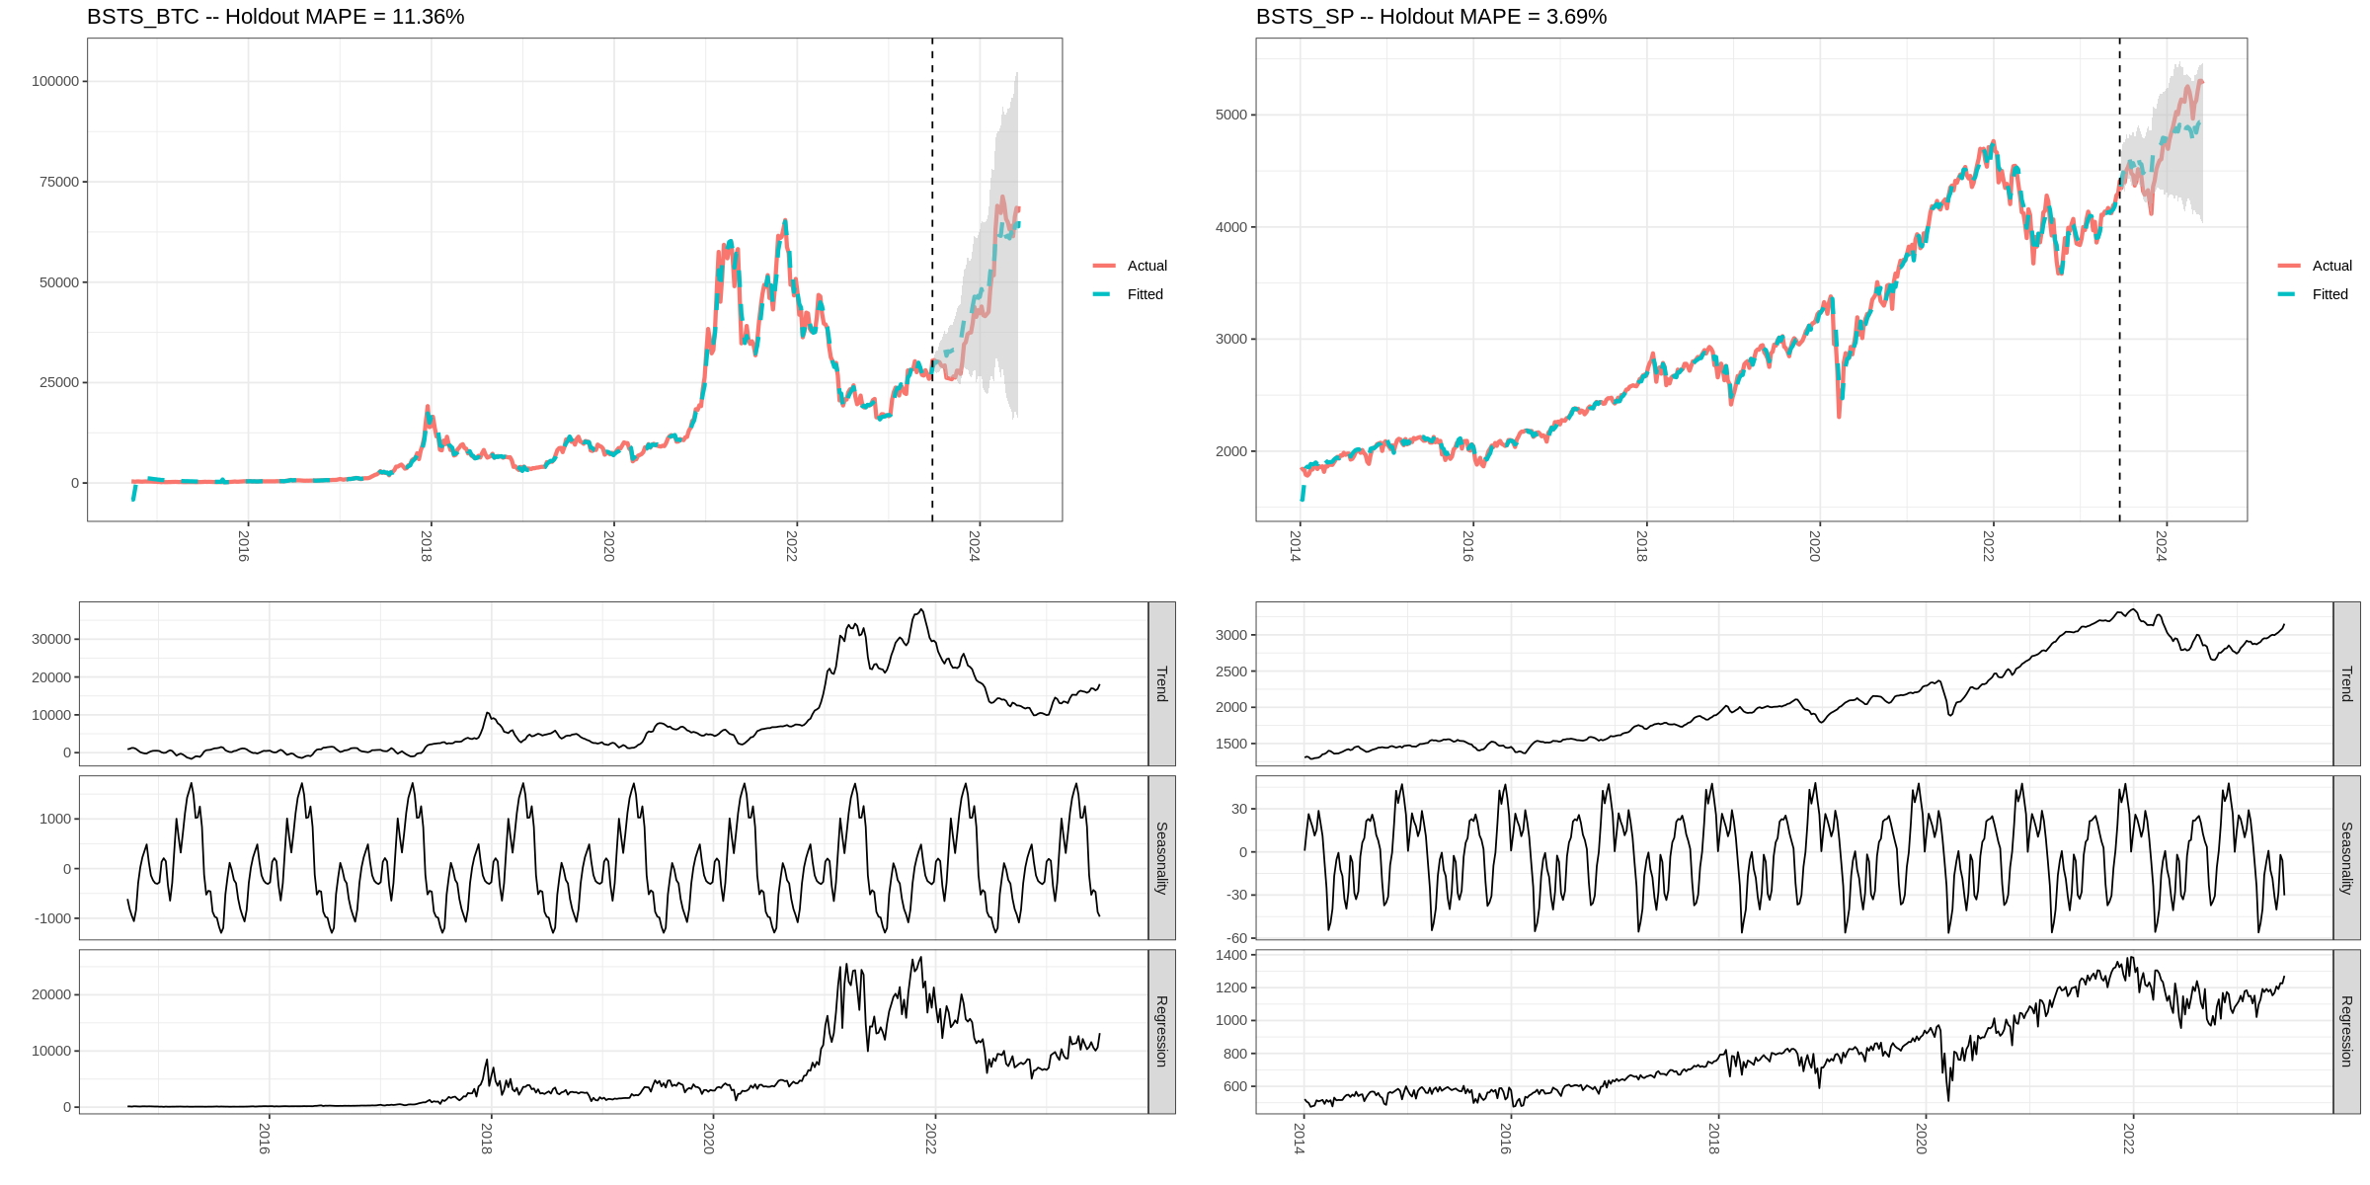
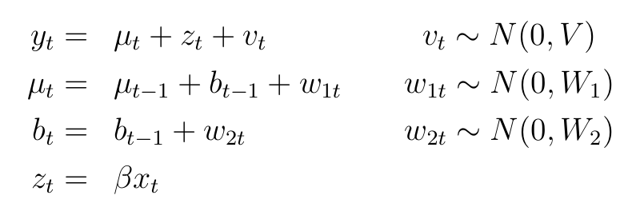
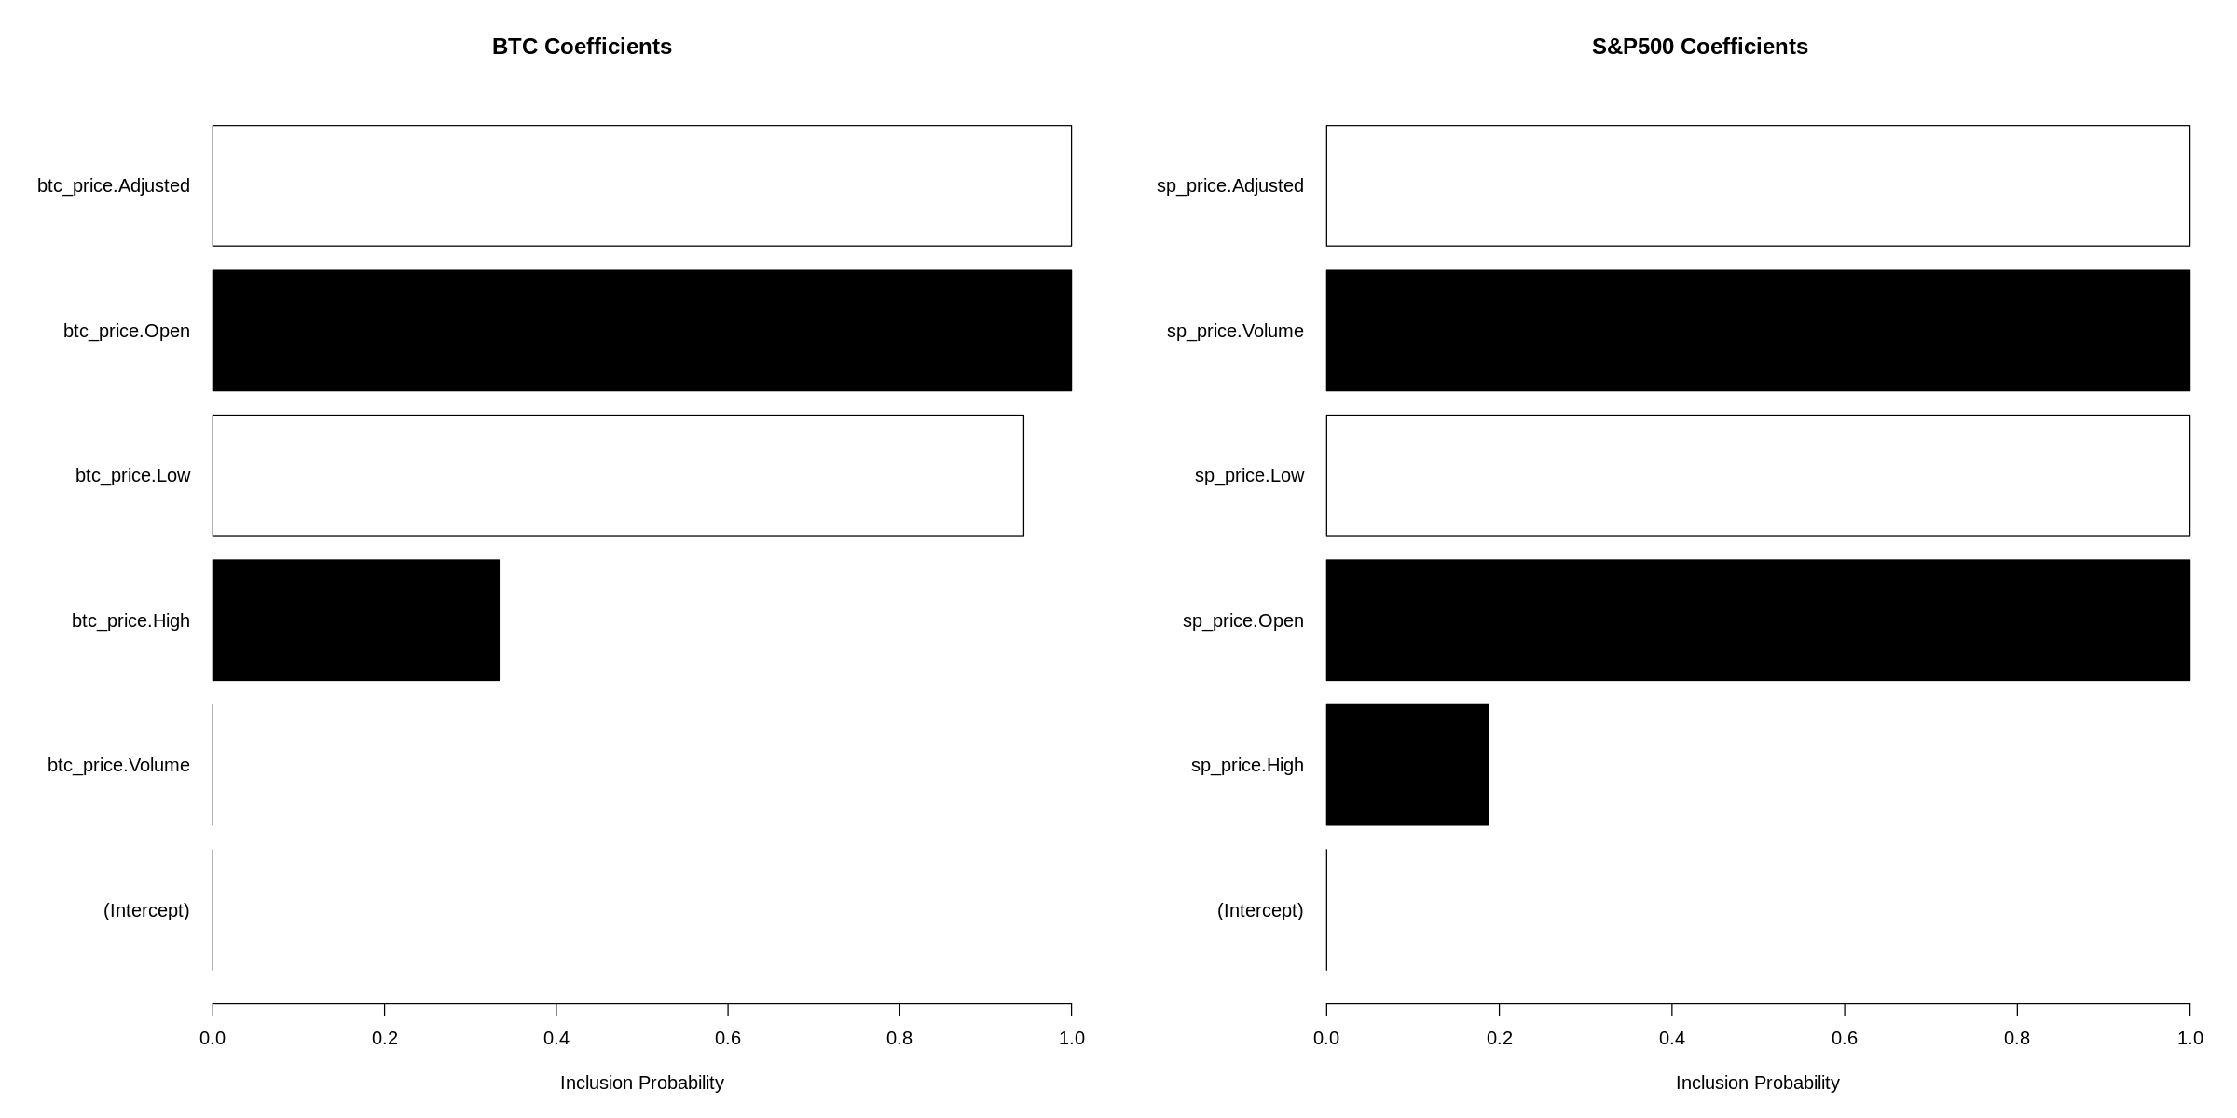
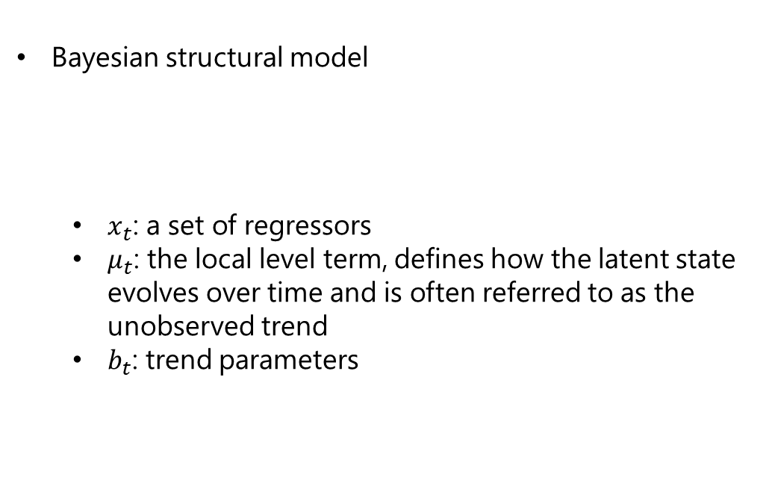
Bayesian Structural Time Series (BSTS)
Bayesian structural model
$x_{t}$: a set of regressors
$μ_{t}$: the local level term, defines how the latent state evolves over time and is often referred to as the unobserved trend
$b_{t}$: trend parameters
BSTS price predict on S&P 500 and BTC

Slide 7
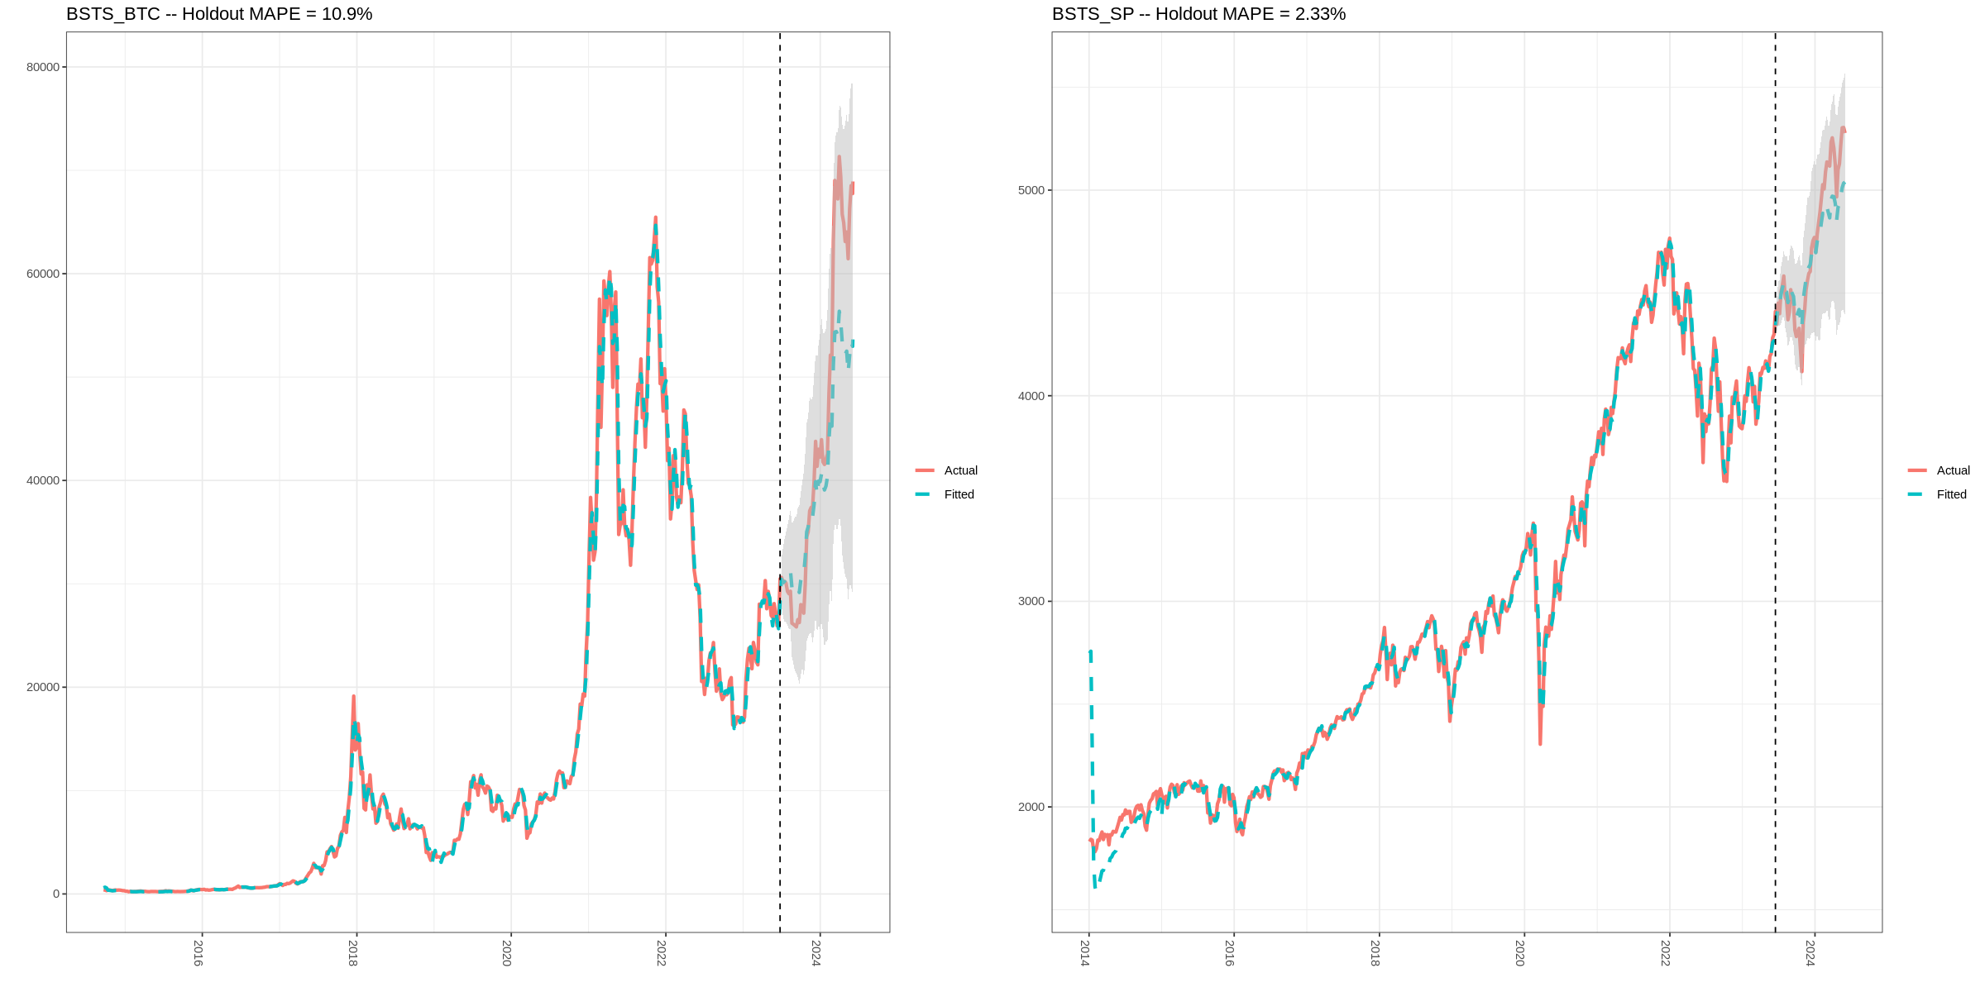
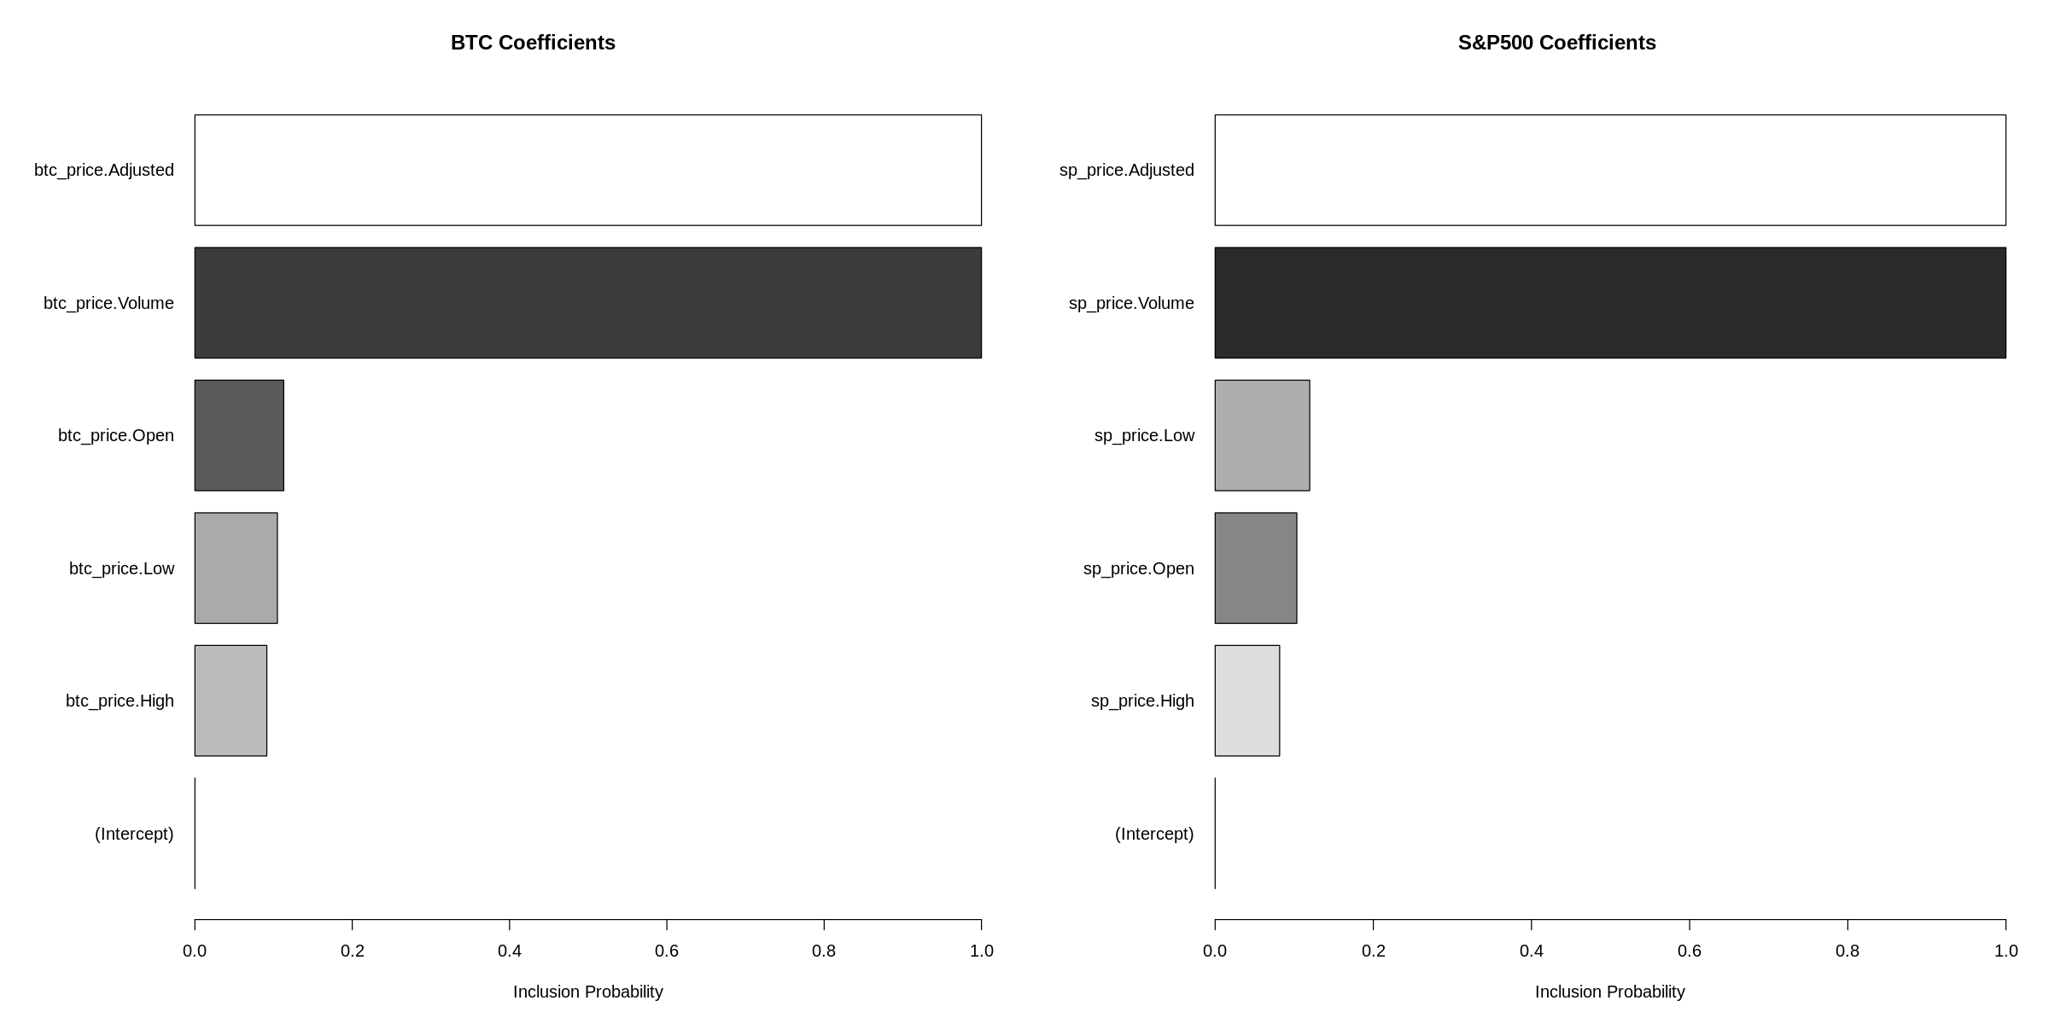
Bayesian Structural Time Series (BSTS): Prior Tuning
Prior:
Adjusted, High, and Low prices variables are highly correlated ➔ reduce the correlation between them
Volume should be included
Previous coefficients
Prior-added coefficients

Slide 8
Question

