Slide 1

What If Your Agent Can Improve Itself?
A local-first pattern for auditable, human-reviewed agent workflow evolution
QUT AI and ML Society | AgentCamp
Local-First AI Workflow Platform
1 / 12

Slide 2
The Fragmentation Problem
Agent workflow logic is split across at least three separate surfaces at once
Python
Decorators
JSON
Configs
Hosted
Dashboard
Schema separate from runtime
Logic buried in code
n8n | Langflow
State lives outside your stack
LangChain | Agent SDK
CrewAI Cloud | Copilot StudioI
No single source of truth
Auditing what changed between runs means diffing three artifacts that were never designed to stay in sync.
2 / 12

Slide 3
The Readability Gap
The LLM being orchestrated cannot read its own workflow instructions
Current Approach
THIS PATTERN
LLM Agent
LLM Agent
reads / proposes
BLOCKED
YAML Spec
Workflow
Instructions
LangGraph Runtime
The LLM executes a pipeline it cannot inspect or reason about
One file both humans and LLMs can read, diff, and propose changes to
3 / 12

Slide 4
Tech Stack
Layer | What It Is
LangGraph | Runtime: executes the graph. This project runs on top of it.
Openrouter / OpenAI | AI Agent model provider, multiple different models to choose from.
Surrounding python code | A thin authoring and review layer on top of any graph runtime.
Best for pipelines needing understandability, auditability, iterative LLM-driven improvement
Not for complex agent pipeline that can’t be display in graph
4 / 12

Slide 5
The Pattern
Make the YAML file the shared contract: human reads it, LLM reads it, runtime compiles it.
① YAML spec
② LLM proposes diff
rollback
snapshot
kept
③ Human reviews graph + eval evidence
④ Apply (write) or Discard
5 / 12

Slide 6
linear_rag.yaml
The only authoring surface: validated by Pydantic, compiled to a LangGraph StateGraph at runtime
schema_version: workflow.graph/v1
name: linear_rag
entry: query_analyser
budget:
cost_usd: 0.50
latency_ms: 240000
nodes:
- id: query_analyser
kind: llm
provider: openai
model: gpt-4o-mini
system_prompt: Rewrite questions
into retrieval queries.
output_state_key: query_analysis
- id: query_embedding
kind: embedding
provider: openrouter
model: google/gemini-embedding-2-preview
output_state_key: query_embedding
- id: vector_retriever
kind: vector_retriever
index_path: evals/linear_rag/vector_index.sqlite
output_state_key: retrieved_context
- id: reranker
kind: llm
provider: openai
model: gpt-4o-mini
output_state_key: reranked_context
- id: synthesiser
kind: llm
provider: openai
model: gpt-4o-mini
output_state_key: final_answer
edges:
- from: query_analyser
to: query_embedding
- from: query_embedding
to: vector_retriever
- from: vector_retriever
to: reranker
- from: reranker
to: synthesiser
- from: synthesiser
to: __end__
schema_version
Versioned: diffable between runs
budget
Cost and latency enforcement per run
kind
Node type: 10 kinds (llm, embedding,
vector_retriever, gate, approval...)
output_state_key
How state flows between nodes
edges
Explicit topology: no magic routing
6 / 12

Slide 7
The Loop: Propose and Validate
Steps 1 to 4: everything here is read-only, nothing writes to disk yet
Input: plain-text mutation goal
Output: validated YAML diff
① Write Goal
② LLM Proposes
③ Validate
④ Diff Shown
Developer states what needs to change in natural language
Full revised YAML returned: the LLM rewrites the spec
Pydantic GraphSpec rejects invalid proposals immediately
Exact line-by-line changes visible before any decision
7 / 12

Slide 8
The Loop: Eval, Apply, Recover
Steps 5 to 7 of 7: only one step writes to disk, and only after explicit confirmation
⑥ Eval in Memory
⑦ Apply or Discard
⑧ Recover
Proposed spec runs against fixture inputs without touching workflows/
Apply overwrites workflows/*.yaml and saves a rollback snapshot
Human-confirmed restore from any snapshot: each restore creates an audit entry
Only this step writes to disk
8 / 12

Slide 9
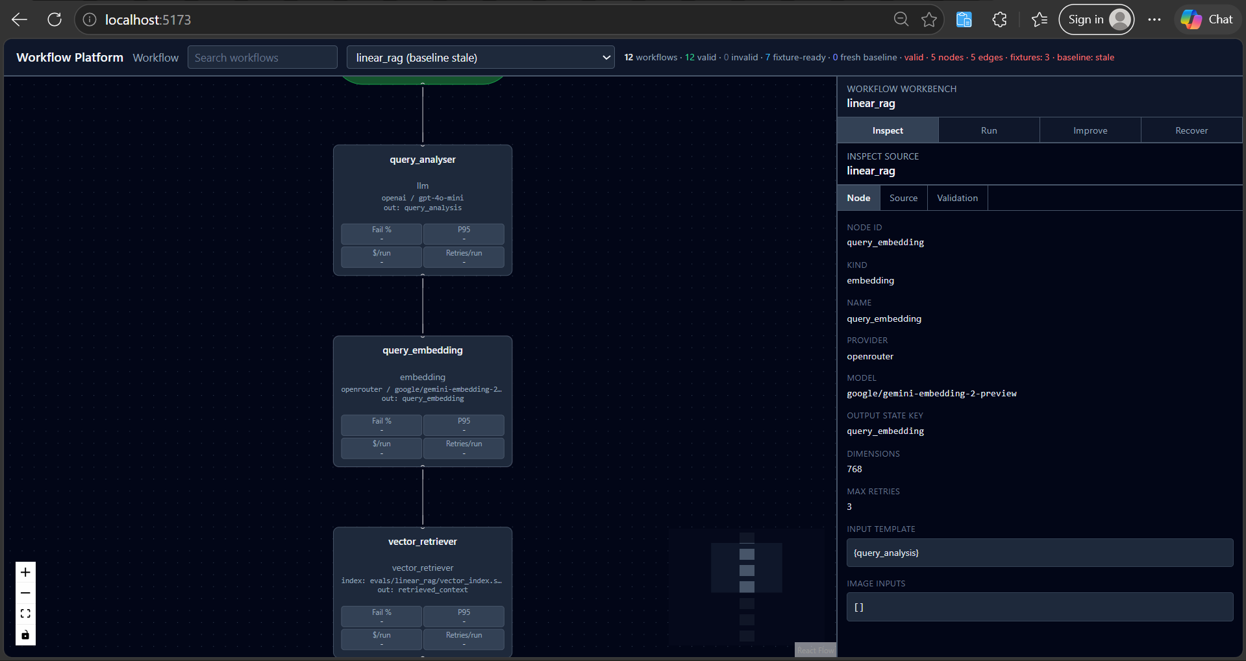
UI Walkthrough
① Workflow selector
② Graph canvas
③ Inspect panel
9 / 12

Slide 10
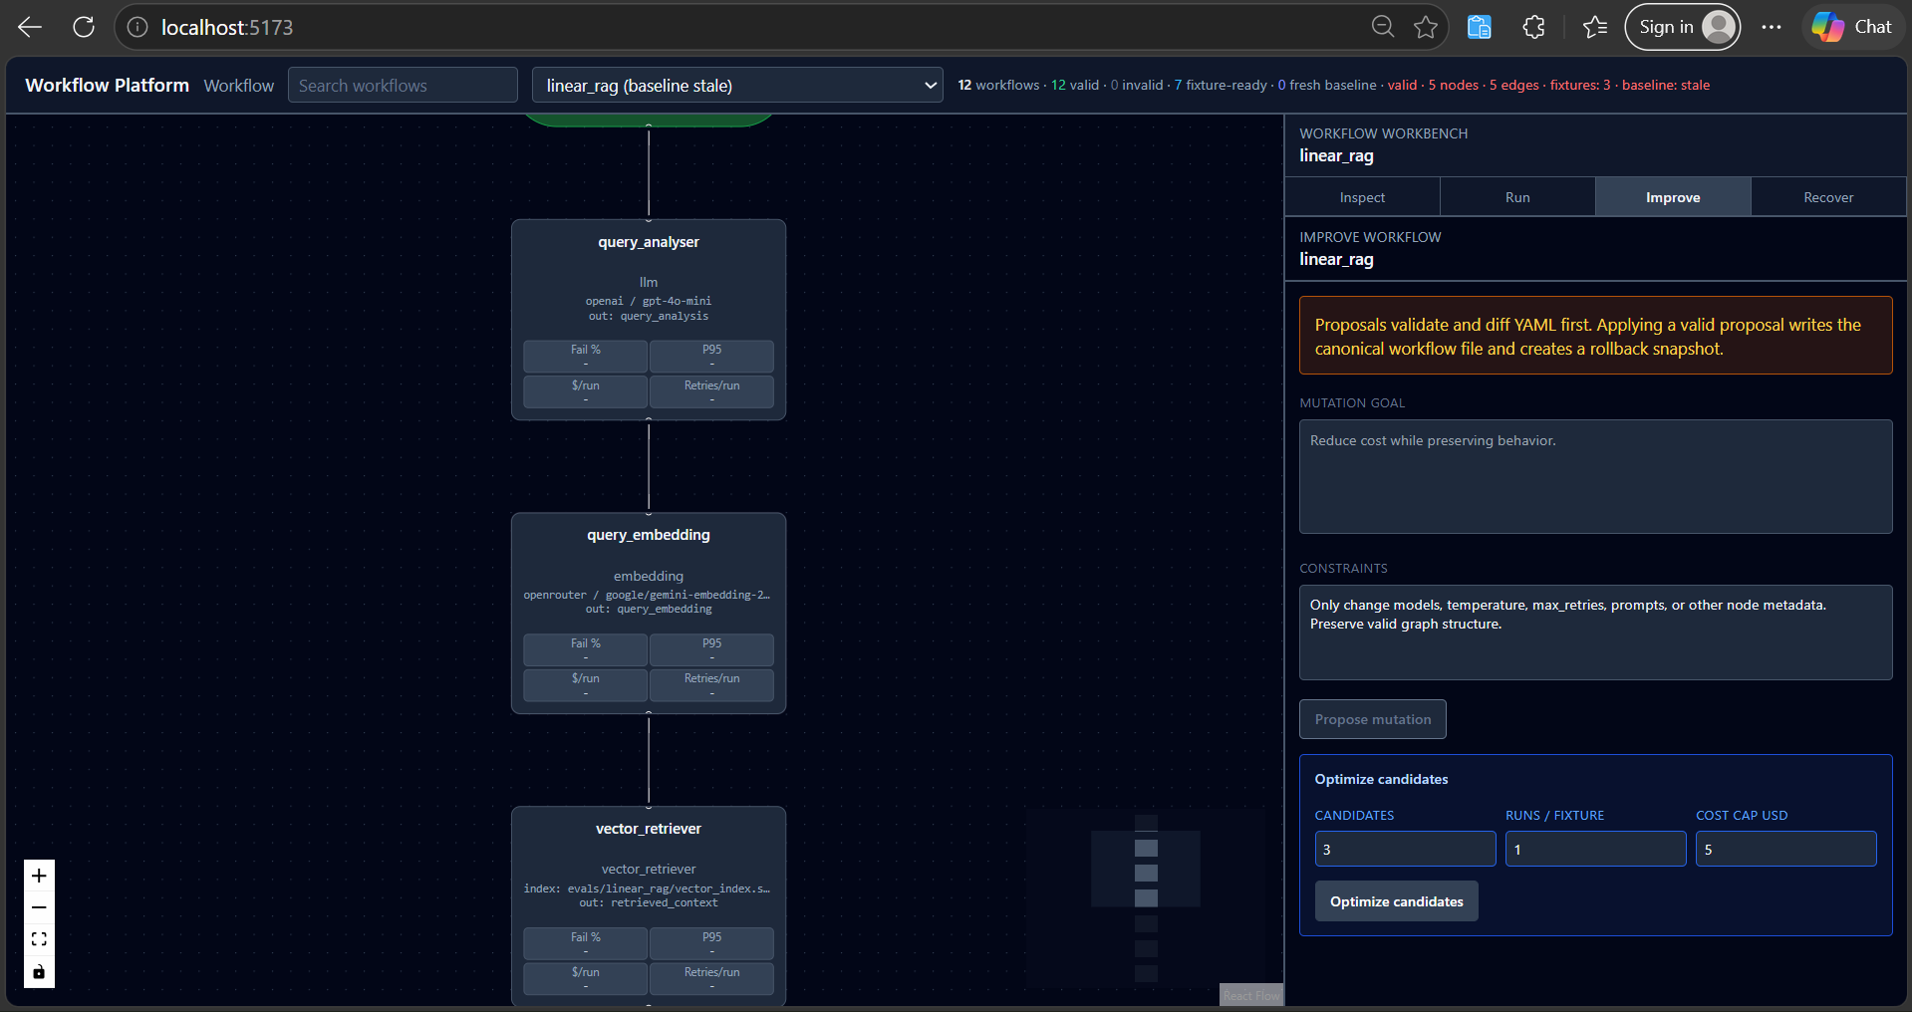
The Improve Tab
10 / 12

Slide 11
Honest Limitations
Proposal quality degrades on large specs
Full YAML rewrite: the LLM holds the entire spec and must reproduce it without drift. A YAML patch format would help.
Eval quality depends on the datasets and scorers you bring
Fixture evals and CSV/JSONL/YAML dataset adapters are included, but subjective scoring and production distribution coverage are still on you.
Budget enforcement is post-node, not mid-stream
A node over budget is rejected after completion, not cancelled mid-generation. Streaming cancellation is deferred.
Only two providers: OpenAI and OpenRouter
Anthropic, Gemini, and Ollama each need a new adapter. The pattern is clean but provider coverage is thin.
Some Agentic workflow do not map cleanly to graph
Replacing placeholder person reID specialists with real model wrappers for visual, text, and body-shape signals.
11 / 12

Slide 12
Take Back Three Things
1
Put the spec in one file both you and the LLM can read
A shared, human-readable YAML is the foundation of every other property
2
Keep mutation human-reviewed
Propose, Eval, explicit Apply. Nothing lands until a human says so.
3
Treat run artifacts as immutable audit records
Fork continuations, don't mutate source runs. Rollback restores overwrite only after confirmation and record an audit entry.
Key question: Can your pipeline be easily understandable? Can the LLM read it and improve it easily?
hieunguyen7337/AI_Agent_Local_Workflow_PLatform
12 / 12

