Slide 1
BACKSTAGE DEMO
How to setup backstage on to AWS Cloud
Where are you in this journey?

Slide 2
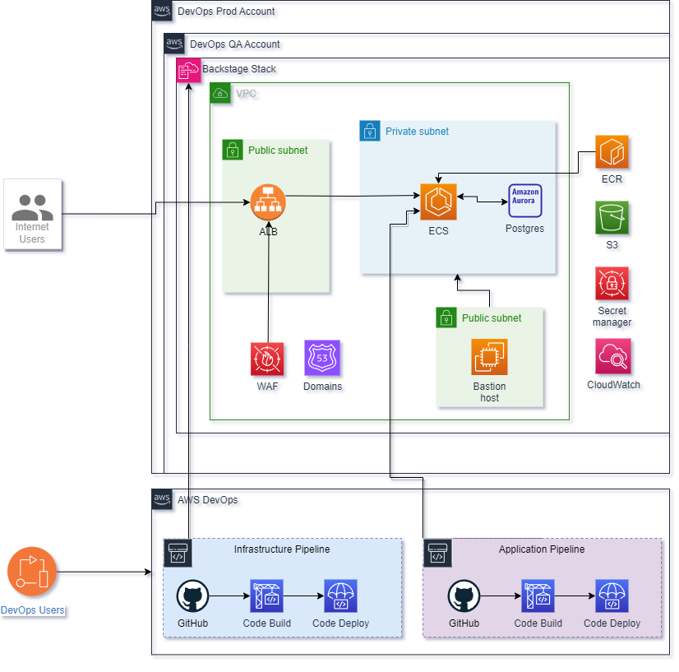

Design Diagram

Slide 3

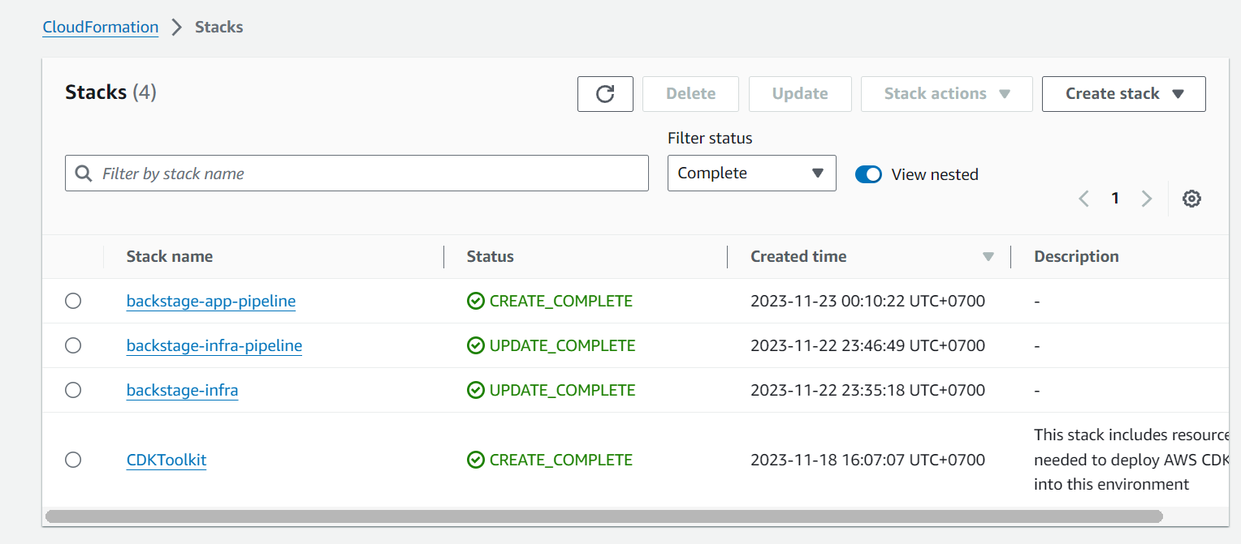
CICD PIPELINES
Infrastructure Pipeline
Application Pipeline
This pipeline is self updating and deploys all of the supporting infrastructure to host the backstage container app
This pipeline is only intended to build and update the containers running in ECS fargate based on changes in the application code, so that we can maintain the two aspects separately and cleanly

Slide 4
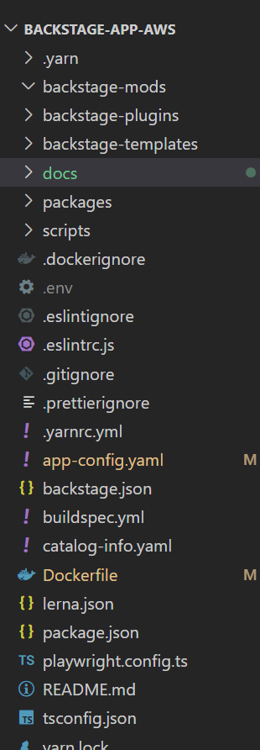
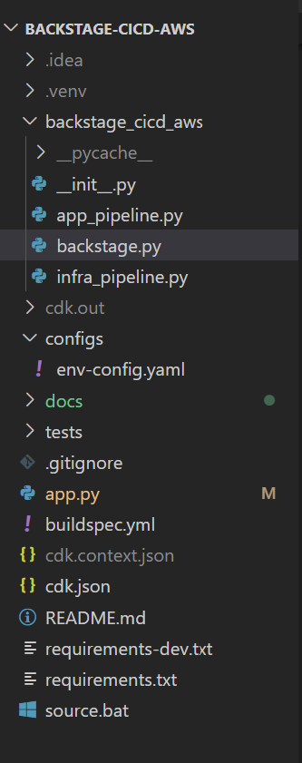
Source
backstage-cicd-aws
Infra code
Backstage Application
backstage-app-aws
© FPT Corporation
| Confidential

Slide 5

THANK YOU!
5

