Slide 1
Smart Voice
Home Assistant
Raspberry Pi + OpenAI + OLED + GPIO Control
VOICE
OPENAI
OLED
GPIO
PYTHON
Final Project Presentation
By: Trung Nguyen

Slide 2
OVERVIEW
Project Overview
•
Voice-activated home assistant
A Raspberry Pi device that waits for a wake command, starts an AI conversation, and gives spoken feedback.
•
Embedded hardware focus
The project uses a voice sensor, OLED display, and GPIO-connected outputs.
•
Documentation goal
The final project is organized like a complete engineering report.

Slide 3
OBJECTIVES
Objectives and Goals
•
Build a working Raspberry Pi voice assistant prototype.
•
Use a dedicated recognition sensor for wake and reset commands.
•
Integrate OpenAI transcription, response generation, and TTS.
•
Display live status on OLED.
•
Control fan, red light, and green light through GPIO.
•
Document design process, issues, results, and future improvements.

Slide 4
COMPARISON
Consumer vs. Custom AI Assistant
Typical Consumer Assistant
This Raspberry Pi Build
• Closed ecosystem and limited hardware access.
• Open Python code and clear documentation.
• Hard to customize GPIO behavior.
• Wake command, OLED feedback, and physical GPIO outputs.
• Usually depends on fixed vendor features.
• OpenAI runtime plus local AI experiments.
• Little visibility into internal logic.
• Expandable for relays, lights, and sensors.

Slide 5
GOAL
Our Goal: Combine Both Worlds
•
Low cost
Use Raspberry Pi hardware and common modules.
•
Small footprint
Prototype can become a compact desktop assistant.
•
AI conversation
Use OpenAI for natural spoken responses.
•
Physical control
Connect the assistant to fan and light indicators.
•
Visible feedback
OLED shows what the assistant is doing.

Slide 6
DESIGN
Design and Development
•
Wake layer
DFRobot voice recognition sensor detects command IDs.
•
Runtime layer
Python starts and cancels threaded assistant sessions.
•
AI layer
OpenAI handles transcription, replies, and TTS audio.
•
Output layer
OLED, speaker audio, and GPIO provide user feedback.

Slide 7
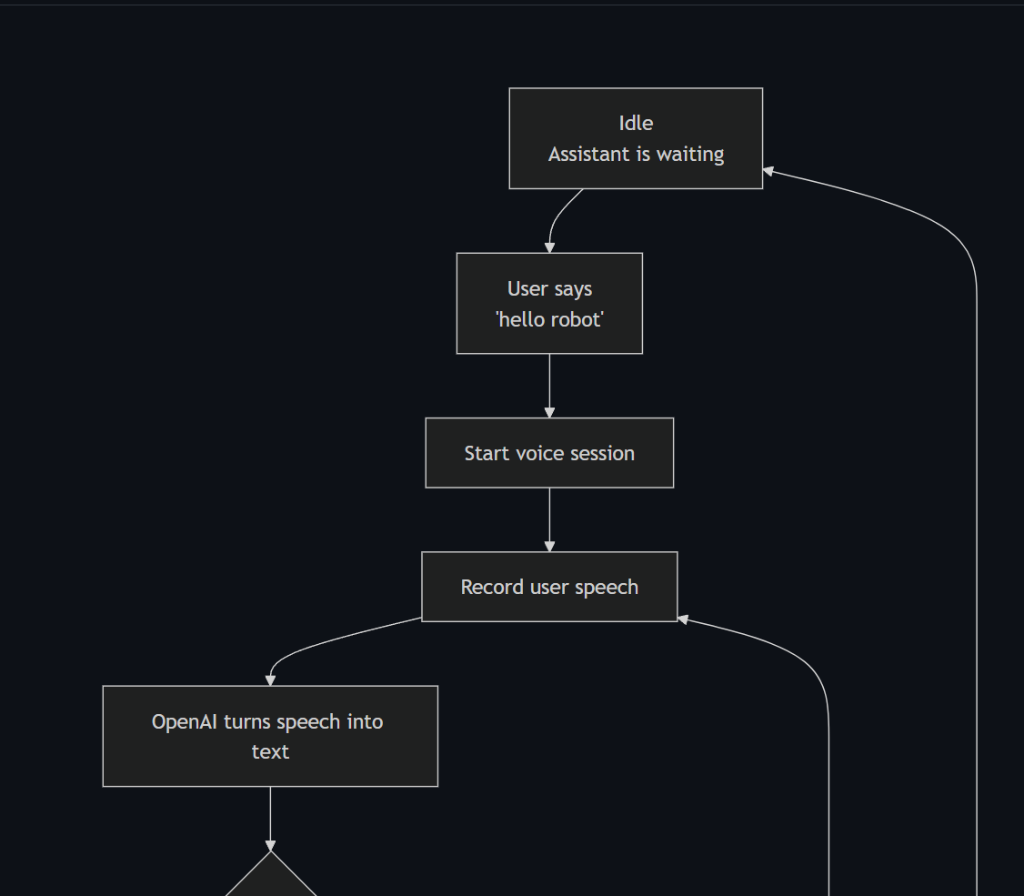
FLOW CHARTS
Final Code Flow Chart
Flow chart was made in Github: LINK

Slide 8
CODE FLOW
Main Loop Behavior
•
Idle loop
OLED refreshes every 0.25 seconds and the DFRobot sensor is read continuously.
•
Hello robot
Command ID 2 starts a session only if no session is active.
•
Reset
Command ID 82 cancels active audio/OpenAI work and returns OLED to idle.

Slide 9
CODE
Launcher and Hardware Loop
What this file does
voice = DFRobot_DF2301Q_UART()
runtime = PiVoiceRuntimeOpenAI()
oled = OLEDStatusDisplay("Rose Carter", "AI assistant")
cmd_id = voice.get_CMDID()
voice_test_openai.py starts first when the Pi boots.
It creates the DFRobot voice sensor, runtime brain, and OLED display.
It stays in a loop waiting for command IDs from the sensor.
It starts or cancels the AI session.
systemd -> voice_test_openai.py -> sensor loop -> runtime session
‹#›

Slide 10
COMMANDS
Wake and Reset Commands
hello robot
reset
HELLO_ROBOT_CMDID = 2
RESET_CMDID = 82
if cmd_id == HELLO_ROBOT_CMDID:
runtime.start_session()
elif cmd_id == RESET_CMDID:
runtime.cancel_session()
Command ID 2 starts listening. If a session is already active, it cancels and starts fresh.
Command ID 82 cancels the current session and returns the OLED to idle.
This makes the wake command stronger: the user can interrupt and give a new command right away.
‹#›

Slide 11
AI + GPIO
OpenAI Runtime and Device Control
How the GPIO decision works
{
"intent": "device_control",
"reply": "Turning on the fan.",
"targets": ["fan"],
"action": "on"
}
pi_voice_runtime_openai.py records the user voice.
OpenAI transcribes the audio into text.
For device commands, OpenAI returns a temporary JSON action plan.
Python maps the JSON target to GPIO and executes the action.
fan -> GPIO 16
red_light -> GPIO 20
green_light -> GPIO 21
OpenAI does not directly touch the pins. Python executes the hardware action.
User says “turn on the fan” -> GPIO 16 turns on
‹#›

Slide 12
AGENTS
PicoClaw Agent Workspaces
What PicoClaw does
Agent folders
PicoClaw is a separate command-line agent runner.
Python still controls microphone, OpenAI transcription, OLED, GPIO, and speaker output.
PicoClaw only generates the text reply for David Miller.
picoclaw_agents/
story_home/.picoclaw/workspace/AGENT.md
device_home/.picoclaw/workspace/AGENT.md
speech_home/.picoclaw/workspace/AGENT.md
"david": {
"mode": "picoclaw",
"home": PICOCLAW_BASE / "story_home"
}
PICOCLAW = Path(".../picoclaw")
PICOCLAW_BASE = Path(".../picoclaw_agents")
select David -> OpenAI transcription -> PicoClaw story_home -> OpenAI TTS -> speaker output
‹#›

Slide 13
MECHANICAL
Mechanical Build
•
Raspberry Pi is the main control board.
•
USB microphone captures user speech during active sessions.
•
OLED is placed where the user can see system state.
•
Voice recognition sensor is positioned for wake/reset commands.
•
Final enclosure CAD is planned after the prototype layout is locked.

Slide 14
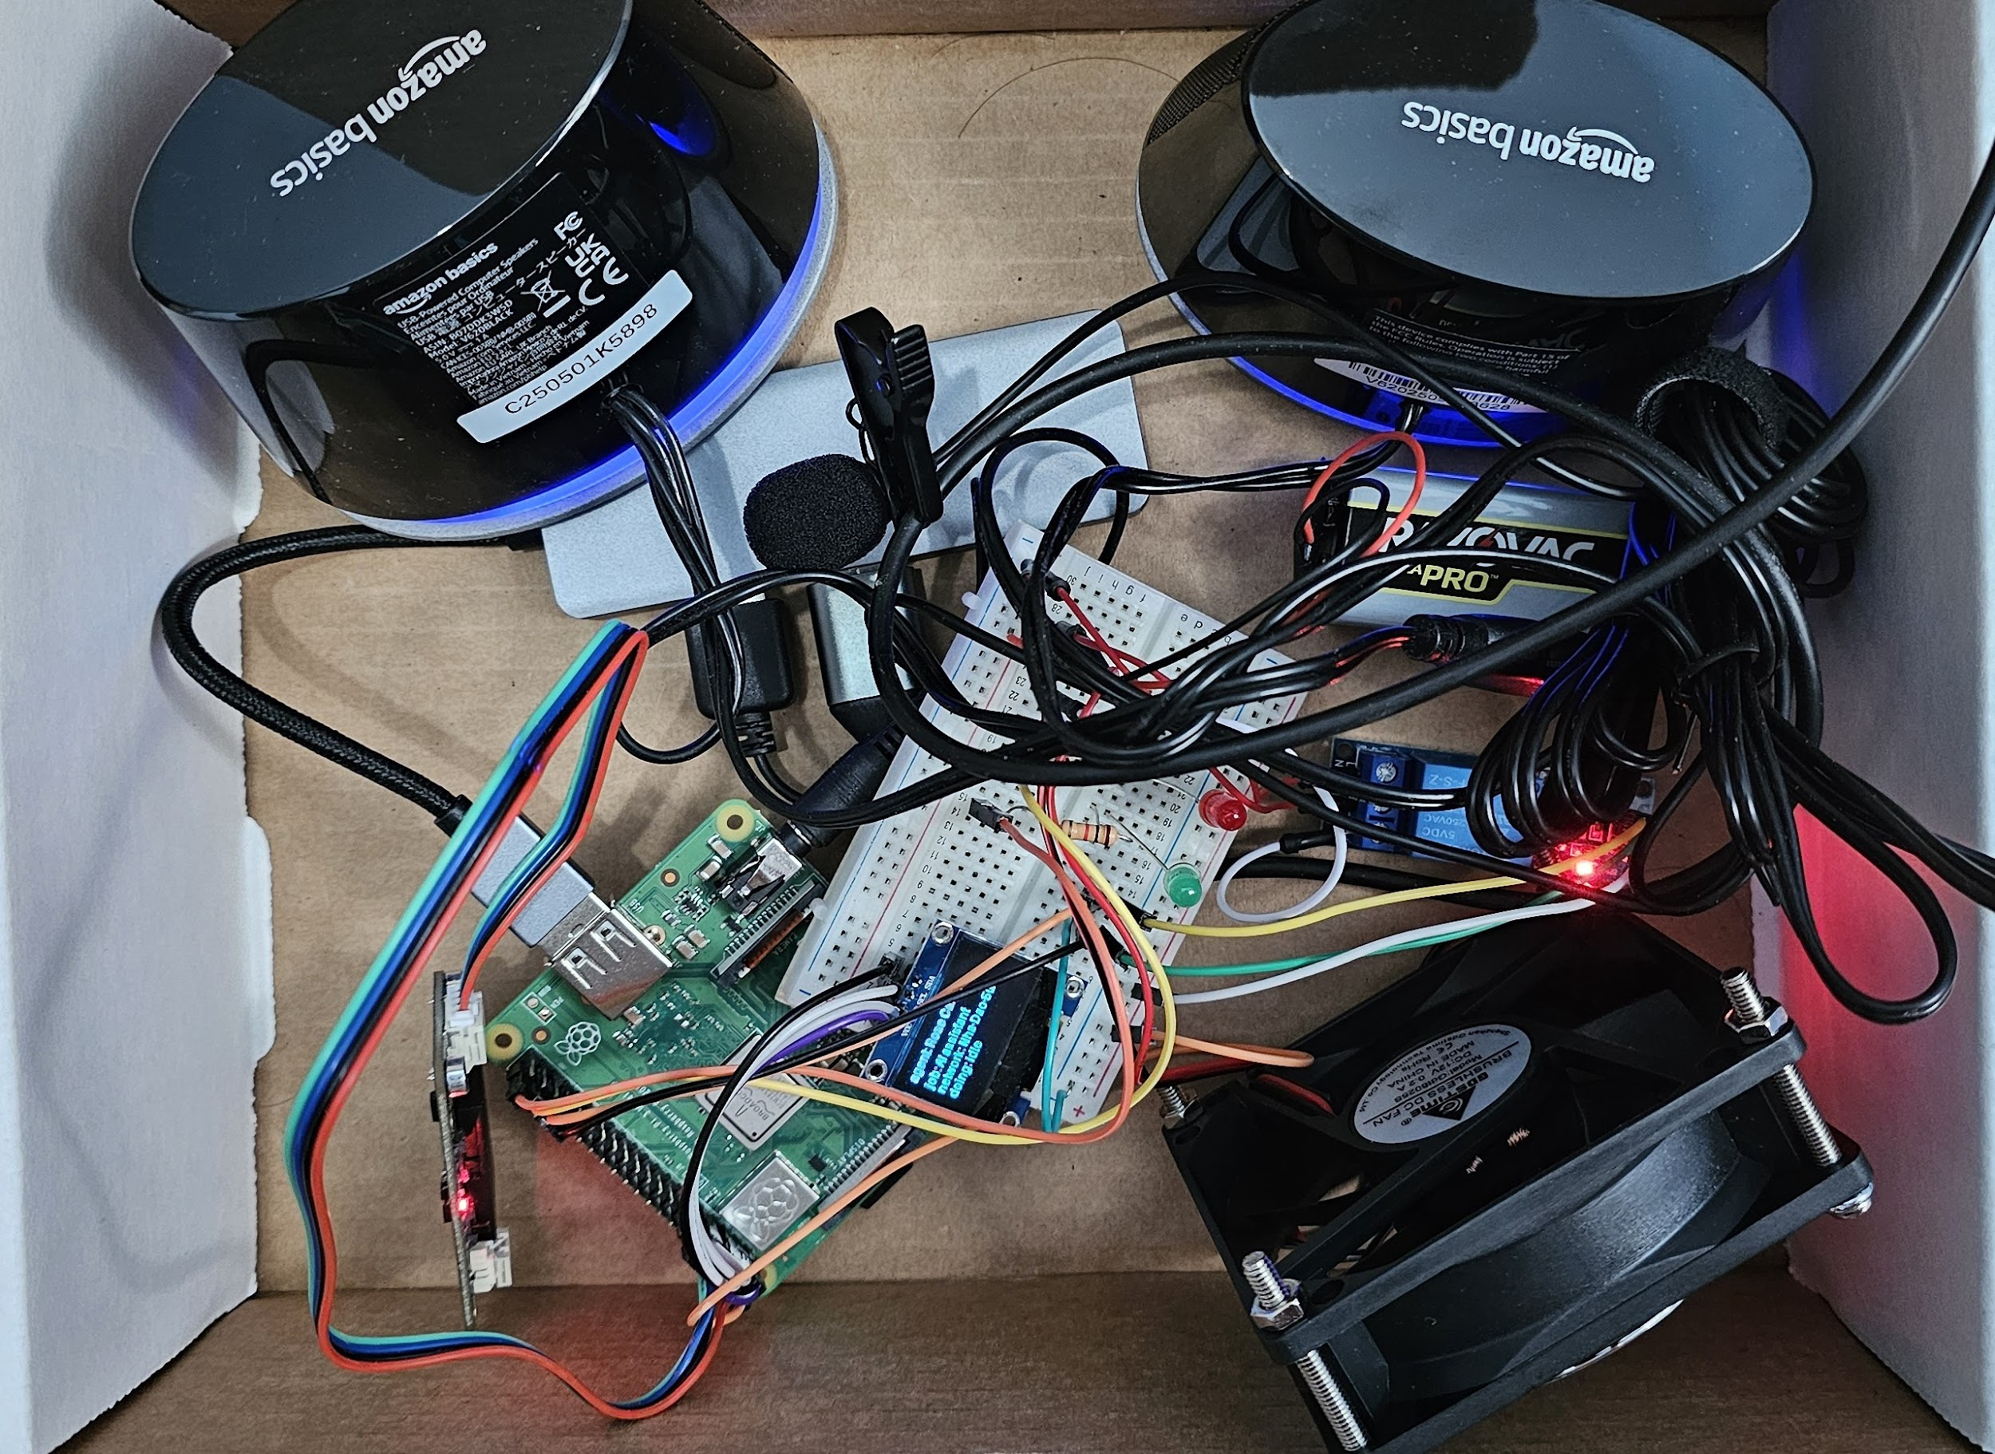
MECHANICAL
Mechanical Prototype Photo
Current prototype layout with Raspberry Pi, OLED display, breadboard wiring, microphone, speakers, fan/relay hardware, and GPIO wiring.

Slide 15
ELECTRICAL
Electrical Design
•
UART voice sensor
Pin 8 / GPIO14 transmits commands. Pin 10 / GPIO15 receives sensor data.
•
OLED display
I2C display at address 0x3C using luma.oled.
•
GPIO outputs
Fan GPIO16, red indicator GPIO20, green indicator GPIO21.
•
Safety
GPIO should control driver or relay circuits for larger loads.

Slide 16
EXPERIMENTS
Local AI Experiments
•
Vosk
Installed and tested for offline speech recognition.
•
Whisper.cpp
Explored for local speech-to-text on Raspberry Pi.
•
Piper
Tested for local text-to-speech voices.
•
Local LLM
Tested locally on the Raspberry Pi.
•
OpenClaw
Tested as an action-agent AI feature.
•
Low-RAM lesson
On Raspberry Pi 3, heavy AI steps must run carefully and not all at once.

Slide 17
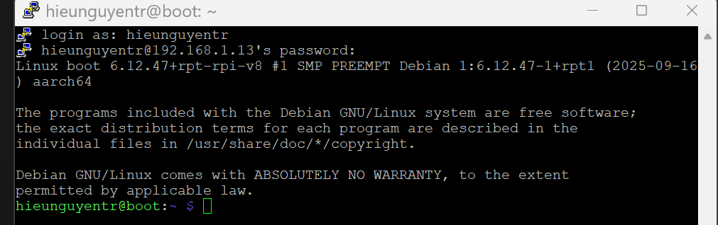
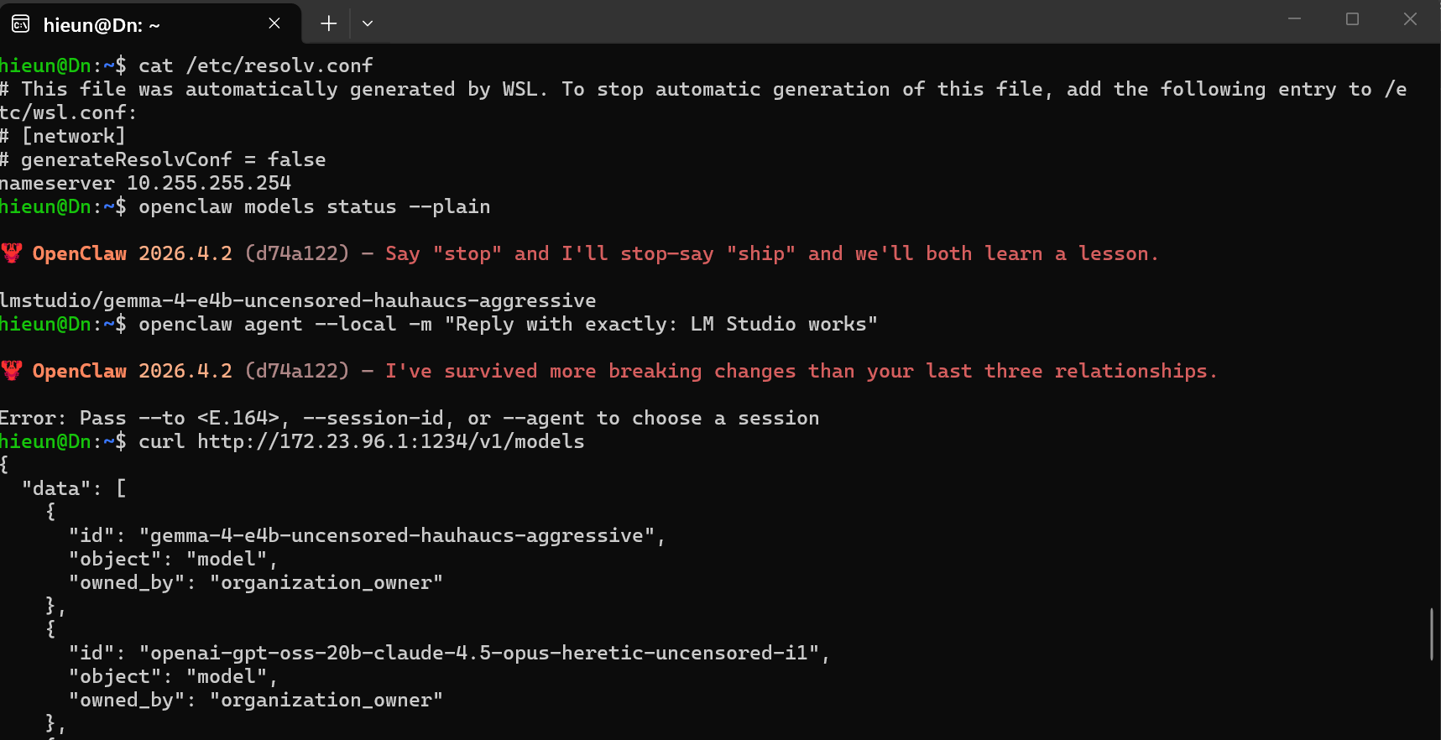
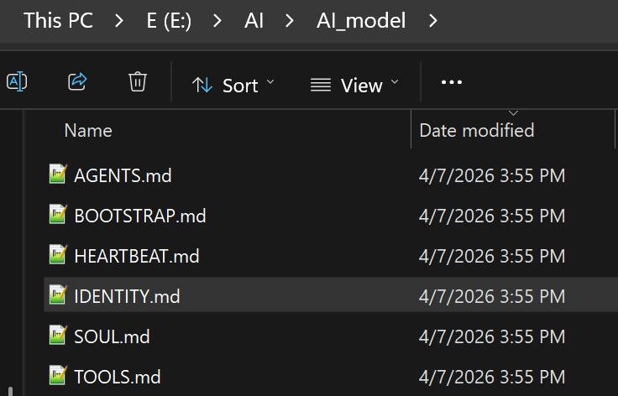
PROGRESS
Development Evidence
Raspberry Pi remote access
OpenClaw setup
File automation workflow

Slide 18
TESTING
Results
Works
Works
Works
Wake command starts session
OLED status updates
OpenAI transcription + response
Works
Tested
Tested
Reset cancels active session
Piper text-to-speech
Local LLM on Raspberry Pi

Slide 19
LESSONS
Issues and Lessons Learned
•
Microphone setup required debugging
USB audio detection worked, but input device selection needed careful testing.
•
Vosk was sensitive to noise
Offline recognition was fast but picked up background sound.
•
Low RAM changed the design
After moving to Raspberry Pi 3, AI tools had to run more carefully and sequentially.
•
Test hardware one part at a time
Sensor, OLED, GPIO, microphone, and AI runtime each needed isolated tests.

Slide 20
BOM
Bill of Materials
Component
Purpose
Raspberry Pi 3 / 4
Main embedded computer
DFRobot DF2301Q
Wake and reset command sensor
USB lavalier microphone
Speech input
OLED display
Status and transcript feedback
Fan / LEDs / relay wiring
Physical device control
microSD + HDMI + VNC/SSH
Setup and remote development

Slide 21
DOCUMENTATION
Project Report
•
Home page with project overview and architecture.
•
Flow charts, BOM, mechanical build, electrical, results, code, progress reports, and CAD sections.
•
Clean public code folder with requirements and service template.
•
Private OpenAI API keys and Wi-Fi credentials are excluded.

Slide 22
FUTURE WORK
Future Improvements
•
Record and publish final demo video.
•
Finalize enclosure CAD and physical mounting.
•
Add exact BOM prices and purchase links.
•
Improve microphone noise handling.
•
Add more device-control commands and safety checks.
•
Package the project for easier installation on a new Raspberry Pi.

Slide 23
FINAL
Conclusion
•
The project successfully demonstrates a Raspberry Pi voice assistant prototype.
•
The assistant connects wake detection, OpenAI responses, OLED feedback, and GPIO device control.
•
The simplified flow chart now matches the final code.
•
Next steps are demo video, exact BOM, enclosure CAD, and install polish.

