Slide 1

Database and Web Technique Project
Khac Hieu Nguyen
Automotive Software Engineering

Slide 2
Outline
MERN Stack Overview
Project Architecture
Frontend
Backend
Database Diagram
Demo

Slide 3
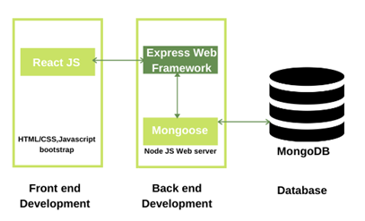
MERN Stack Overview
MongoDB: NoSql DBMS, document-oriented database, stores data in JSON format allows fast exchange of data between client and server
Express: a lightweight framework of Node JS helps building simplified, fast and secure web application
React: open source JS library used to build user interfaces, fast and scalable
Node JS: open source, cross-platform JS runtime environment
Notes:
Oversteering and understeering
The angle of the steering on its own can be used to determine where the front wheels are pointed.
When combined with other pieces of information from the yaw, accelerometer and wheel speed sensors, it is possible to measure the dynamics of the vehicle.

Slide 4
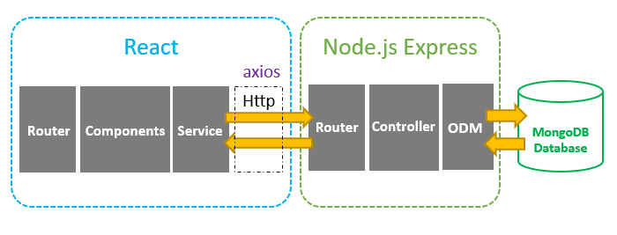
Project Architecture
React client app sends HTTP requests and receives responses using axios, data then will be forward to each components. React Router is used for navigating between different pages.
Express app defines all routes that matching API calls and corresponding controller. Controllers interact with MongoDB database using Mongoose ODM.

Slide 5
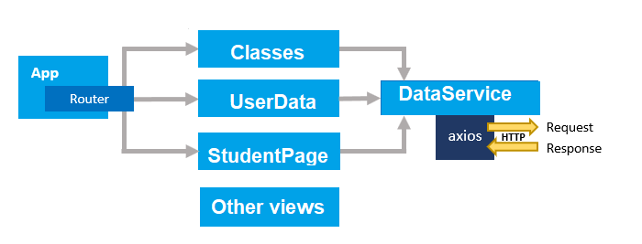
Frontend
The App component is a container with React Router. It has a Navigation bar that links to routes path.
Classes, UserData, StudentPage are components that manage information of class, user, studying subjects of student.
DataService which use axios to make HTTP requests and receive responses then return data to the corresponding components
Notes:
Steering angle sensor system is mounted on steering column of the steering wheel
The system consists of two parts
Mechanical structure
Signal processing circuit

Slide 6
Frontend
React: JS library for creating user interfaces
React Router: supports navigating between different views
React Hooks: functions that let us hook into the React state and lifecycle features from function components. Hooks allow us to easily manipulate the state of our functional component without needing to convert them into class components.
Proptypes: A runtime type checking for React props and similar objects. Using prop-types to document the intended types of properties passed.
Material UI: front-end library, provides a large library of components, fully customizable theme, regularly updated and extensive support for issues and bugs.
Date-fns: manipulate JS dates
Jspdf-autotable: supports generate PDF tables either by parsing HTML tables or by using Javascript data directly.
Axios: a promised based HTTP client for the browser and node.js, supports send requests from client and receive responses from server
Notes:
Steering angle sensor system is mounted on steering column of the steering wheel
The system consists of two parts
Mechanical structure
Signal processing circuit

Slide 7
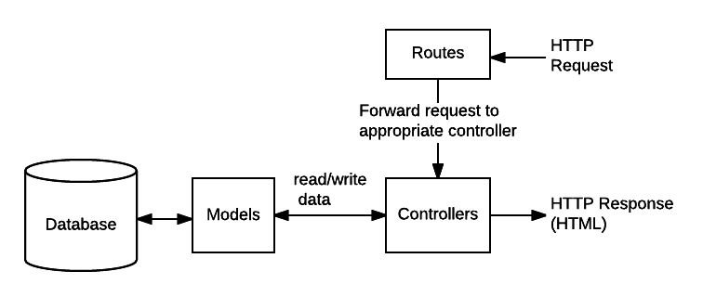
Backend
Routes: forward the supported requests to the appropriate controller functions
Controller functions will get the requested data from the models and return it to the user view in the browser.
Models: define all models using in the project, handle read/write data request from controllers

Slide 8
Backend
Express: is a minimal and flexible Node.js web application framework, provides us a lot of features that help create a robust API is quick and easy
Async: is a utility module which provides straight-forward, powerful functions for working with asynchronous JavaScript
Bcryptjs: Bcrypt is a secured way to store password in database regardless of whatever language app’s backend is built in. By using hash algorithms (one-way function), the resulting hash cannot be reversed
Jsonwebtoken is used to authorize a user when login to our system for accessing features of the app.
Mongoose: is a MongoDB object modeling tool designed to work in an asynchronous environment, provides a straight-forward, schema-based solution to model application data
Nodemon: is a tool that helps develop node.js based applications by automatically restarting the node application when file changes in the directory are detected

Slide 9
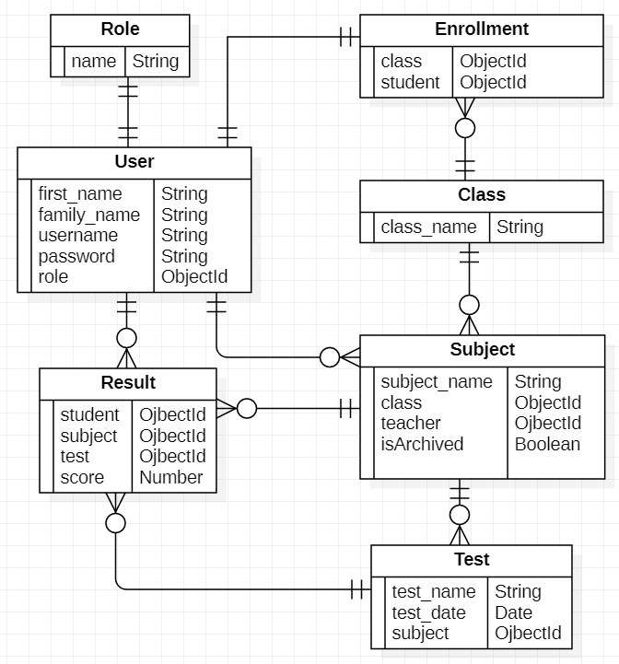
Database Diagram

Slide 10
Demo
Demo scenarios
1 admin
2 classes:
each class has 3 subjects and 4 students
1 subject has no test
1 subject has 3 tests
1 student is not assigned to any class
3 teacher:
1 teacher is not assigned any subject
1 teacher is assigned 2 subjects belongs to 2 different classes and 2 different subjects of the same class

Slide 11
References
Why using MERN stack
https://www.classicinformatics.com/blog/why-is-mern-stack-our-preferred-platform-for-startups-apps
React
https://www.npmjs.com/package/react
React Router
https://reactrouter.com/web/guides/philosophy
React Hooks
https://reactjs.org/docs/hooks-intro.html
Axios
https://www.npmjs.com/package/axios
https://dev.to/cesareferrari/working-with-axios-in-react-540c
Material-UI
https://material-ui.com/
https://material-ui.com/getting-started/usage/
Date-fns
https://date-fns.org/
Jspdf-autotable
https://www.npmjs.com/package/jspdf-autotable

Slide 12
References
Express
http://expressjs.com/
Bcryptjs
https://www.npmjs.com/package/bcryptjs
https://javascript.plainenglish.io/how-bcryptjs-works-90ef4cb85bf4
Jsonwebtoken
https://jwt.io/introduction
https://bezkoder.com/jwt-json-web-token/
Mongoose
https://mongoosejs.com/
https://www.npmjs.com/package/mongoose
MERN stack example application
https://bezkoder.com/react-node-express-mongodb-mern-stack/
https://bezkoder.com/react-crud-web-api/
https://github.com/mdn/express-locallibrary-tutorial
https://github.com/dunky11/react-saas-template
https://developer.mozilla.org/en-US/docs/Learn/Server-side/Express_Nodejs/routes

Slide 13
Thank you for listening

