Slide 1

MIPS Instruction Formats
Instructor: Rebecca Herman

Slide 2
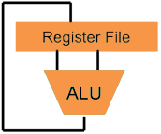
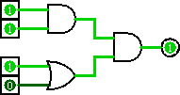
Great Idea #1: Levels of Representation/Interpretation
Higher-Level Language Program (e.g. C)
temp = v[k];
v[k] = v[k+1];
v[k+1] = temp;
Compiler
We__
are__
here._
lw $t0, 0($2)
lw $t1, 4($2)
sw $t1, 0($2)
sw $t0, 4($2)
Assembly Language Program (e.g. MIPS)
Assembler
0000 1001 1100 0110 1010 1111 0101 1000
1010 1111 0101 1000 0000 1001 1100 0110
1100 0110 1010 1111 0101 1000 0000 1001
0101 1000 0000 1001 1100 0110 1010 1111
We__
are__
here._
Machine Language Program (MIPS)
Machine Interpretation
Hardware Architecture Description (e.g. block diagrams)
Architecture Implementation
Logic Circuit Description (Circuit Schematic Diagrams)

Slide 3

Agenda
Stored-Program Concept
R-Format
Your Feedback!
I-Format
Branching and PC-Relative Addressing
J-Format
Bonus: Assembly Practice
Bonus: Disassembly Practice

Slide 4
Big Idea: Stored-Program Concept
INSTRUCTIONS ARE DATA
programs can be stored in memory as numbers
Before: a number can mean anything
Now: make convention for interpreting numbers as instructions

Slide 5
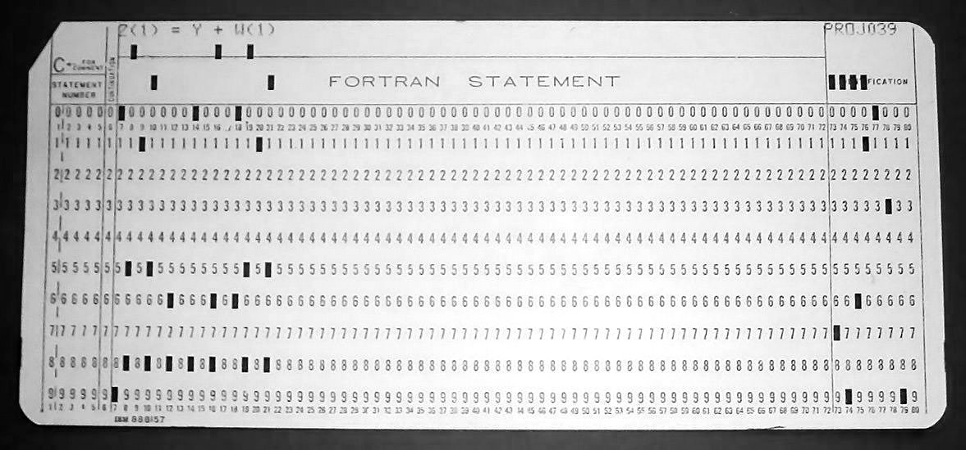
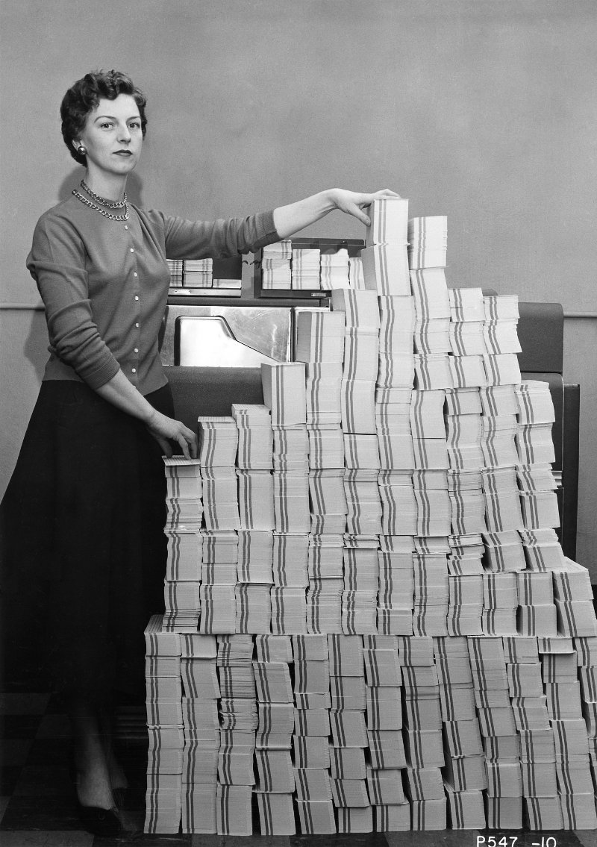
Introduction to Machine Language
Instructor: Rebecca Herman

Slide 6
Instructions as Numbers
By convention, MIPS instructions are each 1 word = 4 bytes = 32 bits
31
0
Divide the 32 bits of an instruction into “fields”
regular field sizes → simpler hardware
will need some variation….
Define 3 types of instruction formats:
R-Format I-Format J-Format

Slide 7
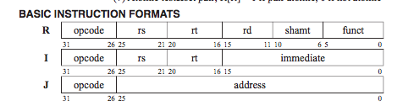
Instruction Formats
R-Format: Register instructions -- good for instructions with ~3 register inputs
I-Format: instructions with immediates, lw/sw (offset is immediate), and beq/bne
not shift instructions
J-Format: j and jal
But not jr
6
5
5
5
5
6

Slide 8
Agenda
Stored-Program Concept
R-Format
Your Feedback!
I-Format
Branching and PC-Relative Addressing
J-Format
Bonus: Assembly Practice
Bonus: Disassembly Practice

Slide 9
R-Format Instructions (1/4)
Define “fields” of the following number of bits each: 6 + 5 + 5 + 5 + 5 + 6 = 32
Each field has a name:
Each field is viewed as its own unsigned int
5-bit fields can represent any number 0-31, while 6-bit fields can represent any number 0-63
31
0
6
5
5
5
5
6
31
0
opcode
rs
rt
rd
shamt
funct

Slide 10
R-Format Instructions (2/4)
31
0
opcode
rs
rt
rd
shamt
funct
opcode (6): partially specifies operation
Set at 0b000000 for all R-Format instructions
funct (6): combined with opcode, this number exactly specifies the instruction
How many R-format instructions can we encode?
opcode is fixed, so just funct: 2⁶ = 64

Slide 11
R-Format Instructions (3/4)
31
0
opcode
rs
rt
rd
shamt
funct
rs (5): 1st operand (“source register”)
rt (5): 2nd operand (second source register -- t is the letter after s)
rd (5): “destination register”
Recall: MIPS has 32 registers
A 5 bit field can represent exactly 2⁵ = 32 things (interpret as the register numbers)

Slide 12
R-Format Instructions (4/4)
31
0
opcode
rs
rt
rd
shamt
funct
shamt (5): The amount a shift instruction will shift by
Shifting a 32-bit word by more than 31 is useless
This field is set to 0 in all but the shift instructions
Shift functions don’t use all 3 registers, so why do we need a separate shamt field? Why don’t we just reuse a register field?
Turns out 32 bits is slightly more than we need to represent the functions we want to implement in hardware. We have extra bits -- why not?

Slide 13

Reading from the Green Sheet
add $t0 $t1 $t2
rd = $t0 = $8 rs = $t1 = $9
rt = $t2 = $10
31
0
???
0
???
9
???
10
???
8
???
0
???
0x20
opcode
opcode
rs
rt
rd
shamt
funct

Slide 14
R-Format Example
MIPS Instruction: add $8,$9,$10
Field representation (decimal):
Field representation (binary):
31
0
0
9
10
8
0
0x20
31
0
000000
01001
01010
01000
00000
100000
_{two}
hex representation: 0x 012A 4020
decimal representation: 19,546,144
Called a Machine Language Instruction
Notes:
$8 = $t0, $9 = $t1, $10 = $t2

Slide 15
Notable R-Type Instructions

Slide 16
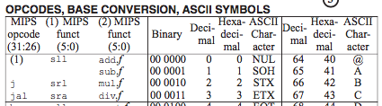
NOP (or NOOP)
What is the instruction 0x00000000?
opcode is 0, so is an R-Format
sll $0,$0,0
What does this do?
Nothing!

Slide 17
Agenda
Stored-Program Concept
R-Format
Your Feedback!
I-Format
Branching and PC-Relative Addressing
J-Format
Bonus: Converting to Machine Code Practice

Slide 18
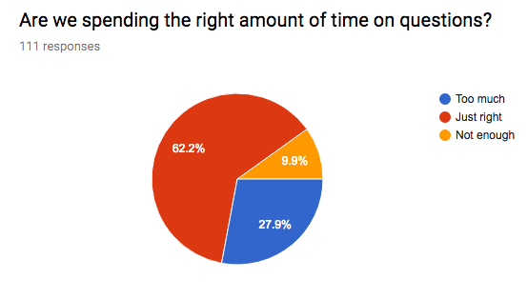
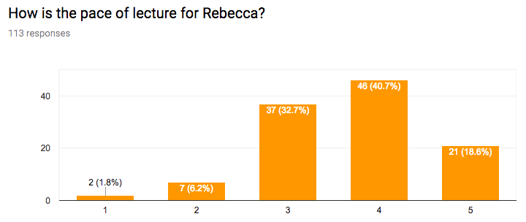
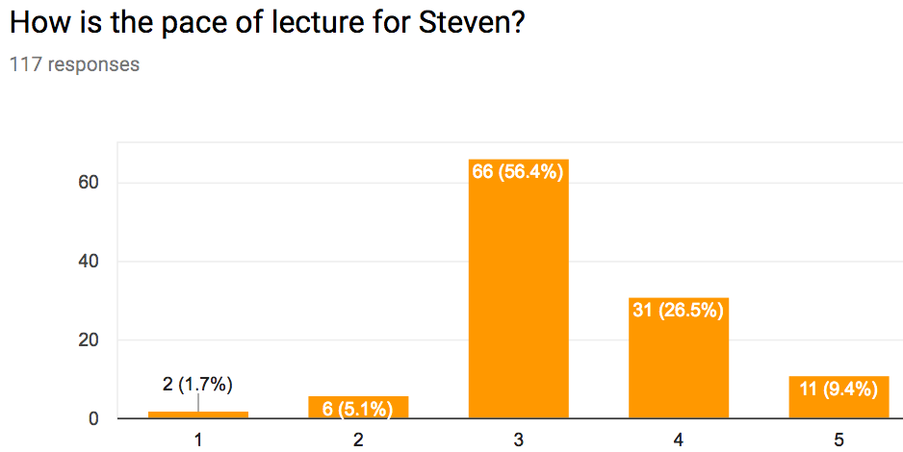
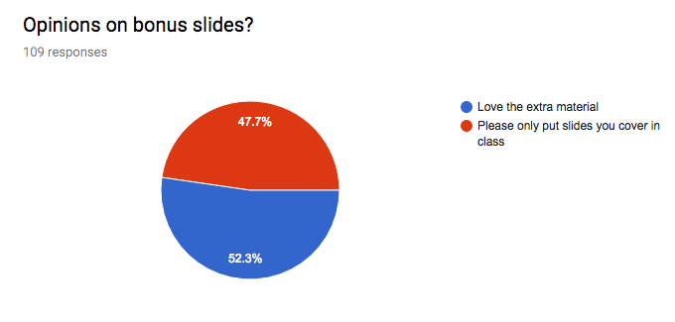
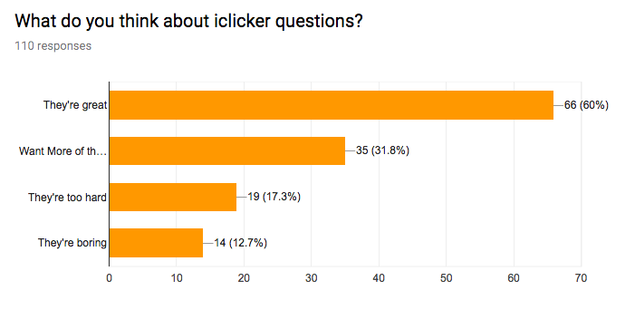
Your Feedback
please slow down...
keep on answering questions
Less time answering questions
I liked it better when Rebecca talked faster btw. We don't have time for you to talk more slowly LOL D':
Harry potter analogy was confusing.
Too slow
Just right
Too fast
I like the metaphors
It would be nice if y'all could also do a real-time Piazza post for questions during lecture, answered by TAs/tutors present.

Slide 19
Agenda
Stored-Program Concept
R-Format
Your Feedback!
I-Format
Branching and PC-Relative Addressing
J-Format
Bonus: Assembly Practice
Bonus: Disassembly Practice

Slide 20
I-Format Instructions (1/4)
What about instructions with immediates?
5- and 6-bit fields too small for most immediates
Ideally, MIPS would have only one instruction format (for simplicity)
Unfortunately here we need to compromise
Define new instruction format that is partially consistent with R-Format
First notice that, if instruction has immediate, then it uses at most 2 registers

Slide 21
I-Format Instructions (2/4)
Define “fields” of the following number of bits each: 6 + 5 + 5 + 16 = 32 bits
Field names:
Key Concept: Three fields are consistent with R-Format instructions
Most importantly, opcode is still in same location
31
0
6
5
5
16
31
0
opcode
rs
rt
immediate

Slide 22
I-Format Instructions (3/4)
31
0
opcode
rs
rt
immediate
opcode (6): uniquely specifies the instruction
All I-Format instructions have non-zero opcode
rs (5): specifies a register operand
Not always used
rt (5): specifies register that receives result of computation (“target register”)
Name makes more sense for I-Format instructions

Slide 23

I-Format Instructions (4/4)
31
0
opcode
rs
rt
immediate
immediate (16): 16 bit number
All computations done in words, so 16-bit immediate must be extended to 32 bits
type of extension types the immediate field
Can represent 2¹⁶ different immediates
This is large enough to handle the offset in a typical lw/sw, plus the vast majority of values for slti

Slide 24

I-Format Example (1/2)
addi $21,$22,-50
rt = $21
rs = $22
31
0
???
8
???
22
???
21
???
-50
opcode
opcode
rs
rt
immediate

Slide 25
I-Format Example (2/2)
MIPS Instruction: addi $21,$22,-50
Field representation (decimal):
Field representation (binary):
hex representation: 0x 22D5 FFCE
decimal representation: 584,449,998
Called a Machine Language Instruction
31
0
8
22
21
-50
31
0
001000
10110
10101
1111111111001110
_{two}
Notes:
$21 = $s5, $22 = $s6

Slide 26
Question: Which instruction has the same representation as 35_{ten}?
OPCODE/FUNCT: Register names and numbers:
subu 0/35 0: $0
lw 35/-- 8-15: $t0-$t7
addi 8/-- 16-23: $s0-$s7
(A)
opcode
rs
rt
rd
shamt
funct
subu $s0,$s0,$s0
(B)
lw $0,0($0)
opcode
rs
rt
offset
(C)
opcode
rs
rt
immediate
addi $0,$0,35
(D)
subu $0,$0,$0
opcode
rs
rt
rd
shamt
funct

Slide 27
Notable I-Type Instructions

Slide 28
Dealing With Large Immediates
How do we deal with 32-bit immediates?
Solution: Don’t mess with instruction formats, just add a new instruction
Load Upper Immediate (lui)
lui reg,imm
Moves 16-bit imm into upper half (bits 31-16) of reg and zeros the lower half of reg (bits 15-0)

Slide 29
lui Example
Want: addi $t0,$t0,0xABABCDCD
This is a pseudo-instruction! (I-instructions don’t have space for 32 bits of data)
Translates into:
lui $at,0xABAB # upper 16
ori $at,$at,0xCDCD # lower 16
add $t0,$t0,$at # move
Now we can handle everything with a 16-bit immediate!
Only the assembler gets to use $at

Slide 30
Branching Instructions
beq and bne
Need to specify an address to go to
Also take two registers to compare
Use I-Format:
31
0
opcode
rs
rt
immediate
opcode specifies beq (4) vs. bne (5)
rs and rt specify registers
How to best use immediate to specify addresses?

Slide 31
Branching Instruction Usage
Branches typically used for loops (if-else, while, for)
Loops are generally small (< 50 instructions)
Recall: Instructions stored in a localized area of memory (Code/Text)
Largest branch distance limited by size of code
Address of current instruction stored in the program counter (PC)

Slide 32
PC-Relative Addressing
31
0
opcode
rs
rt
immediate
PC-Relative Addressing: Use the immediate field as a two’s complement offset to PC
Similar to Base-offset addressing for lw/sw! source register → PC
Can specify ± 2¹⁵ addresses from the PC
So just how much of memory can we reach?

Slide 33
Branching Reach
Recall: MIPS uses 32-bit addresses, and memory is byte-addressed
Instructions are “word-aligned”: Address is always a multiple of 4 (in bytes)
PC ALWAYS points to an instruction
PC is typed as a pointer to a word
can do C-like pointer arithmetic
Let Immediate specify #words instead of #bytes
Can now branch ± 2¹⁵ words = ± 2¹⁷ addresses around PC
Notes:
Locker room analogy

Slide 34
Branch Calculation
If we don’t take the branch:
PC = PC+4 = next instruction
If we do take the branch:
PC = (PC+4) + (immediate*4)
Observations:
immediate is number of instructions to move (remember, specifies words) either forward (+) or backwards (–)
Branch from PC+4 for hardware reasons

Slide 35
Branch Example (1/2)
MIPS Code:
Loop: beq $9,$0,End addu $8,$8,$10 addiu $9,$9,-1 j Loop End: <some instr>
I-Format fields:
opcode = 4 (look up on Green Sheet)
rs = 9 (first operand)
rt = 0 (second operand)
immediate = ???
Start counting from instruction AFTER the branch
1
2
3
3

Slide 36
Branch Example (2/2)
MIPS Code:
Loop: beq $9,$0,End addu $8,$8,$10 addiu $9,$9,-1 j Loop End:
Field representation (decimal):
Field representation (binary):
31
0
4
9
0
3
31
0
000100
01001
00000
0000000000000011

Slide 37
Questions on PC-addressing
Does the value in branch immediate field change if we move the code?
If moving individual lines of code, then yes
If moving all of code, then no
What do we do if destination is > 2¹⁵ instructions away from branch?
Other instructions save us:
beq $s0,$0,far bne $s0,$0,next # next instr --> j far next: # next instr
Notes:
As we will see, jumping instructions can reach farther than branching

Slide 38


Meet the $taff
 | Derek | Zubair
Favorite artist? | Ratatat | Drake
Bribe food? | Poke bowls | Reese’s cups and sugar cookies
Favorite game? | LoL & Codenames | COD Black Ops 1
Coolest place you've been to? | Nepal | Vegas

Slide 39
Agenda
Stored-Program Concept
R-Format
Your Feedback!
I-Format
Branching and PC-Relative Addressing
J-Format
Bonus: Assembly Practice
Bonus: Disassembly Practice

Slide 40
J-Format Instructions (1/4)
For branches, we assumed that we won’t want to branch too far, so we can specify a change in the PC
For general jumps (j and jal), we may jump to anywhere in code memory
Ideally, we would specify a 32-bit memory address to jump to
Unfortunately, we can’t fit both a 6-bit opcode and a 32-bit address into a single 32-bit word

Slide 41
J-Format Instructions (2/4)
Define two “fields” of these bit widths:
As usual, each field has a name:
Key Concepts:
Keep opcode field identical to R-Format and I-Format for consistency
Collapse all other fields to make room for large target address
31
0
6
26
31
0
opcode
target address

Slide 42
J-Format Instructions (3/4)
31
0
00
31
0
6
26
Recall: instructions are word-aligned (addresses are multiples of 4)
26 bits → can specify 2²⁶ things...
Idea: try words instead of bytes! Don’t store the last two bits; append 0b00 when interpreting the instruction (multiply field by 4)
This brings us to 28 bits of a 32-bit address
Take the 4 highest order bits from the “current PC”
Cannot reach quite everywhere, but adequate almost all of the time, since programs aren’t that long
Only problematic if code straddles a 256MiB boundary
If necessary, use jr (R-Format) instead
Notes:
we will see later it actually becomes the “next PC”

Slide 43
Aside: jr
replaced PC with a value from a register, which is 32 bits!
How do we get the address in the register?
MAL: la $dest label
TAL: lui / ori
Can always reach everywhere

Slide 44
J-Format Instructions (4/4)
Jump instruction:
New PC = { (PC+4)[31..28], target address, 0b00 }
Notes:
{ , , } means concatenation { 4 bits , 26 bits , 2 bits } = 32 bit address
Book uses || instead
Array indexing: [31..28] means highest 4 bits
For hardware reasons, use PC+4 instead of PC

Slide 45
Question: When combining two C files into one executable, we can compile them independently and then merge them together.
When merging two or more binaries:
Jump instructions don’t require any changes
Branch instructions don’t require any changes
1 2
(A)
F F
(B)
F T
(C)
T F
(D)
T T

Slide 46
Summary
The Stored Program concept is very powerful
Instructions can be treated and manipulated the same way as data in both hardware and software
MIPS Machine Language Instructions:
Branches use PC-relative addressing, Jumps use absolute addressing
R:
opcode
rs
rt
rd
shamt
funct
I:
opcode
rs
rt
immediate
J:
opcode
target address

Slide 47
BONUS SLIDES
You are responsible for the material contained on the following slides, though we may not have enough time to get to them in lecture.
You may learn the material just by doing other coursework, but hopefully these slides will help clarify the material.

Slide 48
Agenda
Stored-Program Concept
R-Format
Your Feedback!
I-Format
Branching and PC-Relative Addressing
J-Format
Bonus: Assembly Practice
Bonus: Disassembly Practice

Slide 49
Assembly Practice
Assembly is the process of converting assembly instructions into machine code
On the following slides, there are 6-lines of assembly code, along with space for the machine code
For each instruction,
Identify the instruction type (R/I/J)
Break the space into the proper fields
Write field values in decimal
Convert fields to binary
Write out the machine code in hex
Use your Green Sheet; answers follow

Slide 50
Code Questions
Addr Instruction
800 Loop: sll $t1,$s3,2
804 addu $t1,$t1,$s6
808 lw $t0,0($t1)
812 beq $t0,$s5, Exit
816 addiu $s3,$s3,1
820 j Loop
Exit:
Material from past lectures:
What type of C variable is probably stored in $s6?
Write an equivalent C loop using a→$s3, b→$s5, c→$s6. Define variable types (assume they are initialized somewhere) and feel free to introduce other variables as you like.
In English, what does this loop do?

Slide 51
Code Questions
Addr Instruction
800 Loop: sll $t1,$s3,2
804 addu $t1,$t1,$s6
808 lw $t0,0($t1)
812 beq $t0,$s5, Exit
816 addiu $s3,$s3,1
820 j Loop
Exit:
Material from past lectures:
What type of C variable is probably stored in $s6?
int * (or any pointer)
Write an equivalent C loop using a→$s3, b→$s5, c→$s6. Define variable types (assume they are initialized somewhere) and feel free to introduce other variables as you like.
int a,b,*c;
/* values initialized */
while(c[a] != b) a++;
In English, what does this loop do?
Finds an entry in array c that matches b.

Slide 52
Assembly Practice Question
Addr Instruction
800 Loop: sll $t1,$s3,2
804 addu $t1,$t1,$s6
808 lw $t0,0($t1)
812 beq $t0,$s5, Exit
816 addiu $s3,$s3,1
820 j Loop
Exit:
__:
__:
__:
__:
__:
__:

Slide 53
Assembly Practice Answer (1/4)
Addr Instruction
800 Loop: sll $t1,$s3,2
804 addu $t1,$t1,$s6
808 lw $t0,0($t1)
812 beq $t0,$s5, Exit
816 addiu $s3,$s3,1
820 j Loop
Exit:
R:
opcode
rs
rt
rd
shamt
funct
R:
opcode
rs
rt
rd
shamt
funct
I:
opcode
rs
rt
immediate
I:
opcode
rs
rt
immediate
I:
opcode
rs
rt
immediate
J:
opcode
target address

Slide 54
Assembly Practice Answer (2/4)
Addr Instruction
800 Loop: sll $t1,$s3,2
804 addu $t1,$t1,$s6
808 lw $t0,0($t1)
812 beq $t0,$s5, Exit
816 addiu $s3,$s3,1
820 j Loop
Exit:
R:
0
0
19
9
2
0
R:
0
9
22
9
0
33
I:
35
9
8
0
I:
4
8
21
2
I:
8
19
19
1
J:
2
200

Slide 55
Assembly Practice Answer (3/4)
Addr Instruction
800 Loop: sll $t1,$s3,2
804 addu $t1,$t1,$s6
808 lw $t0,0($t1)
812 beq $t0,$s5, Exit
816 addiu $s3,$s3,1
820 j Loop
Exit:
R:
000000
00000
10011
01001
00010
000000
R:
000000
01001
10110
01001
00000
100001
I:
100011
01001
01000
0000 0000 0000 0000
I:
000100
01000
10101
0000 0000 0000 0010
I:
001000
10011
10011
0000 0000 0000 0001
J:
000010
00 0000 0000 0000 0000 1100 1000

Slide 56
Assembly Practice Answer (4/4)
Addr Instruction
800 Loop: sll $t1,$s3,2
0x 0013 4880
804 addu $t1,$t1,$s6
0x 0136 4821
808 lw $t0,0($t1)
0x 8D28 0000
812 beq $t0,$s5, Exit
0x 1115 0002
816 addiu $s3,$s3,1
0x 2273 0001
820 j Loop
0x 0800 00C8
Exit:
R:
R:
I:
I:
I:
J:

Slide 57
Agenda
Stored-Program Concept
R-Format
Your Feedback!
I-Format
Branching and PC-Relative Addressing
J-Format
Bonus: Assembly Practice
Bonus: Disassembly Practice

Slide 58
Disassembly Practice
Disassembly is the opposite process of figuring out the instructions from the machine code
On the following slides, there are 6-lines of machine code (hex numbers)
Your task:
Convert to binary
Use opcode to determine format and fields
Write field values in decimal
Convert fields MIPS instructions (try adding labels)
Translate into C (be creative!)
Use your Green Sheet; answers follow

Slide 59
Disassembly Practice Question
Address Instruction
0x00400000 0x00001025
... 0x0005402A
0x11000003
0x00441020
0x20A5FFFF
0x08100001

Slide 60
Disassembly Practice Answer (1/9)
Address Instruction
0x00400000 00000000000000000001000000100101
... 00000000000001010100000000101010
00010001000000000000000000000011
00000000010001000001000000100000
00100000101001011111111111111111
00001000000100000000000000000001
1) Converted to binary

Slide 61
Disassembly Practice Answer (2/9)
Address Instruction
0x00400000 00000000000000000001000000100101
... 00000000000001010100000000101010
00010001000000000000000000000011
00000000010001000001000000100000
00100000101001011111111111111111
00001000000100000000000000000001
2) Check opcode for format and fields...
0 (R-Format), 2 or 3 (J-Format), otherwise (I-Format)
R
R
I
R
I
J

Slide 62
Disassembly Practice Answer (3/9)
Address Instruction
0x00400000
...
3) Convert to decimal
Can leave target address in hex
R
R
I
R
I
J
0
0
0
2
0
37
0
0
5
8
0
42
4
8
0
+3
0
2
4
2
0
32
8
5
5
-1
2
0x0100001
Notes:
Two ways to find the instruction:
Read field in hex and lookup in “OPCODE/FUNCT” column on the left side of the front of the MIPS Green Sheet (alphabetized by instruction).
Read field in decimal and lookup in table on left side of the back of the MIPS Green Sheet (ordered numerically).

Slide 63
Disassembly Practice Answer (4/9)
Address Instruction
0x00400000 or $2,$0,$0
0x00400004 slt $8,$0,$5
0x00400008 beq $8,$0,3
0x0040000C add $2,$2,$4
0x00400010 addi $5,$5,-1
0x00400014 j 0x0100001
0x00400018
4) Translate to MIPS instructions (write in addrs)
Notes:
Two ways to find the instruction:
Read field in hex and lookup in “OPCODE/FUNCT” column on the left side of the front of the MIPS Green Sheet (alphabetized by instruction).
Read field in decimal and lookup in table on left side of the back of the MIPS Green Sheet (ordered numerically).

Slide 64
Disassembly Practice Answer (5/9)
Address Instruction
0x00400000 or $v0,$0,$0
0x00400004 slt $t0,$0,$a1
0x00400008 beq $t0,$0,3
0x0040000C add $v0,$v0,$a0
0x00400010 addi $a1,$a1,-1
0x00400014 j 0x0100001 # addr: 0x0400004
0x00400018
4) Translate to MIPS instructions (write in addrs)
More readable with register names

Slide 65
Disassembly Practice Answer (6/9)
Address Instruction
0x00400000 or $v0,$0,$0
0x00400004 Loop: slt $t0,$0,$a1
0x00400008 beq $t0,$0,Exit
0x0040000C add $v0,$v0,$a0
0x00400010 addi $a1,$a1,-1
0x00400014 j Loop
0x00400018 Exit:
4) Translate to MIPS instructions (write in addrs)
Introduce labels

Slide 66
Disassembly Practice Answer (7/9)
Address Instruction
or $v0,$0,$0 # initialize $v0 to 0
Loop: slt $t0,$0,$a1 # $t0 = 0 if 0 >= $a1
beq $t0,$0,Exit # exit if $a1 <= 0
add $v0,$v0,$a0 # $v0 += $a0
addi $a1,$a1,-1 # decrement $a1
j Loop
Exit:
4) Translate to MIPS instructions (write in addrs)
What does it do?

Slide 67
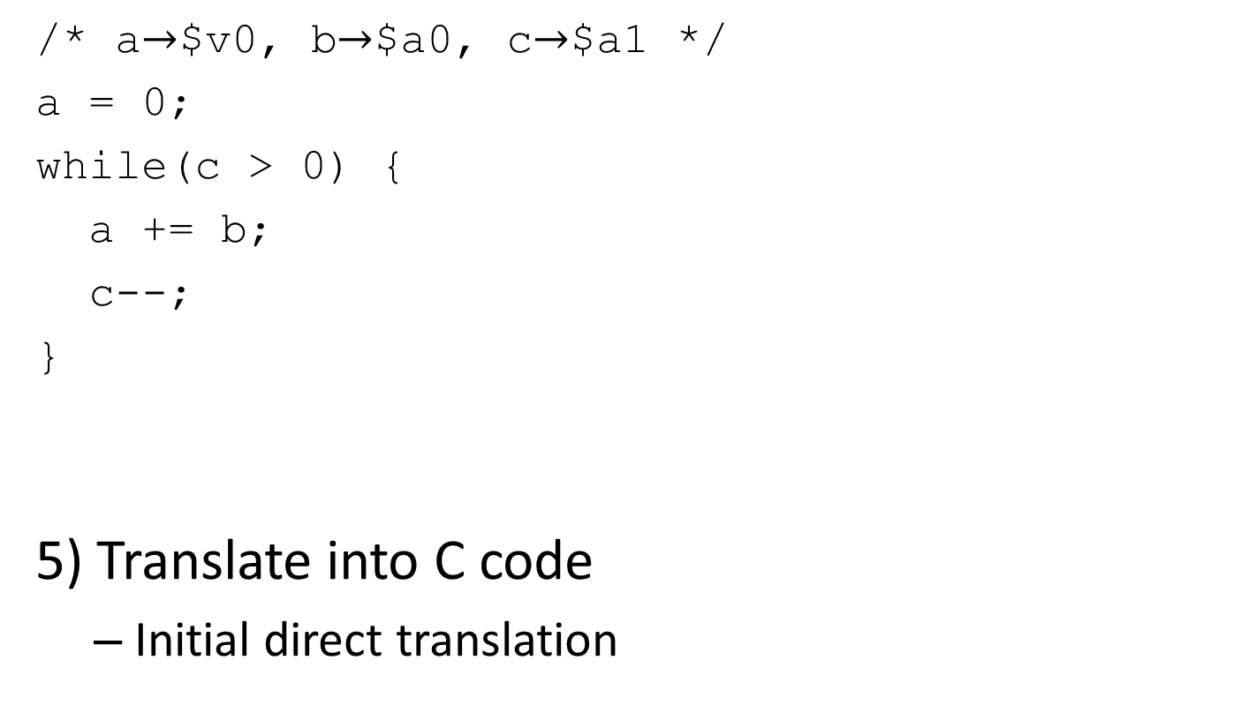
Disassembly Practice Answer (8/9)

Slide 68
Disassembly Practice Answer (9/9)
/* naïve multiplication: returns m*n */
int multiply(int m, int n) {
int p; /* product */
for(p = 0; n-- > 0; p += m) ;
return p;
}
5) Translate into C code
One of many possible ways to write this

