Slide 1
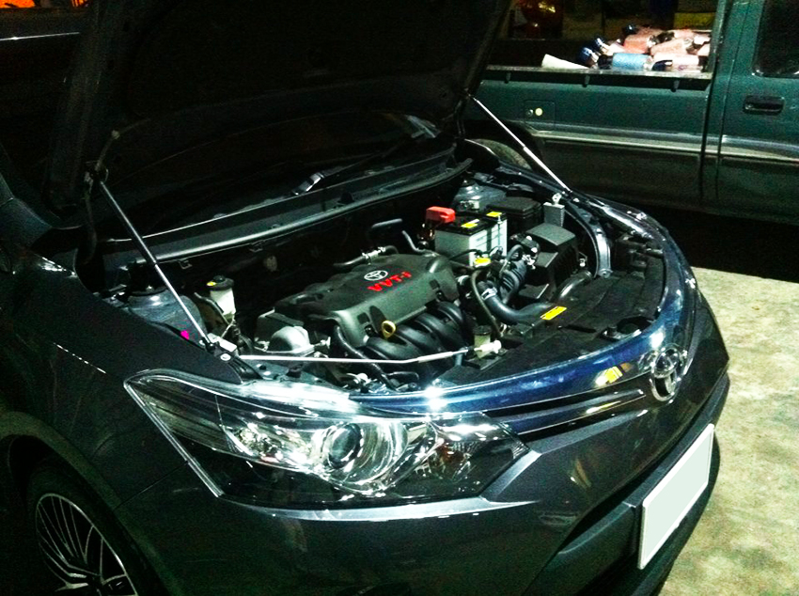
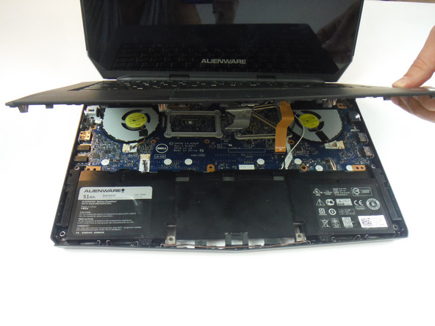
MIPS CPU Datapath, Control Intro
Instructor: Rebecca Herman

Slide 2
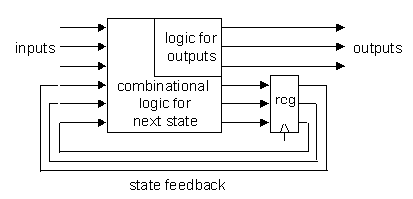
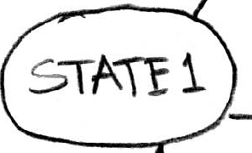
Review -- SDS and Sequential Logic

Slide 3
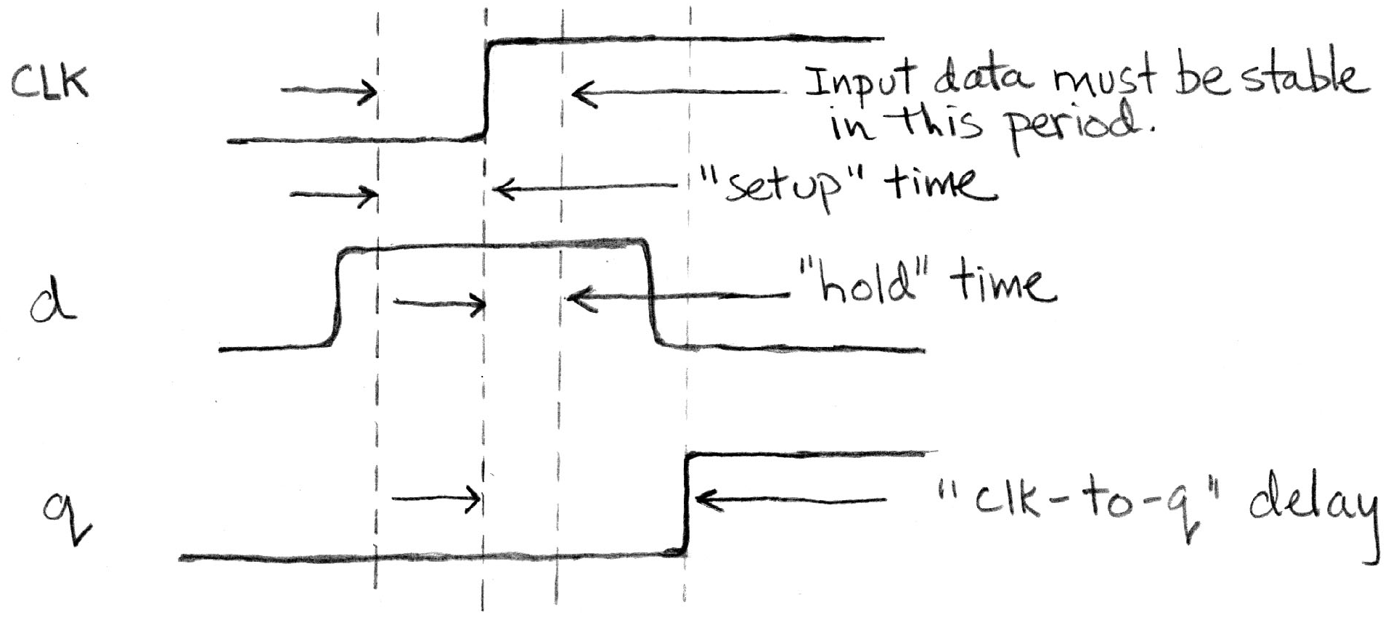
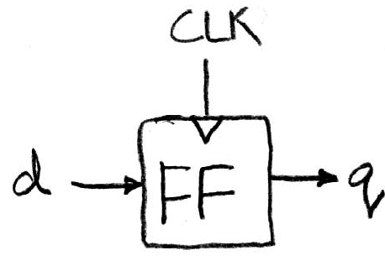
Review -- Timing
Setup Violation
CLK
FF
CL
FF
Clk-to-q + longest CL + setup time <= Clk period

Slide 4
Review -- Timing
Hold Time Violation
CLK
FF
CL
FF
Clk-to-q + shortest CL >= hold time

Slide 5
Review -- SDS and Sequential Logic
Critical Path = Clk-to-q + longest CL + setup time
between ANY two registers

Slide 6
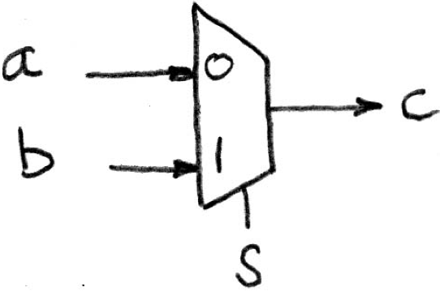
Review -- Combinational Logic
Hardware is permanent. Always do everything you might want
Use MUXes to pick from among input
S input bits selects one of 2^{S} inputs
Ex: ALU

Slide 7
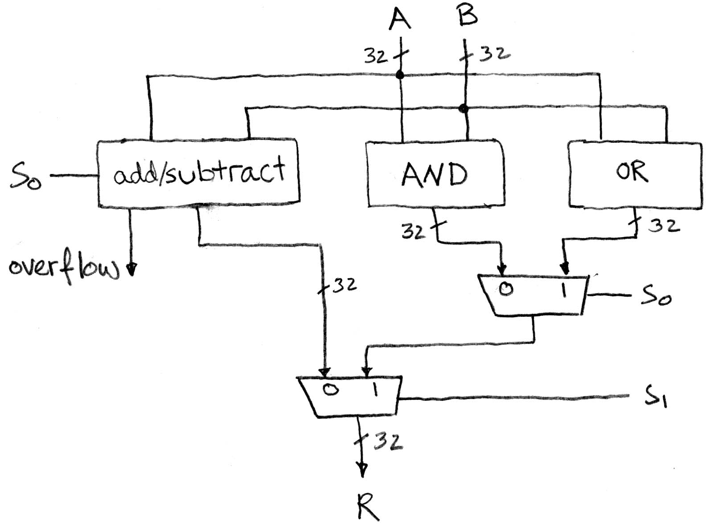
Simple ALU Schematic
Notice that 3 values are ALWAYS calculated in parallel, but only 1 makes it to the Result

Slide 8
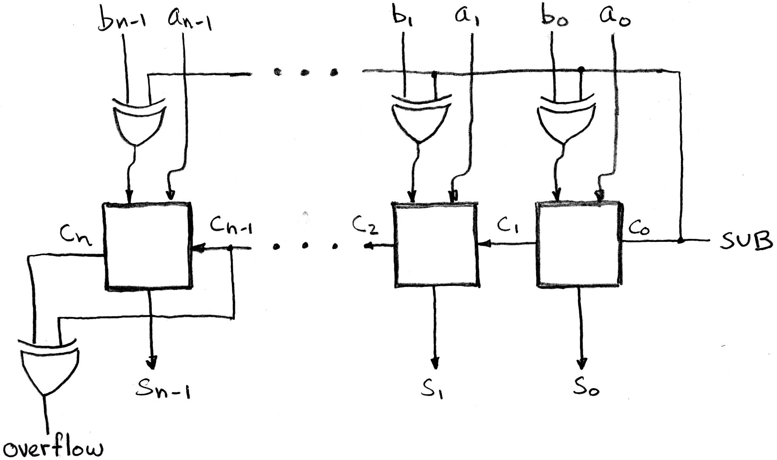
Two’s Complement Adder/Subtractor
Subtraction accomplished by adding negated number:
x ^ 1 = x’
(flips the bits)
Add 1
+
+
+
This signal is only high when you perform subtraction

Slide 9
Detecting Overflow
Unsigned overflow
On addition, if carry-out from MSB is 1
On subtraction, if carry-out from MSB is 0
This case is a lot harder to see than you might think
Signed overflow
Overflow from adding “large” positive numbers
Overflow from adding “large” negative numbers
Notes:
Unsigned: still use signed subtraction procedure (flip bits & add 1). When doing x-x, get all 1s plus 1, which leads to carry-out. If y>x in x-y, then fewer 1s in sum, so no carry-out.

Slide 10
Signed Overflow Examples (4-bit)
Overflow from two positive numbers:
0111 + 0111, 0111 + 0001, 0100 + 0100.
Carry-out from the 2nd MSB (but not MSB)
pos + pos ≠ neg
Overflow from two negative numbers:
1000 + 1000, 1000 + 1111, 1011 + 1011.
Carry-out from the MSB (but not 2nd MSB)
neg + neg ≠ pos
Expression for signed overflow: C_{n} XOR C_{n-1}

Slide 11
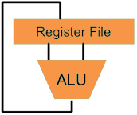
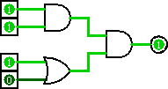
Great Idea #1: Levels of Representation & Interpretation
Higher-Level Language Program (e.g. C)
temp = v[k];
v[k] = v[k+1];
v[k+1] = temp;
Compiler
lw $t0, 0($2)
lw $t1, 4($2)
sw $t1, 0($2)
sw $t0, 4($2)
Assembly Language Program (e.g. MIPS)
Assembler
0000 1001 1100 0110 1010 1111 0101 1000
1010 1111 0101 1000 0000 1001 1100 0110
1100 0110 1010 1111 0101 1000 0000 1001
0101 1000 0000 1001 1100 0110 1010 1111
Machine Language Program (MIPS)
We are here
Machine Interpretation
Hardware Architecture Description (e.g. block diagrams)
Architecture Implementation
Logic Circuit Description (Circuit Schematic Diagrams)
Notes:
Great Ideas:
Levels of Representation & Interpretation
Technology Trends
Principle of Locality & the Memory Hierarchy
Parallelism
Performance Measurement & Improvement
Dependability via Redundancy

Slide 12
Agenda
Datapath Overview
Administrivia
Processor Design and Components
Assembling the Datapath
Control Introduction
Bonus: Rest of Control Examples

Slide 13
Hardware Design Hierarchy
Today
system
datapath
control
code registers
state registers
combinational logic
multiplexer
comparator
register
logic
switching networks

Slide 14
The Processor
Processor (CPU): Instruction Set Architecture (ISA) implemented directly in hardware
Datapath: part of the processor that contains the hardware necessary to perform operations required by the processor (“the brawn”)
Control: part of the processor (also in hardware) which tells the datapath what needs to be done (“the brain”)

Slide 15
Executing an Instruction
Very generally, what steps do you take (order matters!) to figure out the effect/result of the next MIPS instruction?
Get the instruction addu $s0,$t0,$t1
What instruction is it? addu
Gather data read R[$t0],R[$t1]
Perform operation calc R[t0]+R[t1]
Store result save into $s0

Slide 16
Generic Datapath Layout
rd
Register
File
ALU
PC
instruction
memory
rs
Data
memory
rt
+4
imm
MUX
1. Instruction
Fetch
2. Decode/
Register Read
3. Execute
4. Memory
5. Register
Write
Break up the process of “executing an instruction”
Smaller phases easier to design and modify independently
Notes:
Extremely simple datapath (J-format/target address?).
Where is the opcode? Where are the MUXes?

Slide 17
Datapath Overview (1/5)
rd
Register
File
ALU
PC
instruction
memory
rs
Data
memory
rt
+4
imm
MUX
1. Instruction
Fetch
2. Decode/
Register Read
3. Execute
4. Memory
5. Register
Write
Phase 1: Instruction Fetch (IF)
Fetch 32-bit instruction from memory
Increment PC (PC = PC + 4)

Slide 18
Datapath Overview (2/5)
rd
Register
File
ALU
PC
instruction
memory
rs
Data
memory
rt
+4
imm
MUX
1. Instruction
Fetch
2. Decode/
Register Read
3. Execute
4. Memory
5. Register
Write
Phase 2: Instruction Decode (ID)
Read the opcode and appropriate fields from the instruction
Gather all necessary registers values from Register File

Slide 19
Datapath Overview (3/5)
rd
Register
File
ALU
PC
instruction
memory
rs
Data
memory
rt
+4
imm
MUX
1. Instruction
Fetch
2. Decode/
Register Read
3. Execute
4. Memory
5. Register
Write
Phase 3: Execute (EX)
ALU performs operations: arithmetic (+,-,*,/), shifting, logical (&,|), comparisons (slt,==)
Also calculates addresses for loads and stores

Slide 20
Datapath Overview (4/5)
rd
Register
File
ALU
PC
instruction
memory
rs
Data
memory
rt
+4
imm
MUX
1. Instruction
Fetch
2. Decode/
Register Read
3. Execute
4. Memory
5. Register
Write
Phase 4: Memory Access (MEM)
Only load and store instructions do anything during this phase; the others remain idle or skip this phase
Should hopefully be fast due to caches (later in course)

Slide 21
Datapath Overview (5/5)
rd
Register
File
ALU
PC
instruction
memory
rs
Data
memory
rt
+4
imm
MUX
1. Instruction
Fetch
2. Decode/
Register Read
3. Execute
4. Memory
5. Register
Write
Phase 5: Register Write (WB for “write back”)
Write the instruction result back into the Register File
Those that don’t (e.g. sw, j, beq) remain idle or skip this phase

Slide 22
Why Five Stages?
Could we have a different number of stages?
Yes, and other architectures do
So why does MIPS have five if instructions tend to idle for at least one stage?
The five stages are the union of all the operations needed by all the instructions
There is one instruction that uses all five stages: load (lw/lb)

Slide 23
Datapath Walkthroughs (1/3)
add $3,$1,$2 # r3 = r1+r2
IF: fetch this instruction, increment PC
ID: decode as add then read R[1] and R[2]
EX: add the two values retrieved in ID
MEM: idle (not using memory)
WB: write result of EX into R[3]

Slide 24
Example: add Instruction
add $3,$1,$2
R[1] + R[2]
R[1]
3
PC
instruction
memory
registers
1
Data
memory
ALU
2
R[2]
+4
imm
MUX

Slide 25
Datapath Walkthroughs (2/3)
slti $3,$1,17 # r3 = (r1<17) ? 1 : 0
IF: fetch this instruction, increment PC
ID: decode as slti then read R[1]
EX: compare value retrieved in ID with int 17
MEM: idle (not using memory)
WB: write result of EX (1 if R[1]<SignExtImm, 0 otherwise) into R[3]

Slide 26
Example: slti Instruction
slti $3,$1,17
R[1]<17?
R[1]
X
PC
instruction
memory
1
registers
Data
memory
ALU
3
+4
imm
17
MUX

Slide 27
Datapath Walkthroughs (3/3)
lw $3,17($1) # r3 = Mem[r1+17]
IF: fetch this instruction, increment PC
ID: decode as lw then read R[1]
EX: add 17 to value retrieved in ID to compute address
MEM: read memory address computed in EX
WB: write value fetched in MEM into R[3]

Slide 28
Example: lw Instruction
lw $3,17($1)
R[1]+17
R[1]
X
PC
instruction
memory
registers
1
Data
memory
ALU
3
imm
17
+4
MEM[ R[1] + 17 ]

Slide 29
Question: Which of the following MIPS instructions is active in the fewest stages?
rd
Register
File
ALU
PC
instruction
memory
rs
Data
memory
rt
+4
imm
MUX
1. Instruction
Fetch
2. Decode/
Register Read
3. Execute
4. Memory
5. Register
Write
3. Execute
(A)
lw
IF,ID,EX,
MEM,WB
(B)
jal
IF,WB
(C)
beq
IF,ID,EX
(D)
addu
IF,ID,EX,
WB

Slide 30
Question: Which of the following MIPS instructions is active in the fewest stages?
rd
Register
File
ALU
PC
instruction
memory
rs
Data
memory
rt
+4
imm
MUX
1. Instruction
Fetch
2. Decode/
Register Read
3. Execute
4. Memory
5. Register
Write
3. Execute
(A)
lw
IF,ID,EX,
MEM,WB
(B)
jal
IF,WB
(C)
beq
IF,ID,EX
(D)
addu
IF,ID,EX,
WB

Slide 31
Administrivia
HW3 due 7/11
Proj2-1 due tonight!
Happy studying for the first midterm!
Covers through CALL and proj2-1
155 Dwinelle on Monday, during class time
Midterm Review Session tomorrow 2-4pm in 306 Soda
Rebecca OH today! :)

Slide 32
Agenda
Datapath Overview
Administrivia
Processor Design and Components
Assembling the Datapath
Control Introduction
Bonus: Rest of Control Examples

Slide 33
Processor Design Process
Five steps to design a processor:
1. Analyze instruction set → datapath requirements
2. Select set of datapath components & establish clock methodology
3. Assemble datapath components to meet the requirements
4. Analyze implementation of each instruction to determine setting of control points that affect the register transfer
5. Assemble the control logic
Formulate Logic Equations
Design Circuits
Processor
Input
Control
Memory
Now
Datapath
Output

Slide 34
The MIPS-lite Instruction Subset
ADDU and SUBU
addu rd,rs,rt
subu rd,rs,rt
OR Immediate:
ori rt,rs,imm16
LOAD and STORE Word
lw rt,rs,imm16
sw rt,rs,imm16
BRANCH:
beq rs,rt,imm16
31
26
21
16
11
6
0
op
rs
rt
rd
shamt
funct
6 bits
5 bits
5 bits
5 bits
5 bits
6 bits
31
26
21
16
0
op
rs
rt
immediate
6 bits
5 bits
5 bits
16 bits
31
26
21
16
0
op
rs
rt
immediate
6 bits
5 bits
5 bits
16 bits

Slide 35
Register Transfer Language (RTL)
All start by fetching the instruction:
RTL gives the meaning of the instructions:
R-format: {op, rs, rt, rd, shamt, funct} ← MEM[ PC ]
I-format: {op, rs, rt, imm16} ← MEM[ PC ]
Inst Register Transfers
ADDU R[rd]←R[rs]+R[rt]; PC←PC+4
SUBU R[rd]←R[rs]–R[rt]; PC←PC+4
ORI R[rt]←R[rs]|zero_ext(imm16); PC←PC+4
LOAD R[rt]←MEM[R[rs]+sign_ext(imm16)]; PC←PC+4
STORE MEM[R[rs]+sign_ext(imm16)]←R[rt]; PC←PC+4
BEQ if ( R[rs] == R[rt] ) then PC←PC+4 + (sign_ext(imm16) << 2) else PC←PC+4

Slide 36
Step 1: Requirements of the Instruction Set
Memory (MEM)
Instructions & data (separate: in reality just cache$)
Load from and store to
Registers (32 32-bit regs)
Read rs and rt
Write rt or rd
PC
Add 4 (+ maybe extended immediate)
Extender (sign/zero extend)
Add/Sub/OR unit for operation on register(s) or extended immediate
Compare if registers equal?

Slide 37
ALU Requirements
MIPS-lite: add, sub, OR, equality
ADDU R[rd] = R[rs] + R[rt]; ...
SUBU R[rd] = R[rs] – R[rt]; ...
ORI R[rt] = R[rs] | zero_ext(Imm16)...
BEQ if ( R[rs] == R[rt] )...
Equality test: Use subtraction and implement output to indicate if result is 0
What about lw and sw?

Slide 38
Storage Element: Idealized Memory
Memory (idealized)
One input bus: Data In
One output bus: Data Out
Memory access:
Read: Write Enable = 0, data at Address is placed on Data Out
Write: Write Enable = 1, Data In written to Address
Clock input (CLK)
CLK input is a factor ONLY during write operation
During read, behaves as a combinational logic block: Address valid → Data Out valid after “access time”
Write Enable
Address
Data In
DataOut
32
32
CLK

Slide 39
Storage Element: Register
Write Enable
Similar to D flip-flop except:
N-bit input and output buses
Write Enable input
Write Enable:
De-asserted (0): Data Out will not change
Asserted (1): Data In value placed onto Data Out after CLK trigger
Data In
Data Out
N
N
CLK

Slide 40
Storage Element: Register File
RW
RA
RB
Write Enable
5
5
5
Register File consists of 32 registers:
Output buses busA and busB
Input bus busW
Register selection
Place data of register RA (number) onto busA
Place data of register RB (number) onto busB
Store data on busW into register RW (number) when Write Enable is 1
Clock input (CLK)
CLK input is a factor ONLY during write operation
During read, behaves as a combinational logic block: RA or RB valid → busA or busB valid after “access time”
busA
busW
32 x 32-bit
Registers
32
32
busB
Clk
32

Slide 41
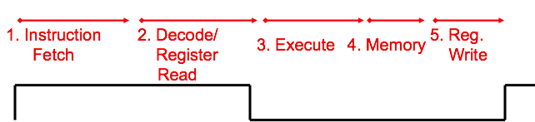
Step 2: CPU Clocking
For each instruction, how do we control the flow of information through the datapath?
Single Cycle CPU: All stages of an instruction completed within one long clock cycle
Clock cycle sufficiently long to allow each instruction to complete all stages without interruption within one cycle

Slide 42
Agenda
Datapath Overview
Administrivia
Processor Design and Components
Assembling the Datapath
Control Introduction
Bonus: Rest of Control Examples

Slide 43
Step 3: Assembling the Datapath
Assemble datapath to meet RTL requirements
Exact requirements will change based on ISA
Here we will examine each instruction of MIPS-lite
The datapath is all of the hardware components and wiring necessary to carry out ALL of the different instructions
Make sure all components (e.g. RegFile, ALU) have access to all necessary signals and buses
Control will make sure instructions are properly executed (the decision making)

Slide 44
Datapath by Instruction
All instructions: Instruction Fetch (IF)
Fetch the Instruction: Mem[PC]
Update the program counter:
Sequential Code: PC ← PC + 4
Branch and Jump: PC ← “something else”
CLK
PC
Next Address
Logic
Address
Instruction
Instruction
Memory
32

Slide 45
Datapath by Instruction
All instructions: Instruction Decode (ID)
Pull off all relevant fields from instruction to make available to other parts of datapath
MIPS-lite only has R-format and I-format
Control will sort out the proper routing (discussed later)
opcode
Wires and
Splitters
6
rs
5
rt
5
Instr
rd
32
5
shamt
5
funct
6
imm
16

Slide 46
Step 3: Add & Subtract
ADDU R[rd]←R[rs]+R[rt];
Hardware needed:
Instruction Mem and PC (already shown)
Register File (RegFile) for read and write
ALU for add/subtract
5
5
5
busA
A
RW
RA
RB
busW
32
32
Result
32
32 x 32-bit
Registers
ALU
busB
B
32
CLK
32
32

Slide 47
Step 3: Add & Subtract
ADDU R[rd]←R[rs]+R[rt];
Connections:
RegFile and ALU Inputs
Connect RegFile and ALU
RegWr (1) and ALUctr (ADD/SUB/OR) set by control in ID
rd
rs
rt
RegWr
ALUctr
5
5
5
busA
A
RW
RA
RB
busW
32
32
Result
32
32 x 32-bit
Registers
ALU
busB
B
32
CLK
32
32

Slide 48
Step 3: Or Immediate
ORI R[rt]←R[rs]|zero_ext(Imm16);
Is the hardware below sufficient?
Zero extend imm16?
Pass imm16 to input of ALU?
Write result to rt?
rd
rs
rt
RegWr
ALUctr
5
5
5
busA
RW
RA
RB
busW
32
Result
32
32 x 32-bit
Registers
ALU
busB
32
CLK
32

Slide 49
Step 3: Or Immediate
ORI R[rt]←R[rs]|zero_ext(Imm16);
Is the hardware below sufficient?
Zero extend imm16?
Pass imm16 to input of ALU?
Write result to rt?
rd
rs
rt
RegWr
ALUctr
5
5
5
busA
RW
RA
RB
busW
32
Result
32
32 x 32-bit
Registers
ALU
busB
32
CLK
32

Slide 50
Step 3: Or Immediate
ORI R[rt]←R[rs]|zero_ext(Imm16);
Add new hardware:
Still support add/sub
New control signals: RegDst, ALUSrc
RegDst
rd
rt
2:1 MUX
1
0
RegWr
rs
rt
ALUctr
5
5
5
RW
RA
RB
busA
32
32
32
RegFile
busB
ALU
0
CLK
32
imm16
ZeroExt
1
16
32
How to implement this?
ALUSrc

Slide 51
Step 3: Load
LOAD R[rt]←MEM[R[rs]+sign_ext(Imm16)];
Hardware sufficient?
Sign extend imm16?
Where’s MEM?
RegDst
rd
rt
1
0
RegWr
rs
rt
ALUctr
5
5
5
RW
RA
RB
busA
32
32
32
RegFile
busB
ALU
0
CLK
32
imm16
ZeroExt
1
16
32
ALUSrc

Slide 52
Step 3: Load
LOAD R[rt]←MEM[R[rs]+sign_ext(Imm16)];
New control signals: ExtOp, MemWr, MemtoReg
RegDst
rd
rt
ALUctr
MemtoReg
What operation should we use?
MemWr
1
0
RegWr
rs
rt
What goes here during a store?
5
5
5
RW
RA
RB
busA
32
busW
32
32
RegFile
busB
ALU
0
0
CLK
32
???
32
WrEn
Addr
Must now also handle sign extension
imm16
Extender
1
Data In
1
16
32
Data
Memory
ALUSrc
CLK
ExtOp

Slide 53
Step 3: Store
STORE MEM[R[rs]+sign_ext(Imm16)]←R[rt];
Connect busB to Data In (no extra control needed!)
RegDst
rd
rt
ALUctr
MemtoReg
1
0
MemWr
RegWr
rs
rt
What goes here during a store?
5
5
5
RW
RA
RB
busA
32
busW
32
32
RegFile
busB
ALU
0
0
CLK
32
???
32
WrEn
Addr
imm16
Extender
1
Data In
1
16
32
Data
Memory
ALUSrc
CLK
ExtOp

Slide 54
Step 3: Branch If Equal
BEQ if(R[rs]==R[rt]) then PC←PC+4 + (sign_ext(Imm16) << 2)
Need comparison output from ALU
RegDst
rd
rt
ALUctr
MemtoReg
1
0
MemWr
RegWr
rs
rt
zero
5
5
5
RW
RA
RB
busA
32
=
busW
32
32
RegFile
busB
ALU
0
0
CLK
32
32
WrEn
Addr
imm16
Extender
1
Data In
1
16
32
Data
Memory
ALUSrc
CLK
ExtOp

Slide 55
Step 3: Branch If Equal
BEQ if(R[rs]==R[rt]) then PC←PC+4 + (sign_ext(Imm16) << 2)
Revisit “next address logic”:
CLK
PC
Next Address
Logic
Address
Instruction
Instruction
Memory
32
Instr Fetch Unit

Slide 56
Step 3: Branch If Equal
BEQ if(R[rs]==R[rt]) then PC←PC+4 + (sign_ext(Imm16) << 2)
Revisit “next address logic”:
How to hook these up?
beq
zero
???
4
Addr
Adder
Instruction
Memory
Instruction
0
32
Sign extend and ×4
MUX
PC
Adder
1
PC Ext
CLK
imm16
Instr Fetch Unit

Slide 57
Step 3: Branch If Equal
BEQ if(R[rs]==R[rt]) then PC←PC+4 + (sign_ext(Imm16) << 2)
Revisit “next address logic”:
nPC_sel should be 1 if branch, 0 otherwise
beq
zero
nPC_sel | zero | MUX
0 | 0 | 0
0 | 1 | 0
1 | 0 | 0
1 | 1 | 1
PC+4
0
MUX
nextPC (nPC)
PC+4 + branchAddr
1
How does this change if we add bne?

Slide 58


Meet The $taff
 | Rebecca | Steven
Spirit Creature | Mountain Goat | Dragon
All-time Favorite Meme | Edited Comics | One Thicc Bih
What wild thing would you do with 1 million dollars? | Buy really expensive violin | $ailboat | As much expensive sushi as possible
Favorite Villian? | The Witch from “Into the Woods” | Ursula from “Little Mermaid”

Slide 59
Agenda
Datapath Overview
Administrivia
Processor Design and Components
Assembling the Datapath
Control Introduction
Bonus: Rest of Control Examples

Slide 60
Processor Design Process
Five steps to design a processor:
1. Analyze instruction set → datapath requirements
2. Select set of datapath components & establish clock methodology
3. Assemble datapath meeting the requirements
4. Analyze implementation of each instruction to determine setting of control points that affect the register transfer
5. Assemble the control logic
Formulate Logic Equations
Design Circuits
Processor
Input
Control
Memory
Datapath
Output
Now

Slide 61
Control
Need to make sure that correct parts of the datapath are being used for each instruction
Have seen control signals in datapath used to select inputs and operations
For now, focus on what value each control signal should be for each instruction in the ISA
Next lecture, we will see how to implement the proper combinational logic to implement the control

Slide 62
Desired Datapath For addu
R[rd]←R[rs]+R[rt];
Instruction <31:0>
Instruction <31:0>
nPC_sel=?
nPC_sel=?
nPC_sel=?
Instr
Fetch
Unit
+4
Instr
Fetch
Unit
<0:15>
<21:25>
<0:15>
<21:25>
<16:20>
<16:20>
<11:15>
<11:15>
CLK
RegDst=?
CLK
RegDst=?
rd
rd
rt
RegDst=?
rt
1
rs
rs
rt
rt
rd
rd
imm16
1
imm16
1
0
0
ALUctr=?
ALUctr=?
RegWr=?
ALUctr=?
RegWr=?
rs
rs
rt
RegWr=?
rt
ADD
1
zero
5
zero
5
5
5
5
5
MemtoReg=?
MemtoReg=?
MemtoReg=?
0
busA
MemWr=?
busA
32
32
MemWr=?
MemWr=?
RW
0
RW
RA
RA
RB
RB
RegFile
RegFile
=
busW
=
busW
32
ALU
32
busB
ALU
32
busB
32
0
0
0
0
32
CLK
32
CLK
32
32
WrEn
WrEn
Addr
Addr
Data
Memory
Data
Memory
imm16
imm16
Data In
1
Data In
1
1
Extender
1
Extender
16
16
32
32
CLK
ALUSrc=?
CLK
ALUSrc=?
ALUSrc=?
ExtOp=?
0
ExtOp=?
ExtOp=?
X

Slide 63
Desired Datapath For ori
R[rt]←R[rs]|ZeroExt(imm16);
Instruction <31:0>
Instruction <31:0>
nPC_sel=?
nPC_sel=?
Instr
Fetch
Unit
+4
Instr
Fetch
Unit
<0:15>
<21:25>
<16:20>
<11:15>
<0:15>
<21:25>
<16:20>
<11:15>
CLK
RegDst=?
rd
rt
CLK
RegDst=?
rd
rt
0
rs
rt
rd
imm16
1
0
rs
rt
rd
imm16
1
0
ALUctr=?
RegWr=?
rs
rt
ALUctr=?
RegWr=?
rs
rt
OR
1
zero
5
5
5
zero
5
5
5
MemtoReg=?
MemtoReg=?
0
busA
32
MemWr=?
busA
32
MemWr=?
RW
RA
RB
0
RW
RA
RB
RegFile
RegFile
=
busW
=
busW
32
ALU
32
busB
ALU
32
busB
0
32
0
0
0
32
CLK
32
CLK
32
32
WrEn
Addr
WrEn
Addr
Data
Memory
Data
Memory
imm16
Data In
imm16
1
Data In
1
1
Extender
1
Extender
16
32
16
32
CLK
ALUSrc=?
CLK
ALUSrc=?
ExtOp=?
1
ExtOp=?
Zero

Slide 64
Desired Datapath For load
R[rt]←MEM{R[rs]+SignExt[imm16]};
Instruction <31:0>
Instruction <31:0>
nPC_sel=?
nPC_sel=?
Instr
Fetch
Unit
+4
Instr
Fetch
Unit
<0:15>
<21:25>
<16:20>
<11:15>
<0:15>
<21:25>
<16:20>
<11:15>
CLK
RegDst=?
rd
rt
CLK
RegDst=?
rd
rt
0
rs
rt
rd
imm16
1
0
rs
rt
rd
imm16
1
0
ALUctr=?
RegWr=?
rs
rt
ALUctr=?
RegWr=?
rs
rt
ADD
1
zero
5
5
5
zero
5
5
5
MemtoReg=?
MemtoReg=?
1
busA
32
MemWr=?
busA
32
MemWr=?
RW
RA
RB
0
RW
RA
RB
RegFile
RegFile
=
busW
=
busW
32
ALU
32
busB
ALU
32
busB
0
32
0
0
0
32
CLK
32
CLK
32
32
WrEn
Addr
WrEn
Addr
Data
Memory
Data
Memory
imm16
Data In
imm16
1
Data In
1
1
Extender
1
Extender
16
32
16
32
CLK
ALUSrc=?
CLK
ALUSrc=?
ExtOp=?
1
ExtOp=?
Sign

Slide 65
Desired Datapath For store
MEM{R[rs]+SignExt[imm16]}←R[rt];
Instruction <31:0>
Instruction <31:0>
nPC_sel=?
nPC_sel=?
Instr
Fetch
Unit
+4
Instr
Fetch
Unit
<0:15>
<21:25>
<16:20>
<11:15>
<0:15>
<21:25>
<16:20>
<11:15>
CLK
RegDst=?
rd
rt
CLK
RegDst=?
rd
rt
X
rs
rt
rd
imm16
1
0
rs
rt
rd
imm16
1
0
ALUctr=?
RegWr=?
rs
rt
ALUctr=?
RegWr=?
rs
rt
ADD
0
zero
5
5
5
zero
5
5
5
MemtoReg=?
MemtoReg=?
X
busA
32
MemWr=?
busA
32
MemWr=?
RW
RA
RB
1
RW
RA
RB
RegFile
RegFile
=
busW
=
busW
32
ALU
32
busB
ALU
32
busB
0
32
0
0
0
32
CLK
32
CLK
32
32
WrEn
Addr
WrEn
Addr
Data
Memory
Data
Memory
imm16
Data In
imm16
1
Data In
1
1
Extender
1
Extender
16
32
16
32
CLK
ALUSrc=?
CLK
ALUSrc=?
ExtOp=?
1
ExtOp=?
Sign

Slide 66
Desired Datapath For beq
BEQ if(R[rs]==R[rt]) then PC←PC+4 + (sign_ext(Imm16) << 2)
Instruction <31:0>
Instruction <31:0>
nPC_sel=?
nPC_sel=?
Instr
Fetch
Unit
Br
Instr
Fetch
Unit
<0:15>
<21:25>
<16:20>
<11:15>
<0:15>
<21:25>
<16:20>
<11:15>
CLK
RegDst=?
rd
rt
CLK
RegDst=?
rd
rt
X
rs
rt
rd
imm16
1
0
rs
rt
rd
imm16
1
0
ALUctr=?
RegWr=?
rs
rt
ALUctr=?
RegWr=?
rs
rt
SUB
0
zero
5
5
5
zero
5
5
5
MemtoReg=?
MemtoReg=?
X
busA
32
MemWr=?
busA
32
MemWr=?
RW
RA
RB
0
RW
RA
RB
RegFile
RegFile
=
busW
=
busW
32
ALU
32
busB
ALU
32
busB
0
32
0
0
0
32
CLK
32
CLK
32
32
WrEn
Addr
WrEn
Addr
Data
Memory
Data
Memory
imm16
Data In
imm16
1
Data In
1
1
Extender
1
Extender
16
32
16
32
CLK
ALUSrc=?
CLK
ALUSrc=?
ExtOp=?
0
ExtOp=?
X

Slide 67
MIPS-lite Datapath Control Signals
ExtOp: 0 → “zero”; 1 → “sign”
ALUsrc: 0 → busB; 1 → imm16
ALUctr: “ADD”, “SUB”, “OR”
nPC_sel: 0 → +4; 1 → branch
MemWr: 1 → write memory
MemtoReg: 0 → ALU; 1 → Mem
RegDst: 0 → “rt”; 1 → “rd”
RegWr: 1 → write register
RegDst
rd
rt
nPC_sel
Instr
Fetch
Unit
1
0
CLK
RegWr
rs
rt
ALUctr
5
5
5
zero
MemtoReg
RW
RA
RB
busA
32
MemWr
busW
RegFile
=
ALU
32
32
busB
0
0
CLK
32
32
WrEn
Addr
Data
Memory
imm16
Extender
1
Data In
1
16
32
ALUSrc
CLK
ExtOp

Slide 68
Summary (1/2)
Five steps to design a processor:
Analyze instruction set → datapath requirements
Select set of datapath components & establish clock methodology
Assemble datapath meeting the requirements
Analyze implementation of each instruction to determine setting of control points that effects the register transfer
Assemble the control logic
Formulate Logic Equations
Design Circuits
Processor
Input
Control
Memory
Datapath
Output

Slide 69
Summary (2/2)
Determining control signals
Any time a datapath element has an input that changes behavior, it requires a control signal (e.g. ALU operation, read/write)
Any time you need to pass a different input based on the instruction, add a MUX with a control signal as the selector (e.g. next PC, ALU input, register to write to)
Your control signals will change based on your exact datapath
Your datapath will change based on your ISA

