Slide 1



MIPS CPU Control, Pipelining
Instructor: Rebecca Herman
ANOTHER MUX?!
Sad Steven
Radiant Rebecca
A
E
Notes:
start with iclicker question
Now that you’ve had 20 hours to recover from the exam, how are you feeling about it? On a scale from Sad Steven to Radiant Rebecca! (“ANOTHER MUX?!”)
Despite a certain piazza post, we actually HAVE started to grade it… It should be out sometime on Wednesday!

Slide 2
Agenda
Datapath Review
Control Implementation
Administrivia
Clocking Methodology
Pipelined Execution
Pipelined Datapath

Slide 3
Datapath Review
Physically implement all assembly instructions
Depends on exact ISA, RTL of instructions
rd
Register
File
ALU
PC
instruction
memory
rs
Data
memory
rt
+4
imm
MUX
1. Instruction
Fetch
2. Decode/
Register Read
3. Execute
4. Memory
5. Register
Write
Decisions using MUXES and control signals

Slide 4
MIPS-lite Datapath Control Signals
ExtOp: 0 → “zero”; 1 → “sign”
ALUsrc: 0 → busB; 1 → imm16
ALUctr: “ADD”, “SUB”, “OR”
beq: 0 → +4; 1 → beq
MemWr: 1 → write memory
MemtoReg: 0 → ALU; 1 → Mem
RegDst: 0 → “rt”; 1 → “rd”
RegWr: 1 → write register
RegDst
rd
rt
beq
Instr
Fetch
Unit
1
0
CLK
RegWr
rs
rt
ALUctr
5
5
5
zero
MemtoReg
RW
RA
RB
busA
32
MemWr
busW
RegFile
=
ALU
32
32
busB
0
0
CLK
32
32
WrEn
Addr
Data
Memory
imm16
Extender
1
Data In
1
16
32
ALUSrc
CLK
ExtOp

Slide 5
MIPS-lite Instruction Fetch
beq
zero
4
Addr
Adder
Instruction
0
Instruction
Memory
32
MUX
PC
Adder
1
PC Ext
CLK
imm16
Instr Fetch Unit

Slide 6
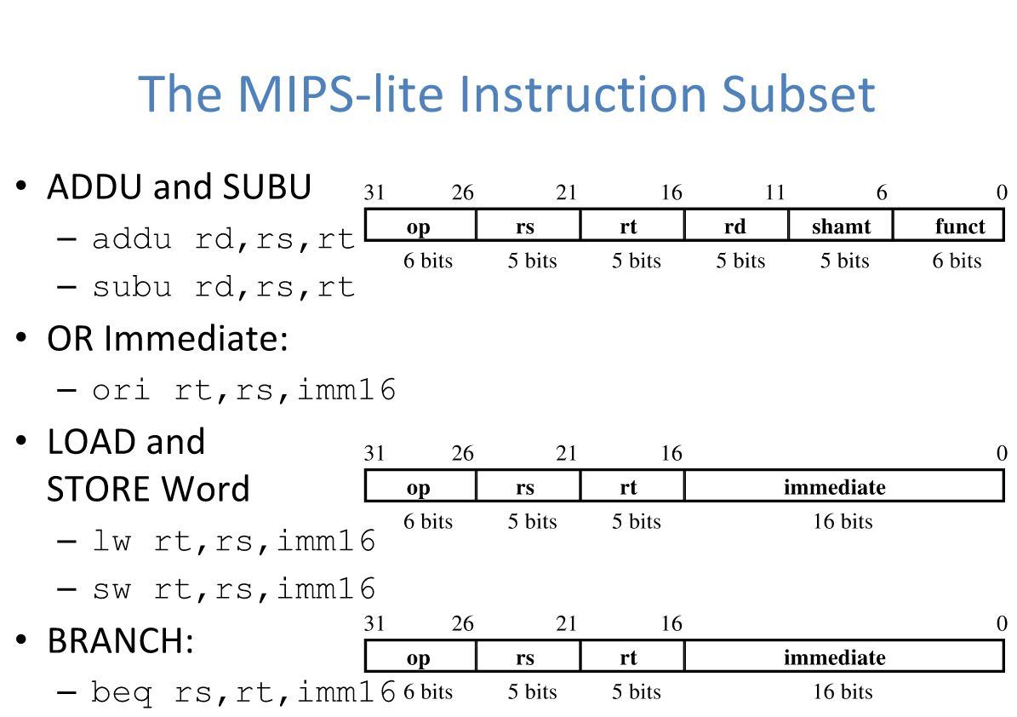

Slide 7
Question: Which statement is TRUE about the MIPS-lite ISA?
(A)
When not in use, parts of the datapath cease to carry a value.
(B)
Adding the instruction jr will not change the datapath.
(C)
All control signals will be don’t care (‘X’) in at least one instruction.
(D)
Adding the instruction addiu will not change the datapath.

Slide 8
Question: Which statement is TRUE about the MIPS-lite ISA?
(A)
When not in use, parts of the datapath cease to carry a value.
(B)
Adding the instruction jr will not change the datapath.
(C)
All control signals will be don’t care (‘X’) in at least one instruction.
(D)
Adding the instruction addiu will not change the datapath.

Slide 9
Agenda
Quick Datapath Review
Control Implementation
Administrivia
Clocking Methodology
Pipelined Execution
Pipelined Datapath

Slide 10
Hardware Design Hierarchy
system
Today
datapath
control
code registers
state registers
combinational logic
multiplexer
comparator
register
logic
switching networks

Slide 11
Processor Design Process
Five steps to design a processor:
1. Analyze instruction set → datapath requirements
2. Select set of datapath components & establish clock methodology
3. Assemble datapath components to meet the requirements
4. Analyze implementation of each instruction to determine setting of control points that affect the register transfer
5. Assemble the control logic
Formulate Logic Equations
Design Circuits
Processor
Input
Control
Memory
Datapath
Output
Now

Slide 13
Control Inputs and Outputs
Instr
Memory
Instruction<31:0>
<31:26>
<25:21>
<20:16>
<15:11>
<5:0>
<0:15>
<0:15>
opcode
rs
rt
rd
funct
imm16
addr
Control Unit
nPC_sel
RegWr
RegDst
ExtOp
ALUSrc
ALUctr
MemWr
MemtoReg
Datapath
Notes:
add addr or take out others
ask what the control actually needs at this point

Slide 14
METHOD 1
Sum of Products

Slide 15
MIPS-lite Instruction RTL
Instr Register Transfer Language
addu R[rd]←R[rs]+R[rt]; PC←PC+4
subu R[rd]←R[rs]–R[rt]; PC←PC+4
ori R[rt]←R[rs]+zero_ext(imm16); PC←PC+4
lw R[rt]←MEM[R[rs]+sign_ext(imm16)]; PC←PC+4
sw MEM[R[rs]+sign_ext(imm16)]←R[rs]; PC←PC+4
beq if(R[rs]==R[rt]) then PC←PC+4+[sign_ext(imm16)||00] else PC←PC+4

Slide 16
MIPS-lite Control Signals (1/2)
Instr Control Signals
addu ALUsrc=RegB, ALUctr=“ADD”, RegDst=rd, RegWr, nPC_sel=“+4”
subu ALUsrc=RegB, ALUctr=“SUB”, RegDst=rd, RegWr, nPC_sel=“+4”
ori ALUsrc=Imm, ALUctr=“OR”, RegDst=rt, RegWr, ExtOp=“Zero”, nPC_sel=“+4”
lw ALUsrc=Imm, ALUctr=“ADD”, RegDst=rt, RegWr, ExtOp=“Sign”, MemtoReg, nPC_sel=“+4”
sw ALUsrc=Imm, ALUctr=“ADD”, MemWr, ExtOp=“Sign”, nPC_sel=“+4”
beq ALUsrc=RegB, ALUctr=“SUB”, nPC_sel=“Br”

Slide 17
MIPS-lite Control Signals (2/2)
See MIPS
func
10 0000
10 0010
n/a
Green Sheet
op
00 0000
00 0000
00 1101
10 0011
10 1011
00 0100
add
sub
ori
lw
sw
beq
RegDst
1
1
0
0
X
X
ALUSrc
0
0
1
1
1
0
MemtoReg
0
0
0
1
X
X
Control Signals
RegWrite
1
1
1
1
0
0
MemWrite
0
0
0
0
1
0
nPC_sel
0
0
0
0
0
1
ExtOp
X
X
0
1
1
X
ALUctr[1:0]
Add
Subtract
Or
Add
Add
Subtract
All Supported Instructions
Now: implement this table with CL

Slide 18
See MIPS
func
10 0000
10 0010
n/a
Green Sheet
op
00 0000
00 0000
00 1101
10 0011
10 1011
00 0100
add
sub
ori
lw
sw
beq
RegDst
1
1
0
0
X
X
ALUSrc
0
0
1
1
1
0
MemtoReg
0
0
0
1
X
X
Control Signals
RegWrite
1
1
1
1
0
0
MemWrite
0
0
0
0
1
0
nPC_sel
0
0
0
0
0
1
ExtOp
X
X
0
1
1
X
ALUctr[1:0]
Add
Subtract
Or
Add
Add
Subtract
All Supported Instructions

Slide 19
INPUTS
OUTPUTS
See MIPS
func
10 0000
10 0010
n/a
Green Sheet
op
00 0000
00 0000
00 1101
10 0011
10 1011
00 0100
add
sub
ori
lw
sw
beq
RegDst
1
1
0
0
X
X
ALUSrc
0
0
1
1
1
0
MemtoReg
0
0
0
1
X
X
Control Signals
RegWrite
1
1
1
1
0
0
MemWrite
0
0
0
0
1
0
nPC_sel
0
0
0
0
0
1
ExtOp
X
X
0
1
1
X
ALUctr[1:0]
Add
Subtract
Or
Add
Add
Subtract
All Supported Instructions

Slide 20
Idea #1: Use instruction variables to generate control signals
X’s: seems for now simplest thing to do is assume 0s…
RegDst = add + sub
INPUTS
OUTPUTS
See MIPS
func
10 0000
10 0010
n/a
Green Sheet
op
00 0000
00 0000
00 1101
10 0011
10 1011
00 0100
add
sub
ori
lw
sw
beq
RegDst
1
1
0
0
X
X
ALUSrc
0
0
1
1
1
0
MemtoReg
0
0
0
1
X
X
Control Signals
RegWrite
1
1
1
1
0
0
MemWrite
0
0
0
0
1
0
nPC_sel
0
0
0
0
0
1
ExtOp
X
X
0
1
1
X
ALUctr[1:0]
Add
Subtract
Or
Add
Add
Subtract
All Supported Instructions

Slide 21
Generating Boolean Expressions
Idea #2: Treat instruction names as Boolean variables!
opcode and funct bits are available to us
Use gates to generate signals that are 1 when it is a particular instruction and 0 otherwise
Examples:
beq = op[5]’∙op[4]’∙op[3]’∙op[2]∙op[1]’∙op[0]’
Rtype = op[5]’∙op[4]’∙op[3]’∙op[2]’∙op[1]’∙op[0]’
add = Rtype∙funct[5]∙funct[4]’∙funct[3]’ ∙funct[2]’∙funct[1]’∙funct[0]’
Notes:
add snippets from green sheets so this makes more sense

Slide 22
Idea #1: Use instruction variables to generate control signals
X’s: seems for now simplest thing to do is assume 0s…
RegDst = add + sub
INPUTS
OUTPUTS
See MIPS
func
10 0000
10 0010
n/a
Green Sheet
op
00 0000
00 0000
00 1101
10 0011
10 1011
00 0100
add
sub
ori
lw
sw
beq
RegDst
1
1
0
0
X
X
ALUSrc
0
0
1
1
1
0
MemtoReg
0
0
0
1
X
X
Control Signals
RegWrite
1
1
1
1
0
0
MemWrite
0
0
0
0
1
0
nPC_sel
0
0
0
0
0
1
ExtOp
X
X
0
1
1
X
ALUctr[1:0]
Add
Subtract
Or
Add
Add
Subtract
All Supported Instructions

Slide 23
Controller Implementation
Use these two ideas to design a SoP controller:
opcode
funct
add
“OR” Logic
RegDst
“AND” Logic
ALUSrc
sub
MemtoReg
ori
RegWrite
lw
MemWrite
sw
nPC_sel
Generate instruction signals
Generate control signals
ExtOp
beq
ALUctr[0]
ALUctr[1]
Notes:
essentially directly implementing SoP (can do better)

Slide 24
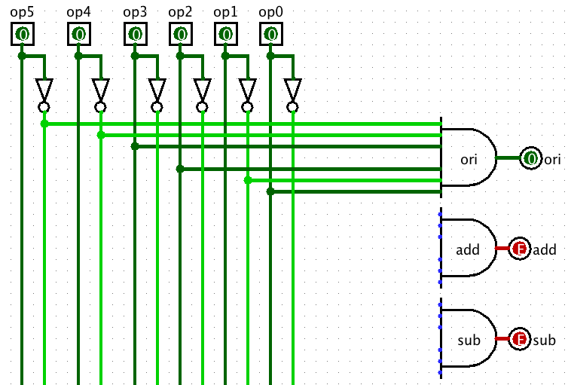
AND Control Logic in Logisim
Notes:
When you implement it in hardware, here’s what the AND logic looks like
DOES THIS LOOK FAMILIAR???? Remind you of a… MUX?!
(add review of Mux)
Logisim file called “Control Plane MIPS.circ”

Slide 25
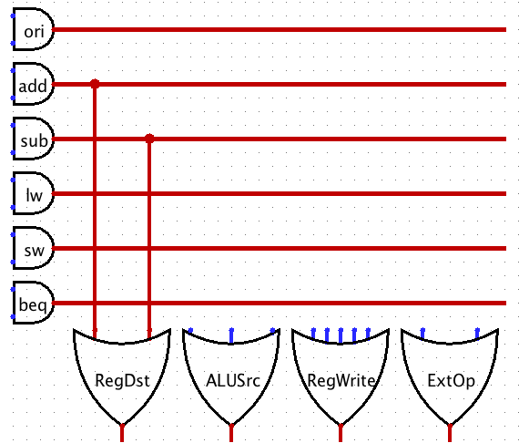
OR Control Logic in Logisim
Notes:
And here’s what the OR logic looks like
WE CAN OFTEN DO BETTER!!!! ADD THINGS
also what’s with the red lines

Slide 26
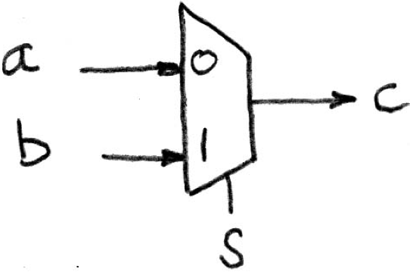
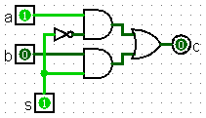
And and Or Logic
DOES THIS LOOK FAMILIAR?!?!
IT’S A MUX
Notes:
except that the options are fixed constants, not variable inputs

Slide 27
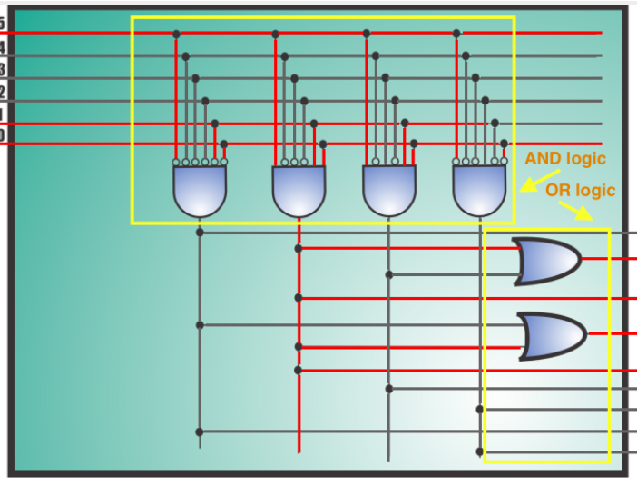

SoP Logic Points
No code like this: (use comparators instead)
If outputs are more complicated than 1 bit, use a BIG MUX

Slide 28

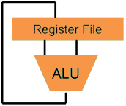
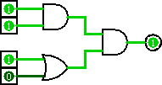
Great Idea #1: Levels of Representation/Interpretation
Higher-Level Language Program (e.g. C)
temp = v[k];
v[k] = v[k+1];
v[k+1] = temp;
Compiler
lw $t0, 0($2)
lw $t1, 4($2)
sw $t1, 0($2)
sw $t0, 4($2)
CALL HOME, WE’VE MADE HARDWARE/SOFTWARE CONTACT!!!
Assembly Language Program (e.g. MIPS)
Assembler
0000 1001 1100 0110 1010 1111 0101 1000
1010 1111 0101 1000 0000 1001 1100 0110
1100 0110 1010 1111 0101 1000 0000 1001
0101 1000 0000 1001 1100 0110 1010 1111
Machine Language Program (MIPS)
Machine Interpretation
Hardware Architecture Description (e.g. block diagrams)
Architecture Implementation
Logic Circuit Description (Circuit Schematic Diagrams)

Slide 29
Method 2
Logic

Slide 30
Idea #1: Use instruction variables to generate control signals
X’s: seems for now simplest thing to do is assume 0s…
RegDst = r-type
INPUTS
OUTPUTS
See MIPS
func
10 0000
10 0010
n/a
Green Sheet
op
00 0000
00 0000
00 1101
10 0011
10 1011
00 0100
add
sub
ori
lw
sw
beq
RegDst
1
1
0
0
X
X
ALUSrc
0
0
1
1
1
0
MemtoReg
0
0
0
1
X
X
Control Signals
RegWrite
1
1
1
1
0
0
MemWrite
0
0
0
0
1
0
nPC_sel
0
0
0
0
0
1
ExtOp
X
X
0
1
1
X
ALUctr[1:0]
Add
Subtract
Or
Add
Add
Subtract
All Supported Instructions

Slide 31
Question: Are the following statements TRUE or FALSE? Assume use of the AND-OR controller design.
Adding a new instruction will NOT require changing any of your existing control logic.
Adding a new control signal will NOT require changing any of your existing control logic.
1 2
(A)
F F
(B)
F T
(C)
T F
(D)
T T

Slide 32
Agenda
Quick Datapath Review
Control Implementation
Administrivia
Clocking Methodology
Pipelined Execution
Pipelined Datapath

Slide 33
Administrivia
OH/Lab Queue!!!! (See end of LOOOONG post…)
HW3 due TONIGHT
HW4 due Thursday
Project 2-2 released; due Monday
Project Party deets?!
Guerilla sesh tomorrow @540AB Cory 5-7 (Datapath)
CA$H Party?
Rebecca and Steven’s OH moving...

Slide 34
Agenda
Quick Datapath Review
Control Implementation
Administrivia
Clocking Methodology
Pipelined Execution
Pipelined Datapath

Slide 35
Clocking Methodology
Clk
.
.
.
.
.
.
.
.
.
.
.
.
Storage elements (RegFile, Mem, PC) triggered by same clock
Critical path determines length of clock period
This includes CLK-to-Q delay and added delay for setup
So far we have built a single cycle CPU – entire instructions are executed in 1 clock cycle
Up next: pipelining to execute instructions in 5 clock cycles
Notes:
add review of critical path, etc

Slide 36
Register-Register Timing: One Complete Cycle for addu
Clk
Clk-to-Q
PC
Old Value
New Value
Rs, Rt, Rd,
Op, Func
Instruction Memory Access Time
Old Value
New Value
Delay through Control Logic
ALUctr
Old Value
New Value
RegWr
Old Value
New Value
Register File Access Time
busA, B
Old Value
New Value
ALU Delay
busW
Old Value
New Value
RegWr
Rd
Rs
Rt
ALUctr
Setup Time
5
5
5
busA
32
Register Write
Occurs Here
busW
Rw
Ra
Rb
32
RegFile
busB
ALU
clk
32
Notes:
Let’s take a more quantitative picture of what is happening.
At each clock tick, the Program Counter will present its latest value to the Instruction memory after Clk-to-Q time.
After a delay of the Instruction Memory Access time, the Opcode, Rd, Rs, Rt, and Function fields will become valid on the instruction bus.
Once we have the new instruction, that is the Add or Subtract instruction, on the instruction bus, two things happen in parallel.
First of all, the control unit will decode the Opcode and Func field and set the control signals ALUctr and RegWr accordingly. We will cover this later.
While this is happening (points to Control Delay), we will also be reading the register file (Register File Access Time).
Once the data is valid on busA and busB, the ALU will perform the Add or Subtract operation based on the ALUctr signal.
Hopefully, the ALU is fast enough that it will finish the operation (ALU Delay) before the next clock tick.
At the next clock tick, the output of the ALU will be written into the register file because the RegWr signal will be equal to 1.
+3 = 45 min. (Y:25)

Slide 37
Register-Register Timing: One Complete Cycle for addu
Clk
Clk-to-Q
PC
Old Value
New Value
Rs, Rt, Rd,
Op, Func
Instruction Memory Access Time
Old Value
New Value
Delay through Control Logic
ALUctr
Old Value
New Value
RegWr
Old Value
New Value
Register File Access Time
busA, B
Old Value
New Value
ALU Delay
busW
Old Value
New Value
RegWr
Rd
Rs
Rt
ALUctr
Setup Time
5
5
5
busA
32
Register Write
Occurs Here
busW
Rw
Ra
Rb
32
RegFile
busB
ALU
clk
32
Notes:
Let’s take a more quantitative picture of what is happening.
At each clock tick, the Program Counter will present its latest value to the Instruction memory after Clk-to-Q time.
After a delay of the Instruction Memory Access time, the Opcode, Rd, Rs, Rt, and Function fields will become valid on the instruction bus.
Once we have the new instruction, that is the Add or Subtract instruction, on the instruction bus, two things happen in parallel.
First of all, the control unit will decode the Opcode and Func field and set the control signals ALUctr and RegWr accordingly. We will cover this later.
While this is happening (points to Control Delay), we will also be reading the register file (Register File Access Time).
Once the data is valid on busA and busB, the ALU will perform the Add or Subtract operation based on the ALUctr signal.
Hopefully, the ALU is fast enough that it will finish the operation (ALU Delay) before the next clock tick.
At the next clock tick, the output of the ALU will be written into the register file because the RegWr signal will be equal to 1.
+3 = 45 min. (Y:25)

Slide 38
Single Cycle Performance
Assume time for actions are 100ps for register read or write; 200ps for other events
Minimum clock period is?
Instr | Instr fetch | Register read | ALU op | Memory access | Register write | Total time
lw | 200ps | 100 ps | 200ps | 200ps | 100 ps | 800ps
sw | 200ps | 100 ps | 200ps | 200ps |  | 700ps
R-format | 200ps | 100 ps | 200ps |  | 100 ps | 600ps
beq | 200ps | 100 ps | 200ps |  |  | 500ps
What can we do to improve clock rate?
Will this improve performance as well?
Want increased clock rate to mean faster programs
Notes:
1.25 GHz

Slide 39
Agenda
Quick Datapath Review
Control Implementation
Administrivia
Clocking Methodology
Pipelined Execution
Pipelined Datapath

Slide 40



At the grading party last night...

Slide 41
Pipeline Analogy: Doing Laundry
Alex, Derek, Rebecca, and Steven each have one load of clothes to wash, dry, fold, and put away
Washer takes 30 minutes
Dryer takes 30 minutes
“Folder” takes 30 minutes
“Stasher” takes 30 minutes to put clothes into drawers
A
D
RR
S
Notes:
lol wash the MIPS green shirts

Slide 42
Sequential Laundry
6 PM
7
8
9
10
11
12
1
2 AM
Sequential laundry takes 8 hours for 4 loads
T
a
s
k
O
r
d
e
r
30
30
30
30
30
30
30
30
30
30
30
30
30
30
30
30
Time
A
D
R
S

Slide 43
Pipelined Laundry
6 PM
7
8
9
10
11
12
1
2 AM
Pipelined laundry takes 3.5 hours for 4 loads!
30
30
30
30
30
Time
T
a
s
k
O
r
d
e
r
30
30
A
D
R
S

Slide 44
Pipelining Lessons (1/2)
6 PM
Pipelining doesn’t help latency of single task, just throughput of entire workload
Multiple tasks operating simultaneously using different resources
Potential speedup = number of pipeline stages
Speedup reduced by time to fill and drain the pipeline: 8 hours/3.5 hours or 2.3X v. potential 4X in this example
7
8
9
T
a
s
k
O
r
d
e
r
Time
30
30
30
30
30
30
30
A
D
R
S

Slide 45
Pipelining Lessons (2/2)
6 PM
Suppose new Washer takes 20 minutes, new Stasher takes 20 minutes. How much faster is pipeline?
Pipeline rate limited by slowest pipeline stage
Unbalanced lengths of pipeline stages reduces speedup
7
8
9
T
a
s
k
O
r
d
e
r
Time
30
30
30
30
30
30
30
A
D
R
S

Slide 46


Meet the $taff
 | Derek | Zubair
Spirit Creature | $loth | Penguin
All-time Favorite Meme | Expanding Brain | Chicken $pongebob, Dark Pepe, ThinkingGuy
What wild thing would you do with 1 million dollars? | Dogs & Cats | Full Frontal Twix
Favorite Villian? | Jessie & James | Zaheer from LoK

Slide 47
Agenda
Quick Datapath Review
Control Implementation
Administrivia
Clocking Methodology
Pipelined Execution
Pipelined Datapath

Slide 48
Recall: 5 Stages of MIPS Datapath
1) IF: Instruction Fetch, Increment PC
2) ID: Instruction Decode, Read Registers
3) EX: Execution (ALU) Load/Store: Calculate Address Others: Perform Operation
4) MEM: Load: Read Data from Memory Store: Write Data to Memory
5) WB: Write Data Back to Register

Slide 49
Pipelined Datapath
rd
Register
File
ALU
PC
instruction
memory
rs
Data
memory
rt
+4
imm
MUX
1. Instruction
Fetch
2. Decode/
Register Read
3. Execute
4. Memory
5. Register
Write
Add registers between stages
Hold information produced in previous cycle
5 stage pipeline
Clock rate potentially 5x faster

Slide 50
Pipelining Changes
Registers separate the information between stages
You can still pass information around registers
At any instance of time, each stage working on a different instruction!
Will need to re-examine placement of wires and hardware in datapath

Slide 51
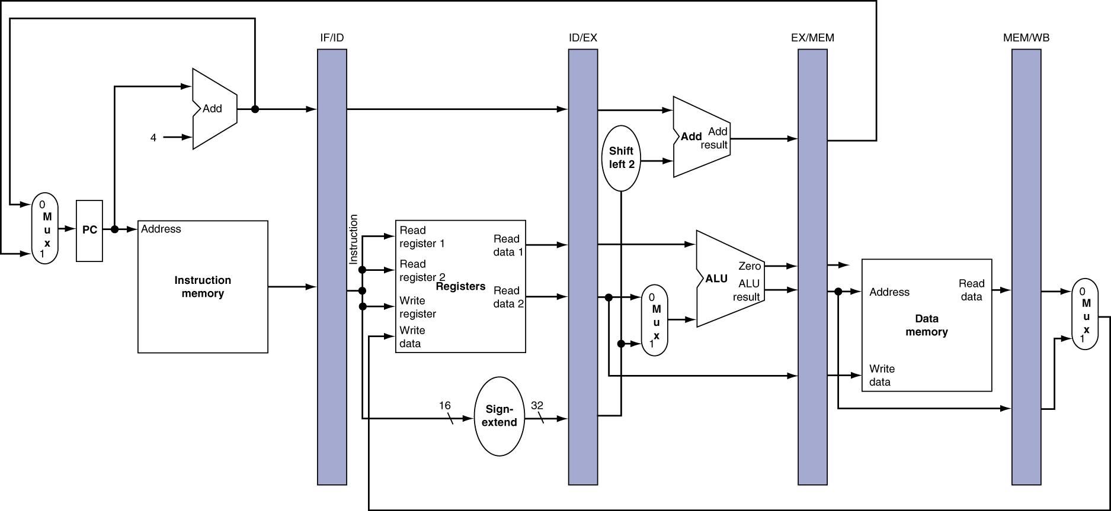
More Detailed Pipeline
Examine flow through pipeline for lw

Slide 52
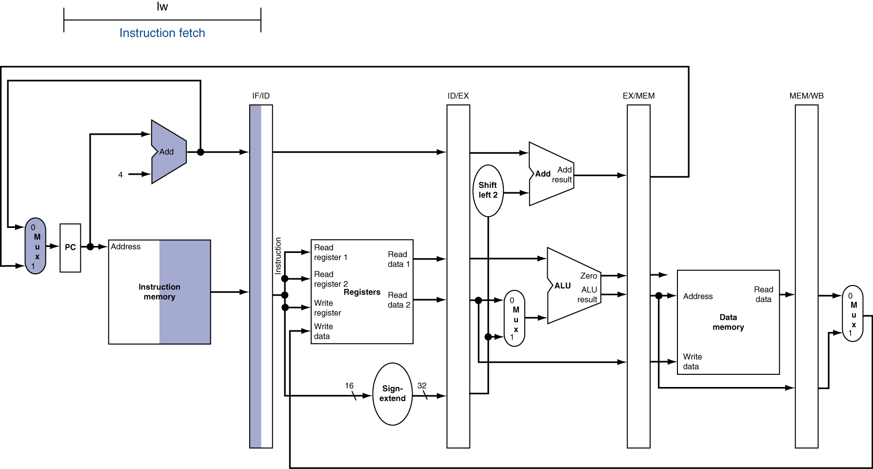
Instruction Fetch (IF) for Load
Components in use are highlighted
For sequential logic, left half means write, right half means read

Slide 53
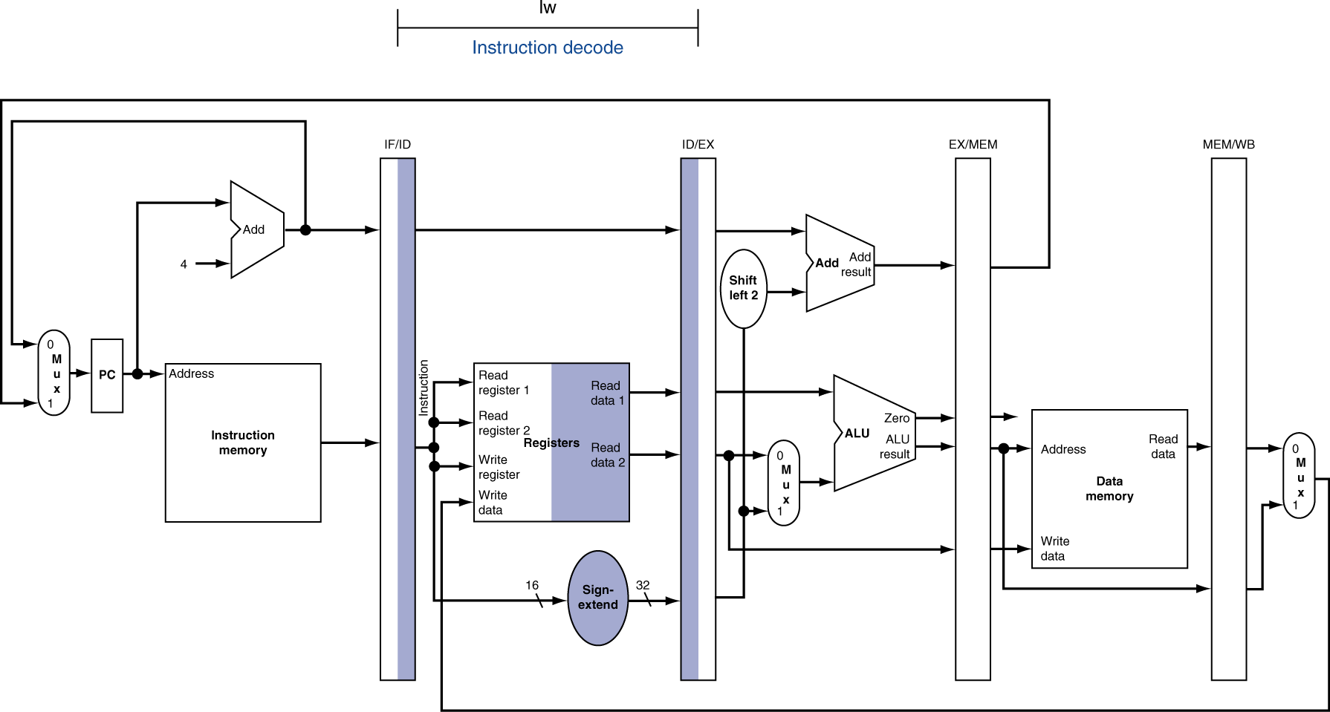
Instruction Decode (ID) for Load

Slide 54
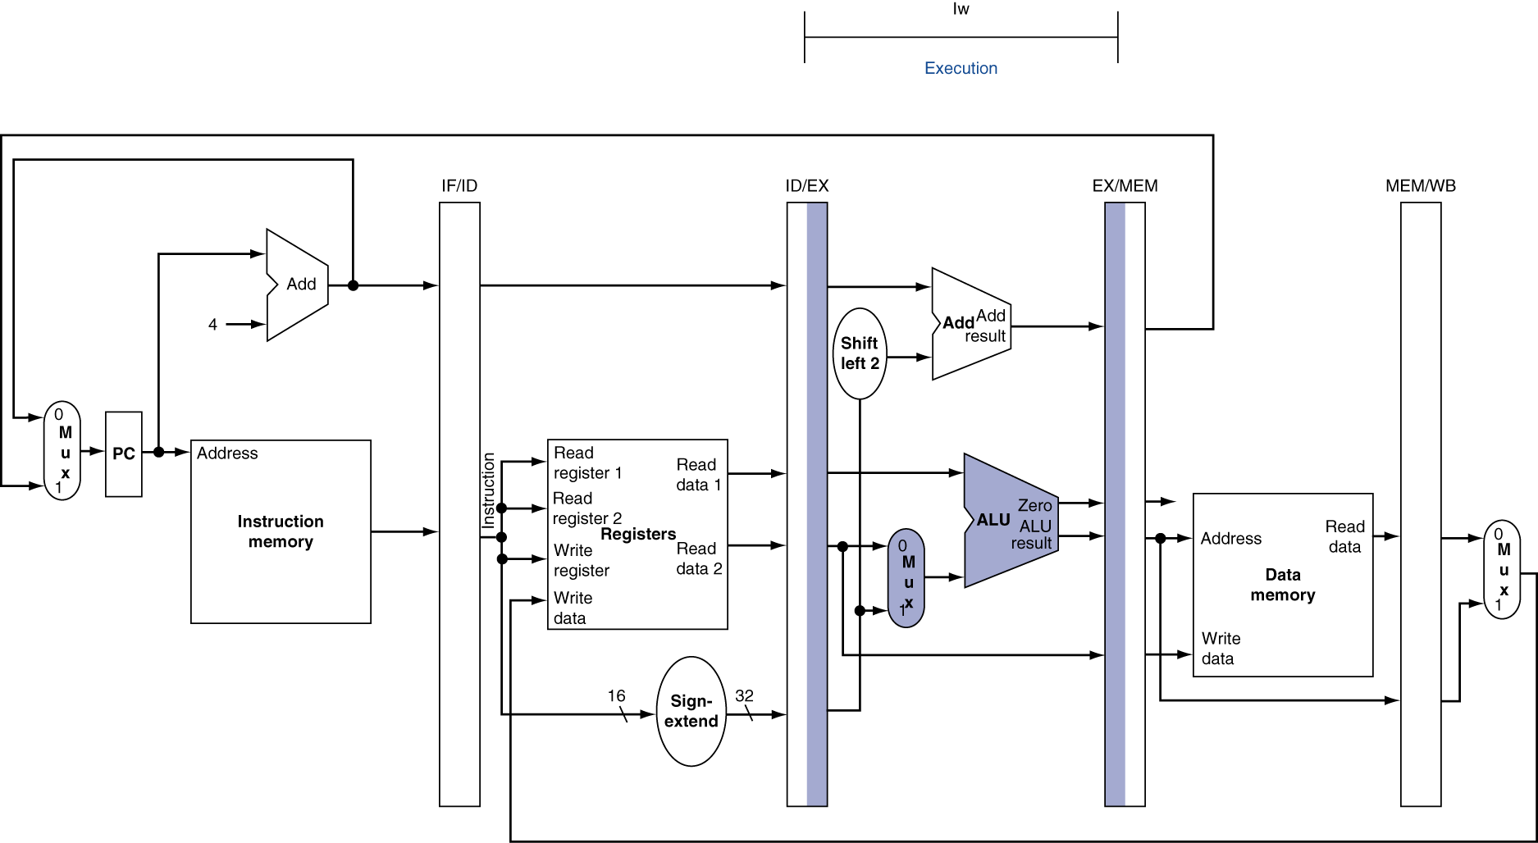
Execute (EX) for Load

Slide 55
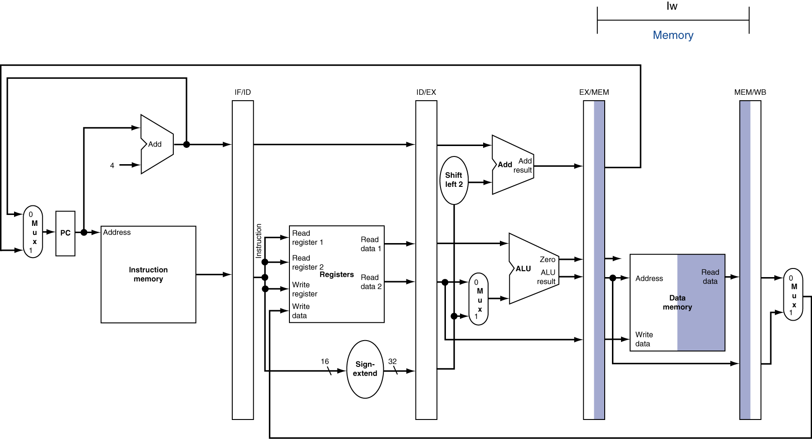
Memory (MEM) for Load

Slide 56
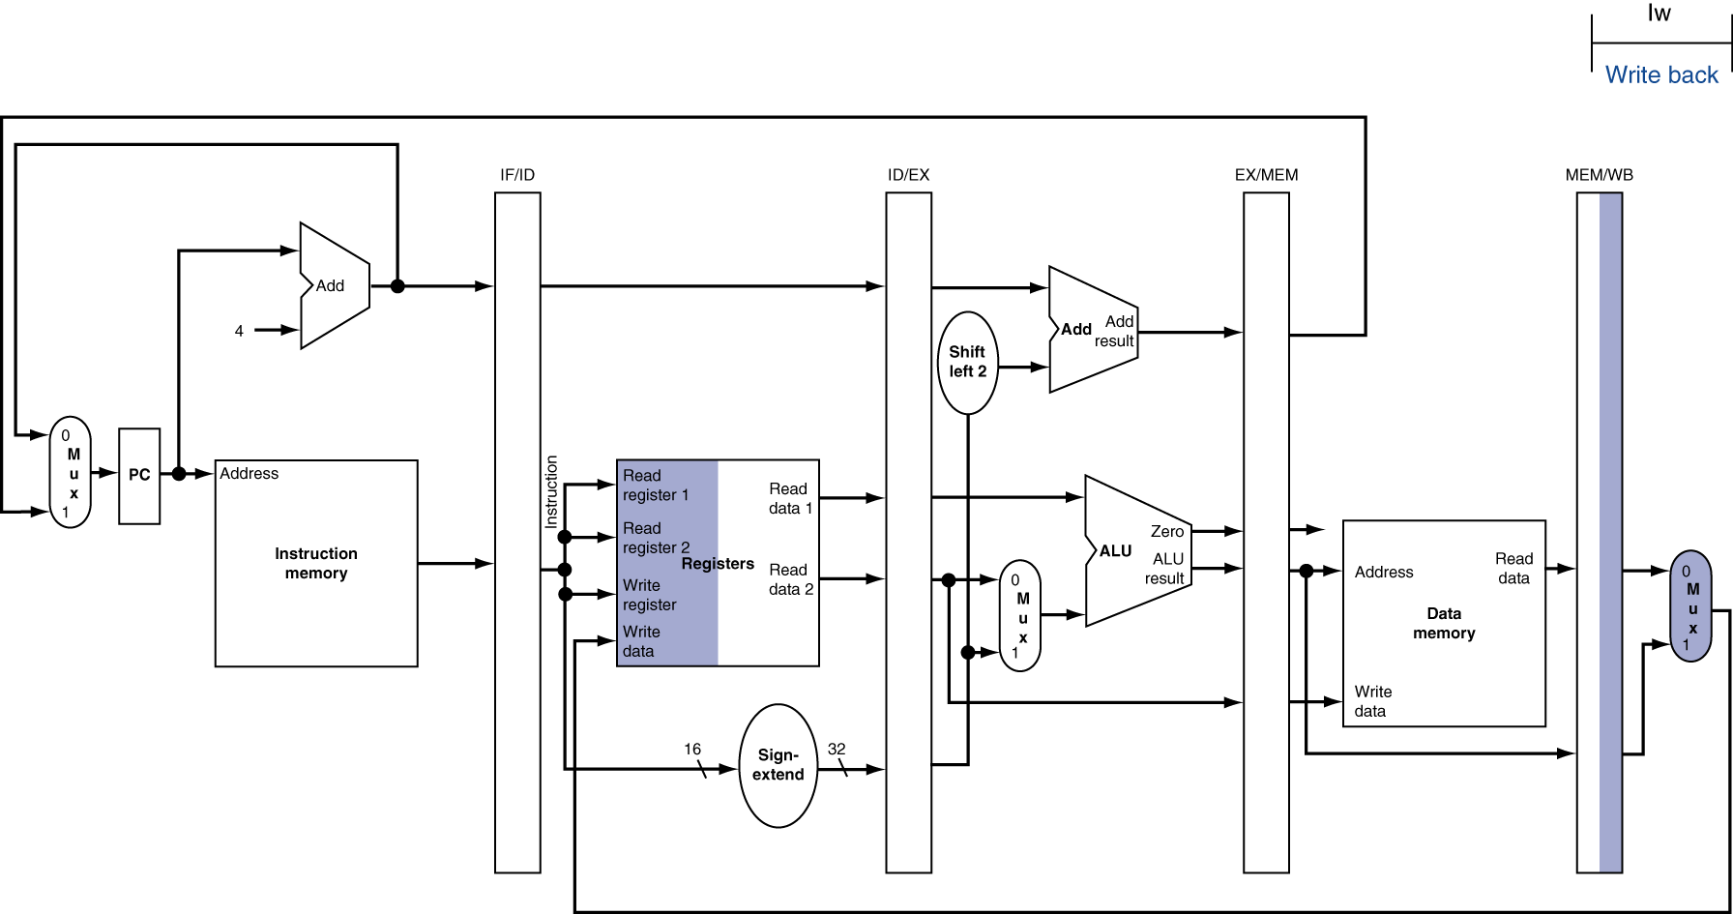
Write Back (WB) for Load
There’s something wrong here! (Can you spot it?)
Wrong register number!

Slide 57
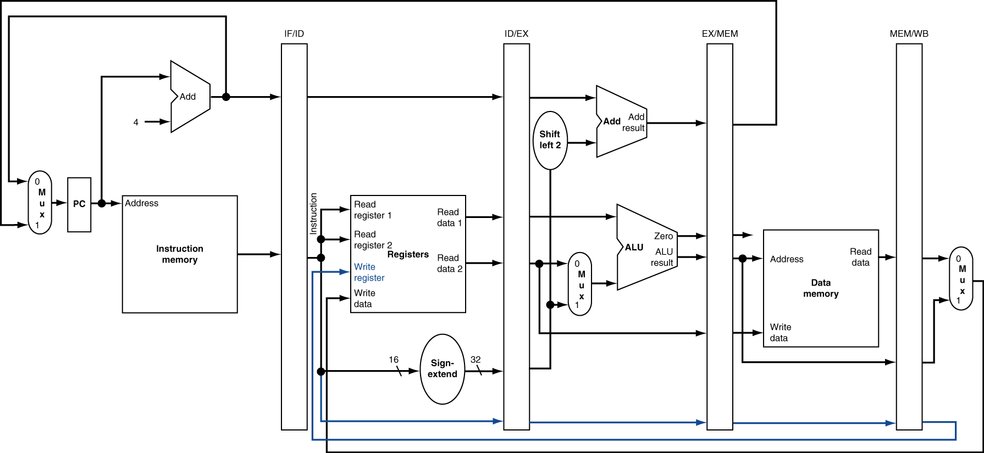
Corrected Datapath
Now any instruction that writes to a register will work properly

Slide 58
Pipelined Execution Representation
Time
IF
ID
EX
MEM
WB
IF
ID
EX
MEM
WB
IF
ID
EX
MEM
WB
IF
ID
EX
MEM
WB
IF
ID
EX
MEM
WB
IF
ID
EX
MEM
WB
Every instruction must take same number of steps, so some will idle
e.g. MEM stage for any arithmetic instruction

Slide 59
Graphical Pipeline Diagrams
rd
Register
File
ALU
PC
instruction
memory
rs
Data
memory
rt
+4
imm
MUX
1. Instruction
Fetch
2. Decode/
Register Read
3. Execute
4. Memory
5. Register
Write
Use datapath figure below to represent pipeline:
IF
ID
EX
Mem
WB
IM
Reg
ALU
DM
Reg

Slide 60
Graphical Pipeline Representation
RegFile: right half is read, left half is write
Time (clock cycles)
I
n
s
t
r
O
r
d
e
r
Load
IM
Reg
ALU
DM
Reg
Add
IM
Reg
ALU
DM
Reg
Store
IM
Reg
ALU
DM
Reg
Sub
IM
Reg
ALU
DM
Reg
Or
IM
Reg
ALU
DM
Reg

Slide 61
Instruction Level Parallelism (ILP)
Pipelining allows us to execute parts of multiple instructions at the same time using the same hardware!
This is known as instruction level parallelism
Later: Other types of parallelism
DLP: same operation on lots of data (SIMD)
TLP: executing multiple threads “simultaneously” (OpenMP)

Slide 62
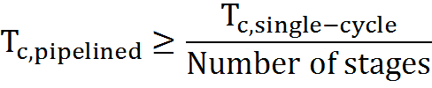
Pipeline Performance (1/3)
Use T_{c} (“time between completion of instructions”) to measure speedup
Equality only achieved if stages are balanced (i.e. take the same amount of time)
If not balanced, speedup is reduced
Speedup due to increased throughput
Latency for each instruction does not decrease

Slide 63
Pipeline Performance (2/3)
Assume time for stages is
100ps for register read or write
200ps for other stages
What is pipelined clock rate?
Compare pipelined datapath with single-cycle datapath
Instr | Instr fetch | Register read | ALU op | Memory access | Register write | Total time
lw | 200ps | 100 ps | 200ps | 200ps | 100 ps | 800ps
sw | 200ps | 100 ps | 200ps | 200ps |  | 700ps
R-format | 200ps | 100 ps | 200ps |  | 100 ps | 600ps
beq | 200ps | 100 ps | 200ps |  |  | 500ps

Slide 64
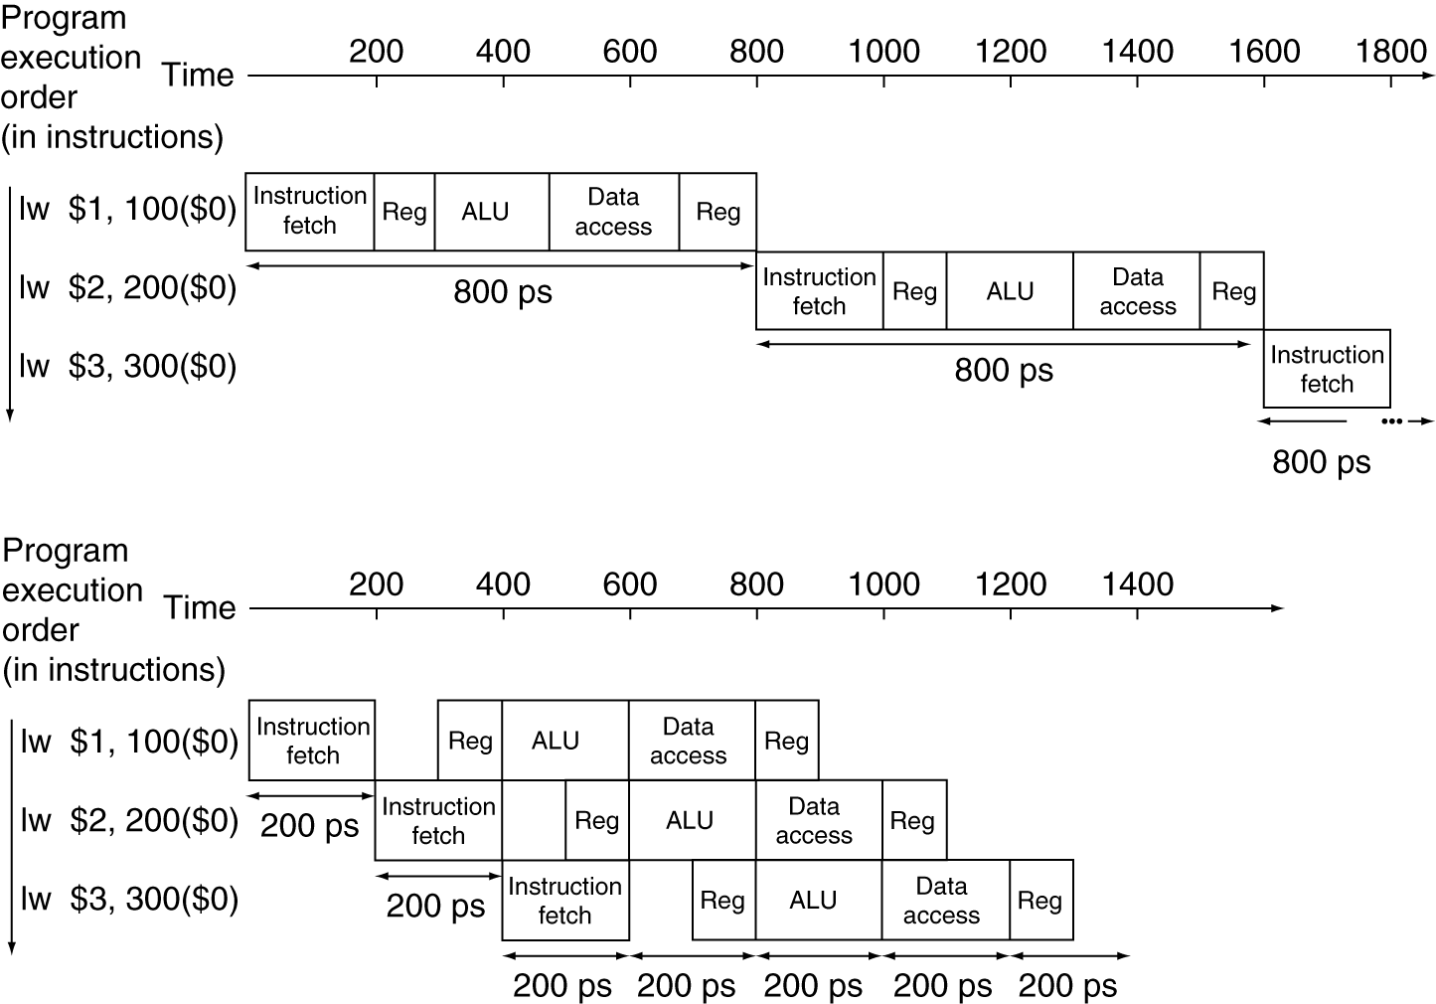
Pipeline Performance (3/3)
Single-cycle
T_{c} = 800 ps
Pipelined
T_{c} = 200 ps
Notes:
Here using T_{c} as “time between completion of instructions.”

Slide 65
Pipelining and ISA Design
MIPS Instruction Set designed for pipelining!
All instructions are 32-bits
Easier to fetch and decode in one cycle
Few and regular instruction formats, 2 source register fields always in same place
Can decode and read registers in one step
Memory operands only in Loads and Stores
Can calculate address 3rd stage, access memory 4th stage
Alignment of memory operands
Memory access takes only one cycle
Notes:
MIPS originally stood for Microprocessor without Interlocked Pipeline Stages

Slide 66
Question: Assume the stage times shown below.
Suppose we remove loads and stores from our ISA. Consider going from a single-cycle implementation to a 4-stage pipelined version.
The latency will be 1.25x slower.
The throughput will be 3x faster.
Instr Fetch | Reg Read | ALU Op | Mem Access | Reg Write
200ps | 100 ps | 200ps | 200ps | 100 ps
1 2
(A)
F F
(B)
F T
(C)
T F
(D)
T T
Notes:
1/600
4/800 = 1/200
1/200*600/1 = 3x faster throughput
800/600 = 4/3 = 1.33!!

Slide 67
Question: Assume the stage times shown below.
Suppose we remove loads and stores from our ISA. Consider going from a single-cycle implementation to a 4-stage pipelined version.
The latency will be 1.25x slower.
The throughput will be 3x faster.
Instr Fetch | Reg Read | ALU Op | Mem Access | Reg Write
200ps | 100 ps | 200ps | 200ps | 100 ps
1 2
No mem access
throughput:
1/(IF+ID+EX+WB) = 1/600 →
4/(4*max_stage) = 1/200
1/200*600/1 = 3x faster
(A)
F F
(B)
F T
(C)
T F
(D)
T T
Notes:
1/600
4/800 = 1/200
1/200*600/1 = 3x faster throughput
800/600 = 4/3 = 1.33!!

Slide 68
Question: Assume the stage times shown below.
Suppose we remove loads and stores from our ISA. Consider going from a single-cycle implementation to a 4-stage pipelined version.
The latency will be 1.25x slower.
The throughput will be 3x faster.
Instr Fetch | Reg Read | ALU Op | Mem Access | Reg Write
200ps | 100 ps | 200ps | 200ps | 100 ps
1 2
No mem access
latency:
IF+ID+EX+WB = 600 →
4*max_stage = 800
800/600 = 1.33x slower!
(A)
F F
(B)
F T
(C)
T F
(D)
T T
Notes:
1/600
4/800 = 1/200
1/200*600/1 = 3x faster throughput
800/600 = 4/3 = 1.33!!

Slide 69
Question: Assume the stage times shown below.
Suppose we remove loads and stores from our ISA. Consider going from a single-cycle implementation to a 4-stage pipelined version.
The latency will be 1.25x slower.
The throughput will be 3x faster.
Instr Fetch | Reg Read | ALU Op | Mem Access | Reg Write
200ps | 100 ps | 200ps | 200ps | 100 ps
1 2
(A)
F F
(B)
F T
(C)
T F
(D)
T T
Notes:
1/600
4/800 = 1/200
1/200*600/1 = 3x faster throughput
800/600 = 4/3 = 1.33!!

Slide 70
Summary
Implementing controller for your datapath
Take decoded signals from instruction and generate control signals
Pipelining improves performance by exploiting Instruction Level Parallelism
5-stage pipeline for MIPS: IF, ID, EX, MEM, WB
Executes multiple instructions in parallel
Each instruction has the same latency
Be careful of signal passing (more on this next lecture)

