Slide 1
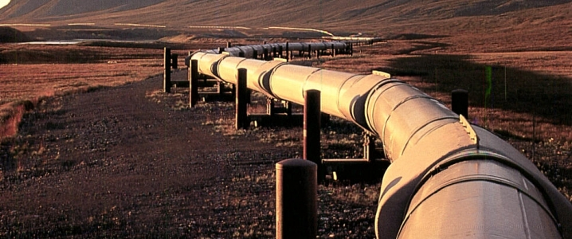
Pipelining and Hazards
Instructor: Rebecca Herman

Slide 2


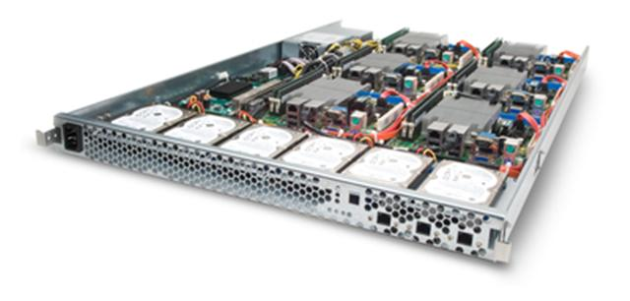
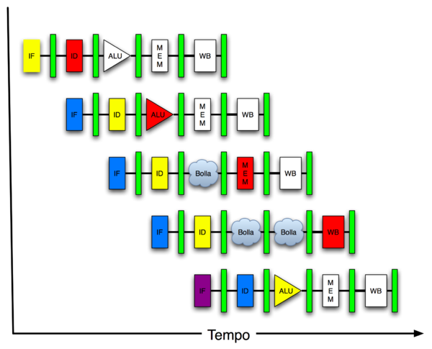
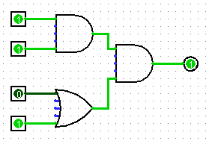
Great Idea #4: Parallelism
Software Hardware
Parallel Requests
Assigned to computer
e.g. search “Garcia”
Parallel Threads
Assigned to core
e.g. lookup, ads
Parallel Instructions
> 1 instruction @ one time
e.g. 5 pipelined instructions
Parallel Data
> 1 data item @ one time
e.g. add of 4 pairs of words
Hardware descriptions
All gates functioning in parallel at same time
Warehouse Scale Computer
Smart Phone
Leverage Parallelism &
Achieve High Performance
Computer
Core
…
Core
Memory
Input/Output
Core
Instruction Unit(s)
Functional
Unit(s)
A₀+B₀
A₁+B₁
A₂+B₂
A₃+B₃
Cache Memory
Logic Gates

Slide 3
Review of Last Lecture
Implementing controller for your datapath
Take decoded signals from instruction and generate control signals
Pipelining improves performance by exploiting Instruction Level Parallelism
5-stage pipeline for MIPS: IF, ID, EX, MEM, WB
Executes multiple instructions in parallel
Each instruction has the same latency
What can go wrong???

Slide 4
Pipelined Datapath
rd
Register
File
ALU
PC
instruction
memory
rs
Data
memory
rt
+4
imm
MUX
1. Instruction
Fetch
2. Decode/
Register Read
3. Execute
4. Memory
5. Register
Write
Add registers between stages
Hold information produced in previous cycle
5 stage pipeline
Clock rate potentially 5x faster

Slide 5
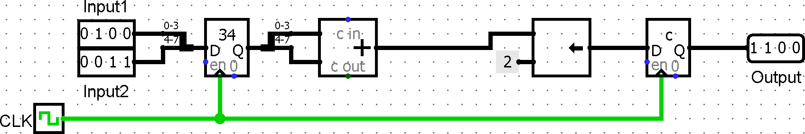
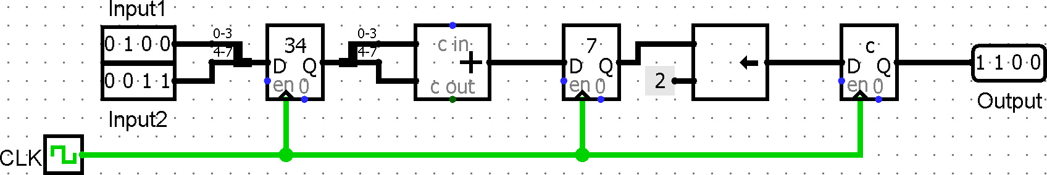
Measurements of Performance
Latency (or response time or execution time)
Time to complete one task (#stages * T_{clk})
Bandwidth (or throughput)
Tasks completed per unit time (#stages/latency)
Example: clk-to-q: 10ms, setup 5ms, add 110ms, shift: 75ms
T_{CLK} =
200ms
Latency? Throughput?
200ms 1/200ms
+ t_{CLK-to-Q} = 5 tasks/sec
Latency? Throughput?
2*125ms 1/125ms
+ t_{CLK-to-Q} = 8 tasks/sec
T_{CLK} =
125ms

Slide 6
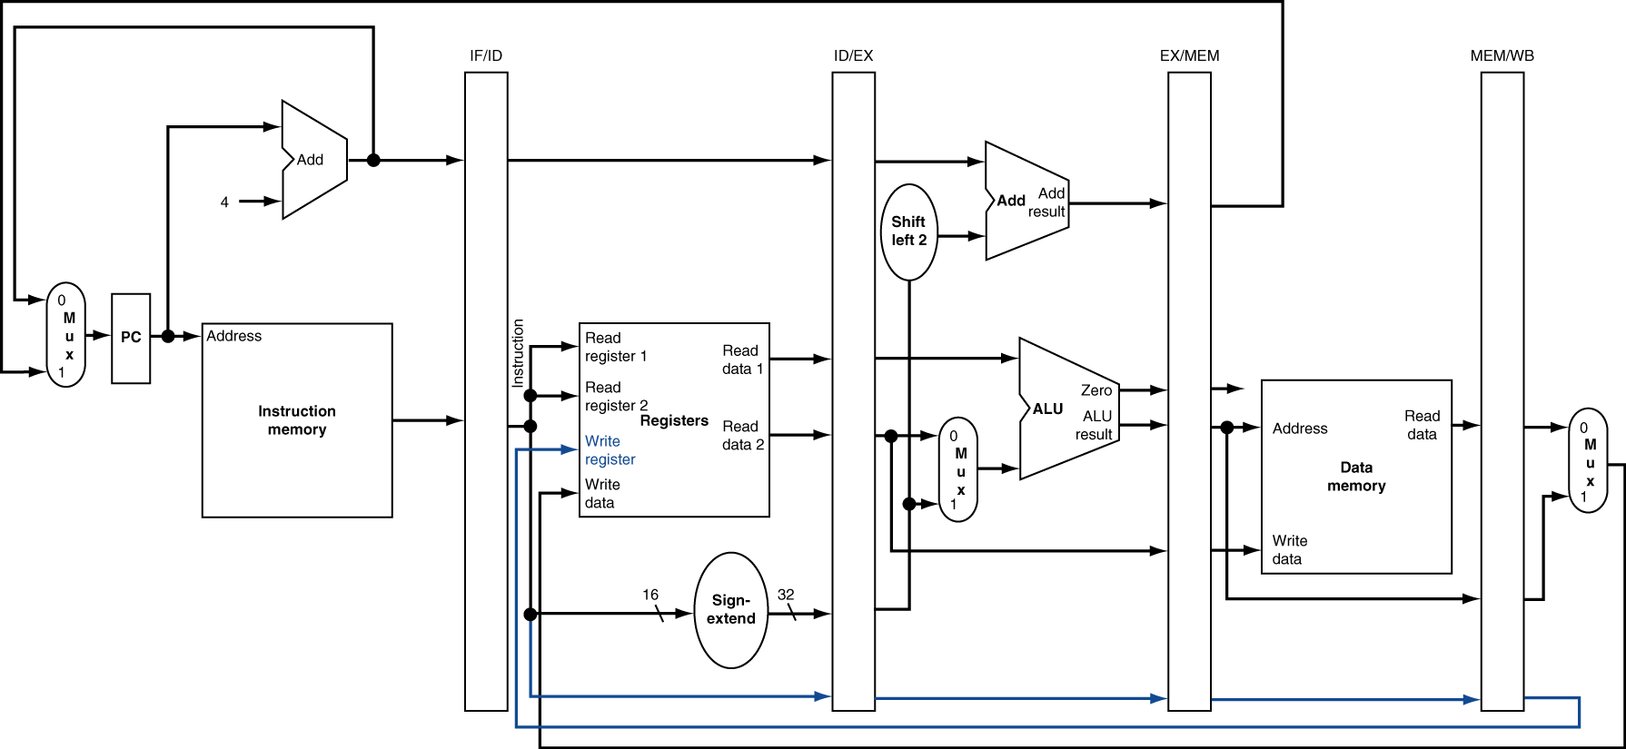
Pipelined Datapath (Detailed)

Slide 7
Graphical Pipeline Representation
RegFile: right half is read, left half is write
Time (clock cycles)
I
n
s
t
r
O
r
d
e
r
Load
I$
Reg
ALU
D$
Reg
Add
I$
Reg
ALU
D$
Reg
Store
I$
Reg
ALU
D$
Reg
Sub
I$
Reg
ALU
D$
Reg
Or
I$
Reg
ALU
D$
Reg

Slide 8
Question: Which of the following signals (buses or control signals) for MIPS-lite does NOT need to be passed into the EX pipeline stage?
(A)
Beq
IF
ID
EX
Mem
WB
(B)
MemWr
(C)
RegWr
I$
Reg
ALU
D$
Reg
(D)
imm16

Slide 9

Hazards Ahead!

Slide 10
Pipelining Hazards
A hazard is a situation that prevents starting the next instruction in the next clock cycle
Structural hazard
A required resource is busy (e.g. needed in multiple stages)
Data hazard
Data dependency between instructions
Need to wait for previous instruction to complete its data write
Control hazard
Flow of execution depends on previous instruction

Slide 11
Agenda
Structural Hazards
Data Hazards
Forwarding
Administrivia
Data Hazards (Continued)
Load Delay Slot
Control Hazards
Branch and Jump Delay Slots
Branch Prediction

Slide 12
1. Structural Hazards
Conflict for use of a resource
Time (clock cycles)
I
n
s
t
r
O
r
d
e
r
Trying to read (and maybe write) same memory twice in same clock cycle
Load
I$
Reg
ALU
D$
Reg
Instr 1
I$
Reg
ALU
D$
Reg
Instr 2
I$
Reg
ALU
D$
Reg
Instr 3
I$
Reg
ALU
D$
Reg
Instr 4
I$
Reg
ALU
D$
Reg

Slide 13
1. Structural Hazards
Conflict for use of a resource
Time (clock cycles)
I
n
s
t
r
O
r
d
e
r
Load
I$
Reg
ALU
D$
Reg
Can we read and write to registers simultaneously?
Instr 1
I$
Reg
ALU
D$
Reg
Instr 2
I$
Reg
ALU
D$
Reg
Instr 3
I$
Reg
ALU
D$
Reg
Instr 4
I$
Reg
ALU
D$
Reg

Slide 14
Structural Hazard #1: Single Memory
Memory is BIG so implemented efficiently (EECS 151)
Physically cannot perform two reads or a read and a write simultaneously
Load/Store requires memory access for data; all code need memory access for the instructions
also a hazard for single-cycle CPU!
Pipelined CPU could solve by stalling: Instruction fetch would have to wait one cycle (Causes pipeline “bubble”)
Solution: Separate instruction/data memories

Slide 15
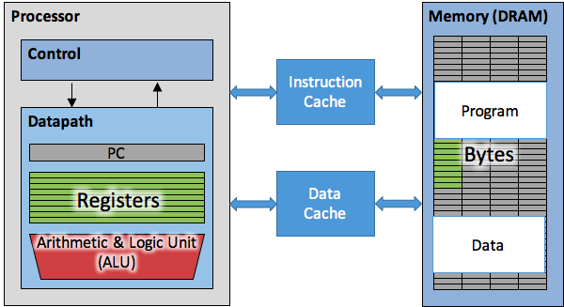
Instruction and Data Caches
Caches -- small and fast “buffer” memory

Slide 16
Structural Hazard #1: Single Memory
Memory is BIG so implemented efficiently (EECS 151)
Physically cannot perform two reads or a read and a write simultaneously
Load/Store requires memory access for data; all code need memory access for the instructions
also a hazard for single-cycle CPU!
Pipelined CPU could solve by stalling: Instruction fetch would have to wait one cycle (Causes pipeline “bubble”)
Solution: Separate instruction/data memories
Separate L1 I$ and L1 D$ take care of this

Slide 17
Structural Hazard #2: Registers
Two alternate solutions:
Build RegFile with independent read and write ports (what you will do in the project; good for single-stage)

Slide 18
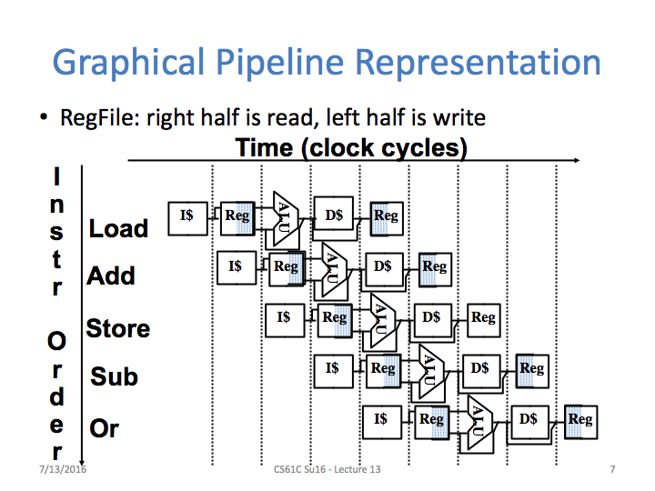
Instr | Instr fetch | Register read | ALU op | Memory access | Register write | Total time
lw | 200ps | 100 ps | 200ps | 200ps | 100 ps | 800ps

Slide 19
Structural Hazard #2: Registers
Two alternate solutions:
Build RegFile with independent read and write ports (what you will do in the project; good for single-stage)
Double Pumping: split RegFile access in two! Prepare to write during 1st half, write on falling edge, read during 2nd half of each clock cycle
Will save us a cycle later...
Possible because RegFile access is VERY fast (takes less than half the time of ALU stage)
Conclusion: Read and Write to registers during same clock cycle is okay

Slide 20
Agenda
Structural Hazards
Data Hazards
Forwarding
Administrivia
Data Hazards (Continued)
Load Delay Slot
Control Hazards
Branch and Jump Delay Slots
Branch Prediction

Slide 21
2. Data Hazards (1/2)
Consider the following sequence of instructions:
add $t0, $t1, $t2
sub $t4, $t0, $t3
and $t5, $t0, $t6
or $t7, $t0, $t8
xor $t9, $t0, $t10
Stored
during WB
Read during ID

Slide 22
2. Data Hazards (2/2)
Data-flow backward in time are hazards
Time (clock cycles)
I
n
s
t
r
O
r
d
e
r
IF
ID/RF
EX
MEM
WB
add $t0,$t1,$t2
I$
Reg
ALU
D$
Reg
Hazard if no double pumping
sub $t4,$t0,$t3
I$
Reg
ALU
D$
Reg
and $t5,$t0,$t6
I$
Reg
ALU
D$
Reg
or $t7,$t0,$t8
I$
Reg
ALU
D$
Reg
xor $t9,$t0,$t10
I$
Reg
ALU
D$
Reg

Slide 23
Data Hazard Solution: Forwarding
Forward result as soon as it is available
OK that it’s not stored in RegFile yet
Arithmetic result
available in EX
IF
ID/RF
EX
MEM
WB
add $t0,$t1,$t2
I$
Reg
ALU
D$
Reg
sub $t4,$t0,$t3
I$
Reg
ALU
D$
Reg
and $t5,$t0,$t6
I$
Reg
ALU
D$
Reg
or $t7,$t0,$t8
I$
Reg
ALU
D$
Reg
xor $t9,$t0,$t10
I$
Reg
ALU
D$
Reg

Slide 24
Datapath for Forwarding (1/2)
What changes need to be made here?

Slide 25
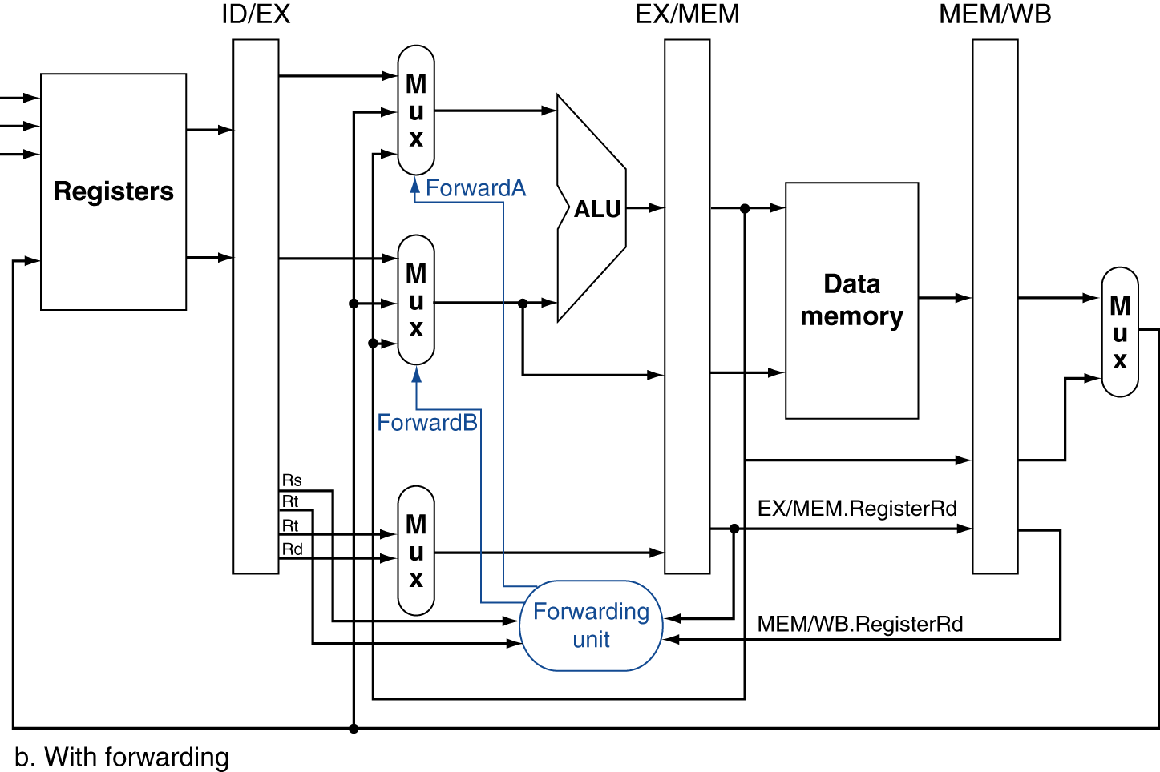
Datapath for Forwarding (2/2)
Handled by forwarding unit
Pictured: ALU → ALU in one and 2 cycles
Notes:
Scan figure 4.54 on p. 368.

Slide 26
Agenda
Structural Hazards
Data Hazards
Forwarding
Administrivia
Data Hazards (Continued)
Load Delay Slot
Control Hazards
Branch and Jump Delay Slots
Branch Prediction

Slide 27
Administrivia
Midterm Grades Released! Regrade requests due Monday, 7/17
We have received multiple regrade requests that were not well-thought out. Please be considerate!
HW4 due tomorrow
Proj2-2 due Monday, 7/17
Steven’s OH: 511 Soda 11-1 F

Slide 28
Agenda
Structural Hazards
Data Hazards
Forwarding
Administrivia
Data Hazards (Continued)
Load Delay Slot
Control Hazards
Branch and Jump Delay Slots
Branch Prediction

Slide 29
Data Hazard: Loads (1/4)
Recall: Dataflow backwards in time are hazards
Can’t solve all cases with forwarding
Must stall instruction dependent on load, then forward (more hardware)
IF
ID/RF
EX
MEM
WB
lw $t0,0($t1)
I$
Reg
ALU
D$
Reg
sub $t3,$t0,$t2
I$
Reg
ALU
D$
Reg

Slide 30
Data Hazard: Loads (2/4)
This is what happens in hardware in a “hardware interlock”
Hardware stalls pipeline
Called “hardware interlock”
IF
ID/RF
EX
MEM
WB
lw $t0, 0($t1)
I$
Reg
ALU
D$
Reg
sub $t3,$t0,$t2
bubble
I$
Reg
ALU
D$
Reg
and $t5,$t0,$t4
I$
bubble
Reg
ALU
D$
Reg
or $t7,$t0,$t6
Must stall entire pipeline
bubble
I$
Reg
ALU
D$

Slide 31
Data Hazard: Loads (3/4)
Stall is equivalent to nop
lw $t0, 0($t1)
I$
Reg
ALU
D$
Reg
nop
bubble
bubble
bubble
bubble
bubble
sub $t3,$t0,$t2
I$
Reg
ALU
D$
Reg
and $t5,$t0,$t4
I$
Reg
ALU
Reg
D$
or $t7,$t0,$t6
I$
Reg
ALU
D$

Slide 32
Data Hazard: Loads (4/4)
Slot after a load is called a load delay slot
SOME HARDWARE IMPLEMENTATIONS:
Detect that an instruction uses the result of the load
stall it for one cycle
equivalent to a nop between the cycles
Idea: Let the assembler put an unrelated instruction in that slot → no stall!

Slide 33
Code Scheduling to Avoid Stalls
Assembler Update!
Reorder code to avoid use of load result in the next instruction!
MIPS code for D=A+B; E=A+C;
# Method 1:
lw $t1, 0($t0)
lw $t2, 4($t0)
add $t3, $t1, $t2
sw $t3, 12($t0)
lw $t4, 8($t0)
add $t5, $t1, $t4
sw $t5, 16($t0)
# Method 2:
lw $t1, 0($t0)
lw $t2, 4($t0)
lw $t4, 8($t0)
add $t3, $t1, $t2
sw $t3, 12($t0)
add $t5, $t1, $t4
sw $t5, 16($t0)
Stall!
Stall!
13 cycles
11 cycles

Slide 34
Agenda
Structural Hazards
Data Hazards
Forwarding
Administrivia
Data Hazards (Continued)
Load Delay Slot
Control Hazards
Branch and Jump Delay Slots
Branch Prediction

Slide 35
3. Control Hazards
Branch (beq, bne) determines flow of control
Fetching next instruction depends on branch outcome
Pipeline can’t always fetch correct instruction
Still working on ID stage of branch
Simple Solution: Stall on every branch until we have the new PC value
How long must we stall?

Slide 36
Branch Stall
When is comparison result available?
Time (clock cycles)
I
n
s
t
r
O
r
d
e
r
beq
I$
Reg
ALU
D$
Reg
TWO bubbles required per branch!
Instr 1
I$
Reg
ALU
D$
Reg
Instr 2
I$
Reg
ALU
D$
Reg
Instr 3
I$
Reg
ALU
D$
Reg
Instr 4
I$
Reg
ALU
D$
Reg

Slide 37
3. Control Hazard: Branching
Option #1: Insert special branch comparator in ID stage
As soon as instruction is decoded, immediately make a decision and set the new value of the PC
Benefit: Branch decision made in 2nd stage, so only one nop is needed instead of two
Side Note: This means that branches are idle in EX, MEM, and WB

Slide 38
Improved Branch Stall
When is comparison result available?
Time (clock cycles)
I
n
s
t
r
O
r
d
e
r
beq
I$
Reg
ALU
D$
Reg
Only one bubble required now
Instr 1
I$
Reg
ALU
D$
Reg
Instr 2
I$
Reg
ALU
D$
Reg
Instr 3
I$
Reg
ALU
D$
Reg
Instr 4
I$
Reg
ALU
D$
Reg

Slide 39
Datapath for ID Branch Comparator
What changes need to be made here?

Slide 40
Data Hazard: Branches!
Recall: Dataflow backwards in time are hazards
Can’t solve all cases with forwarding
Must stall instruction dependent on load, then forward (more hardware)
IF
ID/RF
EX
MEM
WB
add $t0,$t0,$t1
I$
Reg
ALU
D$
Reg
beq $0,$t0,foo
I$
Reg
ALU
D$
Reg

Slide 41
3. Control Hazard: Branching
Option #2: Branch Prediction – guess outcome of a branch, fix afterwards if necessary
Must cancel (flush) all instructions in pipeline that depended on guess that was wrong
How many instructions do we end up flushing?
Achieve simplest hardware if we predict that all branches are NOT taken

Slide 42
3. Control Hazard: Branching
Option #3: Branch delay slot
Whether or not we take the branch, always execute the instruction immediately following the branch
Worst-Case: Put a nop in the branch-delay slot
Better Case: Move an instruction from before the branch into the branch-delay slot
Must not affect the logic of program

Slide 43
3. Control Hazard: Branching
MIPS uses this delayed branch concept
Re-ordering instructions is a common way to speed up programs
Compiler finds an instruction to put in the branch delay slot ≈ 50% of the time
Jumps also have a delay slot
Why is one needed?

Slide 44
Delayed Branch Example
Nondelayed Branch
Delayed Branch
or $8, $9, $10
add $1, $2,$3
add $1, $2, $3
sub $4, $5, $6
sub $4, $5, $6
beq $1, $4, Exit
beq $1, $4, Exit
or $8, $9, $10
xor $10, $1, $11
xor $10, $1, $11
Why not any of the other instructions?
Exit:
Exit:

Slide 45
Delayed Jump in MIPS
MIPS Green Sheet for jal: R[31]=PC+8; PC=JumpAddr
PC+8 because of jump delay slot!
Instruction at PC+4 always gets executed before jal jumps to label, so return to PC+8

Slide 46


Meet The $taff
 | Nikhil | Nick
Spirit Creature | Ostrich | Cookie Monster
All-time Favorite Meme | Covfefe | All Pepes | Fefes | Arthur
What wild thing would you do with 1 million dollars? | Pay off loans & -Fidget spinners or a rap group | Curse people out & afford the lawsuits
Favorite Villian? | Madara | Light from Death Note | Count of Montechristo | Eric Cartman

Slide 47
Agenda
Structural Hazards
Data Hazards
Forwarding
Administrivia
Data Hazards (Continued)
Load Delay Slot
Control Hazards
Branch and Jump Delay Slots
Branch Prediction

Slide 48
Dynamic Branch Prediction
Branch penalty is more significant in deeper pipelines
Use dynamic branch prediction
Have branch prediction buffer (a.k.a. branch history table) that stores outcomes (taken/not taken) indexed by recent branch instruction addresses
To execute a branch
Check table and predict the same outcome for next fetch
If wrong, flush pipeline and flip prediction

Slide 49
1-Bit Predictor: Shortcoming
Examine the code below, assuming both loops will be executed multiple times:
outer: … … inner: …
…
beq …, …, inner … beq …, …, outer
Inner loop branches are predicted wrong twice!
Predict as taken on last iteration of inner loop
Then predict as not taken on first iteration of inner loop next time around

Slide 50
Question: For each code sequences below, choose one of the statements below:
1: lw $t0,0($t0) add $t1,$t0,$t0 | 2: add $t1,$t0,$t0 addi $t2,$t0,5 addi $t4,$t1,5 | 3: addi $t1,$t0,1 addi $t2,$t0,2 addi $t3,$t0,2 addi $t3,$t0,4 addi $t5,$t1,5
A
No stalls as is
B
No stalls with forwarding
C
Must stall

Slide 51
Code Sequence 1
Time (clock cycles)
I
n
s
t
r
O
r
d
e
r
lw
I$
Reg
ALU
D$
Reg
Must stall
add
I$
Reg
ALU
D$
Reg
instr
I$
Reg
ALU
D$
Reg
instr
I$
Reg
ALU
D$
Reg
instr
I$
Reg
ALU
D$
Reg

Slide 52
Code Sequence 2
Time (clock cycles)
forwarding
I
n
s
t
r
O
r
d
e
r
no forwarding
add
I$
Reg
ALU
D$
Reg
No stalls with forwarding
addi
I$
Reg
ALU
D$
Reg
addi
I$
Reg
ALU
D$
Reg
instr
I$
Reg
ALU
D$
Reg
instr
I$
Reg
ALU
D$
Reg

Slide 53
Code Sequence 3
Time (clock cycles)
I
n
s
t
r
O
r
d
e
r
I$
Reg
ALU
D$
Reg
No stalls as is
addi
addi
I$
Reg
ALU
D$
Reg
addi
I$
Reg
ALU
D$
Reg
addi
I$
Reg
ALU
D$
Reg
addi
I$
Reg
ALU
D$
Reg

Slide 54
Summary
Hazards reduce effectiveness of pipelining
Cause stalls/bubbles
Structural Hazards
Conflict in use of datapath component
Data Hazards
Need to wait for result of a previous instruction
Control Hazards
Address of next instruction uncertain/unknown
Branch and jump delay slots

