Slide 1
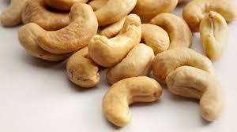


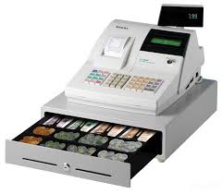



Memory Hierarchy, Fully Associative Caches
Instructor: Steven Ho

Slide 2
Review
Hazards reduce effectiveness of pipelining
Cause stalls/bubbles
Structural Hazards
Conflict in use of datapath component
Data Hazards
Need to wait for result of a previous instruction
Control Hazards
Address of next instruction uncertain/unknown
Branch and jump delay slots

Slide 3
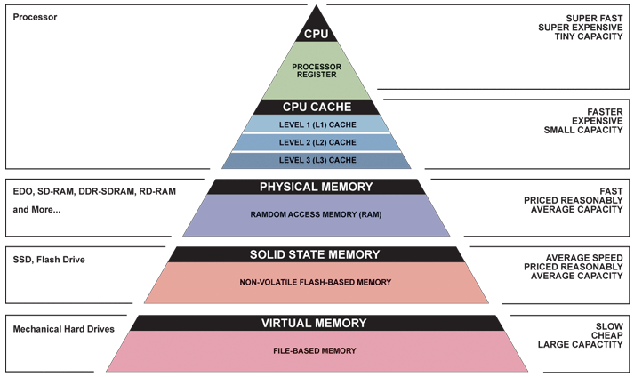
Great Idea #3: Principle of Locality/ Memory Hierarchy

Slide 4
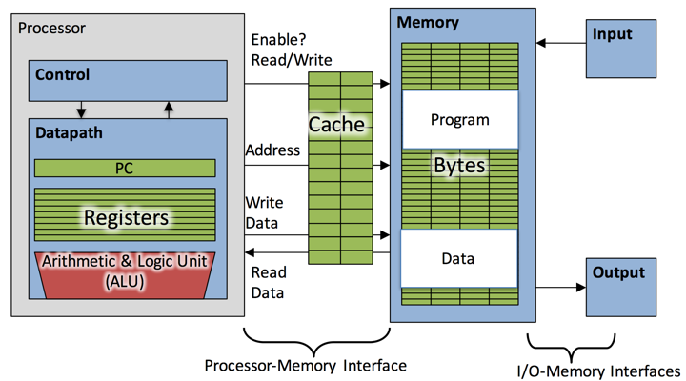

Slide 5
Agenda
Memory Hierarchy Overview
Administrivia
Fully Associative Caches
Cache Reads and Writes

Slide 6
Storage in a Computer
Processor
Holds data in register files (~ 100 B)
Registers accessed on sub-nanosecond timescale
Memory (“main memory”)
More capacity than registers (~ GiB)
Access time ~ 50-100 ns
Hundreds of clock cycles per memory access?!

Slide 7
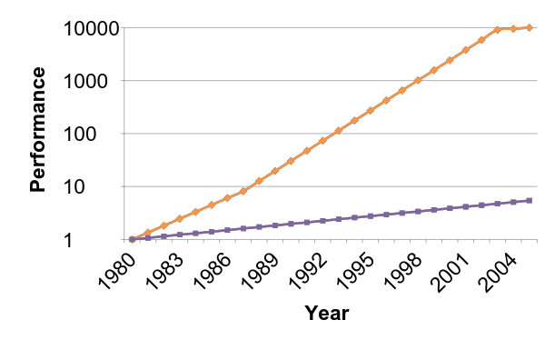
Processor-Memory Gap
1989 first Intel CPU with cache on chip
1998 Pentium III has two cache levels on chip
µProc
55%/year
(2X/1.5yr)
Processor-Memory
Performance Gap (grows 50%/year)
“Moore’s Law”
DRAM
7%/year
(2X/10yrs)

Slide 9
Library Analogy
Writing a report on a specific topic
e.g. history of the computer (your internet is out)
While at library, take books from shelves and put them on shelf above your desk
If need more, go get them and bring back to shelf
Don’t return earlier books since might still need them
Limited space on shelf; which books do we keep?
You hope these ~10 books on shelf enough to write report
Only 0.00001% of the books in UC Berkeley libraries!
Notes:
main stax -> shelf -> desk
Some text explaining
change pix

Slide 10

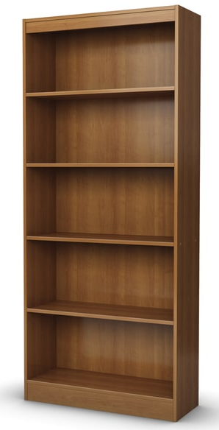



Slide 11
Principle of Locality (1/3)
Principle of Locality: Programs access only a small portion of the full address space at any instant of time
Recall: Address space holds both code and data
Loops and sequential instruction execution mean generally localized code access
Stack and Heap try to keep your data together
Arrays and structs naturally group data you would access together

Slide 12
Principle of Locality (2/3)
Temporal Locality (locality in time)
Go back to the same book on desk multiple times
If a memory location is referenced then it will tend to be referenced again soon
Spatial Locality (locality in space)
When go to shelves, grab many books on computers since related books are stored together
If a memory location is referenced, the locations with nearby addresses will tend to be referenced soon

Slide 13
Principle of Locality (3/3)
We exploit the principle of locality in hardware via a memory hierarchy where:
Levels closer to processor are faster (and more expensive per bit so smaller)
Levels farther from processor are larger (and less expensive per bit so slower)
Goal: Create the illusion of memory being almost as fast as fastest memory and almost as large as biggest memory of the hierarchy
Notes:
Mention that making fast and efficient small hardware is more expensive than bigger, slower hardware

Slide 14
Memory Hierarchy Schematic
Processor
Smaller,
Faster, More expensive
Level 1
Level 2
Lower Higher
Level 3
. . .
Bigger,
Slower, Cheaper
Level n
Notes:
The Processor accesses data out of the highest levels.
Lowest level (usually disk) contains all available data.

Slide 15
Cache Concept
Memory Cache—holds a copy of a subset of main memory
We often use $ (“cash”) to abbreviate cache (e.g. D$ = Data Cache, L1$ = Level 1 Cache) (not like you’ve seen this before o:)
Modern processors have separate caches for instructions and data, as well as several levels of caches implemented in different sizes
Implemented with same IC processing technology as CPU and integrated on-chip – faster but more expensive than main memory

Slide 16
Memory Transfer in the Hierarchy
Processor
4-8 bytes (word)
Inclusive: data in L1$ ⊂ data in L2$ ⊂ data in MM ⊂ data in SM
L1$
Block: Unit of transfer between memory and cache
L2$
8-32 bytes (block)
16-128 bytes (block)
Main Memory
4,096+ bytes (page)
Secondary Memory
Notes:
Symbol ⊂ means “is a subset of”

Slide 17
Managing the Hierarchy
registers ↔ memory
By compiler (or assembly level programmer)
cache ↔ main memory
By the cache controller hardware
main memory ↔ disks (secondary storage)
By the OS (virtual memory, which is a later topic)
Virtual to physical address mapping assisted by the hardware (TLB)
By the programmer (files)
We are here

Slide 18
Typical Memory Hierarchy
On-Chip Components
Secondary
Memory
(Disk
or Flash)
Control
Datapath
Main
Memory
(DRAM)
Instr
Cache
Second
Level
Cache
(SRAM)
RegFile
Data
Cache
Speed: ½’s 1’s 10’s 100’s 1,000,000’s
(cycles)
Size: 100’s 10K’s M’s G’s T’s
(bytes)
Cost/bit: highest lowest

Slide 19
Memory Hierarchy Technologies
Caches use static RAM (SRAM)
Fast (typical access times of 0.5 to 2.5 ns)
Higher power, expensive ($2000 to $4000 per GB in 2011)
Static: content will last as long as power is on
Main memory uses dynamic RAM (DRAM)
Lower power, cheaper ($20 to $40 per GB in 2011)
Slower (typical access times of 50 to 70 ns)
Dynamic: needs to be “refreshed” regularly (~ every 8 ms)
Notes:
In case you didn’t know, RAM stands for Random Access Memory.
Size comparison: DRAM/SRAM is 4 to 8 times
Cost/cycle time comparison SRAM/DRAM is 8 to 16 times
http://parts.digikey.com/1/parts/1211303-ic-sram-1mbit-10ns-32soj-cy7c109d-10vxi.html
Quantity discount 10ns 1MBit SRAM $2.24, $17/Mbyte, $1700/100 Mbyte, $17000/GByte
http://www.frys.com/template/harddrives
DRAM: 4GB @ $70 or $17.50 per GB
24GB@$800 = $33/Gbyte
http://www.frys.com/category/Outpost/Hard+Drives+&+Memory/Memory/Notebook+Memory/Apple+-+Mac++Memory/
DDR2 1GB @ $25 per
DDR3 1 GB @ $37.5 per
FLASH Media
Approx. $2 per Gbyte

Slide 20
Review So Far
Goal: present the programmer with ≈ as much memory as the largest memory at ≈ the speed of the fastest memory
Approach: Memory Hierarchy
Successively higher levels contain “most used” data from lower levels
Exploits temporal and spatial locality
We will start by studying caches

Slide 21
Agenda
Memory Hierarchy Overview
Administrivia
Fully Associative Caches
Cache Reads and Writes

Slide 22
Administrivia
Midterm 1 Regrade Requests due Monday night!
Project 2-1 grades out
Project 2-2 due Monday
HW 4 due today
Halfway through the course!
Midterm 2 at the end of the month!
Will cover material up to 7/25 (SDS, MIPS CPU, Caches, Parallelism)

Slide 23
Agenda
Memory Hierarchy Overview
Administrivia
Fully Associative Caches
Cache Reads and Writes

Slide 24
Cache Management
What is the overall organization of blocks we impose on our cache?
Where do we put a block of data from memory?
How do we know if a block is already in cache?
How do we quickly find a block when we need it?
When do we replace something in the cache?

Slide 25
General Notes on Caches (1/4)
Recall: Memory is byte-addressed
We haven’t specified the size of our “blocks,” but will usually be multiple of word size (32-bits)
How do we access individual words or bytes within a block?
Cache is smaller than memory
Can’t fit all blocks at once, so multiple blocks in memory must map to the same slot in cache
Need some way of identifying which memory block is currently in each cache slot
OFFSET
INDEX
TAG
Notes:
“slot” or “cubby” or “locker” or “location”
Add cache block partitioned to words

Slide 26

31
0
0
j
opcode
target address
0
31 30
23 22
0
S
Exponent
Mantissa
1 bit
8 bits
23 bits
0
31
0
Tag
Index
Offset
T
I
O

Slide 27
General Notes on Caches (2/4)
Recall: hold subset of memory in a place that’s faster to access
Return data to you when you request it
If cache doesn’t have it, then fetches it for you
Cache must be able to check/identify its current contents
What does cache initially hold?
Garbage! Cache considered “cold”
Keep track with Valid bit

Slide 28
General Notes on Caches (3/4)
Effect of block size (K Bytes):
Spatial locality dictates our blocks consist of adjacent bytes, which differ in address by 1
Offset field: Lowest bits of memory address can be used to index to specific bytes within a block
Block size needs to be a power of two (in bytes)
One way to compute the offset field is to mask out the Tag and Index bits
0
31
Tag
Index
Offset
T
I
O
Notes:
Need to check EVERY cache location for block.

Slide 29
General Notes on Caches (4/4)
Effect of cache size (C Bytes):
“Cache Size” refers to total stored data
Determines number of blocks the cache can hold (C/K blocks)
Tag field: Leftover upper bits of memory address determine which portion of memory the block came from (identifier)
Notes:
Can also call tag field the “block number” (only works for fully associative).

Slide 30
Question:
You are given a 256 B cache that holds 8 data blocks. We are working on a 10-bit byte- addressed machine.
Which statement is false?
(A) Each data block holds 32 bytes of data
(B) Our tag can be more than 5 bits
(C) All of main memory could fit into four caches
(D) No two tags can be the same

Slide 31
Question:
You are given a 256 B cache that holds 8 data blocks. We are working on a 10-bit byte- addressed machine.
Which statement is false?
(A) Each data block holds 32 bytes of data
(B) Our tag can be more than 5 bits
(C) All of main memory could fit into four caches
(D) No two tags can be the same

Slide 32
Fully Associative Caches
Each memory block can map anywhere in the cache (fully associative)
Most efficient use of space
Least efficient to check
To check a fully associative cache:
Look at ALL cache slots in parallel
If Valid bit is 0, then ignore
If Valid bit is 1 and Tag matches, then return that data
Notes:
Lazy man’s organization – e.g. clothes in any drawer or strewn around room

Slide 33
Fully Associative Cache Address Breakdown
Memory address fields:
Meaning of the field sizes:
Offset bits ↔ 2^{Offset} bytes per block = 2^{Offset-2} words per block
Tag bits = A – Offset, where A = # of address bits (A = 32 here)
31
0
Tag
Offset
Tag bits
Offset bits

Slide 34
Caching Terminology (1/2)
When reading memory, 3 things can happen:
Cache hit: Cache holds a valid copy of the block, so return the desired data
Cache miss: Cache does not have desired block, so fetch from memory and put in empty (invalid) slot
Cache miss with block replacement: Cache does not have desired block and is full, so discard one and replace it with desired data

Slide 35
Block Replacement Policies
Which block do you replace?
Use a cache block replacement policy
There are many (most are intuitively named), but we will just cover a few in this class
http://en.wikipedia.org/wiki/Cache_algorithms#Examples
Of note:
Random Replacement
Least Recently Used (LRU): requires some “management bits”
Notes:
LRU: Hardware keeps track of access history and replaces the entry that has not been used for the longest time

Slide 36
Caching Terminology (2/2)
How effective is your cache?
Want to max cache hits and min cache misses
Hit rate (HR): Percentage of memory accesses in a program or set of instructions that result in a cache hit
Miss rate (MR): Like hit rate, but for cache misses MR = 1 – HR
How fast is your cache?
Hit time (HT): Time to access cache (including Tag comparison)
Miss penalty (MP): Time to replace a block in the cache from a lower level in the memory hierarchy

Slide 37
Fully Associative Cache Implementation
What’s actually in the cache?
Each cache slot contains the actual data block (8 × K = 8 × 2^{Offset} bits)
Tag field of address as identifier (Tag bits)
Valid bit (1 bit): Whether cache slot was filled in
Any necessary replacement management bits (“LRU bits” – variable # of bits stored in each row)
Total bits in cache = # slots × (8×K + Tag + 1 + ?) = (C/K) × (8×2^{Offset} + Tag + 1 + ?) bits

Slide 38
FA Cache Examples (1/4)
Cache parameters:
Fully associative, address space of 64B, block size of 1 word, cache size of 4 words, LRU (2 bits)
Address Breakdown:
1 word = 4 bytes, so Offset = log₂(4) = 2
A = log₂(64) = 6 bits, so Tag = 6 – 2 = 4
Bits in cache = (4/1) × (8×2² + 4 + 1 + 2) = 156 bits
Memory Addresses:
XX
XX
XX
Block address

Slide 39
FA Cache Examples (1/4)
Cache parameters:
Fully associative, address space of 64B, block size of 1 word, cache size of 4 words, LRU (2 bits)
Offset – 2 bits, Tag – 4 bits
39 bits per slot, 156 bits to implement with LRU
Offset
0
1
2
3
Block Size
V | Tag | 00 | 01 | 10 | 11
X | XXXX | 0x?? | 0x?? | 0x?? | 0x??
X | XXXX | 0x?? | 0x?? | 0x?? | 0x??
X | XXXX | 0x?? | 0x?? | 0x?? | 0x??
X | XXXX | 0x?? | 0x?? | 0x?? | 0x??
LRU
XX
Slot
Cache Size

Slide 40
FA Cache Examples (2/4)
Consider the sequence of memory address accesses
0 2 4 8 20 16 0 2
Starting with a cold cache:
000000
000010
0
miss
2
hit
0 | 0000 | 0x?? | 0x?? | 0x?? | 0x??
0 | 0000 | 0x?? | 0x?? | 0x?? | 0x??
0 | 0000 | 0x?? | 0x?? | 0x?? | 0x??
0 | 0000 | 0x?? | 0x?? | 0x?? | 0x??
1 | 0000 | M[0] | M[1] | M[2] | M[3]
0 | 0000 | 0x?? | 0x?? | 0x?? | 0x??
0 | 0000 | 0x?? | 0x?? | 0x?? | 0x??
0 | 0000 | 0x?? | 0x?? | 0x?? | 0x??
1 | 0000 | M[0] | M[1] | M[2] | M[3]
0 | 0000 | 0x?? | 0x?? | 0x?? | 0x??
0 | 0000 | 0x?? | 0x?? | 0x?? | 0x??
0 | 0000 | 0x?? | 0x?? | 0x?? | 0x??
000100
001000
4
miss
8
miss
1 | 0000 | M[0] | M[1] | M[2] | M[3]
0 | 0000 | 0x?? | 0x?? | 0x?? | 0x??
0 | 0000 | 0x?? | 0x?? | 0x?? | 0x??
0 | 0000 | 0x?? | 0x?? | 0x?? | 0x??
1 | 0000 | M[0] | M[1] | M[2] | M[3]
1 | 0001 | M[4] | M[5] | M[6] | M[7]
0 | 0000 | 0x?? | 0x?? | 0x?? | 0x??
0 | 0000 | 0x?? | 0x?? | 0x?? | 0x??
1 | 0000 | M[0] | M[1] | M[2] | M[3]
1 | 0001 | M[4] | M[5] | M[6] | M[7]
0 | 0000 | 0x?? | 0x?? | 0x?? | 0x??
0 | 0000 | 0x?? | 0x?? | 0x?? | 0x??
1 | 0000 | M[0] | M[1] | M[2] | M[3]
1 | 0001 | M[4] | M[5] | M[6] | M[7]
1 | 0010 | M[8] | M[9] | M[10] | M[11]
0 | 0000 | 0x?? | 0x?? | 0x?? | 0x??

Slide 41
FA Cache Examples (2/4)
Consider the sequence of memory address accesses
0 2 4 8 20 16 0 2
Starting with a cold cache:
M H M M
M
M
M
H
010100
010000
20
miss
16
miss
1 | 0000 | M[0] | M[1] | M[2] | M[3]
1 | 0001 | M[4] | M[5] | M[6] | M[7]
1 | 0010 | M[8] | M[9] | M[10] | M[11]
0 | 0000 | 0x?? | 0x?? | 0x?? | 0x??
1 | 0000 | M[0] | M[1] | M[2] | M[3]
1 | 0001 | M[4] | M[5] | M[6] | M[7]
1 | 0010 | M[8] | M[9] | M[10] | M[11]
1 | 0101 | M[20] | M[21] | M[22] | M[23]
1 | 0000 | M[0] | M[1] | M[2] | M[3]
1 | 0001 | M[4] | M[5] | M[6] | M[7]
1 | 0010 | M[8] | M[9] | M[10] | M[11]
1 | 0101 | M[20] | M[21] | M[22] | M[23]
000000
000010
0
miss
2
hit
1 | 0100 | M[16] | M[17] | M[18] | M[19]
1 | 0001 | M[4] | M[5] | M[6] | M[7]
1 | 0010 | M[8] | M[9] | M[10] | M[11]
1 | 0101 | M[20] | M[21] | M[22] | M[23]
1 | 0100 | M[16] | M[17] | M[18] | M[19]
1 | 0000 | M[0] | M[1] | M[2] | M[3]
1 | 0010 | M[8] | M[9] | M[10] | M[11]
1 | 0101 | M[20] | M[21] | M[22] | M[23]
8 requests, 6 misses – HR of 25%

Slide 42
FA Cache Examples (3/4)
Same requests, but reordered
0 2 2 0 16 20 8 4
Starting with a cold cache:
000000
000010
0
miss
2
hit
1 | 0000 | M[0] | M[1] | M[2] | M[3]
0 | 0000 | 0x?? | 0x?? | 0x?? | 0x??
0 | 0000 | 0x?? | 0x?? | 0x?? | 0x??
0 | 0000 | 0x?? | 0x?? | 0x?? | 0x??
1 | 0000 | M[0] | M[1] | M[2] | M[3]
0 | 0000 | 0x?? | 0x?? | 0x?? | 0x??
0 | 0000 | 0x?? | 0x?? | 0x?? | 0x??
0 | 0000 | 0x?? | 0x?? | 0x?? | 0x??
000010
000000
2
hit
0
hit
1 | 0000 | M[0] | M[1] | M[2] | M[3]
0 | 0000 | 0x?? | 0x?? | 0x?? | 0x??
0 | 0000 | 0x?? | 0x?? | 0x?? | 0x??
0 | 0000 | 0x?? | 0x?? | 0x?? | 0x??
1 | 0000 | M[0] | M[1] | M[2] | M[3]
0 | 0000 | 0x?? | 0x?? | 0x?? | 0x??
0 | 0000 | 0x?? | 0x?? | 0x?? | 0x??
0 | 0000 | 0x?? | 0x?? | 0x?? | 0x??

Slide 43
FA Cache Examples (3/4)
Same requests, but reordered
0 2 2 0 16 20 8 4
Starting with a cold cache:
M H H H
010000
010100
16
miss
20
miss
1 | 0000 | M[0] | M[1] | M[2] | M[3]
0 | 0000 | 0x?? | 0x?? | 0x?? | 0x??
0 | 0000 | 0x?? | 0x?? | 0x?? | 0x??
0 | 0000 | 0x?? | 0x?? | 0x?? | 0x??
1 | 0000 | M[0] | M[1] | M[2] | M[3]
1 | 0100 | M[16] | M[17] | M[18] | M[19]
0 | 0000 | 0x?? | 0x?? | 0x?? | 0x??
0 | 0000 | 0x?? | 0x?? | 0x?? | 0x??
1 | 0000 | M[0] | M[1] | M[2] | M[3]
1 | 0100 | M[16] | M[17] | M[18] | M[19]
1 | 0101 | M[20] | M[21] | M[22] | M[23]
0 | 0000 | 0x?? | 0x?? | 0x?? | 0x??
1 | 0000 | M[0] | M[1] | M[2] | M[3]
1 | 0100 | M[16] | M[17] | M[18] | M[19]
0 | 0000 | 0x?? | 0x?? | 0x?? | 0x??
0 | 0000 | 0x?? | 0x?? | 0x?? | 0x??
001000
000100
8
miss
4
miss
1 | 0000 | M[0] | M[1] | M[2] | M[3]
1 | 0100 | M[16] | M[17] | M[18] | M[19]
1 | 0101 | M[20] | M[21] | M[22] | M[23]
0 | 0000 | 0x?? | 0x?? | 0x?? | 0x??
1 | 0000 | M[0] | M[1] | M[2] | M[3]
1 | 0100 | M[16] | M[17] | M[18] | M[19]
1 | 0101 | M[20] | M[21] | M[22] | M[23]
1 | 0010 | M[8] | M[9] | M[10] | M[11]
1 | 0000 | M[0] | M[1] | M[2] | M[3]
1 | 0100 | M[16] | M[17] | M[18] | M[19]
1 | 0101 | M[20] | M[21] | M[22] | M[23]
1 | 0010 | M[8] | M[9] | M[10] | M[11]
1 | 0000 | M[0] | M[1] | M[2] | M[3]
1 | 0100 | M[16] | M[17] | M[18] | M[19]
1 | 0101 | M[20] | M[21] | M[22] | M[23]
1 | 0010 | M[8] | M[9] | M[10] | M[11]
8 requests, 5 misses – ordering matters!
Notes:
Extra for experts:
Rearrange the same requests so that there are 5 misses and the final tags are (from top to bottom) 0b0000, 0b0011, 0b0001, 0b0100.
Is it possible for this same set of requests to produce fewer than 5 misses?

Slide 44
FA Cache Examples (4/4)
Original sequence, but double block size
0 2 4 8 20 16 0 2
Starting with a cold cache:
000000
0
0 | 000 | 0x?? | 0x?? | 0x?? | 0x?? | 0x?? | 0x?? | 0x?? | 0x??
0 | 000 | 0x?? | 0x?? | 0x?? | 0x?? | 0x?? | 0x?? | 0x?? | 0x??
1 | 000 | M[0] | M[1] | M[2] | M[3] | M[4] | M[5] | M[6] | M[7]
0 | 000 | 0x?? | 0x?? | 0x?? | 0x?? | 0x?? | 0x?? | 0x?? | 0x??
miss
000010
2
1 | 000 | M[0] | M[1] | M[2] | M[3] | M[4] | M[5] | M[6] | M[7]
0 | 000 | 0x?? | 0x?? | 0x?? | 0x?? | 0x?? | 0x?? | 0x?? | 0x??
hit
000100
4
1 | 000 | M[0] | M[1] | M[2] | M[3] | M[4] | M[5] | M[6] | M[7]
0 | 000 | 0x?? | 0x?? | 0x?? | 0x?? | 0x?? | 0x?? | 0x?? | 0x??
hit
001000
8
1 | 000 | M[0] | M[1] | M[2] | M[3] | M[4] | M[5] | M[6] | M[7]
0 | 000 | 0x?? | 0x?? | 0x?? | 0x?? | 0x?? | 0x?? | 0x?? | 0x??
1 | 000 | M[0] | M[1] | M[2] | M[3] | M[4] | M[5] | M[6] | M[7]
1 | 001 | M[8] | M[9] | M[10] | M[11] | M[12] | M[13] | M[14] | M[15]
miss

Slide 45
FA Cache Examples (4/4)
Original sequence, but double block size
0 2 4 8 20 16 0 2
Starting with a cold cache:
M H H M
010100
20
1 | 000 | M[0] | M[1] | M[2] | M[3] | M[4] | M[5] | M[6] | M[7]
1 | 001 | M[8] | M[9] | M[10] | M[11] | M[12] | M[13] | M[14] | M[15]
miss
010000
16
1 | 010 | M[16] | M[17] | M[18] | M[19] | M[20] | M[21] | M[22] | M[23]
1 | 001 | M[8] | M[9] | M[10] | M[11] | M[12] | M[13] | M[14] | M[15]
hit
000000
0
1 | 010 | M[16] | M[17] | M[18] | M[19] | M[20] | M[21] | M[22] | M[23]
1 | 001 | M[8] | M[9] | M[10] | M[11] | M[12] | M[13] | M[14] | M[15]
miss
000010
2
1 | 010 | M[16] | M[17] | M[18] | M[19] | M[20] | M[21] | M[22] | M[23]
1 | 000 | M[0] | M[1] | M[2] | M[3] | M[4] | M[5] | M[6] | M[7]
hit
8 requests, 4 misses – cache parameters matter!

Slide 46
Question:
Starting with the same cold cache as the first 3 examples, which of the sequences below will result in the final state of the cache shown here:
0
1
2
3
1 | 0000 | M[0] | M[1] | M[2] | M[3]
1 | 0011 | M[12] | M[13] | M[14] | M[15]
1 | 0001 | M[4] | M[5] | M[6] | M[7]
1 | 0100 | M[16] | M[17] | M[18] | M[19]
LRU
10
(A)
0 2 12 4 16 8 0 6
(B)
0 8 4 16 0 12 6 2
(C)
6 12 4 8 2 16 0 0
(D)
2 8 0 4 6 16 12 0

Slide 47

Question:
Starting with the same cold cache as the first 3 examples, which of the sequences below will result in the final state of the cache shown here:
0
1
2
3
1 | 0000 | M[0] | M[1] | M[2] | M[3]
1 | 0011 | M[12] | M[13] | M[14] | M[15]
1 | 0001 | M[4] | M[5] | M[6] | M[7]
1 | 0100 | M[16] | M[17] | M[18] | M[19]
LRU
10
(A)
0 2 12 4 16 8 0 6
(B)
0 8 4 16 0 12 6 2
(C)
6 12 4 8 2 16 0 0
(D)
2 8 0 4 6 16 12 0

Slide 48
Question:
Starting with the same cold cache as the first 3 examples, which of the sequences below will result in the final state of the cache shown here:
0
1
2
3
1 | 0000 | M[0] | M[1] | M[2] | M[3]
1 | 0011 | M[12] | M[13] | M[14] | M[15]
1 | 0001 | M[4] | M[5] | M[6] | M[7]
1 | 0100 | M[16] | M[17] | M[18] | M[19]
LRU
10
(A)
0 2 12 4 16 8 0 6
(B)
0 8 4 16 0 12 6 2
(C)
6 12 4 8 2 16 0 0
(D)
2 8 0 4 6 16 12 0

Slide 49


Meet The $taff
 | Ryan | Alex
$pirit Creature | Loon | Eeyore (from WtP)
All-Time Favorite Meme | Dirks | Mask Off Challenges | New $pongebob | DT Worst Trade Deals
What wild thing would you do with 1 million dollars? | Take semester wants & travel world | Hire house cleaner forever
Favorite Villain | Gus Fring | Plankton, Team Rocket

Slide 50
Agenda
Memory Hierarchy Overview
Administrivia
Fully Associative Caches
Cache Reads and Writes

Slide 51
Memory Accesses
The picture so far:
Cache is separate from memory
Possible to hold different data?
CPU
Cache
hit
Addr
miss
data
Main Memory

Slide 52
Cache Reads and Writes
Want to handle reads and writes quickly while maintaining consistency between cache and memory (i.e. both know about all updates)
Policies for cache hits and misses are independent
Here we assume the use of separate instruction and data caches (I$ and D$)
Read from both
Write only to D$ (assume no self-modifying code)

Slide 53
Handling Cache Hits
Read hits (I$ and D$)
Fastest possible scenario, so want more of these
Write hits (D$)
Write-Through Policy: Always write data to cache and to memory (through cache)
Forces cache and memory to always be consistent
Slow! (every memory access is long)
Include a Write Buffer that updates memory in parallel with processor
Assume present in all schemes when writing to memory
Notes:
In a write-back cache, because we cannot overwrite the block (since we may not have a backup copy anywhere), stores either require two cycles (one to check for a hit, followed by one to actually do the write) or require a write buffer to hold that data (essentially pipelining the write).
By comparison, a write-through cache can always be done in one cycle assuming there is room in the write buffer. Read the tag and write the data in parallel. If the tag doesn’t match, the generate a write miss to fetch the rest of that block from the next level in the hierarchy (and update the tag field).

Slide 54
Handling Cache Hits
Read hits (I$ and D$)
Fastest possible scenario, so want more of these
Write hits (D$)
Write-Back Policy: Write data only to cache, then update memory when block is removed
Allows cache and memory to be inconsistent
Multiple writes collected in cache; single write to memory per block
Dirty bit: Extra bit per cache row that is set if block was written to (is “dirty”) and needs to be written back

Slide 55
Handling Cache Misses
Miss penalty grows as block size does
Read misses (I$ and D$)
Stall execution, fetch block from memory, put in cache, send requested data to processor, resume
Write misses (D$)
Always have to update block from memory
We have to make a choice:
Carry the updated block into cache or not?
Notes:
Write allocate almost always paired with write-back.

Slide 56
Write Allocate
Write Allocate policy: when we bring the block into the cache after a write miss
No Write Allocate policy: only change main memory after a write miss
Write allocate almost always paired with write-back
Eg: Accessing same address many times -> cache it
No write allocate typically paired with write-through
Eg: Infrequent/random writes -> don’t bother caching it
Notes:
Write allocate almost always paired with write-back.

Slide 57
Updated Cache Picture
Fully associative, write through
Same as previously shown
Fully associative, write back
Write miss procedure (write allocate or not) only affects behavior, not design
0
1
2
3
V | D | Tag | 00 | 01 | 10 | 11
X | X | XXXX | 0x?? | 0x?? | 0x?? | 0x??
X | X | XXXX | 0x?? | 0x?? | 0x?? | 0x??
X | X | XXXX | 0x?? | 0x?? | 0x?? | 0x??
X | X | XXXX | 0x?? | 0x?? | 0x?? | 0x??
Slot
LRU
XX

Slide 58
Summary
Memory hierarchy exploits principle of locality to deliver lots of memory at fast speeds
Fully Associative Cache: Every block in memory maps to any cache slot
Offset to determine which byte within block
Tag to identify if it’s the block you want
Replacement policies: random and LRU
Cache params: block size (K), cache size (C)
Cache write policies:
Write-back (need dirty bit) and write-through

