Slide 1
Direct-Mapped and Set Associative Caches
Instructor: Steven Ho

Slide 2
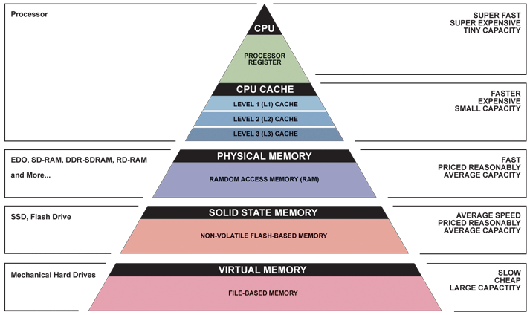
Great Idea #3: Principle of Locality/ Memory Hierarchy

Slide 3
Extended Review of Last Lecture
Why have caches?
Intermediate level between CPU and memory
In-between in size, cost, and speed
Memory (hierarchy, organization, structures) set up to exploit temporal and spatial locality
Temporal: If accessed, will access again soon
Spatial: If accessed, will access others around it
Caches hold a subset of memory (in blocks)
We are studying how they are designed for fast and efficient operation (lookup, access, storage)

Slide 4
Extended Review of Last Lecture
Fully Associative Caches:
Every block can go in any slot
Use random or LRU replacement policy when cache full
Memory address breakdown (on request)
Tag field is unique identifier (which block is currently in slot)
Offset field indexes into block (by bytes)
Each cache slot holds block data, tag, valid bit, and dirty bit (dirty bit is only for write-back)
The whole cache maintains LRU bits

Slide 5
Extended Review of Last Lecture
On memory access (read or write):
Look at ALL cache slots in parallel
If Valid bit is 0, then ignore (garbage)
If Valid bit is 1 and Tag matches, then use that data
On write, set Dirty bit if write-back

Slide 6
Extended Review of Last Lecture
2⁶ = 64 B address space
cache size (C)
block size (K)
Fully associative cache layout in our example
6-bit address space, 16-byte cache with 4-byte blocks
How many blocks do we have? C/K = 4 blocks
LRU replacement (2 bits), write-back and write allocate
Offset – 2 bits, Tag – 4 bits
Since this is write back, we’ll need a dirty bit
LRU bits
Need dirty bit
Offset
0
1
2
3
V | D | Tag | 00 | 01 | 10 | 11
X | X | XXXX | 0x?? | 0x?? | 0x?? | 0x??
X | X | XXXX | 0x?? | 0x?? | 0x?? | 0x??
X | X | XXXX | 0x?? | 0x?? | 0x?? | 0x??
X | X | XXXX | 0x?? | 0x?? | 0x?? | 0x??
V | Tag | 00 | 01 | 10 | 11
X | XXXX | 0x?? | 0x?? | 0x?? | 0x??
X | XXXX | 0x?? | 0x?? | 0x?? | 0x??
X | XXXX | 0x?? | 0x?? | 0x?? | 0x??
X | XXXX | 0x?? | 0x?? | 0x?? | 0x??
Slot
LRU
XX
Yesterday’s example was write through and looked like this

Slide 7
FA Cache Examples (3/4)
Consider the following addresses being requested:
0 2 2 0 16 20 8 4
Starting with a cold cache:
000000
000010
0
miss
2
hit
1 | 0000 | M[0] | M[1] | M[2] | M[3]
0 | 0000 | 0x?? | 0x?? | 0x?? | 0x??
0 | 0000 | 0x?? | 0x?? | 0x?? | 0x??
0 | 0000 | 0x?? | 0x?? | 0x?? | 0x??
1 | 0000 | M[0] | M[1] | M[2] | M[3]
0 | 0000 | 0x?? | 0x?? | 0x?? | 0x??
0 | 0000 | 0x?? | 0x?? | 0x?? | 0x??
0 | 0000 | 0x?? | 0x?? | 0x?? | 0x??
000010
000000
2
hit
0
hit
1 | 0000 | M[0] | M[1] | M[2] | M[3]
0 | 0000 | 0x?? | 0x?? | 0x?? | 0x??
0 | 0000 | 0x?? | 0x?? | 0x?? | 0x??
0 | 0000 | 0x?? | 0x?? | 0x?? | 0x??
1 | 0000 | M[0] | M[1] | M[2] | M[3]
0 | 0000 | 0x?? | 0x?? | 0x?? | 0x??
0 | 0000 | 0x?? | 0x?? | 0x?? | 0x??
0 | 0000 | 0x?? | 0x?? | 0x?? | 0x??

Slide 8
FA Cache Examples (3/4)
Consider the following addresses being requested:
0 2 2 0 16 20 8 4
Starting with a cold cache:
M H H H
010000
010100
16
miss
20
miss
1 | 0000 | M[0] | M[1] | M[2] | M[3]
0 | 0000 | 0x?? | 0x?? | 0x?? | 0x??
0 | 0000 | 0x?? | 0x?? | 0x?? | 0x??
0 | 0000 | 0x?? | 0x?? | 0x?? | 0x??
1 | 0000 | M[0] | M[1] | M[2] | M[3]
1 | 0100 | M[16] | M[17] | M[18] | M[19]
0 | 0000 | 0x?? | 0x?? | 0x?? | 0x??
0 | 0000 | 0x?? | 0x?? | 0x?? | 0x??
1 | 0000 | M[0] | M[1] | M[2] | M[3]
1 | 0100 | M[16] | M[17] | M[18] | M[19]
1 | 0101 | M[20] | M[21] | M[22] | M[23]
0 | 0000 | 0x?? | 0x?? | 0x?? | 0x??
1 | 0000 | M[0] | M[1] | M[2] | M[3]
1 | 0100 | M[16] | M[17] | M[18] | M[19]
0 | 0000 | 0x?? | 0x?? | 0x?? | 0x??
0 | 0000 | 0x?? | 0x?? | 0x?? | 0x??
001000
000100
8
miss
4
miss
1 | 0000 | M[0] | M[1] | M[2] | M[3]
1 | 0100 | M[16] | M[17] | M[18] | M[19]
1 | 0101 | M[20] | M[21] | M[22] | M[23]
0 | 0000 | 0x?? | 0x?? | 0x?? | 0x??
1 | 0000 | M[0] | M[1] | M[2] | M[3]
1 | 0100 | M[16] | M[17] | M[18] | M[19]
1 | 0101 | M[20] | M[21] | M[22] | M[23]
1 | 0010 | M[8] | M[9] | M[10] | M[11]
1 | 0000 | M[0] | M[1] | M[2] | M[3]
1 | 0100 | M[16] | M[17] | M[18] | M[19]
1 | 0101 | M[20] | M[21] | M[22] | M[23]
1 | 0010 | M[8] | M[9] | M[10] | M[11]
1 | 0000 | M[0] | M[1] | M[2] | M[3]
1 | 0100 | M[16] | M[17] | M[18] | M[19]
1 | 0101 | M[20] | M[21] | M[22] | M[23]
1 | 0010 | M[8] | M[9] | M[10] | M[11]
8 requests, 5 misses – ordering matters!
Notes:
Extra for experts:
Rearrange the same requests so that there are 5 misses and the final tags are (from top to bottom) 0b0000, 0b0011, 0b0001, 0b0100.
Is it possible for this same set of requests to produce fewer than 5 misses?

Slide 9
FA Cache Examples (4/4)
Original sequence, but double block size to 8B
0 2 4 8 20 16 0 2
Starting with a cold cache:
000000
0
0 | 000 | 0x?? | 0x?? | 0x?? | 0x?? | 0x?? | 0x?? | 0x?? | 0x??
0 | 000 | 0x?? | 0x?? | 0x?? | 0x?? | 0x?? | 0x?? | 0x?? | 0x??
1 | 000 | M[0] | M[1] | M[2] | M[3] | M[4] | M[5] | M[6] | M[7]
0 | 000 | 0x?? | 0x?? | 0x?? | 0x?? | 0x?? | 0x?? | 0x?? | 0x??
miss
000010
2
1 | 000 | M[0] | M[1] | M[2] | M[3] | M[4] | M[5] | M[6] | M[7]
0 | 000 | 0x?? | 0x?? | 0x?? | 0x?? | 0x?? | 0x?? | 0x?? | 0x??
hit
000100
4
1 | 000 | M[0] | M[1] | M[2] | M[3] | M[4] | M[5] | M[6] | M[7]
0 | 000 | 0x?? | 0x?? | 0x?? | 0x?? | 0x?? | 0x?? | 0x?? | 0x??
hit
001000
8
1 | 000 | M[0] | M[1] | M[2] | M[3] | M[4] | M[5] | M[6] | M[7]
0 | 000 | 0x?? | 0x?? | 0x?? | 0x?? | 0x?? | 0x?? | 0x?? | 0x??
1 | 000 | M[0] | M[1] | M[2] | M[3] | M[4] | M[5] | M[6] | M[7]
1 | 001 | M[8] | M[9] | M[10] | M[11] | M[12] | M[13] | M[14] | M[15]
miss

Slide 10
FA Cache Examples (4/4)
Original sequence, but double block size
0 2 4 8 20 16 0 2
Starting with a cold cache:
M H H M
010100
20
1 | 000 | M[0] | M[1] | M[2] | M[3] | M[4] | M[5] | M[6] | M[7]
1 | 001 | M[8] | M[9] | M[10] | M[11] | M[12] | M[13] | M[14] | M[15]
miss
010000
16
1 | 010 | M[16] | M[17] | M[18] | M[19] | M[20] | M[21] | M[22] | M[23]
1 | 001 | M[8] | M[9] | M[10] | M[11] | M[12] | M[13] | M[14] | M[15]
hit
000000
0
1 | 010 | M[16] | M[17] | M[18] | M[19] | M[20] | M[21] | M[22] | M[23]
1 | 001 | M[8] | M[9] | M[10] | M[11] | M[12] | M[13] | M[14] | M[15]
miss
000010
2
1 | 010 | M[16] | M[17] | M[18] | M[19] | M[20] | M[21] | M[22] | M[23]
1 | 000 | M[0] | M[1] | M[2] | M[3] | M[4] | M[5] | M[6] | M[7]
hit
8 requests, 4 misses – cache parameters matter!

Slide 11
Question:
Starting with the same cold cache as the first 3 examples, which of the sequences below will result in the final state of the cache shown here:
0
1
2
3
1 | 0000 | M[0] | M[1] | M[2] | M[3]
1 | 0011 | M[12] | M[13] | M[14] | M[15]
1 | 0001 | M[4] | M[5] | M[6] | M[7]
1 | 0100 | M[16] | M[17] | M[18] | M[19]
LRU
10
(A)
0 2 12 4 16 8 0 6
(B)
0 8 4 16 0 12 6 2
(C)
6 12 4 8 2 16 0 0
(D)
2 8 0 4 6 16 12 0

Slide 12

Question:
Starting with the same cold cache as the first 3 examples, which of the sequences below will result in the final state of the cache shown here:
0
1
2
3
1 | 0000 | M[0] | M[1] | M[2] | M[3]
1 | 0011 | M[12] | M[13] | M[14] | M[15]
1 | 0001 | M[4] | M[5] | M[6] | M[7]
1 | 0100 | M[16] | M[17] | M[18] | M[19]
LRU
10
(A)
0 2 12 4 16 8 0 6
(B)
0 8 4 16 0 12 6 2
(C)
6 12 4 8 2 16 0 0
(D)
2 8 0 4 6 16 12 0

Slide 13
Question:
Starting with the same cold cache as the first 3 examples, which of the sequences below will result in the final state of the cache shown here:
0
1
2
3
1 | 0000 | M[0] | M[1] | M[2] | M[3]
1 | 0011 | M[12] | M[13] | M[14] | M[15]
1 | 0001 | M[4] | M[5] | M[6] | M[7]
1 | 0100 | M[16] | M[17] | M[18] | M[19]
LRU
10
(A)
0 2 12 4 16 8 0 6
(B)
0 8 4 16 0 12 6 2
(C)
6 12 4 8 2 16 0 0
(D)
2 8 0 4 6 16 12 0

Slide 14
Memory Accesses
The picture so far:
CPU
Cache
hit
Addr
miss
data
Main Memory

Slide 15
Handling Write Hits
Write hits (D$)
Write-Through Policy: Always write data to cache and to memory (through cache)
Forces cache and memory to always be consistent
Slow! (every memory access is long)
Include a Write Buffer that updates memory in parallel with processor
Assume present in all schemes when writing to memory
Notes:
In a write-back cache, because we cannot overwrite the block (since we may not have a backup copy anywhere), stores either require two cycles (one to check for a hit, followed by one to actually do the write) or require a write buffer to hold that data (essentially pipelining the write).
By comparison, a write-through cache can always be done in one cycle assuming there is room in the write buffer. Read the tag and write the data in parallel. If the tag doesn’t match, the generate a write miss to fetch the rest of that block from the next level in the hierarchy (and update the tag field).

Slide 16
Handling Write Hits
Write hits (D$)
Write-Back Policy: Write data only to cache, then update memory when block is removed
Allows cache and memory to be inconsistent
Multiple writes collected in cache; single write to memory per block
Dirty bit: Extra bit per cache row that is set if block was written to (is “dirty”) and needs to be written back

Slide 17
Handling Cache Misses
Miss penalty grows as block size does
Read misses (I$ and D$)
Stall execution, fetch block from memory, put in cache, send requested data to processor, resume
Write misses (D$)
Always have to update block from memory
We have to make a choice:
Carry the updated block into cache or not?
Notes:
Write allocate almost always paired with write-back.

Slide 18
Write Allocate
Write Allocate policy: when we bring the block into the cache after a write miss
No Write Allocate policy: only change main memory after a write miss
Write allocate almost always paired with write-back
Eg: Accessing same address many times -> cache it
No write allocate typically paired with write-through
Eg: Infrequent/random writes -> don’t bother caching it
Notes:
Write allocate almost always paired with write-back.

Slide 19
Updated Cache Picture
Fully associative, write through
Same as our simplified examples from before
Fully associative, write back
Write miss procedure (write allocate or not) only affects behavior, not design
0
1
2
3
V | D | Tag | 00 | 01 | 10 | 11
X | X | XXXX | 0x?? | 0x?? | 0x?? | 0x??
X | X | XXXX | 0x?? | 0x?? | 0x?? | 0x??
X | X | XXXX | 0x?? | 0x?? | 0x?? | 0x??
X | X | XXXX | 0x?? | 0x?? | 0x?? | 0x??
Slot
LRU
XX

Slide 20
How do we use this thing?
Nothing changes from the programmer’s perspective
Still just issuing lw and sw instructions
The rest is handled in hardware:
Checking the cache
Extracting the data using the offset
Why should a programmer care?
Understanding cache parameters = faster programs

Slide 21
Agenda
Review of yesterday
Administrativia
Direct-Mapped Caches
Set Associative Caches
Cache Performance

Slide 22
Administrivia
HW5 due & Proj3-1 due Thursday!
Midterm 2 is Mon 7/31 9:30-11am in 155 Dwinelle again
Review Session Fri 7/28, 2-4pm in HP Auditorium (306 Soda)
2 Doubled-sided sheets of notes
Covers up through Parallel Computing (Next Tuesday’s lecture)

Slide 23
Direct-Mapped Caches (1/3)
Each memory block is mapped to exactly one slot in the cache (direct-mapped)
Every block has only one “home”
Use hash function to determine which slot
Comparison with fully associative
Check just one slot for a block (faster!)
No replacement policy necessary
Access pattern may leave empty slots in cache
Notes:
Check just one location to see if block is in cache.

Slide 24
Direct-Mapped Caches (2/3)
Offset field remains the same as before
Recall: blocks consist of adjacent bytes
Do we want adjacent blocks to map to same slot?
Index field: Apply hash function to block address to determine which slot the block goes in
(block address) modulo (# of blocks in the cache)
Tag field maintains same function (identifier), but is now shorter

Slide 25
TIO Address Breakdown
Memory address fields:
Meaning of the field sizes:
O bits ↔ 2^{O} bytes/block = 2^{O-2} words/block
I bits ↔ 2^{I} slots in cache = cache size / block size
T bits = A – I – O, where A = # of address bits (A = 32 here)
31
0
Tag
Index
Offset
T bits
I bits
O bits

Slide 26
Direct-Mapped Caches (3/3)
What’s actually in the cache?
Block of data (8 × K = 8 × 2^{O} bits)
Tag field of address as identifier (T bits)
Valid bit (1 bit)
Dirty bit (1 bit if write-back)
No replacement management bits!
Total bits in cache = # slots × (8×K + T + 1 + 1) = 2^{I} × (8×2^{O} + T + 1 + 1) bits

Slide 27
DM Cache Example (1/5)
Cache parameters:
Direct-mapped, address space of 64B, block size of 4B, cache size of 16B, write-through
TIO Breakdown:
O = log₂(4) = 2
Cache size / block size = 16/4 = 4, so I = log₂(4) = 2
A = log₂(64) = 6 bits, so T = 6 – 2 – 2 = 2
Bits in cache = 2² × (8×2² + 2 + 1) = 140 bits
Memory Addresses:
XX
XX
XX
Block address
Notes:
Compare with fully associative example from last lecture. This takes 140 bits to implement instead of 150 bits because of shorter Tag and no LRU bits.

Slide 28
DM Cache Example (2/5)
Cache parameters:
Direct-mapped, address space of 64B, block size of 4B, cache size of 16B, write-through
Offset – 2 bits, Index – 2 bits, Tag – 2 bits
35 bits per index/slot, 140 bits to implement
Offset
00
01
10
11
V | Tag | 00 | 01 | 10 | 11
X | XX | 0x?? | 0x?? | 0x?? | 0x??
X | XX | 0x?? | 0x?? | 0x?? | 0x??
X | XX | 0x?? | 0x?? | 0x?? | 0x??
X | XX | 0x?? | 0x?? | 0x?? | 0x??
Index

Slide 29
DM Cache Example (3/5)
Main Memory:
0000xx
0001xx
0010xx
0011xx
0100xx
0101xx
0110xx
0111xx
1000xx
1001xx
1010xx
1011xx
1100xx
1101xx
1110xx
1111xx
Which blocks map to each row of the cache?
(see colors)
On a memory request: (let’s say 001011_{two})
1) Take Index field (10)
2) Check if Valid bit is true in that row of cache
3) If valid, then check if Tag matches
Which blocks map to each row of the cache?
(see colors)
Cache:
Index
Valid
Tag
Data
00
01
10
11
Cache slots exactly match the Index field
Main Memory shown in blocks, so offset bits not shown (x’s)

Slide 30
DM Cache Example (4/5)
Consider the sequence of memory address accesses
0 2 4 8 20 16 0 2
Starting with a cold cache:
000000
000010
0
miss
2
hit
00
01
10
11
0 | 00 | 0x?? | 0x?? | 0x?? | 0x??
0 | 00 | 0x?? | 0x?? | 0x?? | 0x??
0 | 00 | 0x?? | 0x?? | 0x?? | 0x??
0 | 00 | 0x?? | 0x?? | 0x?? | 0x??
1 | 00 | M[0] | M[1] | M[2] | M[3]
0 | 00 | 0x?? | 0x?? | 0x?? | 0x??
0 | 00 | 0x?? | 0x?? | 0x?? | 0x??
0 | 00 | 0x?? | 0x?? | 0x?? | 0x??
00
01
10
11
1 | 00 | M[0] | M[1] | M[2] | M[3]
0 | 00 | 0x?? | 0x?? | 0x?? | 0x??
0 | 00 | 0x?? | 0x?? | 0x?? | 0x??
0 | 00 | 0x?? | 0x?? | 0x?? | 0x??
000100
001000
4
miss
8
miss
00
01
10
11
1 | 00 | M[0] | M[1] | M[2] | M[3]
0 | 00 | 0x?? | 0x?? | 0x?? | 0x??
0 | 00 | 0x?? | 0x?? | 0x?? | 0x??
0 | 00 | 0x?? | 0x?? | 0x?? | 0x??
1 | 00 | M[0] | M[1] | M[2] | M[3]
1 | 00 | M[4] | M[5] | M[6] | M[7]
0 | 00 | 0x?? | 0x?? | 0x?? | 0x??
0 | 00 | 0x?? | 0x?? | 0x?? | 0x??
00
01
10
11
1 | 00 | M[0] | M[1] | M[2] | M[3]
1 | 00 | M[4] | M[5] | M[6] | M[7]
0 | 00 | 0x?? | 0x?? | 0x?? | 0x??
0 | 00 | 0x?? | 0x?? | 0x?? | 0x??
1 | 00 | M[0] | M[1] | M[2] | M[3]
1 | 00 | M[4] | M[5] | M[6] | M[7]
1 | 00 | M[8] | M[9] | M[10] | M[11]
0 | 00 | 0x?? | 0x?? | 0x?? | 0x??

Slide 31
DM Cache Example (5/5)
Consider the sequence of memory address accesses
0 2 4 8 20 16 0 2
Starting with a cold cache:
010100
010000
20
miss
16
miss
00
01
10
11
1 | 00 | M[0] | M[1] | M[2] | M[3]
1 | 00 | M[4] | M[5] | M[6] | M[7]
1 | 00 | M[8] | M[9] | M[10] | M[11]
0 | 00 | 0x?? | 0x?? | 0x?? | 0x??
00
01
10
11
1 | 00 | M[0] | M[1] | M[2] | M[3]
1 | 01 | M[20] | M[21] | M[22] | M[23]
1 | 00 | M[8] | M[9] | M[10] | M[11]
0 | 00 | 0x?? | 0x?? | 0x?? | 0x??
000000
000010
0
miss
2
hit
00
01
10
11
1 | 01 | M[16] | M[17] | M[18] | M[19]
1 | 01 | M[20] | M[21] | M[22] | M[23]
1 | 00 | M[8] | M[9] | M[10] | M[11]
0 | 00 | 0x?? | 0x?? | 0x?? | 0x??
00
01
10
11
1 | 00 | M[0] | M[1] | M[2] | M[3]
1 | 01 | M[20] | M[21] | M[22] | M[23]
1 | 00 | M[8] | M[9] | M[10] | M[11]
0 | 00 | 0x?? | 0x?? | 0x?? | 0x??
8 requests, 6 misses – last slot was never used!

Slide 32
Worst-Case for Direct-Mapped
Cold DM $ that holds four 1-word blocks
Consider the memory accesses: 0, 16, 0, 16,...
000000 010000 000000
HR of 0%
Ping pong effect: alternating requests that map into the same cache slot
Does fully associative have this problem?
0
Miss
16
Miss
0
Miss
00 M[0-3]
00 M[0-3]
01 M[16-19]
. . .

Slide 33
Comparison So Far
Fully associative
Block can go into any slot
Must check ALL cache slots on request (“slow”)
TO breakdown (i.e. I = 0 bits)
“Worst case” still fills cache (more efficient)
Direct-mapped
Block goes into one specific slot (set by Index field)
Only check ONE cache slot on request (“fast”)
TIO breakdown
“Worst case” may only use 1 slot (less efficient)

Slide 34




Meet The $taff
 | Rebecca | Steven
Go-to phone app | Duolingo | Pokemon Go
Catch Phrase | ANOTHER MUX!!! | cool beanz, rad sauce
Spirit Emoji | (cache, not cash) | 💁, 💩, 🙅
Binge Show | The Good Place | Bob's Burgers

Slide 35
Agenda
Review of yesterday
Administrivia
Direct-Mapped Caches
Set Associative Caches
Cache Performance

Slide 36
Set Associative Caches
Compromise!
More flexible than DM, more structured than FA
N-way set-associative: Divide $ into sets, each of which consists of N slots
Memory block maps to a set determined by Index field and is placed in any of the N slots of that set
Call N the associativity
New hash function: (block address) modulo (# sets in the cache)
Replacement policy applies to every set
Notes:
All of the tags of all of the elements of the set must be searched for a match.

Slide 37
Effect of Associativity on TIO (1/2)
Here we assume a cache of fixed size (C)
Offset: # of bytes in a block (same as before)
Index: Instead of pointing to a slot, now points to a set, so I = log₂(C÷K÷N)
Fully associative (1 set): 0 Index bits!
Direct-mapped (N = 1): max Index bits
Set associative: somewhere in-between
Tag: Remaining identifier bits (T = A – I – O)
Notes:
C = cache size, B = block size

Slide 38
Effect of Associativity on TIO (2/2)
For a fixed-size cache, each increase by a factor of two in associativity doubles the number of blocks per set (i.e. the number of slots) and halves the number of sets – decreasing the size of the Index by 1 bit and increasing the size of the Tag by 1 bit
Used for tag comparison
Selects the set
Selects the word in the block
Tag
Index
Block offset
Byte offset
Increasing associativity
Decreasing associativity
Fully associative
(only one set)
Direct mapped
(only one way)
Notes:
For lecture
In 2008, the greater size and power consumption of CAMs generally leads to 2-way and 4-way set associativity being built from standard SRAMs with comparators with 8-way and above being built using CAMs

Slide 39
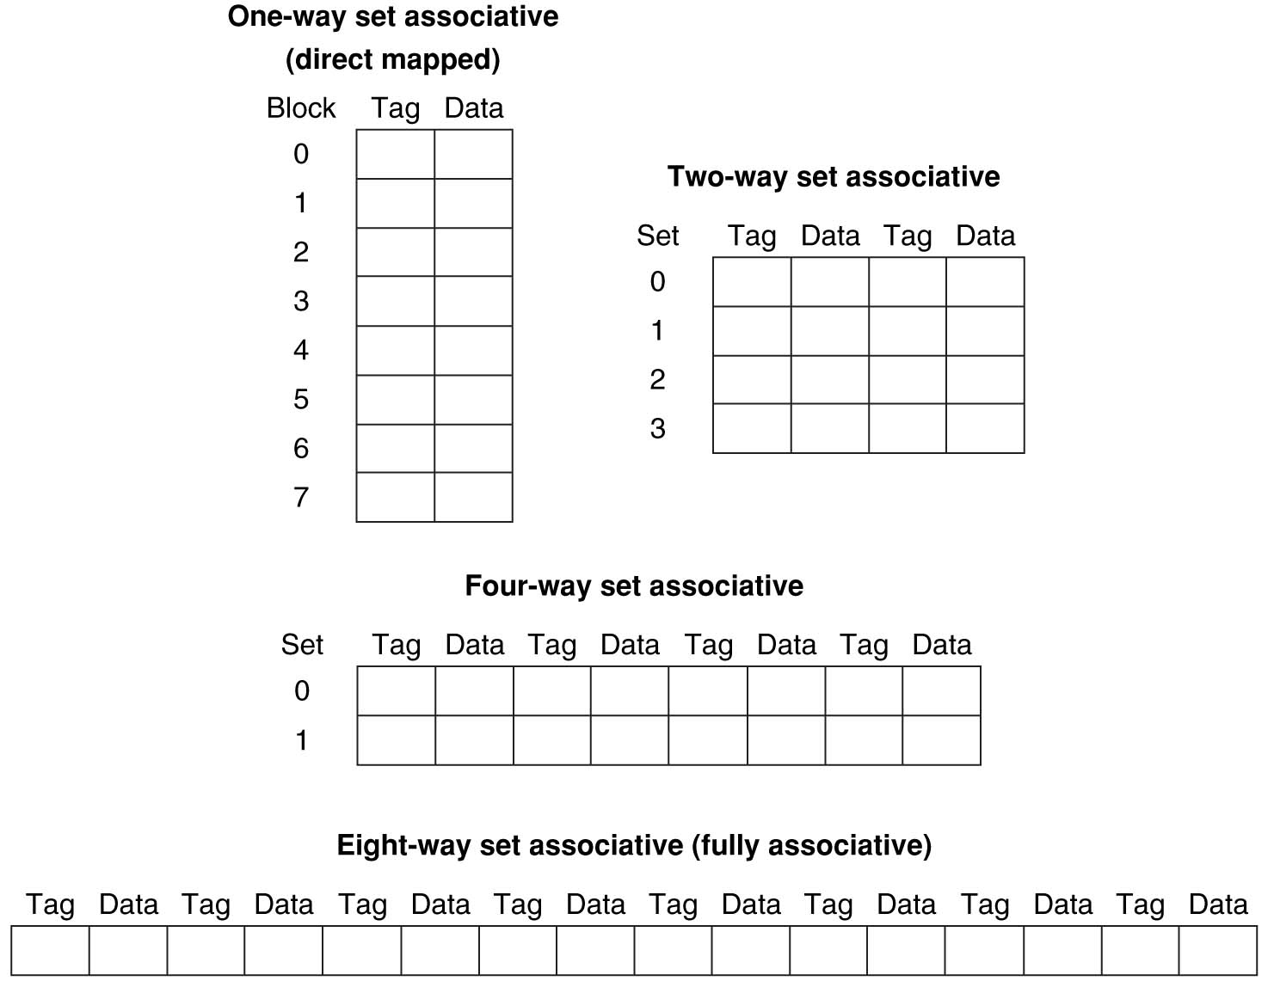
Example: Eight-Block Cache Configs
Total size of $ = # sets × associativity
For fixed $ size, associativity ↑ means # sets ↓ and slots per set ↑
With 8 blocks, an 8-way set associative $ is same as a fully associative $

Slide 40
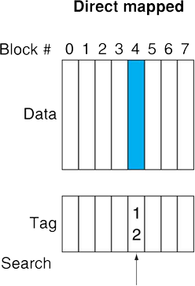
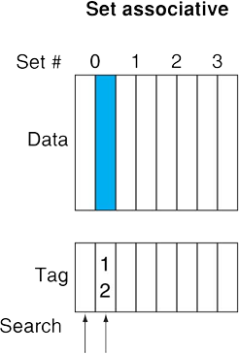
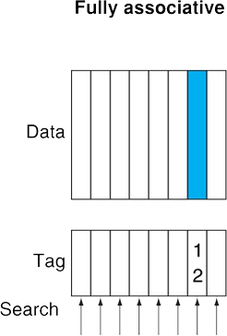
Block Placement Schemes
Place memory block 12 in a cache that holds 8 blocks
Fully associative: Can go in any of the slots (all 1 set)
Direct-mapped: Can only go in slot (12 mod 8) = 4
2-way set associative: Can go in either slot of set (12 mod 4) = 0

Slide 41
SA Cache Example (1/5)
Cache parameters:
2-way set associative, 6-bit addresses, 1-word blocks, 4-word cache, write-through
How many sets?
C÷K÷N = 4÷1÷2 = 2 sets
TIO Breakdown:
O = log₂(4) = 2, I = log₂(2) = 1, T = 6 – 1 – 2 = 3
Memory Addresses:
XXX
X
XX
Block address

Slide 42
SA Cache Example (2/5)
Cache parameters:
2-way set associative, 6-bit addresses, 1-word blocks, 4-word cache, write-through
Offset – 2 bits, Index – 1 bit, Tag – 3 bits
37 bits per slot, 37*2 = 74 bits per set, 2*74 = 148 bits to implement
Offset
0
1
 | 0
 | 1
 | 0
 | 1
V | Tag | 00 | 01 | 10 | 11
X | XXX | 0x?? | 0x?? | 0x?? | 0x??
X | XXX | 0x?? | 0x?? | 0x?? | 0x??
X | XXX | 0x?? | 0x?? | 0x?? | 0x??
X | XXX | 0x?? | 0x?? | 0x?? | 0x??
LRU
X
Index
LRU
X

Slide 43
SA Cache Example (3/5)
Main Memory:
0000xx
0001xx
0010xx
0011xx
0100xx
0101xx
0110xx
0111xx
1000xx
1001xx
1010xx
1011xx
1100xx
1101xx
1110xx
1111xx
Each block maps into one set (either slot)
(see colors)
Cache:
Set
Slot
V
Tag
Data
0
0
1
On a memory request: (let’s say 001011_{two})
1) Take Index field (0)
2) For EACH slot in set,
check valid bit,
then compare Tag
0
1
1
Set numbers exactly match the Index field
Main Memory shown in blocks, so offset bits not shown (x’s)

Slide 44
SA Cache Example (4/5)
Consider the sequence of memory address accesses
0 2 4 8 20 16 0 2
Starting with a cold cache:
000000
000010
0
miss
2
hit
0
1
0
1
0
1
0 | 000 | 0x?? | 0x?? | 0x?? | 0x??
0 | 000 | 0x?? | 0x?? | 0x?? | 0x??
0 | 000 | 0x?? | 0x?? | 0x?? | 0x??
0 | 000 | 0x?? | 0x?? | 0x?? | 0x??
1 | 000 | M[0] | M[1] | M[2] | M[3]
0 | 000 | 0x?? | 0x?? | 0x?? | 0x??
0 | 000 | 0x?? | 0x?? | 0x?? | 0x??
0 | 000 | 0x?? | 0x?? | 0x?? | 0x??
0
1
0
1
0
1
1 | 000 | M[0] | M[1] | M[2] | M[3]
0 | 000 | 0x?? | 0x?? | 0x?? | 0x??
0 | 000 | 0x?? | 0x?? | 0x?? | 0x??
0 | 000 | 0x?? | 0x?? | 0x?? | 0x??
000100
001000
4
miss
8
miss
0
1
0
1
0
1
1 | 000 | M[0] | M[1] | M[2] | M[3]
0 | 000 | 0x?? | 0x?? | 0x?? | 0x??
0 | 000 | 0x?? | 0x?? | 0x?? | 0x??
0 | 000 | 0x?? | 0x?? | 0x?? | 0x??
1 | 000 | M[0] | M[1] | M[2] | M[3]
0 | 000 | 0x?? | 0x?? | 0x?? | 0x??
1 | 000 | M[4] | M[5] | M[6] | M[7]
0 | 000 | 0x?? | 0x?? | 0x?? | 0x??
0
1
0
1
0
1
1 | 000 | M[0] | M[1] | M[2] | M[3]
0 | 000 | 0x?? | 0x?? | 0x?? | 0x??
1 | 000 | M[4] | M[5] | M[6] | M[7]
0 | 000 | 0x?? | 0x?? | 0x?? | 0x??
1 | 000 | M[0] | M[1] | M[2] | M[3]
1 | 001 | M[8] | M[9] | M[10] | M[11]
1 | 000 | M[4] | M[5] | M[6] | M[7]
0 | 000 | 0x?? | 0x?? | 0x?? | 0x??

Slide 45
SA Cache Example (5/5)
Consider the sequence of memory address accesses
0 2 4 8 20 16 0 2
Starting with a cold cache:
M H M M
010100
010000
20
miss
16
miss
0
1
0
1
0
1
1 | 000 | M[0] | M[1] | M[2] | M[3]
1 | 001 | M[8] | M[9] | M[10] | M[11]
1 | 000 | M[4] | M[5] | M[6] | M[7]
0 | 000 | 0x?? | 0x?? | 0x?? | 0x??
1 | 000 | M[0] | M[1] | M[2] | M[3]
1 | 001 | M[8] | M[9] | M[10] | M[11]
1 | 000 | M[4] | M[5] | M[6] | M[7]
1 | 010 | M[20] | M[21] | M[22] | M[23]
0
1
0
1
0
1
1 | 000 | M[0] | M[1] | M[2] | M[3]
1 | 001 | M[8] | M[9] | M[10] | M[11]
1 | 000 | M[4] | M[5] | M[6] | M[7]
1 | 010 | M[20] | M[21] | M[22] | M[23]
000000
000010
0
miss
2
hit
0
1
0
1
0
1
1 | 010 | M[16] | M[17] | M[18] | M[19]
1 | 001 | M[8] | M[9] | M[10] | M[11]
1 | 000 | M[4] | M[5] | M[6] | M[7]
1 | 010 | M[20] | M[21] | M[22] | M[23]
0
1
0
1
0
1
1 | 010 | M[16] | M[17] | M[18] | M[19]
1 | 000 | M[0] | M[1] | M[2] | M[3]
1 | 000 | M[4] | M[5] | M[6] | M[7]
1 | 010 | M[20] | M[21] | M[22] | M[23]
8 requests, 6 misses

Slide 46
Worst Case for Set Associative
Worst case for DM was repeating pattern of 2 into same cache slot (HR = 0/n)
Set associative for N > 1: HR = (n-2)/n
Worst case for N-way SA with LRU?
Repeating pattern of at least N+1 that maps into same set
Back to HR = 0:
0, 8, 16, 0, 8, …
M
M
M
M
M
001 M[8-11]
010 M[16-19]
000 M[0-3]
001 M[8-11]
000 M[0-3]
Notes:
For lecture
Another sample string to try 0 1 2 3 0 8 11 0 3

Slide 47
Question: What is the TIO breakdown for the following cache?
32-bit address space
32 KiB 4-way set associative cache
8 word blocks
A = 32, C = 32 KiB = 2¹⁵ B, N = 4, K = 8 words = 32 B
T I O
O = log₂(K) = 5 bits
C/K = 2¹⁰ slots
C/K/N = 2⁸ sets
I = log₂(C/K/N) = 8 bits
T = A – I – O = 19 bits
(A)
21 8 3
(B)
19 8 5
(C)
19 10 3
(D)
17 10 5

Slide 48
Summary
Set associativity determines flexibility of block placement
Fully associative: blocks can go anywhere
Direct-mapped: blocks go in one specific location
N-way: cache split into sets, each of which have n slots to place memory blocks

