Slide 1
Multilevel Caches, Cache Question
Instructor: Steven Ho

Slide 2
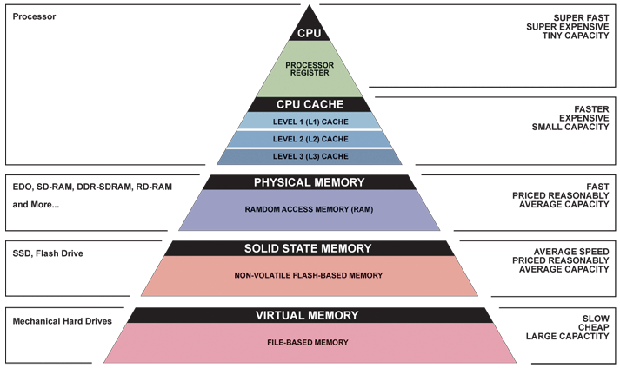
Great Idea #3: Principle of Locality/ Memory Hierarchy

Slide 3
Review of Last Lecture
Direct-Mapped Caches:
Use hash function to determine location for block
Each block maps into a single row
(block address) modulo (# of slots in the cache)
N-way Set Associative Caches:
Split slots into sets of size N, map into set
(block address) modulo (# of sets in the cache)
TIO breakdown of memory address
Index field is result of hash function (which set)
Tag field is identifier (which block is currently in slot)
Offset field indexes into block

Slide 4
Question: How many total bits are stored in the following cache?
4-way SA cache, random replacement
Cache size 1 KiB, Block size 16 B
Write-back
16-bit address space
(A)
2⁶ × (2⁷ + 2³ + 2¹) = 8.625 Kib
(B)
2⁴ × (2⁷ + 2³ + 2⁰) = 2.140625 Kib
(C)
2⁴ × (2⁷ + 2³ + 2¹) = 2.15625 Kib
(D)
2⁴ × (2⁷ + 6 + 2¹) = 2.125 Kib

Slide 5
Question: How many total bits are stored in the following cache?
4-way SA cache, random replacement
Cache size 1 KiB, Block size 16 B
Write-back dirty bit
16-bit address space
# slots?
# bits per slot?
data?
tag?
valid?
dirty?
(A)
2⁶ × (2⁷ + 2³ + 2¹) = 8.625 Kib
(B)
2⁴ × (2⁷ + 2³ + 2⁰) = 2.140625 Kib
(C)
2⁴ × (2⁷ + 2³ + 2¹) = 2.15625 Kib
(D)
2⁴ × (2⁷ + 6 + 2¹) = 2.125 Kib

Slide 6
Question: How many total bits are stored in the following cache?
4-way SA cache, random replacement
Cache size 1 KiB, Block size 16 B
Write-back
16-bit address space
# slots?
2¹⁰B ÷ 2⁴B
= 2⁶ slots
In each slot:
Data: 16B * 8 bits per byte = 128 bits = 2⁷
Tag?
T I O:
O: log₂(16) = 4
I: 2⁶ slots / 4 ways = 2⁴ sets so I = 4
T = 16 - 4 - 4 = 8 = 2^3 bits
Valid and dirty: 2
(A)
2⁶ × (2⁷ + 2³ + 2¹) = 8.625 Kib
(B)
2⁴ × (2⁷ + 2³ + 2⁰) = 2.140625 Kib
(C)
2⁴ × (2⁷ + 2³ + 2¹) = 2.15625 Kib
(D)
2⁴ × (2⁷ + 6 + 2¹) = 2.125 Kib

Slide 7
Cache Performance
Two things hurt the performance of a cache:
Miss rate and miss penalty
Average Memory Access Time (AMAT): average time to access memory considering both hits and misses
AMAT = Hit time + Miss rate × Miss penalty
(abbreviated AMAT = HT + MR × MP)
Goal 1: Examine how changing the different cache parameters affects our AMAT
Goal 2: Examine how to optimize your code for better cache performance (Project 4)

Slide 8
AMAT Example
Processor specs: 200 ps clock, MP of 50 clock cycles, MR of 0.02 misses/instruction, and HT of 1 clock cycle
AMAT = ???
Which improvement would be best?
190 ps clock
MP of 40 clock cycles
MR of 0.015 misses/instruction
+ 0.02
1
× 50 = 2 clock cycles = 400 ps
380 ps
360 ps
350 ps

Slide 9
Cache Parameter Example
What is the potential impact of much larger cache on AMAT? (same block size)
Increase HR
Longer HT: smaller is faster
At some point, increase in hit time for a larger cache may overcome the improvement in hit rate, yielding a decrease in performance

Slide 10
Sources of Cache Misses: The 3Cs
Compulsory: (Many names: cold start, process migration (switching processes), 1st reference)
First access to block impossible to avoid; Effect is small for long running programs
Capacity:
Cache cannot contain all blocks accessed by the program, so full associativity won’t hold all blocks
Conflict: (collision)
Multiple memory locations mapped to the same cache location, so theres a lack of associativity

Slide 11
The 3Cs: Design Solutions
Compulsory:
Increase block size (increases MP; too large blocks could increase MR)
Capacity:
Increase cache size (may increase HT)
Conflict:
Increase associativity (to fully associative) (may increase HT)

Slide 12
Review
Cache performance measured using AMAT
Parameters that matter:
Hit Time (HT)
Miss Rate (MR)
Miss Penalty (MP)
AMAT = Hit Time + Miss Rate x Miss Penalty
The 3 Cs of cache misses and their fixes
Compulsory: Increase block size
Capacity: Increase cache size
Conflict: Make the cache fully associative

Slide 13
Agenda
Multilevel Caches
Administrivia
Improving Cache Performance
Anatomy of a Cache Question
Example Cache Questions
Bonus: Contemporary Cache Specs

Slide 14
Multiple Cache Levels
With advancing technology, have more room on chip for bigger L1 caches and for L2 (and in some cases even L3) cache
Normally lower-level caches are unified (i.e. holds both instructions and data)
Multilevel caching is a way to reduce miss penalty
So what does this look like?

Slide 15
Multilevel Cache Diagram
Legend:
Request for data
Return of data
Main Memory
L2$
L1$
CPU
Memory
Access
Miss
Miss
.
.
.
Return
Hit
Hit
Store
Store
Path of data back to CPU
If Write Allocate
Notes:
The stores back in higher-level caches depends on your write-miss policy (write allocate or no-write allocate).

Slide 16
Multilevel Cache AMAT
AMAT = L1 HT + L1 MR × L1 MP
Now L1 MP depends on other cache levels
L1 MP = L2 HT + L2 MR × L2 MP
If more levels, then continue this chain (i.e. MP_{i} = HT_{i+1} + MR_{i+1} × MP_{i+1})
Final MP is main memory access time
For two levels:
AMAT = L1 HT + L1 MR × (L2 HT + L2 MR × L2 MP)

Slide 17
Multilevel Cache AMAT Example
Processor specs: 1 cycle L1 HT, 2% L1 MR, 5 cycle L2 HT, 5% L2 MR, 100 cycle main memory HT
Here assuming unified L1$
Without L2$:
AMAT₁ = 1 + 0.02 × 100 = 3
With L2$:
AMAT₂ = 1 + 0.02 × (5 + 0.05 × 100) = 1.2

Slide 18
Local vs. Global Miss Rates
Local miss rate: Fraction of references to one level of a cache that miss
e.g. L2$ local MR = L2$ misses/L1$ misses
Specific to level of caching (as used in AMAT)
Global miss rate: Fraction of all references that miss in all levels of a multilevel cache
Property of the overall memory hierarchy
Global MR is the product of all local MRs
Start at Global MR = L_{n} misses/L_{n-1} accesses all multiplied together
So by definition, global MR ≤ any local MR
Notes:
L1$ misses are the only requests that reach L2$

Slide 19
Memory Hierarchy with Two Cache Levels
1000 mem refs
40 mem refs
20 mem refs
CPU
L1$
L2$
MM
1 cycle
10 cycles
100 cycles
For every 1000 CPU-to-memory references
40 will miss in L1$; what is the local MR?
20 will miss in L2$; what is the local MR?
Overall global miss rate?
0.04
0.5
0.02

Slide 20
Rewriting Performance
For a two level cache, we know: MR_{global} = L1 MR × L2 MR
AMAT:
AMAT = L1 HT + L1 MR × (L2 HT + L2 MR × L2 MP)
AMAT = L1 HT + L1 MR × L2 HT + MR_{global} × L2 MP
Aside: Sometimes might have to convert between global and local MR
L2 Global MR = L2 Local MR × L1 MR
L2 Local MR = L2 Global MR ÷ L1 MR
Notes:
AMAT and CPI calculated differently.
AMAT is a direct substitution, where L1 MP = L2 HT + L2 MR * L2 MP.
CPI_{stall} calculates memory-stall cycles, so is additive (HT is hidden away in CPI_{base}).

Slide 21
Design Considerations
L1$ focuses on low hit time (fast access)
minimize HT to achieve shorter clock cycle
L1 MP significantly reduced by presence of L2$, so can be smaller/faster even with higher MR
e.g. smaller $ (fewer rows)
L2$, L3$ focus on low miss rate
As much as possible avoid reaching to main memory (heavy penalty)
e.g. larger $ with larger block sizes (same # rows)

Slide 22
Multilevel Cache Practice (1/3)
Processor specs:
L1$ and L2$
5 cycle L1$ hit time and 4% L1$ miss rate
100 cycle penalty to go to main memory
0.5% L2$ global miss rate
25 cycle penalty to go to L2$
What is AMAT?

Slide 23
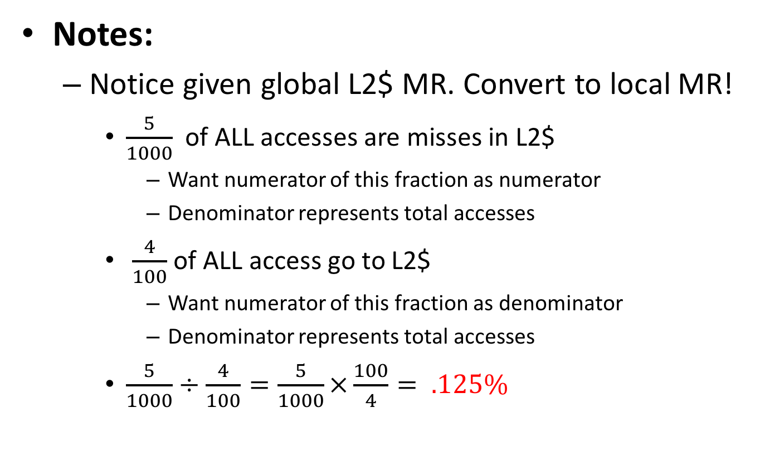
Multilevel Cache Practice (2/3)
L2 Local MR = L2 Global MR ÷ L1 MR

Slide 24
Multilevel Cache Practice (3/3)
Without L2$:
AMAT = (5 + 0.04×100)
= 9 cycles
With L2$:
AMAT = HT_{L1$} + MR_{L1$} × (HT_{L2$} + MR_{L2$} × MP_{L2$})
= 5 + .04 × ( 25 + .125 × 100)
= 6.5 cycles

Slide 25
Agenda
Multilevel Caches
Administrivia
Improving Cache Performance
Anatomy of a Cache Question
Example Cache Questions
Bonus: Contemporary Cache Specs

Slide 26
Administrivia
HW5 (Caches) and Proj3-1 due Thursday
Good midterm practice!
Midterm 2: Mon 7/31
Rebecca and I have moved our office to 329 Soda instead of 783 Soda until ceiling fixed
We are always available by appointment!
Rebecca has no office hours today!
Reward for reporting project solutions
Every solution you report lowers grade bins 1 pt!!
Complete Mid-Semester Survey asap!
We’re planning a game night on Friday

Slide 27
Agenda
Multilevel Caches
Administrivia
Improving Cache Performance
Anatomy of a Cache Question
Example Cache Questions
Bonus: Contemporary Cache Specs

Slide 28
Improving Cache Performance (1/2)
Reduce the Hit Time of the cache
Smaller cache (less to search/check)
Smaller blocks (faster to return selected data)
Reduce the Miss Rate
Bigger cache (capacity)
Larger blocks (compulsory & spatial locality)
Increased associativity (conflict)

Slide 29
Improving Cache Performance (2/2)
Reduce the Miss Penalty
Smaller blocks (less to move)
Use multiple cache levels
Use a write buffer

Slide 30
The Cache Design Space
Several interacting dimensions
Cache parameters:
Cache size, Block size, Associativity
Policy choices:
Write-through vs. write-back
Replacement policy
Optimal choice is a compromise
Depends on access characteristics
Workload and use (I$, D$)
Depends on technology / cost
Simplicity often wins
Cache Size
(Associativity)
Block Size
Bad
Good
Factor A
Factor B
Less
More
Notes:
No fancy replacement policy is needed for the direct mapped cache.
As a matter of fact, that is what cause direct mapped trouble to begin with: only one place to go in the cache--causes conflict misses.

Slide 31
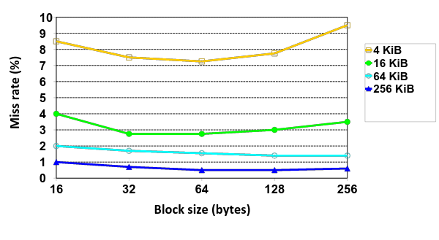
Effect of Block and Cache Sizes on Miss Rate
Cache Size
Miss rate goes up if the block size becomes a significant fraction of the cache size because the number of blocks that can be held in the same size cache is smaller (increasing capacity misses)
Notes:
Increasing the block size usually decreases the miss rate.
A more serious problem is that the miss penalty goes up since it is primarily determined by the time to fetch the block from the next lower level of the hierarchy and load it into the cache.

Slide 32
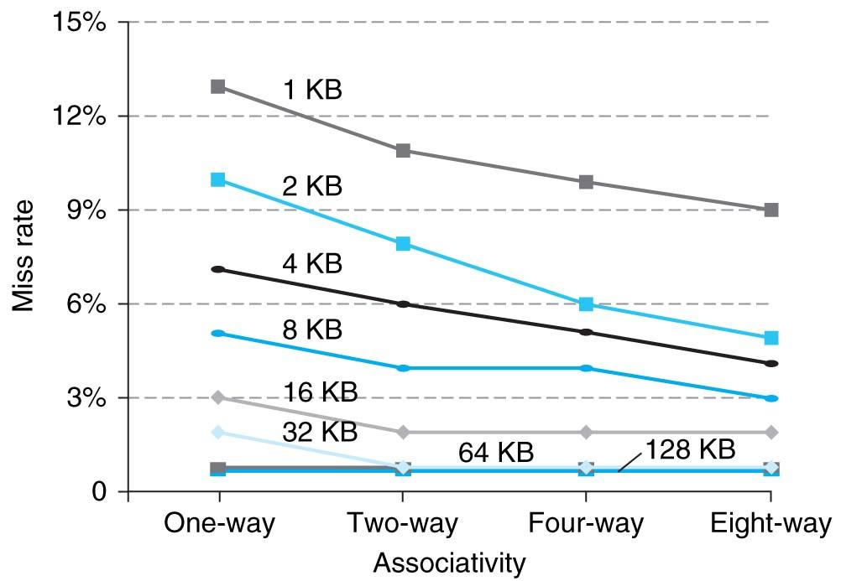
Benefits of Set-Associative Caches
Consider cost of a miss vs. cost of implementation
Largest gains are in going from direct mapped to 2-way (20%+ reduction in miss rate)
Notes:
As cache sizes grow, the relative improvement from associativity increases only slightly; since the overall miss rate of a larger cache is lower, the opportunity for improving the miss rate decreases and the absolute improvement in miss rate from associativity shrinks significantly.

Slide 33
Agenda
Multilevel Caches
Administrivia
Improving Cache Performance
Anatomy of a Cache Question
Example Cache Questions
Bonus: Contemporary Cache Specs

Slide 34
Anatomy of a Cache Question
Cache questions come in a few flavors:
TIO Breakdown
For fixed cache parameters, analyze the performance of the given code/sequence
For fixed cache parameters, find best/worst case scenarios
For given code/sequence, how does changing your cache parameters affect performance?
AMAT

Slide 35
The Cache
What are the important cache parameters?
Must figure these out from problem description
Address size, cache size, block size, associativity, replacement policy
Solve for TIO breakdown, # of sets, set size
Are there multiple levels?
Mostly applies to AMAT questions
What starts in the cache?
Not always specified (best/worst case)

Slide 36
Code: Arrays
Elements stored sequentially in memory
Ideal for spatial locality
Different arrays not necessarily next to each other
Remember to account for data size!
char is 1 byte, int is 4 bytes
Pay attention to access pattern
Touch all elements (e.g. shift, sum)
Touch some elements (e.g. histogram, stride)
How many times do we touch each element?

Slide 37
Code: Linked Lists/Structs
Nodes stored separately in memory
Addresses of nodes may be very different
Type and ordering of linking is important
Remember to account for size/ordering of struct elements
Pay attention to access pattern
Generally must start from “head”
How many struct elements are touched?

Slide 38
Access Patterns
How many hits within a single block once it is loaded into cache?
Will block still be in cache when you revisit its elements?
Are there special/edge cases to consider?
Usually edge of block boundary or edge of cache size boundary

Slide 39
Best/Worst Case
Set Associative (including Fully Associative)
Best: All accessed blocks fit into cache/set
Worst: Block is replaced before you access again
Direct-Mapped
Best: Accessed blocks go into different slots
Worst: Constant conflict misses

Slide 40




Get To Know Your Staff
 | Zubair | Derek
Go-to phone app | Math Workout, Flying Drizzy, Venmo | 7 words | Spotify
Catch Phrase | ayy lmao, rip, rekt | punk, "thank you" to any compliment (esp not to me)
Spirit Emoji | 💩👅 *shudders* | 🙃🙃🙃
Binge Show | The Office | Game of Thrones

Slide 41
Agenda
Multilevel Caches
Administrivia
Improving Cache Performance
Anatomy of a Cache Question
Example Cache Questions
Bonus: Contemporary Cache Specs

Slide 42
Example 1 (Sp07 Final)
1 GiB address space, 100 cycles to go to memory. Fill in the following table:
 | L1 | L2
Cache Size | 32 KiB | 512 KiB
Block Size | 8 B | 32 B
Associativity | 4-way | Direct-mapped
Hit Time | 1 cycle | 33 cycles
Miss Rate | 10% | 2%
Write Policy | Write-through | Write-through
Replacement Policy | LRU | n/a
Tag
Index
Offset
AMAT
17
11
10
14
3
5
AMAT L1 = 1 + 0.1 * 35 = 4.5
AMAT L2 = 33 + 0.02 * 100 = 35

Slide 43
Example 1 (Sp07 Final)
Only use L1$: C = 32 KiB, K = 8 B, N = 4, LRU, write-through
char A[] is block aligned and SIZE = 32 MiB
char *A = (char *) malloc (SIZE*sizeof(char));
/* number of STRETCHes */
for (i = 0; i < (SIZE/STRETCH); i++) {
/* go up to STRETCH */
for(j=0;j<STRETCH;j++) sum += A[i*STRETCH+j];
/* down from STRETCH */
for(j=STRETCH-1;j>=0;j--) prod += A[i*STRETCH+j];
}
2nd inner for loop hits same indices as 1st inner for loop, but in reverse order
Always traverse full SIZE, regardless of STRETCH

Slide 44
Example 1 (Sp07 Final)
Only use L1$: C = 32 KiB, K = 8 B, N = 4, LRU, write-through
char A[] is block aligned and SIZE = 32 MiB
char *A = (char *) malloc (SIZE*sizeof(char));
for (i = 0; i < (SIZE/STRETCH); i++) {
for(j=0;j<STRETCH;j++) sum += A[i*STRETCH+j];
for(j=STRETCH-1;j>=0;j++) prod += A[i*STRETCH+j];
}
As we double our STRETCH from 1 to 2 to 4 (…etc), we notice the number of cache misses doesn’t change! What is the largest value of STRETCH before cache misses changes? (Use IEC)
32 KiB, when STRETCH exactly equals C

Slide 45
Example 1 (Sp07 Final)
Only use L1$: C = 32 KiB, K = 8 B, N = 4, LRU, write-through
char A[] is block aligned and SIZE = 32 MiB
char *A = (char *) malloc (SIZE*sizeof(char));
for (i = 0; i < (SIZE/STRETCH); i++) {
for(j=0;j<STRETCH;j++) sum += A[i*STRETCH+j];
for(j=STRETCH-1;j>=0;j++) prod += A[i*STRETCH+j];
}
If we double our STRETCH from (b), what is the ratio of cache hits to misses?
Now STRETCH = 64 KiB. Moving sequentially by byte, so each block for entire 1st inner loop has 1 miss and 7 hits (7:1). Upper half of STRETCH lives in cache, so first half of 2nd inner loop is 8 hits/block (8:0). Second half is as before (7:1).

Slide 46
Example 1 (Sp07 Final)
Only use L1$: C = 32 KiB, K = 8 B, N = 4, LRU, write-through
char A[] is block aligned and SIZE = 32 MiB
char *A = (char *) malloc (SIZE*sizeof(char));
for (i = 0; i < (SIZE/STRETCH); i++) {
for(j=0;j<STRETCH;j++) sum += A[i*STRETCH+j];
for(j=STRETCH-1;j>=0;j++) prod += A[i*STRETCH+j];
}
If we double our STRETCH from (b), what is the ratio of cache hits to misses?
Considering the equal-sized chunks of half of each inner for loop, we have loop 1 1st (7:1), loop 1 2nd (7:1), loop 2 1st (8:0), and loop 2 2nd (7:1).
7+7+8+7:1+1+0+1 = 29:3

Slide 47

Questions?

Slide 48
Example 2 (Sp13 Final)
32-bit MIPS, 4 GiB memory, single L1$ of size C with block size K (C ≥ K and a power of 2).
A, B are arrays in different places of memory of equal size n (power of 2 and a [natural #] multiple of C), block aligned.
// sizeof(uint8_t) = 1
SwapLeft(uint8_t *A, uint8_t *B, int n) {
uint8_t tmp;
for (int i = 0; i < n; i++) {
tmp = A[i];
A[i] = B[i];
B[i] = tmp;
}
}
Array data size is 1 byte
Do n times:
Read A[i]
Read B[i], Write A[i]
Write B[i]

Slide 49
Example 2 (Sp13 Final)
32-bit MIPS, 4 GiB memory, single L1$ of size C with block size K (C ≥ K and a power of 2).
A, B are arrays in different places of memory of equal size n (power of 2 and a [natural #] multiple of C), block aligned.
If the cache is direct-mapped and the best hit:miss ratio is “H:1”, what is the block size in bytes?
Best case is A[i] and B[i] DON’T map to same slot.
Use every value of i ϵ [0,n) only once.
Rd A, Rd B, Wr A, Wr B → Miss, Miss, Hit, Hit (1st time)
→ Hit, Hit, Hit, Hit (K-1 times in block)
Per block:
4*(K-1)+2:2 = 4K-2:2 = 2K-1:1 = H:1 → K = (H+1)/2

Slide 50
Example 2 (Sp13 Final)
32-bit MIPS, 4 GiB memory, single L1$ of size C with block size K (C ≥ K and a power of 2).
A, B are arrays in different places of memory of equal size n (power of 2 and a [natural #] multiple of C), block aligned.
What is the worst hit:miss ratio?
Worst case is A[i] and B[i] map to same slot (conflict).
Rd A, Rd B, Wr A, Wr B → Miss, Miss, Miss, Miss (all times)
because blocks keep replacing each other
0:1 (or 0:<anything>)

Slide 51
Example 2 (Sp13 Final)
Fill in code for SwapRight so that it does the same thing as SwapLeft but improves the (b) hit:miss ratio.
SwapRight(uint8_t *A, uint8_t *B, int n) {
uint8_t tmpA, tmpB;
for (int i = 0; i < n; i++) {
______________________
______________________
______________________
______________________
}
}
tmpA = A[i];
tmpB = B[i];
B[i] = tmpA;
A[i] = tmpB;
Read A[i]
Read B[i]
Write B[i]
Write A[i]
Notes:
Could also do Rd B, Rd A, Wr A, Wr B.

Slide 52
Example 2 (Sp13 Final)
32-bit MIPS, 4 GiB memory, single L1$ of size C with block size K (C ≥ K and a power of 2).
A, B are arrays in different places of memory of equal size n (power of 2 and a [natural #] multiple of C), block aligned.
What is the worst hit:miss ratio for SwapRight?
Worst case is A[i] and B[i] map to same slot (conflict).
Rd A, Rd B, Wr B, Wr A → Miss, Miss, Hit, Miss (1st time)
→ Hit, Miss, Hit, Miss (K-1 times)
Per block:
(K-1)*2+1:(K-1)*2+3 = 2K-1:2K+1

Slide 53
Example 2 (Sp13 Final)
Change the cache to be 2-way set-associative. Cache size C, block size K. What is the worst hit:miss ratio for SwapLeft with the following replacement policies?
LRU and an empty cache
Even if A[i] and B[i] map to same set, they can both co-exist.
Rd A, Rd B, Wr A, Wr B → Miss, Miss, Hit, Hit (1st time)
→ Hit, Hit, Hit, Hit (K-1 times in block)
So 2K-1:1 (from part (a))
MRU and a full cache
Because cache is full, acts just like direct-mapped.
So 0:<anything> (same as part (b))

Slide 54
Summary
Multilevel caches reduce miss penalty
Local vs. global miss rate
Optimize first level to be fast (low HT)
Optimize lower levels to not miss (minimize MP)
Cache performance depends heavily on cache design (there are many choices)
Effects of parameters and policies
Cost vs. effectiveness
Cache problems are hard!

Slide 55
BONUS SLIDES
You are NOT responsible for the material contained on the following slides, and we may not have enough time to get to them in lecture. They are good to look at if you have free time.
They have been prepared in a way that should be easily readable.

Slide 56
Agenda
Multilevel Caches
Administrivia
Improving Cache Performance
Anatomy of a Cache Question
Example Cache Questions
Bonus: Contemporary Cache Specs

Slide 57
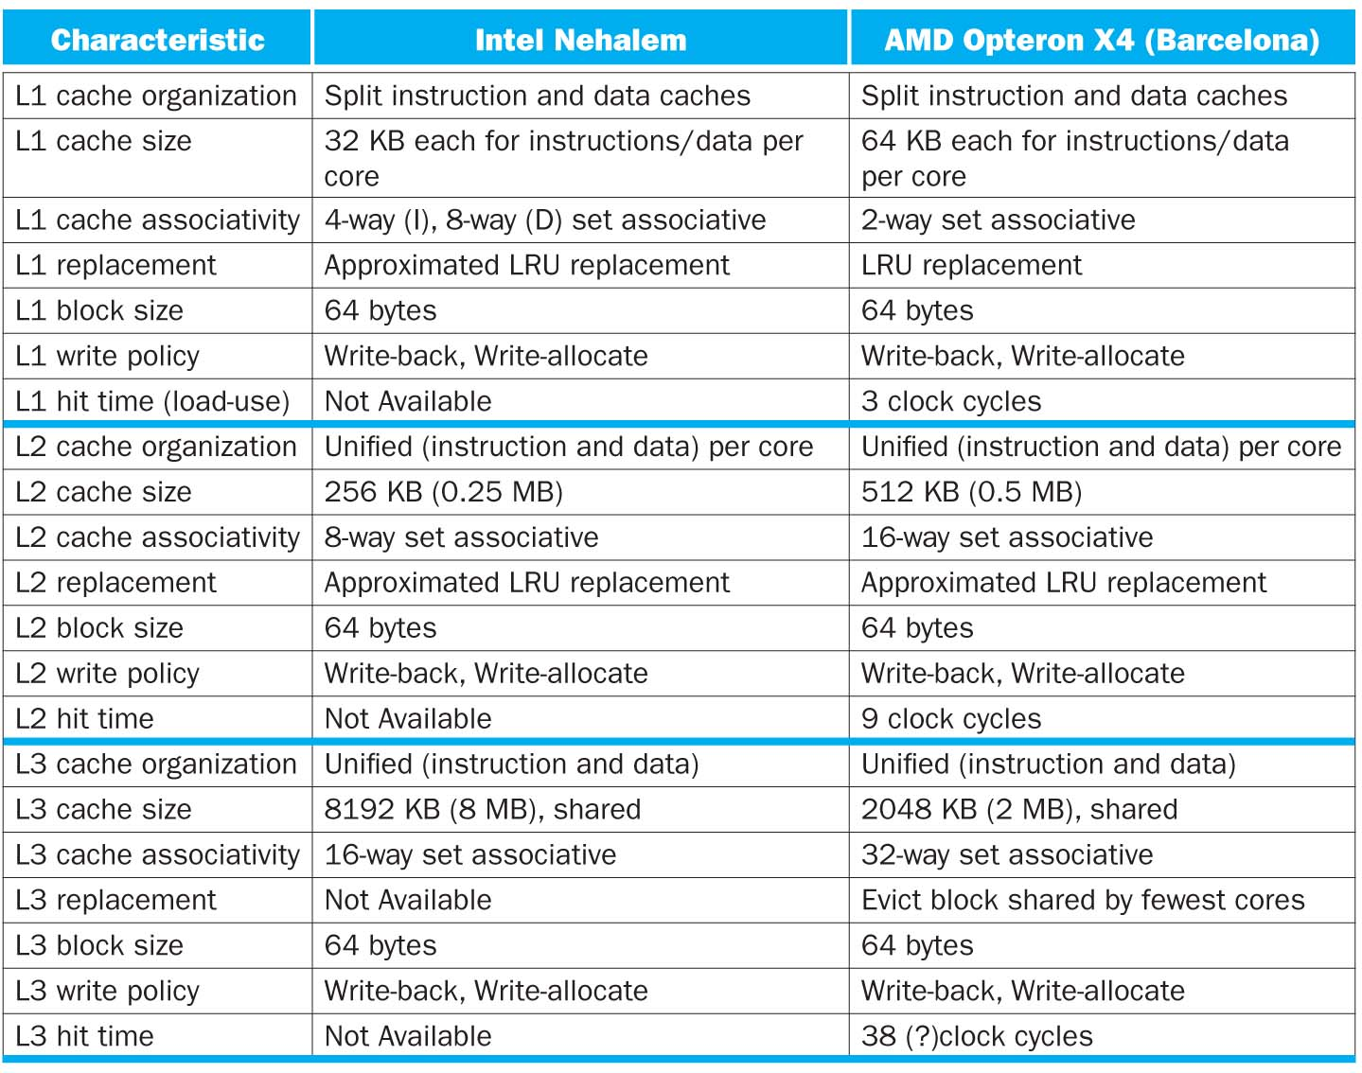

Slide 58
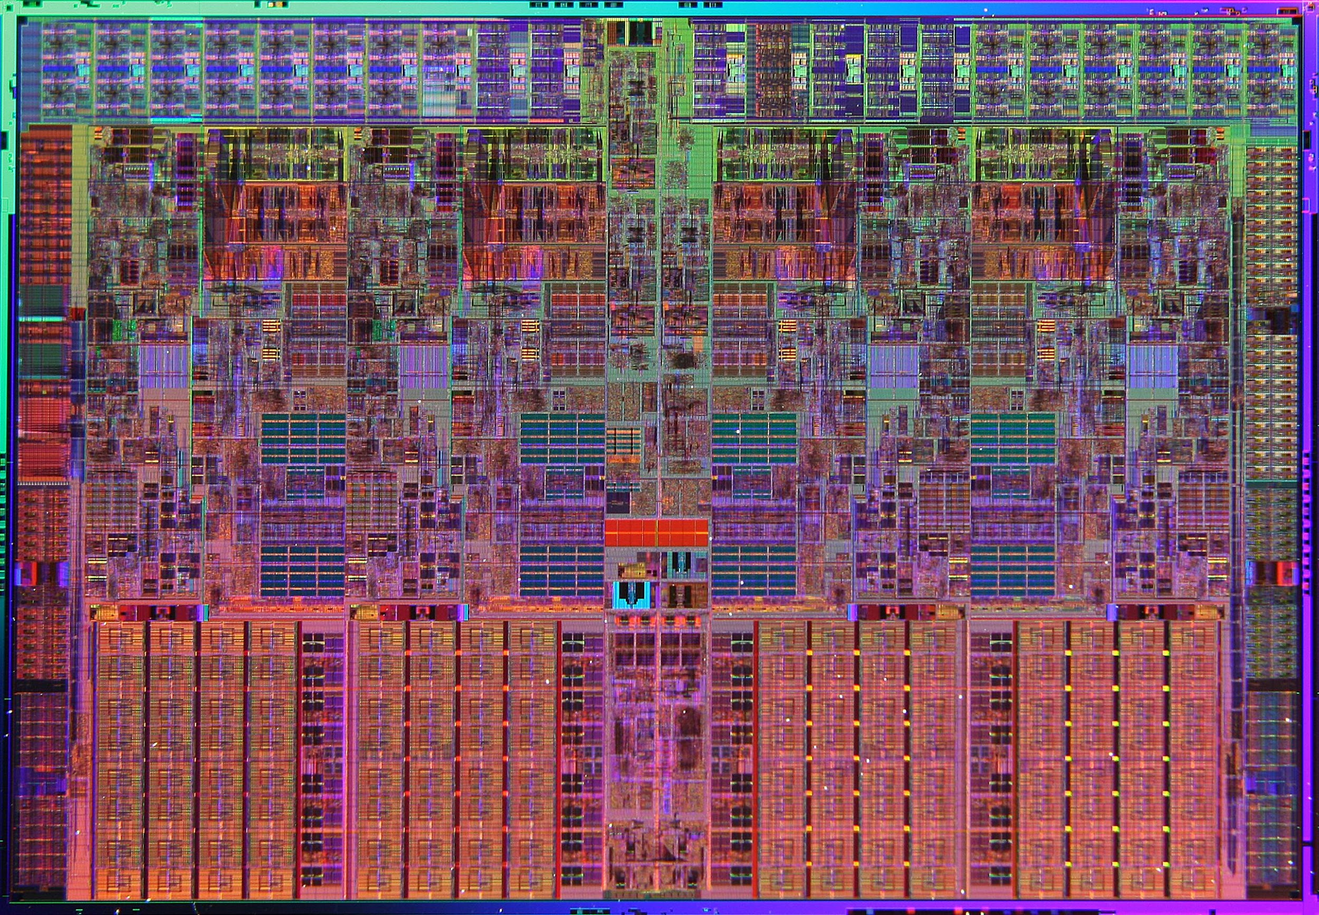
Intel Nehalem Die Photo
Memory Controller
Misc
IO
Misc
IO
Core
Core
Core
Core
13.6 mm (0.54 inch)
Memory
Queue
QPI
0
QPI
1
Shared L3 Cache
18.9 mm (0.75 inch)
Notes:
QPI – QuickPath Interconnect (for floating point)

Slide 59
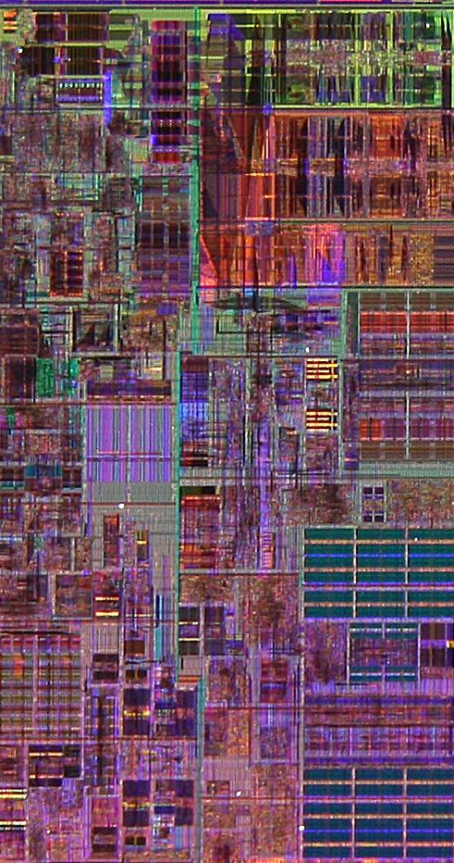
Core Area Breakdown
Memory Controller
Execution Units
32KiB I$ per core
32KiB D$ per core
512KiB L2$ per core
Share one 8-MiB L3$
L1 Data cache
L2 Cache & Interrupt Servicing
L1 Inst cache & Inst Fetch
L3 Cache
Load Store Queue

