Slide 1
Java Programming
STP Samsung program
IT3650

Slide 2
Introduction
Course Objectives
Course Reference Materials
Course Assessment
Organization of the Course

Slide 3
Course Objectives
Upon completing the course, you will understand
  Java applications and applets
  Primitive data types
  Java control flow
  Methods
  Object-oriented programming
  Core Java classes (Swing, exception, internationalization, multithreading, multimedia, I/O, networking)

Slide 4
Course Objectives, cont.
You will be able to
  Write applications and applets
  Develop a GUI interface
  Write interesting projects
  Establish a firm foundation on Java concepts

Slide 5
Course Reference Material
Core Java 2

Slide 6
Course Assessment
Progress (class attendance, Lab practice, exercise,…): 30%
Final term exam: 70%

Slide 7
Course outline
Week | Chapter title | Covered topic
1 | Introduction to Java programming | Java history and versions Java programming environments Installing Java SDK Choosing IDE tool Compiling and running Java application
2+3 | Java programming fundamentals | Program structure Data types Control flows Input/output Object/classes and inheritance Interface

Slide 8
Course outline
4 | Graphics programming and envent handling | Introduction to AWT and SWING Event-driven programming Mouse, Keyboard and other actions programming Customized events
5 | Multithreading and exception handling | Multithreaded applications Synchronization Exception handling
6+7 | Streams and files I/O | Streams and text input/output Reading and writing binary data Compression and decompression Object storage and serialization File management

Slide 9
Course outline
8+9 | Networking | Introduction to TCP/IP Socket programming with Java Connecting to a server Creating a server with Java Creating a client with java
10+11 | Database programming | JDBC architecture Connecting to database server and executing SQL statements Multi-tier applications
12 | Remote method invocation (RMI) and CORBA | RMI basics Implementation details RMI securities

Slide 10
Course outline
13 | Multimedia programming | Transferring media files Playing sound files Java Media Framework
14 | Internationalization | Locales Number formats Date and times Character sets
15 | Java deploying applications and securities | Jar archives Digital signatures Coding singing

Slide 11
Week 1: Introduction to Java
What Is Java?
Getting Started With Java Programming
  Compiling and Running a Java Application
  Compiling and Running a Java Applet

Slide 12
What Is Java?
History
Characteristics of Java

Slide 13
History
By James Gosling in a Green project led by Patrick Naughton starting 1991
May 1995, Sun World: HotJava
  The first Java-enabled Web browser
Sun released the First Java version in 1996 Java 1.0
1998: Java 1.2
2004: Jumped to 5.0

Slide 14
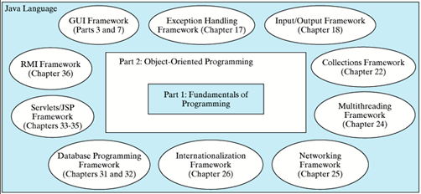
History

Slide 15
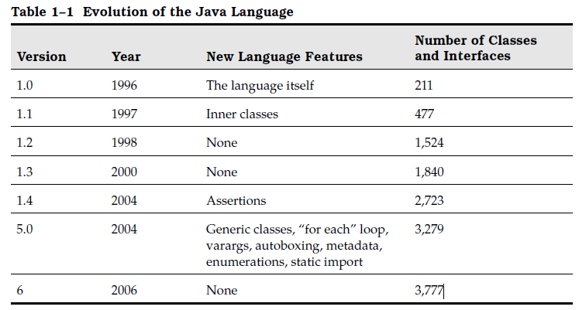
History

Slide 16
Java versions
J2SE
J2EE
J2ME

Slide 17
Characteristics of Java
Java is simple
Java is object-oriented
Java is distributed
Java is interpreted
Java is robust
Java is secure
Java is architecture-neutral
Java is portable
Java’s performance
Java is multithreaded
Java is dynamic

Slide 18
Java IDE Tools
Inprise JBuilder (RAD)
Microsoft Visual J++
Symantec Café (RAD)
Rouge Wave JFactory
Sun Java Workshop
IBM Visual Age for Java (RAD)
Open source Eclipse (IBM)

Slide 19
Getting Started with Java Programming
A Simple Java Application
Compiling Programs
Executing Applications
A Simple Java Applet
Viewing Java Applets
Applications vs. Applets

Slide 20
A Simple Application
Example 1.1
//This application program prints Welcome
//to Java!
public class Welcome
{
public static void main(String[] args)
{
System.out.println("Welcome to Java!");
}
}
Source
Run

Slide 21
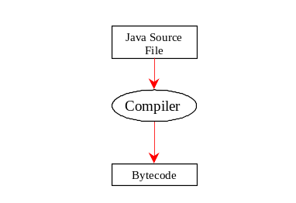
Compiling Programs
On command line
  javac file.java

Slide 22
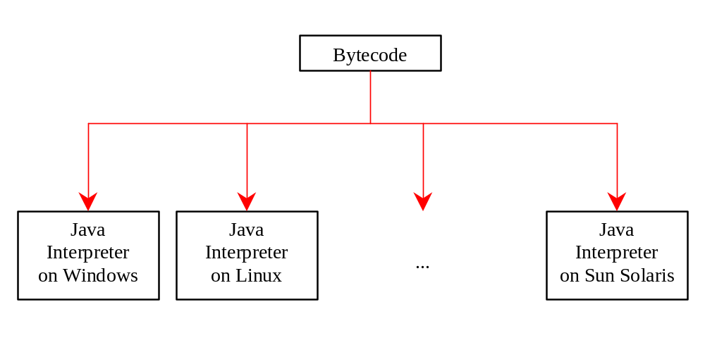
Executing Applications
On command line
  java classname

Slide 23
Example
javac Welcome.java
java Welcome
output:...

Slide 24
A Simple Applet (Optional)
Example 1.2
/* This is an example of Java applets */
import java.awt.Graphics;
public class WelcomeApplet
extends java.applet.Applet
{
public void paint (Graphics g)
{
g.drawString("Welcome to Java!",10,10);
}
}
Source

Slide 25
Creating an HTML File
<html>
<body>
<applet code="WelcomeApplet.class"
width = 100 height = 40>
</applet>
</body>
</html>

Slide 26

Viewing Java Applets

Slide 27
Applet Viewer Utility
appletviewer htmlfile.html
Example:
appletviewer WelcomeApplet.html
Run Applet Viewer

Slide 28
Applications vs. Applets
Similarities
Differences

Slide 29
Security Restrictions on Applets
Applets are not allowed to read from, or write to, the file system of the computer viewing the applets.
Applets are not allowed to run any programs on the browser’s computer.
Applets are not allowed to establish connections between the user’s computer and another computer except with the server where
the applets are stored.

