Slide 1
Week 2-1: Primitive Data Types and Operations
Introducing Programming with an Example
The MyInput class
Identifiers, Variables, and Constants
Primitive Data Types
  byte, short, int, long, float, double, char, boolean
Operators
  +, -, *, /, %, +=, -=, *=, /=, %=, ++, --
Expressions
Style and Documentation
Syntax Errors, Runtime Errors, and Logic Errors

Slide 2
Introducing Programming with an Example
Example 2.1: Computing the Area of a Circle
This program reads the radius from the keyboard and computes the area of the circle.
ComputeArea
Run

Slide 3
The MyInput Class
This class contains the methods for reading an int, a double, or a string from the keyboard.
The methods are readInt, readDouble, and readString
MyInput

Slide 4
Identifiers
An identifier must start with a letter, an underscore, or a dollar sign.
An identifier cannot contain operators, such as
+, -, and so on.
An identifier cannot be a reserved word. (See Appendix A, “Java Keywords,” for a list of reserved words).
An identifier cannot be true, false, or
null.
An identifier can be of any length.

Slide 5
Variables
// Compute the first area
radius = 1.0;
area = radius*radius*3.14159;
System.out.println("The area is “ + area + " for radius "+radius);
// Compute the second area
radius = 2.0;
area = radius*radius*3.14159;
System.out.println("The area is “ + area + " for radius "+radius);

Slide 6
Declaring Variables
int x; // Declare x to be an
// integer variable;
double radius; // Declare radius to
// be a double variable;
char a; // Declare a to be a
// character variable;

Slide 7
Assignment Statements
x = 1; // Assign 1 to x;
radius = 1.0; // Assign 1.0 to radius;
a = 'A'; // Assign 'A' to a;

Slide 8
Declaring and Initializing in One Step
int x = 1;
double d = 1.4;
float f = 1.4;
Is this statement correct?

Slide 9
Constants
final datatype CONSTANTNAME = VALUE;
final double PI = 3.14159;
final int SIZE = 3;

Slide 10
Numerical Data Types
byte 8 bits
short 16 bits
int 32 bits
long 64 bits
float 32 bits
double 64 bits

Slide 11
Number Literals
int i = 34;
long l = 1000000;
float f = 100.2f;
or
float f = 100.2F;
double d = 100.2d
or
double d = 100.2D;

Slide 12
Operators
+, -, *, /, and %
5/2 yields an integer 2.
5.0/2 yields a double value 2.5
5 % 2 yields 1 (the remainder of the division)

Slide 13
Shortcut Operators
Operator Example Equivalent
+= i+=8 i = i+8
-= f-=8.0 f = f-8.0
*= i*=8 i = i*8
/= i/=8 i = i/8
%= i%=8 i = i%8

Slide 14
Increment and
Decrement Operators
x = 1;
y = 1 + x++;
y = 1 + ++x;
y = 1 + x--;
y = 1 + --x;

Slide 15
Numeric Type Conversion
Consider the following statements:
byte i = 100;
long l = i*3+4;
double d = i*3.1+l/2;
int x = l; (Wrong)
long l = x; (fine, implicit casting)

Slide 16
Type Casting
double
float
long
int
short
byte

Slide 17
Type Casting, cont.
Implicit casting
double d = 3; (type widening)
Explicit casting
int i = (int)3.0; (type narrowing)
What is wrong? int x = 5/2.0;

Slide 18
Character Data Type
char letter = 'A'; (ASCII)
char numChar = '4'; (ASCII)
char letter = '\u000A'; (Unicode)
char letter = '\u000A'; (Unicode)
Special characters
char tab = ‘\t’;

Slide 19
Unicode Format
Description Escape Sequence Unicode
Backspace \b \u0008
Tab \t \u0009
Linefeed \n \u000a
Carriage return \r \u000d

Slide 20
The boolean Type and Operators
boolean lightsOn = true;
boolean lightsOn = false;
&& (and) (1 < x) && (x < 100)
|| (or) (lightsOn) || (isDayTime)
! (not) !(isStopped)

Slide 21
The & and | Operators
If x is 1, what is x after this expression?
(1 > x) & ( 1 > x++)
If x is 1, what is x after this expression?
(1 > x) && ( 1 > x++)
How about (1 = x) | (1 > x++)?
(1 = x) || (1 > x++)?

Slide 22
Operator Precedence
Casting
++,--(preincrement,predecrement)
*, /, %
+, -
<, <=, >, >=
==, !=;
&&, &
||, |
=, +=, -=, *=, /=, %=

Slide 23
Programming Style and Documentation
Appropriate Comments
Naming Conventions
Proper Indentation and Spacing Lines
Block Styles

Slide 24
Appropriate Comments
Include a summary at the beginning of the program to explain what the program does, its key features, its supporting data structures, and any unique techniques it uses.
Include your name, class section, instruction, date, and a brief description at the beginning of the program.

Slide 25
Naming Conventions
Choose meaning and descriptive names.
Variables and method names:
  Use lowercase. If the name consists of several words, concatenate all in one, use lowercase for the first word, and capitalize the first letter of each subsequent word in the name. For example, the variables radius and area, and the method computeArea.

Slide 26
Naming Conventions, cont.
Class names:
  Capitalize the first letter of each word in the name. For example, the class name ComputeArea.
Constants:
  Capitalize all letters in constants. For example, the constant PI.

Slide 27
Proper Indentation and Spacing
Indentation
  Indent two spaces.
Spacing
  Use blank line to separate segments of the code.

Slide 28
Block Styles
Use next-line style for braces.

Slide 29
Programming Errors
Syntax Errors
  Detected by the compiler
Runtime Errors
  Causes the program to abort
Logic Errors
  Produces incorrect result

Slide 30
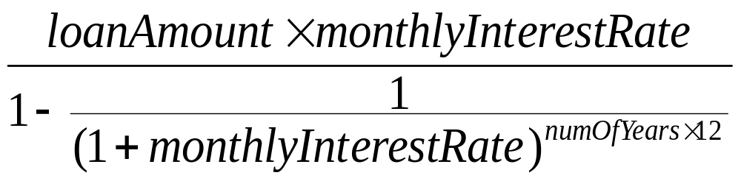
Example 2.2
Computing Mortgages
This program lets the user enter the interest rate, number of years, and loan amount and computes monthly payment and total payment.
ComputeMortgage
Run

Slide 31
Example 2.3
Computing Changes
This program lets the user enter the amount in decimal representing dollars and cents and output a report listing the monetary equivalent in single dollars, quarters, dimes, nickels, and pennies. Your program should report maximum number of dollars, then the maximum number of quarters, and so on, in this order.
ComputeChange
Run

