Slide 1
Week 2-2: Control Statements
Selection Statements
  Using if and if...else
  Nested if Statements
  Using switch Statements
  Conditional Operator
Repetition Statements
  Looping: while, do, and for
  Nested loops
  Using break and continue

Slide 2
Selection Statements
if Statements
switch Statements
Conditional Operators

Slide 3
if Statements
if (booleanExpression)
{
statement(s);
}
Example:
if ((i >= 0) && (i <= 10))
{
System.out.println("i is an “ +
“integer between 0 and 10");
}

Slide 4
The if...else Statement
if (booleanExpression)
{
statement(s)-for-the-true-case;
}
else
{
statement(s)-for-the-false-case;
}

Slide 5
if...else Example
if (radius >= 0)
{
area = radius*radius*PI;
System.out.println("The area for the “
+ “circle of radius " + radius +
" is " + area);
}
else
{
System.out.println("Negative input");
}

Slide 6

Nested if Statements
Example 3.1: Using Nested if Statements
This program reads in number of years and loan amount and computes the monthly payment and total payment. The interest rate is determined by number of years.
TestIfElse

Slide 7
Conditional Operator
if (x > 0) y = 1
else y = -1;
is equivalent to
y = (x > 0) ? 1 : -1;

Slide 8
switch Statements
switch (year)
{
case 7: annualInterestRate = 7.25;
break;
case 15: annualInterestRate = 8.50;
break;
case 30: annualInterestRate = 9.0;
break;
default: System.out.println(
"Wrong number of years, enter 7, 15, or 30");
}

Slide 9
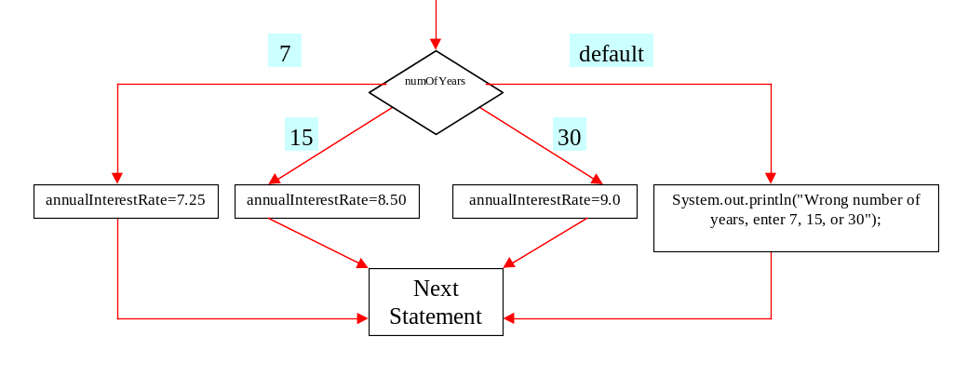
switch Statement Flow Chart

Slide 10
Repetitions
while Loops
do Loops
for Loops
break and continue

Slide 11
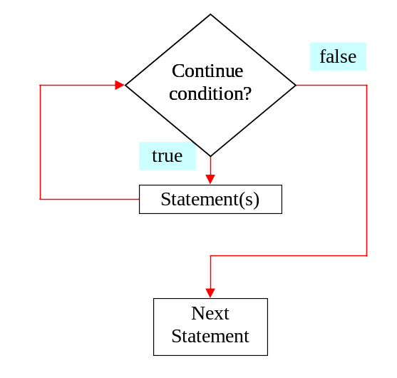
while Loop Flow Chart

Slide 12
while Loops
while (continue-condition)
{
// loop-body;
}
Example 3.2: Using while Loops
TestWhile.java
TestWhile

Slide 13
do Loops
do
{
// Loop body;
} while (continue-condition)

Slide 14
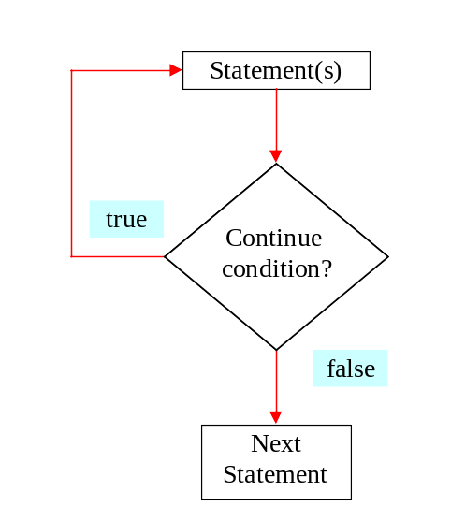
do Loop Flow Chart

Slide 15
for Loops
for (control-variable-initializer;
continue-condition; adjustment-statement)
{
//loop body;
}
int i = 0;
while (i < 100)
{
System.out.println("Welcome to Java! ” + i);
i++;
}
Example:
int i;
for (i = 0; i<100; i++)
{
System.out.println("Welcome to Java! ” + i);
}

Slide 16
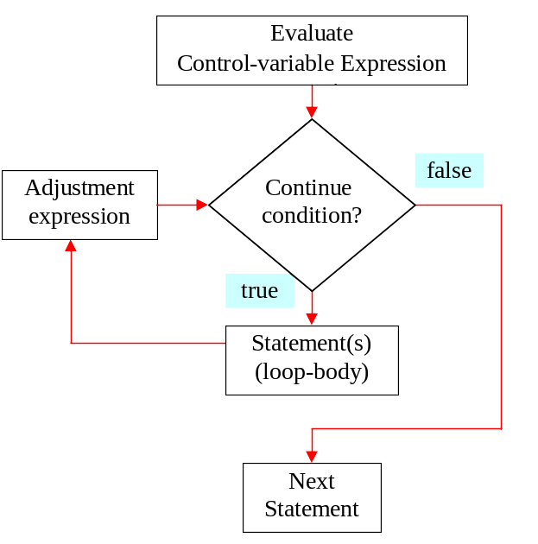
for Loop Flow Chart

Slide 17
for Loop Examples
Examples for using the for loop:
Example 3.3: Using for Loops
TestSum
Example 3.4: Using Nested for Loops
TestMulTable

Slide 18
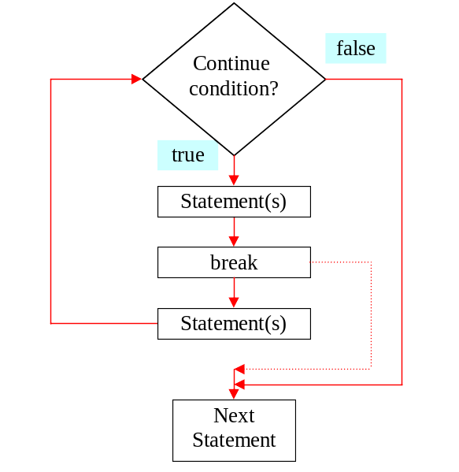
The break Keyword

Slide 19
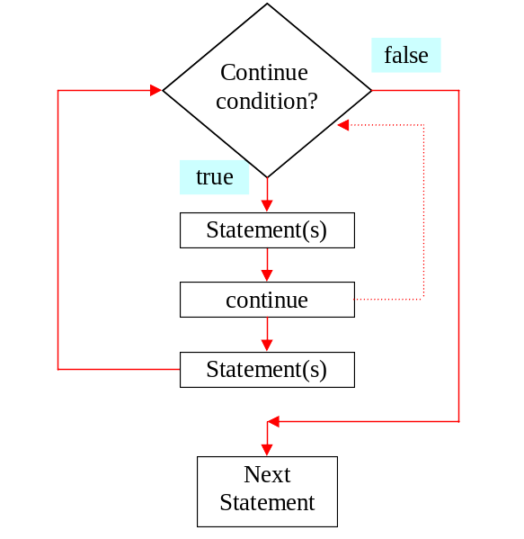
The continue Keyword

Slide 20
Using break and continue
Examples for using the break and continue keywords:
Example 3.5: TestBreak.java
TestBreak
Example 3.6: TestContinue.java
TestContinue

Slide 21
Thực hành
Viết ứng dụng Java nhập vào giá trị tháng và năm rồi hiển thị số ngày trong tháng đó.
import java.util.Scanner;
public class Nhapsolieu
{
public static void main(String[] argv)
{
Scanner input=new Scanner(System.in);
String s="";
System.out.println("Nhap vao ten ban:");
s=input.nextLine();
System.out.println("Xin chao ban: "+s +
", ban co khoe ko?");
}
}

