Slide 1
Week 2-3: Methods
Introducing Methods
Declaring Methods
Calling Methods
Passing Parameters
Pass by Value
Overloading Methods
Method Abstraction
The Math Class
Recursion (Optional)

Slide 2
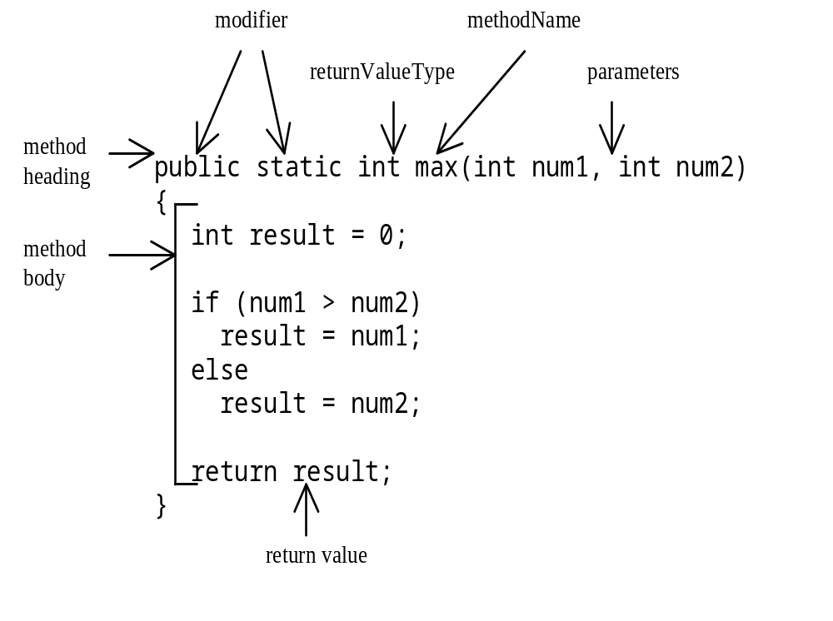
Introducing Methods
Method Structure
A method is a collection of statements that are grouped together to perform an operation.

Slide 3
Declaring Methods
public static int max(int num1, int num2)
{
if (num1 > num2)
return num1;
else
return num2;
}

Slide 4

Calling Methods
Example 4.1 Testing the max method
This program demonstrates calling a method max to return the largest of the int values
TestMax

Slide 5
Passing Parameters
void nPrintln(String message, int n)
{
for (int i=0; i<n; i++)
System.out.println(message);
}

Slide 6
Pass by Value
Example 4.2 Testing Pass by value
This program demonstrates passing values to the methods.
TestPassByValue

Slide 7
Overloading Methods
Example 4.3 Overloading the max Method
double max(double num1, double num2)
{
if (num1 > num2)
return num1;
else
return num2;
}
TestMethodOverloading

Slide 8
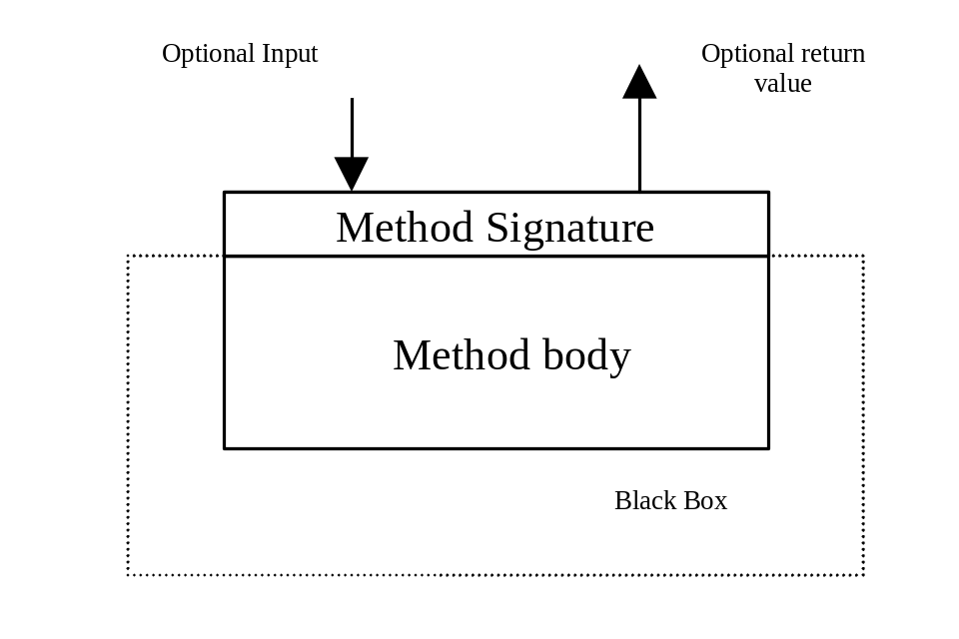
Method Abstraction
You can think of the method body as a black box that contains the detailed implementation for the method.

Slide 9
The Math Class
Class constants:
  PI
  E
Class methods:
  Trigonometric Methods
  Exponent Methods
  Miscellaneous

Slide 10
Trigonometric Methods
sin(double a)
cos(double a)
tan(double a)
acos(double a)
asin(double a)
atan(double a)

Slide 11
Exponent Methods
exp(double a)
  Returns e raised to the power of a.
log(double a)
  Returns the natural logarithm of a.
pow(double a, double b)
  Returns a raised to the power of b.
sqrt(double a)
  Returns the square root of a.

Slide 12
Miscellaneous Methods
max(a, b)and min(a, b)
  Returns the maximum or minimum of two parameters.
abs(a)
  Returns the absolute value of the parameter.
random()
  Returns a random double value
  in the range [0.0, 1.0).

Slide 13
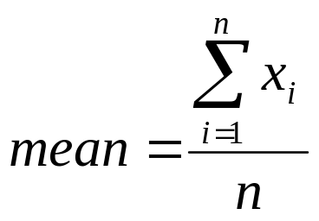
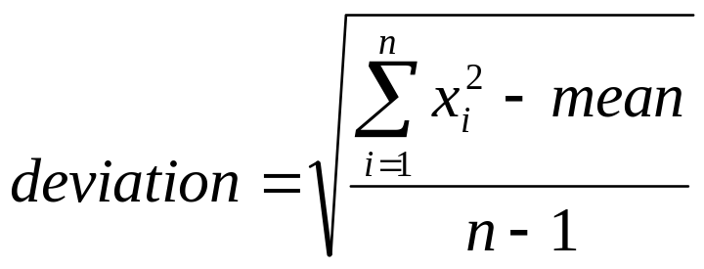
Using Math Methods
Example 4.4 Computing Mean and Standard Deviation
Generate 10 random numbers and compute the mean and standard deviation
ComputeMeanDeviation

Slide 14
Case Studies
Example 4.5 Displaying Calendars
The program reads in the month and year and displays the calendar for a given month of the year.
PrintCalendar

Slide 15
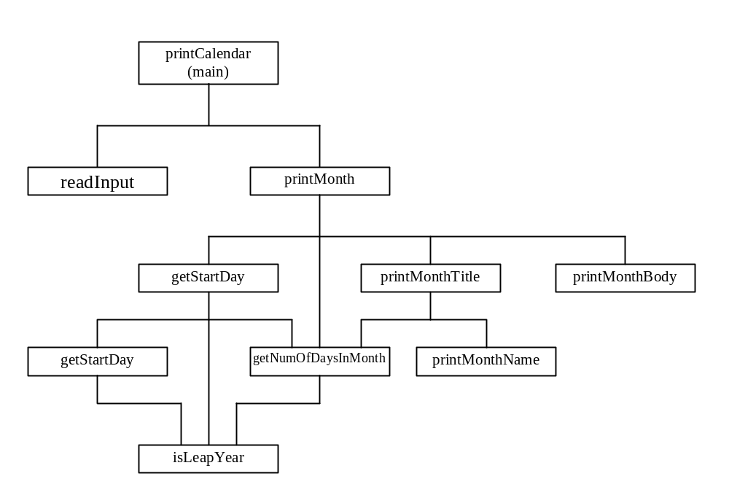
Design Diagram

Slide 16
Recursion (Optional)
Example 4.6 Computing Factorial
factorial(0) = 1;
factorial(n) = n*factorial(n-1);
ComputeFactorial

Slide 17
Fibonnaci Numbers
Example 4.7 Computing Finonacci Numbers
Find Fibonacci numbers using recursion.
fib(0) = 1;
fib(1) =1;
fib(n) = fib(n-2) + fib(n-1); n>=2
ComputeFibonacci

Slide 18
Towers of Hanoi
Example 4.8 Solving the Towers of Hanoi Problem
Solve the towers of Hanoi problem.
TowersOfHanoi

Slide 19
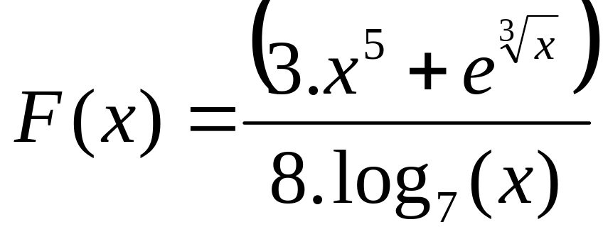
Exercise
Generate 100 random integer values between 0 and 100, then print out total numbers of odd numbers and total numbers of even numbers?
Write a java program to calculate the following formular (x is input from keyboard):

