Slide 1
Week 3
Programming with Objects and Classes
OO Programming Concepts
Declaring and Creating Objects
Constructors
Modifiers (public, private and static)
Instance and Class Variables and Methods
Scope of Variables
Use the this Keyword
Analyze Relationships among Classes
Case Studies (Mortgage class and Rational class)
The Java API and Core Java classes
Processing Strings (String, StringBuffer, and StringTokenizer)

Slide 2
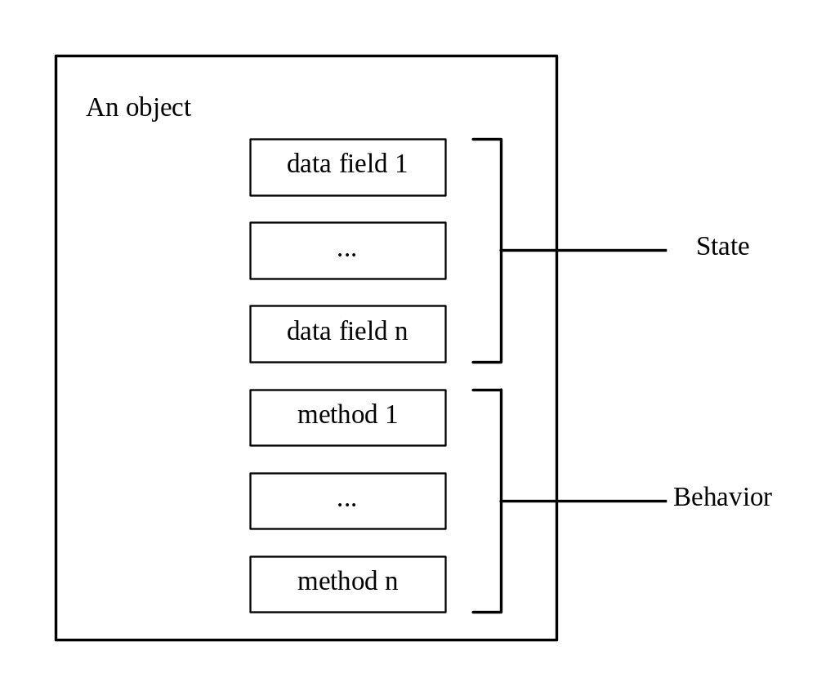
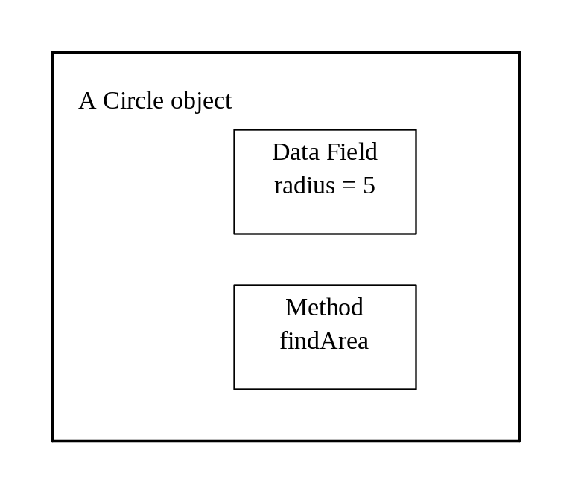
OO Programming Concepts

Slide 3
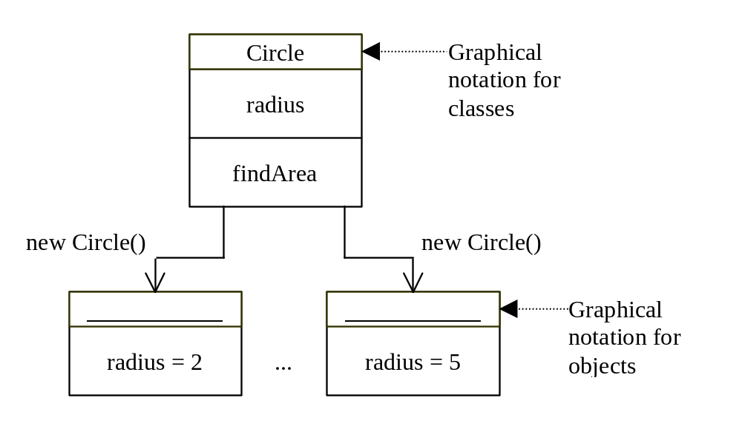
Class and Objects

Slide 4
Class Declaration
class Circle
{
double radius = 1.0;
double findArea()
{
return radius*radius*3.14159;
}
}

Slide 5
Declaring Objects
ClassName objectName;
Example:
Circle myCircle;

Slide 6
Creating Objects
objectName = new ClassName();
Example:
myCircle = new Circle();

Slide 7
Declaring/Creating Objects in a Single Step
ClassName objectName = new ClassName();
Example:
Circle myCircle = new Circle();

Slide 8
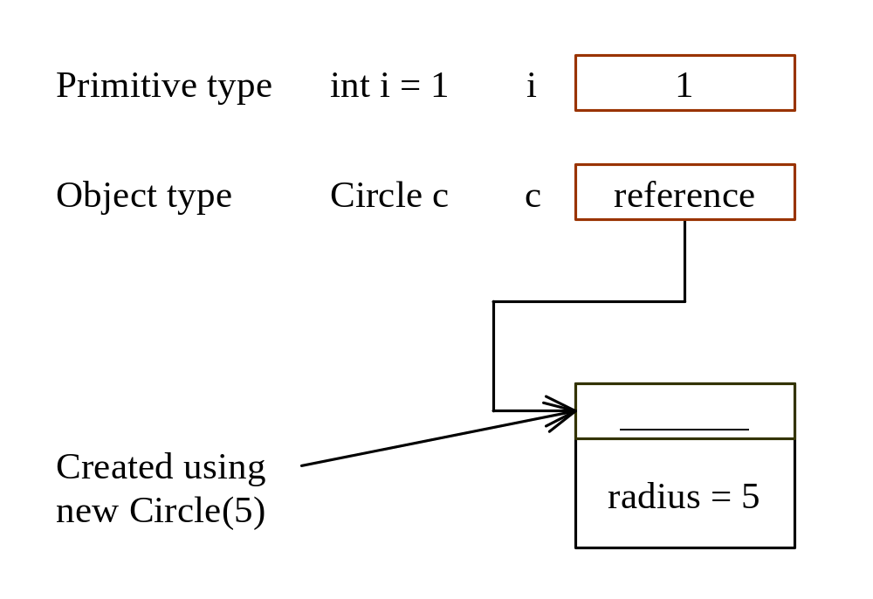
Differences between variables of primitive Data types and object types

Slide 9
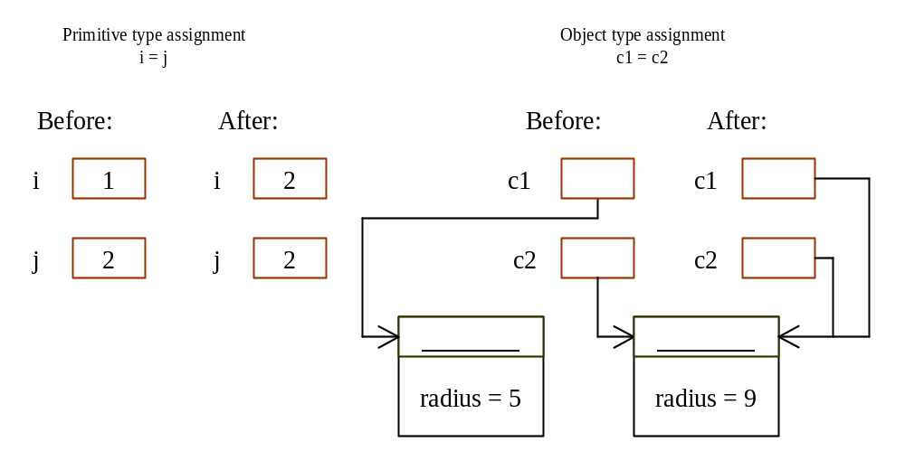
Copying Variables of Primitive Data Types and Object Types

Slide 10
Accessing Objects
Referencing the object’s data:
objectName.data
myCircle.radius
Referencing the object’s method:
objectName.method
myCircle.findArea()

Slide 11
Example 5.1
Using Objects
Objective: Demonstrate creating objects, accessing data, and using methods.
TestCircle
Run

Slide 12
Constructors
Circle(double r)
{
radius = r;
}
Circle()
{
radius = 1.0;
}
myCircle = new Circle(5.0);

Slide 13
Example 5.2
Using Constructors
Objective: Discuss the role of constructors and use them to create objects.
TestCircleWithConstructors
Run

Slide 14
Passing Objects to Methods
Passing by reference
Passing by value
Example 5.3 Passing Objects as Arguments
TestPassingObject
Run

Slide 15
Visibility Modifiers and
Accessor Methods
By default, the class, variable, or data can be
accessed by any class in the same package.
public
The class, data, or method is visible to any class in any package.
private
The data or methods can be accessed only by the declaring class.
The getter and setter accessor methods are used to read and modify private properties.

Slide 16
Example 5.4
Using the private Modifier and Accessor Methods
In this example, private data are used for the radius and the accessor methods getRadius and setRadius are provided for the clients to retrieve and modify the radius.
TestCircleWithPrivateModifier
Run

Slide 17
Instance
Variables, and Methods
Instance variables belong to a specific instance.
Instance methods are invoked by an instance of the class.

Slide 18
Class Variables, Constants, and Methods
Class variables are shared by all the instances of the class.
Class methods are not tied to a specific object.
Class constants are final variables shared by all the instances of the class.

Slide 19
Class Variables, Constants, and Methods, cont.
To declare class variables, constants, and methods, use the static modifier.

Slide 20
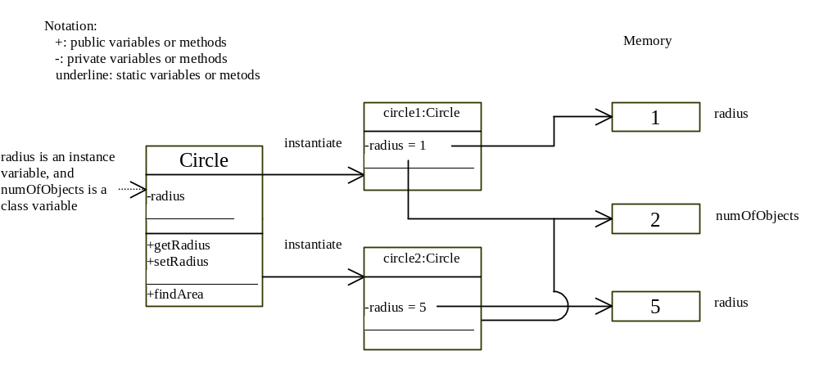
Class Variables, Constants, and Methods, cont.

Slide 21
Example 5.5
Using Instance and Class Variables and Method
Objective: Demonstrate the roles of instance and class variables and their uses. This example adds a class variable numOfObjects to track the number of Circle objects created.
TestInstanceAndClassVariable
Run

Slide 22
Scope of Variables
The scope of instance and class variables is the entire class. They can be declared anywhere inside a class.
The scope of a local variable starts from its declaration and continues to the end of the block that contains the variable. A local variable must be declared before it can be used.

Slide 23
Relationships among Classes
Association
Aggregation
Inheritance

Slide 24
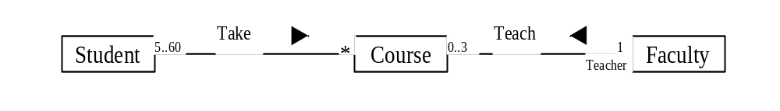
Association
Association represents a general binary relationship that describes an activity between two classes.

Slide 25
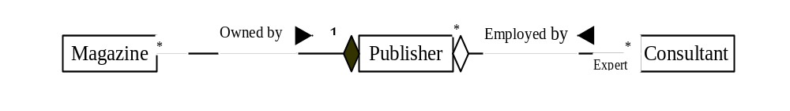
Aggregation
Aggregation is a special form of association, which represents an ownership relationship between two classes. Aggregation models the relationship like has-a, part-of, owns, and employed-by.

Slide 26
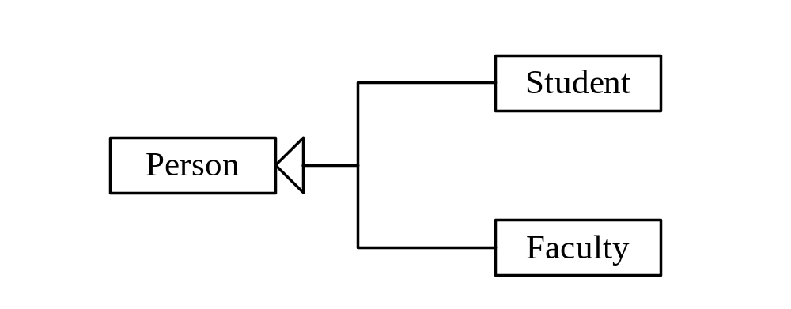
Inheritance
Inheritance models the is-a relationship between two classes.

Slide 27
Class Abstraction
Class abstraction means to separate class implementation from the use of the class. The creator of the class provides a description of the class and let the user know how the class can be used. The user of the class does not need to know how the class is implemented. The detail of implementation is encapsulated and hidden from the user.

Slide 28
Class Design
1. Identify classes for the system.
  2. Describe attributes and methods in each class.
  3. Establish relationships among classes.
  4. Create classes.

Slide 29
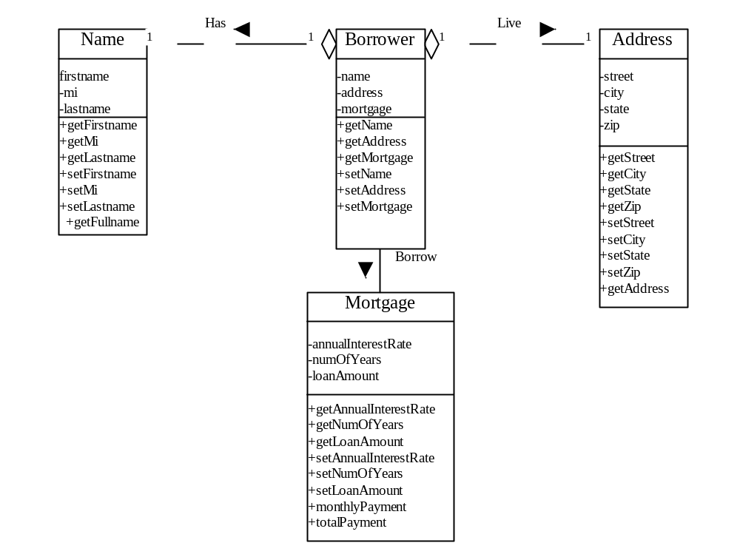
Example 5.6 Borrowing Mortgages
Name
Address
Borrower
Mortgage

Slide 30
Example 5.6 Borrowing Mortgages, cont.
The following is a test program that uses the classes Name, Address, Borrower, and Mortgage.
BorrowMortgage
Run

Slide 31
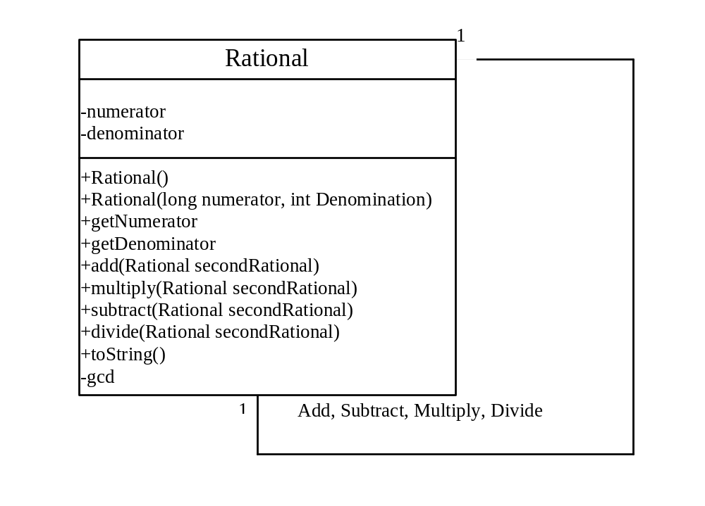
Example 5.7
Using the Rational Class
Objective: Define a class for rational numbers that provides constructors and addition, subtraction, multiplication, and division methods.
Rational
TestRationalClass
Run

Slide 32
Java API and Core Java classes
java.lang
  Contains core Java classes, such as numeric classes, strings, and objects. This package is implicitly imported to every Java program.
java.awt
  Contains classes for graphics.
java.applet
  Contains classes for supporting applets.

Slide 33
Java API and Core Java classes, cont.
java.io
  Contains classes for input and output
  streams and files.
java.util
  Contains many utilities, such as date.
java.net
  Contains classes for supporting
  network communications.

Slide 34
Java API and Core Java classes, cont.
java.awt.image
  Contains classes for managing bitmap images.
java.awt.peer
  Platform-specific GUI implementation.
Others:
java.sql
java.rmi

Slide 35
The String Class
Declaring a String:
  String message = "Welcome to Java!"
  String message = new String("Welcome to Java!“);
  String s = new String();
String Comparisons
String Concatenation
Substrings
String Length
Retrieving Individual Characters
in a String

Slide 36
String Comparisons
equals
String s1 = "Welcome";
String s2 = "welcome";
if (s1.equals(s2))
{ // s1 and s2 have the same contents }
if (s1 == s2)
{
// s1 and s2 have the same reference
}

Slide 37
Substrings
String is an immutable class; its values
cannot be changed individually.
String s1 = "Welcome to Java";
String s2 = s1.substring(0,10) + "HTML";

Slide 38
String Concatenation
String s3 = s1.contact(s2);
String s3 = s1 + s2;

Slide 39
Finding String Length
Finding string length using the length() method:
message = "Welcome";
message.length() (returns 7)

Slide 40
Retrieving Individual Characters in a String
Do not use message[0]
Use message.charAt(index)
Index starts from 0

Slide 41
Example 5.8
Finding Palindromes
Objective: Checking whether a string is a palindrome: a string that reads the same forward and backward.
FindPalindrome
Run

Slide 42
The StringBuffer Class
The StringBuffer class is an alternative to the String class. In general, a string buffer can be used wherever a string is used.
StringBuffer is more flexible than String. You can add, insert, or append new contents
into a string buffer. However, the value of
a string is fixed once the string is created.

Slide 43
StringBuffer Constructors
public StringBuffer()
No characters, initial capacity 16 characters.
public StringBuffer(int length)
No characters, initial capacity specified by the length argument.
public StringBuffer(String str)
Represents the same sequence of characters
as the string argument. Initial capacity 16
plus the length of the string argument.

Slide 44
Appending New Contents into a String Buffer
StringBuffer strBuf = new StringBuffer();
strBuf.append("Welcome");
strBuf.append(' ');
strBuf.append("to");
strBuf.append(' ');
strBuf.append("Java");

Slide 45
The StringTokenizer Class Constructors
StringTokenizer(String s, String delim, boolean returnTokens)
StringTokenizer(String s, String delim)
StringTokenizer(String s)

Slide 46
The StringTokenizer Class Methods
boolean hasMoreTokens()
String nextToken()
String nextToken(String delim)

Slide 47
Example 5.10
Testing StringTokenizer
Objective: Using a string tokenizer, retrieve words from a string and display them on the console.
TestStringTokenizer
Run

Slide 48
Exercise
Write a Java program to input a string from keyboard, then count the number of words in the string. Capitalize all words’ first letter and gather these words to make new string.

