Slide 1

Week 3. Class Inheritance
    Superclasses and Subclasses
    Keywords: super
    Overriding methods
    The Object Class
    Modifiers: protected, final and abstract
    Polymorphism and Object Casting
    Interfaces
    Inner Classes
    Program Development and Class Design

Slide 2
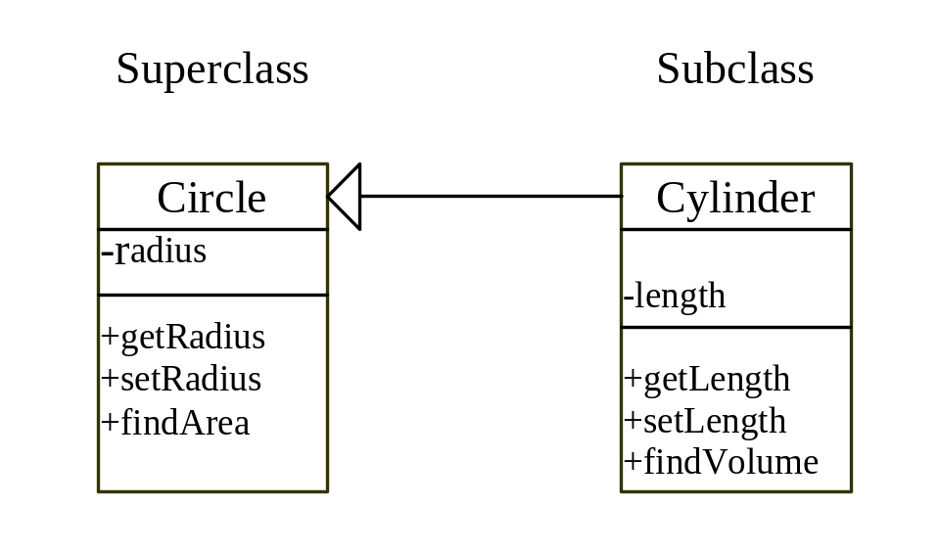
Superclasses and Subclasses
UML Diagram

Slide 3
Creating a Subclass
Creating a subclass extends properties and methods from the superclass. You can also:
  Add new properties
  Add new methods
  Override the methods of the superclass
Cylinder Class

Slide 4
Example 6.1
Testing Inheritance
Objective: Create a Cylinder object and explore the relationship between the Cylinder and Circle classes.
TestCylinder
Run

Slide 5
Using the Keyword super
The keyword super refers to the superclass of the class in which super appears. This keyword can be used in two ways:
To call a superclass constructor
To call a superclass method

Slide 6
Example 6.2
Overriding Methods in the Superclass
The Cylinder class overrides the findArea() method defined in the Circle class.
TestOverridMethods
Run

Slide 7
The Object Class
The Object class is the root of all Java classes.
The toString() method returns a string representation of the object.
The equals() method compares the
contents of two objects.
The clone() method copy objects

Slide 8
The protected Modifier
The protected modifier can be applied on data and methods in a class. A protected data or a protected method in a public class can be accessed by any class in the same package or its subclasses, even if the subclasses are in a different package.

Slide 9
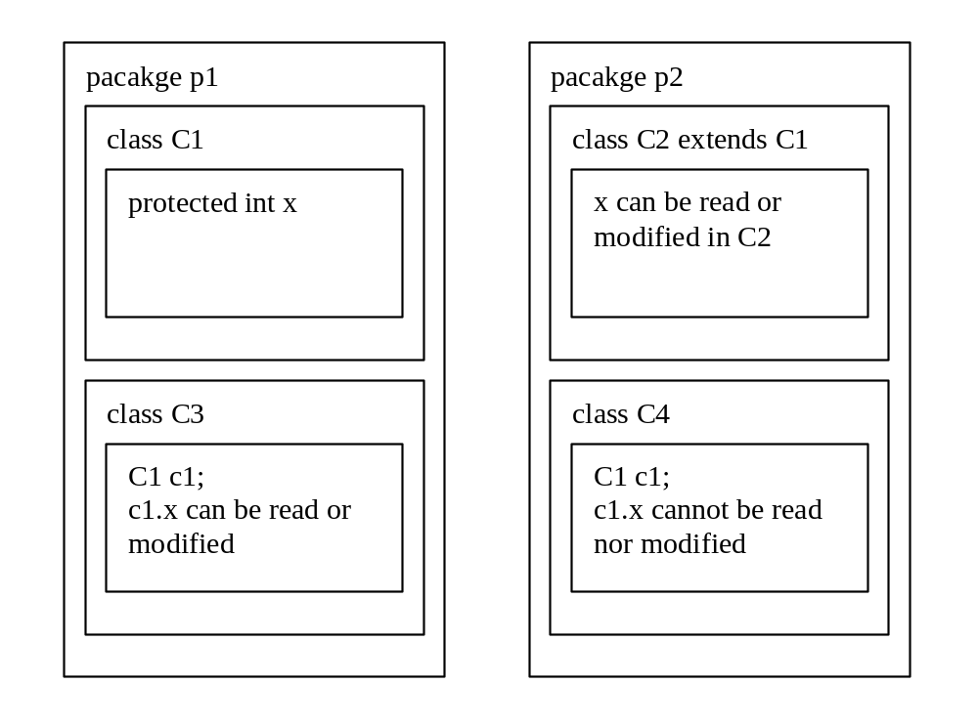
The protected Modifier, cont.

Slide 10
The final Modifier
The final class cannot be extended:
final class Math
{...}
The final variable is a constant:
final static double PI = 3.14159;
The final method cannot be
modified by its subclasses.

Slide 11
The abstract Modifier
The abstract class
  Cannot be instantiated
  Should be extended and implemented in subclasses
The abstract method
  Method signature without
  implementation

Slide 12
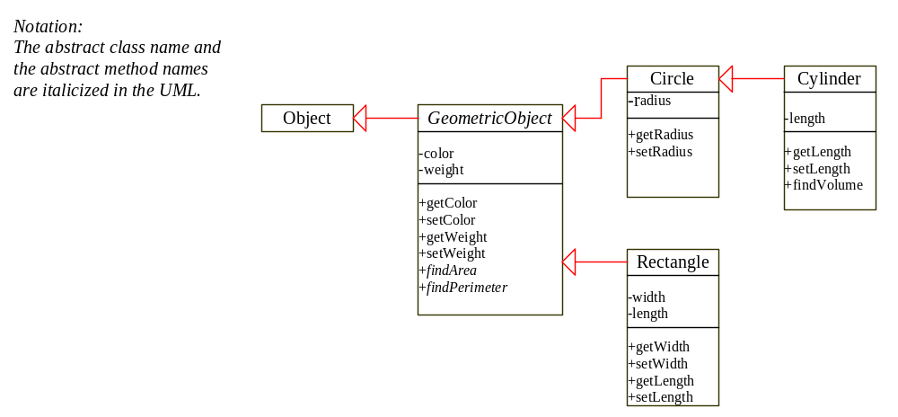
Abstract Classes
Circle
Cylinder
GeometricObject
Rectangle

Slide 13
Polymorphism and Dynamic Binding
Polymorphism refers to the ability to determine at runtime which code to run, given multiple methods with the same name but different operations in the same class or in different classes. This ability is also known as dynamic binding.

Slide 14
Example 6.3
Testing Polymorphism
Objective: This example creates two geometric objects: a circle, and a rectangle, invokes the equalArea method to check if the two objects have equal area, and invokes the displayGeometricObject method to display the objects.
TestPolymorphism
Run

Slide 15
Casting Objects
It is always possible to convert a subclass to a superclass. For this reason, explicit casting can be omitted. For example,
Circle myCircle = myCylinder
is equivalent to
Circle myCircle = (Circle)myCylinder;

Slide 16
Casting from
Superclass to Subclass
Explicit casting must be used when casting an object from a superclass to a subclass. This type of casting may not always succeed.
Cylinder myCylinder = (Cylinder)myCircle;

Slide 17
The instanceof Operator
Use the instanceof operator to test whether an object is an instance of a class:
Circle myCircle = new Circle();
if (myCircle instanceof Cylinder)
{
Cylinder myCylinder = (Cylinder)myCircle;
...
}

Slide 18
Example 6.4
Casting Objects
This example creates two geometric objects: a circle, and a cylinder, invokes the displayGeometricObject method to display the objects. The displayGeometricObject displays the area and perimeter if the object is a circle, and displays area and volume if the object is a cylinder.
TestCasting
Run

Slide 19
Interfaces
What Is an Interface?
Creating an Interface
Implementing an Interface
What is Marker Interface?

Slide 20
Creating an Interface
modifier interface InterfaceName
{
constants declarations;
methods signatures;
}

Slide 21
Example of Creating an Interface
// This interface is defined in
// java.lang package
public interface Comparable
{
public int compareTo(Object o);
}

Slide 22
Generic max Method
  public class Max
  {
  // Return the maximum between two objects
  public static Comparable max
  (Comparable o1, Comparable o2)
  {
  if (o1.compareTo(o2) > 0)
  return o1;
  else
  return o2;
  }
}

Slide 23
Example 6.5
Using Interfaces
Objective: Use the max method to find a find the maximum circle between two circles and a maximum cylinder between two cylinders.

Slide 24
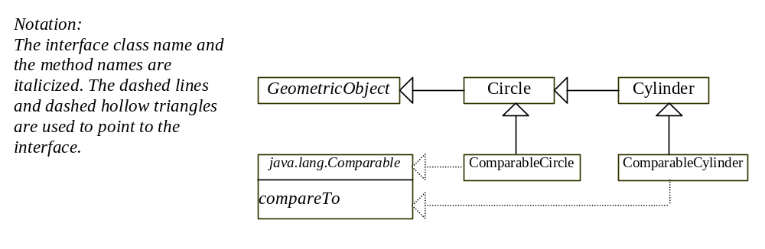
Example 6.5, cont.
TestInterface
Run

Slide 25
Interfaces vs. Abstract Classes
  In an interface, the data must be constants; an abstract class can have all types of data.
  Each method in an interface has only a signature without implementation; an abstract class can have concrete methods. An abstract class must contain at least one abstract method or inherit from another abstract method.

Slide 26
Interfaces vs. Abstract Classes, cont.
  Since all the methods defined in an interface are abstract methods, Java does not require you to put the abstract modifier in the methods in an interface, but you must put the abstract modifier before an abstract method in an abstract class.

Slide 27
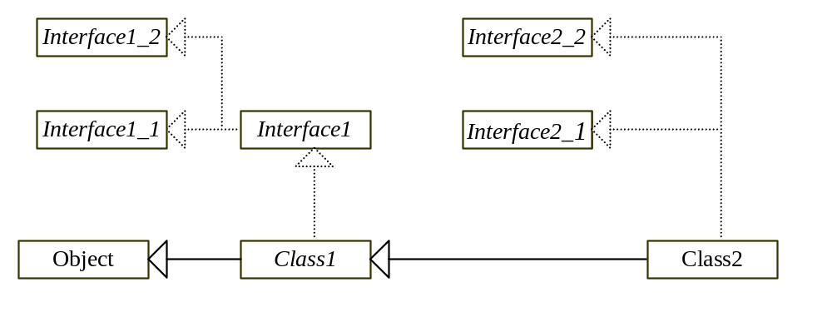
Interfaces vs. Abstract Classes, cont.

Slide 28
The Cloneable Interfaces
  Marker Interface: An empty interface.
  A marker interface does not contain constants or methods, but it has a special meaning to the Java system. The Java system requires a class to implement the Cloneable interface to become cloneable.
  public interface Cloneable
  {
}

Slide 29
Example 6.6
Cloning Objects
Objective: uses the Cloneable interface to mark classes cloneable and uses the clone method to copy objects.
TestCloneable
Run

Slide 30
Inner Classes
Inner class: A class is a member of another class.
Advantages: In some applications, you can use an inner class to make programs simple.
An inner class can reference the data and methods defined in the outer class in which it nests, so you do not need to pass the reference of the outer class to the constructor of the inner class.
ShowInnerClass

Slide 31
Inner Classes (cont.)
Inner classes can make programs simple and concise. As you see, the new class is shorter and leaner. Many Java development tools use inner classes to generate adapters for handling events. Event-driven programming is introduced in Chapter 8, "Getting Started with Graphics Programming.”
An inner class is only for supporting the work of its containing outer class, and it cannot be used by other classes.

Slide 32
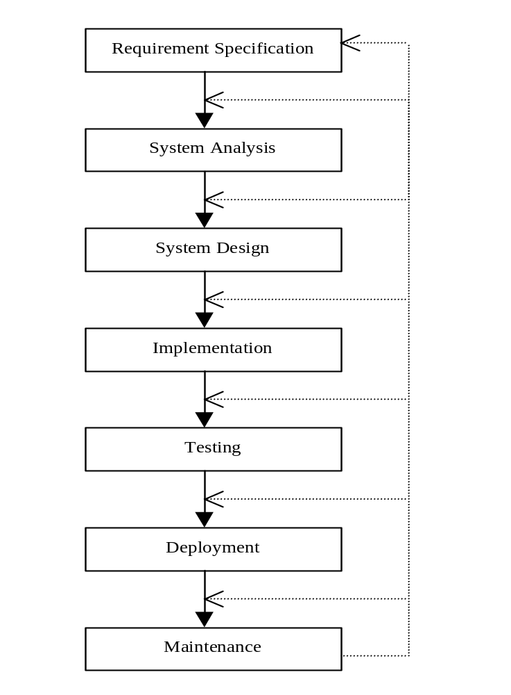
Software Development Process

Slide 33
Class Design Guidelines
Hide private data and private methods.
A property that is shared by all the instances of the class should be declared as a class property.
Provide a public default constructor and override the equals method and the toString method defined in the Object class whenever possible.

Slide 34
Class Design Guidelines, cont.
Choose informative names and follow
consistent styles.
A class should describe a single entity or a set of similar operations.
Group common data fields and operations shared by other classes.

