Slide 1

Week 4. Getting Started with Graphics Programming
Graphics Class Hierarchy
Frames
  Creating frames, centering frames, adding components to frames
Layout Managers
  FlowLayout, GridLayout, BorderLayout
Drawing on Panels
  The paintComponent method
Using Colors, Fonts, and Font Metrics
Drawing Geometric Figures
  Lines, Rectangles, Ovals, Arcs, and Polygons
Event-Driven Programming
  Event Source, Listener, Listener Interface

Slide 2
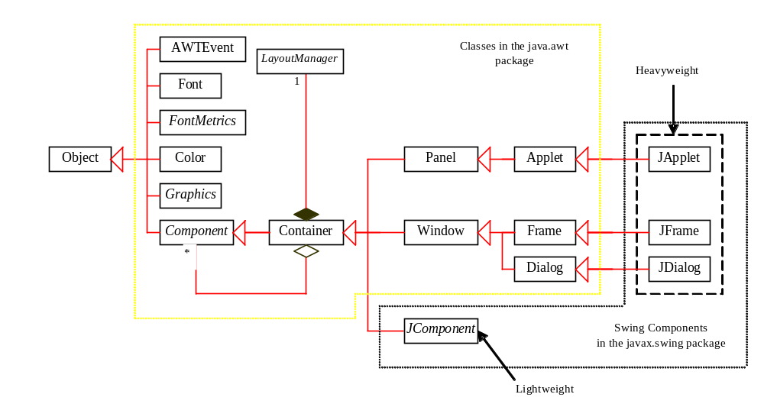
Graphics Class Hierarchy (Swing)

Slide 3
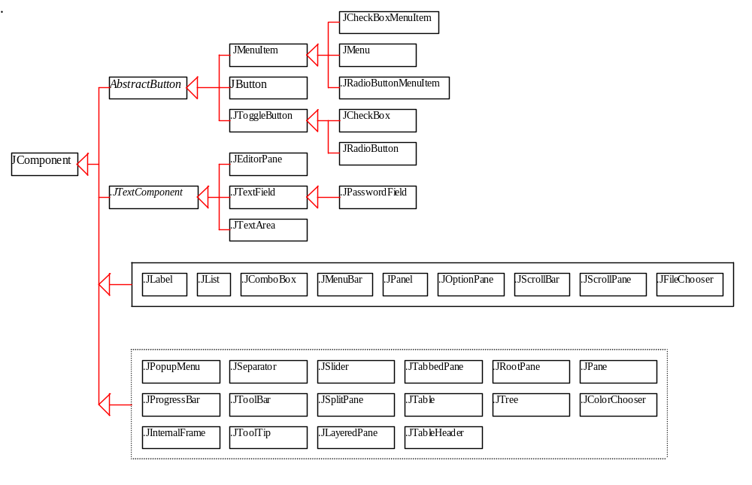
JComponent

Slide 4
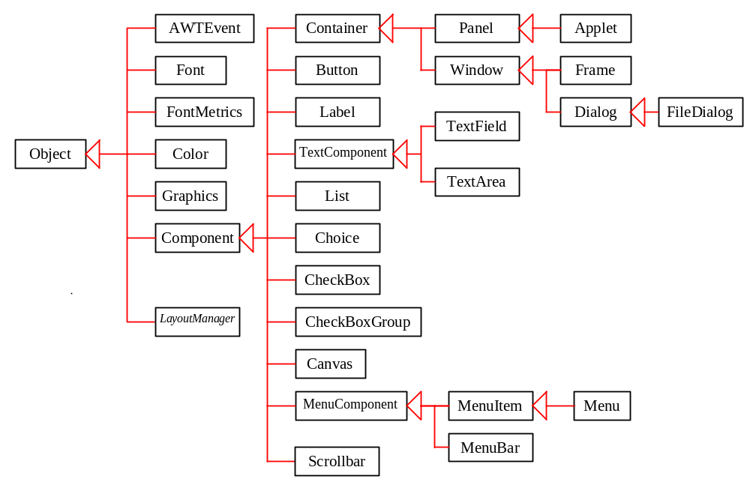
AWT (Optional)

Slide 5
Frames
Frame is a window that is not contained inside another window. Frame is the basis to contain other user interface components in Java graphical applications.
The Frame class can be used to create windows.

Slide 6
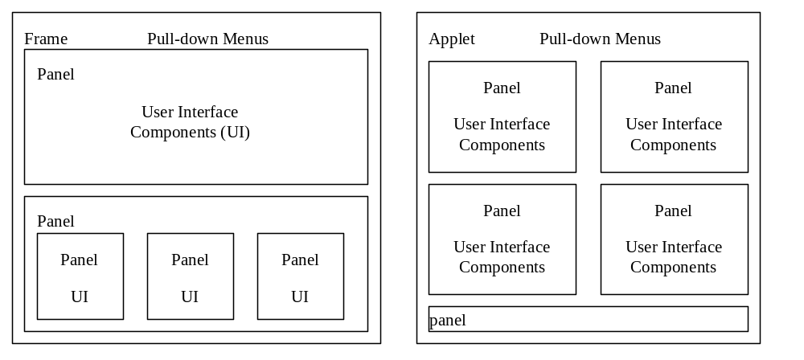
UI Components

Slide 7
Creating Frames
  import javax.swing.*;
  public class MyFrame
  {
  public static void main(String[] args)
  {
  JFrame frame = new JFrame("Test Frame");
  frame.setSize(400, 300);
  frame.setVisible(true);
  // frame.setDefaultCloseOperation(
  JFrame.EXIT_ON_CLOSE);
  }
}
NOTE: To enable it to run in JDK 1.2, the EXIT_ON_CLOSE option is commented.
Run

Slide 8
Centering Frames
By default, a frame is displayed in the upper-left corner of the screen. To display a frame at a specified location, you can use the setLocation(x, y) method in the JFrame class. This method places the upper-left corner of a frame at location (x, y).

Slide 9
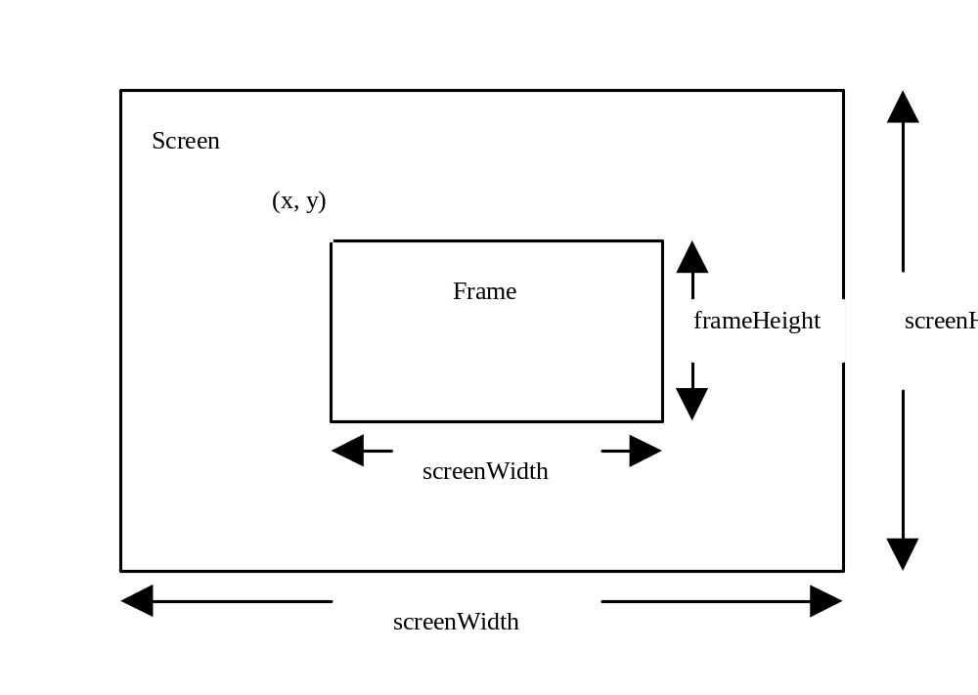
Centering Frames, cont.
CenterFrame
Run

Slide 10
Adding Components into a Frame
  // Add a button into the frame
  frame.getContentPane().add(
  new JButton("OK"));
MyFrameWithComponents
Run

Slide 11
Layout Managers
Java’s layout managers provide a level of abstraction to automatically map your user interface on all windowing systems.
The UI components are placed in containers. Each container has a layout manager to arrange the UI components within the container.

Slide 12
Kinds of Layout Managers
FlowLayout
GridLayout
BorderLayout
CardLayout
GridBagLayout

Slide 13
Example 8.1
Testing the FlowLayout Manager
The components are arranged in the container from left to right in the order in which they were added. When one row becomes filled, a new row is started.
ShowFlowLayout
Run

Slide 14
FlowLayout Constructors
public FlowLayout(int align, int hGap, int vGap)
Constructs a new FlowLayout with a specified alignment, horizontal gap, and vertical gap. The gaps are the distances in
pixel between components.
public FlowLayout(int alignment)
Constructs a new FlowLayout with a specified alignment and a default gap of five pixels for both horizontal and vertical.
public FlowLayout()
Constructs a new FlowLayout with a default
center alignment and a default gap of five pixels
for both horizontal and vertical.

Slide 15
Example 8.2
Testing the GridLayout Manager
The GridLayout manager arranges components
in a grid (matrix) formation with the number of
rows and columns defined by the constructor. The components are placed in the grid from left to right starting with the first row, then the second, and so on.
ShowGridLayout
Run

Slide 16
GridLayout Constructors
public GridLayout(int rows,
int columns)
Constructs a new GridLayout with the specified number of rows and columns.
public GridLayout(int rows, int columns, int hGap, int vGap)
Constructs a new GridLayout with the
specified number of rows and columns,
along with specified horizontal and
vertical gaps between components.

Slide 17
Example 8.3
Testing the BorderLayout Manager
The BorderLayout manager divides the window into five areas: East, South, West, North, and Center. Components are added to a BorderLayout by
using
add(Component, constraint), where constraint is BorderLayout.East, BorderLayout.South, BorderLayout.West", BorderLayout.North", or BorderLayout.Center.
ShowBorderLayout
Run

Slide 18
Using Panels as Containers
Panels act as smaller containers for grouping user interface components.
It is recommended that you place the user interface components in panels and place the panels in a frame. You can also place panels in a panel.

Slide 19
Example 8.4 Testing Panel
This example uses panels to organize components. The program creates a user interface for a Microwave oven.
TestPanels
Run

Slide 20
Drawing on Panels
JPanel can be used to draw graphics (including text) and enable user interaction.
To draw in a panel, you create a new class that extends JPanel and override the paintComponent method to tell the panel how to draw things. You can then display strings, draw geometric shapes, and view images on the panel.

Slide 21
The Color Class
Color c = new Color(r, g, b);
r, g, and b specify a color by its red, green, and blue components.
Example:
Color c = new Color(128, 100, 100);

Slide 22
Setting Colors
You can use the following methods to set the component’s background and foreground colors:
setBackground(Color c)
setForeground(Color c)
Example:
setBackground(Color.yellow); setForeground(Color.red);

Slide 23
The Font Class
Font myFont = Font(name, style, size);
Example:
Font myFont = new Font("SansSerif ", Font.BOLD, 16);
Font myFont = new Font("Serif", Font.BOLD+Font.ITALIC, 12);

Slide 24
Setting Fonts
public void paint(Graphics g)
{
Font myFont = new Font("Times", Font.BOLD, 16);
g.setFont(myFont);
g.drawString("Welcome to Java", 20, 40);
//set a new font
g.setFont(new Font("Courier", Font.BOLD+Font.ITALIC, 12));
g.drawString("Welcome to Java", 20, 70);
}

Slide 25
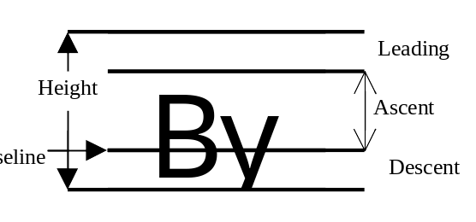
The FontMetrics Class

Slide 26
Get FontMetrics
g.getFontMetrics(Font f);
or
g.getFontMetrics();
public int getAscent()
public int getDescent()
public int getLeading()
public int getHeight()
public int stringWidth(String str)

Slide 27
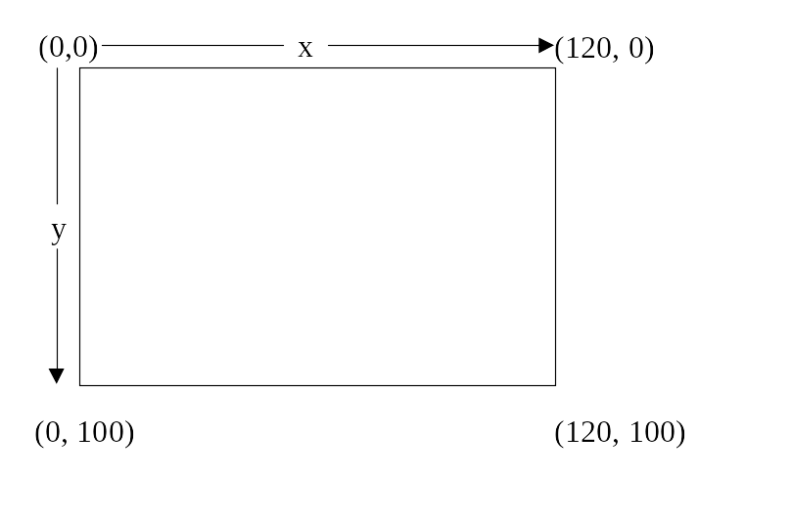
Example 8.5
Using FontMetrics
Objective: Display “Welcome to Java” in SansSerif 20-point bold, centered in the frame.
TestFontMetrics
Run

Slide 28
Drawing Geometric Figures
Drawing Lines
Drawing Rectangles
Drawing Ovals
Drawing Arcs
Drawing Polygons

Slide 29
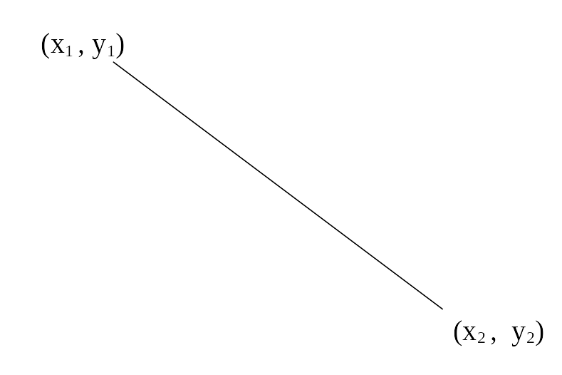
Drawing Lines
drawLine(x1, y1, x2, y2);

Slide 30
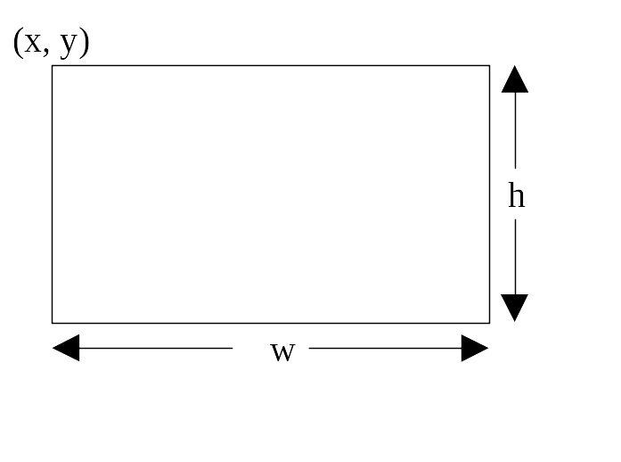
Drawing Rectangles
drawRect(x, y, w, h);
fillRect(x, y, w, h);

Slide 31
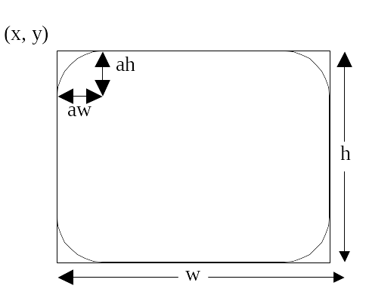
Drawing Rounded Rectangles
drawRoundRect(x, y, w, h, aw, ah);
fillRoundRect(x, y, w, h, aw, ah);

Slide 32
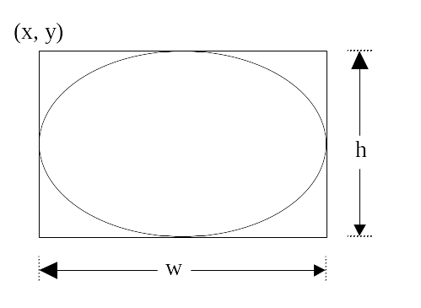
Drawing Ovals
drawOval(x, y, w, h);
fillOval(x, y, w, h);

Slide 33
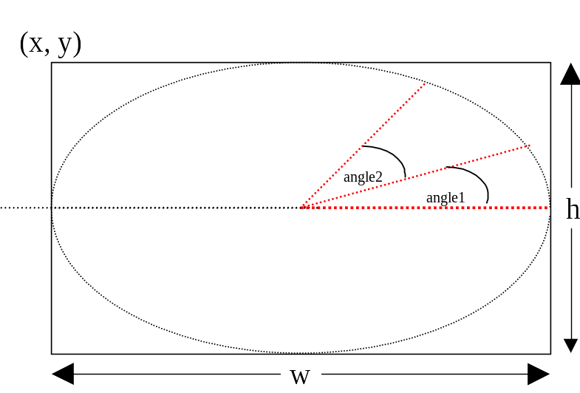
Drawing Arcs
drawArc(x, y, w, h, angle1, angle2);
fillArc(x, y, w, h, angle1, angle2);

Slide 34
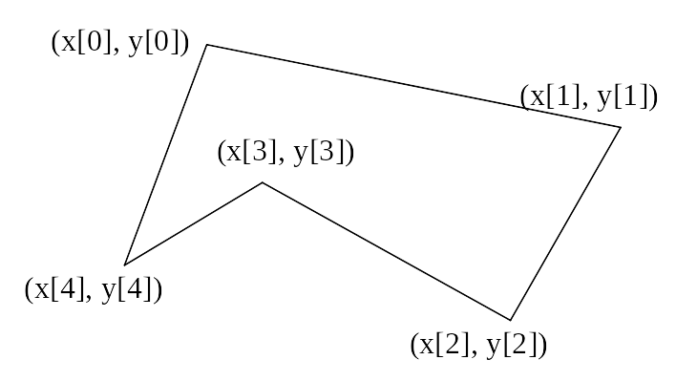
Drawing Polygons
int[] x = {40, 70, 60, 45, 20};
int[] y = {20, 40, 80, 45, 60};
g.drawPolygon(x, y, x.length);
g.fillPolygon(x, y, x.length);

Slide 35
Example 8.6
Drawing a Clock
Objective: Use drawing and trigonometric methods to draw a clock showing the specified hour, minute, and second in a frame.
DrawClock
DisplayClock
Run

Slide 36
Event-Driven Programming
Procedural programming is executed in procedural order.
In event-driven programming, code is executed upon activation of events.

Slide 37
Events
An event can be defined as a type of signal to the program that something has happened.
The event is generated by external user actions such as mouse movements, mouse button clicks, and keystrokes, or by the operating system, such as a timer.

Slide 38
Event Information
id: A number that identifies the event.
target: The source component upon which the event occurred.
arg: Additional information about the source components.
x, y coordinates: The mouse pointer location when a mouse movement event occurred.
clickCount: The number of consecutive clicks for the
mouse events. For other events, it is zero.
when: The time stamp of the event.
key: The key that was pressed or released.

Slide 39
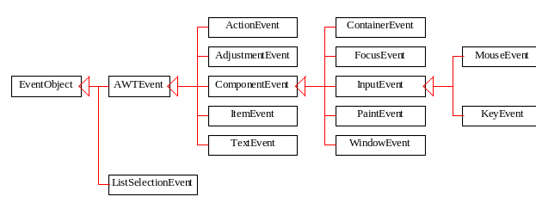
Event Classes

Slide 40
Selected User Actions
Source Event Type
User Action Object Generated
Clicked on a button JButton ActionEvent
Changed text JTextComponent TextEvent
Double-clicked on a list item JList ActionEvent
Selected or deselected an item JList ItemEvent
with a single click
Selected or deselected an item JComboBox ItemEvent

Slide 41
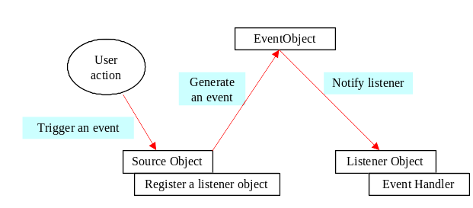
The Delegation Model

Slide 42
Selected Event Handlers
Event Class Listener Interface Listener Methods (Handlers)
ActionEvent ActionListener actionPerformed(ActionEvent)
ItemEvent ItemListener itemStateChanged(ItemEvent)
WindowEvent WindowListener windowClosing(WindowEvent)
windowOpened(WindowEvent)
windowIconified(WindowEvent)
windowDeiconified(WindowEvent)
windowClosed(WindowEvent)
windowActivated(WindowEvent)
windowDeactivated(WindowEvent)
ContainerEvent ContainerListener componentAdded(ContainerEvent)
componentRemoved(ContainerEvent)

Slide 43
Example 8.7
Handling Simple Action Events
Objective: Display two buttons OK and Cancel in the window. A message is displayed on the console to indicate which button is clicked, when a button is clicked.
TestActionEvent
Run

Slide 44
ActionListener
button1.setLabel("button1");
button1.addActionListener(new java.awt.event.ActionListener() {
public void actionPerformed(java.awt.event.ActionEvent evt) {
button1ActionPerformed(evt);
}
});

Slide 45
Example 8.8
Handling Window Events
Objective: Demonstrate handling the window events. Any subclass of the Window class can generate the following window events: window opened, closing, closed, activated, deactivated, iconified, and deiconified. This program creates a frame, listens to the window events, and displays a message to indicate the occurring event.
TestWindowEvent
Run

