Slide 1

Week 4:
Creating User Interfaces
What is JavaBean?
JComponent
JButton
ImageIcon
JLabel
JTextField
JTextArea
JComboBox
JList
JCheckBox
JRadioButton
Menus
Creating Multiple Windows
JScrollBar
JScrollPane

Slide 2
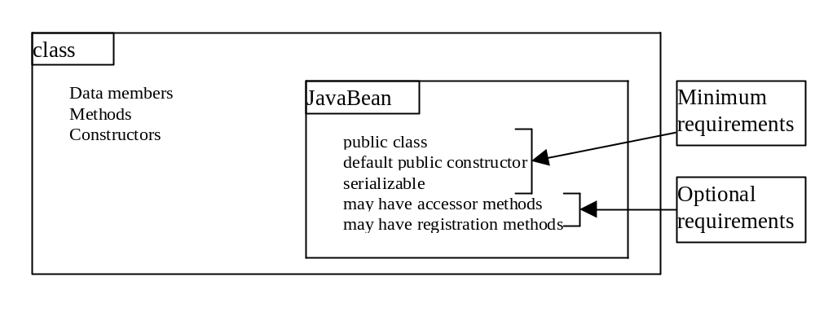
What is a JavaBean?
A JavaBean component is just a Java class that meets the following requirements.

Slide 3
Why JavaBeans?
The JavaBeans technology was developed to enable the programmers to rapidly build applications by assembling objects and test them during design time, thus making reuse of the software more productive.

Slide 4
JComponent Properties
toolTipText
font
background
foreground
doubleBuffered
border
preferredSize
minimumSize
maximumSize

Slide 5
JButton
A button is a component that triggers an action event when clicked. The following are JButton non-default constructors:
JButton(String text)
JButton(String text, Icon icon)
JButton(Icon icon)
Example 9.1: Using Buttons
ButtonDemo
Run

Slide 6
JButton Properties
text
icon
mnemonic
horizontalAlignment
verticalAlignment
horizontalTextPosition
verticalTextPosition

Slide 7
Responding to JButton Events
public void actionPerformed(ActionEvent e)
{
// Get the button label
String actionCommand = e.getActionCommand();
// Make sure the event source is a button
if (e.getSource() instanceof JButton)
// Make sure it is the right button
if ("My Button".equals(actionCommand)
    System.out.println ("Button pressed!");
}

Slide 8
JLabel
A label is a display area for a short text, an image, or both. The non-default constructors for labels are as follows:
JLabel(String text, int horizontalAlignment)
JLabel(String text)
JLabel(Icon icon)
JLabel(Icon icon, int horizontalAlignment)
Example 9.2: Using Labels
LabelDemo
Run

Slide 9
JLabel Properties
text
icon
horizontalAlignment
verticalAlignment

Slide 10
JTextField
A text field is an input area where the user
can type in characters. Text fields are useful
in that they enable the user to enter in variable data (such as a name or a description).
Example 9.3: Using Text Fields
TextFieldDemo
Run

Slide 11
JTextField Constructors
JTextField(int columns)
Creates an empty text field with the specified number of columns.
JTextField(String text)
Creates a text field initialized with the specified text.
JTextField(String text, int columns)
Creates a text field initialized with the
specified text and the column size.

Slide 12
JTextField Properties
text
horizontalAlignment
editable
columns

Slide 13
JTextField Methods
getText()
Returns the string from the text field.
setText(String text)
Puts the given string in the text field.
setEditable(boolean editable)
Enables or disables the text field to be edited. By default, editable is true.
setColumns(int)
Sets the number of columns in this text field.
The length of the text field is changeable.

Slide 14
JTextArea
If you want to let the user enter multiple lines of text, you cannot use text fields unless you create several of them. The solution is to use JTextArea, which enables the user to enter multiple lines of text.

Slide 15
JTextArea Constructors
JTextArea(int rows, int columns)
Creates a text area with the specified number of rows and columns.
JTextArea(String s, int rows, int columns)
Creates a text area with the initial text and
the number of rows and columns specified.

Slide 16
JTextArea Properties
text
editable
columns
lineWrap
wrapStyleWord
rows
lineCount
tabSize

Slide 17
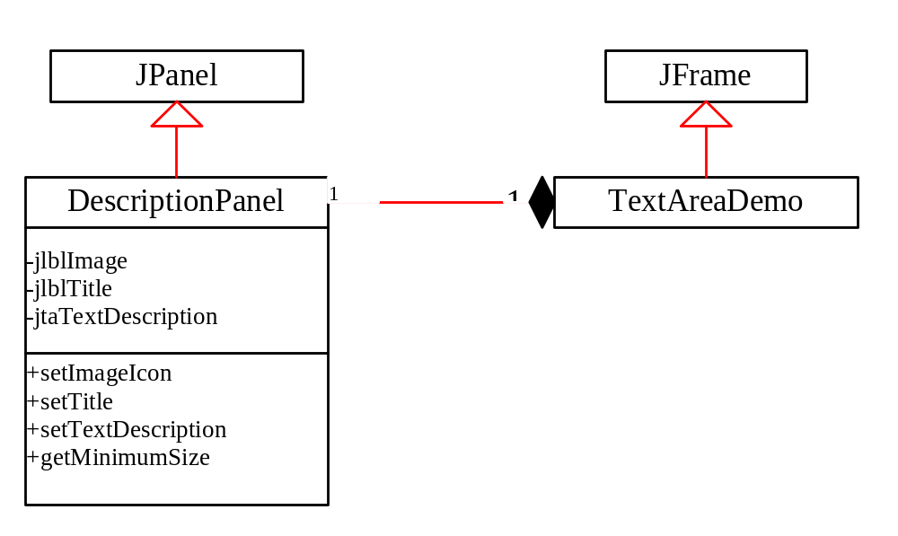
Example 9.4 Using Text Areas
This example gives a program that displays an image in a label, a title in a label, and a text in a text area.
TextAreaDemo
Run

Slide 18
JComboBox
A combo box is a simple list of items from which the user can choose. It performs basically the same function as a list, but can get only one value. To create a choice, use its default constructor:
JComboBox()
Example 9.5: Using Combo Boxes
ComboBoxDemo
Run

Slide 19
JComboBox Methods
To add an item to a JComboBox jcbo, use
jcbo.addItem(Object item)
To get an item from JComboBox jcbo, use
jcbo.getItem()

Slide 20
Using the itemStateChanged Handler
When a choice is checked or unchecked, itemStateChanged() for ItemEvent is invoked as well as the actionPerformed() handler for ActionEvent.
public void itemStateChanged(ItemEvent e)
{
// Make sure the source is a combo box
if (e.getSource() instanceof JComboBox)
String s = (String)e.getItem();
}

Slide 21
JList
A list is a component that performs basically the same function as a combo box, but it enables the user to choose a single value or multiple values.
Example 9.6: Using Lists
ListDemo
Run

Slide 22
JList Constructors
JList()
Creates an empty list.
JList(Object[] stringItems)
Creates a new list initialized with items.

Slide 23
JList Properties
selectedIndexd
selectedIndices
selectedValue
selectedValues
selectionMode
visibleRowCount

Slide 24
JCheckBox
A check box is a component that enables the user to toggle a choice on or off, like a light switch.
Example 9.7: Using Check Boxes
CheckBoxDemo
Run

Slide 25
JCheckBox Constructors
JCheckBox()
JCheckBox(String text)
JCheckBox(String text, boolean selected)
JCheckBox(Icon icon)
JCheckBox(String text, Icon icon)
JCheckBox(String text, Icon icon, boolean selected)

Slide 26
JCheckBox Properties
JCheckBox has all the properties in JButton. Additionally, JButton has the following property:
selected

Slide 27
JRadioButton
Radio buttons are variations of check boxes. They are often used in the group, where only one button is checked at a time.
Example 9.8: Using Radio Buttons
RadioButtonDemo
Run

Slide 28
JRadioButton Constructors
JRadioButton()
JRadioButton(String text)
JRadioButton(String text, boolean selected)
JRadioButton(Icon icon)
JRadioButton(String text, Icon icon)
JRadioButton(String text, Icon icon, boolean selected)

Slide 29
JRadioButton Properties
JRadioButton has all the properties in JButton. Additionally, JButton has the following property:
selected

Slide 30
Grouping Radio Buttons
  ButtonGroup btg = new ButtonGroup();
  btg.add(jrb1);
  btg.add(jrb2);

Slide 31
Borders
You can set a border on any object of the JComponent class, but often it is useful to set a titled border on a JPanel that groups a set of related user interface components.
Example 9.9: Using Borders
BorderDemo
Run

Slide 32
Static Method for Creating Borders
createTitledBorder(String title)
createLoweredBevelBorder()
createRaisedBevelBorder()
createLineBorder(Color color)
createLineBorder(Color color, int thickness)
createEtchedBorder()
createEtchedBorder(Color highlight, Color shadow, boolean selected)
createEmptyBorder()
createMatteBorder(int top, int left, int bottom, int right, Icon tileIcon)
createCompoundBorder(Border outsideBorder, Border insideBorder)

Slide 33
Message Dialogs
A dialog is normally used as a temporary window to receive additional information from the user, or to provide notification that some event has occurred.

Slide 34
Creating Message Dialogs
Use static method in JOptionPane class.
showMessageDialog(Component parentComponent, Object message, String title, int messageType)
showMessageDialog(Component parentComponent, Object message, String title, int messageType, Icon icon)

Slide 35
Example 9.10: Using Message Dialogs
Objective: Display student exam scores. The program prompts the user to enter the user’s last name and the password in a dialog box. Upon receiving the correct user name and password, the program displays the student’s full name and the exam score.
DialogDemo
Run

Slide 36
Menus
Java provides several classes—JMenuBar, JMenu, JMenuItem, JCheckBoxMenuItem, and JRadioButtonMenuItem —to implement menus in a frame.
A JFrame or JApplet can hold a menu bar to which the pull-down menus are attached. Menus consist of menu items that the user can select (or toggle on or off). Menu bars can be viewed as a structure to support menus.

Slide 37
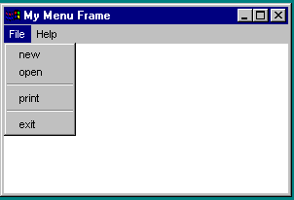
Menu Demo

Slide 38
The JMenuBar Class
A menu bar holds menus; the menu bar can only be added to a frame. Following is the code to create and add a JMenuBar to a frame:
JFrame f = new JFrame();
f.setSize(300, 200);
f.setVisible(true);
JMenuBar mb = new JMenuBar(); f.setJMenuBar(mb);

Slide 39
The Menu Class
You attach menus onto a JMenuBar. The following code creates two menus, File and Help, and adds them to the JMenuBar mb:
JMenu fileMenu = new JMenu("File", false);
JMenu helpMenu = new JMenu("Help", true);
mb.add(fileMenu);
mb.add(helpMenu);

Slide 40
The JMenuItem Class
You add menu items on a menu. The following code adds menu items and item separators in
menu fileMenu:
fileMenu.add(new JMenuItem("new"));
fileMenu.add(new JMenuItem("open"));
fileMenu.add(new JMenuItem("-"));
fileMenu.add(new JMenuItem("print"));
fileMenu.add(new JMenuItem("exit"));
fileMenu.add(new JMenuItem("-"));

Slide 41
Submenus
You can add submenus into menu items. The following code adds the submenus “Unix,” “NT,” and “Win95” into the menu item “Software.”
JMenu softwareHelpSubMenu = new JMenu("Software");
JMenu hardwareHelpSubMenu = new JMenu("Hardware");
helpMenu.add(softwareHelpSubMenu);
helpMenu.add(hardwareHelpSubMenu);
softwareHelpSubMenu.add(new JMenuItem("Unix"));
softwareHelpSubMenu.add(new JMenuItem("NT"));
softwareHelpSubMenu.add(new JMenuItem("Win95"));

Slide 42
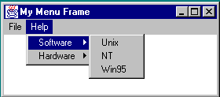
Submenu Demo

Slide 43
Example 9.11: Using Menus
Objective: Create a user interface that performs arithmetic. The interface contains labels and text fields for Number 1, Number 2, and Result. The Result box displays the result of the arithmetic operation between Number 1 and Number 2.
MenuDemo
Run

Slide 44
Creating Multiple Windows
The following slides show step-by-step how to create an additional window from an application or applet.

Slide 45
Creating Additional Windows, Step 1
Step 1: Create a subclass of JFrame (called a SubFrame) that tells the new window what
to do. For example, all the GUI application programs extend JFrame and are subclasses
of JFrame.

Slide 46
Creating Additional Windows, Step 2
Step 2: Create an instance of SubFrame in the application or applet.
Example:
SubFrame subFrame = new
SubFrame("SubFrame Title");

Slide 47
Creating Additional Windows, Step 3
Step 3: Create a JButton for activating the subFrame.
add(new JButton("Activate SubFrame"));

Slide 48
Creating Additional Windows, Step 4
Step 4: Override the actionPerformed()
method as follows:
public actionPerformed(ActionEvent e)
{
String actionCommand = e.getActionCommand();
if (e.target instanceof Button)
{
if ("Activate SubFrame".equals(actionCommand))
{
subFrame.setVisible(true);
}
}
}

Slide 49
Example 9.12 Creating Multiple Windows
This example creates a main window with a text area in the scroll pane, and a button named "Show Histogram." When the user clicks the button, a new window appears that displays a histogram to show the occurrence of the letters in the text area.
MultipleWindowsDemo
Run
Histogram

Slide 50
JScrollBar
A scroll bar is a control that enables the user to select from a range of values. The scrollbar appears in two styles: horizontal and vertical.
Example 9.13: Using Scrollbars
ScrollBarDemo
Run

Slide 51
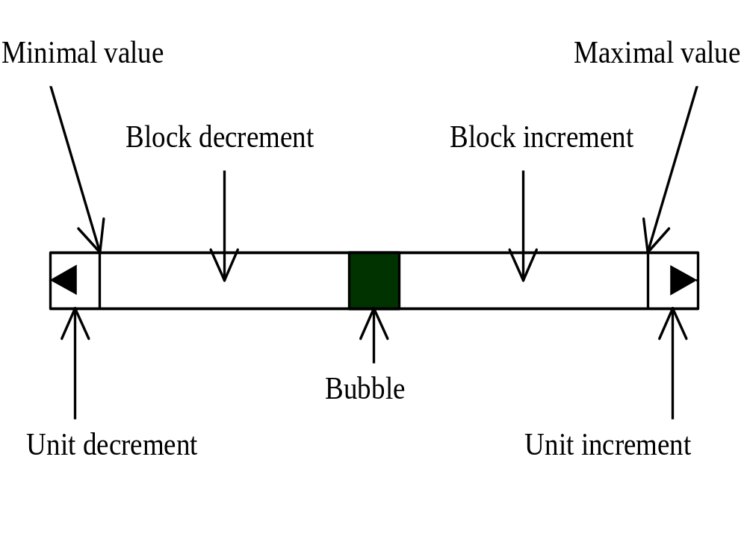
Scroll Bar Properties

Slide 52
JScrollPane
A scroll pane is a component that supports automatically scrolling without coding.
Example 9.14: Using Scroll Panes
ScrollPaneDemo
Run

Slide 53
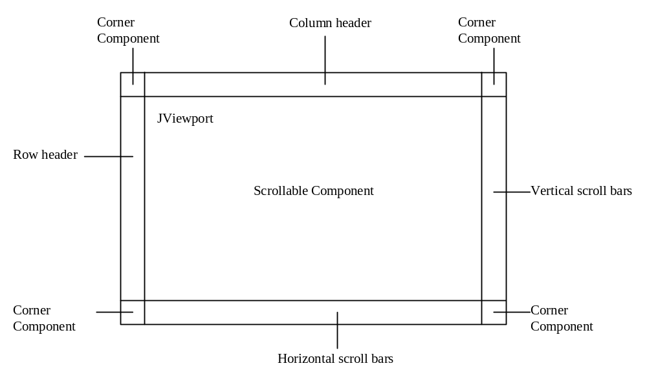
Scroll Pane Structures

Slide 54
JTabbedPane
A tabbed pane provides a set of mutually exclusive tabs for accessing multiple components.
Example 9.15: Using Tabbed Panes
TabbedPaneDemo
Run

