Slide 1

Week 4: Applets and Advanced Graphics
The Applet Class
The <applet> HTML Tag
Passing Parameters to Applets
Conversions Between Applications and Applets
Running a Program as an Applet and as an Application
Handling the Mouse Event
Handling the Keyboard Event
Model dynamic behavior using sequence diagrams and statecharts diagrams
Advanced Layout (CardLayout and GridBagLayout and using No Layout Manager) (Optional)

Slide 2
The Applet Class
public class MyApplet extends JApplet
{
public void init()
{ ... }
public void start()
{ ... }
public void stop()
{ ... }
public void destroy()
{ ... }
//your other methods
}

Slide 3
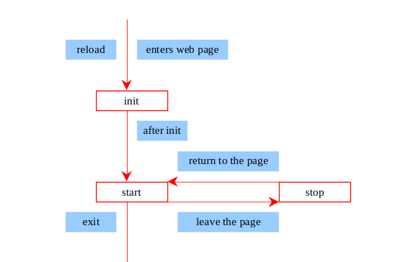
Browser Calling Applet Methods

Slide 4
The init() Method
Invoked when the applet is first loaded and again if the applet is reloaded.
Common functions implemented in this method include creating threads, loading images, setting up user-interface components, and getting parameters from the <applet> tag in the
HTML page.

Slide 5
The start() Method
Invoked after the init() method is executed; also called whenever the applet becomes active again after a period of inactivity (for example, when the user returns to the page containing the applet after surfing other Web pages).
Functionality might include restarting threads
(for example, to resume an animation) or
simply telling the applet to run again.

Slide 6
The stop() Method
The opposite of the start() method, which is called when the user moves back to the page containing the applet; the stop() method is invoked when the user moves off the page.
When the user leaves the page, any threads the applet has started—but not completed—will continue to run.

Slide 7
The destroy() Method
Invoked when the browser exits normally to inform the applet that it is no longer needed and that it should release any resources it has allocated.
Usually, you will not need to override this method unless you need to release specific resources, such as threads that the applet created.

Slide 8
Example 10.1 Using Applets
Objective: Compute mortgages. The applet enables the user to enter the annual interest rate, the number of years, and the loan amount. Click the Compute Mortgage button, and the applet displays the monthly payment and the total payment.
MortgageApplet
Run Applet Viewer

Slide 9
Writing Applets
Always extends the JApplet class, which is a subclass of Applet for Swing components.
Override init(), start(), stop(), and destroy() if necessary. By default, these methods are empty.
Add your own methods and data if necessary.
Applets are always embedded in an
HTML page.

Slide 10
The <applet> HTML Tag
<applet
code=classfilename.class
width=applet_viewing_width_in_pixels
height=applet_viewing_height_in_pixels
[archive=archivefile]
[codebase=applet_url]
[vspace=vertical_margin]
[hspace=horizontal_margin]
[align=applet_alignment]
[alt=alternative_text]
>
<param name=param_name1
value=param_value1>
</applet>

Slide 11
Running Applets in Java Plug-In
Why to Use Java Plug-In?
Java Plug-in enables Web browsers to run Java applets consistently on all the platforms.

Slide 12
How to Use Java Plug-In
Convert the HTML file to a new HTML file using the HTMLConverter Utility. The new HTML file contains the tags for invoking the Java Plug-In.
If the Plug-In is not installed, the new HTML file automatically downloads it from the Sun JavaSoft Web site.

Slide 13
Passing Parameters to Applets
<applet
code = "DisplayMessage.class"
width = 200
height = 50>
<param name=MESSAGE value="Welcome
to Java">
<param name=X value=20>
<param name=Y value=20>
alt="You must have a Java-enabled browser to view the applet"
</applet>

Slide 14
Example 10.2 Passing Parameters to Java Applets
Objective: Display a message at a specified location. The message and the location (x, y) are obtained from the HTML source.
DisplayMessage
Run Applet Viewer

Slide 15
Conversions Between Applications and Applets
Conversions between applications and applets are simple and easy.
You can always convert an applet into an application.
You can convert an application to an
applet as long as security restrictions are
not violated.

Slide 16
Example 10.3 Converting Applets into Applications
Objective: Convert MortgageApplet (from Example 10.1) to a Java application.
MortgageApplication
Run

Slide 17
Example 10.4 Converting Applications into Applets
Objective: Convert a Java application that performs simple numeric calculations (MenuDemo, from Example 9.11) into a Java applet.
AppletMenuDemo
Run Applet Viewer

Slide 18
Example 10.5
Running a Program as an Applet and as an Application
Objective: Modify MortgageApplet to enable it to run both as an applet and as an application.
DisplayMessageApp
Run as Application
Run as Applet

Slide 19
Handling Mouse Events
Java provides two listener interfaces, MouseListener and MouseMotionListener, to handle mouse events.
The MouseListener listens for actions such as when the mouse is pressed, released, entered, exited, or clicked.
The MouseMotionListener listens for
actions such as dragging or moving the
mouse.

Slide 20
Example 10.6
Moving Message Using Mouse
Objective: Create a program to display a message in a panel. You can use the mouse to move the message. The message moves as the mouse drags and is always displayed at the mouse point.
MoveMessageDemo
Run as Application
Run as Applet

Slide 21
Example 10.7
Handling Complex Mouse Events
Objective: Create a program for drawing using a mouse. Draw by dragging with the left mouse button pressed; erase by dragging with the right button pressed.
Scribble Demo
Run as Application
Run as Applet

Slide 22
Handling Keyboard Events
To process a keyboard event, use the following handlers in the KeyListener interface:
keyPressed(KeyEvent e)
Called when a key is pressed.
keyReleased(KeyEvent e)
Called when a key is released.
keyTyped(KeyEvent e)
Called when a key is pressed and then
released.

Slide 23
The KeyEvent Class
Methods:
getKeyChar() method
getKeyCode() method
Keys:
Home VK_HOME
End VK_End
Page Up VK_PGUP
Page Down VK_PGDN
etc...

Slide 24
Example 10.8
Keyboard Events Demo
Objective: Display a user-input character. The user can also move the character up, down, left, and right using the arrow keys.
KeyboardEventDemo
Run as Application
Run as Applet

Slide 25
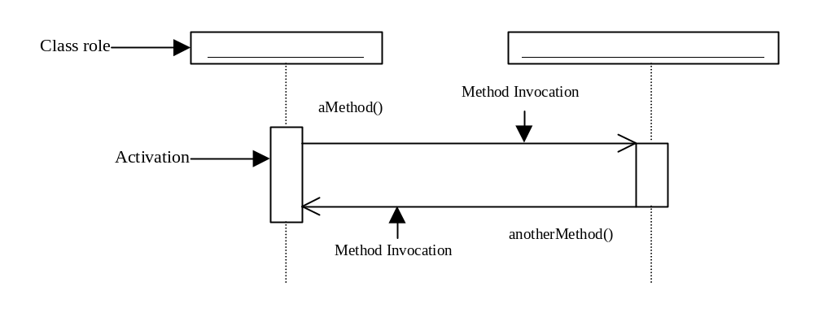
Sequence diagrams
Sequence diagrams describe interactions among objects by depicting the time ordering of method invocations.

Slide 26
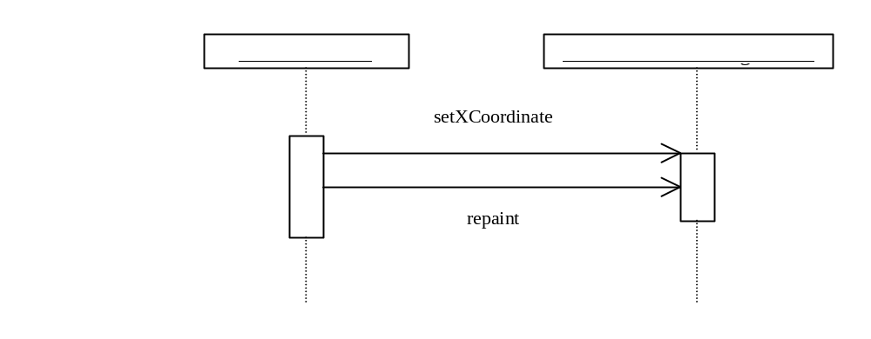
Sequence diagrams, cont.

Slide 27
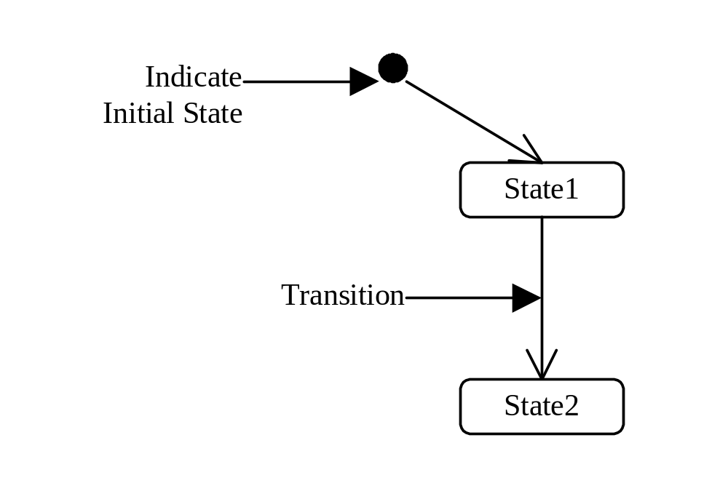
Statechart diagrams
Statechart diagrams describe flow of control of the object.

Slide 28
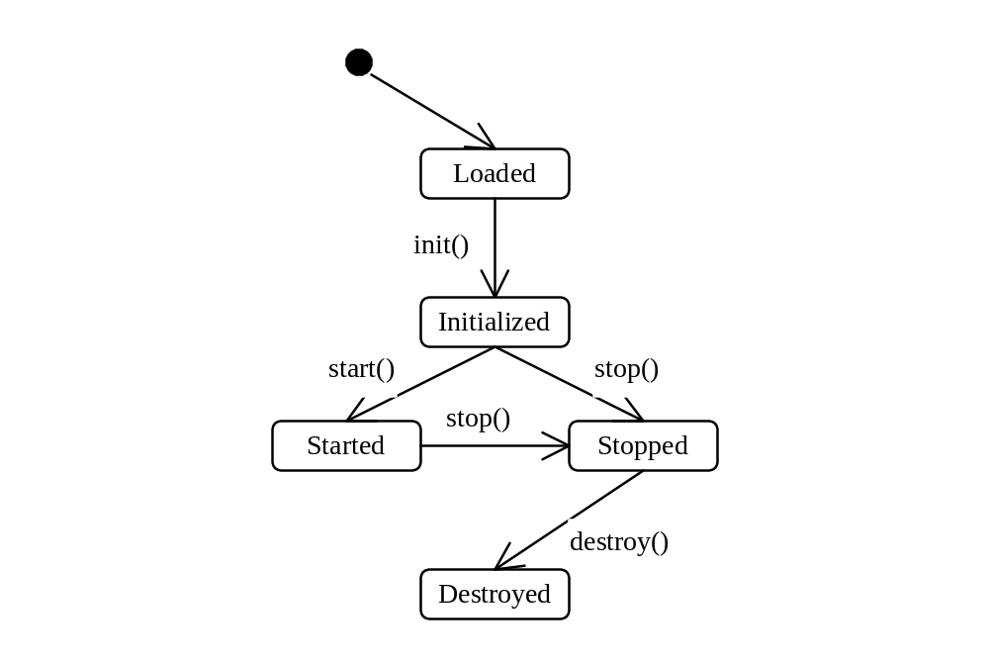
Statechart diagrams, cont.

Slide 29
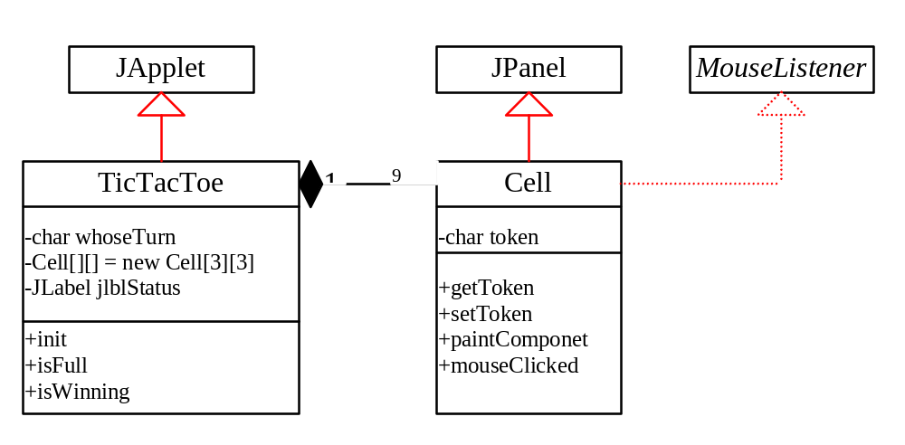
Example 10.9
The TicTacToe Game
TicTacToe
Run as Application
Run as Applet

Slide 30
Advanced Layout
(Optional from here on)
CardLayout
GridBagLayout
Using No Layout Manager

Slide 31
CardLayout (Optional from here on)
The CardLayout manager arranges components
in a queue of cards. You can only see one card at
a time. To construct a CardLayout, simply use
the constructor CardLayout().
To add a component in the CardLayout container, use the following method:
void add(Component com,
String name)

Slide 32
CardLayout View Components
void first(container)
void last(container)
void next(container)
void previous(container)
void show(Container, String name)

Slide 33
Example 10.10
Testing CardLayout Manager
Objective: Create two panels in a frame. The first panel holds named components. The second panel uses buttons and a choice box to control which component is shown.
ShowCardLayout
Run

Slide 34
GridBagLayout
The GridBagLayout manager is the most flexible and the most complex. It is similar to the GridLayout manager in the sense that both layout managers arrange components in a grid. The components can vary in size, however, and can be added in any order in GridBagLayout.
Example 10.11: Using GridBagLayout Manager
ShowGridBagLayout
Run

Slide 35
Using No Layout Manager
You can place components in a container without using any layout manager. In this case, the component must be placed using the component’s instance method setBounds().
Example 10.12: Using No Layout Manager
ShowNoLayout
Run

