Slide 1

Week 5: Exception Handling
Exceptions and Exception Types
Claiming Exceptions
Throwing Exceptions
Catching Exceptions
Rethrowing Exceptions
The finally Clause
Cautions When Using Exceptions
Creating Your Own Exception Classes (Optional)

Slide 2

Exceptions and Exception Types

Slide 3
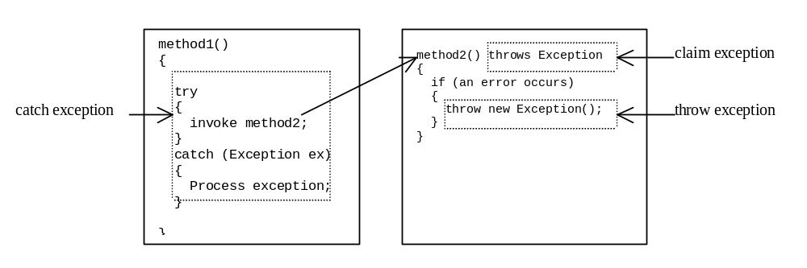
Claiming, Throwing, and Catching Exceptions

Slide 4
Claiming Exceptions
public void myMethod()
throws IOException
public void myMethod()
throws IOException, OtherException

Slide 5
Throwing Exceptions
throw new TheException();
TheException e = new TheException();
throw e;

Slide 6
Throwing Exceptions Example
public Rational divide(Rational r) throws Exception
{
if (r.numer == 0)
{
throw new Exception("denominator
cannot be zero");
}
long n = numer*r.denom;
long d = denom*r.numer;
return new Rational(n,d);
}

Slide 7
Catching Exceptions
try
{
statements;
}
catch (Exception1 e)
{ handler for exception1 }
catch (Exception2 e)
{ handler for exception2 }
...
catch (ExceptionN e)
{ handler for exceptionN }

Slide 8
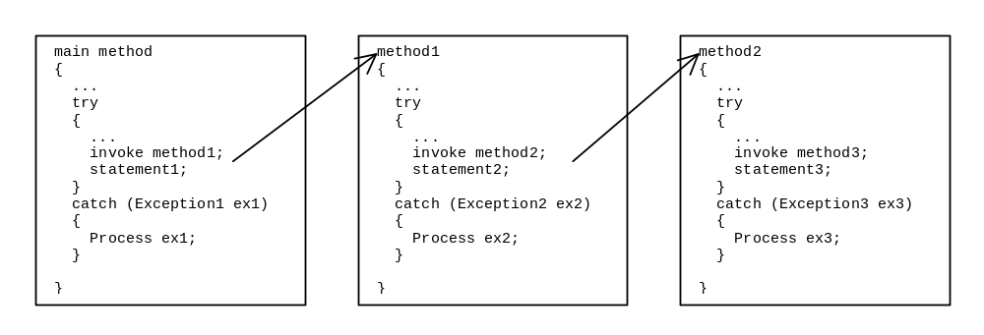
Catching Exceptions

Slide 9
Example 11.1 Claiming, Throwing, and Catching Exceptions
Objective: Write a program to test the new Rational class.
TestRationalException
Rational
Run

Slide 10
Example 11.2 Exceptions in GUI Applications
An error message appears on the console, but the GUI application continues running.
Re-run the MenuDemo applet from Example 9.9 and divide by 0 to see how a GUI deals with unhandled exceptions.
MenuDemo
Run

Slide 11
Rethrowing Exceptions
try
{
statements;
}
catch(TheException e)
{
perform operations before exits;
throw e;
}

Slide 12
The finally Clause
try
{
statements;
}
catch(TheException e)
{
handling e;
}
finally
{
finalStatements;
}

Slide 13
Cautions When Using Exceptions
Exception handling separates error-handling code from normal programming tasks, thus making programs easier to read and to modify. Be aware, however, that exception handling usually requires more time and resources because it requires instantiating a new exception object, rolling back the call stack, and propagating the errors to the calling methods.

Slide 14
Example 11.3 (Optional)
Creating Your Own Exception Classes
Objective: This program creates a Java applet for handling account transactions. The applet displays the account id and balance, and lets the user deposit to or withdraw from the account. For each transaction, a message is displayed to indicate the status of the transaction: successful or failed. In case of failure, the failure reason is reported.

Slide 15
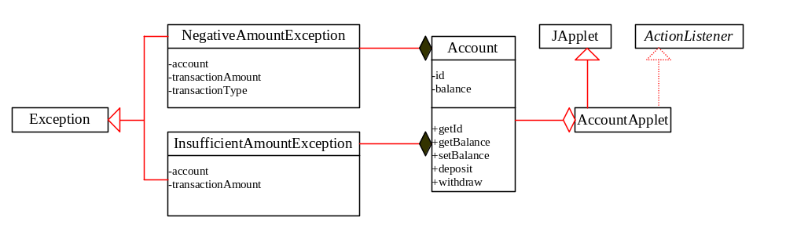
Example 11.3, cont.
InsufficientFundException
Account
NegativeAmountException
Account Applet
Run

Slide 16
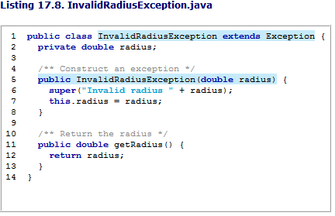
Custom exception

Slide 17
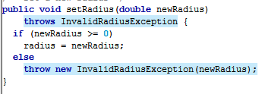

Slide 18
