Slide 1

Week 5: Multithreading
Threads Concept
Creating Threads by Extending the Thread class
Creating Threads by Implementing the Runnable Interface
Controlling Threads and Thread Status
Thread Groups
Synchronization
Creating Threads for Applets
Case Studies

Slide 2

Threads Concept
Multiple threads on multiple CPUs
Multiple threads sharing a single CPU

Slide 3
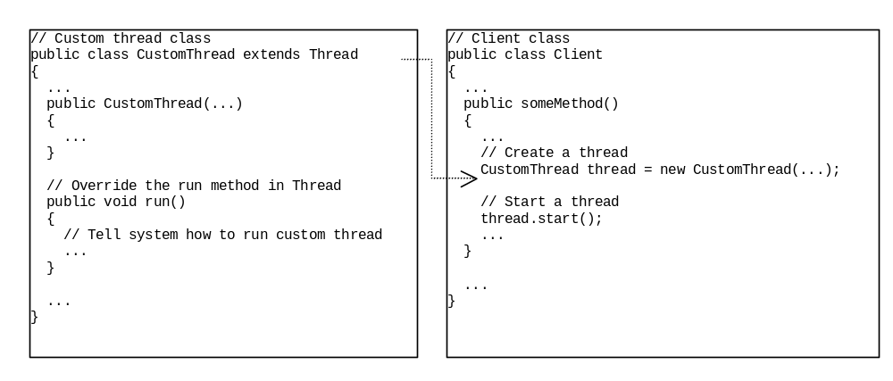
Creating Threads by Extending the Thread class

Slide 4
Example 13.1
Using the Thread Class to Create and Launch Threads
Objective: Create and run three threads:
  The first thread prints the letter a 100 times.
  The second thread prints the letter b 100 times.
  The third thread prints the integers 1 through 100.

Slide 5
Example 13.1
Using the Thread Class to Create and Launch Threads, cont.
TestThread
Run
Click the Run button to access the DOS prompt; then type java TestThread

Slide 6
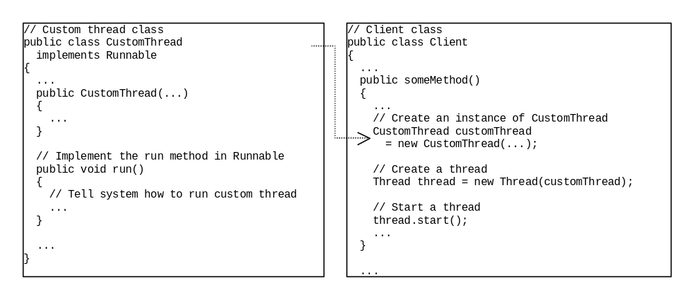
Creating Threads by Implementing the Runnable Interface

Slide 7
Example 13.2
Using the Runnabel Interface to Create and Launch Threads
Objective: Create and run three threads:
  The first thread prints the letter a 100 times.
  The second thread prints the letter b 100 times.
  The third thread prints the integers 1 through 100.
Run
TestRunnable
Click the Run button to access the DOS prompt; then type
java TestRunnable

Slide 8
Controlling Threads and Thread States
void run()
  Invoked by the Java runtime system to execute the thread. You must override this method and provide the code you want your thread to execute.
void start()
  Starts the thread, which causes the run() method to be invoked. Called by the runnable object in the client class.
static void sleep(long millis)
throws InterruptedException
Puts the runnable object to sleep for a specified
time in milliseconds.

Slide 9
Controlling Threads and Thread States, cont.
void stop()
Stops the thread. (deprecated in JDK 1.2)
void suspend() (deprecated in JDK 1.2)
Suspends the thread. Use the resume() method to resume.
void resume() (deprecated in JDK 1.2)
Resumes the thread suspended with the suspend() method.

Slide 10
Thread Priority
Each thread is assigned a default priority of Thread.NORM_PRIORITY. You can reset the priority using setPriority(int priority).
Some constants for priorities include Thread.MIN_PRIORITY Thread.MAX_PRIORITY Thread.NORM_PRIORITY

Slide 11
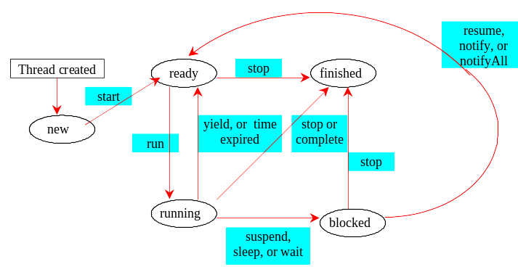
Thread States

Slide 12
Thread Groups
Construct a thread group using the ThreadGroup constructor:
ThreadGroup g = new ThreadGroup("timer thread group");
Place a thread in a thread group using the Thread constructor:
Thread t = new Thread(g, new ThreadClass(), "This thread");

Slide 13
Thread Groups, cont.
To find out how many threads in a group are currently running, use the activeCount() method:
System.out.println("The number of “
+ “ runnable threads in the group ” +
g.activeCount());

Slide 14
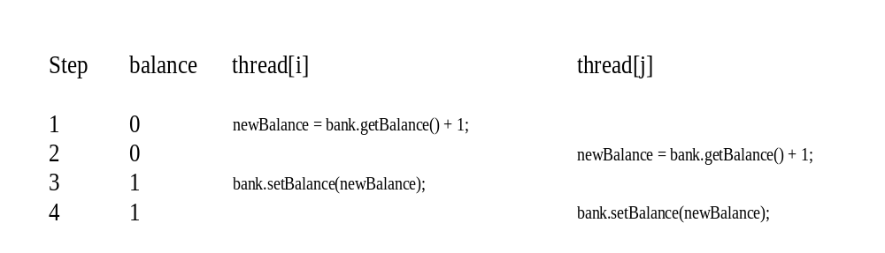
Synchronization
A shared resource may be corrupted if it is accessed simultaneously by multiple threads. For example, two unsynchronized threads accessing the same bank account causes conflict.

Slide 15
Example 13.3
Showing Resource Conflict
Objective: create and launch 100 threads, each of which adds a penny to a piggy bank. Assume that the piggy bank is initially empty.

Slide 16
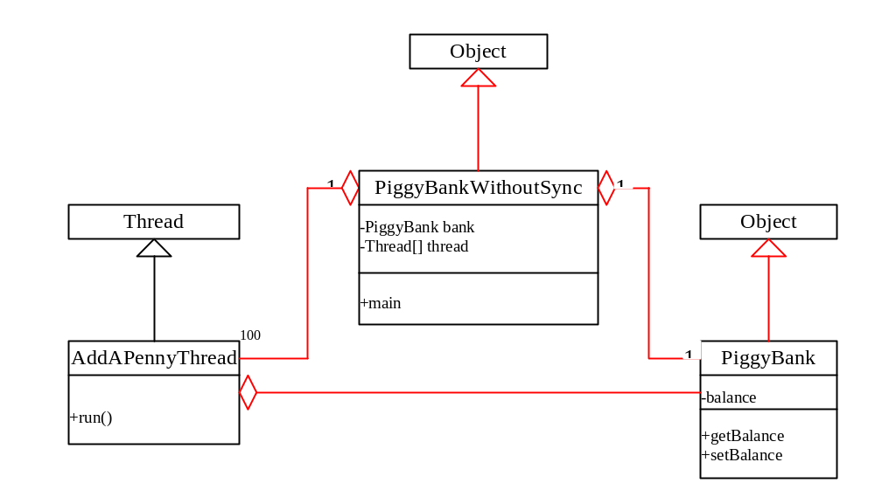
Example 13.3, cont
PiggyBankWithoutSync
Run

Slide 17
The synchronized keyword
To avoid resource conflicts, Java uses the keyword synchronized to synchronize method invocation so that only one thread can be in a method at a time. To correct the data-corruption problem in Example 13.3, you can rewrite the program as follows:
PiggyBankWithSync
Run

Slide 18
Creating Threads for Applets
In Example 12.1, "Displaying a Clock," you drew a clock to show the current time in an applet. The clock does not tick after it is displayed. What can you do to let the clock display a new current time every second? The key to making the clock tick is to repaint it every second with a new current time. You can use the code given below to override the start() method in CurrentTimeApplet:

Slide 19
Creating Threads for Applets
  public void start()
  {
  while (true)
  {
  stillClock.repaint();
  try
  {
  Thread.sleep(1000);
  }
  catch(InterruptedException ex)
  {
  }
  }
  }
  What is wrong in this code?
  As long as the while loop is
  running, the browser cannot serve
  any other event that might be
  occurring.

Slide 20
Creating a Thread to run the while loop
public class MyApplet extends JApplet implements Runnable
{ private Thread timer = null;
public void init()
{ timer = new Thread(this);
timer.start();
}
...
public void run()
{ ... }
}

Slide 21
Creating a Thread to run the while loop, cont.
  public void run()
  { while (true)
  { repaint();
  try
  { thread.sleep(1000);
  waitForNotificationToResume();
  }
  catch (InterruptedException ex)
  { }
  }
  }

Slide 22
Creating a Thread to run the while loop, cont.
  private synchronized void
  waitForNotificationToResume()
  throws InterruptedException
  {
  while (suspended)
  wait();
  }

Slide 23
Creating a Thread to run the while loop, cont.
  public synchronized void resume()
  {
  if (suspended)
  {
  suspended = false;
  notify();
  }
  }
  public synchronized void suspend()
  {
  suspended = true;
  }

Slide 24
Example 13.4 Displaying a Running Clock in in an Applet
Objective: Simulate a running clock by using a separate thread to repaint the clock.
ClockApplet
Run Applet Viewer

Slide 25
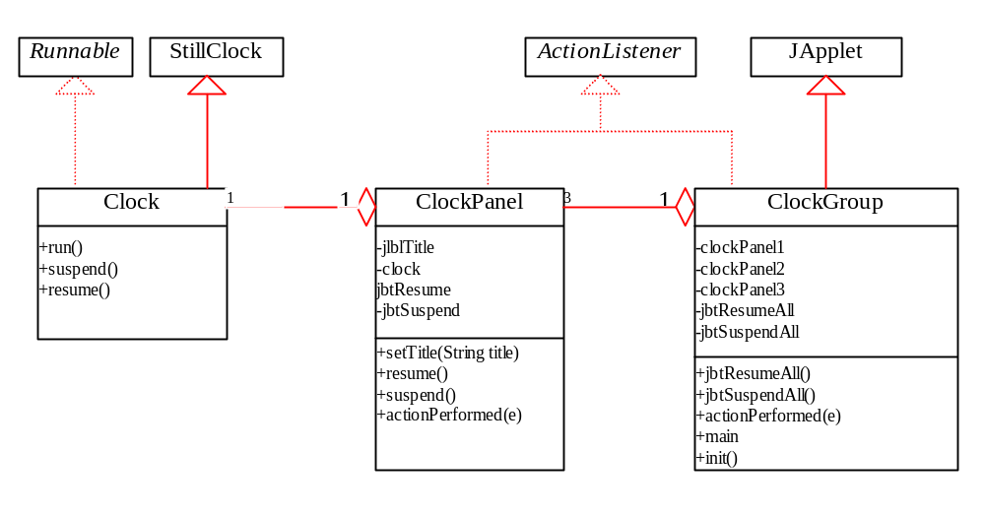
Example 13.5
Controlling a Group of Clocks
ClockGroup
ClockPanel
Clock
Run

