Slide 1
MC697 Object-Oriented Programming Using Java

Slide 2
In this class, we will cover:
How the class will be structured
Difference between object-oriented programming and procedural programming
Advantages of OOP
Introduction to Java
Building a Java class

Slide 3
How the class will be structured
Learn syntax before OO concepts
  It's hard to learn concepts when you're struggling with the language.
We will not use IDE’s in this class.
For the labs, bring a laptop to class if you have one.
Syllabus online at www2.bc.edu/bernier

Slide 4
Object-Oriented Programming (OOP) vs. Top-Down (Procedural) Programming
OO approach
  System is defined as a collection of objects that work together to accomplish tasks
    Objects carry out actions when asked
    Each object maintains its own data
Procedural approach
  System is defined as a set of procedures that interact with data
    Data is maintained separately from procedures

Slide 5
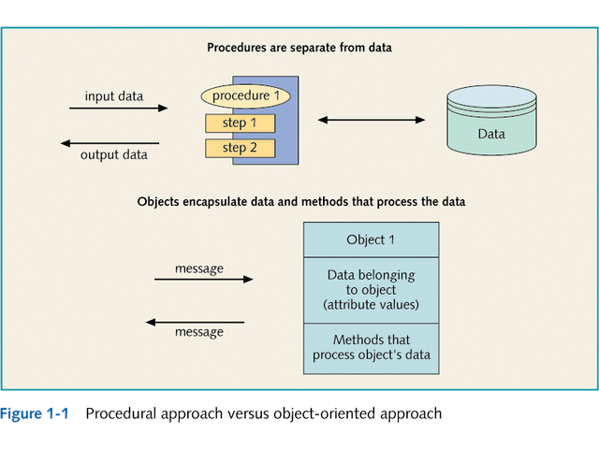

Slide 6
Advantages of Object-Oriented System Development
Objects are more natural
Reuse
  Classes and objects can be invented once and used many times during analysis, design, and programming
  Do not need source code for reused class, simply need to know interface

Slide 7
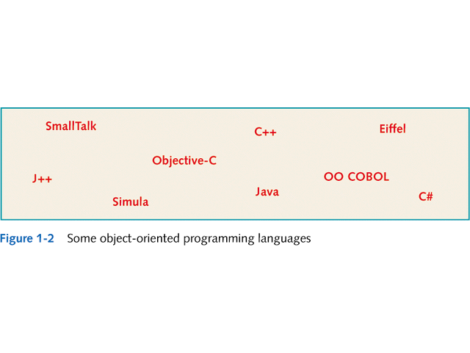

Slide 8
Introducing Java
Released mid 1995 by Sun Microsystems
Designed to be:
  A powerful, full-featured, pure OO development language
  Easy to learn - syntax is similar to C++
  Platform independent
  Support development of applications for networked environment
  Ideal for Web-based applications

Slide 9
Introducing Java
Powerful
  Class library
    Hundreds of prewritten classes
    Provide methods to accomplish various tasks
OO
  Implements OO concepts described in Ch. 1
  Encourages good software design
    Reduces debugging and maintenance

Slide 10
Introducing Java
Simplicity
  Keywords
    Java has 48 keywords
      vs. Cobol or VB which have hundreds
    Have special meaning in the language
    Used in writing statements

Slide 11
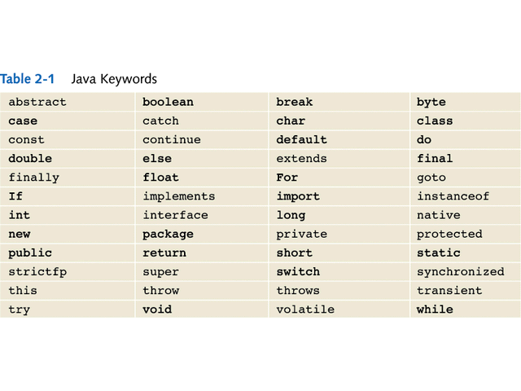

Slide 12
Introducing Java
Portability
  Programs can be written and compiled once, then run on different platforms
    Important for internet applications (applets)
  Achieved by using:
    Bytecode
      Produced when a Java program is compiled
    Interpreter (Java Virtual Machine – JVM)
      Execution environment for bytecode on each platform

Slide 13
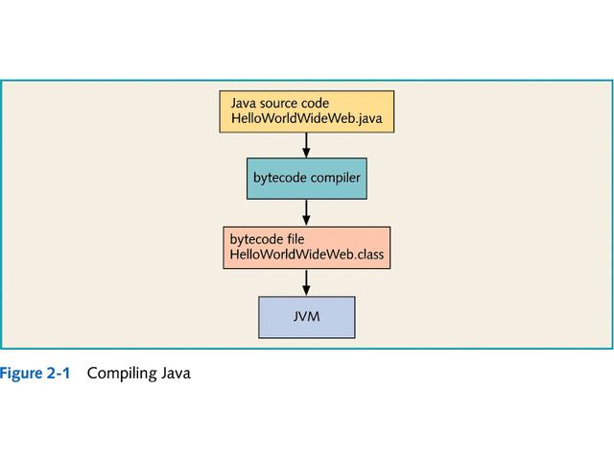

Slide 14
Introducing Java
Development environments
  Java Development Kit
    Available free from Sun Web site: java.sun.com
    Includes: compiler JVM and prewritten classes
  Integrated Development Environments (IDEs)
    Provide:
      Sophisticated editors
      Debugging tools
      Graphical development tools

Slide 15
Building a Java Class
Applets vs. Applications vs. Servlets
  Applets run on the client in a browser
  Applications run on the client on their own
  Servlets run on the server
Each source code file defines a class
  Class
    HelloWorldWideWeb
  File
    HelloWorldWideWeb.java

Slide 16
Building a Java Class
Class header
  Describes class contained in source code file
  Keywords:
    public
      Indicates class has public availability
    class
      Indicates line of code is a class header

Slide 17
Building a Java Class
Identifiers
  Name of a class, method, or variable
    Can be any length
    Can include any character except a space
    Must begin with a letter of the alphabet, a dollar sign ($), or the underscore (_) character
  Java is case sensitive
    Public isn’t the same as public

Slide 18
Building a Java Class
Block of code
  Used to group statements
  Delineated by open curly brace ({) and closed curly brace (})
  All code in Java is enclosed in a single block of code, which can contain additional blocks

Slide 19
Building a Java Class
Indentation
  Not required → recommended
Line continuation
  Can extend statements over multiple lines
    No continuation character required

Slide 20
Building a Java Class
Java code generally consists of:
  Variable definitions
  One or more methods
Method header
  Comments to identify method and describe some of its characteristics

