Slide 1
Interfaces

Slide 2
In this class, we will cover:
What an interface is
Why you would use an interface
Creating an interface
Using an interface
Cloning an object

Slide 3
Sample Problem
Say you need to design a system for a shop that sells different types of bicycles. You will most likely set up a Bicycle class that defines what a bike can and cannot do in terms of “bicycleness” (I.e. number of wheels, etc.). You will also most likely create some subclasses of bicycle like (RacingBike, MountainBike, HybridBike) to hold specialized characteristics.
But bicycles interact with the world on other terms. For example, say you want to include your Bicycle class in an inventory system. For this system you will want to include inventory characteristics with the bicycle (and its subclasses), such as price, tracking number and quantity. In OOA you would want to create a Product class and have each type of bicycle be a subclass. So, for example, you would want to make MountainBike a subclass of Product.
But wait, this is a problem…why?

Slide 4
Sample Problem
You’ve already extended MountainBike from Bicycle. How can you make this class extend from Product as well?
Problem: Java does not allow multiple inheritance like C++ does.
The Java designers did this on purpose. Multiple inheritance can cause a lot of problems and make things inefficient.
The solution they came up with was Interfaces which give most of the benefits of multple inheritance without the complexities and inefficiencies.

Slide 5
What are Interfaces?
Interfaces:
  are Java’s way of overcoming the problem of multiple inheritance.
  describe what a class should do without telling it how to do it.
  are devices or systems that unrelated entities use to interact
    for example, a remote control is an interface between you and your tv
  are a set of requirements and are analagous to a protocol (an agreed upon behavior)
    some other languages actually call their interfaces protocols
To sum up the concept of interfaces:
  Knowing how to use something means knowing how to interface with it
  The methods an instance can respond to can be defined as the interface to the instance
  Interfaces are used to assure that an instance has a defined set of methods:

Slide 6
What are Interfaces?
So, let’s go back to our Bicycle example:
  An inventory program doesn't care what class of items it manages as long as each item provides certain information, such as price and tracking number.
  Instead of forcing class relationships on otherwise unrelated items, the inventory program sets up a protocol of communication. This protocol comes in the form of a set of constant and method definitions contained within an interface.
  The inventory interface would define, but not implement, methods that set and get the retail price, assign a tracking number, and so on.
  To work in the inventory program, the bicycle class must agree to this protocol by implementing the interface.
  When a class implements an interface, the class agrees to implement all the methods defined in the interface. Thus, the bicycle class would provide the implementations for the methods that set and get retail price, assign a tracking number, and so on.

Slide 7
What are Interfaces?
So, the supplier of some service (like the inventory program) basically says “If your class conforms to a particular interface, then I’ll perform the service”.
  In other words, if the Bicycle class implements certain methods that the inventory program (the Product class) is looking for, then the inventory program will manage the tracking of the bikes in inventory.
  Similarly, a completely unrelated object could also implement this interface, than the inventory program can handle that object (e.g. televisions).

Slide 8
Example of Interfaces in Action
Let’s look at another concrete example:
  The Arrays class has a sort() method that will sort an array of objects on one condition. The objects must implement the interface Comparable.
    public interface Comparable {
    int compareTo (Object other);
    }
  This means that any class that implements the Comparable interface is required to have a compareTo method that accepts an Object parameter and return an integer. Note: all methods of an interface are automatically public.
    When calling x.compareTo(y) this method is supposed to return a negative number if x < y, zero if x = y, and a positive number if x > y.
  So, let’s say we want to sort an array of Employee objects based on their salary. You need to do two things:
    Declare that the Employee class implements the Comparable interface.
    Supply the definition for the compareTo method.
    See http://www2.bc.edu/~bernier/MC697/LectureNotes/EmployeeSortTest.java

Slide 9
Example of Interfaces in Action
Why can’t the Employee class just provide a compareTo method without implementing the Comparable interface.
  which means that when the compiler compiled the Arrays class (which contains the sort method) a long time ago, it needed to check that the compareTo method actually exists.
  In the Arrays.sort method there are lines like:
  if (a[i].compareTo(a[j]) > 0)
  {
  // rearrange a[i] and a[j]
  …
  }
  When the Arrays class was compiled, the compiler needed to know that a[i] will actually have a compreTo method. If a is an array of Comparable objects, then the existence of the method is assured, because every class that implements the Comparable interface must supply the method.

Slide 10
Creating an Interface
Creating a interface
  Looks much like a class, except all of its methods must be abstract and all of its data (if any) must be static final (constants). Methods are automatically public.
  Created much the same way as a class
    Interfaces are similar to abstract classes with no instance fields
Using an interface
  Use the keyword implements and the interface name in the class header
  implements exposes elements of the program to the user without exposing the source code
  Note: You can implement more than one interface.
    Use a comma to separate them.
  public class Employee extends Person implements Cloneable, Comparable {
  }

Slide 11
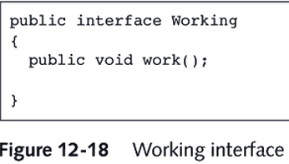

Slide 12
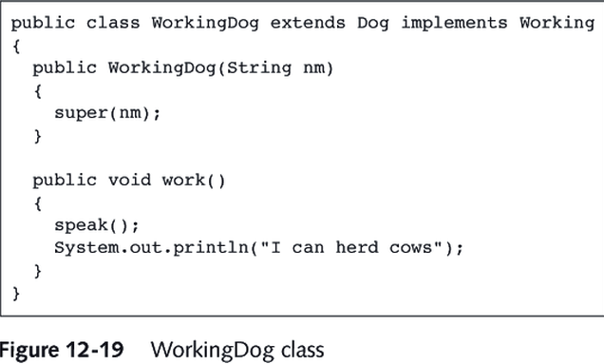

Slide 13
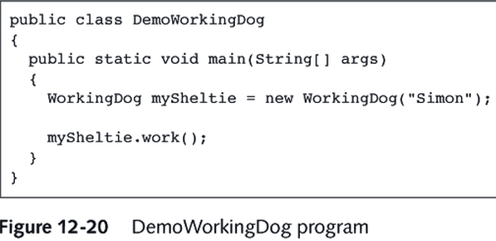

Slide 14
Interface Properties
Declaring interface variables
  Like classes, you can declare interface variables.
  You do not construct interface objects.
    e.g. x = new Comparable(…); // Wrong!!
  Instead you declare them like this:
  Comparable x;
  x = new Employee( ); // this is ok if Employee implements Comparable
  You can also use the instanceOf check to see if an object implements an interface
  if (anObject instanceOf Comparable) {…}
  is similar to
  if (anObject instanceOf Employee) { … }

Slide 15
Interface Properties
Building hierarchical chains of interfaces
  Like inheritance in classes, you can extend interfaces.
  Public interface Moveable {
  void move(double x, double y);
  }
  public interface Powered extends Moveable {
  double milesPerGallon();
  }
  A class that implements Powered would need to implement the methods move and milesPerGallon.

Slide 16
When Should You Use Interfaces
Interfaces are particularly useful when:
  Component-based development
    System components interact using well-defined interface built from a variety of technologies
      If interface is known → can be used in a system that does not need to know the technology used or the internal structure of component
  Working with gui’s.
    used to handle events
      similar to passing a function in other languages, but it is more flexible to pass an object - that is the OO approach
    we will go over this more later
  See http://www2.bc.edu/~bernier/MC697/LectureNotes/TimerTest.java

Slide 17
Cloning an Object
When you copy a reference variable, the original and copy are references to the same object.
  Any change to either variable affects the other.
To create a new object that is separate from the original, use the clone() method.
  clone() is a method of the Object class.
  You must cast the clone because the clone() method returns an object.
  Employee original = new Employee(“John Public”, 50000);
  Employee copy = (Employee) original.clone();
  The clone() method returns a “shallow copy”
    basic data types in the cloned object are copied fine
    reference to mutable sub-objects though (e.g. Dates and Strings) in the cloned object still point to the original object’s sub-objects
  So, in the Employee example:
    salary would copy just fine
    name and hireDate copies, however, would just be reference pointers to the original sub-objects. So any change to the original’s name would affect copy’s name.

Slide 18
Cloning an Object
To fix this, we need to use a “deep copy”.
To perform a deep copy, the object needs to define its own clone() method.
  In the clone method, it will need to clone the mutatable sub objects.
Whether you are doing a shallow copy or a deep copy, you must define the clone() method. Below are examples of each kind.
Example of a shallow copy:
class Employee implements Cloneable {
public Object clone() { // raise the visibility of clone()
try {
return super.clone();
}
catch (CloneNotSupportedException e) { return null; }
// this won’t happen since we implemented Cloneable
}
}

Slide 19
Cloning an Object
Example of a deep copy:
class Employee implements Cloneable {
public Object clone() { // raise the visibility of clone()
try {
Employee cloned = (Employee) super.clone();
// clone the mutable sub-objects
cloned.hireDay = (Date) hireDay.clone();
return cloned;
}
catch (CloneNotSupportedException e) { return null; }
// this won’t happen since we implemented Cloneable
}
}
See http://www2.bc.edu/~bernier/MC697/LectureNotes/CloneTest.java

