Slide 1
Fundamental Programming Structures in Java:
Comments, Data Types, Variables, Assignments, Operators

Slide 2
In this class, we will cover:
Building a Java class
Using Java variables and data types
Method Definitions
Computing with Java

Slide 3
Building a Java Clss
Previous lab and homework demonstrated a simple Java application.
public class HelloWorld {
public static void main(String[] args) {
System.out.println(“Hello World”);
}
}
Be familiar with the basic components of this sample. All applications will have this framework.
Remember: Class names should begin with a capital.

Slide 4
Building a Java Class
Java code generally consists of:
  Comments
  Variable definitions
    e.g.
      int aNumber = 1;
      boolean isFound = true;
      double anotherNumber = 1.50;
      String s = “example of a string”;
    note the naming conventions
  Method definitions
    e.g.
      the main method in applications
      public static void main (String[] args) {
      }
      public computeTax();
    again note the naming conventions

Slide 5
Building a Java Class
Comments
  Single line
    // compiler ignores everything to end of line
  Multi-line
    /* compiler ignores everything in between */
  Multi-line (documentation)
    /** compiler ignores everything in between */
    Used for JavaDoc
  Comments do not appear in executable code

Slide 6
Variable Definitions
Variable definitions
  Variable: name of place in memory that can contain data
  All variables have:
    Data type → kind of data variable can contain
    Name → identifier that refers to the variable
    Value → the default or specified value
      also called the literal of the statement
    Semicolon
      Remember: All java statements end with a semicolon!
  e.g.
    String s = “MC697”;
    int count = 5;

Slide 7
Variable Definitions
Initializing Variables
  Assignment operator (=)
    Used to assign value to a variable
      char c = ‘a’; - note the single quotes
      boolean b = true;
      double d = 1.25;
    Important: This is different from the comparative equals (==)
    If variable is not initialized, most will default to null.
    All variables should be initialized.

Slide 8
Data Types
Declaring Variables
  Variable data type must be declared prior to initialization
  There are two basic data types:
    Primitive data types
      Eight available primitive data types
      Primitive data types are not capitalized in variable declarations
        int aNumber = 5;
    Reference data types
      These data types are capitalized.
        String s = “example string”;

Slide 9
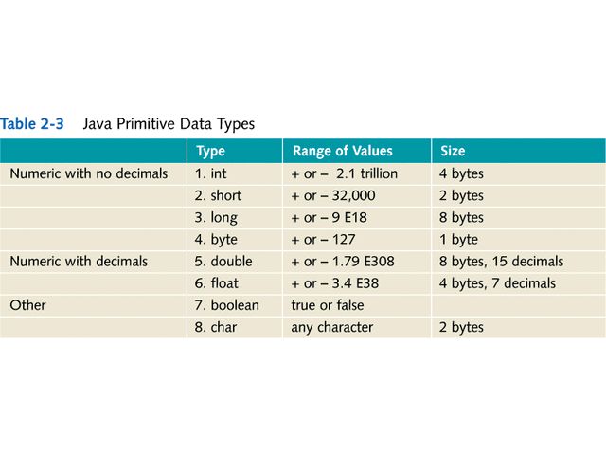

Slide 10
Data Types
Using Reference Variables
  Uses class name as a data type
  Points to an instance of that class
  Example:
        String s = “Hello World”;
        Employee emp1;

Slide 11
Variable Constants
Using Constants
  Variable with a value that doesn’t change
  Keyword
    final
      Denotes value cannot change
  Example:
    final double SALES_TAX_RATE = 4.5;
    note the naming convention
    other examples?

Slide 12
Method Defnitions
Methods contain:
  access modifier
    defines who can call this method
  return type
    defines what this method will return
  static
    optional - we will discuss this later
  method name
    should begin with a lower case
  argument definition section
    defines what input is expected in this method
  block of code with statements

Slide 13
Statements Within a Method
This is the logic of the program.
  Can define and assign variables.
  Can invoke another method
    Send the method a message asking it to execute
    Message is sent in the argument section.
      e.g. System.out.println(“output from method”);
      What is the argument in this method?

Slide 14
Computing with Java
Changing Data Types
  If changing data type results in no loss of precision, can be done implicitly:
    int c = 5; double a, b = 3.5;
    a = b + c;
  What is it called when you explicitly change the data type?

Slide 15
Computing with Java
  Casting allows data type changes explicitly with loss of precision:
    int a, c = 5; double b = 3.5;
    a = (int) b + c;

Slide 16
Computing with Java
Operators
  Arithmetic operators (+,-,*,/)
    addition, subtraction, multiplication, division
    Precedence using parentheses
    Remainder (modulus) operator (%)
      Produces remainder from division of two integers
    Concatenation operator (+)
      Joins String literals and variables
      Automatically converts numeric and Boolean values to strings before use in println method
Math Class
  Methods for exponentiation, rounding, etc.

Slide 17
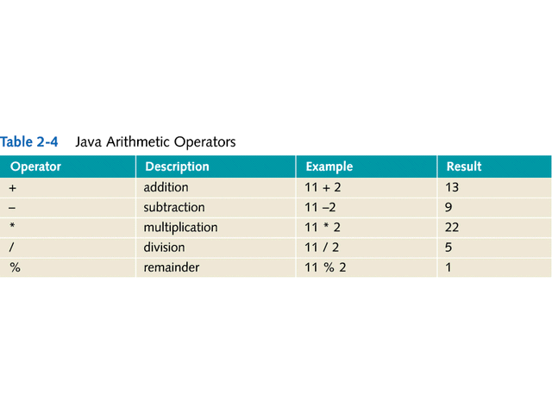

Slide 18
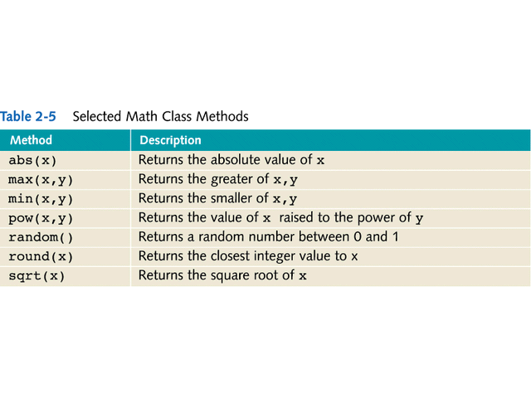

Slide 19
Computing with Java
Special Operators
  For writing shortcut code
    Increment operator (++)
      Add one to a variable
    Decrement operator (--)
      Subtract one from a variable
    Assignment operator with arithmetic operators:
      total = total + 5;
      What is another way of writing this statement?

Slide 20
Review Questions from Reading:
Which primitive data types are you most likely to use?
In the following variable definitions:
String s = “sample string”;
char char1 = ‘a’;
Why is String capitalized and char not?
What is Casting?

