Slide 1
Fundamental Programming Structures in Java:
Control Flow, Arrays and Vectors

Slide 2
In this class, we will cover:
Blocks and scope
Writing decision-making statements
Writing loops
Declaring and accessing arrays and vectors

Slide 3
Blocks and Scope
All classes and methods contain code within curly brackets called blocks.
Where is the error in this class.
class ScopeExample {
public static void main(String[] args) {
// aNumber comes into existence
int aNumber = 22;
System.out.println("Number is " + aNumber);
{
// anotherNumber comes into existence
int anotherNumber = 99;
System.out.println("aNumber is " + aNumber);
System.out.println("anothreNumber is " + anotherNumber);
} // End of block - anotherNumber ceases to exist
System.out.println("aNumber is " + aNumber);
System.out.println("anotherNumber is " + anotherNumber);
} // End of outer block - anumber ceases to exist
}

Slide 4
Writing Decision-Making Statements
Decision-Making Statements
  Determine whether a condition is true, and take some action based on determination
  What are the three ways to write a decision-making statement in Java?

Slide 5
Three ways to write decision-making statements:
  if statement
  switch statement
  conditional operator

Slide 6
Writing Decision-Making Statements
Writing if Statements
  if statement:
    Interrogates logical expression enclosed in parentheses
      boolean expressions can use just one word
      example:
      boolean isFound=true;
      if (isFound)
      System.out.println(“The object is found.”);
    Determines whether it is true or false
    Uses logical operators to compare values

Slide 7
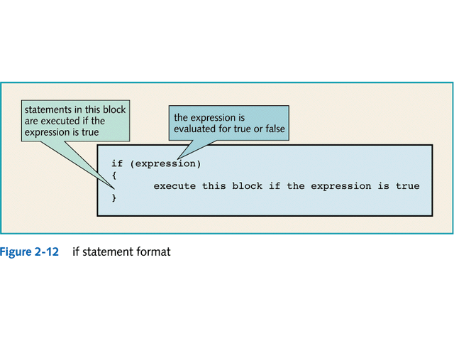

Slide 8
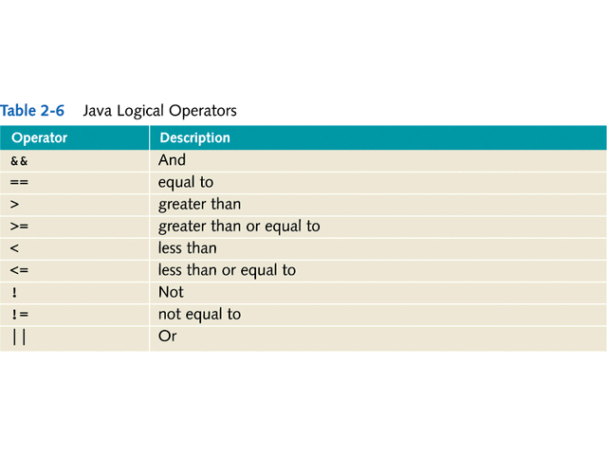

Slide 9
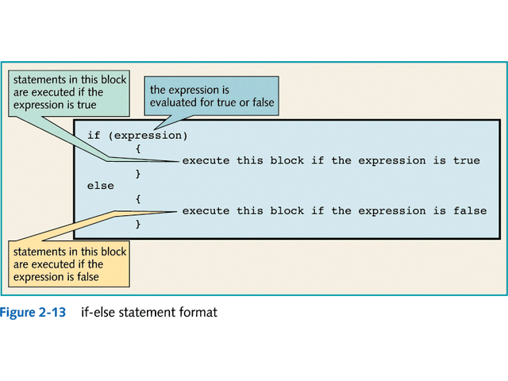

Slide 10
Writing Decision-Making Statements
Writing if Statements
  You don’t need the brackets for only one statement.
  if statements can contain compound expressions
    Two expressions joined using logical operators
      OR → ||
      AND → &&
  Nested if statement
    if statement written inside another if statement
    the else statement always corresponds with the closest if statement

Slide 11
Writing Decision-Making Statements
Using the Conditional Operator
  Conditional operator (?)
    Provides a shortcut to writing an if-else statement
    Structure:
      variable = expression ? value1:value2;
    example
    int smallerNumber = (a < b) ? a : b;

Slide 12
Writing Decision-Making Statements
Writing switch Statements
  Acts like a multiple-way if statement
  Transfers control to one of several statements or blocks depending on the value of a variable
  Used when there are more than two values to evaluate
  Restrictions:
    Each case evaluates a single variable for equality only
    Variable being evaluated must be: char, byte, short, or int

Slide 13
Example of Switch Statement
char eventType;
…
switch (eventType)
{
case ‘A’:
eventCoordinator = “Dustin”;
break;
case ‘B’:
eventCoordinator = “Heather”;
break;
case ‘C’:
eventCoordinator = “Will”;
break;
default:
eventCoordinator = “Invalid Entry”;
}

Slide 14
Writing Loops
Loops
  Provides for repeated execution of one or more statements until a terminating condition is reached
  Three basic types:
    while
    do
    for
  What is the difference between the while and do loops?

Slide 15
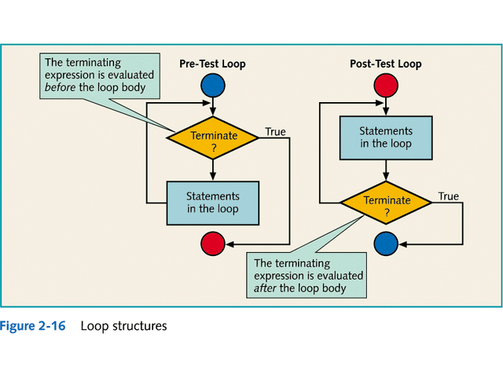

Slide 16
Writing Loops
Writing while Loops
  Loop counter
    Counts number of times the loop is executed
  Two kinds of loops
    Pre-test loop
      Tests terminating condition at the beginning of the loop
    Post-test loop
      Tests terminating condition at the end of the loop
  Example of a while loop
  while (count <= 10) {
  System.out.println(“count = “ + count);
  count++;
  }

Slide 17
Writing Loops
Writing do Loops
  Loop counter
    Counts number of times the loop is executed
  Post-test loop
      Tests terminating condition at the end of the loop
      Forces execution of statements in the loop body at least once
  Example:
    do {
    System.out.println(“count = “ + count);
    count++;
    }
    while (count <= 10);

Slide 18
Writing Loops
Writing for Loops
  Loop counter
    Counts number of times the loop is executed
  Pre-test loop
      Tests terminating condition at the beginning of the loop
  Includes counter initialization and incrementing code in the statement itself
  Example:
    for (int count=1; count<=10; count++) {
    System.out.println(“count = “ + count);
    }

Slide 19
Writing Loops
Writing Nested Loops
  A loop within a loop
  Useful for processing data arranged in rows and columns
  Can be constructed using any combinations of while, do, and for loops

Slide 20
Declaring and Accessing Arrays
Arrays
  Allows the creation of a group of variables with the same data type
  Consist of elements:
    Each element behaves like a variable
  Can be:
    One dimensional
    Multi-dimensional

Slide 21
Declaring and Accessing Arrays
Using One-Dimensional Arrays
  Keyword
    new
      Used to create a new array instance
      int testScores[] = new int[10];
  Use brackets ([]) and indices to denote elements:
    testScores[5] = 75;
  Note: Arrays in Java begin with 0 not 1
  Used in the main method of applications.

Slide 22
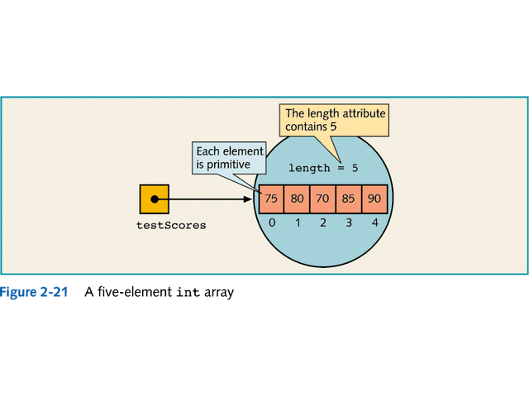

Slide 23
Declaring and Accessing Arrays
Using Multidimensional Arrays
  Array of arrays
    Three dimensions → cube
    Four dimensions → ???
  Each dimension has its own set of brackets:
    testScoreTable[5][5] = 75;

Slide 24
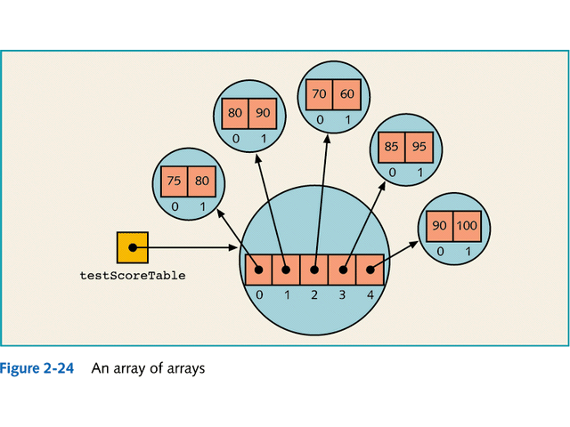

Slide 25
Vectors
Similar to arrays but do not need to declare size
Can contain a list of different object types
Structure
    Vector vec = new Vector();
Vector class has many helpful methods such as:
  isEmpty()
  indexOf(Object arg)
  contains(Object arg)
  See java docs for more info

Slide 26
Vectors
Use the Enumeration class to iterate through a vector
  Example:
  Vector vec = new Vector();
  vec.addElement(“one”);
  vec.addElement(“two”);
  vec.addElement(“three”);
  Enumeration e = vec.elements();
  while (e.hasMoreElements()) {
  System.out.println(“element = “ + e.nextElement());
  }
  Result:
  element = one
  element = two
  element = three

