Slide 1
Fundamental Programming Structures in Java:
Strings

Slide 2
In this class we will cover how to:
Manipulate characters
Declare a String object
Compare String values
Use other String methods
Convert Strings to numbers
Use the StringBuffer class
Use of the StringTokenizer class

Slide 3
Manipulating Characters
Character class- Contains standard methods for testing the values of characters, such as letters or digits
  Primitive data type char is used to hold any single character
  The Character class is defined in java.lang.Object
  Automatically imported into every program you write
  What is the difference between char and Character?

Slide 4
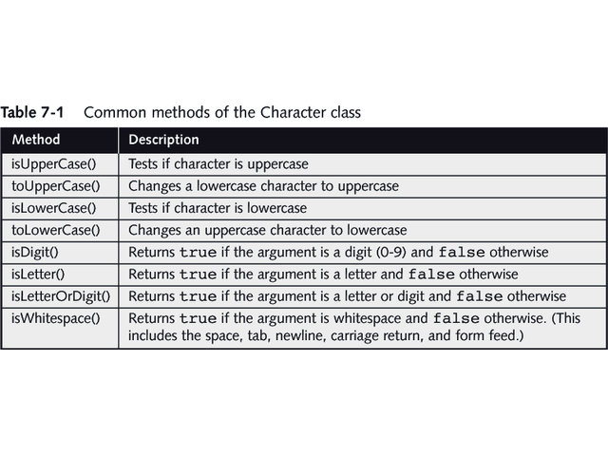

Slide 5
Example of Using Character Class
Source code:
  public class CharacterUse {
  public static void main(String[] args) {
  char c = 'c';
  System.out.println("uppercase is " +
  Character.toUpperCase(c));
  }
  }
Result:
  uppercase is C

Slide 6
Declaring a String Object
String variable
An object of the class String
  The class String is defined in java.lang.String and is automatically imported into every program
The string itself is distinct from the variable you use to refer to it
Create a String object by using the keyword new and the String constructor method
  String aGreeting = new String(“Hello”);
What does it mean when someone says Strings are immutable?

Slide 7
Strings are Immutable
Immutable- Strings and other objects that can’t be changed
  String is a class; each created String is a class object
  Strings are never actually changed; instead new Strings are created and String variables hold the new addresses.
  A part of the Java system called the garbage collector will eventually discard the unused strings
So, what does this mean for Java programmers?

Slide 8
Changing String Values
Strings have no methods to let you change an existing character in a string.
  To change a string you have to reassign the variable to a new string.
  example:
    String greeting = “Hello”;
    greeting = greeting.substr(0,4) + “!”;
    Result: greeting is now “Hell!”

Slide 9
Comparing String Values
Because String variables hold memory addresses, you cannot make a simple comparison
The String class provides a number of methods
  equals() method
  equalsIgnoreCase() method
  compareTo() method

Slide 10
Comparing String Values
equals() method- Evaluates the contents of two String objects to determine if they are equivalent
  This method returns true if the two String objects have identical contents
  Can take either a variable String object or a literal string as its argument
    s1.equals(s2);
    s1.equals(“Hello”);

Slide 11
Comparing String Values
equalsIgnoreCase() method- Similar to the equals() method
  Ignores case when determining if two Strings are equivalent
  Useful when users type responses to prompts in your program

Slide 12
Comparing String Values
compareTo() method- Used to compare two Strings
  It provides additional information to the user in the form of an integer value
  Returns zero only if the two Strings hold the same value
  If there is any difference between the Strings, a negative number is returned if the calling object is “less than” the argument
  A positive number is returned if the calling object is “more than” the argument
  Strings are considered “less than” or “more than” each other based on their Unicode values

Slide 13
Using Other String Methods
There are additional String methods available in the String class
  toUpperCase() and toLowerCase() convert any String to its uppercase or lowercase equivalent
  substr() returns a portion of a String
    e.g. String s = “Hello”;
    String s2 = s.substring(1,4);
    What is the value of s2?
  What are some other String methods?
  See the API documentation for a complete list of String methods

Slide 14
Using Other String Methods
  indexOf() method determines whether a specific character occurs within a String
    If it does contain that character, the method returns the position of the character
    The first position of a String is zero, not one
    The return value is -1 if the character is not in the String

Slide 15
Using Other Methods
charAt() method requires an integer argument which indicates the position of the character that the method returns
endsWith() method and the startsWith() method each take a String argument and return true or false if a string object does or does not end or start with the specified argument
replace() method allows you to replace all occurrences of some character within a String
toString() method converts any primitive type to a String

Slide 16
Concatenation
Concatenation- Joining strings
Examples:
  “45” + “36” = “4536”
  String name = “Cartman”;
  System.out.println(“Name is “ + name);

Slide 17
Converting Strings to Numbers
To convert a String to a number
Use the Integer class
  Part of java.lang
parseInt() method is part of the Integer class and takes a String argument and returns its integer value
  Use the integer value as any other integer
  Useful for taking in integer parameters
  e.g. String s = args[0];
  int aNumber = Integer.parseInt(s);
  aNumber++;
To convert a String object to a double value you must use the Double class

Slide 18
Learning about the StringBuffer Class
A String class limitation is that the value of a String is fixed after the string is created
To circumvent these limitations you can use the StringBuffer class

Slide 19
StringBuffer
StringBuffer is an alternative to the String class
Part of the java.lang package
Must use the keyword new and provide an initializing value between parentheses
A StringBuffer object contains a memory block called a buffer which might not contain a string

Slide 20
StringBuffer
The length of the String may not be the same as the length of the buffer
The length of the buffer is referred to as the capacity of the StringBuffer object
You can change the length of a String in a StringBuffer object with the setLength() method
When the StringBuffer object’s length is longer than the String it holds, the extra characters contain ‘\u0000’
If you use the setLength() method to specify a length shorter than its String, the string is truncated

Slide 21
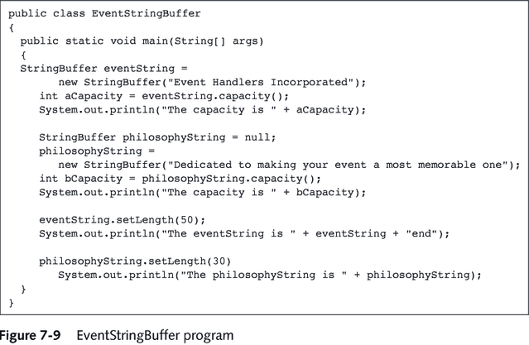

Slide 22
StringBuffer
Using StringBuffer objects provide more flexibility than String objects because you can insert or append new contents into a StringBuffer

Slide 23
StringBuffer Constructors
The StringBuffer class provides 3 constructors
  public StringBuffer() constructs a StringBuffer with no characters and a default size of 16 characters
  public StringBuffer(int length) constructs a StringBuffer with no characters and a capacity specified by length
  public StringBuffer(String s) contains the same characters as those stored in the String object s

Slide 24
StringBuffer Methods
append() method- Lets you add characters to the end of a StringBuffer object
insert() method- Lets you add characters at a specified location within a StringBuffer object
setCharAt() method- Use to alter just one character in a StringBuffer

Slide 25
StringBuffer Methods
charAt() method extracts characters from a StringBuffer object
  Accepts an argument that is the offset of the character position from the beginning of a String

Slide 26
StringTokenizer
Used to break up a string based on a certain “token”
  e.g. take the string “Homer, Marge, Bart, Lisa, Maggie”
  You can use the StringTokenizer to break up the string based
  on the comma to get five separate strings
  “Homer” “Marge” “Bart” “Lisa” and “Maggie”
Easier than using the “if” statement
Example:
  String testString = “one-two-three”;
  StringTokenizer st = new StringTokenizer(testString,”-");
  while (st.hasMoreTokens()) {
  String nextName = st.nextToken();
  System.out.println(nextName);
  }
  Result:
  one
  two
  three

