Slide 1
Basic OOP Concepts and Terms

Slide 2
In this class, we will cover:
Objects and examples of different object types
Classes and how they relate to objects
Object attributes and methods
Object interactions and messages
Encapsulation and information hiding
Inheritence and polymorphism
The three-tier architecture design
An introduction to UML

Slide 3
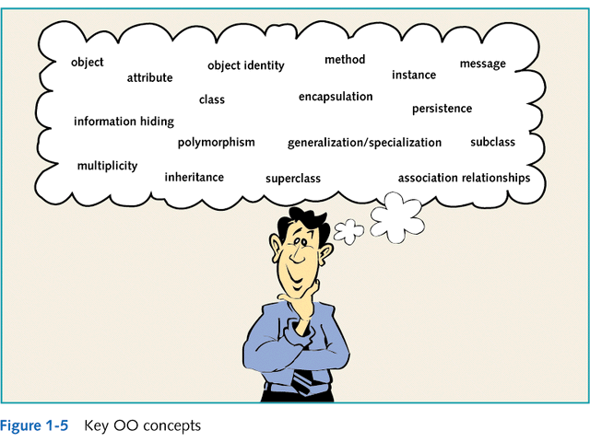

Slide 4
Objects
Most basic component of OO design. Objects are designed to do a small, specific piece of work.
Objects represent the various components of a business system

Slide 5
Examples of Different Object Types
GUI objects
  objects that make up the user interface
  e.g. buttons, labels, windows, etc.
Problem Domain objects
  Objects that represent a business application
  A problem domain is the scope of what the system to be built will solve. It is the business application.
    e.g. An order-entry system
    A payroll system
    A student system

Slide 6
Sample Problem Domain
Company ABC needs to implement an order-entry system that takes orders from customers for a variety of products.
What are the objects in this problem domain?
Hint: Objects are usually described as nouns.

Slide 7
Possible Objects for this Problem Domain
Customer
Order
Product

Slide 8
Classes and Objects
Classes
  Define what all objects of the class represent
  It is like a blueprint. It describes what the objects look like
  They are a way for programs to model the real world
Objects
  Are the instances of the class

Slide 9
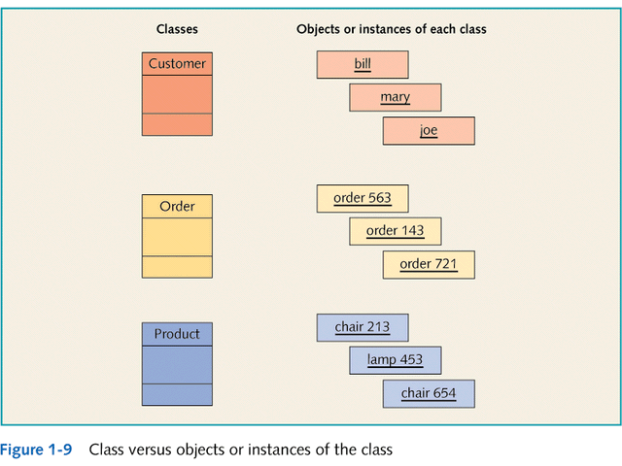

Slide 10
Object Attributes and Methods
Classes contain two things:
  Fields (attributes, data members, class variables):
    Data items that differentiate one object of the class from another. e.g. employee name, student number
    Characteristics of an object that have values
    What are some possible attributes for the customer object?
  Methods (behaviors):
    Named, self-contained blocks of code that typically operate on the fields
    Describe what an object can do
    Can be thought of as the verbs in a problem domain
    What are some possible methods for the customer object?

Slide 11
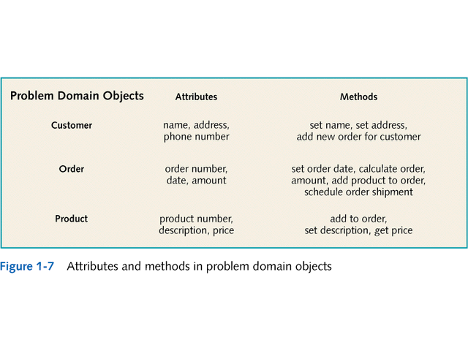

Slide 12
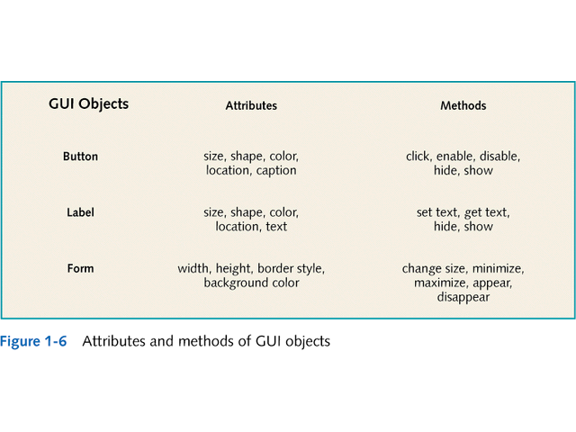

Slide 13
Object Interactions and Messages
Objects interact with other objects in a variety of relationships
  e.g. one-to-one, one-to-many
Messages
  The means by which objects interact
  Example:
    User initiates interaction via messages to GUI objects
    GUI objects interact with problem domain objects via messages
    Problem domain objects interact with each other and GUI objects via messages
    GUI objects respond to user via messages

Slide 14
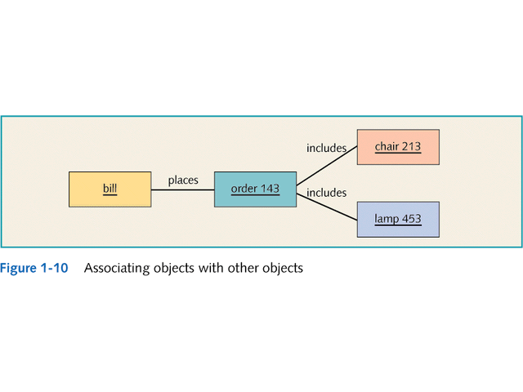

Slide 15
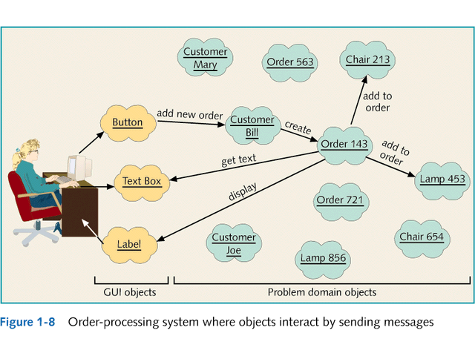

Slide 16
Encapsulation and Information Hiding
Encapsulation
  Objects have attributes and methods combined into one unit
Information Hiding
  Hiding the internal structure of objects, protecting them from corruption
Identity
  Unique reference for each object
Persistent objects
  Defined as available for use over time

Slide 17
Inheritance and Polymorphism
Inheritance
  One class of objects takes on characteristics of another class and extends them
  Superclass → subclass
  Generalization/specialization hierarchy
    Also called an inheritance hierarchy
    Result of extending class into more specific subclasses
  This is an important concept!!

Slide 18
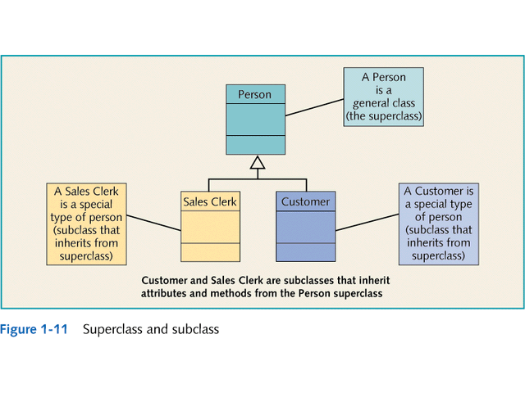

Slide 19
Inheritance and Polymorphism
Polymorphism
  literally means “many forms”
  in Java means using the same message (or method name) with different classes
    different objects can respond in their own way to the same message
    e.g. toString()

Slide 20
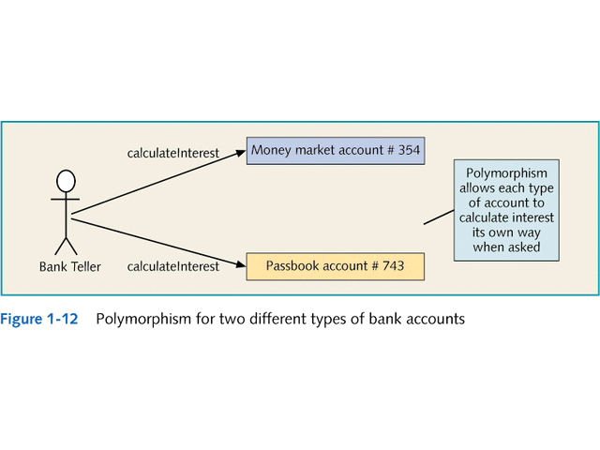

Slide 21
Learning OO Development
Introducing Three-Tier Design
  Objects that interact in OO system are separated into three categories of classes:
    Problem domain classes
      Specific to a particular business application
    GUI classes
      Define objects that make up the UI to the application
    Data access classes
      Work with DBMS to store/retrieve object information

Slide 22
Unified Modeling Language (UML)
Standard OOA&D modeling notation
Uses model-driven approach
  Enables creation of graphical models of the system requirements and system design
Components include
  Class diagrams
  Use Case diagrams
  Sequence diagrams
  Statecharts

Slide 23
