Slide 1
Inheritance

Slide 2
In this chapter, we will cover:
The concept of inheritance
Extending classes
Overriding superclass methods
Working with superclasses that have constructors
Using superclass constructors that require arguments
Accessing superclass methods
Learning about information hiding
Using methods you cannot override

Slide 3
Learning about the Concept of Inheritance
Inheritance
  Mechanism that enables one class to inherit both the behavior and the attributes of another class
The classes you create can inherit data and methods from existing classes
You can apply your knowledge of a general category to a more specific category
What is an example of when you would use inheritance?

Slide 4
Inheritance Advantages
When you use inheritance you:
  Save time
  Reduce errors
  Ease understanding

Slide 5
Inheritance Terms
Base class – a class that is used as a basis for inheritance
  Superclass
  Parent class
  e.g. Employee class
Derived class – a class that inherits from a base class
  Subclass
  Child class
  e.g. Manager class
Manager has an “is-a” relationship to Employee.
Subclasses have more functionality than superclasses.
  Subclasses can use the fields and methods of superclass and can add additional fields and methods.

Slide 6
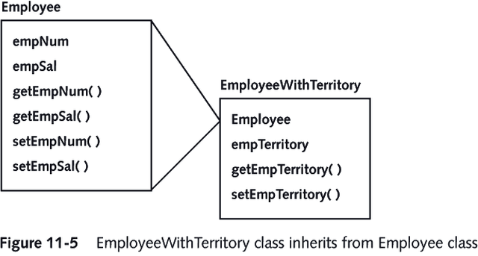

Slide 7
Extending classes
Use the keyword extends to achieve inheritance within the Java programming language
  public class EmployeeWithTerritory extends Employee
Creates a superclass-subclass relationship between Employee and EmployeeWithTerritory
You only need to indicate the differences between the subclass and the superclass in the subclass definition.

Slide 8
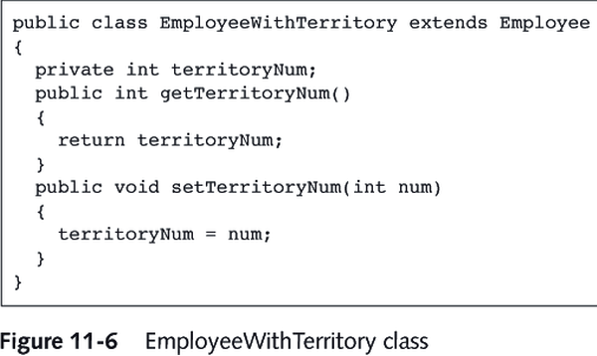

Slide 9
What is Polymorphism?

Slide 10
Overriding Superclass Methods
Polymorphism
  Using the same method name to indicate different implementations
Means “many forms”
Each child class method overrides the method that has the same name in the parent class
  e.g. getSalary method is different for managers than from other employees.
    should return the base salary plus the bonus
    because the subclass Manager cannot access private fields of superclass, it needs to use the public method getSalary().
    to differentiate from the subclass definition of this method we have to use super.getSalary().

Slide 11
Working with Superclasses that Have Constructors
When you create any subclass object, the superclass constructor must execute first, and then the subclass constructor executes
When you instantiate an object that is a member of a subclass, you are actually calling at least two constructors:
  the constructor for the base class
  the constructor for the extended, derived class

Slide 12
Using Superclass Constructors that Require Arguments
When you create a class and do not provide a constructor, Java automatically supplies you with one that never requires arguments
When you write your own constructor, you replace the automatically supplied version
The constructor you create for a class might require arguments

Slide 13
Using Superclass Constructors that Require Arguments
When a superclass requires arguments, you must include a constructor for each subclass
Your subclass constructor can contain any number of statements, but the first statement must call the superclass constructor
  super(list of arguments);
  For example, because subclasses cannot access private fields of superclass, it must initialize them thru the superclass constructor:
    super(n, s, year, month, day)
Keyword super always refers to the superclass of the class in which you use it

Slide 14
Accessing Superclass Methods
You might want to use the superclass method within a subclass
You can use the keyword super to access the parent class method
for example:
public class Manager extends Employee {
public Manager(String name, int salary) {
super(name, salary);
bonus=0;
}
}

Slide 15
Information Hiding
Information Hiding
  The concept of keeping data private
When you employ information hiding, your data can be altered only by the methods you choose and only in ways that you control
Private members of the parent class are not inherited
  When a program is a class user, it cannot directly alter any private field

Slide 16
Methods You Cannot Override
There are four types of methods that you cannot override in a subclass:
  private methods
  static methods
  final methods
  Methods within final classes
  Final methods and classes have some advantages:
    Efficiency: Dynamic binding has more overhead and runs slower.
    Safety: Designer has no control over what a method will do in a subclass. Final methods guarantee what the method wil do when called.

