Slide 1
Advanced Inheritance Concepts

Slide 2
In this chapter, we will cover:
Creating and using abstract classes
Using dynamic method binding
Creating arrays of subclass objects
Using the Object class and its methods
Using inheritance to achieve good software design.

Slide 3
Creating and Using Abstract Classes
Abstract class
  A class from which you cannot create any concrete objects, but from which you can inherit
  You can only extend abstract classes
  Use the keyword abstract
  You cannot use the keyword new

Slide 4
Creating and Using Abstract Classes
Non-abstract classes from which objects can be instantiated are called concrete classes
In other programming languages, such as C++, abstract classes are known as virtual classes

Slide 5
Abstract Methods
Abstract method
  A method with no method statements
To create an abstract method, you provide
  the keyword abstract
  the intended method type, name, and arguments
  but you do not provide any statements within the method
You must code a subclass method to override any inherited abstract superclass method

Slide 6
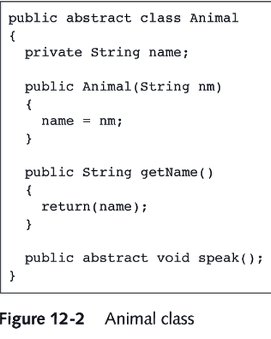

Slide 7
Using Dynamic Method Binding
When you create a superclass and one or more subclasses, each object of the subclass “is a” superclass object
  Because every subclass “is a” superclass member, you can convert subclass objects to superclass objects
You can create a reference to a superclass
  But you do not use the keyword new
  You create a variable name to hold the memory address of a subclass concrete object
Dynamic method binding
  The program’s ability to select the correct subclass method
  Is also called late binding

Slide 8
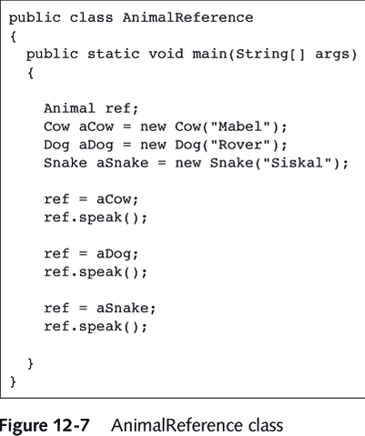

Slide 9
Creating Arrays of Subclass Objects
You might want to create a superclass reference and treat subclass objects as superclass objects so you can create an array of different objects that share the same ancestry
  Manipulate an array of subclass objects by invoking the appropriate method for each subclass
  Elements in a single array must be of the same type
  You can then cast the objects in the array back to appropriate subclass.
    e.g if (shapes[count] instanceof Wheel)
    ((Wheel) shapes[count]).setSpokes(5);

Slide 10
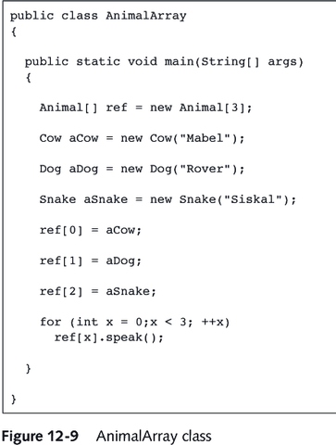

Slide 11
Using the Object Class and Its Methods
Every class in Java is a subclass except for the Object class
  The Object class is defined in the java.lang packag
    java.lang is automatically imported every time you write a program
  The Object class includes methods that you can override
    toString Method
      If you do not create a toString() method for a class, then you can use the superclass version of the toString() method
      Can be useful for debugging
    equals() method
      Takes a single argument, which must be the same type as the type of the invoking method
      Returns a Boolean value

Slide 12
Using Inheritance to Achieve Good Software Design
Extended superclass advantages
  Subclass creators save development time
  Subclass creators save testing time
  Programmers who create or use new subclasses already understand how the superclass woks, so the time it takes to learn the new class features is reduced
  When you create a new subclass in Java, neither the superclass source code nor the superclass bytecode is changed; the superclass maintains its integrity
When you create a number of classes that inherit from each other, you will often find it convenient to place these classes in a package

Slide 13
Design Hints for Inheritance
Place common operations and fields in the superclass
Don’t overuse protected fields.
  Malcious subclasses can access these fields.
Use inheritance to model the “is-a” relationship.
Don’t use inheritance unless all inherited methods make sense.
Use polymorphism, not type information.
  if (x is of type 1)
  action
  else if (x is of type 2) …
  think polymorphism.
Don’t overuse reflection.
  reflection is used for tools, not applications.

