Slide 1
Week 6: Input and Output
  Stream Classes
  Processing External Files
  Data Streams
  Print Streams
  Buffered Streams
  Use JFileChooser
  Text Input and Output on the Console
  Random Access Files
  Parsing Text Files

Slide 2
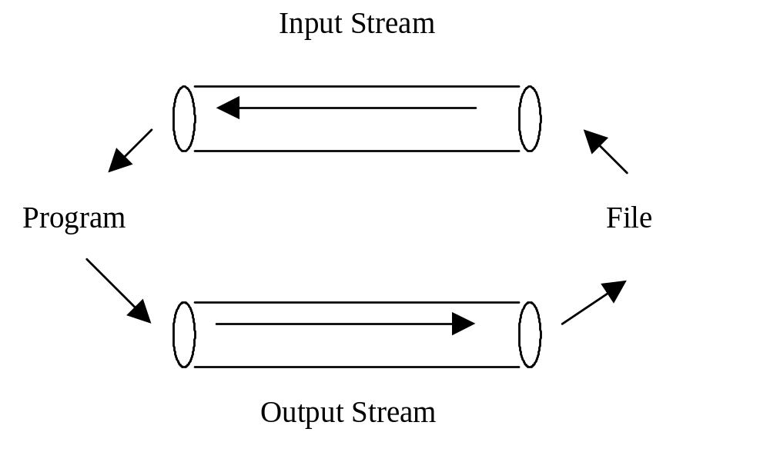
Streams
A stream is an abstraction of the continuous one-way flow of data.

Slide 3
Stream Classes
The stream classes can be categorized into two types: byte streams and character streams.
The InputStream/OutputStream class is the
root of all byte stream classes, and the Reader/
Writer class is the root of all character stream
classes. The subclasses of InputStream/
OutputStream are analogous to the
subclasses of Reader/Writer.

Slide 4
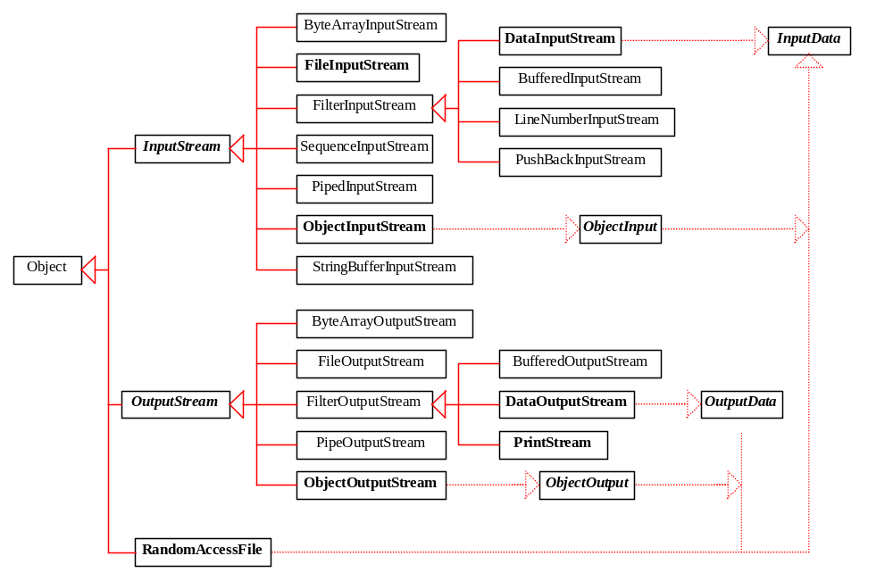
Byte Stream Classes

Slide 5
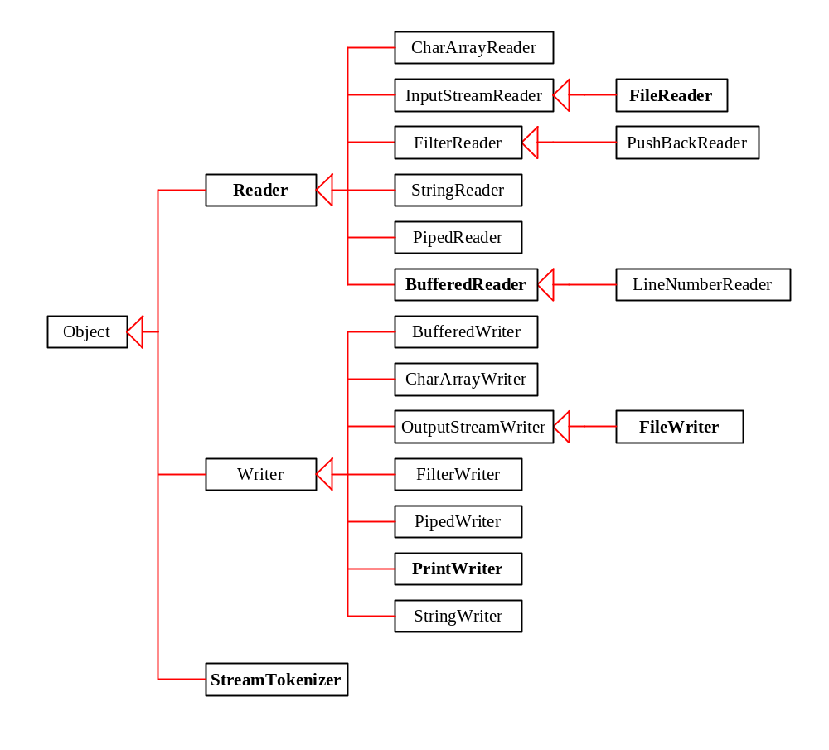
Character Stream Classes

Slide 6
InputStream
abstract int read() throws IOException
int read(byte b[]) throws IOException
void close() throws IOException
void available() throws IOException
void skip() throws IOException

Slide 7
Reader
The Reader class is similar to the InputStream class. The methods in Reader are subject to character interpretation.
abstract int read() throws IOException
int read(char b[]) throws IOException
void close() throws IOException
void skip() throws IOException

Slide 8
OutputStream
abstract void write(int b) throws IOException
void write(byte[] b) throws IOException
void close() throws IOException
void flush() throws IOException

Slide 9
Writer
abstract void write(int b) throws IOException
void write(char[] b) throws IOException
void close() throws IOException
void flush() throws IOException

Slide 10
Processing External Files
You must use file streams to read from or write
to a disk file. You can use FileInputStream or FileOutputStream for byte streams, and you can use FileReader or FileWriter for character streams.

Slide 11
File I/O Stream Constructors
Constructing instances of FileInputStream, FileOutputStream, FileReader, and FileWriter from file names:
FileInputStream infile = new FileInputStream("in.dat");
FileOutputStream outfile = new FileOutputStream("out.dat");
FileReader infile = new FileReader("in.dat");
FileWriter outfile = new FileWriter("out.dat");

Slide 12
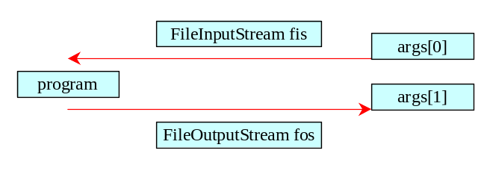
Example 15.1
Processing External Files
CopyFileUsingByteStream
Run
Click the Run button to access the DOS prompt; then type java CopyFileUsingByteStream ButtonDemo.java t.java and press Enter. (If working from the CD, add a path to the hard disk or floppy disk drive for t.java.)

Slide 13
Data Streams
The data streams (DataInputStream and DataOutputStream) read and write Java primitive types in a machine-independent fashion, which enables you to write a data file in one machine and read it on another machine that has a different operating system or file structure.

Slide 14
DataInputStream Methods
int readByte() throws IOException
int readShort() throws IOException
int readInt() throws IOException
int readLong() throws IOException
float readFloat() throws IOException
double readDouble() throws IOException
char readChar() throws IOException
boolean readBoolean() throws
IOException
String readUTF() throws IOException

Slide 15
DataOutputStream Methods
void writeByte(byte b) throws IOException
void writeShort(short s) throws IOException
void writeInt(int i) throws IOException
void writeLong(long l) throws IOException
void writeFloat(float f) throws IOException
void writeDouble(double d) throws IOException
void writeChar(char c) throws IOException
void writeBoolean(boolean b) throws IOException
void writeBytes(String l) throws IOException
void writeChars(String l) throws IOException
void writeUTF(String l) throws IOException

Slide 16
Data I/O Stream Constructors
DataInputStream infile = new
DataInputStream(new FileInputStream("in.dat"));
Creates an input file for in.dat.
DataOutputStream outfile = new
DataOutputStream(new FileOutputStream("out.dat"));
Creates an output file for out.dat.

Slide 17
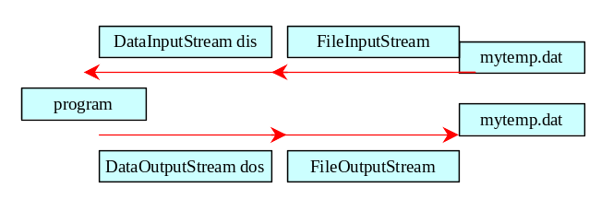
Example 15.2
Using Data Streams
TestDataStreams
Run
Click the Run button to access the DOS prompt; then type java TestDataStreams and press Enter. (Note: You cannot run this from the CD; the program writes to disk.)

Slide 18
Print Streams
The data output stream outputs a binary represen-tation of data, so you cannot view its contents as text. In Java, you can use print streams to output data into files. These files can be viewed as text.
The PrintStream and PrintWriter classes provide this functionality.

Slide 19
PrintWriter Constructors
PrintWriter(Writer out)
PrintWriter(Writer out, boolean autoFlush)
PrintWriter(OutputStream out)
PrintWriter(OutputStream out, boolean autoFlush)

Slide 20
PrintWriter Methods
void print(Object o)
void print(String s)
void println(String s)
void print(char c)
void print(char[] cArray)
void print(int i)
void print(long l)
void print(float f)
void print(double d)
void print(boolean b)

Slide 21
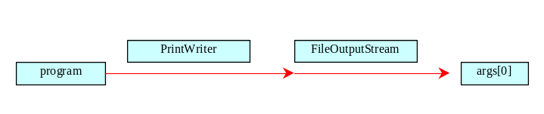
Example 15.3
Using Print Streams
TestPrintWriters
Run
Click the Run button to access the DOS prompt; then type java TestPrintWriters t.dat and press Enter. (Note: You cannot run this from the CD; the program writes to disk.)

Slide 22
Buffered Streams
Java introduces buffered streams that speed up input and output by reducing the number of reads and writes. In the case of input, a bunch of data is read all at once instead of one byte at a time. In the case of output, data are first cached into a buffer, then written all together to the file.
Using buffered streams is highly recommended.

Slide 23
Buffered Stream Constructors
BufferedInputStream (InputStream in)
BufferedInputStream (InputStream in, int bufferSize)
BufferedOutputStream (OutputStream in)
BufferedOutputStream (OutputStream in, int bufferSize)
BufferedReader(Reader in)
BufferedReader(Reader in, int bufferSize)
BufferedWriter(Writer out)
BufferedWriter(Writer out, int
bufferSize)

Slide 24
Example 15.4
Displaying a File in a Text Area
Objective: View a file in a text area. The user enters a filename in a text field and clicks the View button; the file is then displayed in a text area.
ViewFile
Run

Slide 25
Example 15.5
Using File Dialogs
Objective: Create a simple notepad using JFileChooser to open and save files. The notepad enables the user to open an existing file, edit the file, and save the note into the current file or to a specified file. You can display and edit the file in a text area.
FileDialogDemo
Run
Note: You cannot run this from the CD; the program
writes to disk.

Slide 26
Text Input and Output on the Consoles
There are two types of interactive I/O. One involves simple input from the keyboard and simple output in a pure text form. The other involves input from various input devices and output to a graphical environment on frames and applets. The former is referred to as text interactive I/O, and the latter is known as graphical interactive I/O.

Slide 27
Console Output/Input
To perform console output, you can use any of the methods for PrintStream in System.out. However, keyboard input is not directly supported in Java. In order to get input from the keyboard, you first use the following statements to read a string from the keyboard.
MyInput

Slide 28
Object Streams
Object streams enable you to perform input and output at the object level.
To enable an object to be read or write, the object's defining class has to implement the java.io.Serializable interface or the java.io.Serializable interface or the java.io.Externalizable interface.

Slide 29
The Serializable Interface
The Serializable interface is a marker interface. It has no methods, so you don't need to add additional code in your class that implements Serializable.
Implementing this interface enables the Java serialization mechanism to automate the process of storing the objects and arrays.

Slide 30
The Object Streams
You need to use the ObjectOutputStream class for storing objects and the ObjectInputStream class for restoring objects.
These two classes are built upon several other classes.

Slide 31
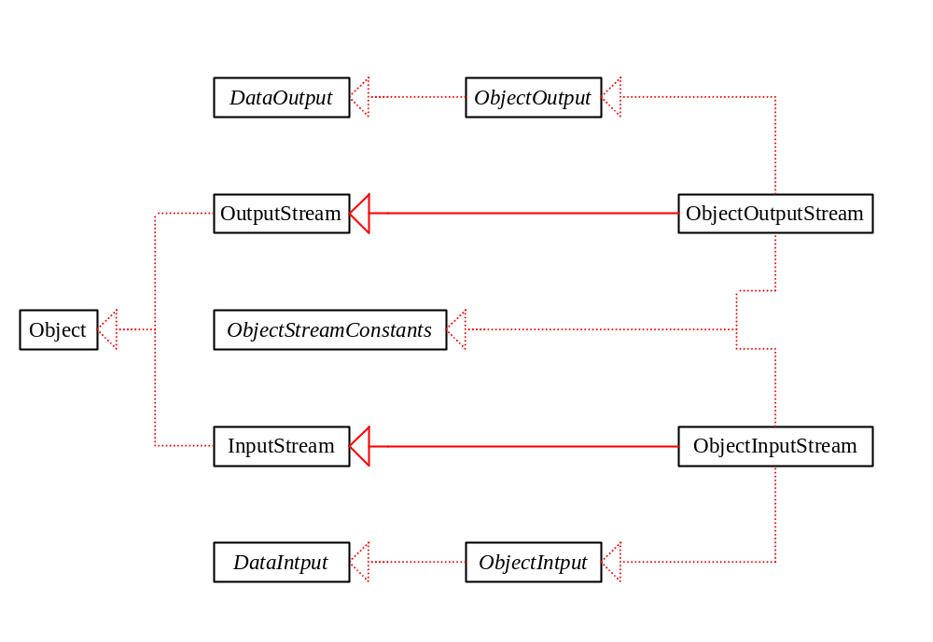
The ObjectOutput and ObjectInput Streams

Slide 32
Example 15.6
Testing Object Streams
Objective: Stores objects of MessagePanel and Date, and Restores these objects.
ObjectStreamDemo
Run
Note: You cannot run this from the CD; the program
writes to disk.

Slide 33
Random Access Files
Java provides the RandomAccessFile class to allow a file to be read and updated at the same time.
The RandomAccessFile class extends Object and implements DataInput and DataOutput interfaces.

Slide 34
RandomAccessFile Methods
Many methods in RandomAccessFile are the same as those in DataInputStream and DataOutputStream. For example, readInt(), readLong(), writeDouble(), readLine(), writeInt(), and writeLong() can be used in data input stream or data output stream as well as in RandomAccessFile streams.

Slide 35
RandomAccessFile Methods, cont.
void seek(long pos) throws IOException;
Sets the offset from the beginning of the RandomAccessFile stream to where the next read
or write occurs.
long getFilePointer() IOException;
Returns the current offset, in bytes, from the
beginning of the file to where the next read
or write occurs.

Slide 36
RandomAccessFile Methods, cont.
long length()IOException
Returns the length of the file.
final void writeChar(int v) throws IOException
Writes a character to the file as a two-byte Unicode, with the high byte written first.
final void writeChars(String s)
throws IOException
Writes a string to the file as a sequence of
characters.

Slide 37
RandomAccessFile Constructor
RandomAccessFile raf =
new RandomAccessFile("test.dat", "rw"); //allows read and write
RandomAccessFile raf =
new RandomAccessFile("test.dat", "r"); //read only

Slide 38
Example 15. 7 Using Random Access Files
Objective: Create a program that registers students and displays student information.
TestRandomAccessFile
Run
Note: You cannot run this from the CD; the program
writes to disk.

Slide 39
Parsing Text Files (Optional)
The StreamTokenizer class lets you take an input stream and parse it into words, which are known as tokens. The tokens are read one at a
time. The following is the StreamTokenizer constructor:
StreamTokenizer st =
StreamTokenizer(Reader is)

Slide 40
StreamTokenizer Constants
TT_WORD
The token is a word.
TT_NUMBER
The token is a number.
TT_EOL
The end of the line has been read.
TT_EOF
The end of the file has been read.

Slide 41
StreamTokenizer Variables
int ttype
Contains the current token type, which matches one of the constants listed on the preceding slide.
double nval
Contains the value of the current token if that token is a number.
String sval
Contains a string that gives the
characters of the current token if that
token is a word.

Slide 42
StreamTokenizer Methods
public int nextToken() throws
IOException
Parses the next token from the input stream of this StreamTokenizer.
The type of the next token is returned in the ttype
field. If ttype == TT_WORD, the token is stored
in sval; if ttype == TT_NUMBER, the
token is stored in nval.

Slide 43
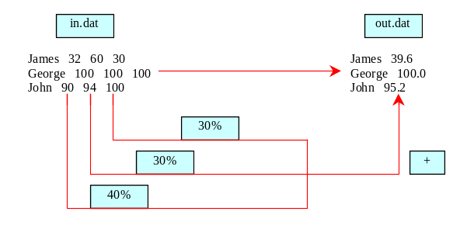
Example 15.8
Using StreamTokenizer
ParsingTextFile
Run
Click the Run button to access the DOS prompt; then type java ParsingTextFile and press Enter. (Note: You cannot run this from the CD; the program writes to disk.)

