Slide 1
Introduction to Electrical and Computer Engineering
Instructor: Dr. Pham Ngoc Nam

Slide 2
3. Electrical concepts and components

Slide 3
Basic Circuit Theory
What are ...
Current?
Voltage?
Power?
Energy?

Slide 4
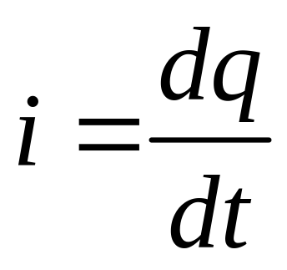
Current: Formal Definition
Current is the net flow of charges, per time, past an arbitrary “plane” in some kind of electrical device.
We will only be concerned with the flow of positive charges. A negative charge moving to the right is conceptually the same as a positive charge moving to the left.
Mathematically, current is expressed as…
Charge, typically in Coulombs [C]
Current,
typically in
Amperes [A]
Time, typically in seconds [s]
Notes:
For a steady flow, the current I in amperes can be calculated with the following equation:
where Q is the electric charge in coulombs transferred, and t is the time in seconds
More generally, electric current can be represented as the time rate of change of charge, or

Slide 5
The Ampere
The unit of current is the [Ampere], which is a flow of 1 [Coulomb] of charge per second, i.e.:
1[A] = 1[Coul/sec]
Remember that current is defined in terms of the flow of positive charges.
One coulomb of positive charges per second flowing from left to right
- is equivalent to -
one coulomb of negative charges per second flowing from right to left.
Around 6.242 × 10¹⁸ electrons passing a given point each second constitutes one ampere.

Slide 6
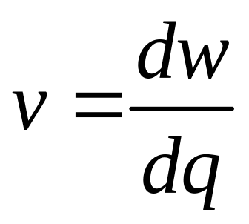
Voltage: Formal Definition
When we move a charge in the presence of other charges, energy is transferred. Voltage is the change in potential energy as we move between two points; it is a potential difference.
Mathematically, this is expressed as…
Energy, typically in Joules [J]
Voltage,
typically in
Volts [V]
Charge, typically in Coulombs [C]
Notes:
Voltage is the rate of change of energy with movement of a charge. Voltage is the potential to do work.

Slide 7
Volt
The unit of voltage is the [Volt]. A [Volt] is defined as a [Joule per Coulomb].
Remember that voltage is defined in terms of the energy gained or lost by the movement of positive charges.
One [Joule] of energy is lost from an electric system when a [Coulomb] of positive charges moves from one potential to another potential that is one [Volt] lower.

Slide 8
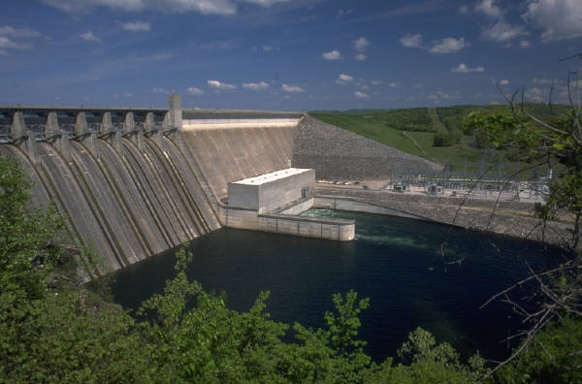


Energy
Energy is the ability or the capacity to do work.
It is a quantity that can take on many forms, among them heat, light, sound, motion of objects with mass.
Notes:
Several forms of energy are symbolized by these pictures. Light and heat are two forms of energy. Two forms of the generation of electric energy are symbolized by the nuclear power plant, and the hydroelectric power plant.

Slide 9
Joule Definition
The unit for energy that we use is the Joule [J].
A Joule is a Newton-meter.
In everything that we do in circuit analysis, energy will be conserved.
One of the key concerns in circuit analysis is this: Is a device, object, or element absorbing energy or delivering energy?

Slide 10
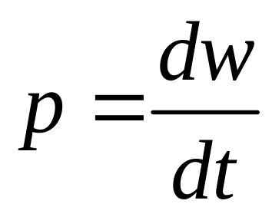
Power
Power is the rate of change of the energy, with time. It is the rate at which the energy is absorbed or delivered.
Again, a key concern is this: Is power being absorbed or delivered? We will show a way to answer this question.
Mathematically, power is defined as:
Energy, typically in Joules [J]
Power,
typically in
Watts [W]
Time, typically in seconds [s]
Notes:
Power is the rate of change of energy with time. Be careful; the same letter, w, is used for the units of power, and the symbol for energy. This is one reason I put units inside square brackets.

Slide 11

Watt Definition
A Watt is defined as a Joule per second.
We use a capital [W] for this unit.
Light bulbs are rated in [W]. Thus, a 100[W] light bulb is one that absorbs 100[Joules] every second that it is turned on.

Slide 12
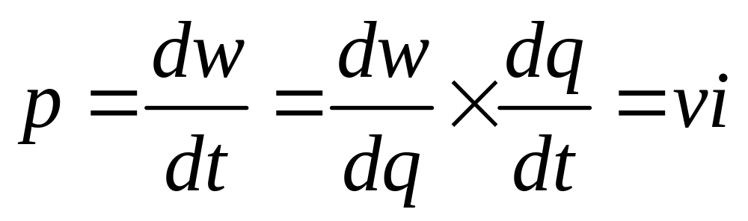
Power from Voltage and Current
Power can be found from the voltage and current, as shown below. Note that if voltage is given in [V], and current in [A], power will come out in [W].

Slide 13
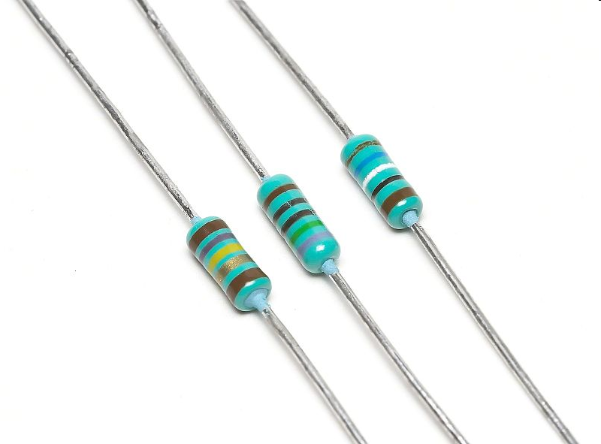
Passive electrical components
Passive devices need no external electrical power source in order to operate: resistors, capacitors, inductors
Active devices require an external electrical power source in order to function: transistors
A resistor is a two-terminal electronic component that produces a voltage across its terminals that is proportional to the electric current passing through it in accordance with Ohm's law:
  V = IR
Europe
US

Slide 14
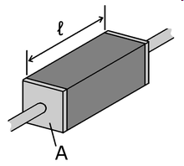

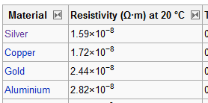
Passive electrical components
The resistance R of a conductor of uniform cross section can be computed as
  where
  l is the length of the conductor, measured in metres [m]
  A is the cross-sectional area of the current flow, measured in square metres [m²]
  ρ (Greek: rho) is the electrical resistivity (also called specific electrical resistance) of the material, measured in Ohm · metre (Ω m). Resistivity is a measure of the material's ability to oppose electric current.

Slide 15

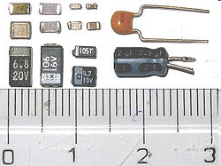
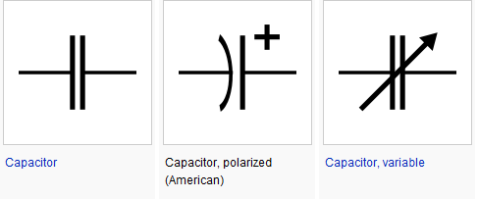
Passive electrical components
A capacitor is simply two conductors, separated by a dielectric material, which have a voltage difference between them and have charges of different polarities on the two conductors
Mathematically, C is the charge on one of the conductors divided by the voltage difference:
Farad

Slide 16
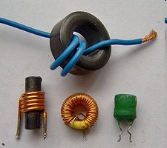
Passive electrical components
An inductor is a passive electrical component that can store energy in a magnetic field created by the electric current passing through it. An inductor's ability to store magnetic energy is measured by its inductance, in units of henries. Typically an inductor is a conducting wire shaped as a coil, the loops helping to create a strong magnetic field inside the coil due to Faraday's Law of Induction.

Slide 17
