Slide 1
Introduction to Electrical and Computer Engineering
Instructor: Dr. Pham Ngoc Nam

Slide 2
3. Active components and Integrated Circuits

Slide 3
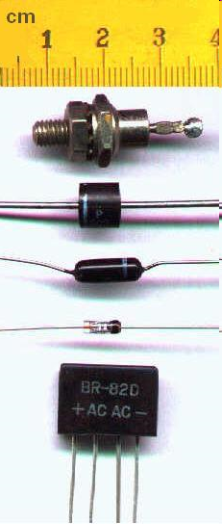
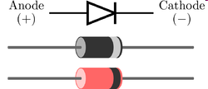
Active electrical components
Diode
  a diode is a two-terminal electronic component that conducts electric current in only one direction

Slide 4
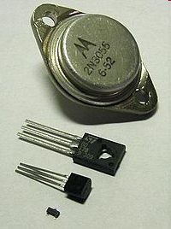
Active electrical components
Transistor
  A transistor is a semiconductor device used to amplify or switch electronic signals. It is made of a solid piece of semiconductor material, with at least three terminals for connection to an external circuit. A voltage or current applied to one pair of the transistor's terminals changes the current flowing through another pair of terminals. Because the controlled (output) power can be much more than the controlling (input) power, the transistor provides amplification of a signal.

Slide 5
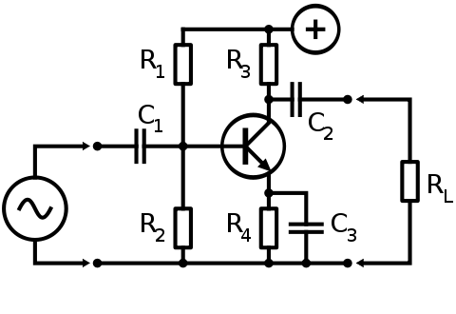
Active electrical components
Transistor

Slide 6
Active electrical components
Integrated circuits (ICs)
  an integrated circuit (also known as IC, microcircuit, microchip, silicon chip, or chip) is a miniaturized electronic circuit (consisting mainly of semiconductor devices, as well as passive components) that has been manufactured in the surface of a thin substrate of semiconductor material. Integrated circuits are used in almost all electronic equipment in use today and have revolutionized the world of electronics.
  Generations: SSI, MSI, LSI, VLSI

Slide 7
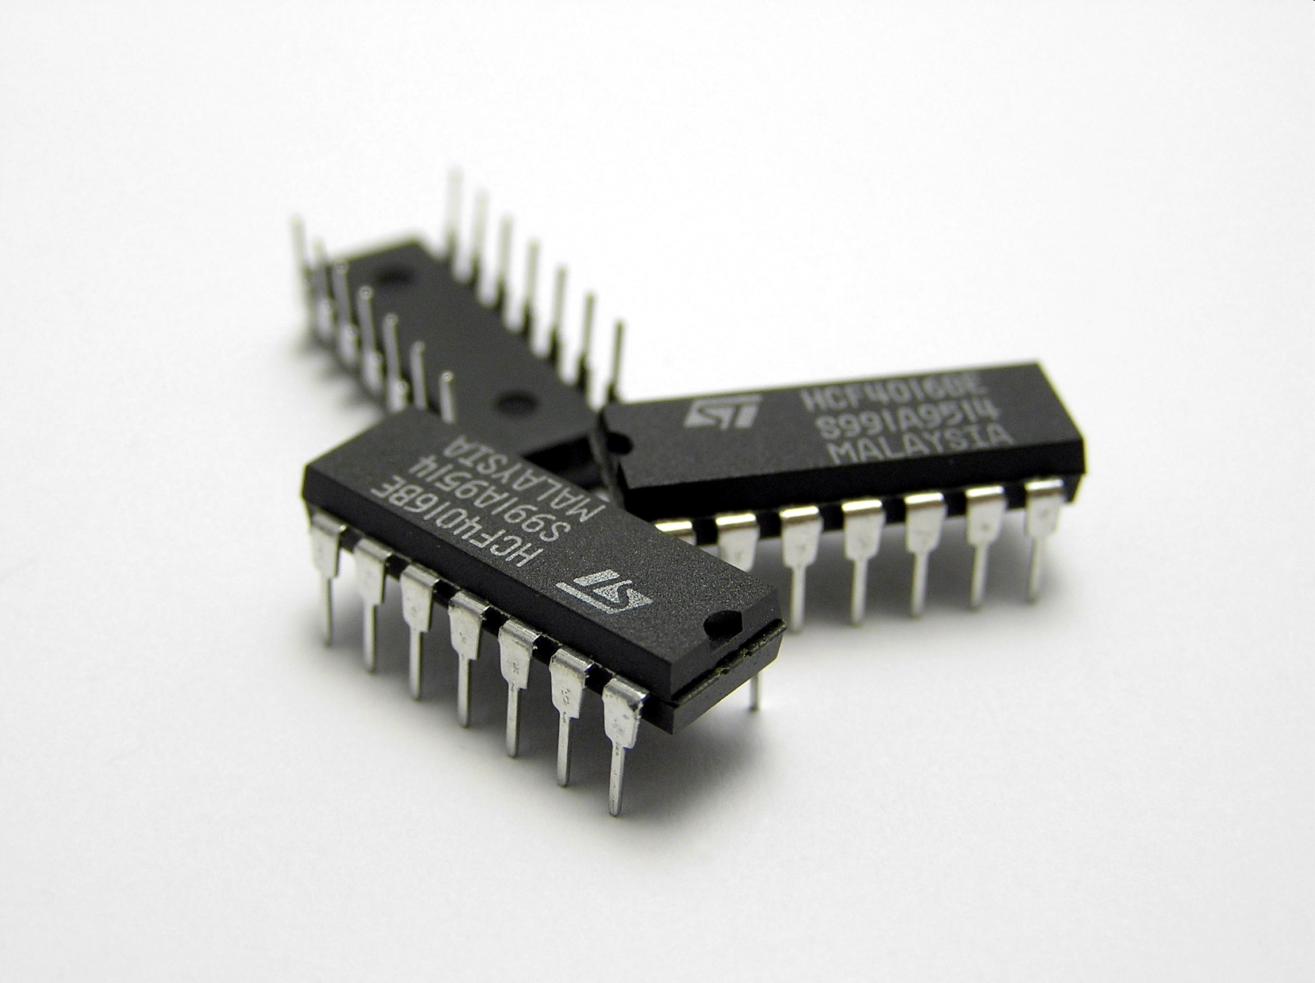
Active electrical components
Integrated circuits (ICs)

Slide 8
Digital Electronics

Slide 9
Basic logic gates and Boolean algebra
Logic gates: electronics circuits which combine signals according to the Boolean algebra
Positive logic: is an electronic representation in which the true state is at a higher voltage:
  5 V represents logic 1 and 0 V represents logic 0
Negative logic: is an electronic representation in which the true state is at a lower voltage:
  0 V represents logic 1 and 5 V represents logic 0

Slide 10
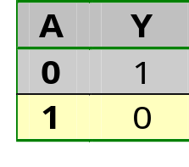
Basic logic functions
NOT, AND, NAND, OR, NOR, XOR and XNOR
Inverter function (NOT)
_{Logic equation}
NOT operator
_{Truth table}
A
Y =A
_{Logic symbol}
_{A}

Slide 11
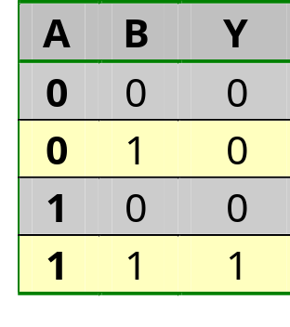
Basic logic functions
AND function
AND operator
A
Y=A.B
B
_{A}
_{B}

Slide 12
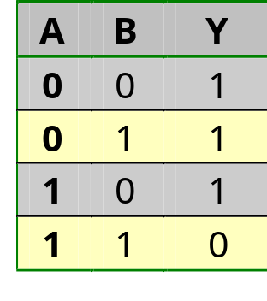
Basic logic functions
NAND function
NAND operator
A
Y=AB
B
_{A}
_{B}

Slide 13
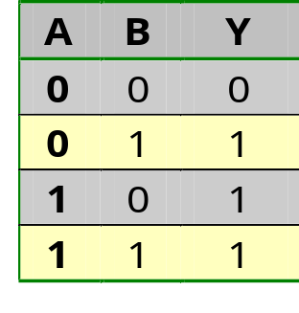
Basic logic functions
OR function
OR operator
A
Y=A+B
B
_{A}
_{B}
_{Y}

Slide 14
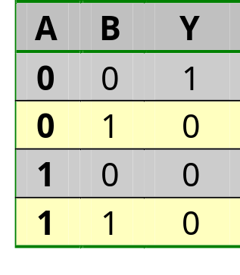
Basic logic functions
NOR function
NOR operator
A
Y=A+B
B
_{A}
_{B}

Slide 15
Basic logic functions
NOR function
NOR operator
A
Y=A+B
B
_{A}
_{B}

Slide 16
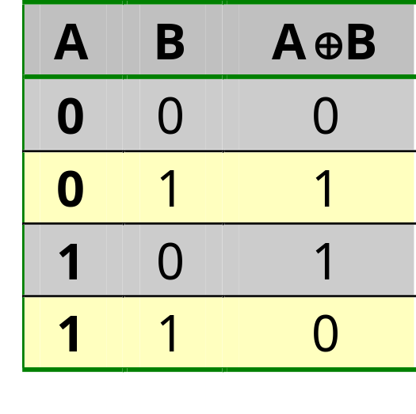
Basic logic functions
Exclusive-OR function (XOR)
XOR operator
A
Y=A ⊕ B
B
_{Y=A ⊕ B =AB + AB}
_{Y}
₁
_{A}
_{B}
₁
₀
₀

Slide 17
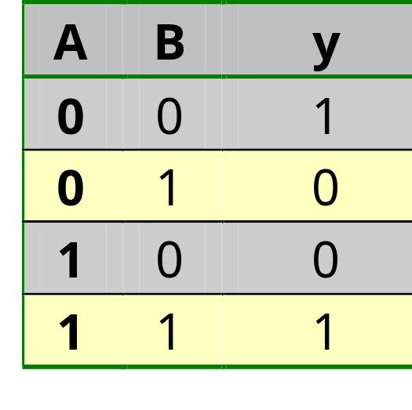
Basic logic functions
Exclusive-NOR function (XNOR)
XNOR operator
A
Y=A ⊕ B
B
_{Y=A ⊕ B =AB + AB}
₁
₁
_{A}
_{B}
₀
₀

Slide 18
Implementation of logic circuit from logic equation
Combinatorial logic circuit
  The basic logic gates are combined to form all other digital logic functions
Combinatorial circuit analysis: 2 methods
  Direct analysis from circuit inputs to outputs
  Using truth table
    Specify all possible input combinations and the output result for each input combination

Slide 19
Implementation of logic circuit from logic equation
Example:
_{B}
F = AB
_{A}
K= F+G = AB + AC
_{C}
G = AC
Inputs | Intermediate nodes | Outputs
A B C | F=AB G=AC | K=F +G
0 0 0 | 0 0 | 0
0 0 1 | 0 0 | 0
0 1 0 | 0 0 | 0
0 1 1 | 0 0 | 0
1 0 0 | 0 0 | 0
1 0 1 | 0 1 | 1
1 1 0 | 1 0 | 1
1 1 1 | 1 1 | 1

Slide 20
Boolean Algebra
Boolean algebraic laws
  Commutative law of addition and multiplication
    A + B = B + A
    AB = BA
  Associative law of addition and multiplication
    A + (B + C) = (A + B) + C
    A(BC) = (AB)C
  Distributive law
    A(B+C) = AB + AC
    (A +B)(C+D)=AC + AD + BC + BD

Slide 21
Boolean Algebra
Boolean identities and theorems
  A.0= 0
  A.1=A
  A+0=A
  A+1=1
  A.A=A
  A.A=0
  A+ A=1
Demorgan’s theorems
  A + B = A.B
  A.B = A + B

Slide 22
Logic simplification
Algebraic manipulation
  F₁ =xy+xy’z+x’yz =xy+xyz+xy’z+x’yz (absorption)
  =xy+x(y+y’)z+x’yz (distributive)
  =xy+x1z+x’yz (complement)
  =xy+xz+x’yz (identity)
  =xy+xyz+xz+x’yz (absorption)
  =xy+xz+(x+x’)yz (distributive)
  =xy+xz+1yz (complement)
  =xy+xz+yz (identity)

Slide 23
Logic simplification
F₁=xy+xy’z+x’yz
F₁=xy+xz+yz
x
y
z
x
y
z
F₁
F₁

Slide 24
Logic simplification
Two standard forms:
  Sum of Products (SOP); a sum (OR) of several products (AND) terms
    E.g. X= ABC + DEF
  Products of Sums (POS): a product (AND) of several sum (OR) terms
    E.g. Y = (A + B + C) (D + E + F)
SOP and POS expression can be derived from the truth table

Slide 25
Logic simplification
SOP procedure
  Derive the SOP expression using only those input combinations that result in an output of logic 1
  Input variables of 1 are written in their true form
  Input variables of 0 are written in their inverted form
  Input variables are ANDed to form the input terms
  Input terms are ORed together to give the final output result

Slide 26
Logic simplification
POS procedure
  Derive the POS expression using only those input combinations that result in an output of logic 0
  Input variables of 0 are written in their true form
  Input variables of 1 are written in their inverted form
  Input variables are ORed to form the input terms
  Input terms are ANDed together to give the final output result

