Slide 1
Introduction to Electrical and Computer Engineering
Instructor: Dr. Pham Ngoc Nam

Slide 2
5. Engineering tools for ECE

Slide 3
General ideas and Safety considerations
Use electrical equipments safely
  Why? Mistakes or carelessness
    pose danger to yourself and others
    cause damages to expensive equipments
    delay the completion of the experiment or project
  How?
    Always study the operation manual before using unfamiliar equipment.
    Determine the maximum levels of voltages and currents that can be applied to the equipment
    Always connect the source of power last when hooking up a circuit and disconnect it first when tearing down the experiment.
    Know the characteristics and limitations of the measuring instruments.

Slide 4
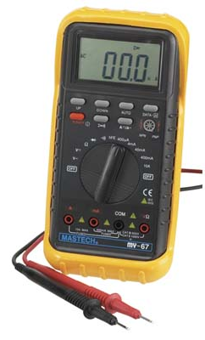
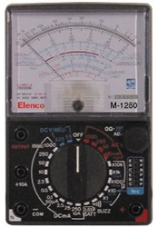
Meters
VOM meter: used to measure voltage, resitance and current
  The quantity being measured and the range of the quantity being measured are adjusted by knobs.
  Always start with the maximum range of the variable to be measured.

Slide 5
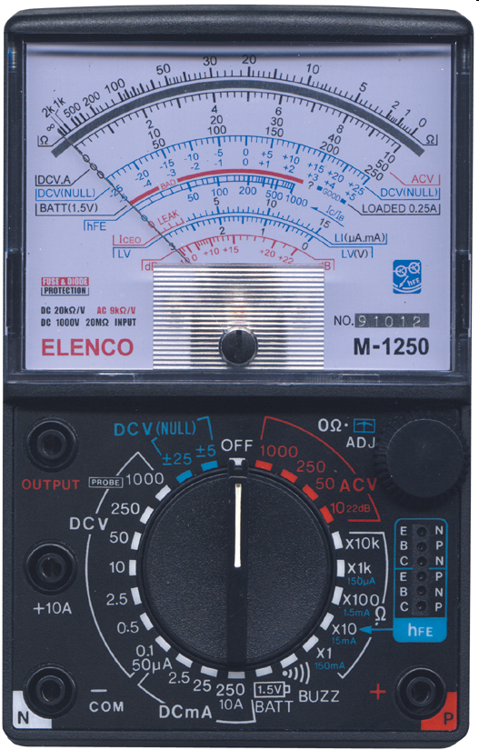
Meters
needle
scale
knob

Slide 6
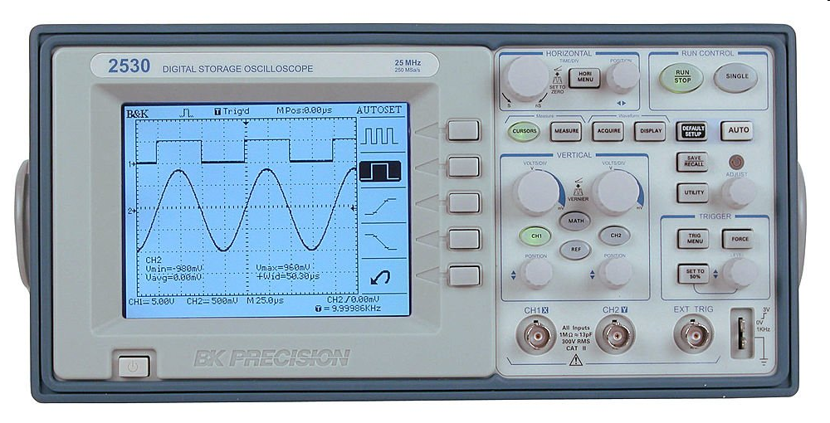
Oscilloscopes
Used to observe time-varying voltages or currents

Slide 7
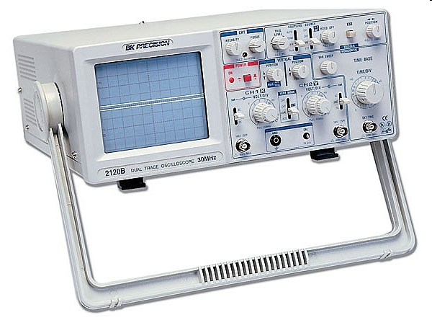
Oscilloscopes

Slide 8
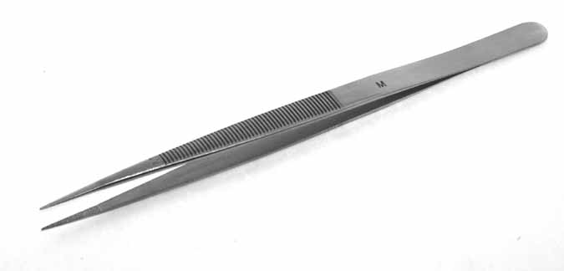
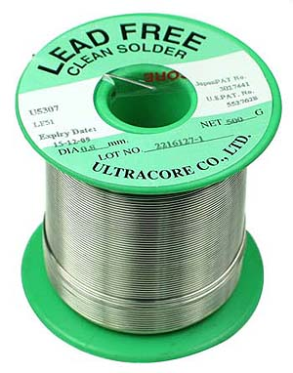
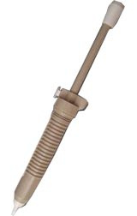
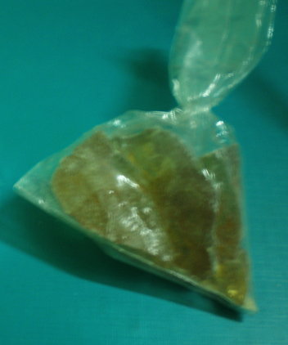
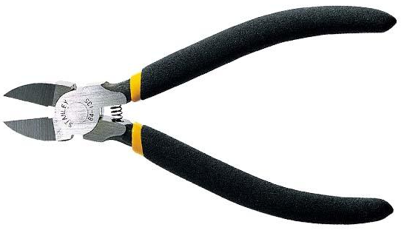
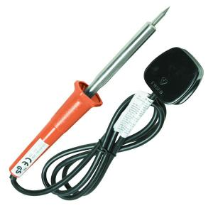
Soldering tool
Solder wire
tweezers
Solder removal tool
resin
soldering iron

Slide 9
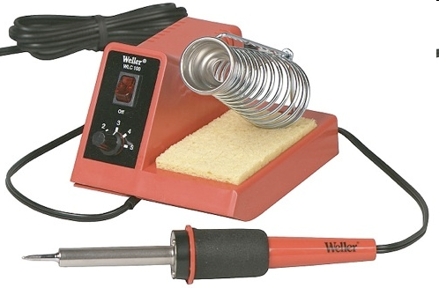
Soldering tool

Slide 10
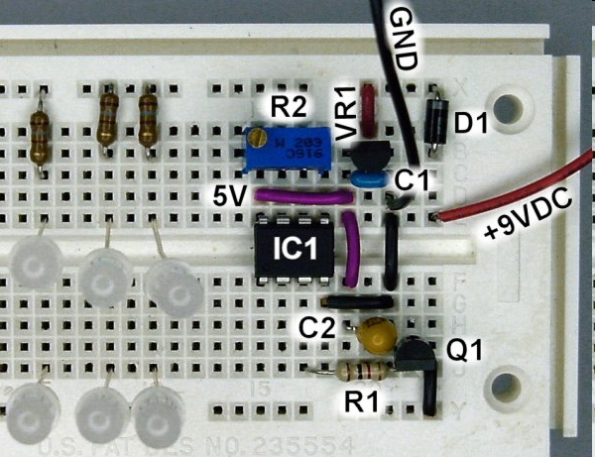
Breadboard

Slide 11
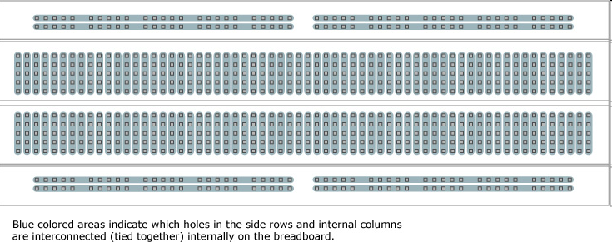
Breadboard

Slide 12
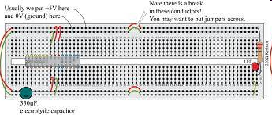
Breadboard

Slide 13
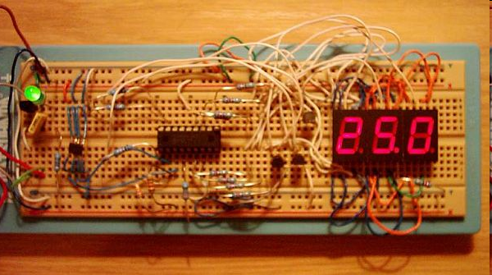
Breadboard

Slide 14
Application softwares
Problem solving software
  E.g. MATLAB
Circuit simulation
  E.g. PSPICE
Office software
  Spreadsheets: Excel
  Databases: Access
  Word processing
  Presentation: powerpoint
Programming languages
  C, C++, Java

Slide 15

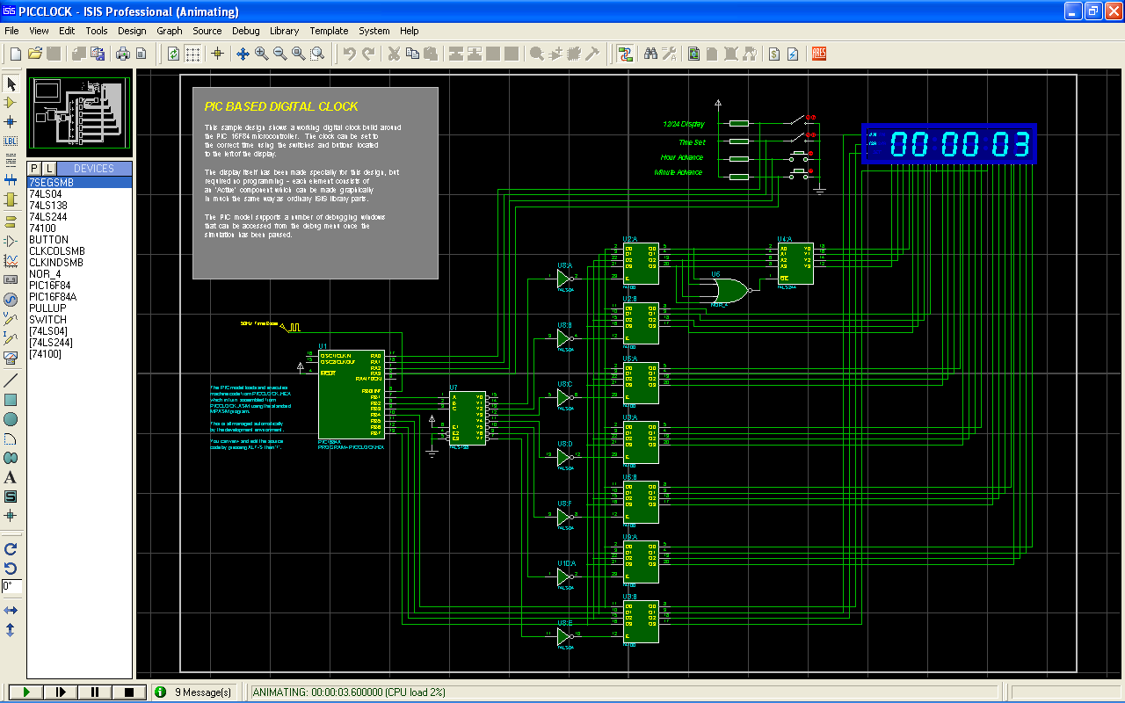
Simulation Tool

Slide 16

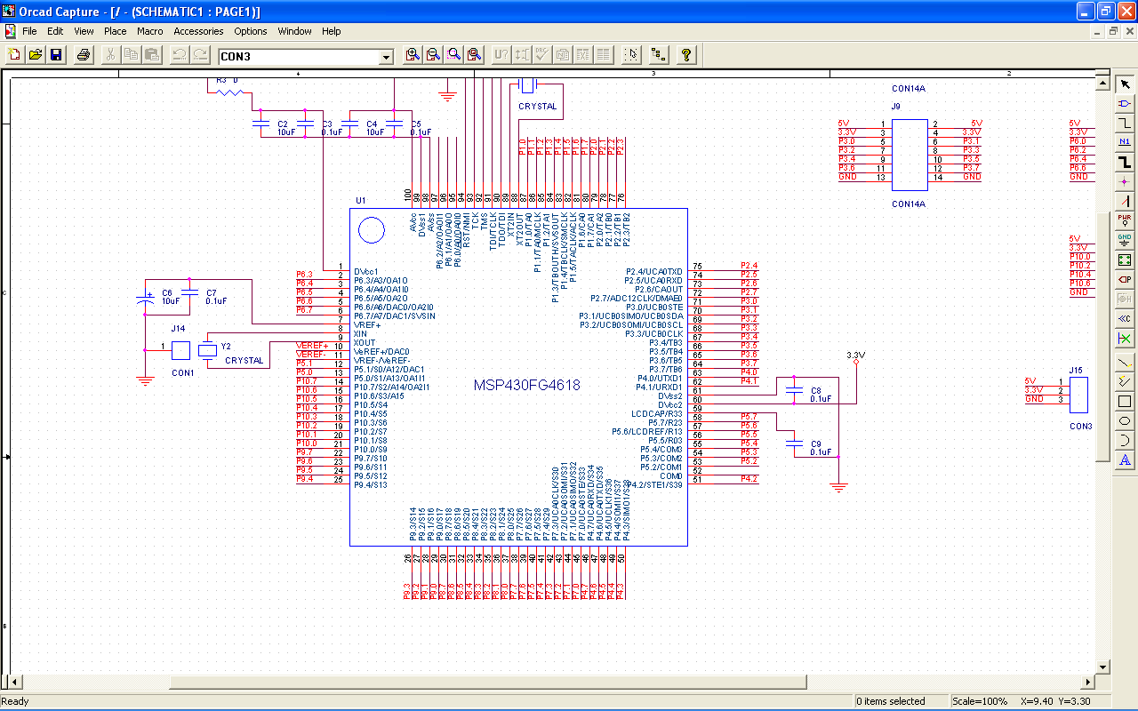
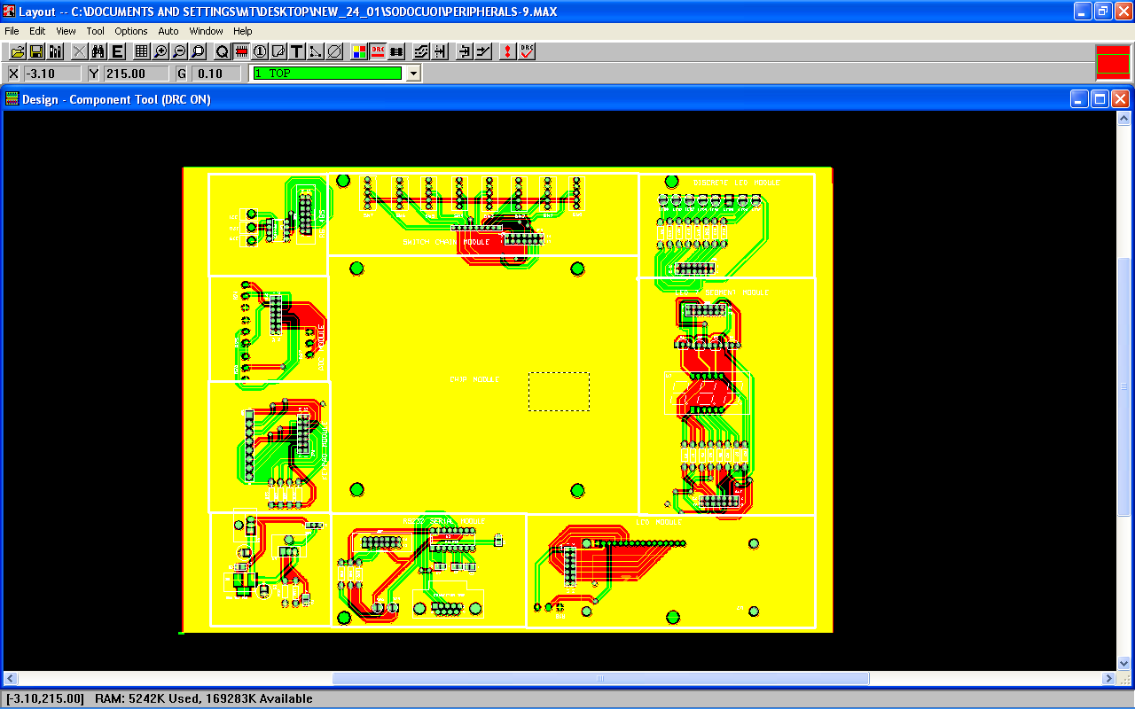
Circuit Design Tool

Slide 17

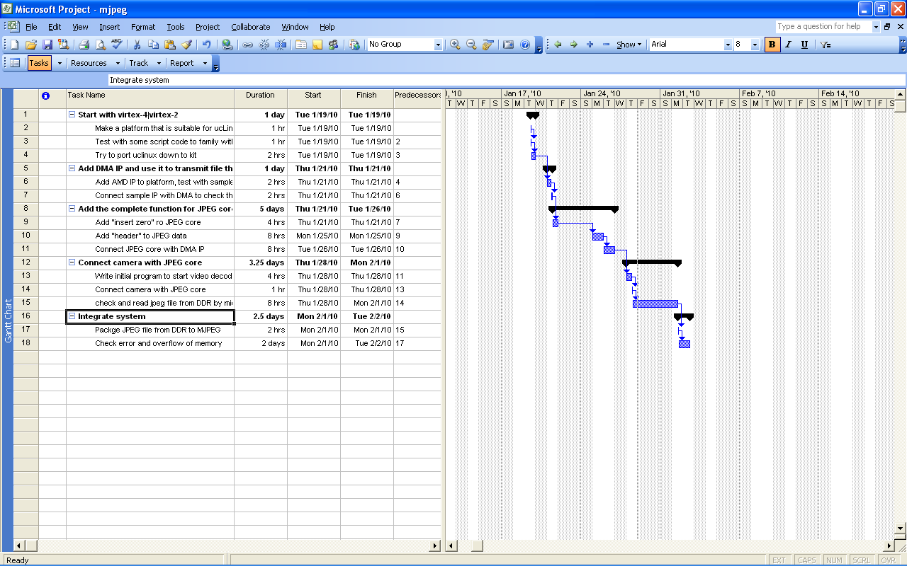
Planning Tool

Slide 18

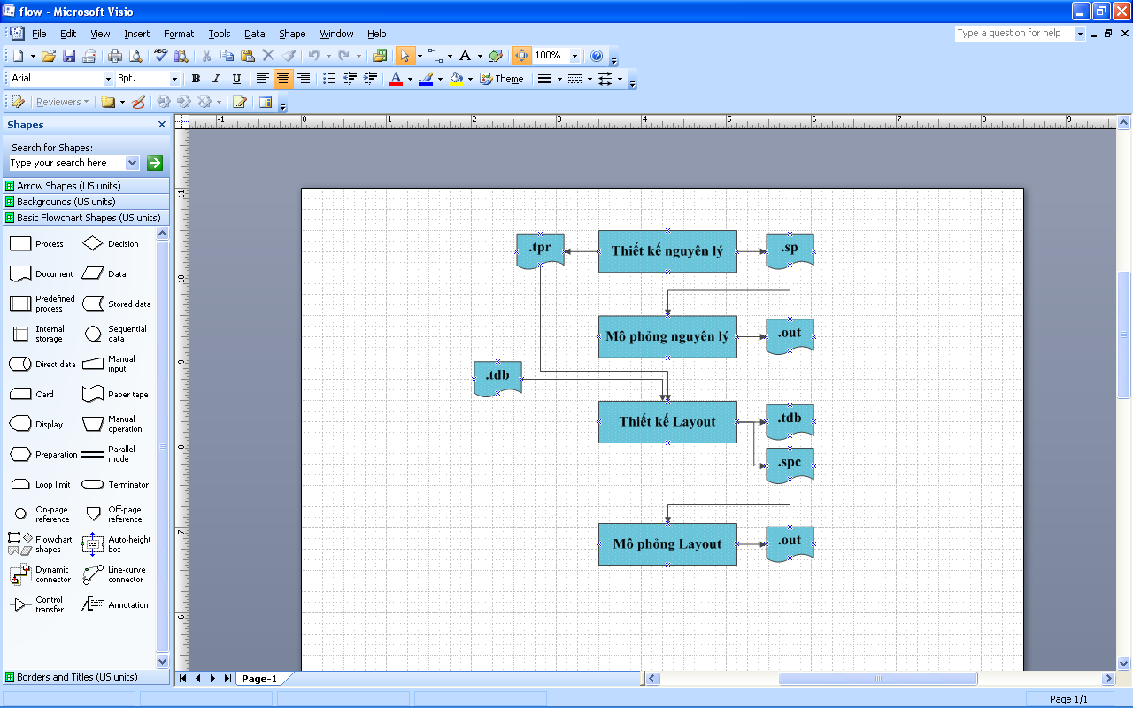
Drawing Tool

Slide 19
Assigment
Visit one of the following stores and buy the necessary tools
  17 Han Thuyen street
  104 Trung Liet street
  269 Doi Can street
  Hoa Binh market, Hang Bai street
Install the MATLAB, ORCAD, Microsoft project and Microsoft Visio software on your computer

