Slide 1
PHÂN TÍCH THIẾT KẾ
HƯỚNG ĐỐI TƯỢNG
TRƯỜNG ĐẠI HỌC BÁCH KHOA HÀ NỘI
VIỆN ĐIỆN TỬ VIỄN THÔNG
CHƯƠNG 3
Phân tích (tiếp)
Bộ môn Điện tử - Kỹ thuật Máy tính

Slide 2
Chương 3. Phân tích
3.1. Xác định rõ yêu cầu
3.2. Mô hình hóa chức năng
3.3. Mô hình hóa cấu trúc
3.4. Mô hình hóa hoạt động
OOD - DEI.FET.HUT

Slide 3
3.2. Mô hình hóa chức năng
Tiền đề: Các yêu cầu người sử dụng (phần trước)
Các bước mô hình hóa chức năng
  Sử dụng sơ đồ hoạt động (activiy diagrams) để mô hình hóa toàn bộ quá trình nghiệp vụ thông qua các yêu cầu thu thập được.
  Xác định các kịch bản sử dụng (use cases) có thể xuất hiện thông qua việc nhận biết các hoạt động
  Chuẩn bị các bản mô tả cho các use cases
  Đưa các use cases vào các sơ đồ use case (use case diagram) để thể hiện quá trình xử lý nghiệp vụ đối với bên ngoài hệ thống
Bước tiếp theo: mô hình hóa cấu trúc.
OOD - DEI.FET.HUT

Slide 4
Mô hình hóa quy trình nghiệp vụ bằng
Sơ đồ Hoạt động (Activity Diagrams)
A number of activities support a business process across several departments
Activity diagrams model the behavior in a business process
  Sophisticated data flow diagrams
  Addresses parallel concurrent activities and complex processes
OOD - DEI.FET.HUT

Slide 5
Mô hình hóa quy trình nghiệp vụ bằng
Sơ đồ Hoạt động
Elements of an Activity Diagram
Guidelines for Creating Activity Diagrams
OOD - DEI.FET.HUT

Slide 6
Actions and Activities
Performed for a specific business reason
Names begin with a verb and end with a noun
  “Make Appointment”
Each activity normally associated with a use case
<name>
OOD - DEI.FET.HUT

Slide 7
Object Nodes
Activity and Actions usually modify objects
Object nodes model these objects
Objects represent a flow of information between activities or actions
<name>
OOD - DEI.FET.HUT

Slide 8
Control & Object Flows
Control Flows
  Paths of execution through the business process
  Can only be attached to actions or activities
Object Flows
  Model the flow of objects through a business process
  Show actual objects entering and exiting the system
  An object is on one end, an action or activity is on the other end
OOD - DEI.FET.HUT

Slide 9
Control Nodes
Initial – Only one, at top left
Final Activity – Stop the process
Final Flow – Stop this flow only
Decision – Guarded test conditions
Merge – Following decisions
Fork – Split parallel execution
Join – Join parallel execution
[Dicision
Criteria]
[Dicision
Criteria]
OOD - DEI.FET.HUT

Slide 10
Swimlanes
The business process may be broken into persons of responsibility
Identify this with swimlanes
<Lane1>
<Lane2>
OOD - DEI.FET.HUT

Slide 11
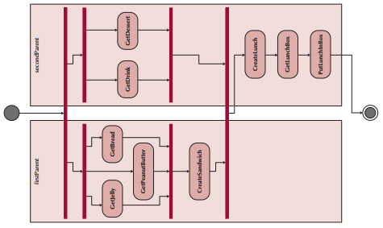
Example: an activity diagram with swimlanes
OOD - FET.HUST

Slide 12
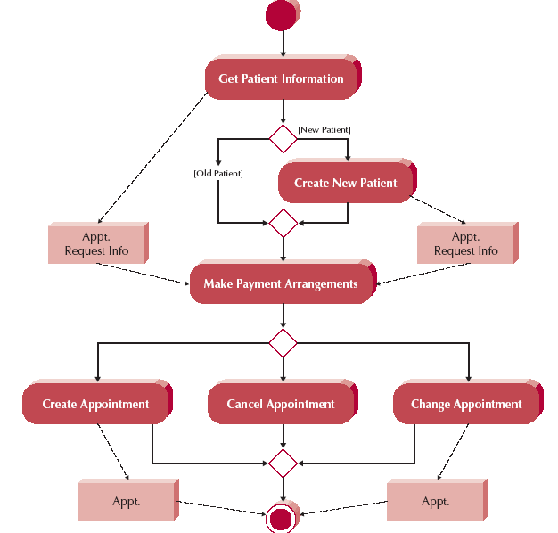
Activity Diagram Example –
An Appointment System
An Object Node:
■ Is used to represent the flow of information from one activity to another
■ Is labelled by its class name
An Object Flow:
■ Shows the flow of an object from one activity
(or action) to another
OOD - DEI.FET.HUT

Slide 13
Guidelines for Creating Activity Diagrams
Set the context or scope of the activity being modeled and give the diagram an appropriate title.
Identify the activities, control flows, and object flows that occur between the activities.
Identify any decisions that are part of the process being modeled.
Attempt to identify any prospects for parallelism in the process.
Draw the activity diagram.
OOD - DEI.FET.HUT

Slide 14
CD Selections
Internet Order System – Functional requirements:
Maintain CD Information
  1.1…… 1.2….. 1.3…..
Maintain CD marketing information
  2.1…. 2.2…. 2.3….
Place CD Orders
  3.1 Search CDs from “CD Selection” web site; 3.2 Place orders;
  3.3……
Maintain Orders
  4.1….. 4.2…
  4.3 Place Instore Hold: If ordered CDs are available in a near store, the CDs are on hold and to be picked up in the store
  4.4. Place Special Order: If ordered CDs is not available in a near store, the ordered CDs will be sent to a near store and email to the customer when it is available in the near store
OOD - DEI.FET.HUT

Slide 15
CD Selections
Exercise: Create the activity diagram for Internet Order System
Analysis:
Main activities: Maintain CD Information, Maintain CD marketing information, Place CD Orders, Maintain ordered CDs
Control flows: Three main parallel processes:
  Maintain CD Information
  Maintain CD marketing information
  Place CD Orders -> Maintain ordered CDs in which a decision needs to be made related to placing instore hold or placing special order
OOD - DEI.FET.HUT

Slide 16
Application
Example:
CD Selections
Solution to the exercise:
Maintain CD marketing information
Place CD Order
Maintain CD Information
[If available in near store]
[If not]
Place instore hold
Place
special order
OOD - DEI.FET.HUT

Slide 17
USE-CASE DESCRIPTIONS

Slide 18
Key Ideas
An use case illustrates the activities that are performed by users of a system.
Use cases are logical models -- they describe the activities of a system without specifying how the activities are implemented.
OOD - DEI.FET.HUT

Slide 19
Use Case
A formal way of representing how a business interacts with its environment
The discrete activities performed by the user
External bird's eye view of the system from the user's point of view
Used to document the as-is system, or to develop the to-be system
OOD - DEI.FET.HUT

Slide 20
Use Case
Use cases are logical models
  They describe the activities of a system
  Do not address implementation details
The implementation is addressed in the Design Phase
OOD - DEI.FET.HUT

Slide 21
Use Case
Steps to create a use case:
  Gather requirements
  Prepare Use Case Descriptions for each Use Case
  Prepare Use Case Diagrams for each Use Case
OOD - DEI.FET.HUT

Slide 22
When use cases are used?
Describe basic functions of the system
  What the user can do
  How the system responds
  That is, model the dialog between the actors (i.e., users) and the system
Be used to model both the contexts of the system and the detailed requirements for the system
Can be used for both the as-is and to-be behavioral models
OOD - DEI.FET.HUT

Slide 23
How Are Use-Cases Created?
Two steps:
  Write text-based use case descriptions
  Translate descriptions into use case diagrams
Each use case describes one and only one function, but may have multiple paths.
Developer working with users for content.
OOD - DEI.FET.HUT

Slide 24
Types of Use-Cases
Overview vs. Detail
Overview
  High level overview of requirements
  Users and analysts agree on major requirements
  Created early, documents only basic info
    Name, ID, primary actor, type, brief description
Detail
  Documents all information needed for the Use Case
OOD - DEI.FET.HUT

Slide 25
Types of Use-Cases
Essential vs. Real
Essential
  Describes only essential issues needed to understand the required functionality (e.g. "make appt")
Real
  Goes further and describes a specific set of steps (e.g. "make entry into outlook database)
OOD - DEI.FET.HUT

Slide 26
Elements of a Use-Case Description
Use Case Name: ID: Importance Level:
Primary Actor: Use Case Type:
Stakeholders and Interests:
Brief Description:
Trigger:
Relationships: (Association, Include, Extend, Generalization)
Normal Flow of Events:
Subflows:
Alternate/Exceptional Flows:
Overview
Relationships
Flow of
events
OOD - DEI.FET.HUT

Slide 27
Overview Information
Use Case Name
  verb-noun phrase (Make Appt)
Use Case ID Number
  Allows specific reference
Importance level
  Can be fuzzy or based on detailed analysis
Primary Actor
  Normally the trigger
OOD - DEI.FET.HUT

Slide 28
Overview Information
Use Case Type
  Overview, detail, essential, or real
Stakeholders and interests
  Always includes the primary actor
Brief Description
  One sentence captures the essence
Trigger
  Event that causes Use Case to begin
OOD - DEI.FET.HUT

Slide 29
Relationships
Explains how the Use Case is related to:
  Other Use Cases
  Users
Four type of relationships
  Association
  Extend
  Include
  Generalization
OOD - DEI.FET.HUT

Slide 30
Association Relationship
Documents the communication between the use case and the actors
All actors are documented with the association relationship
OOD - DEI.FET.HUT

Slide 31
Extend Relationship
The extension of the functionality to handle optional behavior
  Make Appointment → Create New Patient
OOD - DEI.FET.HUT

Slide 32
Include Relationship
Represents mandatory inclusion of another Use Case
Enable functional decomposition
  Make Appointment → Make Payment Arrangements
OOD - DEI.FET.HUT

Slide 33
Generalization Relationship
Allows use of Inheritance
Gathers the common behaviors together
OOD - DEI.FET.HUT

Slide 34
Flow of Events
Describes the individual steps in the business process
Three type of flows
  Normal flow of events
  Sub-Flows
  Exceptional flows
OOD - DEI.FET.HUT

Slide 35
Normal Flow of Events
Includes only steps normally executed
Listed in the order that they are performed
OOD - DEI.FET.HUT

Slide 36
Sub-Flows
Normal flow of events are decomposed into sub-flows
Try to keep normal flow simple and understandable
Can list each sub-flow as part of the Use Case
If it make sense, can convert a sub-flow into its own Use Case
OOD - DEI.FET.HUT

Slide 37
Exceptional Flows
Flows that are anticipated, but not considered normal
OOD - DEI.FET.HUT

Slide 38
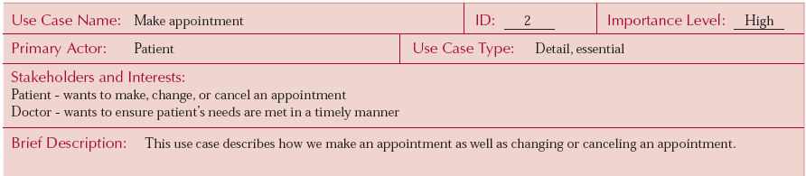
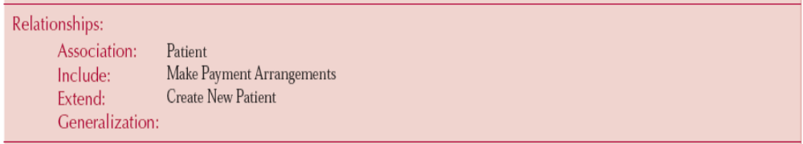
An Example of a Use-Case Description
OOD - DEI.FET.HUT

Slide 39
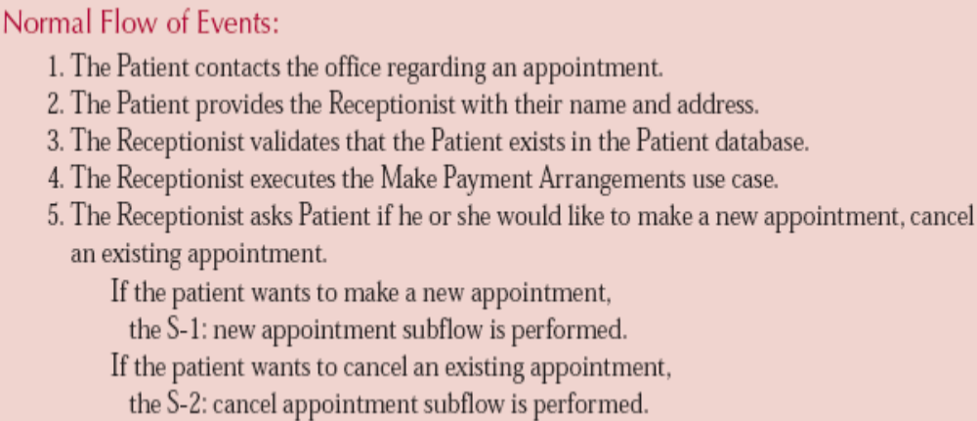
An Example of a Use-Case Description
OOD - DEI.FET.HUT

Slide 40
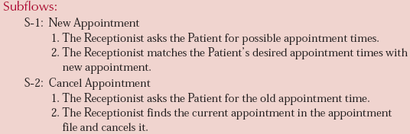
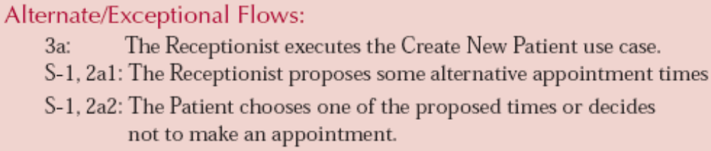
An Example of a Use-Case Description
OOD - DEI.FET.HUT

Slide 41
Guidelines for Creating Use-Case Descriptions
Write each step in “SVDPI (subject-verb-direct object and optionally preposition-indirect object)” form
  Example. “The patient (subject) contacts (verb) the office (direct object) regarding (preposition) an appointment (indirect object).
Clarify initiator and receivers of action
Write from independent observer perspective
Write at same level of abstraction
Ensure a sensible set of steps
Apply KISS (keep it simple, stupid) principle liberally
Write repeating instructions after the set of steps to be repeated.
OOD - DEI.FET.HUT

Slide 42
USE-CASE DIAGRAMS

Slide 43
Use Case Diagrams
Summarized into a single picture…
All of the use cases for the part of the system being modeled
Use Case Diagram tells what the system will do
Good for communicating with users
OOD - DEI.FET.HUT

Slide 44

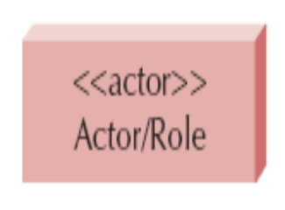
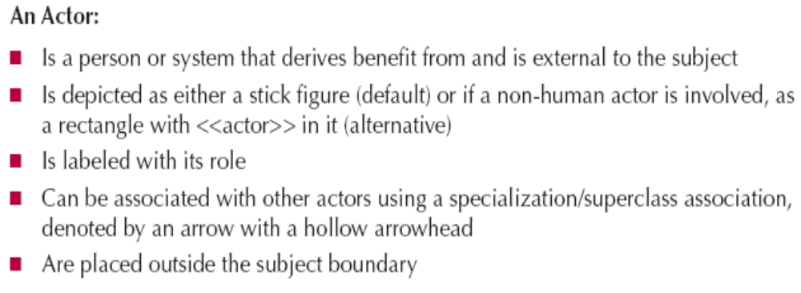
Syntax for Use-Case Diagram
OOD - DEI.FET.HUT

Slide 45
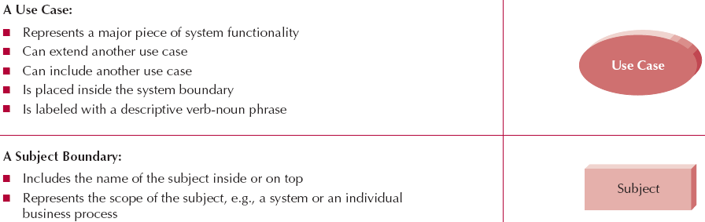
Syntax for Use-Case Diagram
OOD - DEI.FET.HUT

Slide 46
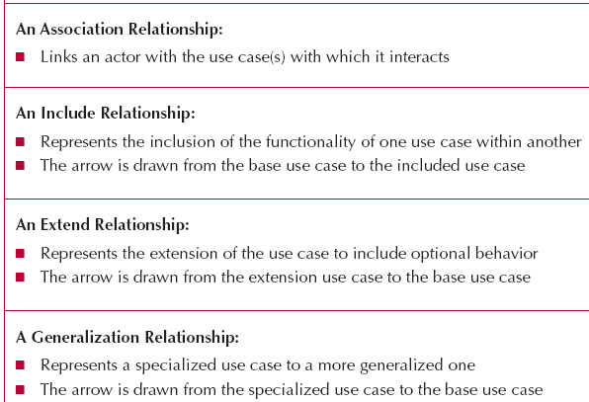

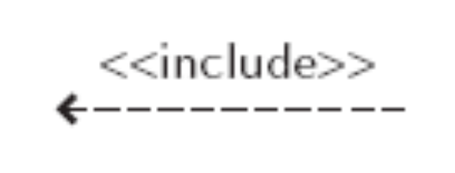

Syntax for Use-Case Diagram
OOD - DEI.FET.HUT

Slide 47
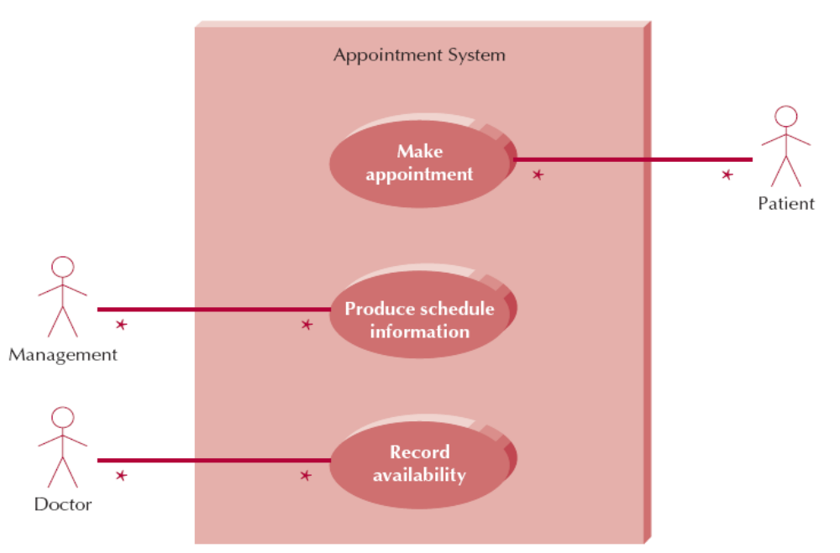
An Example: The Use-Case Diagram for Appointment System
A Subject Boundary
An Actor
An associate relationship
A use case
OOD - DEI.FET.HUT

Slide 48
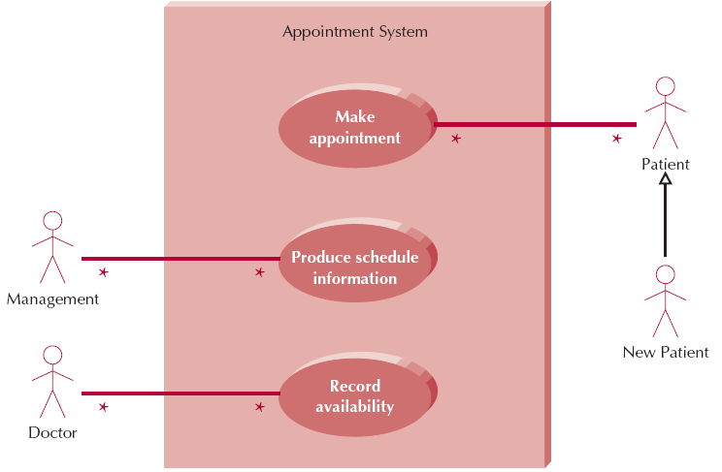
Use-Case Diagram with Specialized Actor
OOD - DEI.FET.HUT

Slide 49
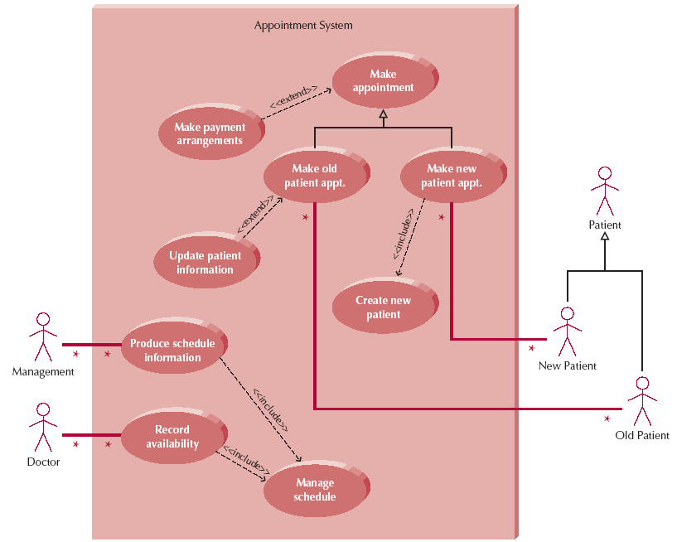
Extend and Include Relationships
OOD - DEI.FET.HUT

Slide 50
CREATING USE-CASE DESCRIPTIONS AND USE-CASE DIAGRAMS

Slide 51
Major Steps in Writing Use-Case Description and Use-case Diagrams
Step 1. Identify the major use-cases
Step 2. Expand the major use-case
Step 3. Confirm the major use-cases
Step 4. Create the use-case diagram
OOD - DEI.FET.HUT
Notes:
As can be seen by comparing this list to figure 6-7, it is a very high level
summary. Teachers of this material might want to spend significant time reviewing
what happens in each of these steps.

Slide 52
Step 1. Identifying the Major Use-Cases
Review the activity diagram
Identify the system’s boundaries
List the primary actors and their goals
Identify and write the major use-cases
Carefully review use-cases and revise as needed
OOD - DEI.FET.HUT

Slide 53
Step 1. Identifying the Major Use-Cases - Example
Review activity diagram of
Internet order System:
Maintain CD marketing information
Place CD Order
Maintain CD Information
Maintain CD Order
OOD - DEI.FET.HUT

Slide 54
Step 1. Identifying the Major Use-Cases - Example
Identify and write the major (overview) use-cases
Use case name | Primary actor | Relationship
 |  | Association | Include | Exclude
Maintain marketing information | Vendor | Vendor
Maintain CD information | Distribution system | Distribution system
Place order | Customer | Customer | Maintain order
Maintain order | Customer
OOD - DEI.FET.HUT

Slide 55
Step 2. Expand the Major Use-Cases
Choose one major use-case to expand
Fill in details on the use-case template
Fill in the steps of the normal flow of events
Normalize the size of each step (i.e., if the normal flow of events is too complex or long, decompose into subflows or introduce a new use case)
Describe alternate or exceptional flows
For each alternate or exceptional flow, list how the actor and/or system should react
OOD - DEI.FET.HUT

Slide 56
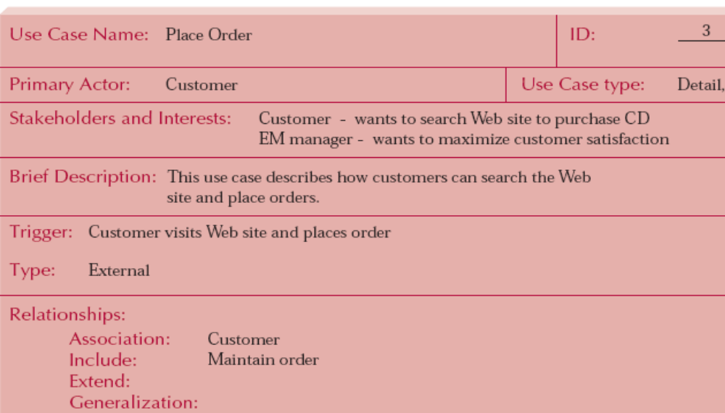
Step 2. Expand the Major Use-Cases - Example
OOD - DEI.FET.HUT

Slide 57
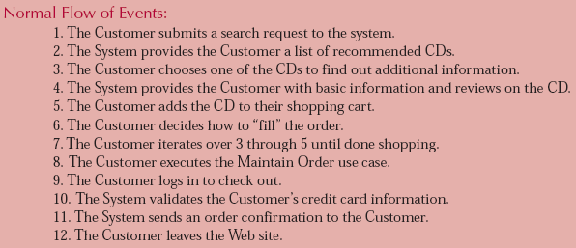
Step 2. Expand the Major Use-Cases - Example
OOD - DEI.FET.HUT

Slide 58
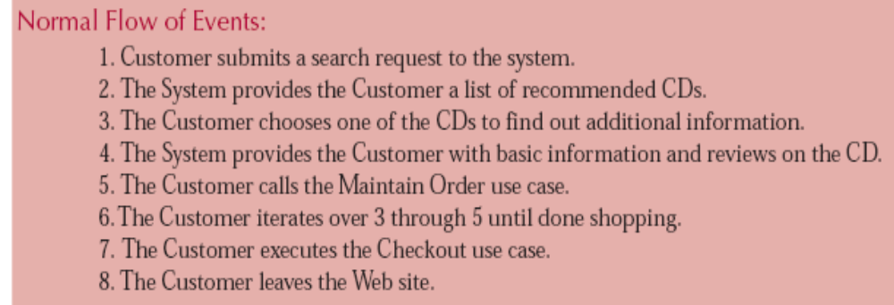
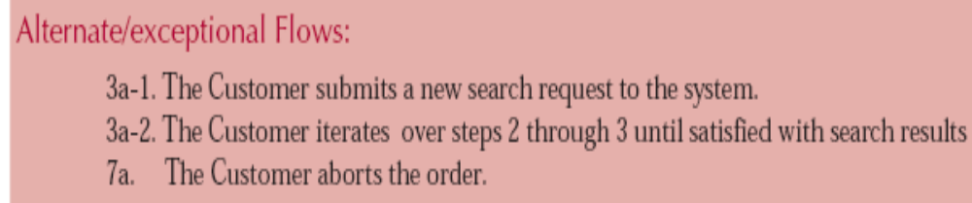
Step 2. Expand the Major Use-Cases - Example
New use case
OOD - DEI.FET.HUT

Slide 59
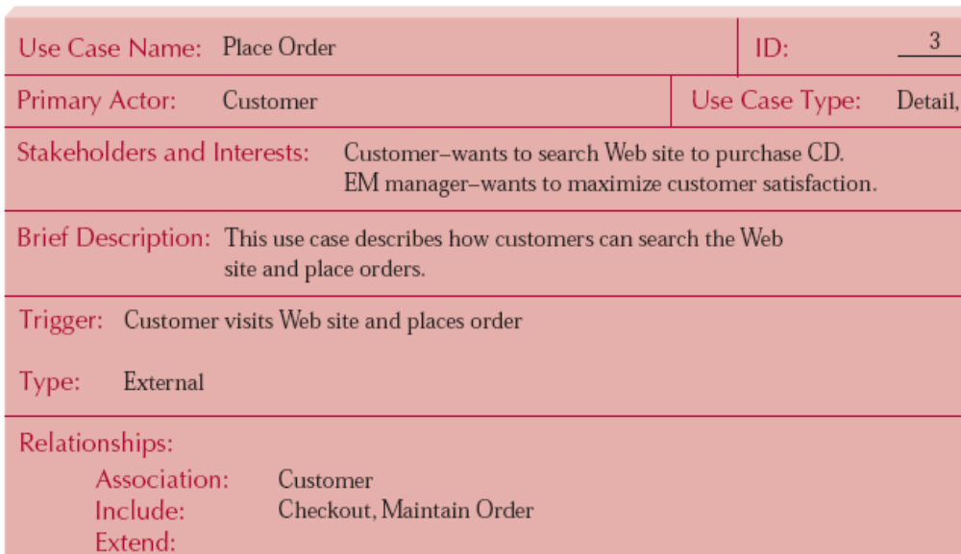
Step 2. Expand the Major Use-Cases - Example
OOD - DEI.FET.HUT
New use case

Slide 60
Step 2. Expand the Major Use-Cases - Example
Expand the major use-case
  By writing down the detailed use cases, it is identified that 3 new use cases are needed
    As shown in the last slide, one “include” use case “Check out” for Place Order use case
    Similarly, Two “extend” use cases “Place instore hold” and “Place special order” for Maintain Order use case
OOD - DEI.FET.HUT

Slide 61
Step 3. Confirm the Major Use Cases
Review the current set of use case, revise as needed
  Consider semantics and syntax
  Helpful to involve the users
Iterate the entire set of steps until all use cases are defined
OOD - DEI.FET.HUT

Slide 62
Step 4. Create the Use-Case Diagram
Draw the system boundary
Place the use cases on the diagram (better to put them in order to be easy to read)
Place the actors on the diagram
Draw the associations (such as connecting actors to use cases by lines etc)
OOD - DEI.FET.HUT

Slide 63
Exercise: Draw use-case diagram
Question. Suppose that 7 major use cases have been identified as below, draw the corresponding use-case diagram
Use case name | Primary actor | Relationship
 |  | Association | Include | Exclude
1. Maintain marketing information | Vendor | Vendor
2. Maintain CD information | Distribution system | Distribution system
3. Place order | Customer | Customer | Check out, Maintain order
4. Check out | Customer | Customer, Credit Centre | Maintain order
5. Maintain order | Customer |  |  | Place Instore hold, Place special order
6. Place Instore hold | Customer | Store
7. Place special order | Customer | Store
OOD - DEI.FET.HUT

Slide 64
Exercise: Draw use-case diagram
Question. Suppose that 7 major use cases have been identified as below, draw the corresponding use-case diagram
Use case name | Primary actor | Relationship
 |  | Association | Include | Extend
1. Maintain marketing information | Vendor | Vendor
2. Maintain CD information | Distribution system | Distribution system
3. Place order | Customer | Customer | Check out, Maintain order
4. Check out | Customer | Credit Centre | Maintain order
5. Maintain order | Customer
6. Place Instore hold | Customer | Store |  | Maintain order
7. Place special order | Customer | Store |  | Maintain order
OOD - DEI.FET.HUT

Slide 65


Maintain CD
marketing information
Place CD
order
<<include>>
<<actor>>
Credit
Card
Centre
Check out
<<include>>
Maintain CD
order
Place instore hold
<<actor>>
Store
<< extend >>
Place special order
<<actor>>
Distribution
System
Maintain CD
information
OOD - DEI.FET.HUT

Slide 66
Summary
Use-case descriptions are the basis for further analysis and design. They are created based on 7 guidelines and 13 steps.
Use-case diagrams present a graphical overview of the main functionality of a system.
OOD - DEI.FET.HUT

