Slide 1
PHÂN TÍCH THIẾT KẾ
HƯỚNG ĐỐI TƯỢNG
TRƯỜNG ĐẠI HỌC BÁCH KHOA HÀ NỘI
VIỆN ĐIỆN TỬ VIỄN THÔNG
CHƯƠNG 3
Phân tích (tiếp theo và hết)
Bộ môn Điện tử Kỹ thuật máy tính

Slide 2
Chương 3. Phân tích
3.1. Xác định rõ yêu cầu
3.2. Mô hình hóa chức năng
3.3. Mô hình hóa cấu trúc
3.4. Mô hình hóa hoạt động
OOD - DEI.FET.HUT

Slide 3
Introduction
Last two chapters:
  Use Case ⇒ External Behavior
  (how the system is used)
  Structural Model ⇒ Static View of system
  (how the system is structured)
This Chapter
  Behavioral Model
  (how the system behaves)
    Internal behavior
    Dynamic view of the information system
OOD - DEI.FET.HUT

Slide 4
Introduction
We'll look at two types of Behavioral Models:
  For Business Processes
    Sequence and collaboration diagrams
  For Changes in underlying data
    Statechart diagrams
OOD - DEI.FET.HUT

Slide 5
Key Ideas
Behavioral models describe the internal dynamic aspects of an information system that supports business processes in an organization
Key UML behavioral models:
  Sequence Diagrams
  Communication Diagrams
  State Machine Diagrams
OOD - DEI.FET.HUT

Slide 6
Behavioral Models
Purpose of Behavioral Models
  Show how objects in the structural model collaborate to support each use case
  Depict the internal view of the business process
  To show the effects of varied processes on the system
  To be used to verify and modify functional and structure models
Types of Behavioral Models
  Interaction Diagrams
  Behavioral state machine diagram
OOD - DEI.FET.HUT

Slide 7
Interaction Diagrams
Interaction Diagrams
  sequence diagrams
  communication diagrams
Interaction Diagram Components
  Objects
    Instantiation of a class
    Has attributes that describe an object
  Operations
    Send and receive messages
  Messages
    Tell object to execute a behavior
OOD - DEI.FET.HUT

Slide 8
Sequence Diagrams
Illustrate the objects that participate in a use-case
Show the messages that pass between objects for a particular use-case
OOD - DEI.FET.HUT

Slide 9
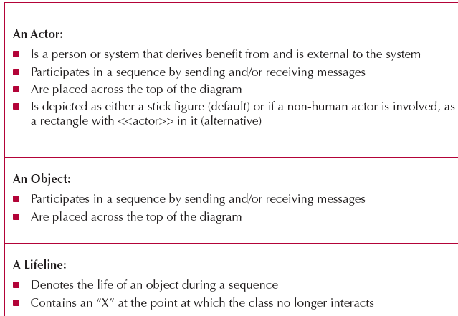
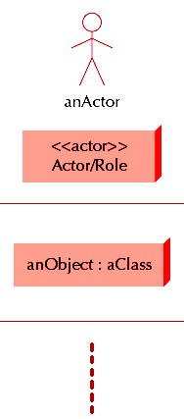
Elements of Sequence Diagram
OOD - DEI.FET.HUT

Slide 10
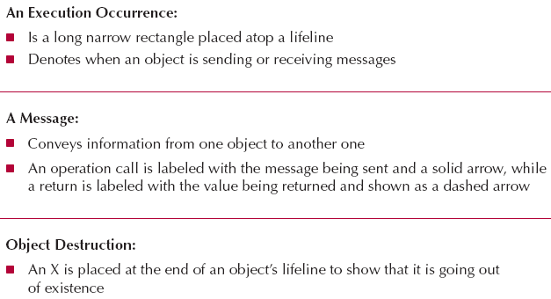
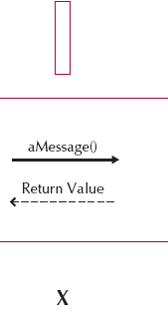
Elements of Sequence Diagram
OOD - DEI.FET.HUT

Slide 11
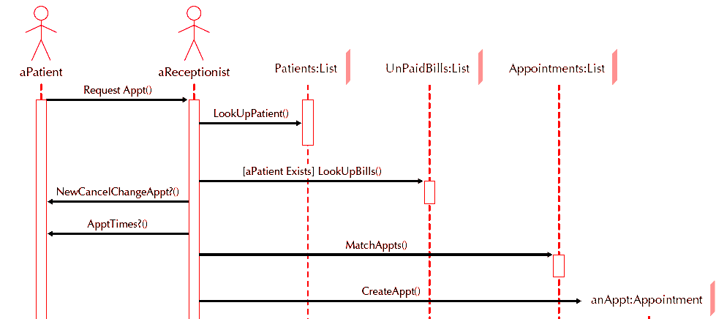
An Example of Sequence Diagrams
OOD - DEI.FET.HUT

Slide 12
Building a Sequence Diagram
Determine the context of the SD
  A system, use case, use case scenario, or class method
Identify the participating objects
  Developed in structural model
Set the lifeline for each object (dotted lines)
Add messages (horizontal arrows)
Place the focus of control on each object’s lifeline (when the classes send/receive)
Validate the sequence diagram
OOD - DEI.FET.HUT

Slide 13
Application
Example:
CD Selections
Normal Flow of Events:
1. Customer submits a search request to the system.
2. The system provides the customer a list of recommended CDs.
3. The customer chooses one of the CDs to find additional
information.
4. The system provides the customer with basic (market)
information & CD Reviews
5. The customer calls the maintain order use case.
6. The customer iterates over 3 through 5 until finished shopping.
7. The customer executes the checkout use case.
8. The customer leaves the website.
OOD - DEI.FET.HUT

Slide 14
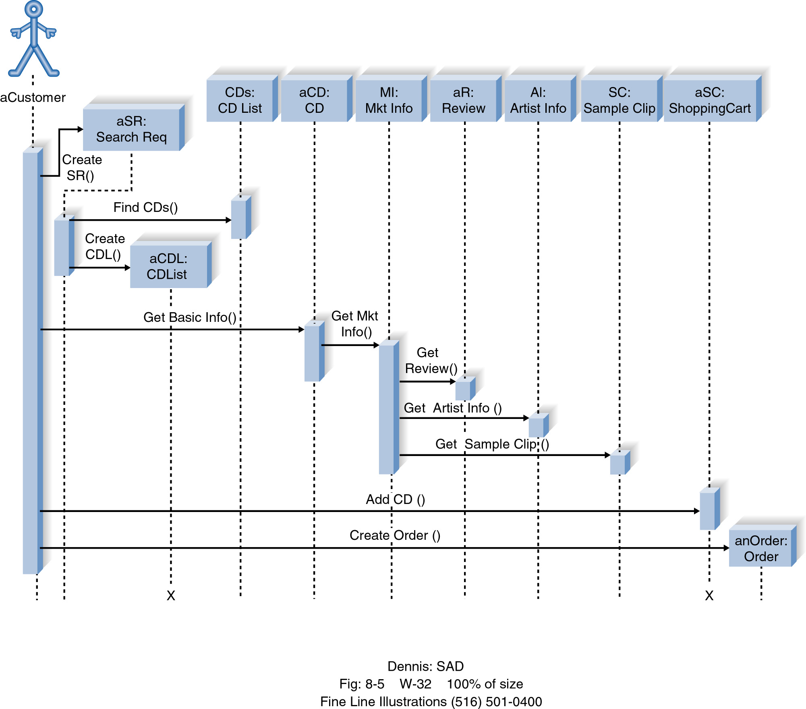
Application
Example:
CD Selections
OOD - DEI.FET.HUT

Slide 15
Collaboration/ Communication Diagrams

Slide 16
Collaboration Diagrams
Essentially an object diagram that shows
  Message passing relationships
  Associations with other objects
Emphasize
  The flow of messages among objects
  Rather than timing and ordering of messages
OOD - DEI.FET.HUT

Slide 17
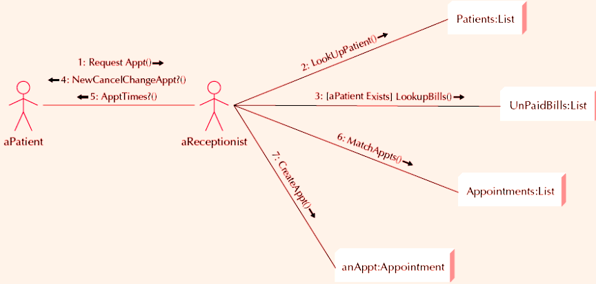
Example Collaboration Diagram
OOD - DEI.FET.HUT

Slide 18


Elements of a Collaboration Diagram
Actor
Object
Association
Message
OOD - DEI.FET.HUT

Slide 19
Building Collaboration Diagrams
1. Set the context.
2. Identify which objects (actors) and the associations between the objects participate in the collaboration.
3. Layout the communication diagram.
4. Add messages.
5. Validate the communication diagram.
OOD - DEI.FET.HUT

Slide 20
Technique to Identify Collaborations between Objects - “CRUD” Analysis
What is “CRUD” analysis:
  identifying the processes to Create, Read or Reference, Update or Delete objects based on use cases
  The process of each use case is represented by “CRUD” matrix: a class-by-class matrix in which each cell in the matrix represents the interaction between instances of the classes
OOD - DEI.FET.HUT

Slide 21
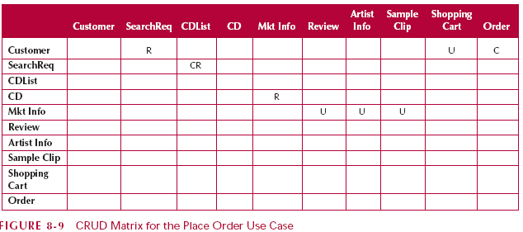
“CRUD” Analysis Example
C
C
OOD - DEI.FET.HUT

Slide 22
Application
Example:
CD Selections
Normal Flow of Events:
1. Customer submits a search request to the system.
2. The system provides the customer a list of recommended CDs.
3. The customer chooses one of the CDs to find additional
information.
4. The system provides the customer with basic (market)
information & CD Reviews
5. The customer calls the maintain order use case.
6. The customer iterates over 3 through 5 until finished shopping.
7. The customer executes the checkout use case.
8. The customer leaves the website.
OOD - DEI.FET.HUT

Slide 23
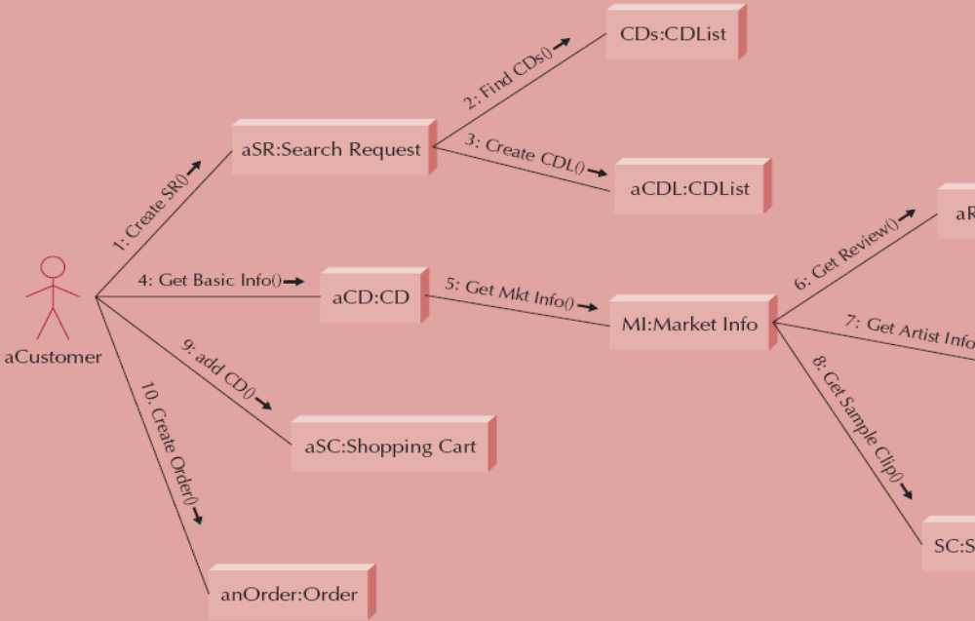
Application
Example:
CD Selections
OOD - DEI.FET.HUT

Slide 24
Behavioral State
Machines Diagrams

Slide 25
Behavioral State Machines
The behavioral state machine is a dynamic model that shows this
The behavioral state machine shows
  The different states of an object
  The events
    That cause the object to change from one state to another
OOD - DEI.FET.HUT

Slide 26
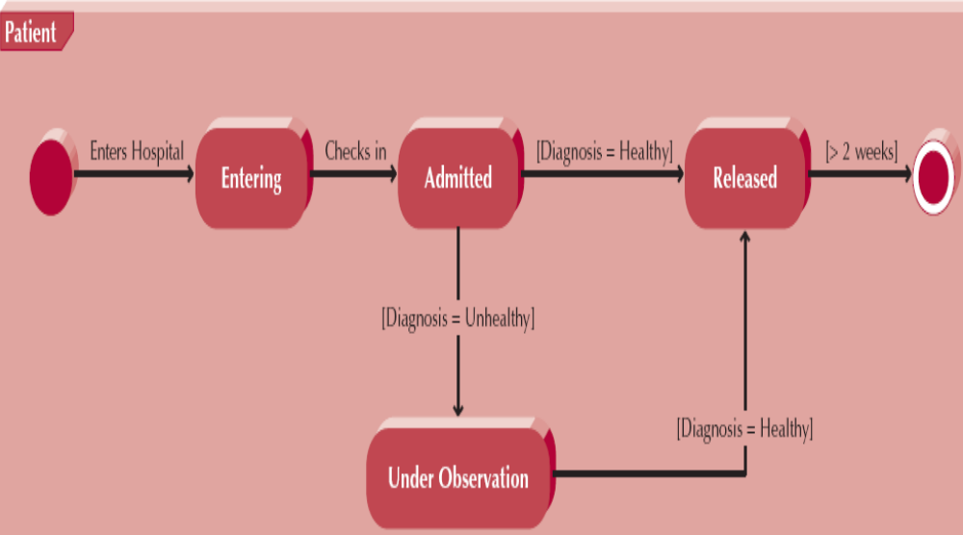
Example Behavioral State Machine Diagram
OOD - DEI.FET.HUT

Slide 27
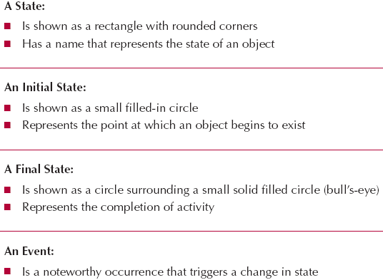
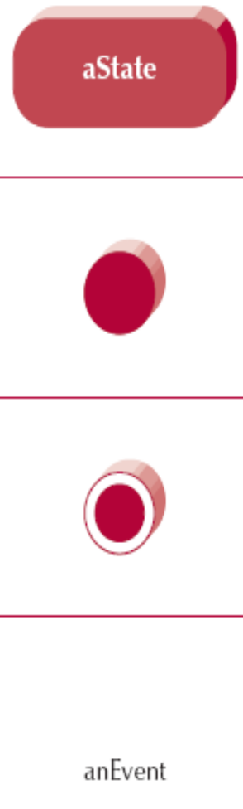
Elements of Behavioral State Machine Diagram
OOD - DEI.FET.HUT

Slide 28

Elements of Behavioral State Machine Diagram
Transitions: A transition indicates a movement from one state to the next one, denoted by lines with arrowheads. A transition has a label in the form of three parts: Event [guard]/activity. All three parts are optional.
Event or Trigger: the signal event that triggers a potential change of state
Guard: If presented, is a Boolean condition that must be true in order for the trigger to cause the transition
Action or Activity: is some behaviour that has executed during the transition
Event [guard]/activity
state
transition
OOD - DEI.FET.HUT

Slide 29
Building Behavioral State Machine Diagrams
Set the context
Identify the initial, final, and stable states of the object
Determine the order in which the object will pass through stable states
Identify the events, actions, and guard conditions associated with the transitions
Validate the state machine diagram
OOD - DEI.FET.HUT

Slide 30
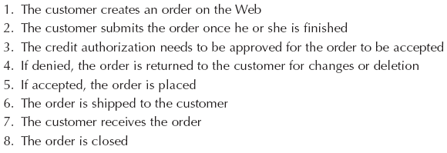
Application
Example:
CD Selections
The Life of an Order Object:
OOD - DEI.FET.HUT

Slide 31
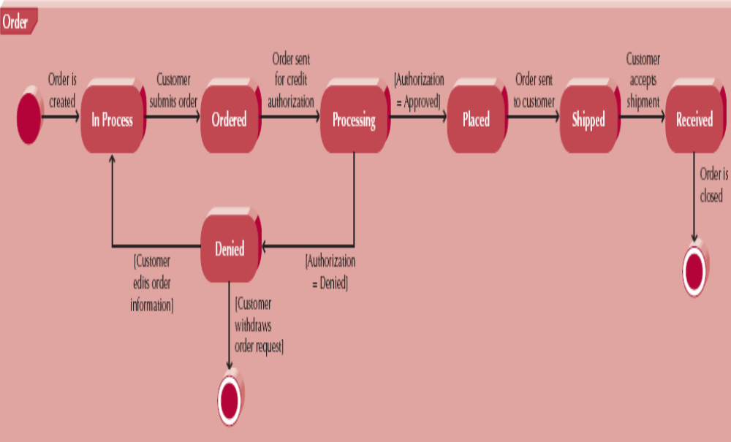
Application
Example:
CD Selections
OOD - DEI.FET.HUT

Slide 32
Summary
Sequence diagrams illustrate the classes that participate in a use case and the messages that pass between them.
Communication diagrams provide a dynamic view of the object-oriented system and accentuate message passing between collaborating actors and objects.
Behavioral State Machine diagrams show the different states that a single class passes through in response to events.
OOD - DEI.FET.HUT

Slide 33
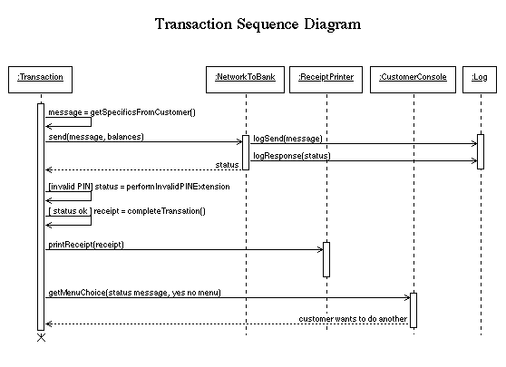
OOD - DEI.FET.HUT

Slide 34
References
http://www.cs.gordon.edu/courses/cs211/ATMExample/index.html
http://www.cs.gordon.edu/courses/cs211/AddressBookExample/index.html
OOD - DEI.FET.HUT

