Slide 1
PHÂN TÍCH THIẾT KẾ
HƯỚNG ĐỐI TƯỢNG
TRƯỜNG ĐẠI HỌC BÁCH KHOA HÀ NỘI
KHOA ĐIỆN TỬ VIỄN THÔNG
CHƯƠNG 4. Thiết kế

Slide 2
Chương 4. Thiết kế
4.1. Chuẩn bị thiết kế
4.2. Thiết kế lớp và phương thức
4.3. Thiết kế lớp quản lý dữ liệu
4.4. Thiết kế giao diện giao tiếp người-máy
4.5. Thiết kế kiến trúc vật lý
OOD - DEI.FET.HUT

Slide 3
4.1. Moving on Design
The purpose of the analysis phase is to figure out what the business needs. The purpose of the design phase is to figure out how to provide it.
The steps in both analysis and design phases are highly interrelated and may require much “going back and forth”
OOD - DEI.FET.HUT

Slide 4
REVISITING THE OBJECT-ORIENTED APPROACH TO ANALYSIS AND DESIGN

Slide 5
OO Analysis and Design Foundation
Use-case driven
Architecture centric
Iterative and incremental
OOD - DEI.FET.HUT

Slide 6
Combining Three Views of a System
Functional View
  External behavior of the system
  From perspective of the user
Static View
  Structure of the system
  Classes, attributes, methods, etc.
Dynamic
  Internal behavior
  Message passing, state changes, etc.
OOD - DEI.FET.HUT

Slide 7
A “Minimalist” Approach
Planning
Gathering requirements
Perform a series of “builds”
  Analysis, Design, Implementation
Use results of each build as feedback for design and implementation
OOD - DEI.FET.HUT

Slide 8
MOOSAD
Chapter | Steps | Deliverable
3 | Identifying business value | System request
 | Analyze feasibility | Feasibility Study
4 | Develop workplan | Work plan
 | Staff the project | Staff plan
 | Control and direct project | GANTT Chart
5 | Requirements determination | Information
6 | Functional modeling | Function Models
7 | Structural modeling | Structure Models
8 | Behavioral modeling | Dynamic Models
9 | Moving on to design | Factored Models
OOD - DEI.FET.HUT

Slide 9
MOOSAD
Chapter | Steps | Deliverable
10 | Class and method design | logic design
11 | Data management layer design | Database design
12 | Human computer interaction layer design | Interface design
13 | Physical architecture layer design | Architecture design
14 | Construction and verification | Completed syst
15 | Installation | Training plan
 | Operations and support | Support plan
OOD - DEI.FET.HUT

Slide 10
EVOLVING THE ANALYSIS MODELS INTO DESIGN MODELS

Slide 11
What's Different?
During Analysis
  Define functional Requirements
  Ignore non-functional requirements
During Design
  Address both functional and non-functional requirements
  Refine the analysis by adding the system environment
OOD - DEI.FET.HUT

Slide 12
Avoid Classic Design Mistakes
Reducing design time
  Use timeboxing
Feature creep
  Only make vital changes, postpone others
  Make sure users know impact
Silver bullet syndrome
  If a tool seem too good to be true…
Switching tools in mid-project
  Just say "No"
OOD - DEI.FET.HUT

Slide 13
Factoring
Creating modules that account for similarities and differences between units of interest
New classes
  Generalization
  Aggregation
OOD - DEI.FET.HUT

Slide 14
Factoring
Abstraction
  Create "higher" level idea from a set of ideas
  May lead to Abstract or Concrete Classes
Refinement
  Opposite of abstraction
  Identify additional subclasses
OOD - DEI.FET.HUT

Slide 15
Partitions and Collaborations
A partition is an Object Oriented equivalent of a subsystem
Used to reduce the amount of detail that needs to be absorbed at one time
Group units that collaborate into a partition
  Look at collaboration diagrams of Ch. 8
The more messages or Client / Server contracts between objects, the more likely they are in the same partition
OOD - DEI.FET.HUT

Slide 16
Purpose of Layers
Model-View-Controller (MVC) architecture
  Models implement application logic
  Views and controllers do user interfaces
Separating application logic from user interface logic
OOD - DEI.FET.HUT

Slide 17
Layers
Layers are a way to add the system environment information
A Layer represents an element of the software architecture of the new system
OOD - DEI.FET.HUT

Slide 18
Layers
There is a layer for each different element in the system environment
  System Architecture
  User Interface
  Data Management
Layers separate application logic from user interface logic
OOD - DEI.FET.HUT

Slide 19
Layers
Software architecture can be based on the following layers
  Foundation
  System Architecture
  Human-Computer Interaction
  Data Management
  Problem Domain
OOD - DEI.FET.HUT

Slide 20
Layers
Foundation Layer
  Contains basic classes needed for any application
    Fundamental data types (integers, floating points, strings, Booleans, etc)
    Fundamental data structures (lists, stacks, sets, trees, etc.)
    Useful abstract classes (date, time, money, mathematics)
OOD - DEI.FET.HUT

Slide 21
Layers
System Architecture Layer
  How the software will execute on specific computers and networks
    Communication between SW and OS
    Communication between SW and HW
    Classes to interact with middleware
  Need to address computer/network choices before implementing this layer
OOD - DEI.FET.HUT

Slide 22
Layers
Human-Comp. Interaction Layer
  Separates UI from problem domain
    Buttons, windows, scroll bars, etc.
  Makes SW more portable
  Need to address
    UI consistency, user experience, help systems, types of input/output elements
OOD - DEI.FET.HUT

Slide 23
Layers
Data Management Layer
  Separates storage from problem domain
  How objects are stored/retrieved
  Increases portability
  Addresses
    storage format (db, client/server, etc.)
    storage optimization (clustering, indexing)
OOD - DEI.FET.HUT

Slide 24
Layers
Problem Domain Layer
  What we have focused on so far in this class
  Previous layers deal with the environment
  This layer is our actual application
OOD - DEI.FET.HUT

Slide 25
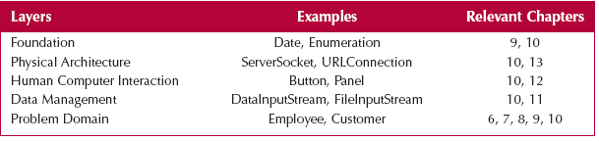
Layers
OOD - DEI.FET.HUT

Slide 26
PACKAGES AND PACKAGE DIAGRAMS

Slide 27
Packages
Logical grouping of UML elements
Simplifies UML diagrams
  Groups related elements into a single higher-level element
Dependency relationships
  Shows a dependency between packages
OOD - DEI.FET.HUT

Slide 28
Package
A general construct that groups units together
A package can contain
  Collaborations
  Partitions
  Layers
Used to reduce complexity of models
OOD - DEI.FET.HUT

Slide 29
Package Diagrams
A package diagram shows packages only
Like a class diagram but shows only packages
Packages can have different relationships, depending on what's in them
  (i.e. classes)
OOD - DEI.FET.HUT

Slide 30
Package Diagrams
Also, define a new relationship called a "dependency relationship"
OOD - DEI.FET.HUT

Slide 31
Syntax for Package Diagram
A PACKAGE Package
A DEPENDENCY RELATIONSHIP
OOD - DEI.FET.HUT

Slide 32
Modification Dependency
A change in one package requires a change in another package.
Example:
  A change in one method
    → Causes a change in the interface for all objects of the class.
    → Causes change in all classes that send messages to the changed class.
OOD - DEI.FET.HUT

Slide 33
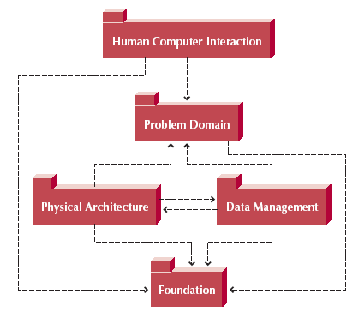
Package Diagram of Dependency Relationships Among Layers
OOD - DEI.FET.HUT

Slide 34
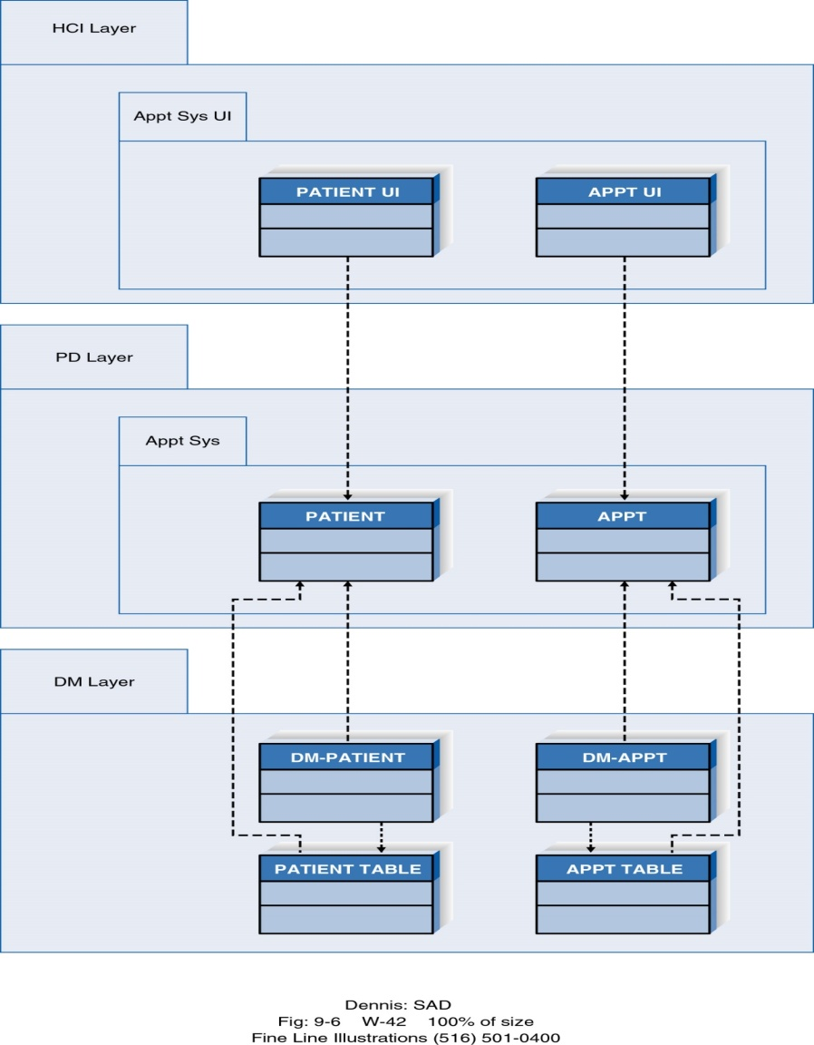
Package Diagram of Appointment System
OOD - DEI.FET.HUT

Slide 35
Steps for Identifying Packages and Building Package Diagrams
Set the context
Cluster classes together
  Based on shared relationships
  Generalization, aggregation, associations, messages sent
  Model clustered classes as a package
Place clusters into partitions and model them as packages
Identify dependency relationships among packages
Place dependency relationships between packages
OOD - DEI.FET.HUT

Slide 36
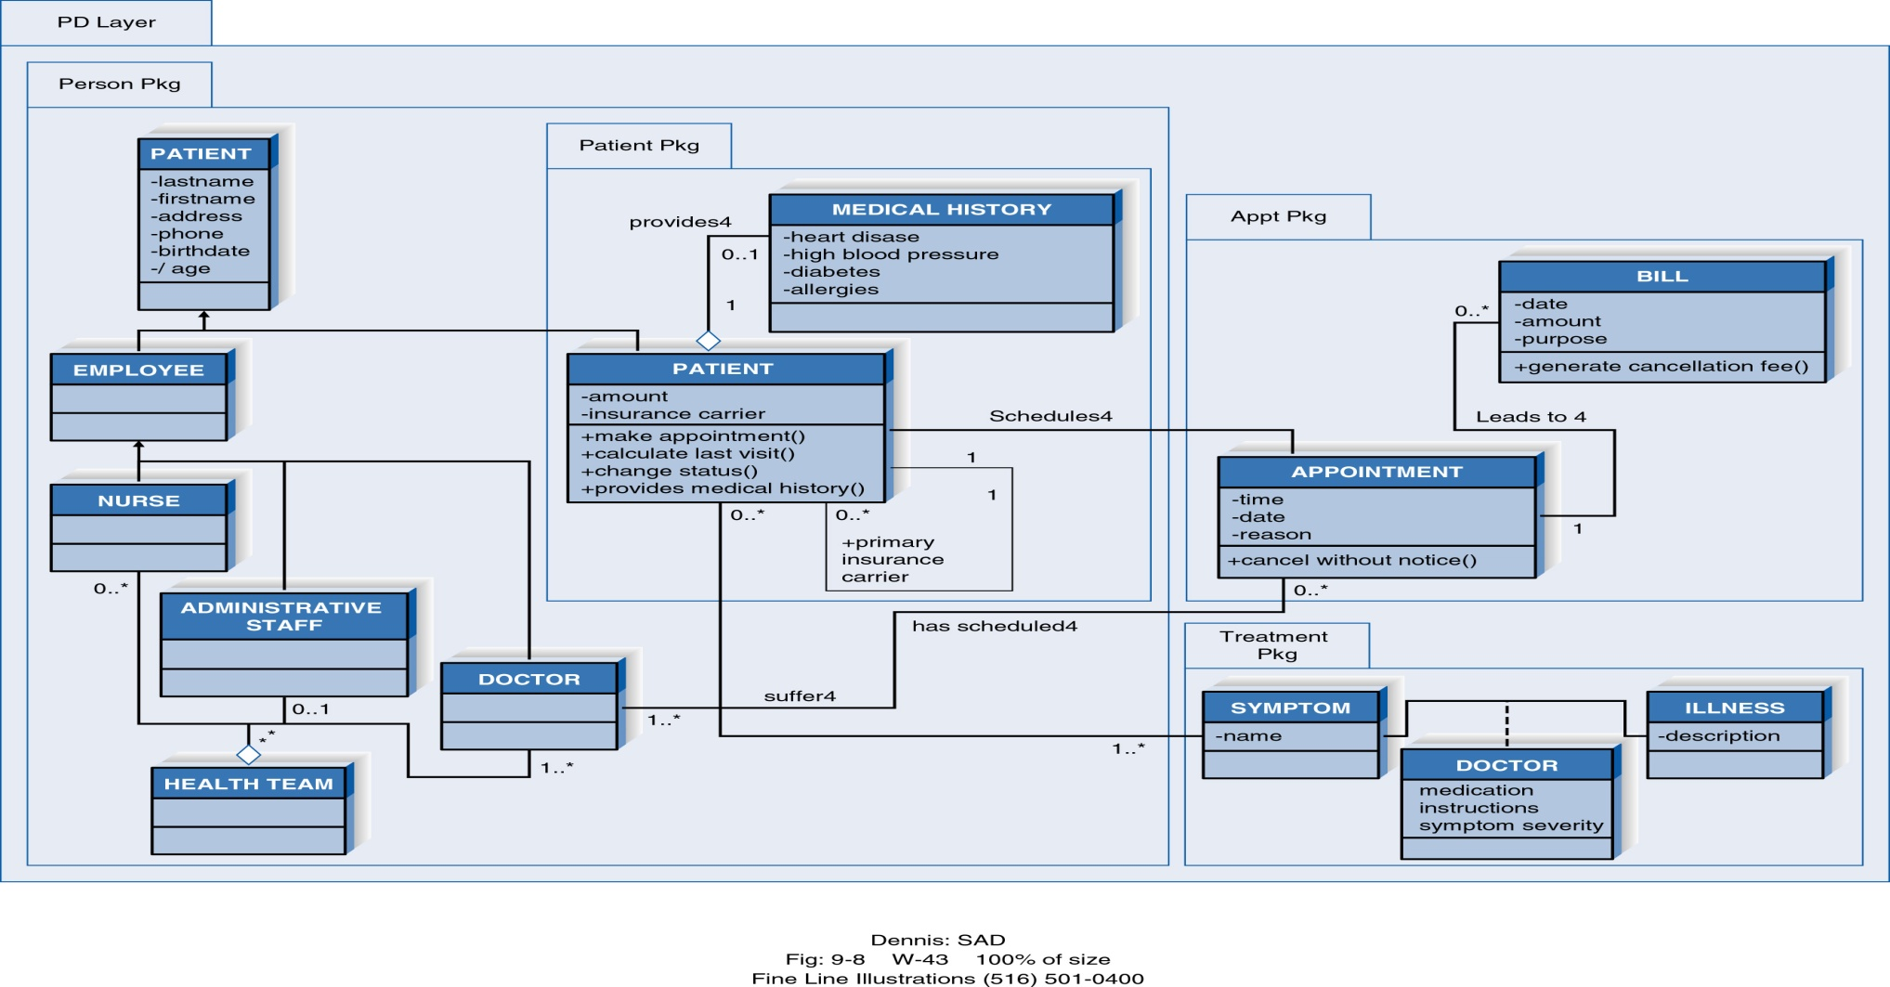
Package Diagram of the PD Layer for the Appointment System

Slide 37
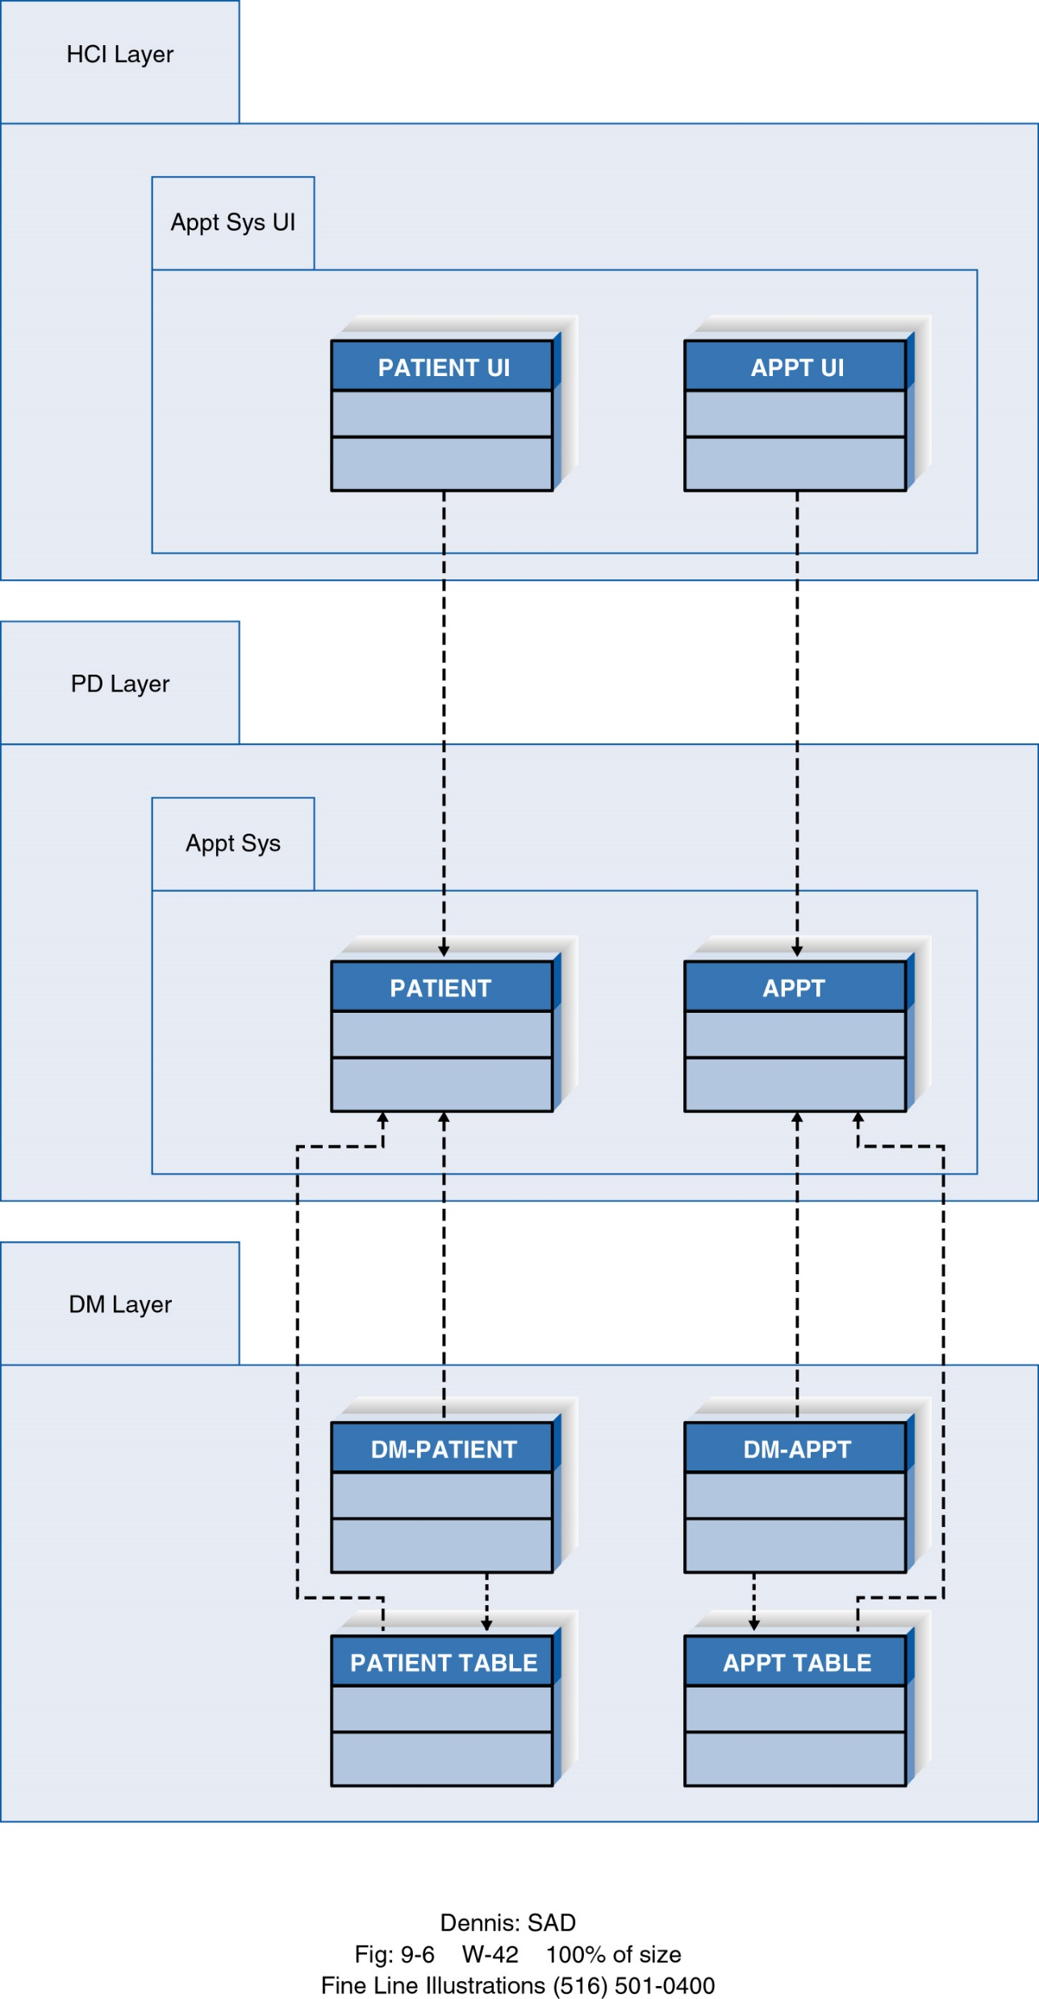
  Step 1: Set the context
  VD: mô hình hóa một partition hoặc một Layer. Đối với appointments system chúng ta có thể chọn: context = problem domain (PD) layer
OOD - DEI.FET.HUT

Slide 38
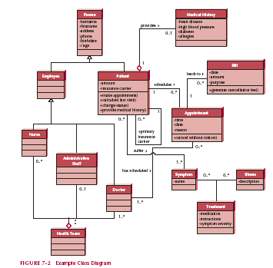
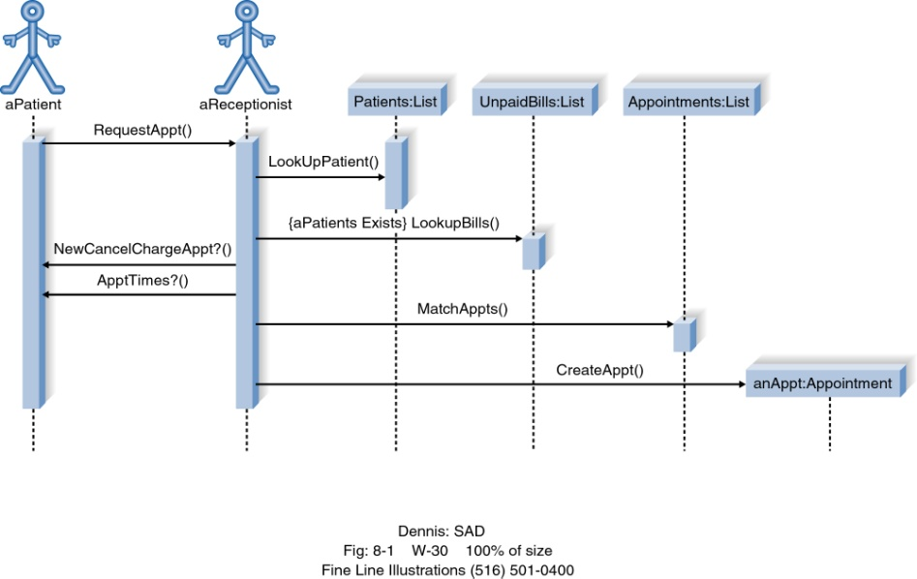
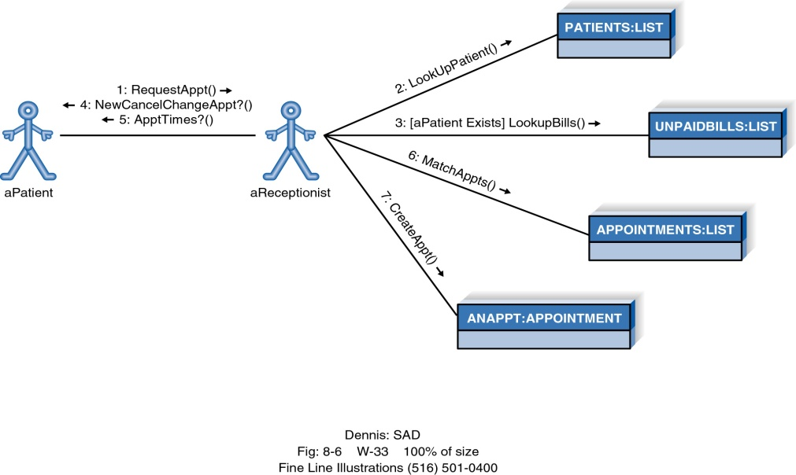
  Step 2: Cluster classes together based on shared relationships, i.e. form partitions
  using relationships (generalization, aggregation, kinds of association
  and message passing between objects) shared by classes
  Examine analysis models
Sequence Diagram(s)
Class Diagram
  Classes in a generalization
  hierarchy put in a single
  partition
Communication Diagram(s)
OOD - DEI.FET.HUT

Slide 39
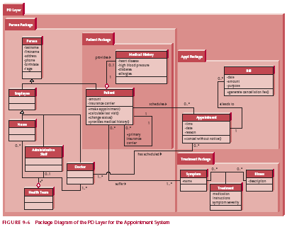
Step 3: Place clustered classes in partition and model clustered classes as a package, i.e. model partitions as packages
OOD - DEI.FET.HUT

Slide 40
Step 4: Identify dependency relationships between packages, i.e. relationships that cross boundaries of packages = potential dependencies
a) association relationship between
Person Pkg and Appt. Pkg via
Association between Doctor class
and Appt. class and Patient Pkg
contained in Person Pkg
b) Appt. pkg via association between
Patient and Appt classes
and Treatment Pkg via association
between Patient and Symptom classes
OOD - DEI.FET.HUT

Slide 41
Step 5: Place dependency relationships between packages, i.e. between Person Package and Appt. Package, Person Package and Treatment Package
PD Layer
Person Package
Appt. Package
Patient Package
Treatment Package
OOD - DEI.FET.HUT

Slide 42
DESIGN STRATEGIES

Slide 43
Design Strategies
We have assumed that the project team would actually build the new system
This isn't necessarily the case
There are three options:
  Develop custom application in-house
  Buy a package off the shelf and customize it if necessary
  Outsource development to external vendor
OOD - DEI.FET.HUT

Slide 44
Custom Development
Gives project team complete control
Allows for meeting highly specialized requirements
Allows flexibility and creativity in solving problems
Easier to change components
Builds personnel skills
May tax firm’s resources
May add significant risk
OOD - DEI.FET.HUT

Slide 45
Packaged Software
Software already written
May be more efficient
May be more thoroughly tested and proven
May range from components to tools to whole enterprise systems
Must accept functionality provided
May require change in how the firm does business (technology drives the business!)
May require significant “customization” or “workarounds”
OOD - DEI.FET.HUT

Slide 46
System Integration
Combining packages, legacy systems, and new software
Key challenge is integrating data
Write data in the same format
Revise existing data formats
Develop “object wrappers”
OOD - DEI.FET.HUT

Slide 47
Outsourcing
Requires little in-house experience
Gives you access to greater resources and experience
May reduce development duration
Could compromise sensitive info
Understand the requirements. Never outsource what you don’t understand
OOD - DEI.FET.HUT

Slide 48
Outsourcing
Carefully choose vendor
Prepare contract and payment style carefully
  Time and Materials
  Fixed Price
  Value Added
OOD - DEI.FET.HUT

Slide 49
Selecting a Design Strategy
Business need
In-house experience
Project skills
Project management
Time frame
OOD - DEI.FET.HUT

Slide 50
Selecting a Design Strategy
 | Custom Development | Packaged System | Outsourcing
Business Need | Business need is unique | Business need is common | Business is not core
In-house experience | Functional and tech experience exists | Functional exp exists | Neither Functional nor tech. exp exists
Project Skills | Want to build in-house skills | Skills not strategic | Strategic decision to outsource
Project Mgmt | Skilled mgr w/ methodology | Mgr to coordinate vendors | Mgr at same level as vendor
Time Frame | Flexible | Short | Short or Flexible
OOD - DEI.FET.HUT

Slide 51
DEVELOPING THE ACTUAL DESIGN

Slide 52
The Alternative matrix
Combines several feasibility analyses into one grid
Revisits technical, economic, and organizational feasibility
OOD - DEI.FET.HUT

Slide 53
Request for Proposals
Description of the system you propose to be built
Vendors, developers, service providers respond with proposals including how they will address needs as well as stating cost and time requirements.
OOD - DEI.FET.HUT

Slide 54
Summary
When evolving analysis into design models, it is important to review the analysis models then add system environment information.
Packages and package diagrams help provide structure and less complex views of the new system.
Custom building, packages, and outsourcing are alternative ways of creating the new system.
The alternative matrix can help with the selection of a design strategy.
OOD - DEI.FET.HUT

