Slide 1
PHÂN TÍCH THIẾT KẾ
HƯỚNG ĐỐI TƯỢNG
TRƯỜNG ĐẠI HỌC BÁCH KHOA HÀ NỘI
VIỆN ĐIỆN TỬ VIỄN THÔNG
CHƯƠNG 4
Thiết kế (tiếp)
Bộ môn Điện tử Kỹ thuật máy tính

Slide 2
Chương 4. Thiết kế
4.1. Chuẩn bị thiết kế
4.2. Thiết kế lớp và phương thức
4.3. Thiết kế lớp quản lý dữ liệu
4.4. Thiết kế giao diện giao tiếp người-máy
4.5. Thiết kế kiến trúc vật lý
OOD - DEI.FET.HUT

Slide 3
Key Concepts
Low-level or detailed design is critical despite libraries and components
Pre-existing classes need to be understood and organized
Some, if not all code, is generally still needed to instantiate new classes
OOD - DEI.FET.HUT

Slide 4
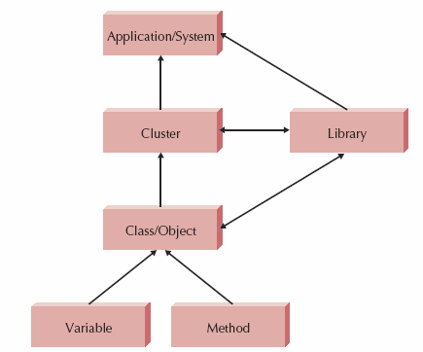
Levels of Abstraction
OOD - DEI.FET.HUT

Slide 5
Design Criteria

Slide 6
Coupling
Indicates the interdependence or interrelationships of the modules
Interaction coupling
Inheritance coupling
OOD - DEI.FET.HUT

Slide 7
Interaction Coupling
Relationships with methods and objects through message passage
Level | Type | Description
Good | No Direct Coupling | Methods don't call each other
 | Data | Calling method passes object, called method uses the entire object
 | Stamp | Calling method passes object, called method uses only part of the object
 | Control | Calling method passes a control variable whose value controls the execution of the called method
 | Common or Global | Methods refer to a "global data area" that is outside of the individual objects
Bad | Content or Pathological | A method of one object refers to the hidden part of another object.
OOD - DEI.FET.HUT

Slide 8
Interaction Coupling
Law of Demeter = minimise number of objects that can receive messages from a given object
Objects only send message to:
  A) Itself
  B) An object an object “contained” in an attribute of itself (or an object of one of its superclasses)
  C) An object passed as a parameter to the mehod
  D) An object created by the method
  E) An object stored in a variable whose declaration scope is the entire program (a “global” variable)
Coupling increase if:
  calling method passes attributes to called method
  Calling method depends on value returned by called method
OOD - DEI.FET.HUT

Slide 9
Inheritance Coupling
Relationship between classes in an inheritance hierarchy
Problematic as inheritance mechanism, forms of inheritance conflict, redefinition abilities & dynamic binding are language dependent
Must not violate encapsulation and information hiding principles
Hence tradeoff is between violating principles and increasing desirable coupling between classes and subclasses
Should only use inheritance to form generalisation/specialisation semantics (A-Kind_of) and principle of substitutability
  Recall object of a subclass should be substitutable anywhere object of its superclass is expected
OOD - DEI.FET.HUT

Slide 10
Cohesion
“Single-mindedness of a module”
Method cohesion
  A method should do just a single task
Class cohesion
  A class should represent just one thing
Generalization/specialization cohesion
  Addresses inheritance
  Should represent "a-kind-of" or "is-a"
OOD - DEI.FET.HUT

Slide 11
Types of Method Cohesion
Level | Type | Description
Good | Functional | A method performs a single task
 | Sequential | Method performs two tasks, the output of the first is the input of the second
 | Communicational | Method combines two functions that use the same attributes (calc current and final GPA)
 | Procedural | Method supports many loosely related functions (calc current GPA, print, calc final GPA, print)
 | Temporal or Classical | Method supports multiple functions related in time (initialize all variable, print all reports)
 | Logical | Method supports many functions controlled by a passed control variable
Bad | Coincidental | Method's purpose cannot be determined, or it supports multiple unrelated functions
OOD - DEI.FET.HUT

Slide 12
Types of Class Cohesion
Level | Type | Description
Good | Ideal | Class has none of the mixed cohesions
 | Mixed-Role | Class has some attributes that relate to other classes on the same layer, but the attributes are unrelated to the semantics of the class
 | Mixed-Domain | Class has some attributes that relate to classes on a different layer.
Worse | Mixed-Instance | Class represents two different types of objects. Should be decomposed into two classes.
OOD - DEI.FET.HUT

Slide 13
Ideal Class Cohesion
Contain multiple methods that are visible outside the class
Have methods that refer to attributes or other methods defined with the class or its superclass
Not have any control-flow coupling between its methods
OOD - DEI.FET.HUT

Slide 14
Connascence
Literally means "born together"
Generalizes the ideas of cohesion and coupling
Combines these ideas with the arguments for encapsulation
Two modules are so intertwined that a change to one automatically means a change to the other
OOD - DEI.FET.HUT

Slide 15
Connascence
Minimize overall connascence
Minimize across encapsulation boundaries
Maximize within encapsulation boundary
OOD - DEI.FET.HUT

Slide 16
Types of Connascence
Type | Description
Name | Method refers to an attribute by name. If the name changes, the method must change
Type or Class | If the type of a class's attribute changes, the attribute declaration must also change
Convention | If the range of values of a class's attribute has some meaning, and that meaning changes, all methods that use that attribute must also change
Algorithm | It two different methods of a class rely on the same algorithm and that algorithm changes, the methods must change (insert and sort)
OOD - DEI.FET.HUT

Slide 17
Object Design Activities

Slide 18
Additional Specification
Review the current set of models
  Classes on the Problem Domain Layer should be
    Necessary and Sufficient to solve the underlying problem
  No missing attributes or methods
  No extraneous attributes or methods
Examine visibility
OOD - DEI.FET.HUT

Slide 19
Additional Specification
Decide on the signature of every method
  Signature:
    Name of the method
    Type of the parameters passed to the method
    Type returned by the method
OOD - DEI.FET.HUT

Slide 20
Additional Specification
Define constraints that must be preserved by the objects
Types of constraints
  Pre-conditions
  Post-conditions
  Invariants
Decide how to handle violations (exceptions in C++ and Java)?
OOD - DEI.FET.HUT

Slide 21
Identify Opportunities for Reuse
Frameworks
  A set of implemented classes
  Can be reused to implement an app
  Allow you to create subclasses from the classes in the framework
  Tend to be domain specific, for example
    Object Persistence Framework
    User Interface Framework
OOD - DEI.FET.HUT

Slide 22
Identify Opportunities for Reuse
Class libraries
  A set of implemented classes
  Can be reused to implement an app
  Tend not to be domain specific
  Rather, provide some functionality
    Statistical library
    File management library
OOD - DEI.FET.HUT

Slide 23
Identify Opportunities for Reuse
Components
  Self-contained piece of Software
  Can be "plugged" into your app
  Has a well-defined API
  Often Active-X or JavaBeans
OOD - DEI.FET.HUT

Slide 24
Restructuring the Design
Factoring
  Separate aspects of a method or class into a new method or class
Normalization
  Identifies classes missing from the design
Challenge inheritance relationships to ensure they only support a generalization/specialization semantics
OOD - DEI.FET.HUT

Slide 25
Optimizing the Design
To this point, the design has been centered on understandability
Now, think about performance
Review access paths
  If there is a long access path through many objects, provide a direct path
OOD - DEI.FET.HUT

Slide 26
Optimizing the Design
Review attributes of each class
  Which classes use the attributes
  If only one class uses it, and it only reads and updates
  Move the attribute to the calling class
Review direct and indirect fan-out
  Fan-out is number of messages sent
  If high compared to other methods
  Consider optimization of the method
OOD - DEI.FET.HUT

Slide 27
Optimizing the Design
Consider execution order of statements in often-used methods
  Order of searching
  Statements inside loops
Avoid re-computation by creating derived attributes and triggers
  Update when "ancestor" attributes are updated
  Update when derived attribute is used
OOD - DEI.FET.HUT

Slide 28
Map Problem Domain Classes to Implementation Languages
Single-Inheritance Language
  Convert relationships to association relationships
  Flatten inheritance hierarchy by copying attributes and methods of additional superclass(es)
OOD - DEI.FET.HUT

Slide 29
Implement in Object-Based Language
Factor out all uses of inheritance from the problem domain class design
OOD - DEI.FET.HUT

Slide 30
Implement in a Traditional Language
Stay away from this!
But if necessary, factor out all uses of
  Polymorphism
  Dynamic binding
  Encapsulation
  Information hiding
OOD - DEI.FET.HUT

Slide 31
Constraints and Contracts

Slide 32
Constraints and Contracts
A set of constraints and guarantees
If the constraints are met, the called method guarantees certain results
Can be written in natural language, structured English, pseudocode, or formal language
OOD - DEI.FET.HUT

Slide 33
Constraints and Contracts
Preconditions
  A constraint that must be met in order for a method to execute
  Should be checked by the method prior to execution
Postcondition
  The guaranteed behavior of the method, given that the preconditions are met when the method is called
OOD - DEI.FET.HUT

Slide 34
Constraints and Contracts
Invariants
  Must be true for all instances of the class at all times
  Types of attributes
    Order number is unsigned long
  Multiplicity of of attributes
    Customer ID must have one and only one value (1..1) ref. chapter 7
  Values of attributes
    Values within certain ranges
OOD - DEI.FET.HUT

Slide 35
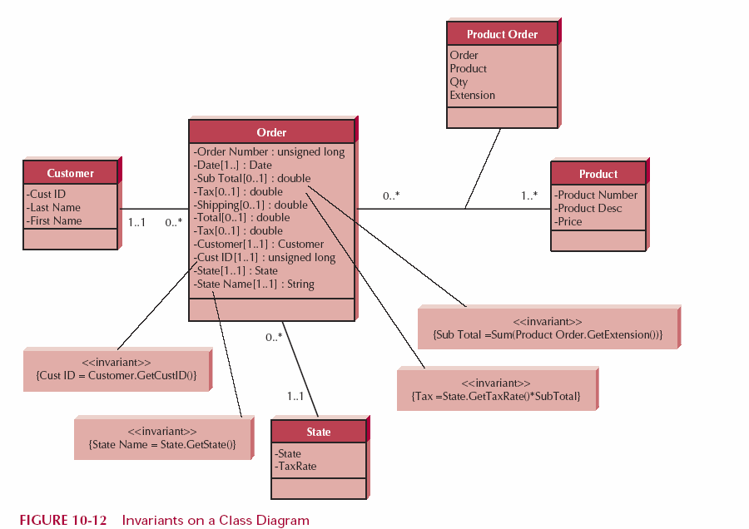
Invariants
OOD - DEI.FET.HUT

Slide 36
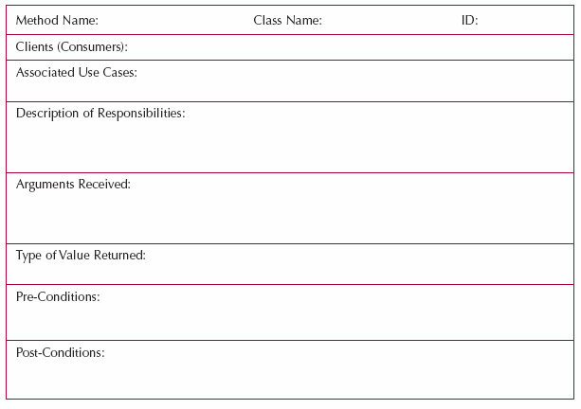
Elements of a Contract
CalDays
NgayThang
Month, year
OOD - DEI.FET.HUT

Slide 37
Method Specification

Slide 38
Method Specification
Written documents that include explicit instruction on how to write the code to implement the method
Given to the programmer during the implementation phase
OOD - DEI.FET.HUT

Slide 39
Syntax
No formal syntax specification
General information
  Name of the method
  Name of the class containing the method
  Contract ID for method
  Programmer
  Due date
  Programming language
OOD - DEI.FET.HUT

Slide 40
Syntax
Events
  List events that trigger the method
Message Passing
  Describes the messages passing to and from the method
  Identified in sequence and collaboration diagrams
OOD - DEI.FET.HUT

Slide 41
Syntax
Algorithm Specification
  Written in Structured English, pseudocode, or some formal language (JML)
OOD - DEI.FET.HUT

Slide 42
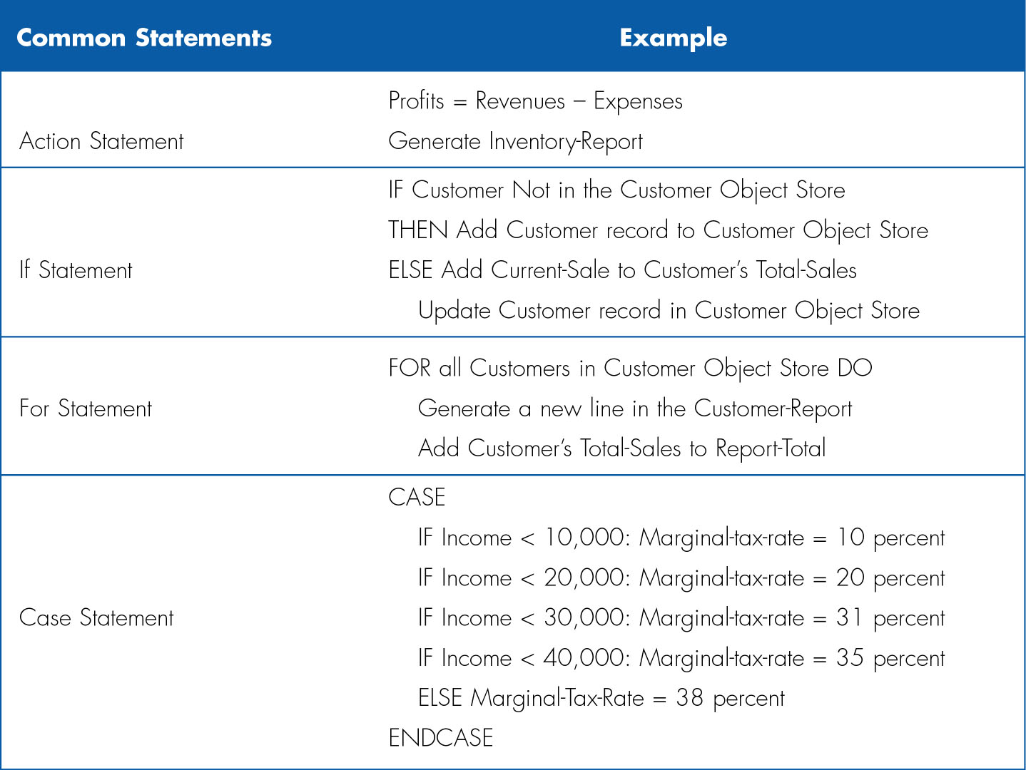
Structured English
OOD - DEI.FET.HUT

Slide 43

Pseudocode Example
Pseudocode = “programming specific” language with initialisation and linking instructions
(Get CD-info module)
Accept (CD_title) {Required}
Accept (CD_artist) {Required}
Accept (CD_category) {Required}
Accept (CD_length)
Return
OOD - DEI.FET.HUT

