Slide 1
PHÂN TÍCH THIẾT KẾ
HƯỚNG ĐỐI TƯỢNG
TRƯỜNG ĐẠI HỌC BÁCH KHOA HÀ NỘI
VIỆN ĐIỆN TỬ VIỄN THÔNG
CHƯƠNG 4
Thiết kế (tiếp)

Slide 2
Chương 4. Thiết kế
4.1. Chuẩn bị thiết kế
4.2. Thiết kế lớp và phương thức
4.3. Thiết kế lớp quản lý dữ liệu
4.4. Thiết kế giao diện giao tiếp người-máy
4.5. Thiết kế kiến trúc vật lý
OOD - DEI.FET.HUT

Slide 3
Key Definitions
Object persistence
  Involves the selection of a storage format and optimization for performance
OOD - DEI.FET.HUT

Slide 4
Key Definitions
Four basic formats used for object persistence are:
  Files
  OO databases
  Object-relational databases
  Relational databases
OOD - DEI.FET.HUT

Slide 5
Introduction
Recall
4 Layers on which to base software:
  Foundation
  System Architecture
  Human-Computer Interaction
  Data Management
This chapter deals with the Data Management Layer
OOD - DEI.FET.HUT

Slide 6
Introduction
Recall:
4 Functions of applications
  Data Storage
  Data Access Logic
  Application Logic
  Presentation Logic
This chapter deals with Data Storage
OOD - DEI.FET.HUT

Slide 7
Data Management Layer
Choose object-persistence format to support the system
  Problem domain objects drive object storage design
Design of Data Storage
  Must optimize processing efficiency
Data access and manipulation
  Separate problem domain classes from storage format
  Handle all communication with the database
OOD - DEI.FET.HUT

Slide 8
OBJECT PERSISTENCE FORMATS

Slide 9
Object Persistence Formats
Four types of object persistence formats:
  Files
  Relational databases
  Object-relational databases
  OO databases
OOD - DEI.FET.HUT

Slide 10
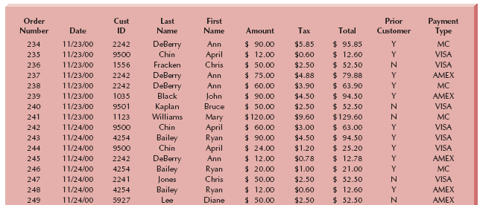
Files: Customer Order File
OOD - DEI.FET.HUT

Slide 11
Files
Supported by most programming languages (e.g. istream, ostream)
Sequential Access Files
  Data stored in order based on a particular attribute
  File can only be accessed sequentially
  Typically efficient for reports using all or most of the file’s data
  Inefficient for random access (key search)
  On average 50% of file must be searched
OOD - DEI.FET.HUT

Slide 12
Files
Unordered Sequential File
  Just a list on disk
  Items appended to end
Ordered Sequential File
  Items are inserted in the proper order
  Involves additional overhead
  Often entire list is copied
  Can also use pointers and a linked list
OOD - DEI.FET.HUT

Slide 13
Files
Random Access Files
  Also called Direct Access files
  Data stored in unordered fashion
  Typically efficient for finding individual records
  Inefficient for sequential access (e.g. reports)
OOD - DEI.FET.HUT

Slide 14
Other Files
To access randomly or sequentially
  Use a sequential file of pointers into a random file
  Use sequential file for sequential access
  Use random file directly for random access
Master files
  Store core information for long term
  New entries appended to end of file
OOD - DEI.FET.HUT

Slide 15
Other Files
Transaction files
  Used to update master file periodically
  Can be destroyed after master is updated
Audit
  Contains before and after images
  Used to audit the change after the fact
OOD - DEI.FET.HUT

Slide 16
Other Files
History (archive file)
  stores past transactions no longer needed
  Normally stored off line
Look-up
  Static values such as zip codes
  Seldom changed
OOD - DEI.FET.HUT

Slide 17
Files
Strengths:
  Usually part of OO programming language
  Files can be very efficient for fast performance
  Good for short term storage
Weaknesses
  Must be manipulated with a program
  Often results in multiple data
  Only access control is through the OS
OOD - DEI.FET.HUT

Slide 18
Relational Databases
Most popular and common
Made up of collection of tables
  Each column in the table is a field
  Each row is a record
Every table has a Primary Key
  The value of a primary key is unique for each record
OOD - DEI.FET.HUT

Slide 19
Relational Databases
Tables are related by placing the primary key from one table into another table
  The key is then called a Foreign Key
The data is accesses using Structured Query Language (SQL)
An SQL query joins tables based on the keys and treats the result as a single large table
OOD - DEI.FET.HUT

Slide 20
Relational Databases
Most RDBMS ensure Referential integrity
  If you try to add a Foreign Key, it makes sure that a record exists with that key's value
Objects must be converted so they can be stored in a table
  Map UML class diagram to relation database schema
OOD - DEI.FET.HUT

Slide 21
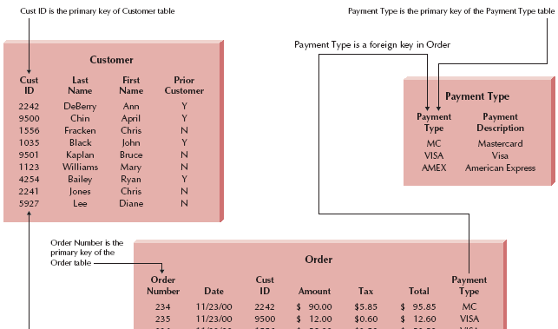
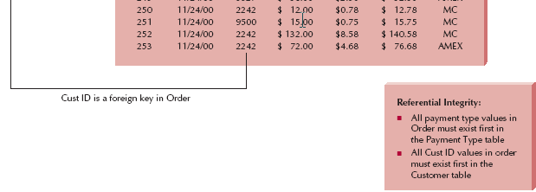
Example of Referential Integrity
OOD - DEI.FET.HUT

Slide 22
Relational Databases
Strengths
  Proven commercial technology
  Can handle diverse data needs
Weaknesses
  Limited to native atomic types
  Don't support object orientation
    Impedance Mismatch
OOD - DEI.FET.HUT

Slide 23
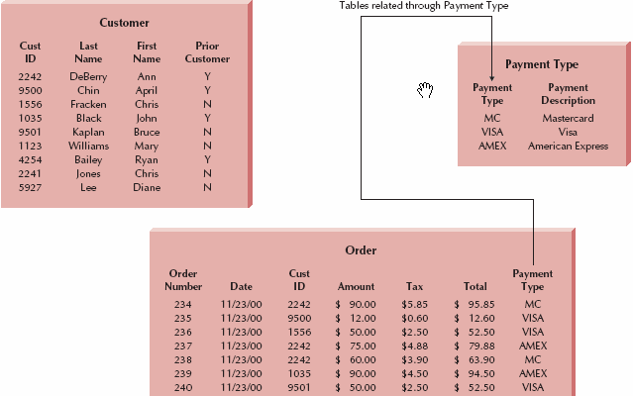
Customer Order Database
OOD - DEI.FET.HUT

Slide 24
Structured Query Language (SQL)
Standard language for accessing data in tables
SQL Commands
  Create, edit, and delete tables
  Add, edit, and delete data
  Display data from one or more related tables
  Display data computed from data in one or more related tables
OOD - DEI.FET.HUT

Slide 25
Object-Relational Databases
In pure relational databases, attributes are limited to atomic data types
With ORDBMS
  A relational database is extended to handle the storage of objects
Use of user-defined data types
Extended SQL (ad hoc or SQL3)
Inheritance tends to be language dependent
OOD - DEI.FET.HUT

Slide 26
Object-Relational Databases
Strengths
  Still based on SQL
  Can handle complex types
Weaknesses
  Limited support for object orientation
    For example inheritance
  Not standardized, still vendor specific
  May still suffer form Impedance Mismatch
OOD - DEI.FET.HUT

Slide 27
Object-Oriented Databases
Two approaches
  Adding persistence extensions to OO languages
  Separate database management systems
    Objects are associated with an Extent
    An Extent is a set of instances associated with a class (equivalent to a table)
    Unique object ID assigned to each instance
    Referential integrity maintained
    Inheritance still tied to language
    Mainly support multimedia applications
    Sharp learning curve
OOD - DEI.FET.HUT

Slide 28
Object-Oriented Databases
Strengths
  Can handle complex data types
  Direct support for object orientation
  No impedance mismatch
Weaknesses
  Still emerging technology
  May be risky
  Hard to find
OOD - DEI.FET.HUT

Slide 29
Major Strengths & Weaknesses
Files
  Very efficient for given task
  Manipulation done by OOPL
  Redundant data usually results
RDBMS
  Proven commercial technology
  Handle diverse data
  No support for object orientation
OOD - DEI.FET.HUT

Slide 30
More Strengths and Weaknesses
ORDBMS
  Inherit RDBMS strengths
  Support complex data types
  Limited support for object-orientation (vendor dependent)
OODBMS
  Support complex data types
  Support object-orientation directly
  Still maturing (lacks skilled labor and may have a steep learning curve)
OOD - DEI.FET.HUT

Slide 31
Criteria for Object Persistence Formats
Data types supported
  If application stores only atomic data types
    RDBMS may work fine
  If application stores complex data types
    OO or ORDBMS may be better
Types of application systems
  Transaction processing
    Very fast access to predefined specific queries
  DSS
    Speed not as critical, but queries can vary widely
Existing Storage Formats
  Reduce learning curve and transition time
OOD - DEI.FET.HUT

Slide 32
Criteria for Object Persistence Formats
Future Needs
  Look at technology trends
  Anticipate future needs of application
Other miscellaneous Criteria
  Cost
  Concurrency control
  Security
OOD - DEI.FET.HUT

Slide 33
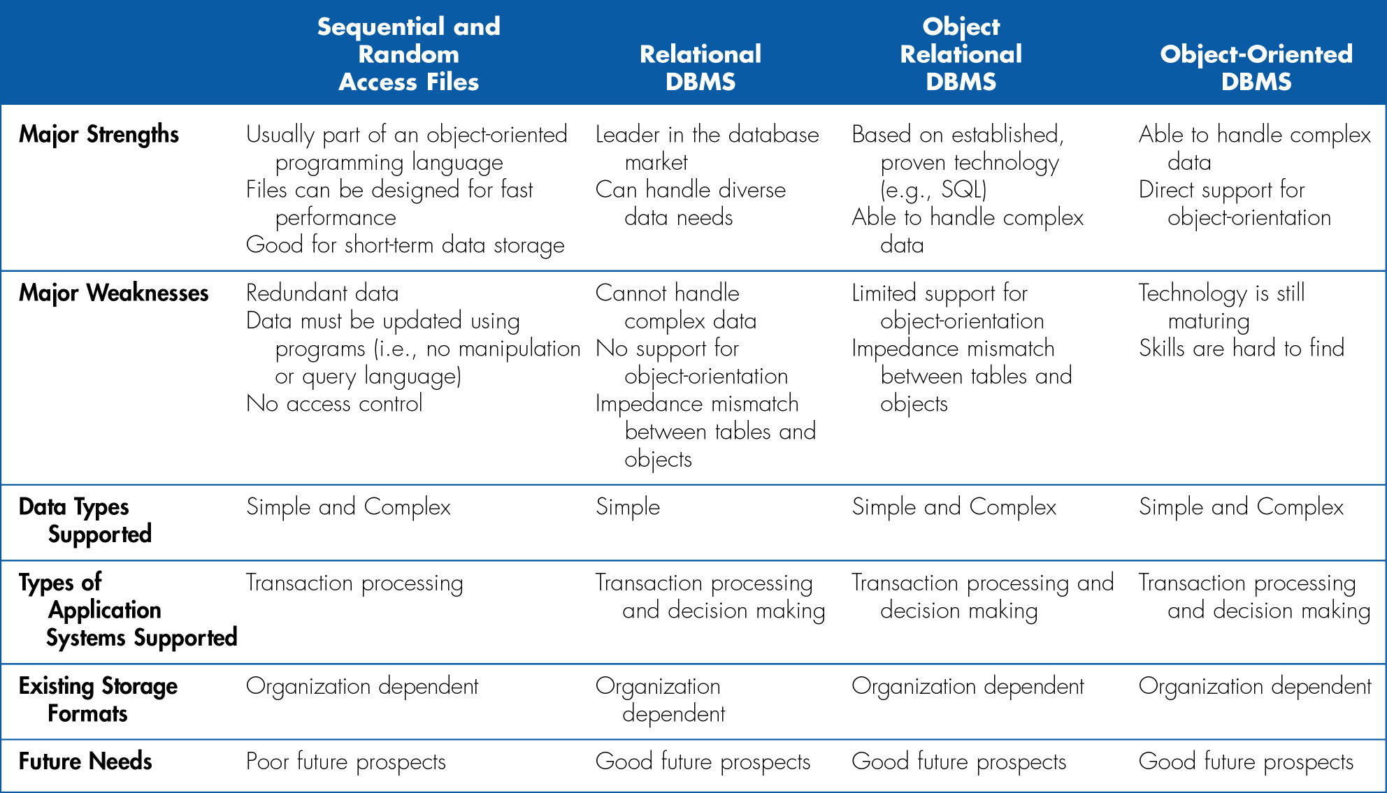
Selecting an Object Persistence Format
OOD - DEI.FET.HUT

Slide 34
MAPPING PROBLEM DOMAIN OBJECTS TO OBJECT PERSISTENCE FORMATS

Slide 35
Initial Points to Consider
Adding primary and foreign keys to the problem domain
  Unless they add too much overhead
Do Data management only at the data management layer
  Separates storage from application logic
  May add overhead, but aids in portability and reuse
OOD - DEI.FET.HUT

Slide 36
Mapping PD Objects to OODBMS Format
1-1 mapping from PD objects to data management objects
Data management object will have the functionality needed to store object
This leaves PD objects unchanged and portable
OOD - DEI.FET.HUT

Slide 37
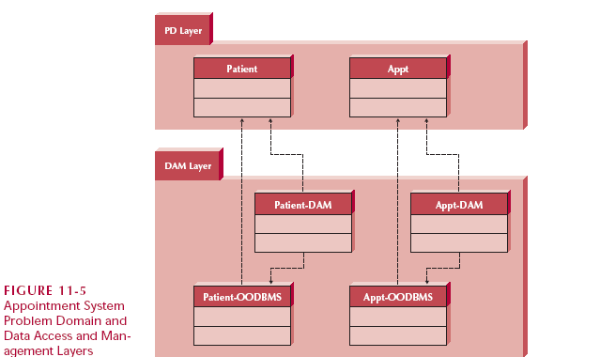
Mapping Objects to Object-Persistence Formats
OOD - DEI.FET.HUT

Slide 38
Factoring Out Multiple Inheritance Effect
Often OODBMS don't support multiple inheritance
Before you save:
  Need to factor out multiple inheritance
OOD - DEI.FET.HUT

Slide 39
Factoring Out Multiple Inheritance Effect
Rule 1a
  Create instance of data management super class
  Add attribute for Object ID each subclass of the super class
OR
Rule 1b
  Flatten inheritance by copying attributes & methods down to all subclasses
OOD - DEI.FET.HUT

Slide 40
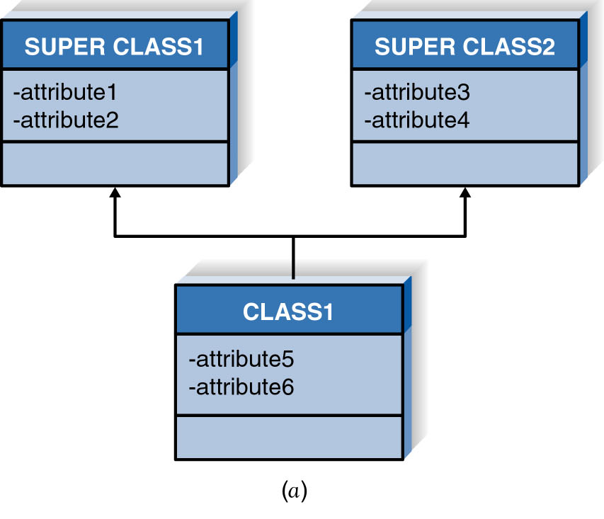
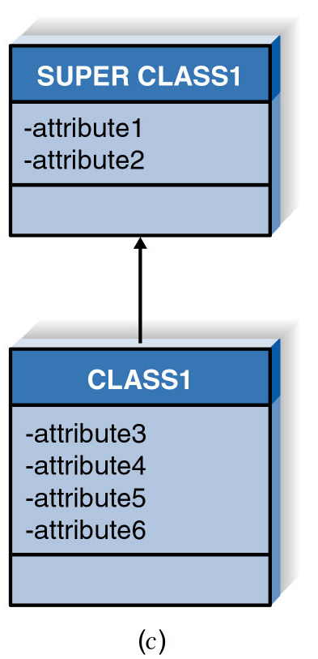
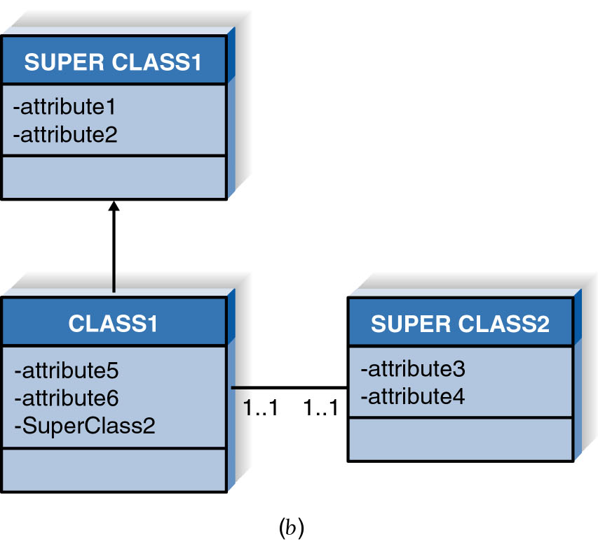
Factoring Out Multiple Inheritance Effect
OOD - DEI.FET.HUT

Slide 41
Mapping PD Objects to ORDBMS or RDBMS Format
Mapping is much more involved
Varies depending on the system used
  not standardized
Basic Idea:
  Convert all OO relations
    Inheritance, aggregation, etc.
  Into RDBMS type relations
OOD - DEI.FET.HUT

Slide 42
Maintain a Clean Problem Domain Layer
Modifying the problem domain layer
  Can create problems between
    System architecture layer and
    Human computer interface layer
The development and production costs of OODBMS
  May offset the production cost
    of having the data management layer implemented in ORDBMS
OOD - DEI.FET.HUT

Slide 43
OPTIMIZING RDBMS-BASED OBJECT STORAGE

Slide 44
Dimensions of Data Storage Optimization
Storage efficiency
  Minimize storage space
Speed of access
  Minimize retrieval time
OOD - DEI.FET.HUT

Slide 45
Optimizing Storage Efficiency
Reduce redundant data
  Can lead to update anomalies
    Forget to update one of the copies
Limit null values
  Multiple interpretations can lead to mistakes
A well-formed logical data model
  Does not contain redundancy or many null values
OOD - DEI.FET.HUT

Slide 46
Normalization
It may be easier to envision
  An inefficient system
  That has duplicates and nulls
Once it is understood
  Then refine (Normalize) it
    To make it efficient
OOD - DEI.FET.HUT

Slide 47
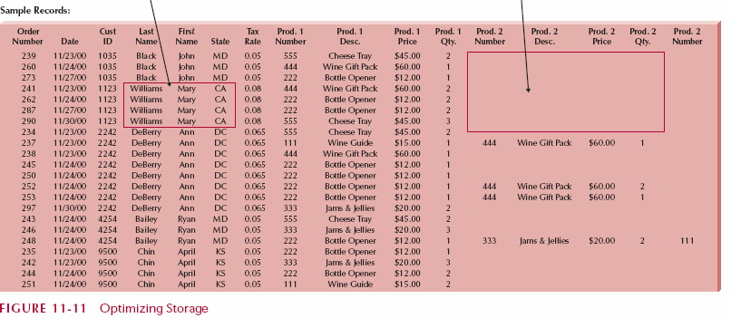
Example of Non-normalized Data
Redundant Data
Null Cells
OOD - DEI.FET.HUT

Slide 48
Normalization Rules
A series of steps taken to normalize the data
Figure 11-11 shows a model in 0 Normal Form
  Not normalized
OOD - DEI.FET.HUT

Slide 49
Normalization Rules
First Normal Form (1NF)
  Does not lead to multivalued fields
    Fields that store a set of values
  Does not lead to repeating fields
    Fields repeats for multiple values
  Each record has the same number of fields
  Each field stores only one value
OOD - DEI.FET.HUT

Slide 50
Normalization Rules
Second Normal Form (2NF)
  Must be 1NF
  Fields are dependent on the whole primary key
    The primary key for a record
    Determines the value for all fields in that record
OOD - DEI.FET.HUT

Slide 51
Normalization Rules
Third Normal Form (3NF)
  Must be 1NF and 2NF
  No fields are dependent on non-primary keys
    Example: Tax rate depends on state to which order is being shipped
OOD - DEI.FET.HUT

Slide 52
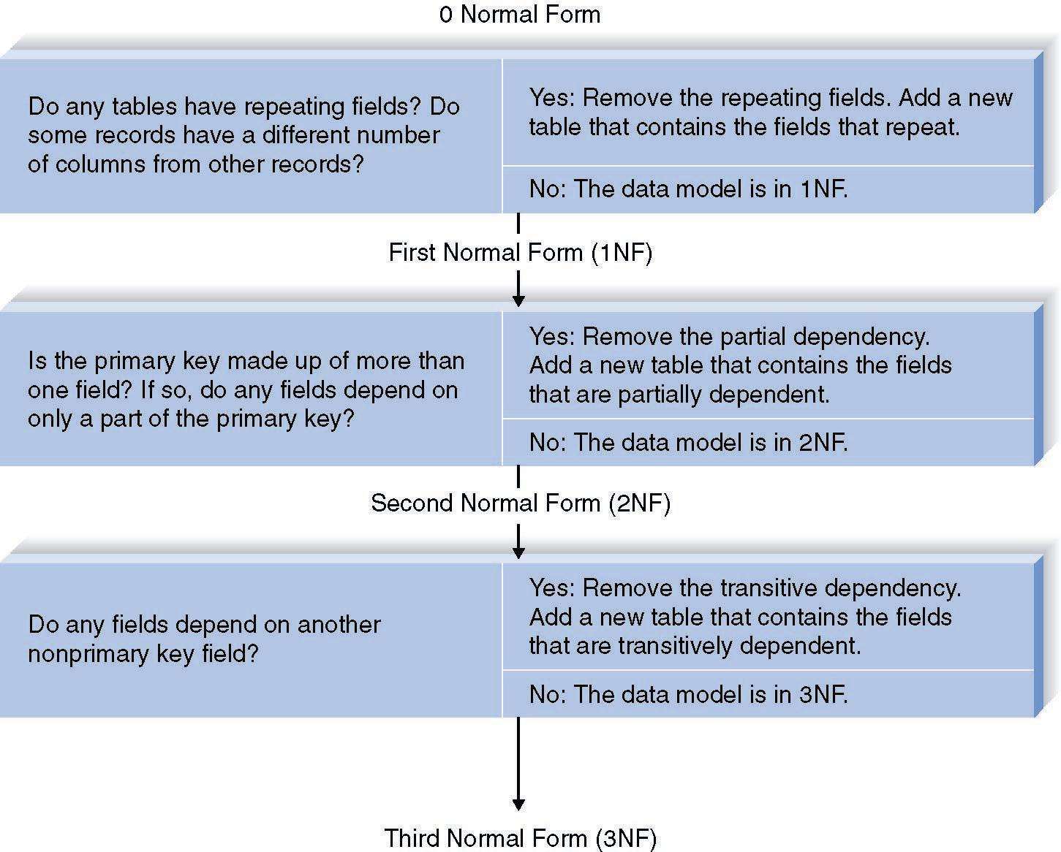
The Steps of Normalization
OOD - DEI.FET.HUT

Slide 53
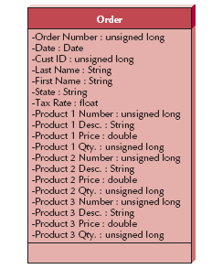
Normalization Example
Original Model
OOD - DEI.FET.HUT

Slide 54
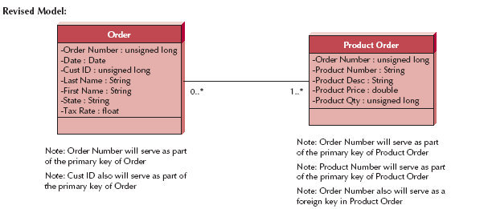
Normalization Example
Original Model
OOD - DEI.FET.HUT

Slide 55
Optimizing Access Speed
In 3NF, multiple tables must be accessed to perform work
To make system faster,
De-normalization
  Reduces number of joins required
OOD - DEI.FET.HUT

Slide 56
Optimizing Access Speed
Consider de-normalization for:
  Look-up tables
    Data is static and unchanging
    Include data with key
  One-One relationships
    Normally accessed together
  Include parents attributes in all children
OOD - DEI.FET.HUT

Slide 57
Optimizing Access Speed
Clustering – store similar records close together
  Avoid table scan
  Intra-file clustering
    Like records in a table are stored together
    That way they are stored near each other on the media
  Inter-file clustering
    Store associated tables near each other on the media
Indexing
  Use separate index of keys
OOD - DEI.FET.HUT

Slide 58
Guidelines for Creating Indexes
Use indexes sparingly for transaction systems
  They require overhead with each update
Use many indexes to increase response times in decision support systems
For each table
  Create a unique index based on the primary key
  Create an index based on the foreign key
Create an index for
  Frequently used fields
  Grouping, sorting, or search criteria
OOD - DEI.FET.HUT

Slide 59
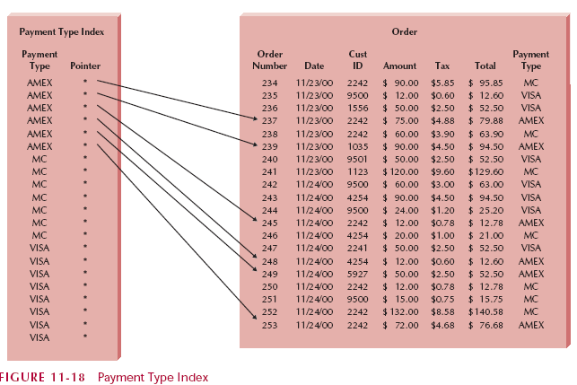
Indexing Example
OOD - DEI.FET.HUT

Slide 60
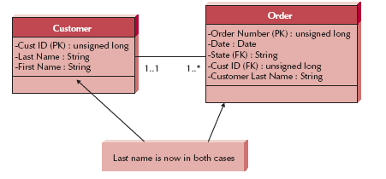
Example Optimising
OOD - DEI.FET.HUT

Slide 61
Estimating Data Storage Size
If the db server cannot handle the file size
  The system will perform poorly
Even if you did all your work right
Use volumetrics
  Estimating storage size
OOD - DEI.FET.HUT

Slide 62
Estimating Data Storage Size
Include your estimate into the hardware specifications
Requirements =
  Raw data + RDBMS overhead
Raw Data
  Your actual application data
Overhead
  indexes and pointers
OOD - DEI.FET.HUT

