Slide 1
PHÂN TÍCH THIẾT KẾ
HƯỚNG ĐỐI TƯỢNG
TRƯỜNG ĐẠI HỌC BÁCH KHOA HÀ NỘI
VIỆN ĐIỆN TỬ VIỄN THÔNG
CHƯƠNG 4
Thiết kế (tiếp)

Slide 2
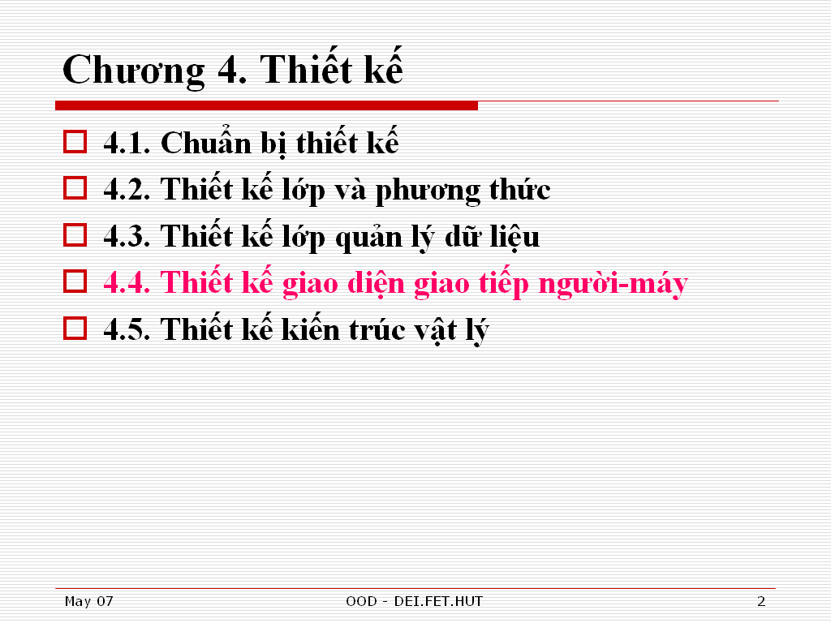

Slide 3
1. Introduction
A system’s user interface includes
  [1] Screens for navigation through system
  [2] Screens and forms that capture data
  [3] Reports produced by system (paper, screen, other media)
User-interface design requires:
  Principles and processes
  Interface structure and standards
  I/O design
  Navigation design
Interface design defines how system interacts with other external entities
  Humans and other software systems
    System interfaces designed during integration
    Defined as part of physical architecture and data management layers
HCI layer defines:
  Way in which users interact with system
  I/O accepted/generated by system
  Has three parts:
    [1] Navigation mechanism (in a WIMPs environment, e.g. buttons, menus, etc)
    [2] Input mechanism (e.g. windows containing dialogues, forms, etc)
    [3] Output mechanism(e.g. web pages, reports, etc)
Notes:
WIMPs - Windows, Icons, Menus and Pointers

Slide 4
1. The Nature of UI Design
UI design may be significant portion of overall development effort, e.g. <=50%
UI design may be:
  “mission critical” - UI to a commercial organisation’s web site
  “safety critical” – UI to aircraft Engine Instrument System (EIS)
Users are unpredictable, designer’s intuition may be incorrect

Slide 5
1. The Nature of UI Design
Ideally, UI design involves a team of specialists, e.g.
  graphic designers
  interaction / interface designers
  information architects
  technical writers
  marketers
  test engineers
  usability engineers
  software engineers
  users
UI design is inevitably constrained by the I/O devices available
I/O now exploits graphical (non-persistent) displays, via keyboards, cursors and pointing devices (mouse, pen, tablet, etc)
Major physical constraint is size of area available for UI
  Interaction must be effective (for users), but to be effective (e.g. simple) often needs to be presented in >1 page/screen

Slide 6
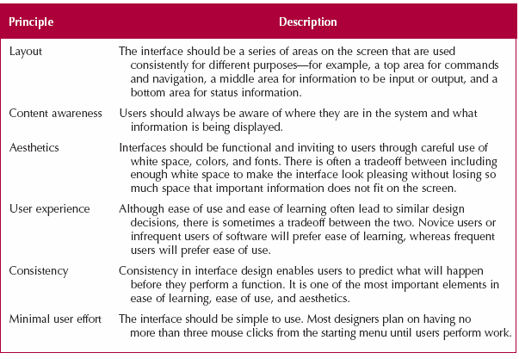
2. UI Design Principles
Principle = a simplifying generalisation
  Accepted as true
  Can be used as a basis for reasoning
UI Design Principle = guideline

Slide 7
2.1 Layout…
Layout = graphic design
  The realm of graphic designers (and human cognition experts…)
The notion of “intuitive flow” is used to minimise unnecessary movement between different areas presented to users, e.g.
  Left-to-right & top-to-bottom
  Chronological order
  Least-to-most specific
  Most-to-least frequent
Vertical Flow
“Horizontal” Flow
Patient Information
Patient Name:
First Name:
Last Name:
Address:
House No./Name:
Street:
Town/City:
Postcode:
…
Patient Information
Patient Name:
First Name: Last Name:
Address:
House No./Name: Street:
Town/City: Postcode:
…

Slide 8
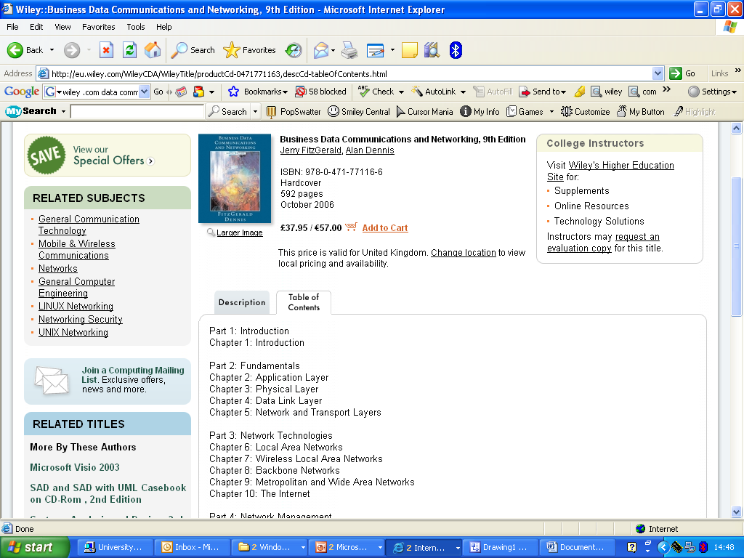
2.2 Content Awareness (hence human cognition experts…)
Macintosh (then Windows)
introduced “standardised” layout
System Navigation
Section
Navigation
Page Navigation
Status Bar

Slide 9
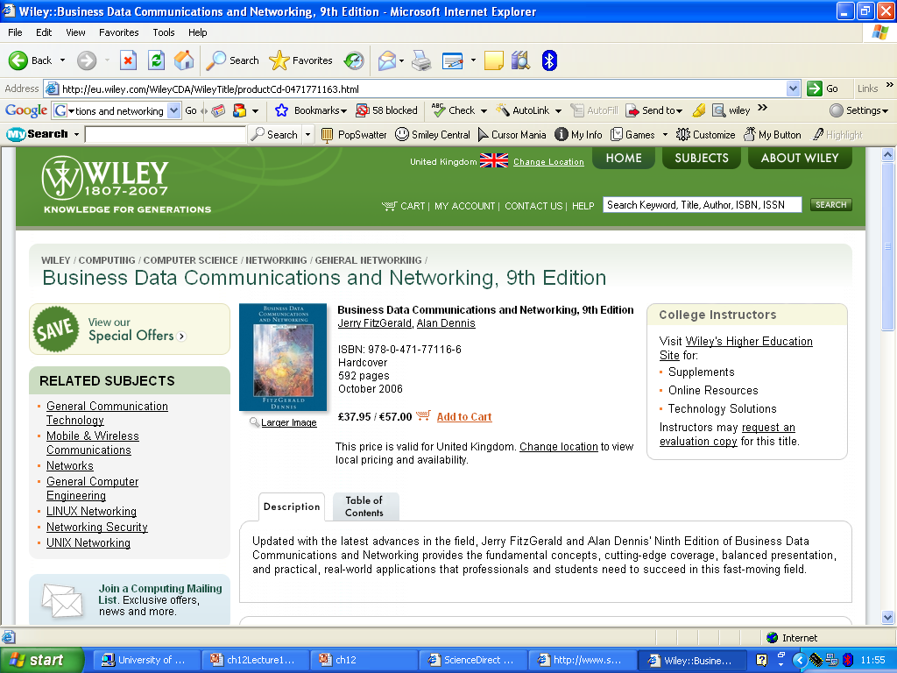
2.2 continued…
[2] Menus should indicate current location
and at least most recent location
(ideally a history of recent locations)
[1] All interfaces should be titled
[3] Sections (or areas) should
be marked using lines, colours,
headings
[4] Input fields should
indicate the type of the values
that are legal

Slide 10
2.3 Aesthetics
Aesthetics in IT emphasises HCI issues, e.g. user-friendly devices and software applications
Aesthetically pleasing GUI’s can improve human productivity
  Have even been patented, e.g. http://www.freepatentsonline.com/20030107597.html
Software (arguably) has aesthetic “dimensions”, likewise information-technology-mediated processes and experiences, e.g. computer games and virtual reality simulations.
Digital culture is a distinct aesthetic used to judge the appeal of digital environments e.g. Web Browsers, Web Sites, icons, etc.
The notion of cyberspace as an “electronic medium”
For practical purposes, in IT systems, aesthetics requires minimalist interfaces
  All forms and reports have a minimum of white space (or negative space) that is left intentionally blank
    Whitespace = portion of a page left unmarked: the space between graphics, margins, gutters, columns, lines of type or figures and objects drawn or depicted.
  Text should have same font and font size
    Changes in font and size = changes in kind of information presented
    Avoid italics and underlining
  Serif fonts for printed reports
  San-serif fonts for displays and headings
  Colour used sparingly for a specific purpose

Slide 11
2.4 User Experience
Users may be novice or expert
  But experience changes significantly over time
  Novice requires ease of learning
  Expert requires ease of (re)use
  Menus can be comprehensive or contextual
    All available operations on a selected object
    Most frequently used operations on an object
  WIMPs (Windows, Icons, Menus, Pointing device) embody object oriented notion of
    Currently selected object (at the user interface)
    Type of object, including its state, constraining operations that can be applied to those operations which are semantically meaningful given the current state of an object (and possibly the history of previously applied operations)
    Such interfaces are strongly-typed
      Type of object = values (or states) that object may take
      Constraints on application of operations can be expressed formally

Slide 12
2.5 Consistency
Consistency enables users to predict what will happen
  Interaction with one part of system = interaction with other parts (+ new interactions due to elements unique to other parts)
Consistency applies on different scales
  Navigation controls (icons, commands)
  Terminology (customer or client, not customer and client
  Across systems, i.e. at the Enterprise Level
    Application-specific views are achieved via object-orientation
    Subclassing generic views to create specific views.
2.6 Minimising User Effort
Fewest possible mouse clicks or keystrokes to navigate
  e.g. in max 3 clicks

Slide 13
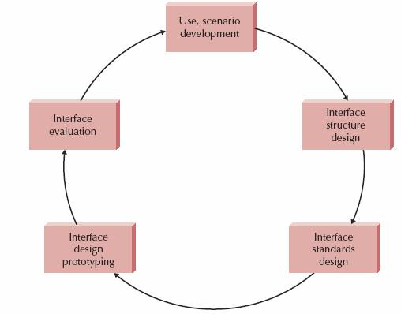
3. Interface Design Process
A five-step iterative process
  Movement forwards and backwards between steps
First, Use Cases and Sequence Diagrams from analysis phase used in user interviews
  User interviews develop scenarios describing commonly used patterns of actions users perform
Secondly, analysts develop windows navigation system defining underlying structure of interface
  Diagrams show all interfaces (screen, form, report) in system and their interconnections
Thirdly, Analysts design interface standards
  Underlying design elements for interfaces in system
Fourthly, Analysts create interface design prototype for each interface
  E.g. navigation controls (including conversion of essential use cases to actual use cases), input screens, output screens, forms (inlcdung pre-printed paper forms), and reports
Fifthly, individual interfaces are evaluated for usability

Slide 14
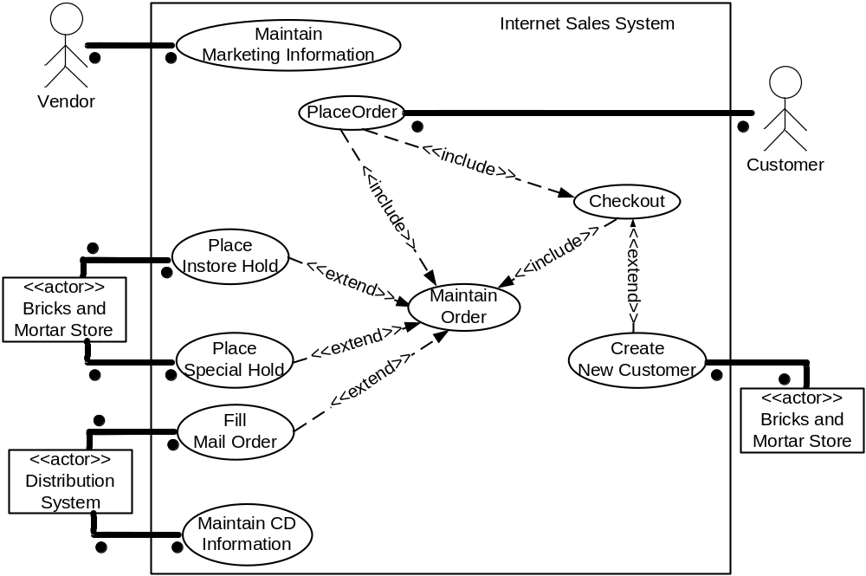
3.1 Use Scenario Development
Use scenario shows steps users perform to accomplish some part of their work
  One path through and essential use case
Use Scenario: Browsing Shopper
1. May search for specific artist
OR browse though music category(1)
2. Usually reads basic information for
several CD’s AND marketing material for
some CD’s. Usually listens to music
samples AND browses related CD’s(3)
Use Case Diagram
3. Puts several CD’s in shopping cart
AND continues to browse(5)
4. Finally, places the order BUT
usually wants to examine CD’s in
shopping cart and discard some
CD’s first(7)
Two or three Use Scenarios
for most common interactions
Main Order
distinct from
Checkout
both included in
Place Order use case

Slide 15
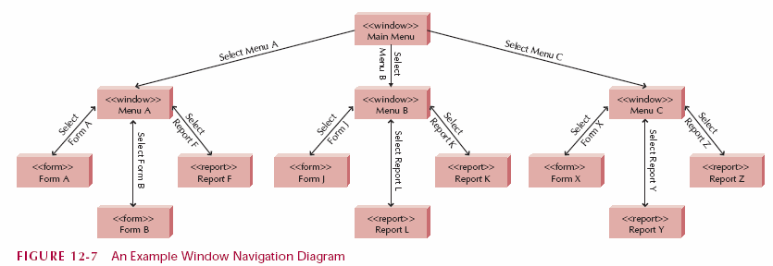
3.2 Interface Structure Design
Defines underlying components of interface AND how they collectively provide required functionality
Described by Window Navigation Diagram (WND) for all screens, forms and reports
  How they are related to each other
  How user moves from one to another
  Non-trivial systems will require several WND’s
  Similar to behavioural state machine, i.e. models state changes in user interface
  States represented by boxes
  Box corresponds to user interface component e.g. window, form, button, report
Transition:
No return
(to main menu)
=13 states
Action causing
Change of state
Transition:
Return required
(to Menu A)
<<sterotype>>
=
Type of interface component

Slide 16
3.3 Interface Standards
Underlying design elements common to individual screens, forms, and reports
May be different standards for different parts of system…
  One for web screens, another for paper reports, another for input forms
  Each interface may contain some of the elements in a standard
  Each interface may have additional elements to a standard
Standards applied to templates, metaphors, objects, actions and icons
  Interface Temples abstract define underlying appearance of ALL screens, forms and reports
    Position of navigation areas, status area, form & report area
    Colour scheme
    Position and order for common interface actions (e.g. File Edit View in that order, left to right)
  Interface Metaphors defines how interface works, e.g. shopping cart = “real world” counterpart
    Enables user to predict what features interface provides
  Interface Objects
    Object names often appropriate, e.g. shopping cart is CALLED “Shopping Cart” in user interface teplate
    Sometimes object names inappropriate, e.g. searching for CD’s <> searching for tapes
  Interface Actions: template defines navigation and command language style, & names of commonly used actions
    e.g. menu, grammar, “buy” vs “purchase”
  Interface Icons: Represent state of objects and actions
    e.g. icon to represent “deleted”

Slide 17
3.4 Interface Design Prototyping
Prototype = working model
  e.g. executable simulation of screen, form or report
Can be storyboard, HTML, (implementation) language
  HTML = HyperText Markup Language for creating web pages
  Describes structure of text in a document by denoting certain text as headings, paragraphs, lists, etc and supplements text with interactive forms, embedded images, and other objects.
Storyboard: shows structure of screens and actions that move user between screens
HTML: Series of web pages in HTML
  Users interact with pages directly
  Pages linked, e.g. via buttons, hypertext
  No underlying functionality (e.g. “Delete” does not delete)
(Implementation) Language: Build using same language or software tool used to develop system
  E.g. Visual basic used to create screen and links
  Show exactly how final system will appear and function
  No underlying functionality (e.g. “Insert” does not insert)

Slide 18
3.5 Interface Validation (or “evaluation”)
Improvements to interface design before system completion
  Heuristic
    Evaluates interface with reference to heuristics or design principles
    Evaluated against checklist
  Walkthrough
    Storyboard, HTML or (implementation) language prototype evaluated by users of system as presented by system developers
  Interactive
    HTML or (implementation) language prototype enables users to follow Use Scenarios in real Use Cases (OR navigate themselves through system)
  Formal Usability Testing
    (Implementation) language OR final system enables users to accomplish tasks in Use Scenarios unaided whilst monitored, e.g. by video camera for every action in an interaction

Slide 19
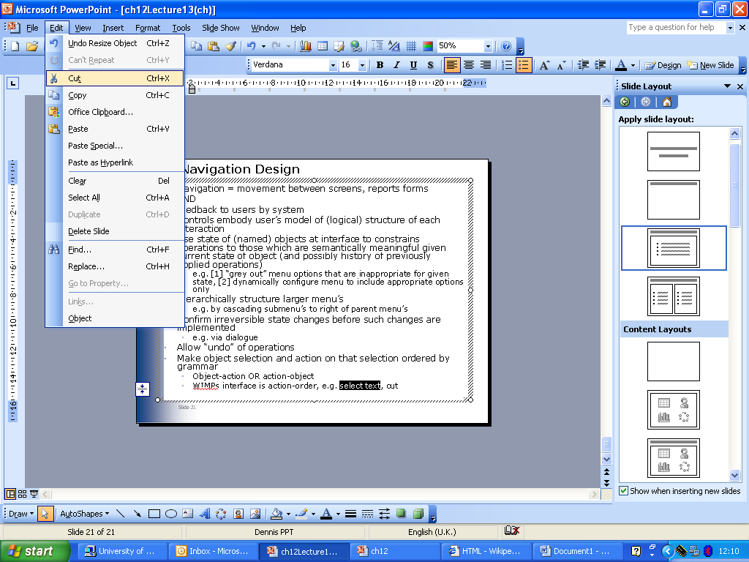
4. Navigation Design
Navigation = movement between screens, reports forms
AND feedback to users by system
Controls embody user’s model of (logical) structure of each interaction
Use state of (named) objects at interface to constrains operations to those which are semantically meaningful given current state of object (and possibly history of previously applied operations)
  e.g. [1] “grey out” menu options that are inappropriate for given state, [2] dynamically configure menu to include appropriate options only
Hierarchically structure larger menu’s
  e.g. by cascading submenu’s to right of parent menu’s
Confirm irreversible state changes before such changes are implemented
  e.g. via dialogue
Allow “undo” of operations
Make object selection and action on that selection ordered by grammar
  Object-action OR action-object
  WIMPs interface is action-order, e.g. select text, cut
[2] order (command) = cut
[1] action = select text

Slide 20
4.1 Kinds of Navigation Control
Three approaches to defining user commands:
Languages
  Command language
    Have (formal) syntax rules (or grammar)
    Enable arbitrarily complex commands to be constructed by user
    Even large (and complex) languages can be made easier to use, e.g. via syntax sensitive and (ideally) syntax directed editors (a form of structure editor)
  Natural language
    Use inbuilt simplifying grammar or dictionary of key words to interpret user natural language string e.g. Microsoft’s Office Assistant
Menus
  Menu options enable user to choose action to be performed (or applied to selected object)
  Options set should reflect current state of object (possibly history of previously applied operations)
  Larger menus should be structured as submenu’s hierarchically, and cascaded to aid user
  “hot keys” provide use with single keystroke option for commonly used actions

Slide 21
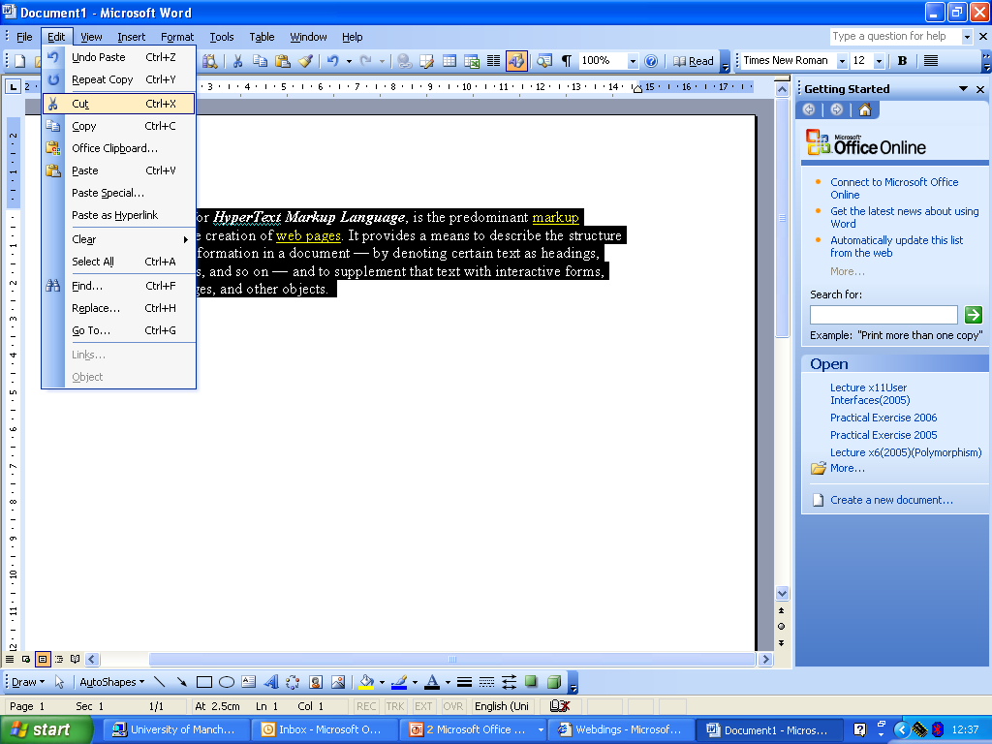
4.1 continued
Menus can group options by interface objects OR interface actions
Menu Bar
Tool Bar
with buttons
Menu Divide for greyed-out options
Drop-Down Menu
Greyed-Out option = command

Slide 22
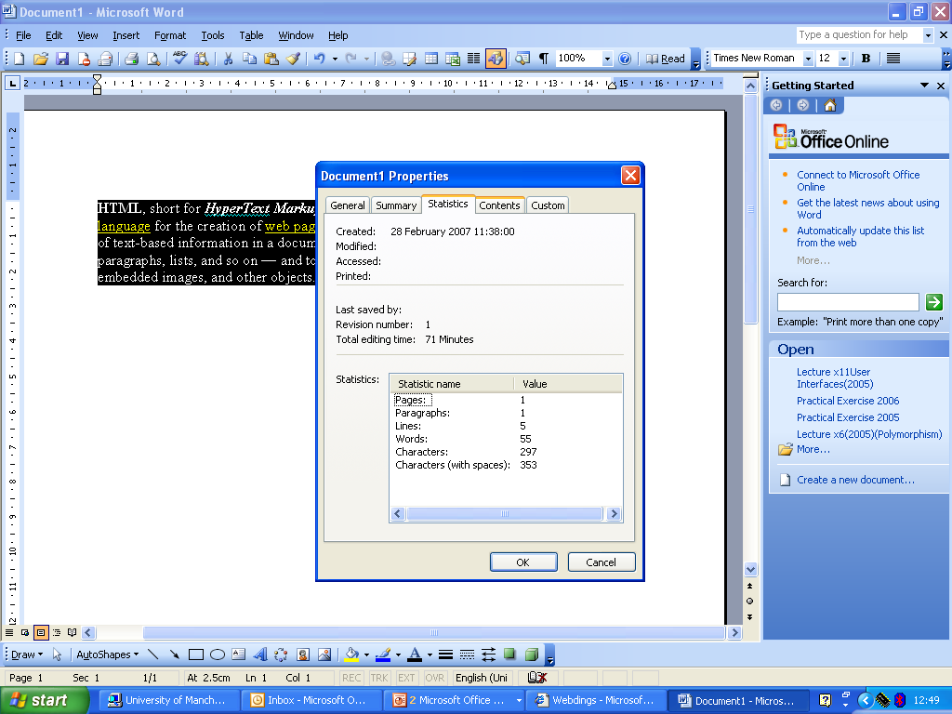
4.1 continued…
Menu kinds include menu bars, drop-down menus, pop-up menus, tab menus, tool bars and image maps
Is also tab menu
Pop-up
menu

Slide 23
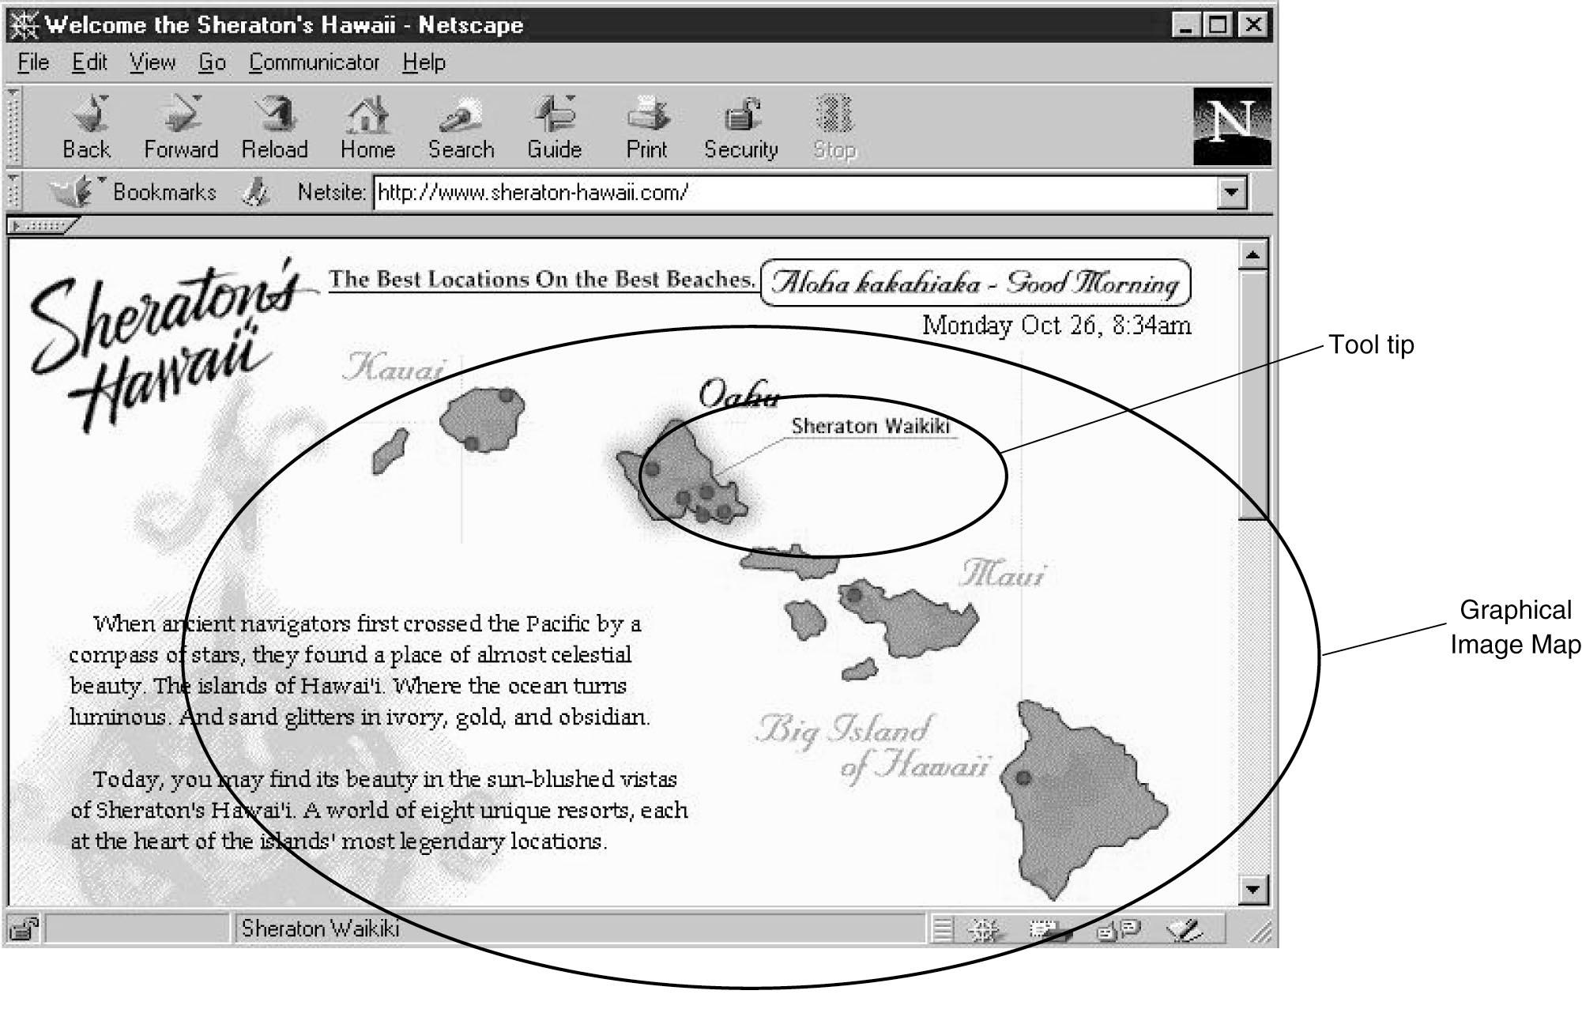
4.1 continued…
Image Map

Slide 24
4.1 continued…
Direct Manipulation
WIMPs interfaces support direct manipulation
  Provide screen cursor via mouse (or trackball, touch screen, pen, etc) and mouse that enables object(s) at interface to be selected, or cursor positioned within components of an object (e.g. within text), or action applied to selected object (e.g. “cut” selected text) via menu option
    Keyboard can also be used via  keys
  Used with icons to start programs
  Used to shape and size objects
  May not be intuitive for all commands

Slide 25
4.1 continued…
Kinds of menu and their appropriate use
Menu Bar Main system menu Use O/S ordering (File, Edit, View, etc)
Legend is single word
Always take user to another menu
Constrain users to meaningful actions
Drop Down submenus Legend often > single word
Menu Options [1] take use to another menu
or [2] perform actionr
Pop_up Shortcut to command Often invoked by right-click
Menu (MS Windows)
Usually duplicate functionality
provided in other menus
Tab Menu Multiple related setting Legends on tabs single word
changes OR multiple Single row of tabs - selecting
related commands tab to open dialogue can change
order of tabs…
Tool Bar Shortcut to commands All buttons on same bar same size
Maximum two sizes of legends
Buttons with icons have tool tip

Slide 26
4.2 Messages
Dialogue with user
  Presents status information
  Dialogue requires user to acknowledge message
  May be text or icons
  Must be useful dialogue for user
    e.g. unique number enables helpdesk or web knowledge-base to be searched effectively
    May involve non-trivial dialogue to aid user in correcting error
Kinds of message
  Error message
    User has selected impermissible or unsupported operation
    Dialogue explains nature of impermissible or unsupported action, suggest corrective measures
  Confirmation message
    User selects action which cannot be undone
    Dialogue explains nature of actions effect on object action is applied to
    User confirms action or cancels action at end of dialogue

Slide 27
4.2 continued…
  Acknowledgment message
    Only for critical actions
    Object action applied to should have screen representation updated to confirm state change to user
  Delay message
    For any action that has indeterminate termination
    Dialogue allows user to cancel action
    Dialogue shows predicted completion time and elapsed time e.g. as updating icon
  Help message
    System wide feature
    Organised as table of contents and/or keyword search
    Context-sensitive via state of selected object or action to be applied to object
    Discussed in more detail in later lecture

Slide 28
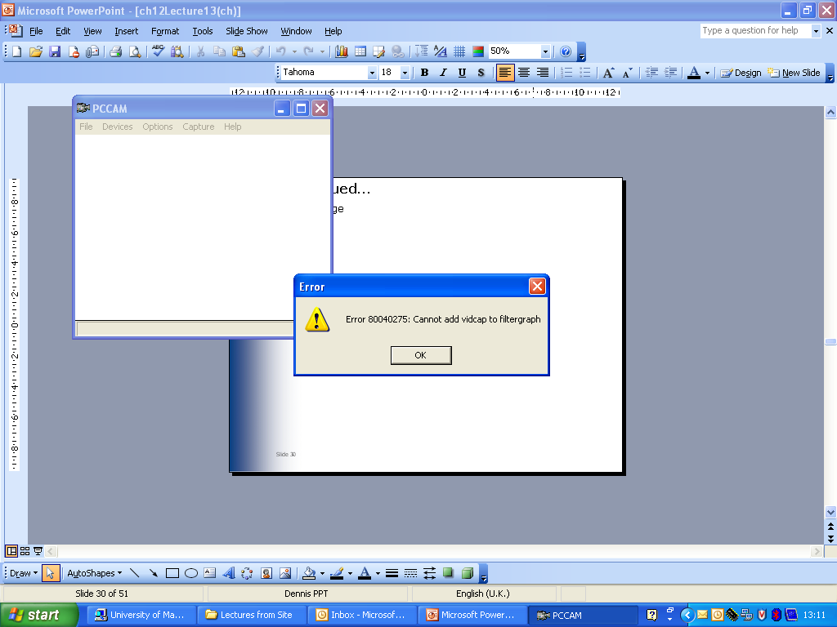
4.2 continued…
Error message
Error No.
Reason
For Error
Minimal
Dialogue
(no suggested corrective action)

Slide 29
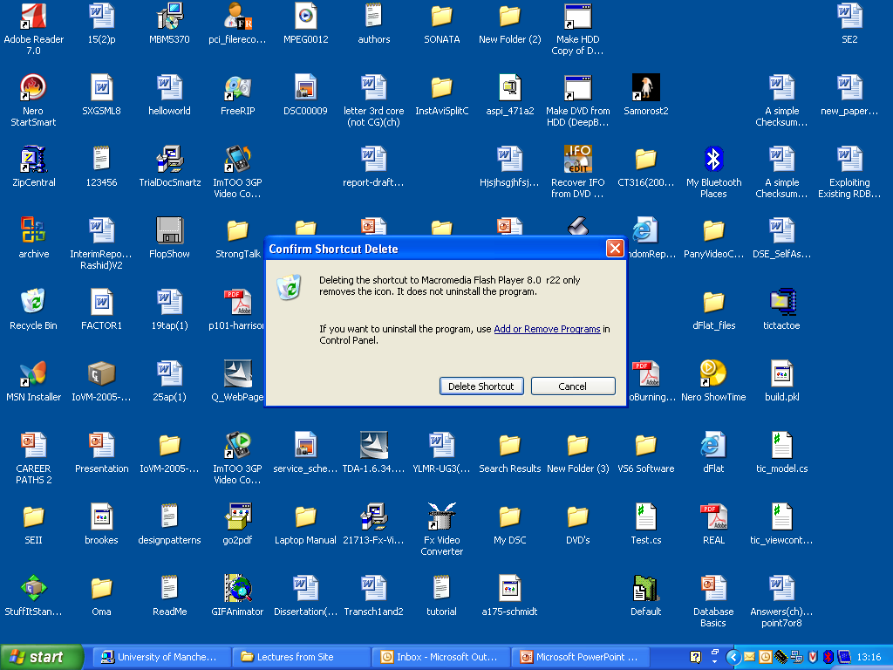
4.2 continued…
Confirmation message
Explanation of
Cause and suggested
Corrective action
Confirmation
Dialogue

Slide 30
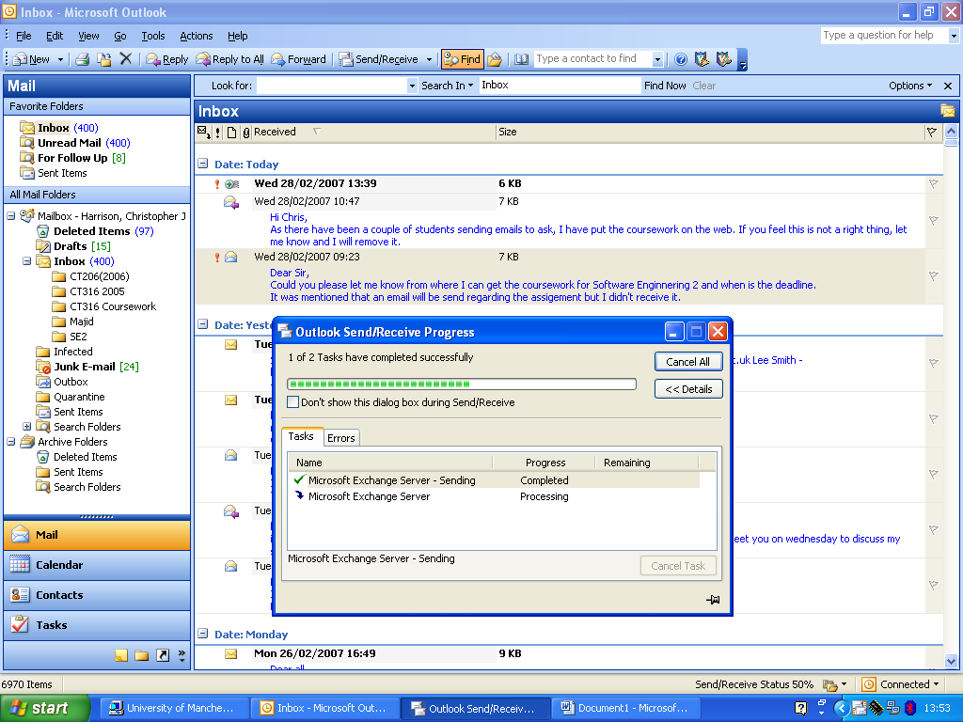
4.2 continued…
Example delay message
Progress bar
Tabbed
progress
dialogue

Slide 31
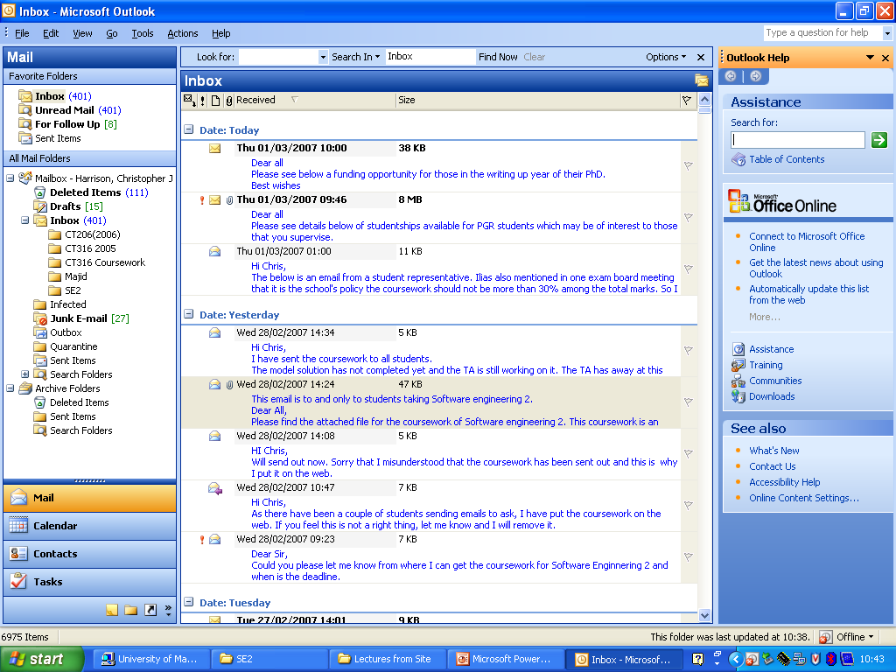
4.2 continued…
Keyword
Search
Table
Of
Contents
Help message
Help Dialogue

Slide 32
5 Input Design
Input design may involve highly structured OR unstructured input
  Data may be entered via a screen
  A form (on a screen)
  A dialogue
  Basic Principles
Goal is to simply (easily) and accurately capture information
Principles used depend on nature of the inputs
  Batch
    All inputs collected over a “period of time” are collated and entered as a batch
    Typical use is for non “real-time” applications
  Online (interactive) transaction processing
    Each input item entered individually
    e.g. at same time as the event or transaction that prompted for input
Find ways to simplify their collection

Slide 33
5.1 Principle = Capture Data at the Source
Reduces duplicate work
  No separate paper representation
Reduces processing time
  No paper representation to process
Decreases cost
  No separation of entry from processing
Decreases probability of error
  Transcription, transposition and omission errors from paper to processed form removed
Modern transaction processing systems capture data at source
  Source data automation = sprecial hardware to automatically capture data (values) without keyboard/mouse driven entry, e.g. bar code readers, OCR, magnetic strip readers, smart cards, dedicated hand-held devices, etc
  Electronic forms allow greater quantities of data to be captured at source
  Modern internet-based systems enable interactive dialogue between peers, between clients and servers, for capturing data at source

Slide 34
5.2 Principle: Minimize Keystrokes
Only require input of data unobtainable by any other means
  Retrieve known values from stored representation
Selection from list of alternatives is more efficient than entering text of selection
Use default values where possible e.g. current system date, time, etc

Slide 35
5.4 Types of Inputs
Data items linked to labelled fields on forms
  Template box, e.g. for date, enables user to correctly enter required values
Text (box)
  Fixed length
  Scrollable
    Single/multiple lines
  Labelled on left and region (for size) clearly delimited (by a box)
  Aligned if multiple fields
Numbers
  Use appropriate support for type of number, e.g. date, time, currency,, etc
Selection boxes
  Items in list ordered
  Initialised to highest frequency item in list

Slide 36
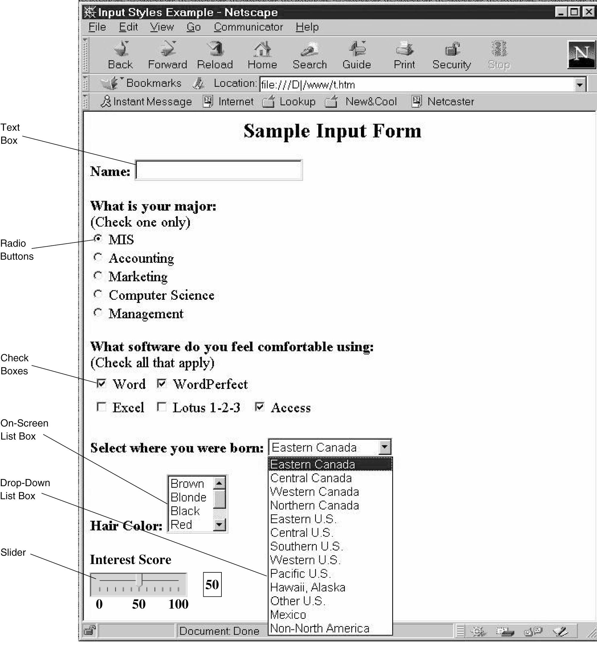
5.4.1 Example

Slide 37
5.4.2 Types of Selection Box
Check Box
  Lists all alternatives with box to select
  Enables multiple alternatives from list
  Alternatives may not be mutually exclusive
  No negatives alternatives
  Box labels should be ordered
  Max. 10 alternatives (if >10 use subcategories)
Radio Buttons
  Lists all mutually exclusive alternatives, each with circle to select
  Enables single unique alternative from list
  Max. 6 alternatives (if >6 use drop-down list box)
  If 2 alternatives, use one check box instead
  Avoid radio buttons & check boxes
On-screen list box
  List of alternatives in a box
  Only use if no room for check boxes or radio buttons
  Enables [1] single unique alternative c.f. radio button or [2] multiple alternatives (c.f. check boxes)
  Alternatives in list can be scrolled
Drop-down list box
  Selected item in one-line box, box opens to reveal alternatives
  Use when no room to display all alternatives
  Similar to radio buttons but more compact
  Hides alternatives until opened
  Simplifies design if no. of alternatives is unclear

Slide 38
5.4.2 continued…
Combo box
  Drop-down list box for keyboard entry with scrolling
  Use as shortcut for experienced users
Slider
  Graphic scale with sliding pointer to select a number
  Used when entering approximate value from large continuous scale
  Slider selection of value is inexact
  Can include updating number box to indicate current exact value on scale

Slide 39
5.5 Types of Input Validation
All data must be validated to ensure accuracy = at least one check, ideally ALL appropriate checks (URR = “think” Units, Range, Resolution)
Data failing any check should be rejected until valid
Six different kinds of check
  [1] Completeness check
    Ensures all required data has been entered
    Used when several fields must be completed before form can be processed
    If any of required data is missing, incomplete for re-presented to user, e.g. with required fields highlighted
  [2] Format check
    Ensures data values are correct type and in correct format
    Used when fields contain numeric values or values are codes
    Ideally values are not entered as text, if string is entered it must be convertible to numeric value
    If coded values have format, values must be checked against format
  [3] Range check
    Ensures data values are within specified range
    Used with ALL numeric data
    Can include logical checks e.g. implied age >110 years

Slide 40
5.5 continued…
[5] Consistency checks
  Ensures data combinations are valid
  Used when data values are related
  Related data common, e.g. date of birth precedes date of driving licence issue
  System prompts for invalid related values to be consistent
[6] Database checks
  Data values compared with stored (correct) values
  Used when critical values are already stored (elsewhere)
    e.g. National Insurance number
  Usually performed after all other kinds of check
    Possibly opening database (or file) and always reading requires extra processing so only validated valued are queried and compared for correctness

Slide 41
5.6 Output Design
Output must be comprehensible and accurate
  [1] Requires understanding of how output is used
  Often, output is a report
    Report is used as [a] reference or [b] to find specific item
    Items must be ordered or grouped within categories
    Web reports must be [a] scrollable in entirety or [b] paged with (hypertext) links
    Reference reports must be page numbered and dated
    “Real-time” reports ‘vs’ batch (processed) reports
Manage “information load” (or “overload”)
  Report has a purpose – only information for that purpose should be present
  Different reports (for different purposes) may contain common information
  Information should be suitable for purpose without modification
    Appropriately sorted, highlighted and with all necessary calculations
Minimize bias
  Bias is usually unintentional
    Sorted data emphasises initial entries
    Scales on axes introduce bias

Slide 42
5.6 continued…
Types of Report (not mutually exclusive)
  Detail reports
    Details of all items requested
    Used for comprehensive analysis
    Produced via query with constraint on items to be included
    Presented in detail for all items to be considered
  Summary report
    Summarises details of all items
    Used for brief, collective information on similar or related items
    Usually produced via query with constraint on items to be included, but may be for whole file/database
    Presented for comparison of collective data items
    Sorted order significant to comparison process
  Turnaround document
    Reports that are subsequently used as inputs
    Used when output report requires subsequent input from user based on that report
  Graphs
    Graphical representation (rather than tabular)
    Presented for comparisons over several items
    My indicate time-ordered (temporal) relationships
    Inappropriate for precise numeric values of individual items
    Bar-charts better represent tables of numbers
    Line-charts better represent time-ordered relationships
    Scatter-charts enable clusters to be identified, e.g. unusual data values
    Pie-carts show proportions of a whole

Slide 43
5.7 Output Media
Increasingly, new media have become available
Electronically-stored reports can be made available in multiple alternative formats
File- or web-server responds to user requests interactively
  Enables on-demand and ad-hoc report generation
  Modern computer-supported cooperative working applications enable reports to be generated and/or appended in electronic form to other forms of communication, and contained within other kinds of stored representation
Archiving of (potentially very) large volumes of data now commonplace
  May be a legal requirement to maintain archive securely for several years
  Archived data sets can be “warehoused” and “mined”
    Modern widely available software applications and tools support both Data Warehousing and Data Mining
    A data warehouse is the main repository of the organization's historical data, a form of “corporate memory”.
    Stores “raw material” for management's decision support system (DSS)
    Enables analyst to perform complex queries and analysis (such as data mining) on the information without impeding other operational systems

