Slide 1
PHÂN TÍCH THIẾT KẾ
HƯỚNG ĐỐI TƯỢNG
TRƯỜNG ĐẠI HỌC BÁCH KHOA HÀ NỘI
VIỆN ĐIỆN TỬ VIỄN THÔNG
CHƯƠNG 4
Thiết kế (tiếp theo và hết)
Bộ môn Điện tử Kỹ thuật máy tính

Slide 2
Chương 4. Thiết kế
4.1. Chuẩn bị thiết kế
4.2. Thiết kế lớp và phương thức
4.3. Thiết kế lớp quản lý dữ liệu
4.4. Thiết kế giao diện giao tiếp người-máy
4.5. Thiết kế kiến trúc vật lý
OOD - DEI.FET.HUT

Slide 3
Key Definitions
Physical Architecture Layer Design
  The plan for the
    Hardware
    Software
    Communications infrastructure
    Security
    Global support
OOD - DEI.FET.HUT

Slide 4
Key Definitions
Must decide on the architecture
  Server-based
    Processing built in to the server
  Client-based
    Processing done on client PCs
  Client-server based
    Processing shared between client and server
OOD - DEI.FET.HUT

Slide 5
Key Definitions
Network model
  Shows major components of the system
  Where they are located
  How they will be interconnected
Hardware and software specification
  Give details of NW model components
  Guides purchase and acquisition
OOD - DEI.FET.HUT

Slide 6
Key Definitions
Global support and security plan
  Address global issues of the app.
    Standards, support, culture, etc.
  Addresses security
    Disruption, data corruption, disaster recovery, unauthorized access, etc.
OOD - DEI.FET.HUT

Slide 7
ARCHITECTURAL
COMPONENTS

Slide 8
Components of the Architectures
Servers
  Mainframes, Minis, Micros, Cloud’s VMs
Clients
  Input/Output HW used by users
  Terminals, PCs, Mobiles, special purpose HW
Network
  HW and SW to connect clients to servers
OOD - DEI.FET.HUT

Slide 9

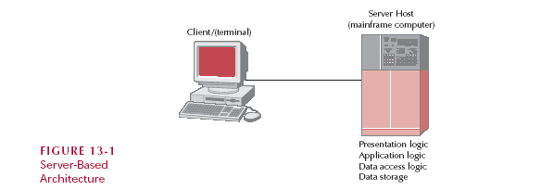
Server Based Architecture
More machines and/or
more applications slows
server response times
Server
Must
Process
All
Messages
Upgrade
Or
New
Server
Expensive
All messages
through one
central server
Application software
and its data stored
on same computer
OOD - DEI.FET.HUT
Notes:
Initially all architectures were server-based
Central (mainframe) computer performed all four application functions
Clients (dumb terminals) enables messages (keystrokes) to be sent to server and received messages from server (instructions defining what to display)

Slide 10
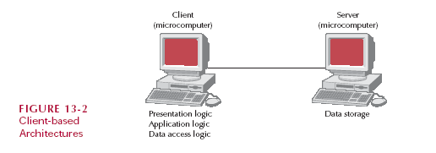
Client-Based Computing
Presentation Logic
Application Logic
Data Access Logic
Presentation Logic
Application Logic
Data Access Logic
All data must
travel from server
to client for processing
Presentation Logic
Application Logic
Data Access Logic
Presentation Logic
Application Logic
Data Access Logic
Presentation Logic
Application Logic
Data Access Logic
Only
Application software
has Presentation Logic,
its own (application)
Logic, and Data Access
logic
Presentation Logic,
Application Logic
Data Access Logic
OOD - DEI.FET.HUT
Notes:
Client = PC, server is (high-end) PC on same Local Area Network (LAN)
Client has its own processing capability
Client does most of the work
Server just stores the data
Network traffic can be great
All data must travel over the NW for processing
e.g. DB query

Slide 11
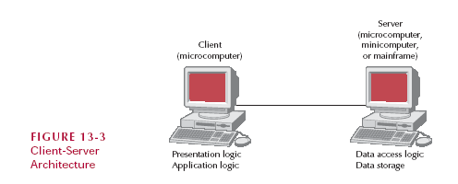
Client-Server-Based Computing
If most of
Application Logic on
Server = “Thin” Client
If most of
Application Logic on
Client = “Thick” (or “Fat”) Client
Application logic
OOD - DEI.FET.HUT
Notes:
Client has Presentation Logic
Server has Data Access Logic and Data Storage
Application Logic
[1] On Client
[2] On Server
[3] Shared between Client and Server

Slide 12
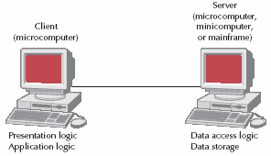
Advantages of Client-Server-Based Computing
Scalable
  Easy to increase storage capacity
    Add another HD or server
  Easy to increase number of clients
Supports a variety client types
More reliable, no
single point of failure
Less expensive
OOD - DEI.FET.HUT

Slide 13
Limitations of Client-Server-Based Computing
Complexity
  Applications have two parts
  Writing software effectively is hard
OOD - DEI.FET.HUT

Slide 14
Client-Server Attributes
Typical Pros
  Compatible with web-based system design
  Scaleable
  Works with multiple vendors/products
  No central point of failure
Typical Cons/Limits
  Complexity
  New programming languages and techniques (stress for personnel)
  More complex to update
OOD - DEI.FET.HUT

Slide 15
Client-Server Tiers
Client has
Presentation
And Application
Server has
Data
OOD - DEI.FET.HUT
Tier
Tier
= 2 Tier
Notes:
Most common partitioning of Application Logic between Client and Server is:-
Different ways to split application logic between client and server
Previous examples
Server is responsible for the data
Client is responsible for application and presentation logic

Slide 16

Three-Tiered Client-Server
Database Server
(microcomputer
minicomputer
mainframe)
Client
(microcomputer)
Application Server
(microcomputer)
Presentation logic
Application logic
Data access logic
Data storage
Common for Web interface to a DB
OOD - DEI.FET.HUT

Slide 17
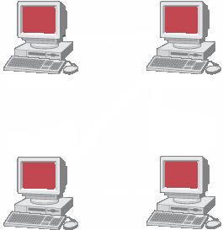
n - Tiered Client-Server
Client
(microcomputer)
Application Server
(microcomputer)
Presentation logic
Application logic
Application Server
(microcomputer)
Database Server
(micro, mini, mframe)
Application logic
Data access logic
Data storage
OOD - DEI.FET.HUT

Slide 18
n - Tiered Client-Server Attributes
Typical Pros
  Separates processing to better balance load
  More scaleable
Typical Cons/Limits
  Greater load on the network
  More difficult to program and test
OOD - DEI.FET.HUT

Slide 19
Distributed Objects Computing (DOC)
Middleware
  Between clients and servers
  Support objects in distributed computing
  Makes physical network transparent
  Allows developer to focus on the application, rather than which server has which objects
  Can ignore physical location of server objects
OOD - DEI.FET.HUT
Notes:
Previously “messages” were sent between distributed components
“Message” may be request from Client to resolve SQL query and return data from Database Server via Data Access Logic (on same server)
DOC is middleware layer between Clients & Servers
Middleware enables interactions between distributed objects

Slide 20
Distributed Objects Computing (DOC)
So servers can be added / removed without updating client code
  Only the middleware needs to be changed
The price?
  May reduce efficiency of the application
OOD - DEI.FET.HUT

Slide 21
Competing Approaches
Object Management Group
  Common Object Request Broker Architecture (CORBA)
Sun
  Enterprise JavaBeans (EJB)
  Java 2 Enterprise Edition (J2EE)
Microsoft
  Distributed Component Object Model (DCOM)
  .net framework
OOD - DEI.FET.HUT
Notes:
Currently three “approaches” (standards) for DOC
[1] OMG’s CORBA Common Object Request Broker Architecture standard
[2] Sun’s EJB Enterprise JavaBeans (EJB)
Java 2 Enterprise Edition (J2EE)
[3] MicroSoft’s DCOM Distributed Component Object Model and .Net

Slide 22
Selecting a Computing Architecture
Server-Based Client-based Client-server
Cost of infrastructure Very high Medium Low
Cost of development Medium Low High
Ease of development Low High Low-medium
Interface capabilities Low High High
Control and security High Low Medium
Scalability Low Medium High
OOD - DEI.FET.HUT

Slide 23
INFRASTUCTURE DESIGN

Slide 24
(UML) Deployment Diagram
Show relationships between hardware components in physical infrastructure (of information system)
  IF a WAN (Wide Area Network) used for distributed system THEN communication relationships between nodes in network defined
Also used to represent software components and their deployment over physical architecture/infrastructure
  IF software represented THEN diagram = execution environment (for system)
OOD - DEI.FET.HUT

Slide 25
Deployment Diagram Components
Nodes
  Any piece of hardware in the model
  A computational resource
  Labeled by its name
  Stereotype to label the type of node
Artifacts
  Piece of the information system
    Such as software or a database table
OOD - DEI.FET.HUT

Slide 26
Deployment Diagram Components
Node with Deployed Artifact
  Shows artifact placed on a physical node
  Good for showing distribution data or software
Communication paths
  Links between nodes of the network
OOD - DEI.FET.HUT

Slide 27


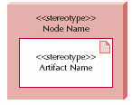
Deployment Diagram
Node
Artifact
Node with
Deployment Artifact
Communication Path
OOD - DEI.FET.HUT

Slide 28
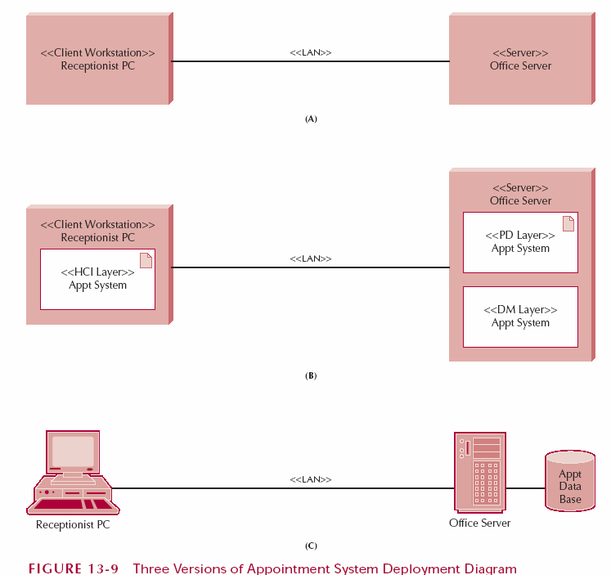
Diagram Examples
Basic Standard Notation
Stereotypes
Imply
Hardware
Requirements
Artefact Deployed on Node
Extended Notation
Emphasises hardware requirements (Omits software distribution)
OOD - DEI.FET.HUT
Notes:
Three different versions of a Deployment Diagram

Slide 29
The Network Model
Conveys complexity of the system and how components fit together
Components are
  Clients / Servers
  Network equipment
  Connection to external systems or networks
OOD - DEI.FET.HUT
Notes:
Major components of IT system and their geographic locations in “high-level” UML Deployment Diagram
Shows software components and their interrelationships
Used to develop hardware and software specification
Elements are clients, servers, network equipment, external systems & networks
Locations are geographic sites related to elements

Slide 30
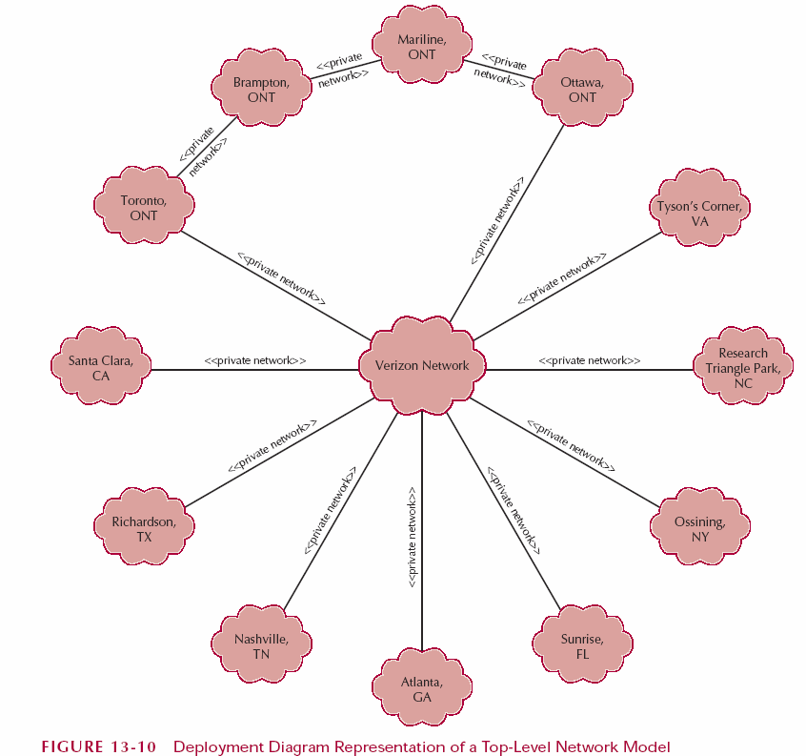
Network Model Example
Application
Locations in
Canada
Many-to-many
connections
by External
Service
provider
Application
Locations in
US
Network
connection
between
Brampton
and
Ottawa
OOD - DEI.FET.HUT

Slide 31
Nonfunctional Requirements
Operational
  Specify the operating environment
    Operating system
    System software
    Information systems
    Physical environment
      Usually only if harsh environment or hardening is required
Technical Environment
  Type of hardware and software the system will require
  Focus on
    Hardware platforms
      Intel, Motorola, PDA
    OS
    Database system
    System software
OOD - DEI.FET.HUT

Slide 32
Nonfunctional Requirements
System Integration
  Interaction with other systems
  Both internal and external systems
  Import/export data formats
Portability
  Response to changing environments
  New platforms
  New data formats
Maintainability
  Expected business requirement changes
  How easily can the system be updated
OOD - DEI.FET.HUT

Slide 33
Performance Requirements
Speed
  Response time of the system
    Local action are faster
    Remote services are slower
  Transaction update time
    How long for a change to propagate throughout the system
    e.g.. Inventory updates
Capacity
  Number of users
    Total and simultaneous
    Affects hardware specification
    Load balancing?
  Volume of data
OOD - DEI.FET.HUT

Slide 34
Performance Requirements
Availability and Reliability
  Specify available times
    When can the users count on the system
    Work week only?
    Global usage?
  Permissible failure rate
    Be realistic
Security
  Protect from disruption and data loss
OOD - DEI.FET.HUT

Slide 35
SECURITY

Slide 36
Identifying Threats to the System
Threat
  Any potential adverse occurrence that can harm the application or its data
Threats come from
  Internal sources
  External sources
OOD - DEI.FET.HUT

Slide 37
Identifying Threats to the System
Two categories of threats
  Disruptions, destruction and disaster
    Disruption – can't use app for awhile
    Destruction – corrupt files, crash HD
    Disaster – natural or man-made
  Unauthorized access
    Internal and external
OOD - DEI.FET.HUT

Slide 38
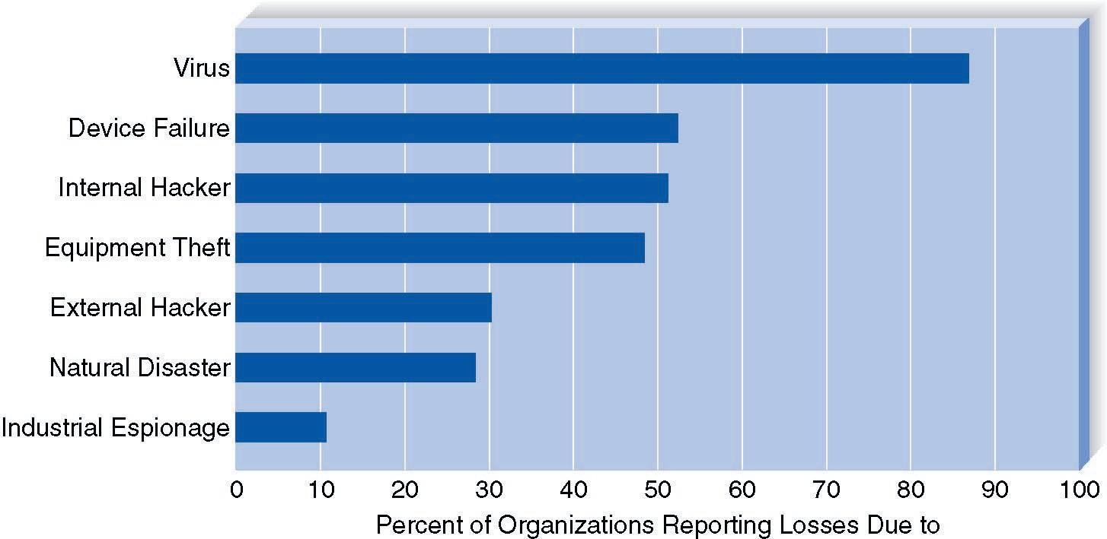
Most Common Threats
OOD - DEI.FET.HUT

Slide 39
Assessing the Risk of Each Threat
After the threats are identified
  List threats across top of page
  List components down side
    In order of importance
  List controls in the cells created
Control – Something that stops or mitigates the consequences of the threat
OOD - DEI.FET.HUT

Slide 40
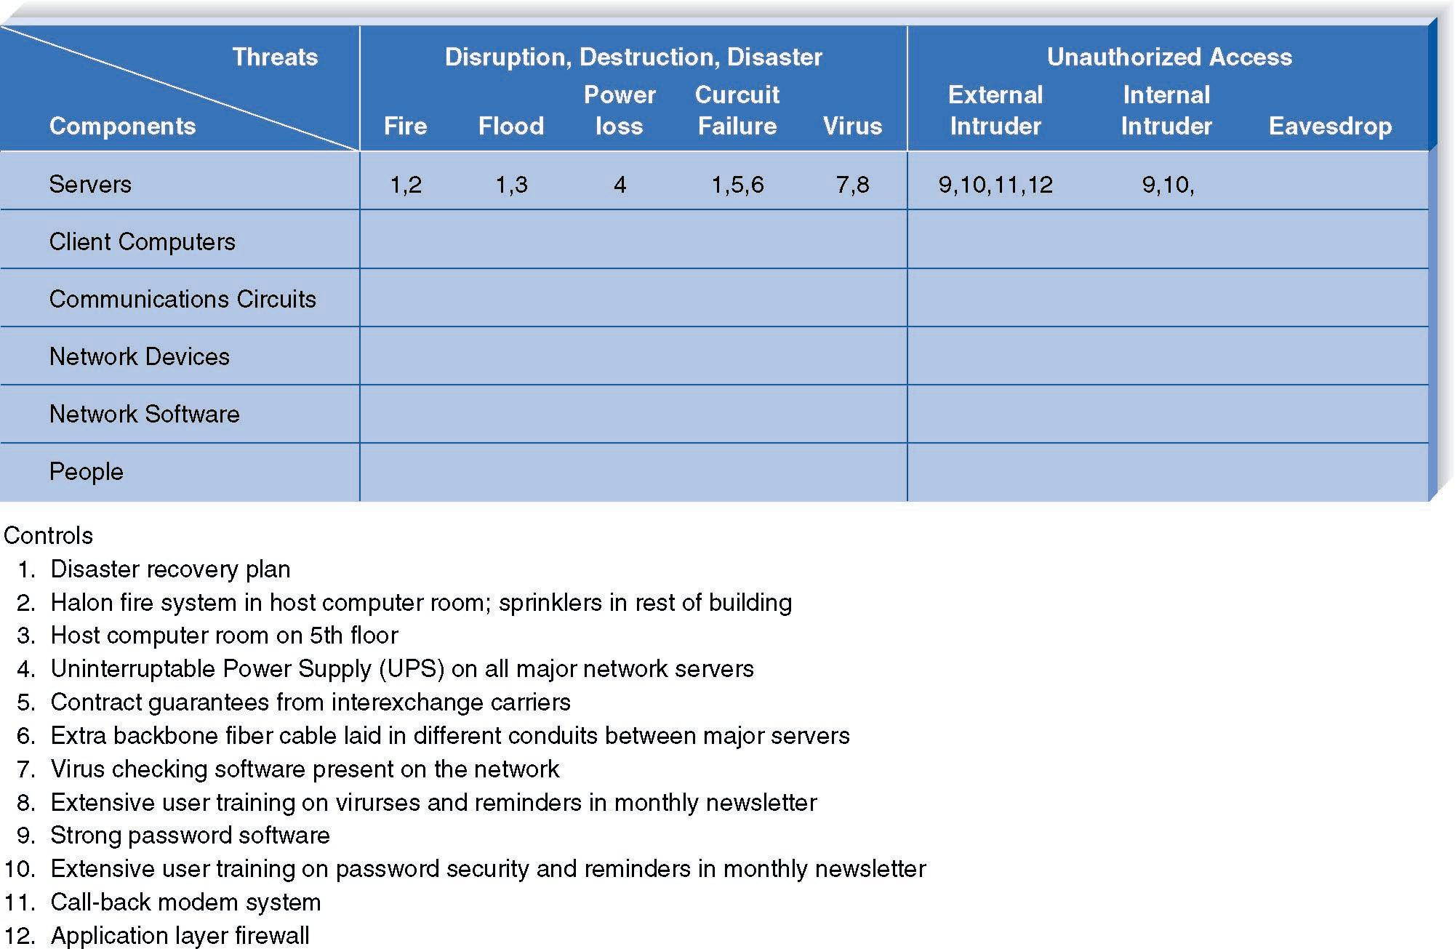
Assessing the Risk of Each Threat
OOD - DEI.FET.HUT

Slide 41
Creating Controls
Controls for disruption, destruction and disaster
  redundancy
    Fault tolerant
    Auto transfer
  disaster recovery plans
  Virus protection
OOD - DEI.FET.HUT

Slide 42
Creating Controls
Controls for unauthorized access
  Security policy and training
  Screen users
  Use authentication and encryption
  Firewalls
  Physical security
OOD - DEI.FET.HUT

Slide 43
Additional Controls Include
A security policy
Passwords and encryption
Firewalls
OOD - DEI.FET.HUT

Slide 44
Cultural and Political Requirements

Slide 45
Multilingual Requirements
Need good translations
  KFC example
Concurrent multilingual systems
  Handle language on the fly
Discrete multilingual systems
  Separate parts written for each language
OOD - DEI.FET.HUT

Slide 46
Customization
Who has control of the application?
Can each region make changes to the system
Can they allow subsidiaries to make changes?
OOD - DEI.FET.HUT

Slide 47
Unstated Norms
Make assumptions explicit
Some examples:
  Date format
  Numeric format
  Name order
  24/7 support
OOD - DEI.FET.HUT

