Slide 1
PHÂN TÍCH THIẾT KẾ
HƯỚNG ĐỐI TƯỢNG
TRƯỜNG ĐẠI HỌC BÁCH KHOA HÀ NỘI
VIỆN ĐIỆN TỬ VIỄN THÔNG
CHƯƠNG 5
Triển khai
Bộ môn Điện tử Kỹ thuật máy tính

Slide 2
Chương 5. Triển khai
5.1. Xây dựng hệ thống
5.2. Cài đặt và vận hành
OOD - DEI.FET.HUT

Slide 3
Key Definitions
Construction: The development of all parts of the software itself, documentation, and new operating procedures.
Testing: A form of insurance. It’s cheaper to fix bugs earlier, rather than later.
Documentation: Provides information to make the system easier to use and maintain
OOD - DEI.FET.HUT

Slide 4
Main Tasks of Managing the Programming Effort
Assigning the programmers
Coordinating the activities
Managing the schedule
OOD - DEI.FET.HUT

Slide 5
Assigning Programmers
Start by looking at the package diagrams
Assign similar modules to the same programmer
Fewer programmers is normally better
OOD - DEI.FET.HUT

Slide 6
Coordinating Activities
Hold weekly project meetings
  discuss changes to the system
  discuss other issues of the past week
Create and follow standards
Set up separate workspace for
  development, testing, production
  as a minimum, separate files
Use change control
  program log, sign-in/-out
Use CASE tools
OOD - DEI.FET.HUT

Slide 7
Managing the Schedule
Use initial time estimates as a baseline
Revise time estimates as construction proceeds
Fight against scope creep
Monitor “minor” slippage
Create risk assessment and track changing risks
  Risks change as deadline approaches
Fight the temptation to lower quality to meet unreasonable schedule demands
OOD - DEI.FET.HUT

Slide 8
Avoid Classic Mistakes
1. Research-oriented development
If you use state-of-the art technology, lengthen planned time
2. Using “low-cost” personnel
You get what you pay for.
If using a significant number of entry level personnel, lengthen planned time
3. Lack of code control
Use source code library to keep programmers from changing the same code at the same time. Why?
4. Inadequate testing
Always allocate sufficient time for formal testing
OOD - DEI.FET.HUT

Slide 9
Designing Tests

Slide 10
Designing Tests
Testing can never prove there are no errors
The purpose is not to demonstrate that the system is free of errors
The purpose is to detect as many errors as possible
Question:
  What are considered good test results?
OOD - DEI.FET.HUT

Slide 11
Testing Philosophy
It is dangerous to test early modules without an overall testing plan
It may be difficult to reproduce sequence of events causing an error
Testing must be done systematically and results documented carefully
OOD - DEI.FET.HUT

Slide 12
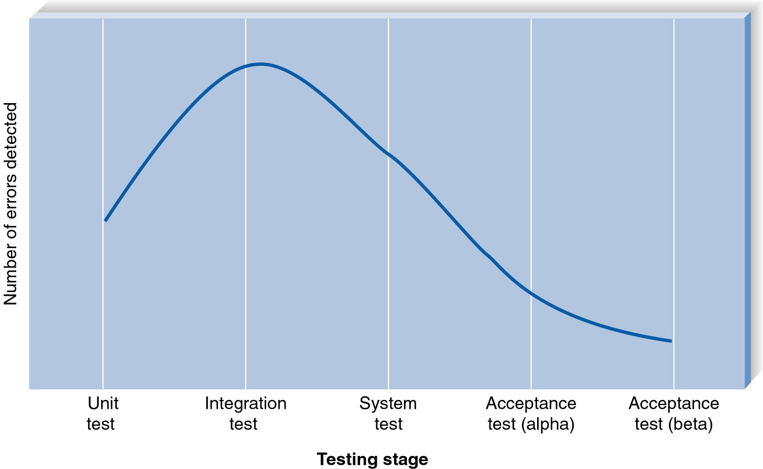
Error Discover Rates
OOD - DEI.FET.HUT

Slide 13
Testing and Object-Orientation
Encapsulation and information hiding
  Attributes and actions are combined and hidden
  This makes testing hard
  So you need to test
    the business process represented by use cases
Polymorphism and dynamic binding
  Don't know ahead of time which method will be bound at run time
  Rather than testing individual classes
    Focus on the class as the smallest unit of testing
Reuse
  When code is reused in a different context
  It must be re-tested
OOD - DEI.FET.HUT

Slide 14
Testing and Object-Orientation
Inheritance
  If you find a bug in a class you don't know if it came from an ancestor class
  If so, you may see the same bug in sibling classes
OO Development process and products
  Test all deliverables of the process
  Even the non-executable ones
  Can do this with a walk through
OOD - DEI.FET.HUT

Slide 15
Test Planning
Address all products created during development
  So develop test plan early
  Example, test completeness of CRC cards
Each test:
  Has as specific objective
  Has specific test cases to examine
  Uses test specifications
If the tested class requires methods that aren't ready
  Use stubs (hard coded fake methods)
OOD - DEI.FET.HUT

Slide 16
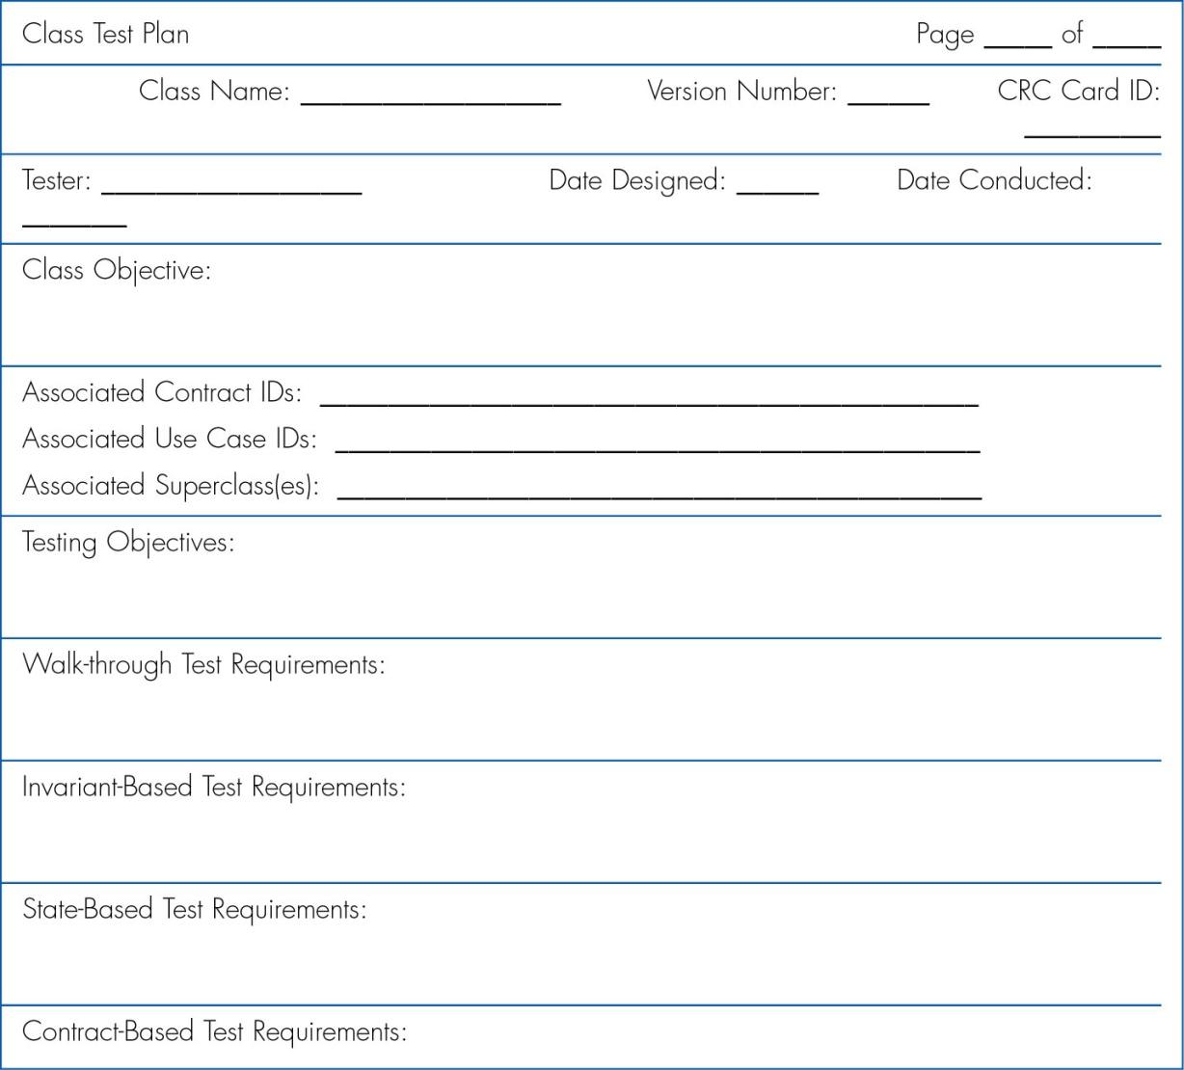
Class Test Plan
OOD - DEI.FET.HUT

Slide 17
Stages of Testing
Unit testing
  Tests each module to assure that it performs its function
Integration testing
  Tests the interaction of modules to assure that they work together
System testing
  Tests to assure that the software works well as part of the overall system
Acceptance testing
  Tests to assure that the system serves organizational needs
OOD - DEI.FET.HUT

Slide 18
Unit Testing
Tests a single unit (a class)
Black Box Testing
  Most common
  Looks just at inputs and outputs
  Tests whether the unit meets requirements stated in specification
OOD - DEI.FET.HUT

Slide 19
Unit Testing
White-Box Testing
  Looks inside the module to test its major elements
  Limited usefulness in OO design
    because units are so small
Unit tests based on
  CRC cards, state diagrams
  Pre and Post conditions
OOD - DEI.FET.HUT

Slide 20
Integration Testing
After the classes pass unit tests
Test classes that must work together
OOD - DEI.FET.HUT

Slide 21
Integration Testing
Four types of Integrating tests
  User interface testing
    Tests each interface function
    Move through each menu/screen
  Use-case testing
    Ensures that each use case works correctly
    Step through each use case
    Often combined with UI testing
OOD - DEI.FET.HUT

Slide 22
Integration Testing
  Interaction testing
    Start with a package
    Each method is a stub
    Add methods one at a time, testing as you go
    Once all packages are done, repeat on the package level
  System interface testing
    Ensures data transfer between systems
OOD - DEI.FET.HUT

Slide 23
System Testing
Requirements Testing
Usability Testing
Security Testing
Performance Testing
Documentation Testing
OOD - DEI.FET.HUT

Slide 24
System Testing
See that all classes work together
Similar to integration testing but broader
  Requirements Testing
    Are business requirements met?
    Ensures that integration did not cause new errors
  Usability Testing
    Tests how easy and error-free the system is in use
    Informal or formal
OOD - DEI.FET.HUT

Slide 25
System Testing
  Security Testing
    Assures that security functions are handled properly
      e.g. Disaster recovery
  Performance Testing
    Assures that the system works under high volumes of activity
  Documentation Testing
    Analysts check that documentation and examples work properly
OOD - DEI.FET.HUT

Slide 26
Acceptance Testing
Done by users with support from project team
Ensure the system meets the originally stated requirements
Alpha Testing
  Repeat tests by users to assure they accept the system, uses known data
Beta Testing
  Uses real data, not test data
OOD - DEI.FET.HUT

Slide 27
DEVELOPING DOCUMENTATION

Slide 28
Documentation
Developed throughout SDLC
  Not left to the end of the project
Two types of documentation
  System Documentation
  User Documentation
OOD - DEI.FET.HUT

Slide 29
System Documentation
Helps programmers and analysts understand the application
Used for development and maintenance
Largely a byproduct of the system analysis and design phases
Often stored in project binders
Often can be automated (JavaDoc)
OOD - DEI.FET.HUT

Slide 30
User Documentation
Help users operate the system
High quality documentation takes about 3 hours per page to produce
Should not be left to the end of the project
Build into the schedule time needed
On-line documentation is growing in importance
OOD - DEI.FET.HUT

Slide 31
Types of User Documentation
Reference documents (help system)
  User needs to learn a specific task
Procedures manuals
  How to perform a business function
  May require several tasks
Tutorials
  How to use major function of system
OOD - DEI.FET.HUT

Slide 32
Online Documentation Strengths
Facilitates searching
Same information can be presented in different formats
Provide interaction with users using links or “tool-tips”
Less expensive to distribute
OOD - DEI.FET.HUT

Slide 33
On-Line Documentation Structure
Documentation topics
  Material users want to read
    Common tasks
      This is where most uses start
      Because they know what they want to do
      They don’t know what command to look up
    Commands and menus
      Good if user knows that command or menu to use
    Definitions
      Good when user is using other parts of help system
OOD - DEI.FET.HUT

Slide 34
On-Line Documentation Structure
Navigation controls
  How user moves through help system
    Table of contents
    Index based on keywords & logically ordered
    Text search
      more words than index
      not in any logical order
    Intelligent agent
      Accepts natural language for searches
    Links between topics
OOD - DEI.FET.HUT

Slide 35
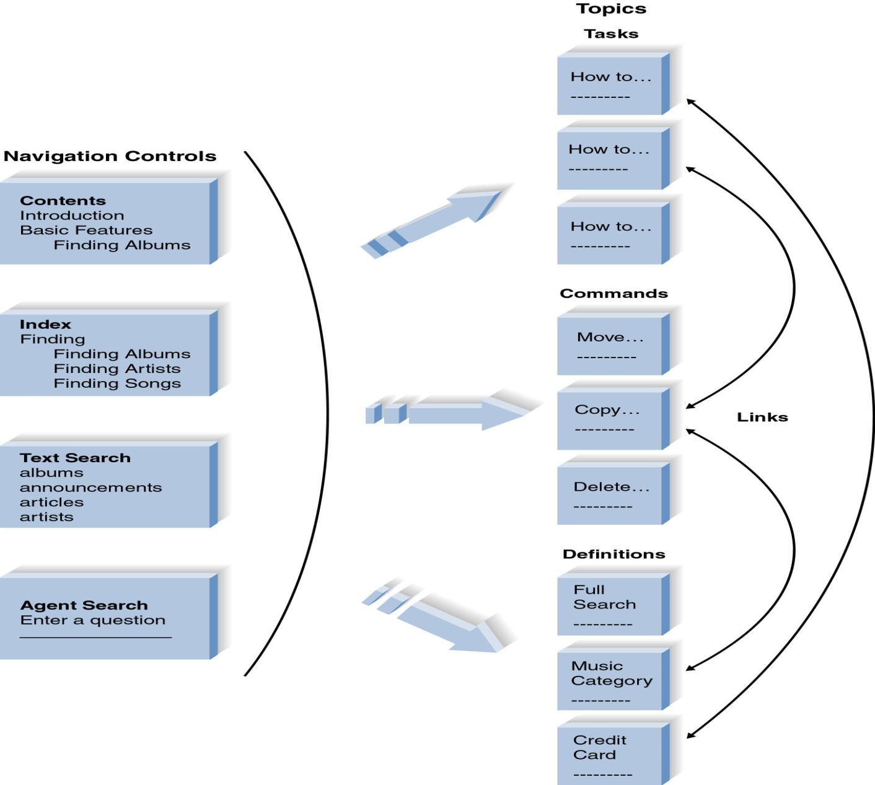
Organizing On-Line Reference Documents
OOD - DEI.FET.HUT

Slide 36
Writing Documentation Topics
Need good understanding of users
Focus on what the users wants to do
  No on what the system can do
Start with clear titles
Followed by an introduction that defines the topic
Then give detailed step-by-step instructions
  Can include "show me" examples
Include navigation controls
OOD - DEI.FET.HUT

Slide 37
Guidelines for Crafting Documentation Topics
Use the active voice
  Finding the albums is done using the album title.
  You can find an album by using the album title
Minimize use of “to be” verbs
  The text you want to copy must me selected
  Select the text you want to copy
OOD - DEI.FET.HUT

Slide 38
Guidelines for Crafting Documentation Topics
Use consistent terms
  “Selected text” and “Marked text”
Use simple language
  Eschew Recondite Locution
Use friendly language
  Back up all essential documents
  You should make a backup copy of all data that is important to you
OOD - DEI.FET.HUT

Slide 39
Guidelines for Crafting Documentation Topics
Use parallel grammatical structure
  Opening files, Saving a document, How to delete files
  Opening a file, Saving a file, Deleting a file
Use steps correctly
  “After cutting the blue wire”
Use short paragraphs
  Enough said
OOD - DEI.FET.HUT

Slide 40
Identifying Navigation Terms
As you write a help topic
  Identify terms for
    Table of contents, Index, Text Search
  Other entries for index and search
    Commands in User Interface
      Both action and object parts of commands
      “save” and “files”
    Major concepts of the system
      Often from use cases and classes
    Business tasks performed by users
    Synonyms for the above three
OOD - DEI.FET.HUT

Slide 41
Summary
The project manager needs to manage coordination, scheduling, and overall effectiveness of the project.
Testing begins early in the development process and continues looking to find problems throughout the development lifecycle.
Documentation helps the user quickly assimilate the new technology and provide assistance in transitioning to the new business processes.
OOD - DEI.FET.HUT

