Slide 1
PHÂN TÍCH THIẾT KẾ
HƯỚNG ĐỐI TƯỢNG
TRƯỜNG ĐẠI HỌC BÁCH KHOA HÀ NỘI
VIỆN ĐIỆN TỬ VIỄN THÔNG
CHƯƠNG 5
Triển khai (tiếp theo và hết)
Bộ môn Điện tử Kỹ thuật máy tính

Slide 2
Chương 5. Triển khai
5.1. Xây dựng hệ thống
5.2. Cài đặt và vận hành
OOD - DEI.FET.HUT

Slide 3
Key Ideas
Transitioning to new systems involves managing change from pre-existing norms and habits.
Change management involves:
  Unfreezing -- loosening up peoples’ habits and norms
  Moving -- transition from old to new systems
  Refreezing -- institutionalize and make efficient the new way of doing things
OOD - DEI.FET.HUT

Slide 4
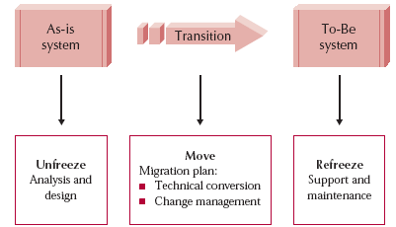
Implementing Change
OOD - DEI.FET.HUT

Slide 5
Unfreezing

Slide 6
Unfreezing
Activities to date facilitate unfreezing
Users:
  Already know of the new system
  Helped in the analysis phase
  Helped in the design
This probably has already unfreeze current habits and norms
OOD - DEI.FET.HUT

Slide 7
Moving – Conversion

Slide 8
Migration Planning
Helps move people from As-Is system to To-Be system
What activities will be performed when and by whom
  Technical aspects
    Installing hardware and software
    Converting data
  Organizational aspects
    Training users on the system
    Motivating employees to use the new system to aid in their work
OOD - DEI.FET.HUT

Slide 9
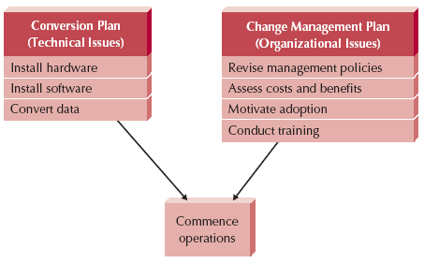
Elements of a Migration Plan
OOD - DEI.FET.HUT

Slide 10
Conversion Styles
Direct conversion
  Cold Turkey, Big Bang, Abrupt Cutover
  The new system instantly replaces the old
  Upgrading to new version of word processor
  Simplest and most straightforward
  Most risky
Parallel conversion
  Old and new systems used side by side
  Old is turned off when new is shown to work
  Provides a safety net
  Added expense and complexity of running both
OOD - DEI.FET.HUT

Slide 11
Conversion Location
Which parts of the organization are converted, and when
Pilot conversion
  A few locations are converted first
  Once bugs are worked out, other locations are converted
  Provides additional testing before going live
  Requires more time
  Different parts of the organization are using different versions
OOD - DEI.FET.HUT

Slide 12
Conversion Location
Phased conversion
  Partition the organization
  Convert each partition one at a time
  Allows smaller installation team
  Same pros and cons as pilot conversion
Simultaneous conversion
  All locations are converted at the same time
  Can be used with direct or parallel conversion
  Everyone uses same version
  Requires large staff to perform conversion
OOD - DEI.FET.HUT

Slide 13
Conversion Modules
Which part of the new system is installed when
Whole system conversion
  All modules converted in one step
  Most common
  May be a steep learning curve for users
Modular conversion
  Separate modules are converted one at a time
  Application must be written for this
OOD - DEI.FET.HUT

Slide 14
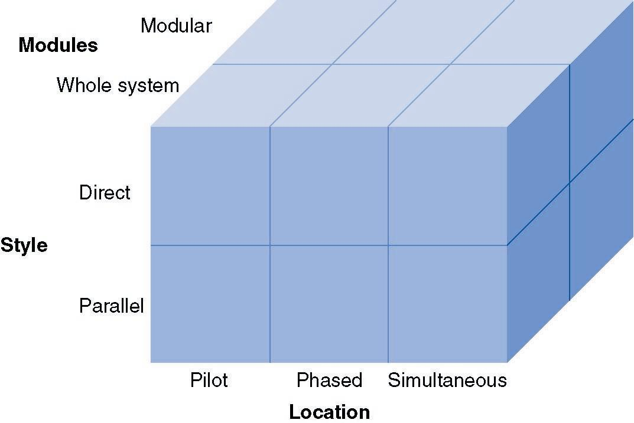
Conversion Strategies
OOD - DEI.FET.HUT

Slide 15
Key Factors in Selecting a Conversion Strategy
Risk
  Seriousness of remaining bugs
  Parallel less risky than direction conversion
    Bugs can be fixed before shutting down old system
  Pilot less risky than phased or simultaneous
Cost
  Parallel requires paying for two systems for a period of time
  Simultaneous requires more staff to support all locations
OOD - DEI.FET.HUT

Slide 16
Key Factors in Selecting a Conversion Strategy
Time
  Direct conversion is fastest
  Parallel takes longer
    Need to wait for the turn off of the old system
  Simultaneous is fast
    All locations done at once
  Phased takes longer
    Need to wait until all modules are installed
OOD - DEI.FET.HUT

Slide 17
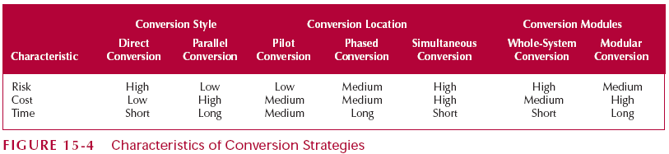
Characteristics of Conversion Strategies
OOD - DEI.FET.HUT

Slide 18
CHANGE MANAGEMENT

Slide 19
Change Management
Conversion was the technical aspect of moving to the new system
Change management is the organizational aspect of moving to the new system
OOD - DEI.FET.HUT

Slide 20
Key Players in Change Management
The sponsor
  The business person who initiated the request for the new system
  Usually senior management
  Must be visible leader of change
  Development team doesn’t have the clout to change minds and hearts
OOD - DEI.FET.HUT

Slide 21
Key Players in Change Management
The change agent
  The person(s) leading the change effort
  Plan and implement the change
  Usually outside the business unit
  Had no management authority
Potential adopter(s)
  The people who must change
  This is who the system is designed for
OOD - DEI.FET.HUT

Slide 22
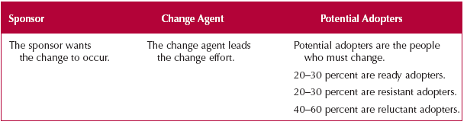
Change Management Actors
OOD - DEI.FET.HUT

Slide 23
Resistance to Change
Good for the organization
≠
Good for individual workers
Are workers paid more when they are more productive?
OOD - DEI.FET.HUT

Slide 24
Resistance to Change
Workers perform their own cost/benefit analysis
  Based on their perceptions
That is why it is important to sell the system
OOD - DEI.FET.HUT

Slide 25
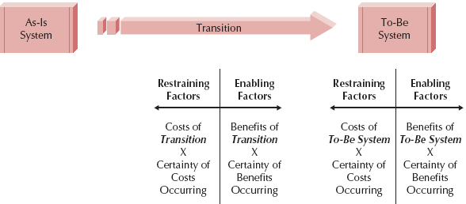
Costs and Benefits of Change
OOD - DEI.FET.HUT

Slide 26
Revising Management Policies
Change management policies first
If policies don’t support the new system, it will fail
Management Policies:
  Provide goals
  Define work processes
  Determine rewards
OOD - DEI.FET.HUT

Slide 27
Management tools for supporting adoption
Standard operating procedures (SOPs)
  Formal and informal
  Become the norms for an organization
  Formal SOPs must match To-Be system
  Informal SOPs will then follow
OOD - DEI.FET.HUT

Slide 28
Management tools for supporting adoption
Measurements and rewards
  What does it mean to “do a good job”
  Measurement and rewards help workers know
  Measurements indicate what is important to the organization
  Rewards enforces the measurements
OOD - DEI.FET.HUT

Slide 29
Management tools for supporting adoption
Resource allocation
  Put your money where your mouth is
  Has tangible and symbolic impact
    Tangible – the benefits of the resources
    Symbolic – Shows that the new project is important to management
OOD - DEI.FET.HUT

Slide 30
Assessing Costs and Benefits
What Actions
Will
Encourage
the Fullest
Measure of
Each Factor?
Factors in Successful Change
Benefits of to-be system
Certainty of benefits
Costs of transition
Certainty of costs
OOD - DEI.FET.HUT

Slide 31
Motivating Adoption
Two strategies:
  Informational
  Political
Informational Strategy
  Convince adopters that the change will benefit them
  Write memos, hold seminars
    Sell the new system
  Similar to an advertising campaign
OOD - DEI.FET.HUT

Slide 32
Motivating Adoption
Political Strategy
  Organizational power is used to motivate change
  Used when costs outweigh benefits for individuals
  “Adopt the system or your fired”
  “Adopt the system and you’ll gain new sills”
OOD - DEI.FET.HUT

Slide 33
Types of Adopters
Ready Adopters (20% - 30%)
  Recognize the benefits
  Quickly adopt the system
  Become proponents of the system
Resistant adopters (20% - 30%)
  Refuse to accept the change
  Fight against the system
Reluctant Adopters (40% - 60%)
  Apathetic & blow with the wind
OOD - DEI.FET.HUT

Slide 34
Enabling Adoption: Training
Users must be capable of adopting the system
They may need new skills
Learning these skills may involve use of the technology itself
New skills may be needed to handle the changed business processes
OOD - DEI.FET.HUT

Slide 35
What to Train
Helping users accomplish their tasks
  Don’t show off the new system
Show users how the system connects to the big picture
Use cases are a good place to look to see what to train
OOD - DEI.FET.HUT

Slide 36
How to Train
Classroom Training
  Trains many users with one instructor
  Creates a shared experience among users
  Efficient use of resources
One-on-One Training
  More expensive
  Has most impact on users
  Meets individual’s needs
  Used for important users or when there are very few users
OOD - DEI.FET.HUT

Slide 37
How to Train
Computer Based Training (CBT)
  Expensive to develop
  Cheap to deliver
  Has least impact on users
    One size doesn’t fit all
  Greatest reach
    Train most users, over the greatest distance, in the shortest time
OOD - DEI.FET.HUT

Slide 38
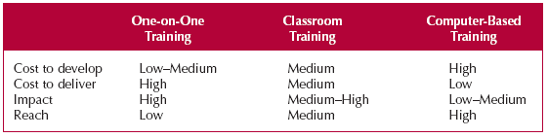
Selecting a Training Method
OOD - DEI.FET.HUT

Slide 39
POST-IMPLEMENTATION ACTIVITIES - Refreezing

Slide 40

Goal
To institutionalize the use of the new system
  Make it the normal, routing, accepted way of doing business
Three key activities
  System support
  System maintenance
  Project assessment
OOD - DEI.FET.HUT

Slide 41
System Support
On-demand training
  At the time of users’ need
Online support
  Frequently asked questions (FAQ)
Help desk
  Phone service for known issues
    80% success with first call
  Level 2 Support
    For the other 20%
OOD - DEI.FET.HUT

Slide 42
System Maintenance
Refining the system so it continues to meet business needs
More money spent on maintenance than initial development
OOD - DEI.FET.HUT

Slide 43
Sources of Change Requests
Problem reports (bugs)
  From operations group
Requests for enhancements
  Users have ides for improvements
  Helps build user support for system
Other system development projects
  Integration with other new systems
OOD - DEI.FET.HUT

Slide 44
Sources of Change Requests
Changes in underlying systems
  For example, OS updates
  May be invisible to users
Organization strategy changes
  From senior management
OOD - DEI.FET.HUT

Slide 45
Project Assessment
Determine what worked, and what didn’t
Important for future projects
Especially important for junior personnel
OOD - DEI.FET.HUT

Slide 46
Project Team Review
Each member prepares 2-3 pages
  Reports his/her actions during the project
Reviewed by the project manager
  Focus on improvement not penalties
  Excellent behaviors are acknowledged and diffused to others
  Team leader summarizes and distributes lessons learned
OOD - DEI.FET.HUT

Slide 47
System Review
Was the cost/benefit estimate valid?
Start with system request and feasibility analysis
Helps improve future cost/benefit estimates
Helps initiators to be honest about the need for a new system
OOD - DEI.FET.HUT

Slide 48
Expanding the Domain
An excellent source of information all aspects of training Computer-Based, web-based, and classroom is the American Society for Training and Development:
http://www.astd.org/
OOD - DEI.FET.HUT

