Slide 1

The Title Of Your Talk
Project: xxxxxx
Authors: Nguyen Huu Kim
Nguyen Van A
Nguyen Van B

Slide 2
Content
Motivation
Review what have been done so far
Current technical problems
Current and future human resource problem
Future plan
Conclusions

Slide 3
Review
Milestones
7/2016
Starting
(Learn Project)
9/2016
Designing
(Design project
Write app on smartphone)
1/2017
Market
(Advertise via Media)
We are here
8/2016
Planing
(Determine specification )
12/2016
Complete and launch product

Slide 4
Specification modified
- Hiển thị các thông số không khí đo được lên smart phone
- Đánh giá các chỉ số: tốt, bình thường, không tốt
- Cập nhật thông tin, lưu thông tin so sánh đối chiếu chất lượng không khí
NEW modification

Slide 5

Introduction
2001, BS, Hanoi University of Science and Technology
2005, MS, University Kiel, Germany
2012, PhD, University of California, Davis, USA
2013, Post-Doc, Fujitsu Laboratories of America, Sunnyvale

Slide 6

New math

Slide 7
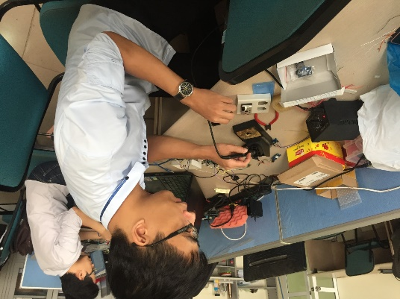
Future plan
Time | Actions | Member
Nov 23 – Nov 26 | Soldering the new circuits
Nov 23 - Nov 30 | Update new equation
Nov 26 - Nov 27 | Exam time | All

Slide 8
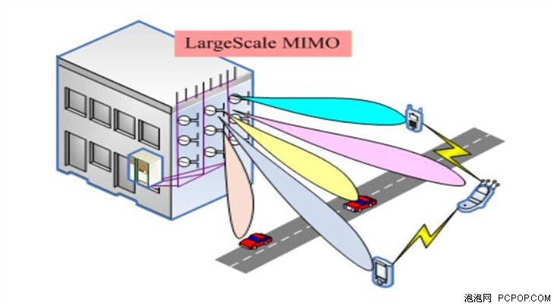
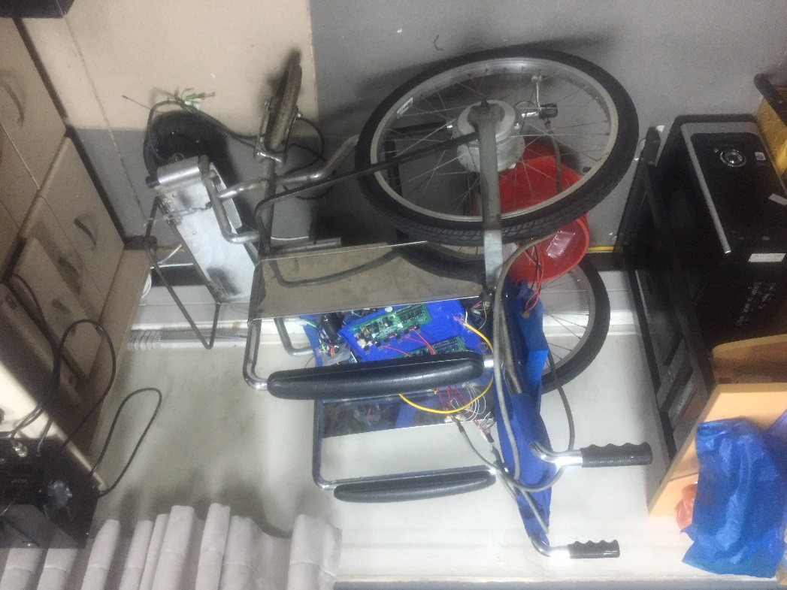

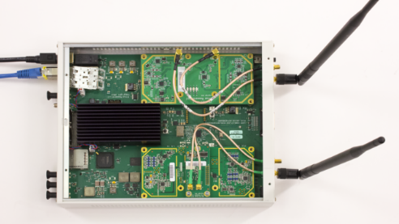
Signal processing and Radio Communications Lab
Create something useful for somebody

Slide 9
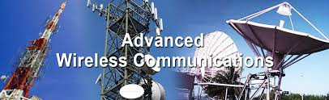

Learning

Slide 10
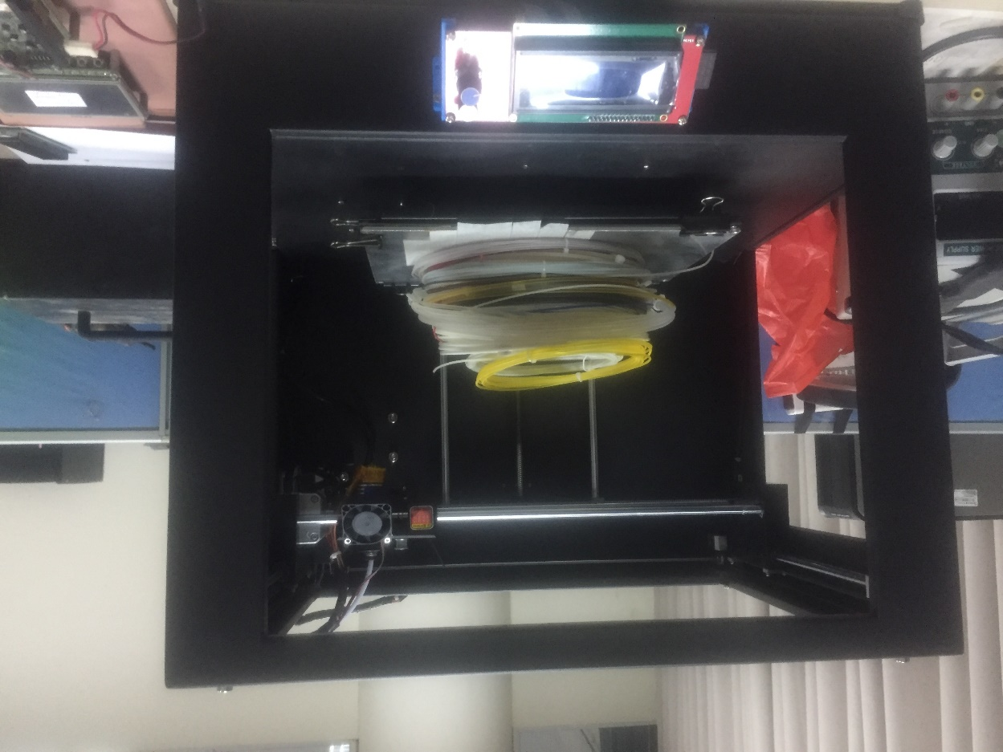
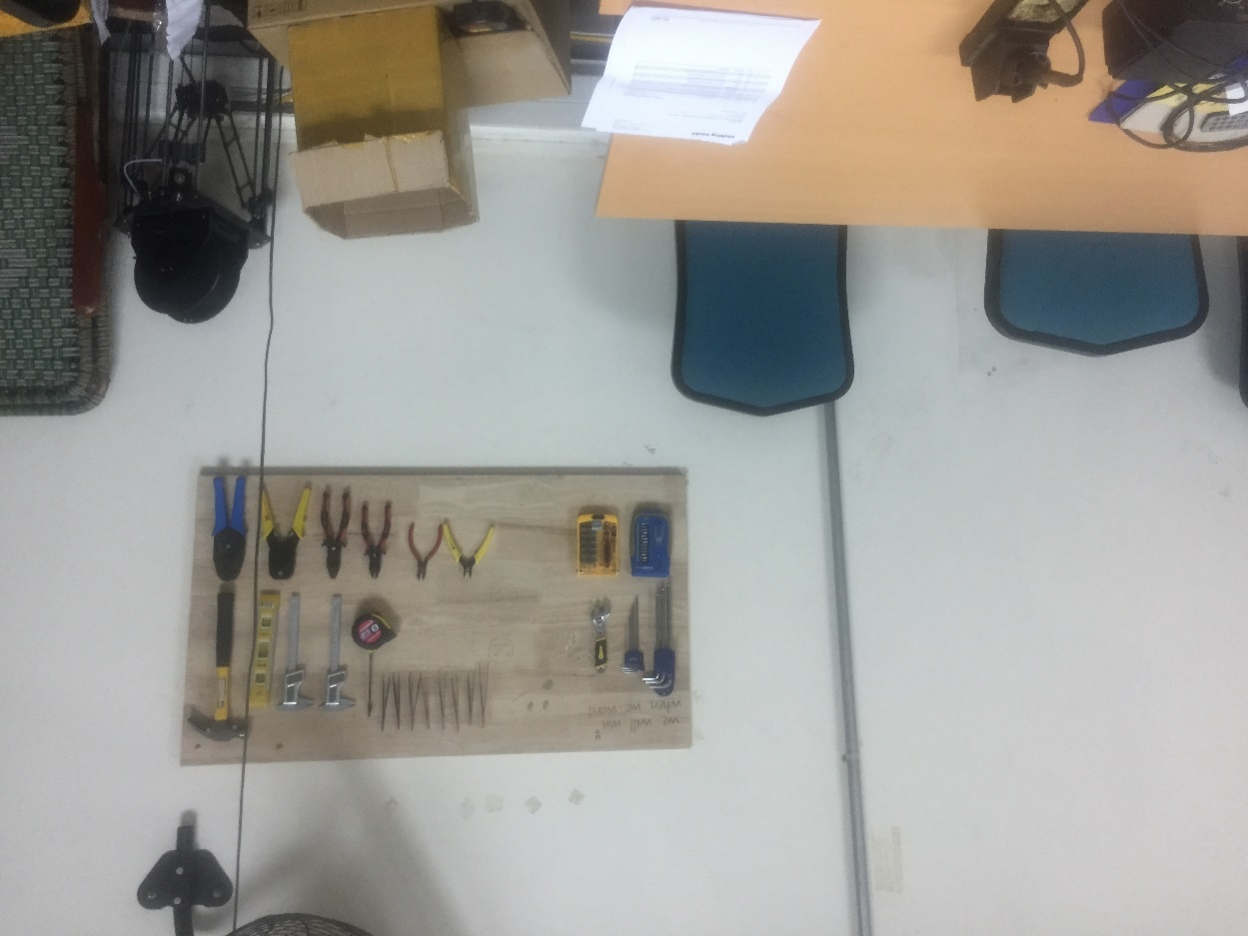
Facilities

Slide 11

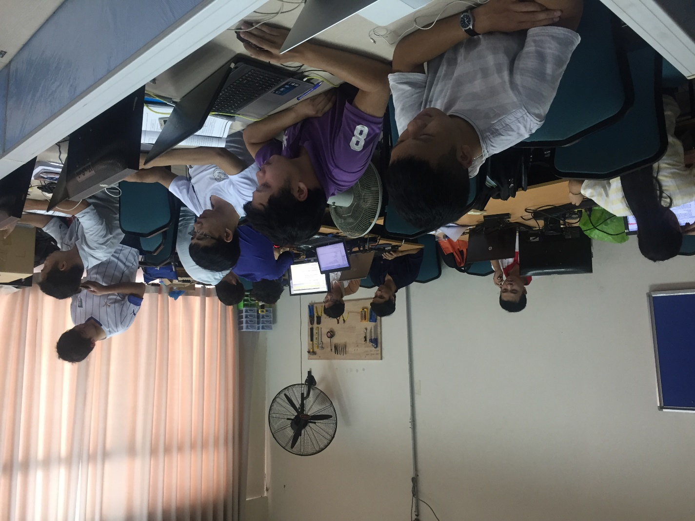
Liên hệ: hanhuydung.hust@gmail.com

